Slide 1
Many thanks to our hosts in beautiful Williamsburg!

Slide 2
CAMWS 2017 The University of Waterloo and the Waterloo Institute for Hellenistic Studies Sheila Ager and Andrew Faulkner University of Waterloo

Slide 3
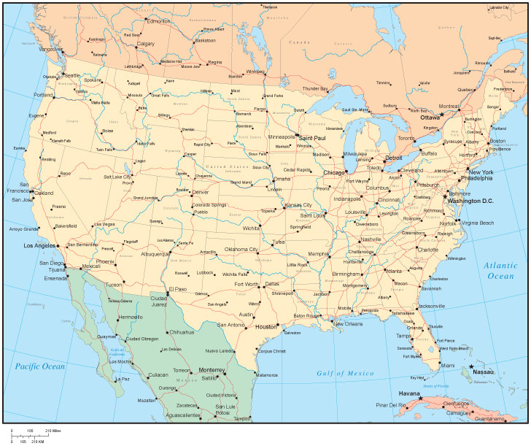
The Twin Cities: Kitchener-Waterloo, Ontario, Canada (third time’s a charm!)
Notes:
Previous CAMWS meetings in Canada: Toronto (1952) and Hamilton (1991).

Slide 4
Classics Beyond the Wall…

Slide 5
March in Waterloo
Notes:
This is Japan, I think.

Slide 6
April in Waterloo
Notes:
Actually, St. Johns.

Slide 7
Just kidding!!!

Slide 8
Just kidding!!!

Slide 9
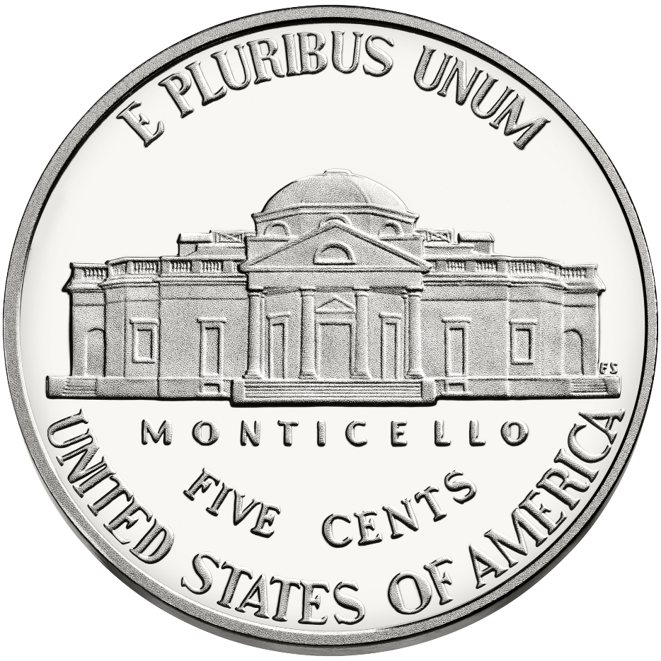
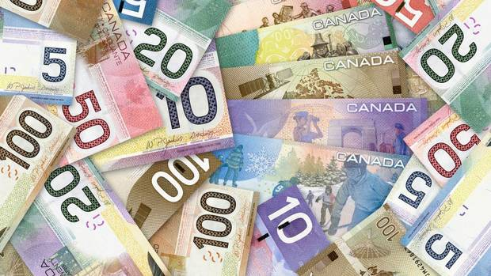
=

Slide 10
Southwestern Ontario
Notes:
St. Agatha.

Slide 11
Uptown Waterloo
Notes:
Land grant to Six Nations by Britain during American Revolution; settled by Pennsylvania Mennonites early 1800s; township named Waterloo in 1816, year following the Battle of Waterloo; German settlement through 1800s, much of it in the area southeast of Waterloo, which became Berlin in 1833 and Kitchener in 1916.

Slide 14
Mike Lazaridis, co-founder of
Research In Motion (RIM) and
Inventor of the BlackBerry
Notes:
BlackBerry (previously RIM) remains largest single employer in Waterloo; other main employers: ManuLife, SunLife, the two universities. Plus host of tech start-ups.

Slide 15
DowntownKitchener
University of
Waterloo
Uptown
Waterloo
My house
Notes:
German settlement through 1800s, much of it in the area southeast of Waterloo, which became Berlin in 1833 and Kitchener in 1916. Note that Mennonite pacifism and refusal to join war effort in WWI exacerbated tensions in the region.

Slide 16
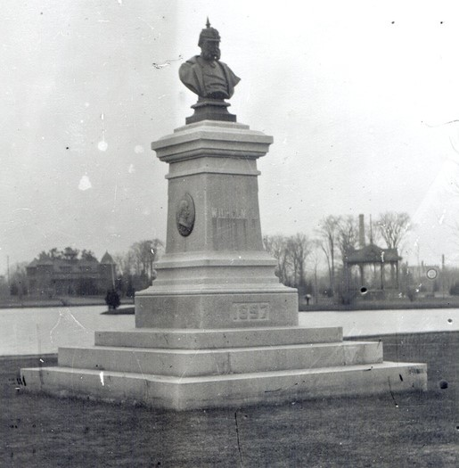
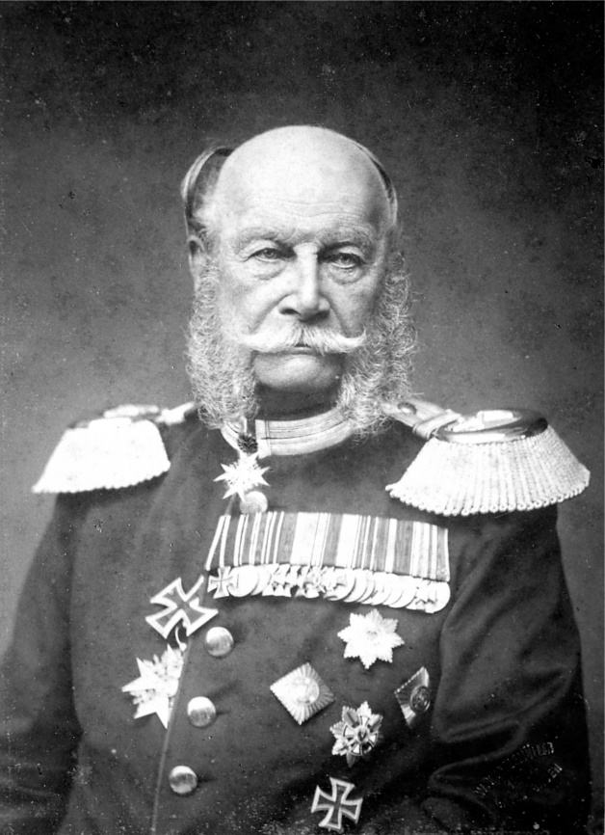
Victoria Park, Berlin, Ontario
Bust of Kaiser Wilhelm I
Notes:
Bust of Kaiser Wilhelm torn down at beginning of WWI and dropped in Victoria Lake; later recovered but ultimately went missing.

Slide 18
Soldiers of the
118th Battalion,
1916

Slide 19
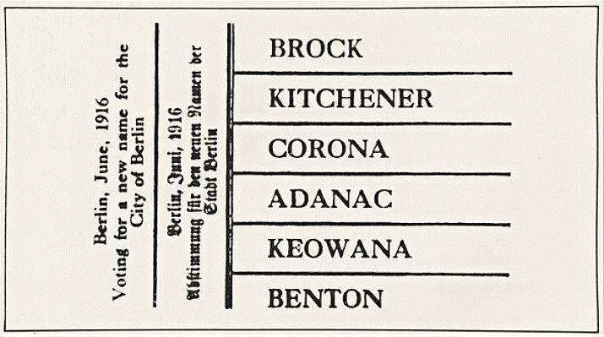
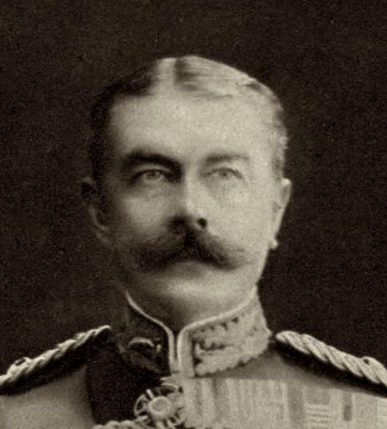
The ballot of 1916: 346 out of 892 votes in favour of ‘Kitchener’.
Horatio Herbert,
Lord Kitchener
d. 5 June 1916
Notes:
Note that there was no option to keep it ‘Berlin’. Population over 15,000 – less than 1000 voted. Kitchener died 5 June 1916. Adanac is just ‘Canada’ backwards (such as Setats Detinu).

Slide 20
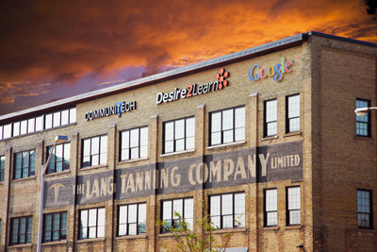
Former Lang Tannery building
Notes:
Former Lang Tannery, now hub of tech startups (Communitech). Established as tannery in 1850s. Eceonomic base of manufacturing largely dried up; Kitchener shares in some of the tech sector fervour as Waterloo.

Slide 21
Local Attractions

Slide 22
St. Jacobs

Slide 23
Notes:
St. Jacobs Farmers Market.

Slide 24
Elora

Slide 27
Schneider House, 1816

Slide 28
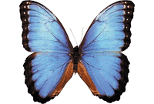
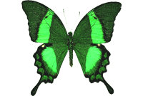
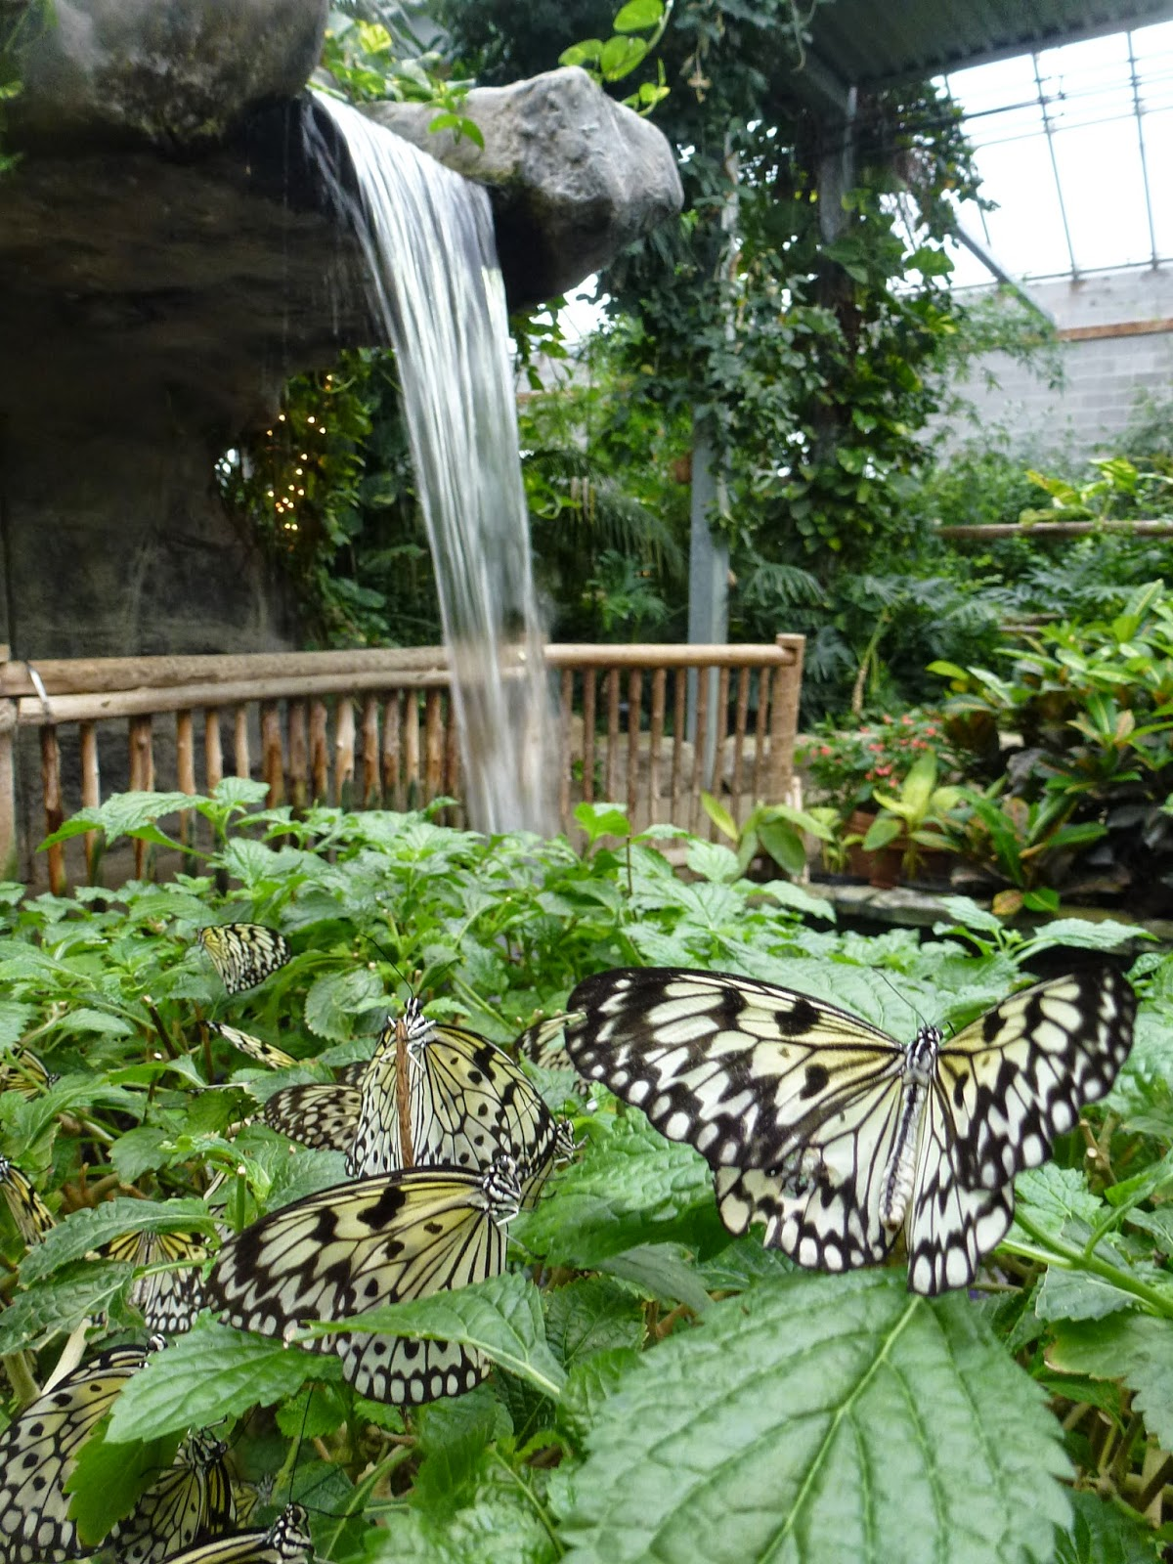
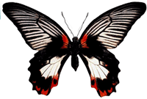
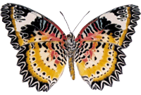
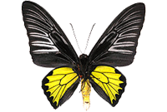
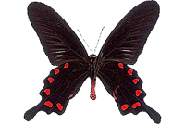
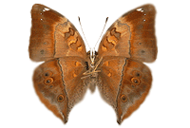
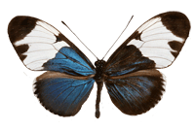
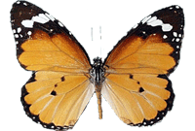
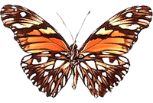
Cambridge Butterfly Conservatory

Slide 29
Niagara
Notes:
Niagara-on-the-Lake.

Slide 32
Peninsula Ridge Estates
Winery

Slide 33
Featuring such labels as…
‘Contrarian’
‘Narcissist’
‘Pompous’
‘Bigmouth’
‘Vainglorious’
and ‘My Way’
Megalomaniac Winery

Slide 34
And if all this isn’t enough, there is some hick town a little way to the east…

Slide 35
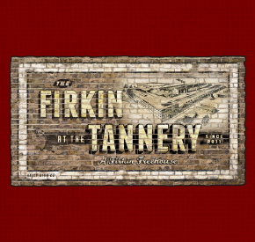
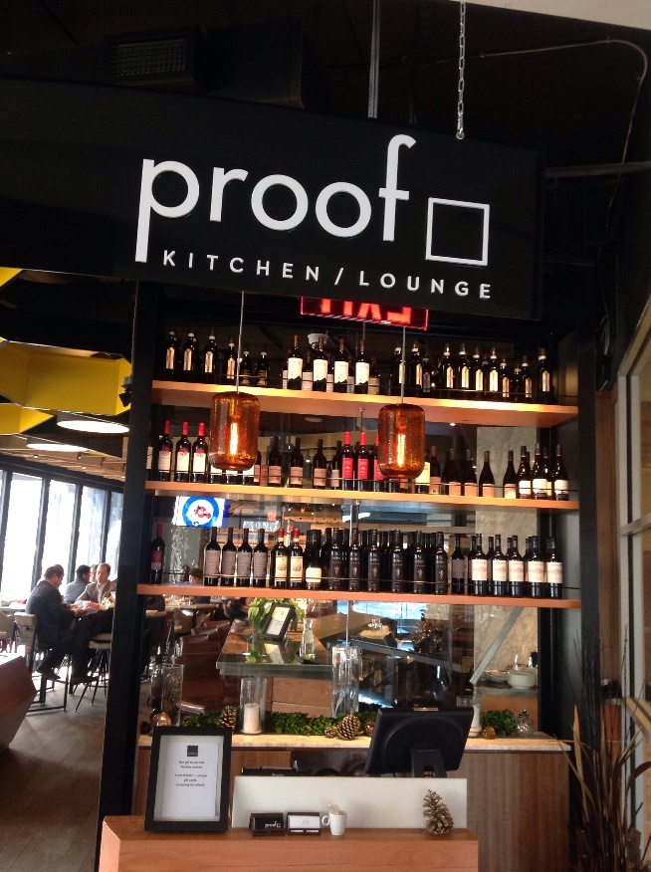
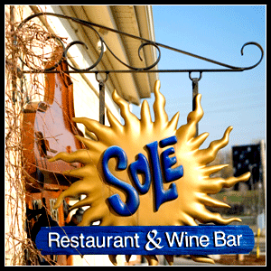
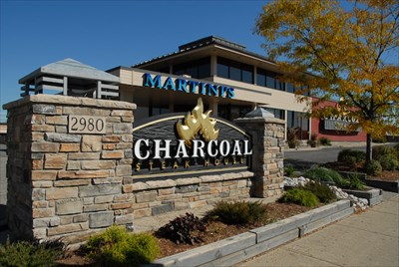
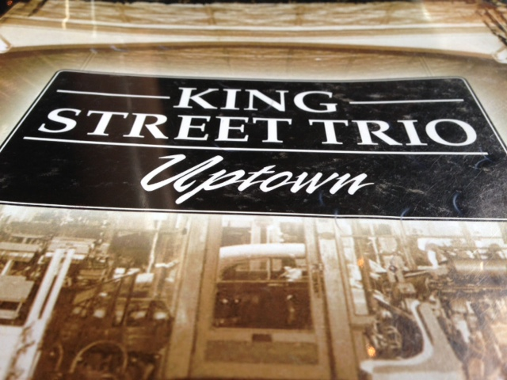
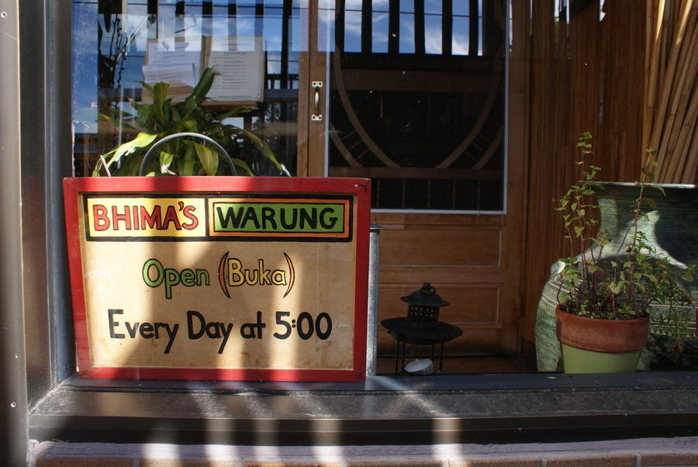
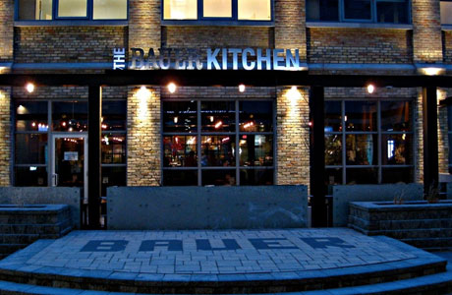
Local Dining

Slide 36
The Bauer Kitchen at
the Bauer Lofts

Slide 37
The University of Waterloo
‘Established to fill the need
to train engineers and
technicians for Canada’s
growing postwar economy.’
Notes:
Founded as an affiliate of Western in 1957, incorporated as a University in 1959. “It was established to fill the need to train engineers and technicians for Canada's growing postwar economy.”

Slide 38
Mike and Ophelia Lazaridis Quantum-Nano Centre, University of Waterloo
Notes:
Quantum computing and nano-technology.

Slide 39
The Perimeter Institute for Theoretical Physics and Stephen Hawking Centre

Slide 40
The Waterloo Institute for
Hellenistic Studies

Slide 41
Your Hosts: The UW Classical Studies Department

Slide 42
Your Hosts: The UW Classical Studies Department

Slide 43
Actually, we are a little nicer than that… and we look forward to welcoming you in 2017!

