Slide 1
Caesar, the Geographoi and Lewis and Clark: The Use of Animals in Describing New Lands
CAMWS April, 2018
Notes:
Intro self….two loves in Classics…..teaching Latin and animal studies
Like to see the light bulb…..1) pedagogical concepts/classical literacy 2) more to Latin than pitching camps and conquering enemies
Didn’t have that when I took Caesar Sophomore year

Slide 2
AP Caesar
Caesar, Gallic War
Book 1: Chapters 1-7
Book 4: Chapters 24-35 and the first sentence of Chapter 36
(Eodem die legati . . . venerunt.)
Book 5: Chapters 24-48
Book 6: Chapters 13-20
https://apcentral.collegeboard.org/courses/ap-latin/course/ap-latin-reading-list?course=ap-latin
Notes:
AP Vergil/Caesar Exam
They stopped about 5 chapters too early

Slide 3
Hercynian Forest

Slide 4
A text that should have been included
“Huius Hercyniae silvae
etc.”
6.25-28
Notes:
Go to handouts
Discuss briefly authenticity issue a. Caesar wrote it b. Marginal notation that was later included (doesn’t fit rest of commentary) in tone. Generally unresolved
Recent argument that it is authentic b/c C is equating wild animals with wild Germans
Empire theory
Also long tradition of describing places through their animals.
Then go through text…..

Slide 5
What are we looking for
#1 One horned cow-stag
Est bos cervi figura, cuius a media fronte inter aures unum cornu exsistit excelsius magisque directum his, quae nobis nota sunt, cornibus: ab eius summo sicut palmae ramique late diffunduntur. Eadem est feminae marisque natura, eadem forma magnitudoque cornuum.
There is an ox with the shape of a stag.
A single horn rises from the middle of its forehead, between its ears, higher and straighter than horns which are known to us.
From the top of this, things like palms and branches stretch out widely.
The nature of the female and of the male is the same; the appearance and the size of the horns are the same.
Notes:
Click for each
For first stress the fact that both genders have horns

Slide 6
#2 Kneeless “elks” (alces)
27 Sunt item, quae appellantur alces. Harum est consimilis capris figura et varietas pellium, sed magnitudine paulo antecedunt mutilaeque sunt cornibus et crura sine nodis articulisque habent; neque quietis causā procumbunt neque, si quo adflictae casu conciderunt, erigere sese aut sublevare possunt.
There are also animals which are called elks.
The shape of these, and the varied color of their pelts, is much like goats, but they are a bit bigger
and have stunted horns and legs that lack knee caps and joints. They do not lie down to rest, nor, if they have fallen down due to some accident or other, they cannot right themselves or lift themselves up.

Slide 7
http://daten.schule.at/index.php?url=pages&kthid=1818

Slide 8
http://daten.schule.at/index.php?url=pages&kthid=1818

Slide 9
#3 The URI
28 Tertium est genus eorum, qui uri appellantur. Hi sunt magnitudine paulo infra elephantos specie et colore et figurā tauri. Magna vis eorum est et magna velocitas, neque homini neque ferae quam conspexerunt parcunt. ….
Amplitudo cornuum et figura et species multum a nostrorum boum cornibus differt. Haec studiose conquisita ab labris argento circumcludunt atque in amplissimis epulis pro poculis utuntur.
28 There is a third kind of the creatures there which are called uri. These are a little smaller in size than the elephant, with the appearance, color, and shape of a bull. Great is their strength and great their speed. They spare neither man nor wild beast which they have espied. These they readily kill after they have been captured in pits.
The size, shape, and appearance of their horns differ greatly from the horns of our oxen. These are eagerly sought after and they line the edges of the horns with silver, and use them as cups at their most lavish banquets.

Slide 10
Cervus elaphus The Red Deer
By Lviatour - Own work, CC BY-SA 3.0, https://commons.wikimedia.org/w/index.php?curid=16566391
Notes:
Distribution extending from Europe into North Africa and the Middle East
Size: Length: Male typically between 6 and 8 feet long and weighs 350 to 530 lb the female 5’3” to just under 8 feet long
weighs 260 to 370 lbs
shoulder height 37 to 51 in = just under 3’ to 4’3”
Note its somewhat palmate antlers
CLICK as you can see it is native to Germany

Slide 11
eius summo sicut palmae ramique late diffunduntur.

Slide 12
Alces??? Cervus canadensis (Wapiti / Elk)
Wapiti (White Rump)
Modern Range of Cervus Canadensis
Notes:
Range: Click….. No way the Hercynian Forest was this big

Slide 13
Alces: The Modern Term
North American moose
Alces americanus
Eurasian elk
Alces alces alces
Notes:
A.A. America and Canada only AAA European May or may not be two separate species and there is DNA evidence of interbreeding. But if this is one of Caesar’s animals, he saw the one to the left

Slide 14
Modern range of Alces alces alces
Notes:
Range has shrunk since ancient times. Clearly could have been in Germany.

Slide 15
Chinese water deer

Slide 17
One horned?
Notes:
All cervids shed their horns except the Chinese water deer.
Left: roe deer that has broken off one antler in a fight
Right: And they can lose them by having them shed at different times, NEXT SLIDE

Slide 18
Moose shed their antlers annually in winter = mutilae cornibus?
Notes:
This might explain the tree story
Left: Bloody velvet is what they are sloughing off
Might also be what he meant by “mutilae cornibus”

Slide 19
Mutilaeque sunt cornibus???
Notes:
Left Getty images Right http://www.norrellphotography.com/one-antler-moose/
Right Reindeer new antlers

Slide 20
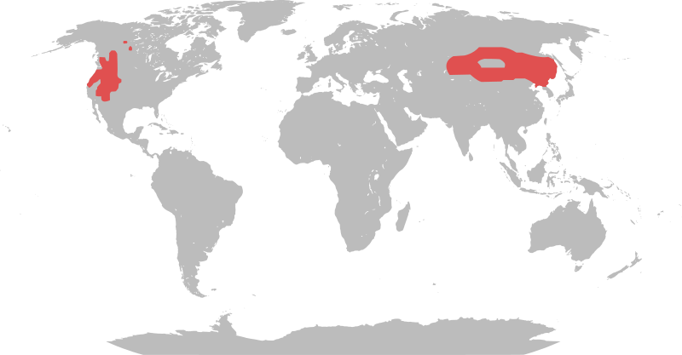
Rangifer tarandus = Caribou/Reindeer
AKA “Caribou”
AKA “Reindeer”
Notes:
Has been suggested
Unique among cervids in that both males and females bear horns. These are two bulls. Female antlers are smaller and shed later,.

Slide 21
The uri
C. The uri: Just a bit smaller than an elephant, bull-like in shape and color, strong, fierce, swift, horns used as cups

Slide 22
Two candidates
Bos primigenius Aurochs
Bison bonasus European bison/Wisent

Slide 23
Bos primigenius Aurochs
Ancestor of our cattle
Extinct, last one died 1627 in Poland
Hunted as sport, fierce opponent
Attempting to back breed

Slide 24
And……
Notes:
Hunting horn of Sigismund III of Poland, inscription in polis at top, dated to 1620

Slide 25
Sigismund von Herberstein, 1556 Urus sum, polonis Tur, germanis Aurox: ignari Bisontis nomen dederant
Notes:
Sigismund von Herberstein (1486-1566; Imperial diplomat), Rerum moscoviticarum commentarii. Vienna: Egydius Aquila, 1549. Basic text written 1517-49. Cited text: Notes upon Russia, translated by R. H. Major. 2 vols. London: Hakluyt Society, 1851-52; reprint, New York: B. Franklin, 1963?

Slide 27
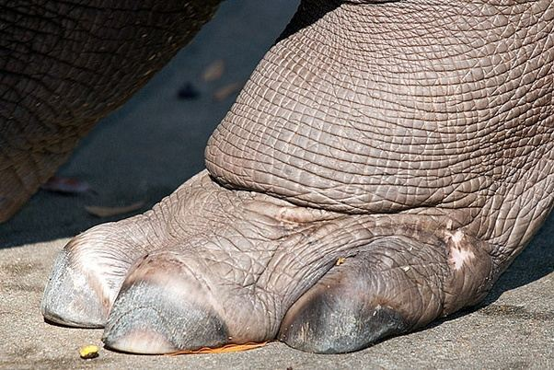
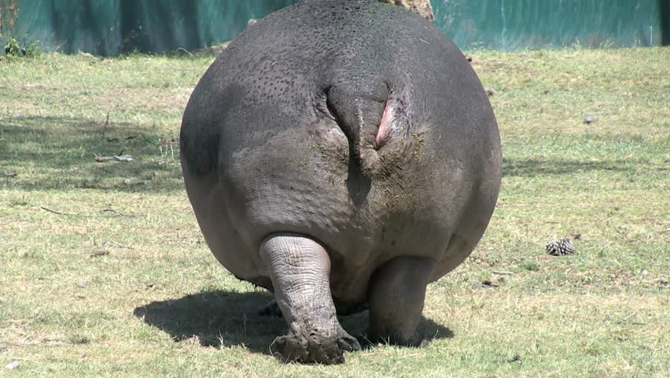

Slide 28
Herodotus’ Flying snakes 2.76

Slide 29
Martichora/Manticore (Topsell 1572 – 1625)

Slide 32
Lengths, including tails
Rose-Ringed Parakeet, length ca. 16”
Falcons-- 10” to 26 “

Slide 33
Γὀριλλαι
By Bourrichon - An English translation of Bourrichon's French map on Wikimedia Commons, CC BY-SA 3.0, https://commons.wikimedia.org/w/index.php?curid=62895740

Slide 34
Agatharchides
By George Tsiagalakis - Own work, GFDL, https://commons.wikimedia.org/w/index.php?curid=37514360

Slide 36
Crocotta

Slide 37
Lewis & Clark

Slide 38
The “Barking Squirrel” September 7, 1804 From Clark’s diary
ther mouth resemble the rabit, head longer, legs short, & toe nails long ther tail like a g[round] Squirel which they Shake and make chattering noise ther eyes like a dog, their colour is Gray and Skin contains Soft fur

Slide 39
September 18, 1804 Clark’s diary
I Killed a prarie wolf to day about the Sise of a Gray fox with a bushey tail the head and ears like a Fox wolf, and barks like a Small Dog— The annimale which we have taken for the Fox is this wolf, we have seen no Foxes

