Slide 1
Scipione l’Africano: Scipio and Mussolini
Jessi Mellenthin

Slide 2
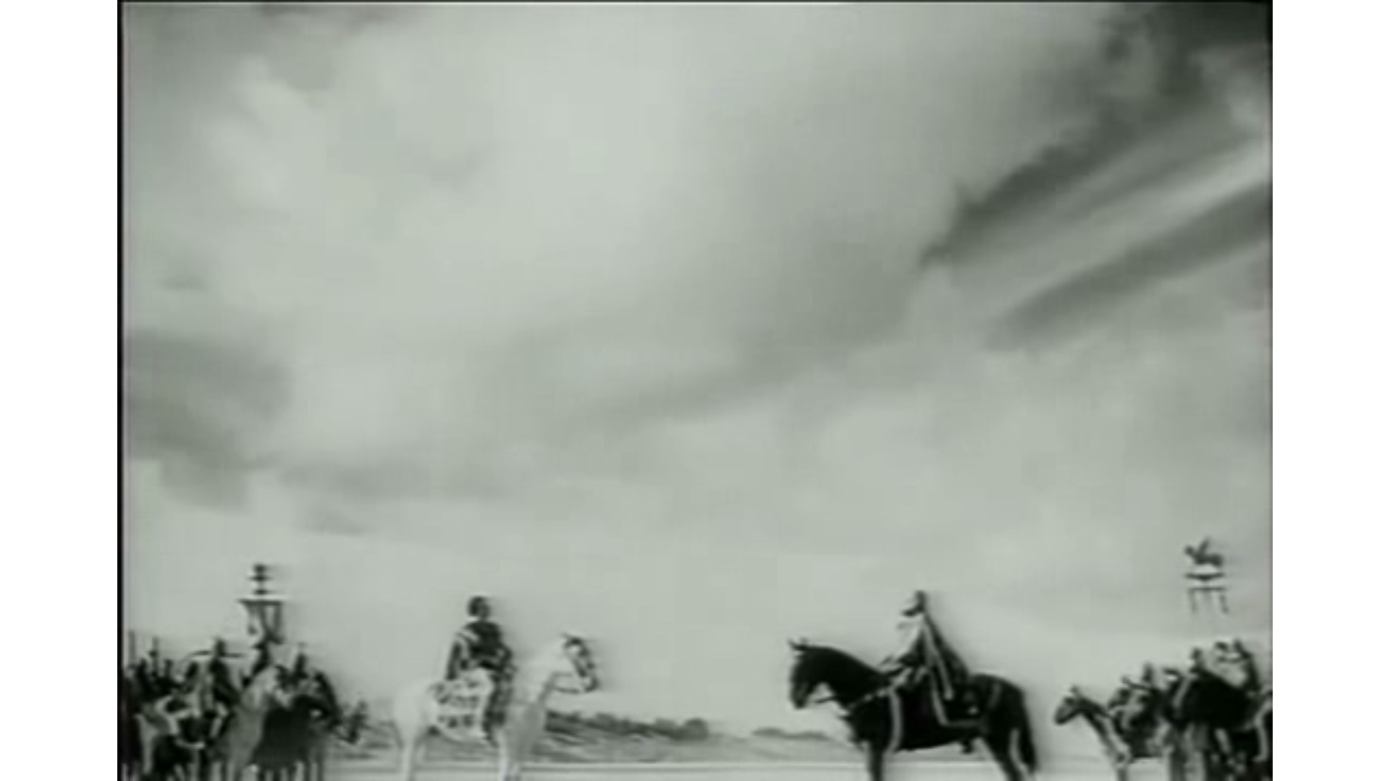
Figure 1

Slide 3
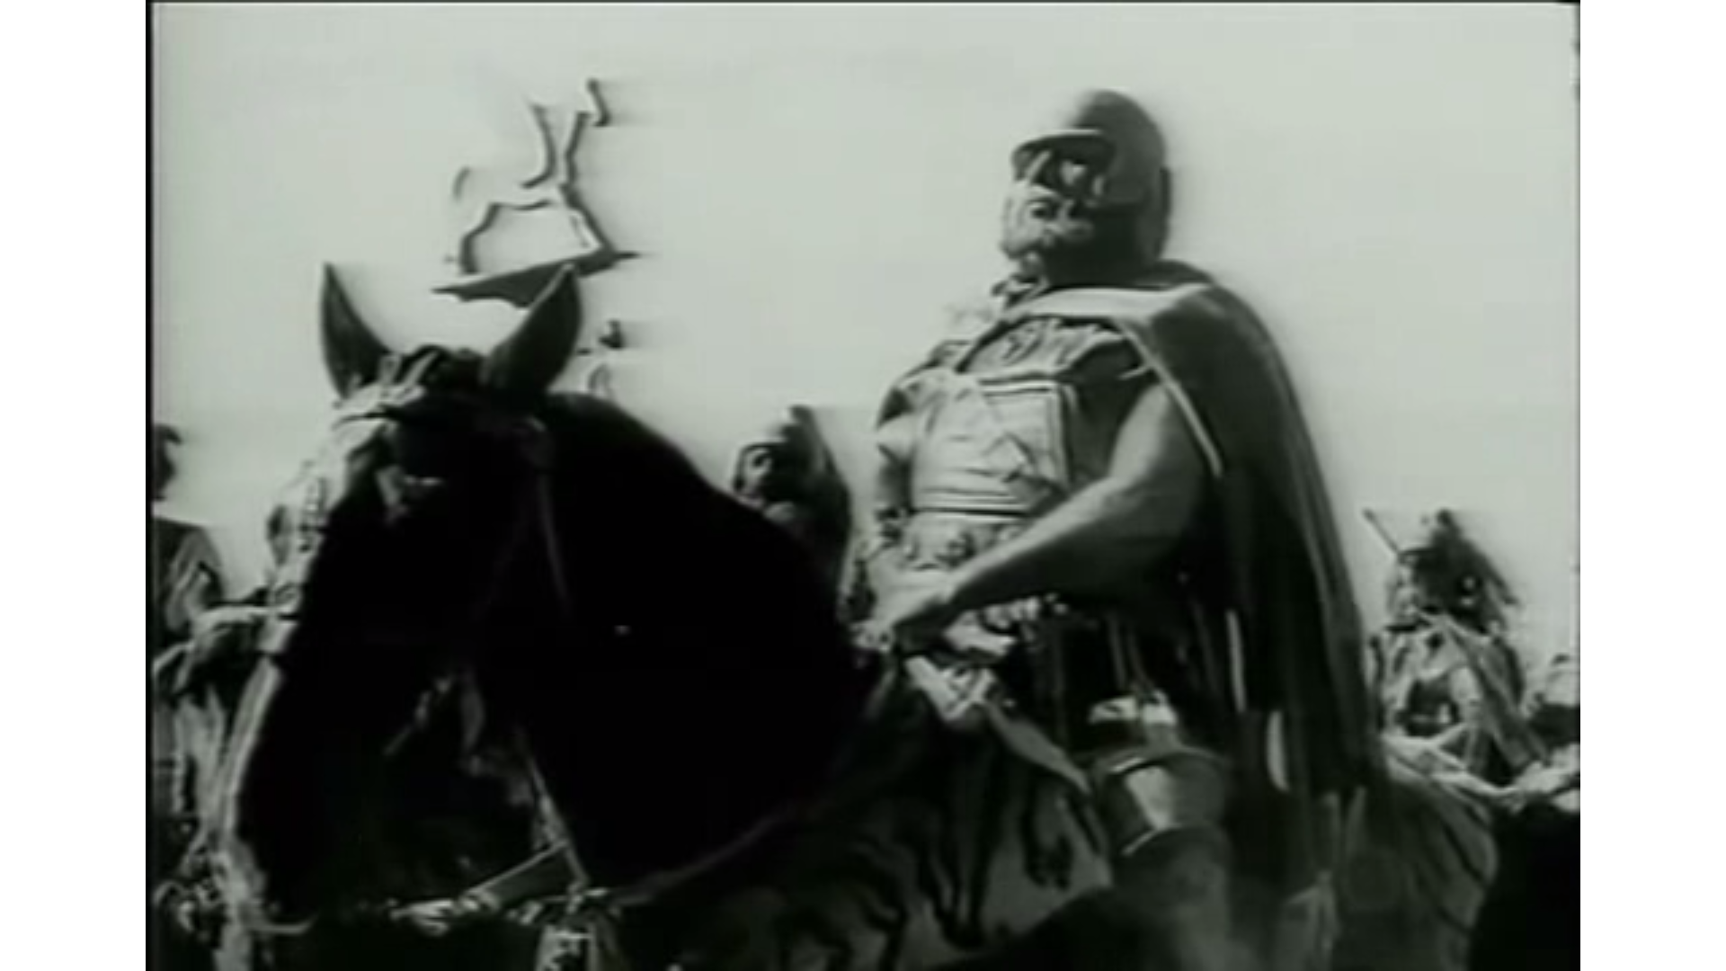
Figure 2

Slide 4
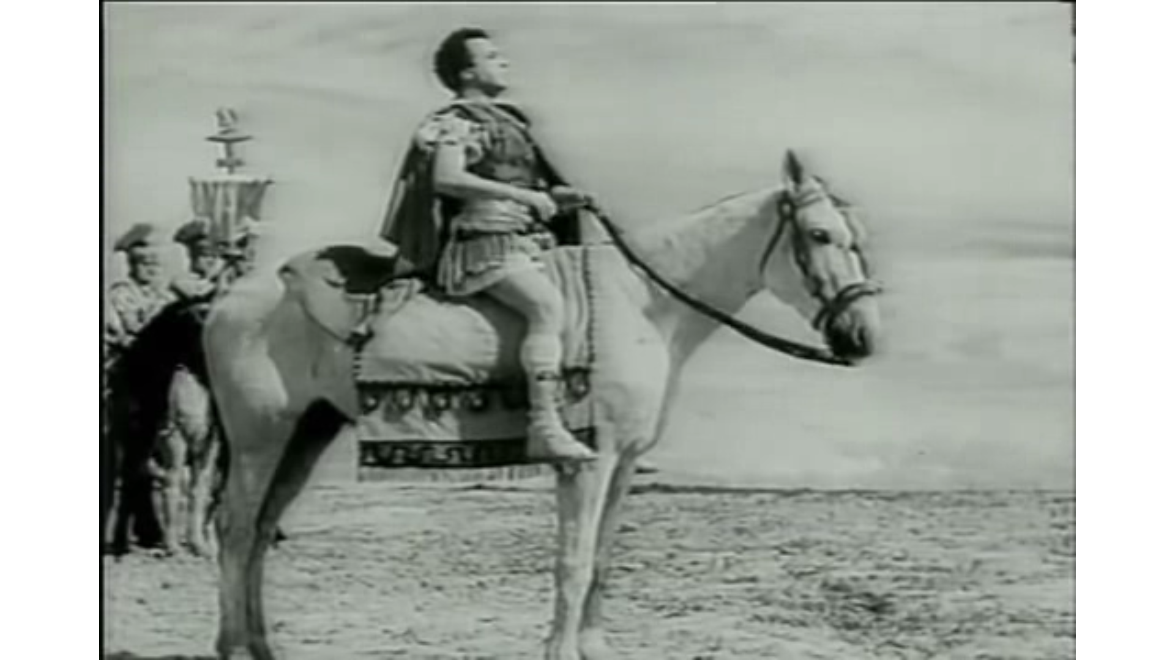
Figure 3

Slide 5
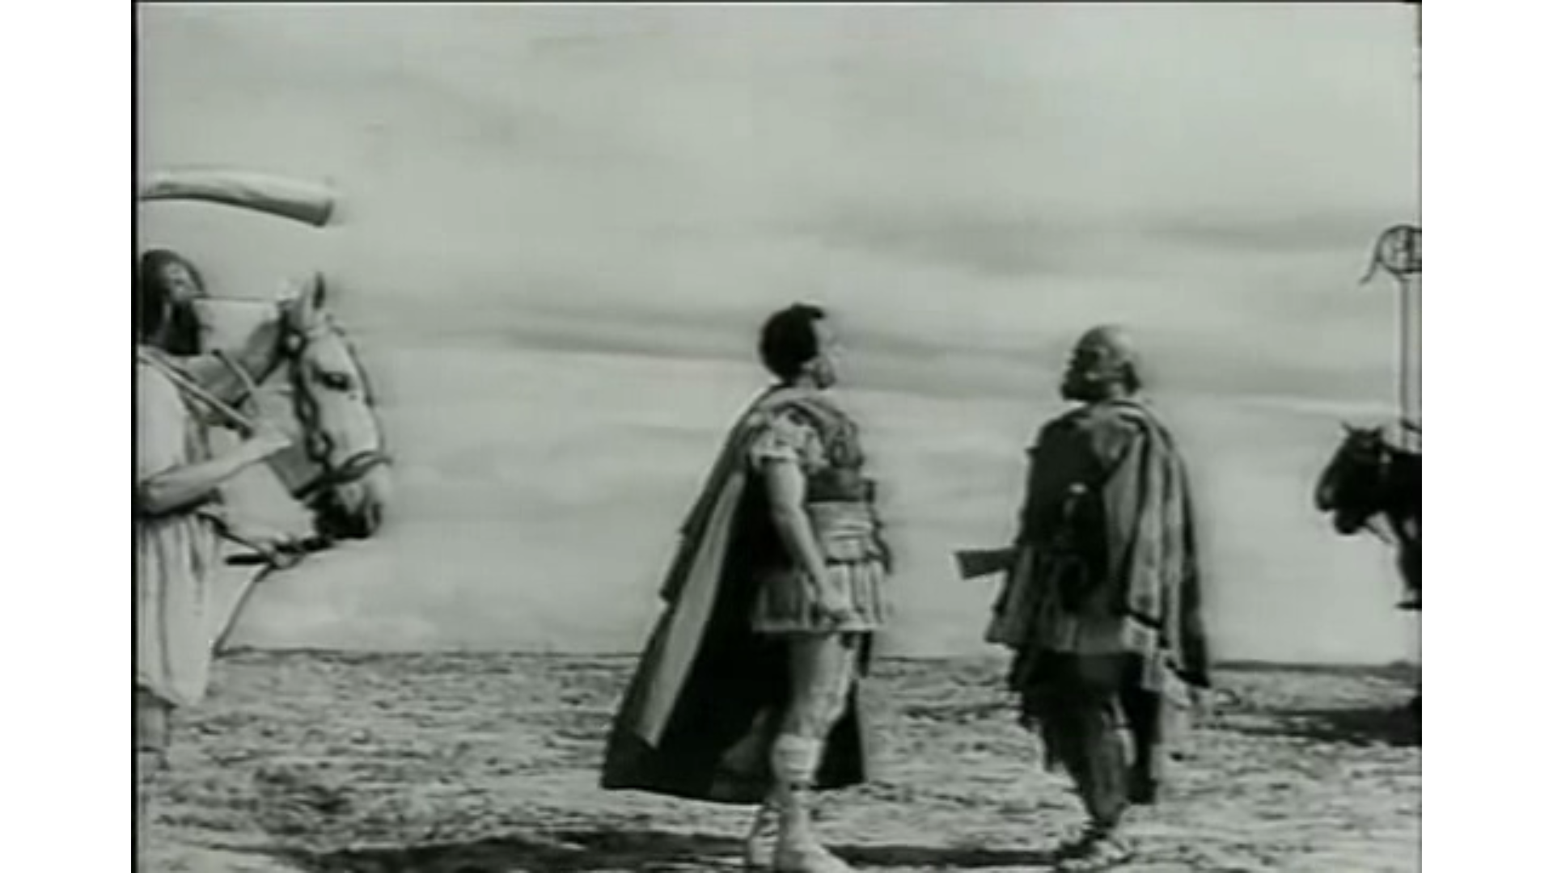
Figure 4

Slide 6
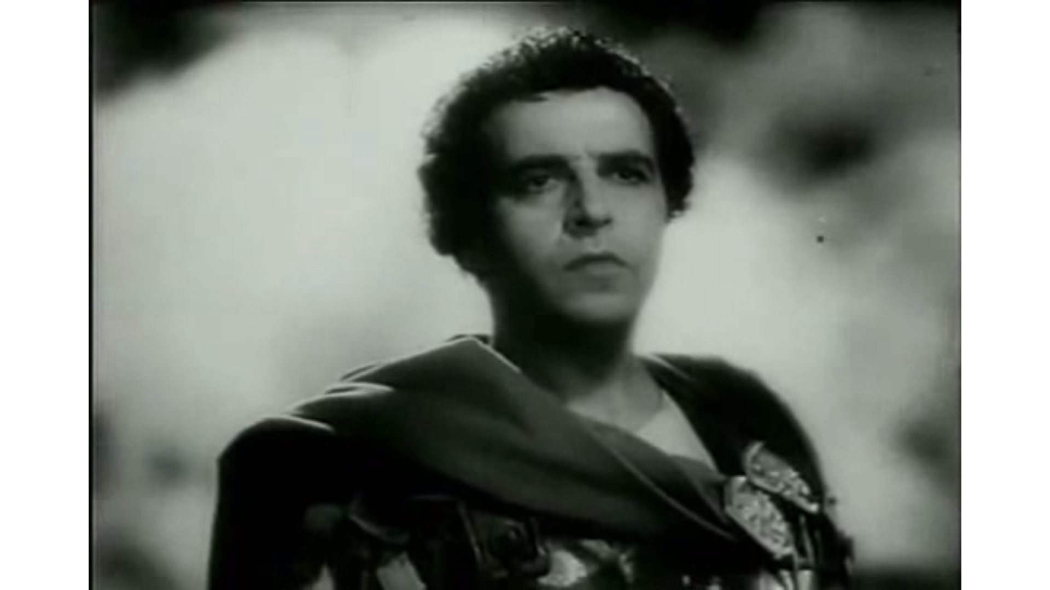
Figure 5

Slide 7
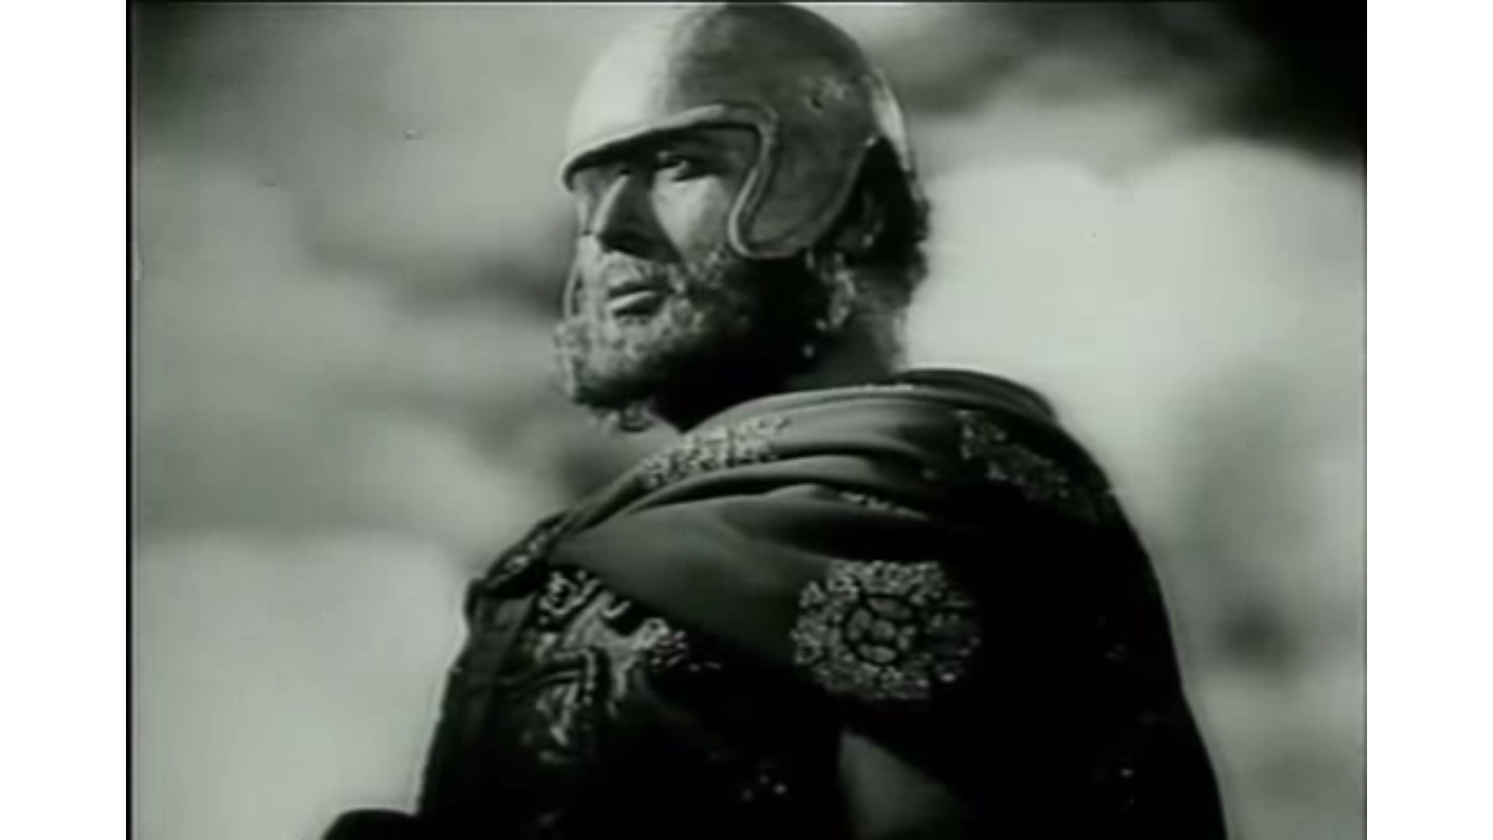
Figure 6

Slide 8
Figure 5

Slide 9
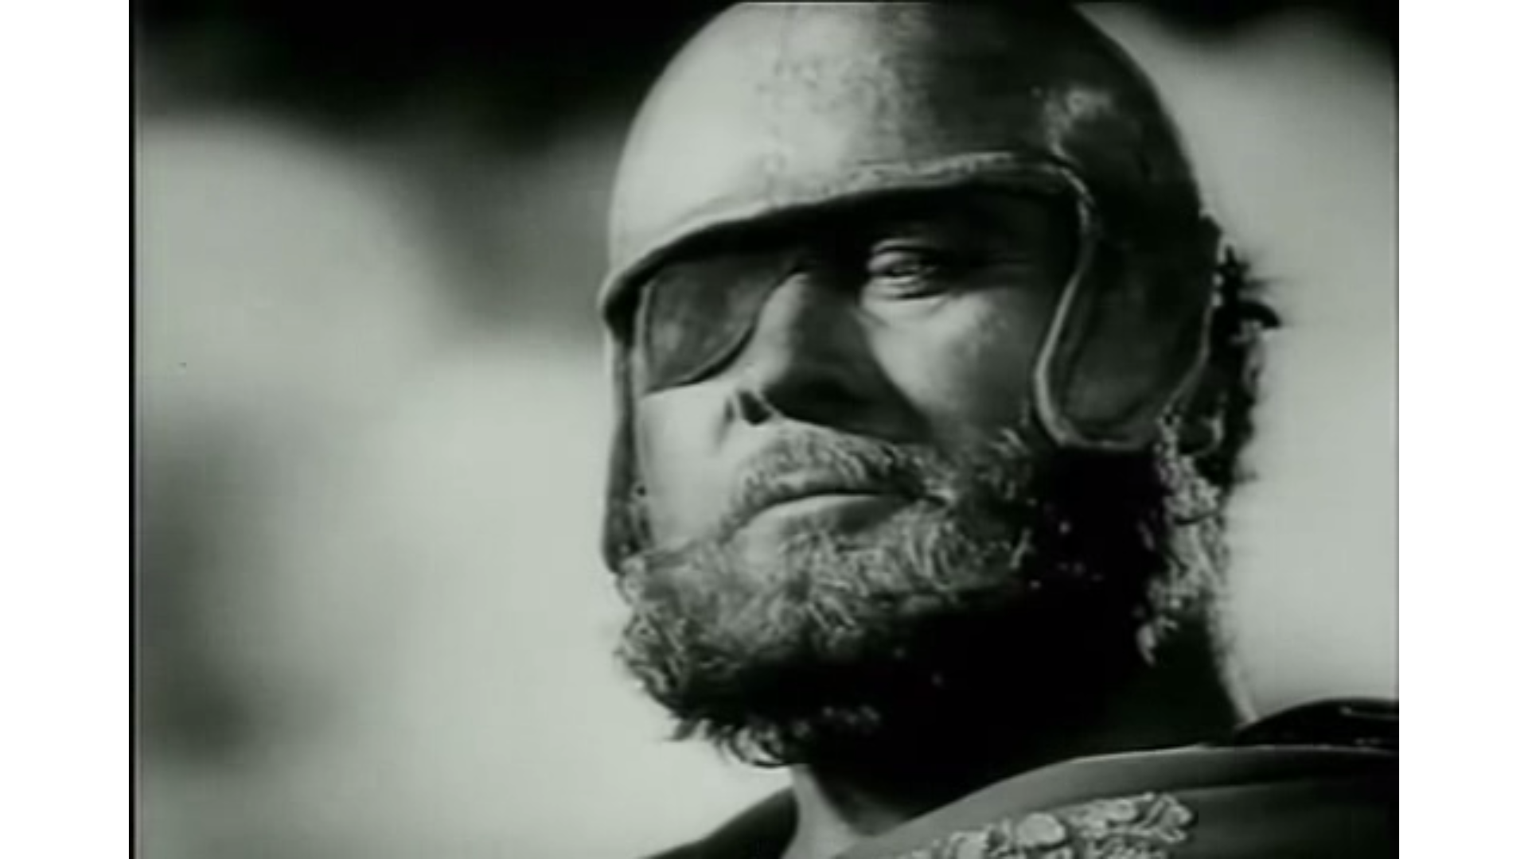
Shot reverse-shot

Slide 10
Figure 7

Slide 11
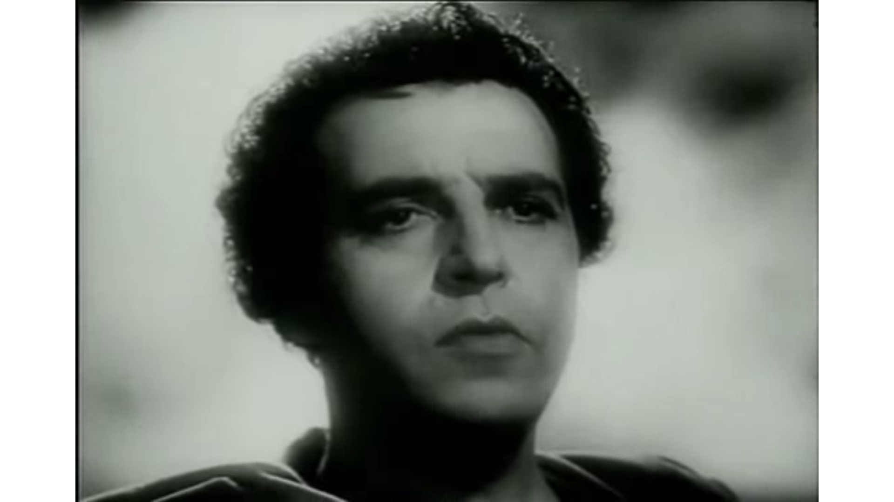
Figure 8

Slide 12
Shot reverse-shot

Slide 13
Reaction shot

Slide 14
Reverse shot

Slide 15
Scipio Closeup

Slide 16
Reaction shot

Slide 17
Scipio Closeup

Slide 18
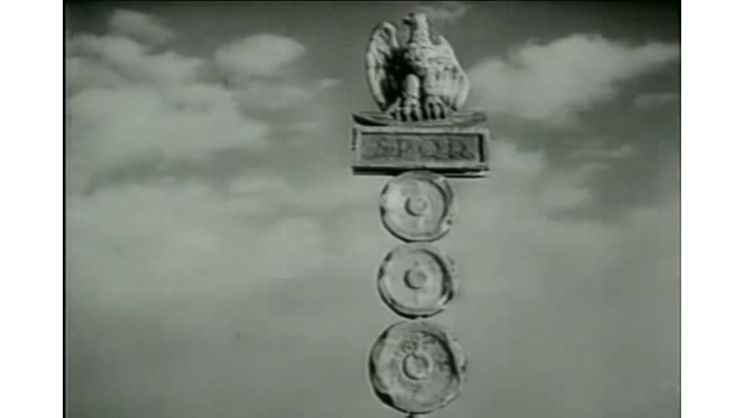
Figure 9

