Slide 1
Prediction and Persuasion:
The Rhetoric of Mindreading in Demosthenes’
Early Deliberative Speeches

Slide 2
Dem. 18. 172
But, it seems that that moment that day called for a man who was not only devoted and wealthy but had also followed events from the beginning and had correctly inferred what Philip was aiming at and what his intentions were in taking the action he did (sullelogismenon orthos tinos heneka taut’ epratten ho Philippos kai ti boulomenos); trans. Yunis 2005 slightly adapted).

Slide 3
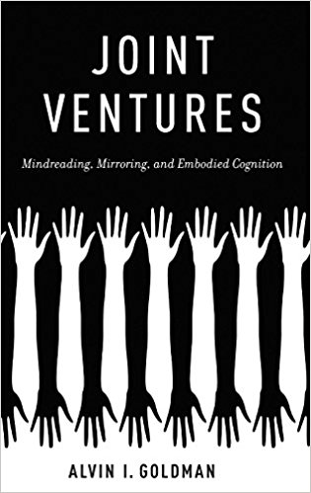
Collected essays with overview of various forms of ToM

Slide 4
Dem. 14.6-7
By making it clear to everybody that we have reviewed our armed forces and are well prepared and that our policies are based upon the principle of justice (phainetai de dikaia phronein epi taute te proairesei) (trans. Trevett 2011)

Slide 5
One of many examples of folk psychology, theory-theory
For no one would go to war for the sake of making a profit in the same way as he would for the sake of his own property, but everyone fights as hard as he can to hold onto things that someone else is trying to deprive him of. When it comes to making a profit, the situation is quite different: men aim at it, if they have the chance; but if they are prevented, they do not think that their opponents have done them an injustice (15.10, trans. Trevett 2011).

Slide 6
Simulation of Artemisia
I do not believe that even Artemisia would be opposed to our taking this action, if the city is fully committed to it. As for my reasoning, listen for a moment and judge whether or not it is correct. In my view, if the King were being quite as successful in Egypt as he hopes to be, Artemisia would have tried very hard to make Rhodes over to him, not out of goodwill towards the King but from a wish to do him a considerable favor, since he is in the vicinity, in order to induce him to treat her as amicably as possible. [12] But if he is doing as is rumored, and has failed in his undertaking, she thinks that this island, as is the case, has no other use to the King at present than as an obstacle to prevent her making any move at all and so in my view she would rather that you have it, as long as she does not surrender it to you publicly, than that he take it. I do not even think that she would help; but if she did, she would do so in a cursory and ineffective way (15.10-11, trans. Trevett 2011).

Slide 7
Sequential mind-reading – Jane thinks that Peter thinks that Sarah thinks, etc.
Recursive mind-reading – Jane thinks that Peter thinks that Jane thinks, etc.
A novelist writing about relationships between three people has to intend that the reader think that character A supposes that character B wants character C to believe…five orders of intentionality.
Robin Dunbar, “On the origin of the Human Mind,” 2000, see also Why we read fiction, theory of mind and the novel, Lisa Zunshine, 2008.

Slide 8
Aeschines calls out Demosthenes’ supposed Quarantine failure
…he dared to say that Alexander would never venture out of Macedonia, for he was content, he said, to saunter around in Pella, and keep watch over the omens; and he said this statement was not based on conjecture, but on accurate knowledge, for arete was to be purchased at the price of blood. For Demosthenes, having no blood himself, formed his judgment of Alexander, not from Alexander's nature, but from his own cowardice (Aes. 3.160).

Slide 9
Some Conclusions
Demosthenes and other speakers - in virtue of their craft - developed an awareness of the ubiquitous but normally automatic and often unconscious or subconscious ToM habit.
Demosthenes and others identify some of the biases and mechanisms that current research associates with ToM.
Demosthenes teaches ToM in the form of social intelligence and introspection.
ToM perspective allows us to identify and isolate key aspects of Demosthenes’ foreign policy thinking.

Slide 10
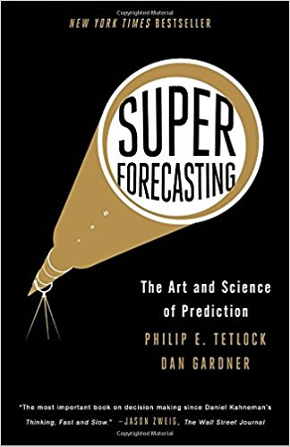

Slide 11
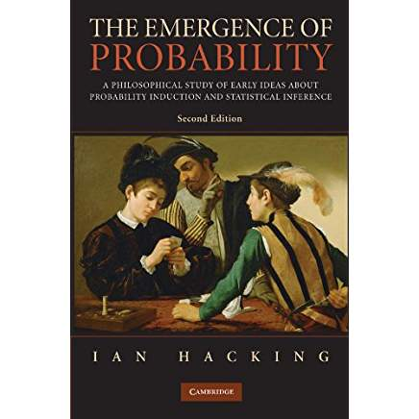

Slide 12
