Slide 1
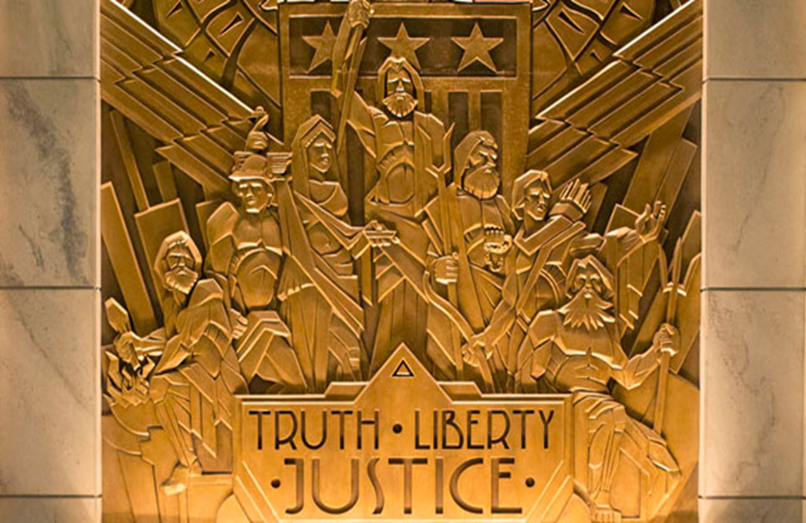
The Return of the Olympians
The Justice League
Jonathan Burks
jpburks@email.arizona.edu
University of Arizona

Slide 2
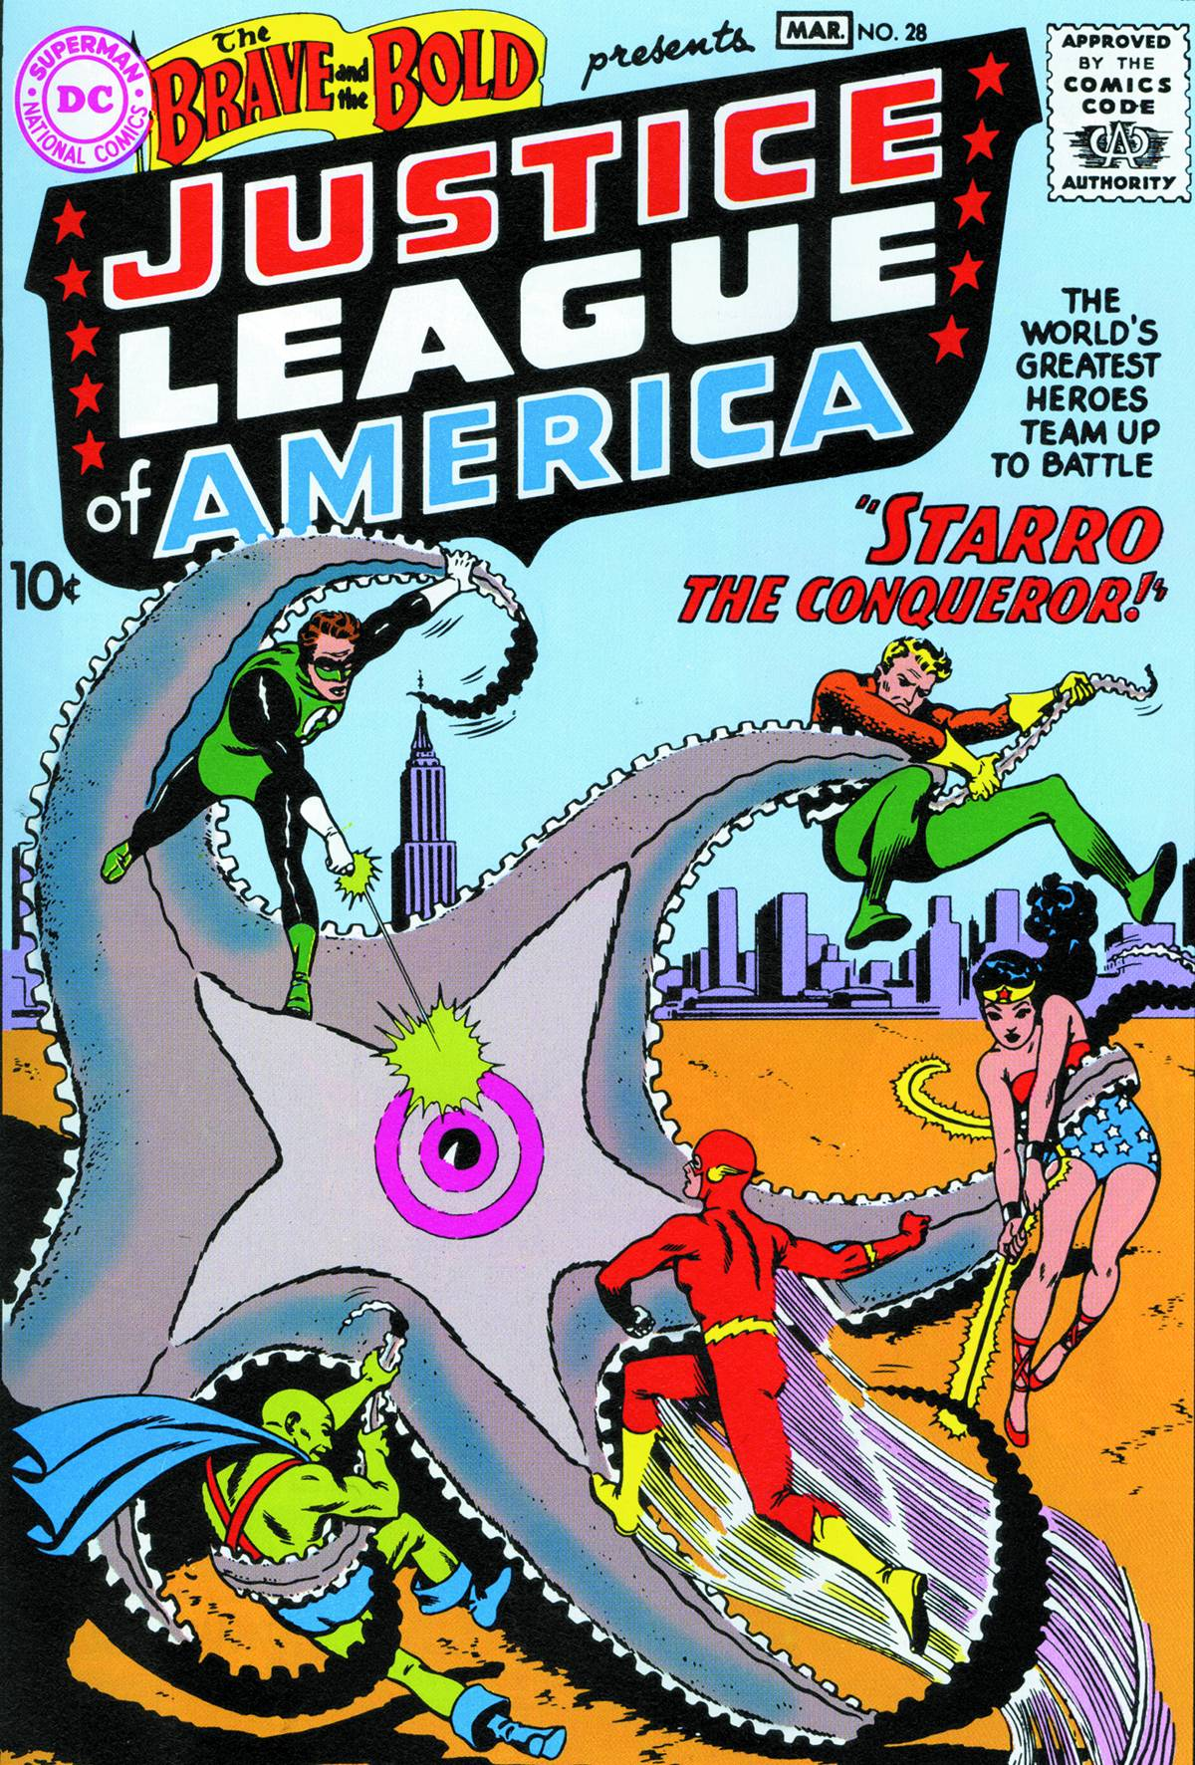

Slide 3
“We awarded the team a modern Mount Olympus in the form of the new “Watchtower” on the moon, Earth’s first line of defense against invasions from beyond. What’s more, we added a few new members to adhere more closely to the lineup of Greek gods: Superman was Zeus, Wonder Woman, Hera; Batman, Hades; The Flash, Hermes; Green Lantern, Apollo; Aquaman, Neptune; Plastic Man, Dionysus; and so on.”
- Grant Morrison, Supergods. 2011

Slide 4
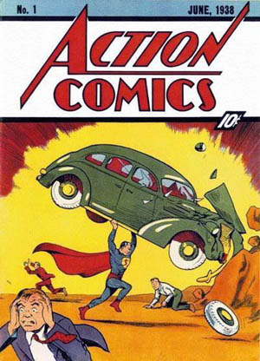

Slide 8
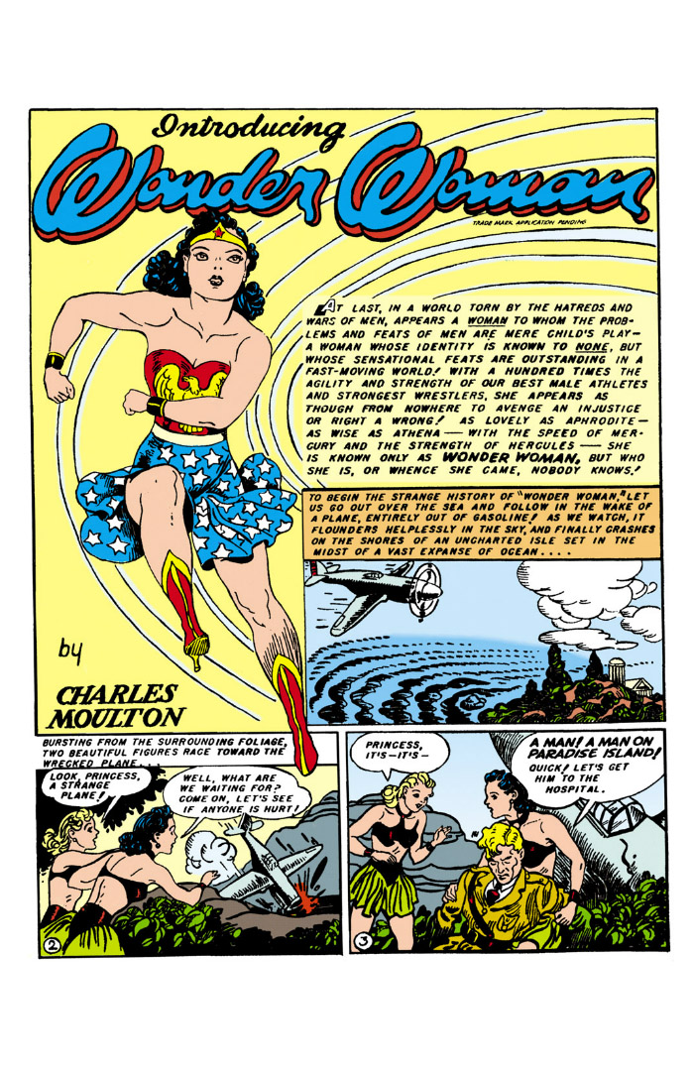

Slide 9
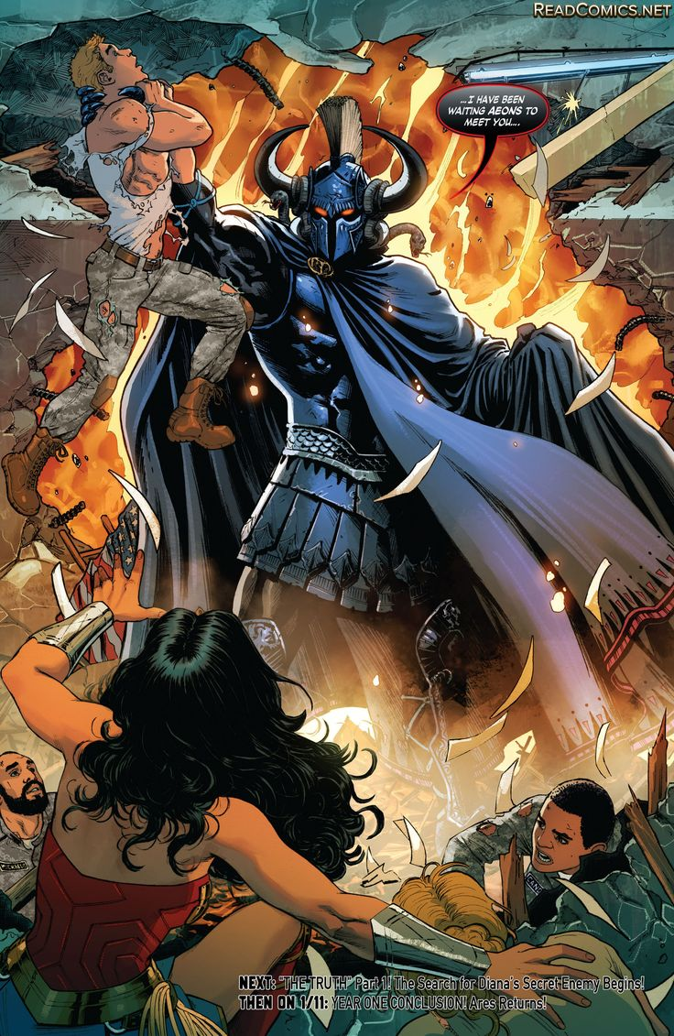

Slide 10
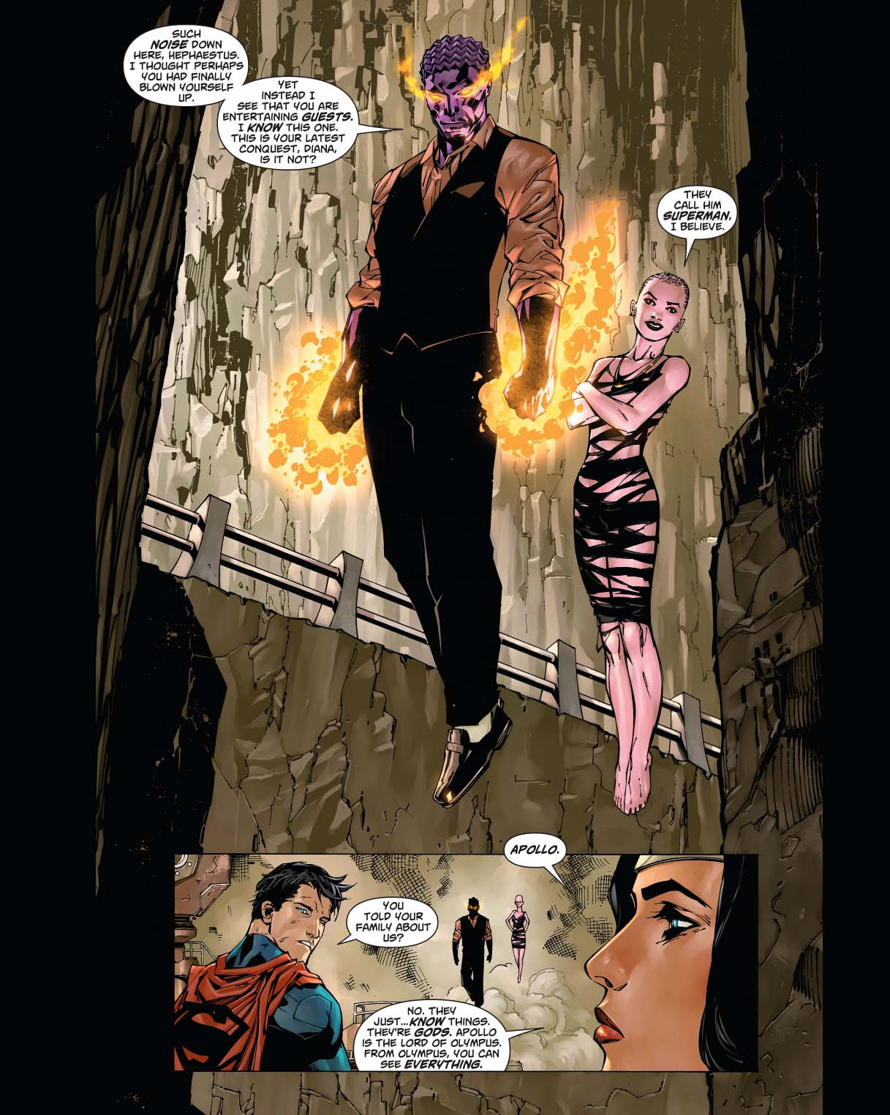

Slide 13
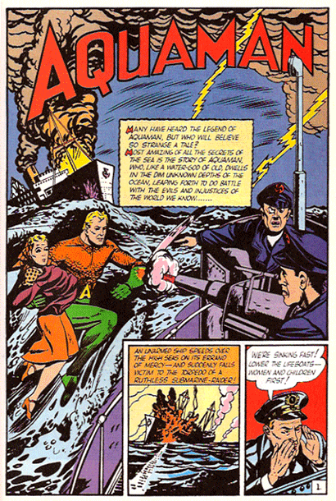

Slide 18
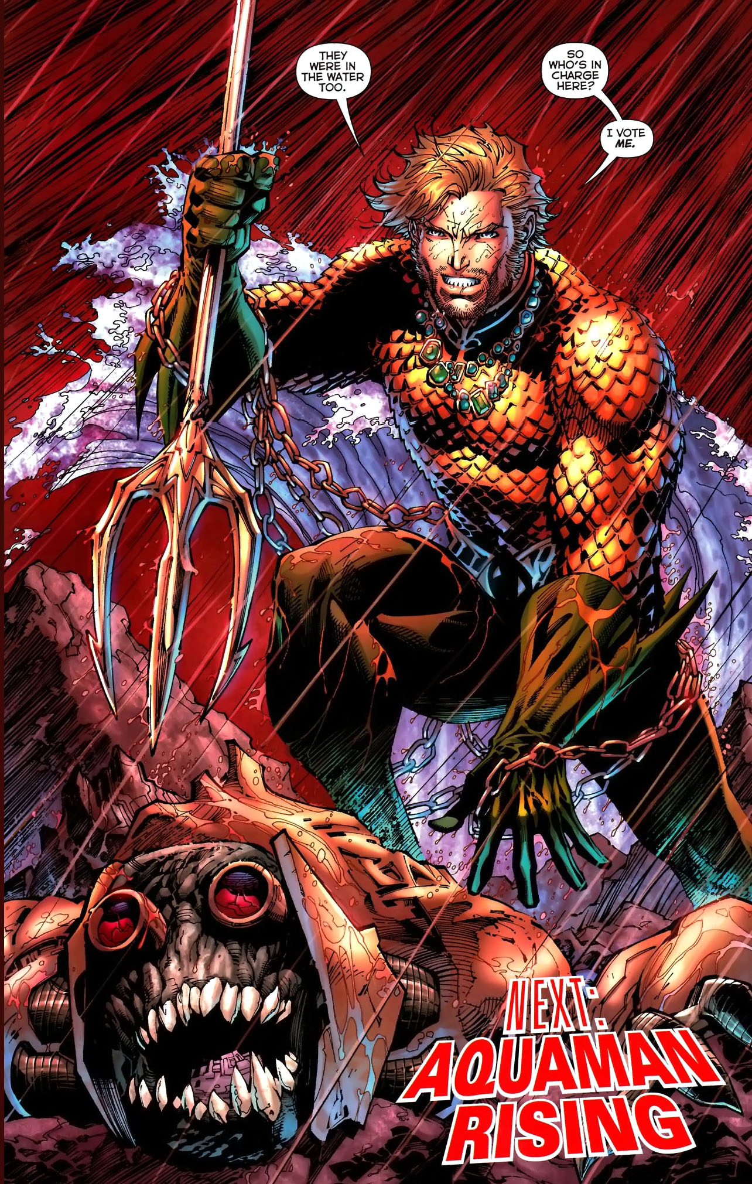
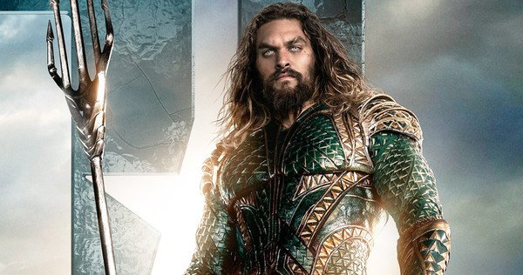

Slide 19
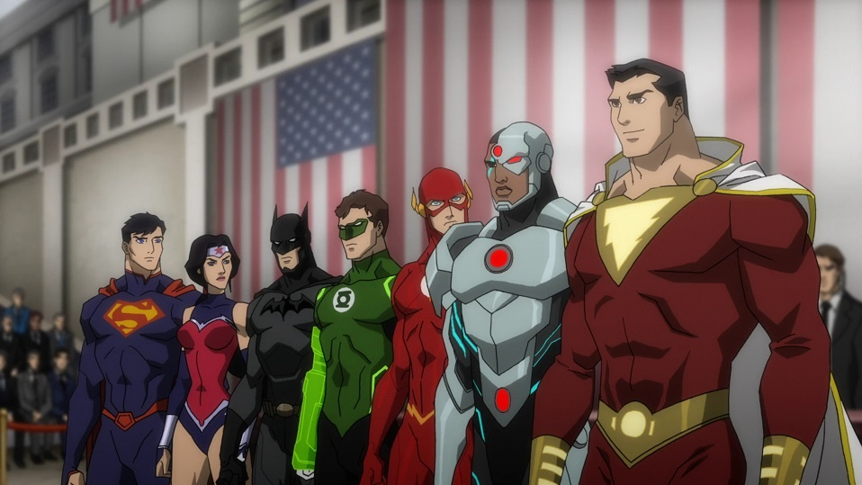
Wonder Woman: Yes, it was good to talk among a pantheon again.
Superman: How do you mean?
Wonder Woman: Hades, Apollo, Hermes, Zeus... each a god in their right.
- Justice League War, 2014

Slide 20
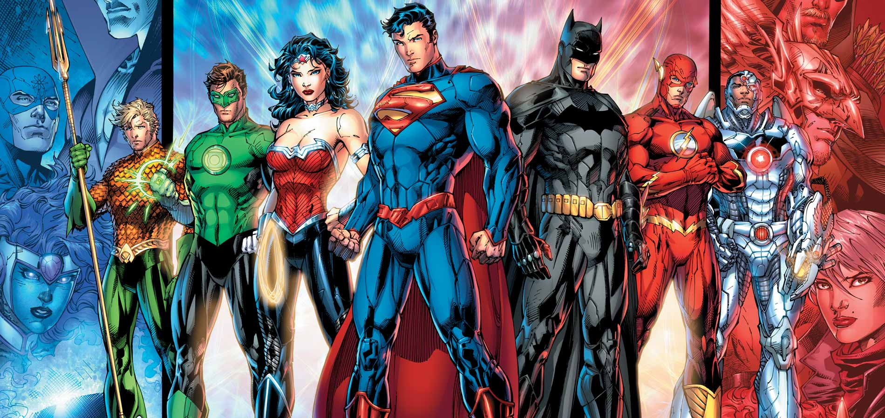

Slide 21
Bibliography
Batman v Superman. Directed by Zach Snyder. DVD. Burbank: Warner Bros Pictures, 2016
Family Guy. Episode 114. “Baby Not on Board” Directed by Julius Wu. Written by Mark Hentemann. Fox. November, 2008.
Hardwick, Lorna and Classical Association (Great Britain). 2003: Reception Studies. Vol. no. 33; Oxford; New York: Published for the Classical Association [by] Oxford University Press.
JLA, #13. Written by Grant Morrison. Pencils by Howard Porter. Inks by John Dell. “Rock of Ages” Burbank: DC Comics, 1998.
JLA, Written by Grant Morrison. Pencils by Howard Porter. Gary Frank and Greg Land. Inks by John Dell and Bob McLeod. JLA #15. Burbank: DC Comics. 1998.
JLA #16. Written by Grant Morrison. Pencils by Howard Porter. Inks by John Dell. “Camelot” Burbank: DC Comics. 1998.
JLA #17. Written by Grant Morrison. Pencils by Arnie Jorgensen. Inks by Davis Meikis and Mark Pennington. “Prometheus Unbound” Burbank: DC Comics. 1998.
JLA #25. Written by Grant Morrison. Pencils by Howard Porter. Inks by John Dell. “Scorched Earth” Burbank: DC Comics. 1999.
JLA Secret Files #2. Written by Christopher Priest. Pencils by Yanick Paquette. Inks by Mark Lipka. Burbank: DC Comics. 1998.
Justice League Vol 2. New 52. Written by Geoff Johns. Pencils by Jim Lee. Inks by Scott William. #3. Burbank: DC Comics. 2012.
Justice League. “Hereafter.” Episodes 45-46. Written by Dwayne McDuffie. Directed by Butch Lukic. Cartoon Network. November, 2003.
Kovacs, George and C. W. Marshall, Classics and Comics. 2011: Oxford; New York; Oxford University Press, 2011.
Morrison, Grant. Supergods. New York: Spiegel & Grau. 2011.
The Brave and the Bold #28, Written by Gardner Fox, Pencils by Mike Sekowsky, Inks by Bernard Sachs, (Burbank: DC Comics, 1960).
The Flash. “Fastest Man Alive.” Episode 2. Directed by David Nutter. Written by Greg Berlanti and Andrew Kreisberg. The CW. October, 2014.
Justice League: War. Animated Film. Directed by Jay Oliva. 2014; Burbank: Warner Bros Animation & DC Entertainment. 2014. Video.

