Slide 1
Death in Your Classroom: What the Romans Did and Believed, and How You Can Bring it to Class
Lori Kissell lkissell@fcps1.org
E-mail me for the Dropbox link
Or check the CAMWS uploads

Slide 2
Today’s questions
What did the Romans believe about death and the afterlife?
What were their funerary practices and beliefs?
What evidence do we have for those practices and beliefs?
How can you add this to your classroom?
that we’re going to answer.

Slide 3
Belief in an afterlife seems common
Beliefs:
Notes:
Inherited from Etruscans? Burial with provisions for an afterlife. Native religions and imported mystery cults

Slide 4
Belief in an afterlife seems common
Survival of an undifferentiated personality
Beliefs:
Notes:
Earliest versions of an afterlife feature an undifferentiated mass of the dead. Souls in Terra Mater as “Dis Manes”, powerful but not individual collective which can aid or hinder the living. Some mystery cults have the soul become part of the universal soul/lifeforce but not as a surviving personality

Slide 5
Belief in an afterlife seems common
Survival of an undifferentiated personality
Survival of an individual personality
Beliefs:
Notes:
Shift to belief in survival of the individual personality. Early afterlife was temporary then dissipate. Slow change from “mass of ancestors” to individual ancestors who can wish good or ill on the living an impact them. Earlier/Greeks seems the heroes and those being punished retained individuality. Mystery cults began to feature union with the deity without losing individuality.

Slide 6
Belief in an afterlife seems common
Survival of an undifferentiated personality
Survival of an individual personality
Location of surviving soul
Beliefs:
Notes:
Where does the soul go? Underworld – good, bad or indifferent. Elysium opens up to all (not just heroes.)
In the collective mass in Terra Mater
In the outer spheres with a mystery cult deity
Stays in or near the tomb

Slide 7
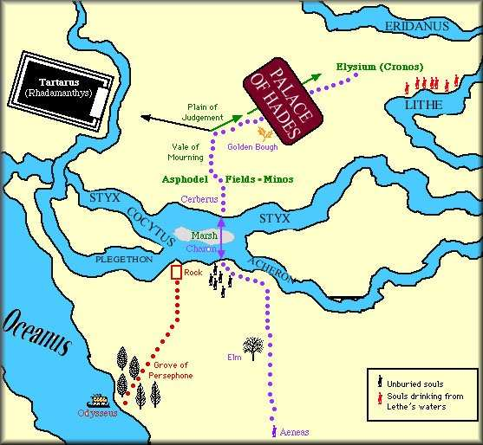

Slide 9
Inhumation
Funerary practices:
Notes:
Cicero, Pliny and Polybius all refer to inhumation as the earliest
Sarcoletum in Forum includes inhumation and cremation from 6th C BCE
Poor –directly into ground, sometimes shrouded, fossae graves, shielded with roof tiles, flooring tiles, very poor/slaves into burial pits
Moderate to wealthy – shrouded, coffins/sarcophagi, grave goods, gypsum
Twelve Tables makes provisions for both
Some clans retain inhumation e.g. Cornelians, Sulla first one cremated
Jews/Christians/Semitics opt for inhumation, esp. with catacombs and loculi
Infants often buried near houses – no pollution?

Slide 11
Inhumation
Embalming
Funerary practices:
Notes:
Regarded as foreign and exotic, but examples exist and appear to have been done in Italy, not brought back complete from Egypt
Young girl found, wrapped with painted face mask (like Faiyum?)
Two women found, separately, in 1960s
Possibly Isis devotees, but not proven

Slide 12
Inhumation
Embalming
Cremation
Funerary practices:
Notes:
Regarded as the “Romanus mos”
Ashes into burial vessel – urn, house model, ash chest, sarcophagus
Replaced in late fourth/fifth centuries with inhumation – theories – more elaborate sarcophagi and tombs for inhumation? Christianity?

Slide 13
Inhumation
Embalming
Cremation
Tombs/monuments
Funerary practices:
Notes:
Dead need to be remembered, locus for the soul ergo tombs/monuments
Simple to elaborate
Etruscan rock-cut tombs, complete with real/carved grave goods, home
Elaborately carved sarcophagi
Outside city along roads, to be remembered (not just sanitary)

Slide 14
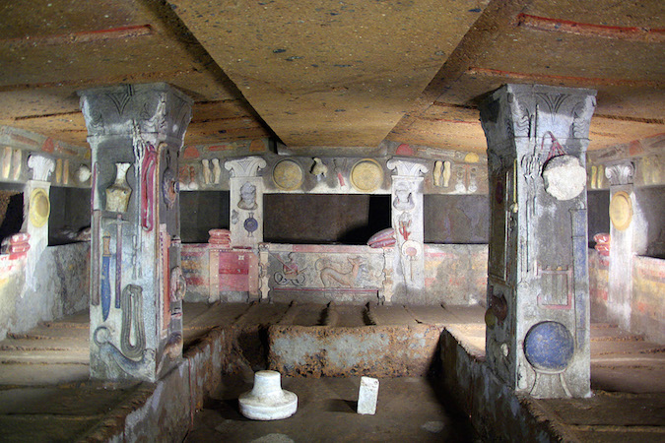
Notes:
Etruscan tomb with carved/false grave goods

Slide 15
Notes:
Gaius Cestius’ pyramid
Baker’s grave in Pompeii

Slide 16
Notes:
Augustus’ mausoleum
Caecilia Metelli’s tomb

Slide 18
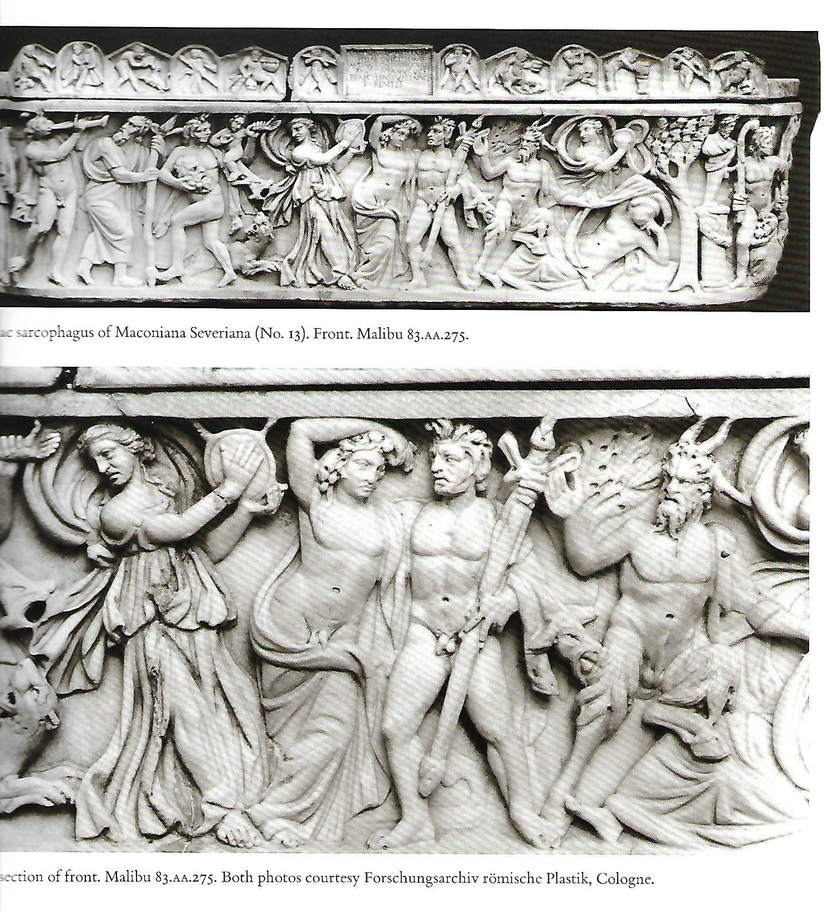
Notes:
Dionysiac sarcophagus

Slide 19
Notes:
Columbarium with individual niches (nidus)

Slide 21
Notes:
Street of the tombs, Pompeii

Slide 22
Inhumation
Embalming
Cremation
Tombs/monuments
Rituals
Funerary practices:
Notes:
Dead bring pollution (ritual and real) propitiate and expiate
Bare minimum required to propitiate dead and avoid vengeance – handful of dirt on corpse (before inhumation & cremation)
Funus applies to all activities between death and finally leaving the corpse at its permanent site
Funus translaticum (ordinary citizen of moderate to considerable means) funus militare (soldiers) funus publicum (rendered distinguished service to state) funus imperatorium (emperor, imperial family)

Slide 23
Funus:
Before death, family/friends gather
Kiss, close eyes
Conclamare
Body moved from bed to ground
Washed, dressed, by family or professionals
Notes:
Gather around bed
Nearest relative catch last breath/soul
Minimum of three calls to dead, but usually many more/near constant until inhumed/cremated
Formal clothing – togate and wreathed if applicable
Lie in state with feet toward house door if applicable up to seven days

Slide 24
Funus:
Professionals: Libitinarii
Pollinctores
Vespilliones with sandapila
Ustores
Fossores
Dissignatores
Praeco
Notes:
Libitinarii – undertakers
Pollinctores – powderers
Vespilliones –bearers for poor, sandapila- cheap bier
Ustores – burners
Fossores – gravediggers
Dissignatores – mc
Praeco – herald to announce and summon citizens

Slide 25
Funus: pompa
Procession at night, torchlight
On bier
Stop at rostra for laudatio
Dissignator, tibicines, tubicines, cornicines
Praeficae
Relatives
Actors/family with imagines
Notes:
Later, funerals of all but children and poor in daylight, with torches
Imagines unlikely to be true death-masks, more like portraits and later portrait busts

Slide 27
Funus: at site
Cremation at interment site/dedicated burning ground (ustrinum)
Head covered (toga) nearest male relative fires up body
Cremation & inhumation can include personal items/grave goods
Wine to douse embers
Ashes, bone fragments into urn/vessel
Notes:
Unguents mask odor and help burn
Wine also congeals ashes

Slide 28
Funus: post-burial
Silicernium
Suffitio
Feriae denicales
Cena novendialis
Parentalia & Lemuria
Notes:
Grave isn’t legally a grave until a pig is sacrificed on it
Silicernium funeral feast at the house for friends and family on day of funeral
Suffitio ritual purification by fire and water for friends and family who participated in the funeral
Feriae denicales purification of the house, begins day of funeral
Cena novendialis meal at tomb on ninth day so dead don’t feel neglected

Slide 29
Notes:
Tomb in Wales with libation tube visible

Slide 30
Literary
Evidence:

Slide 35
Literary
Funerary art
Evidence

Slide 36
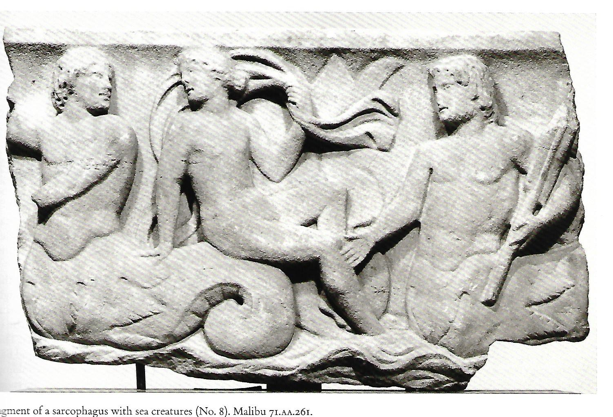

Slide 37
Literary
Funerary art
Epigraphy
Evidence

Slide 38
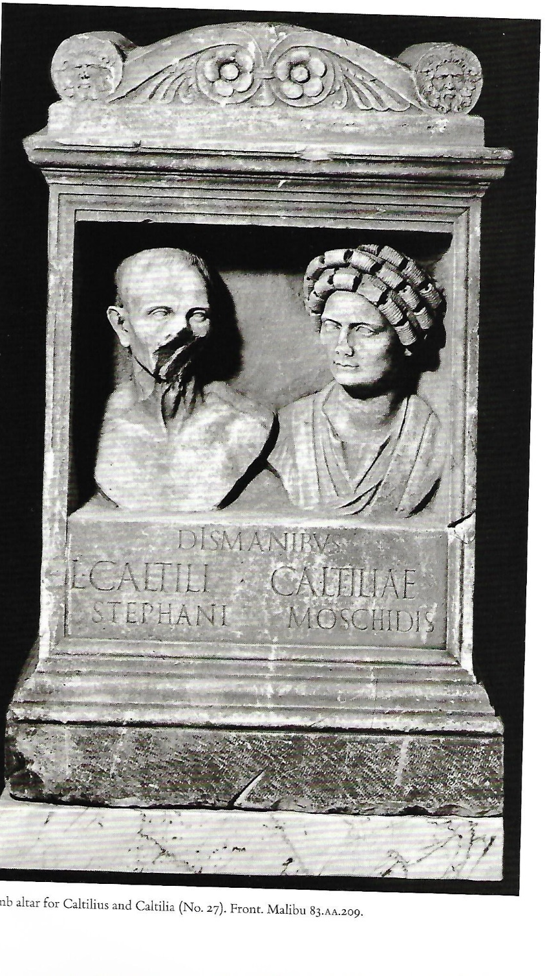

Slide 39
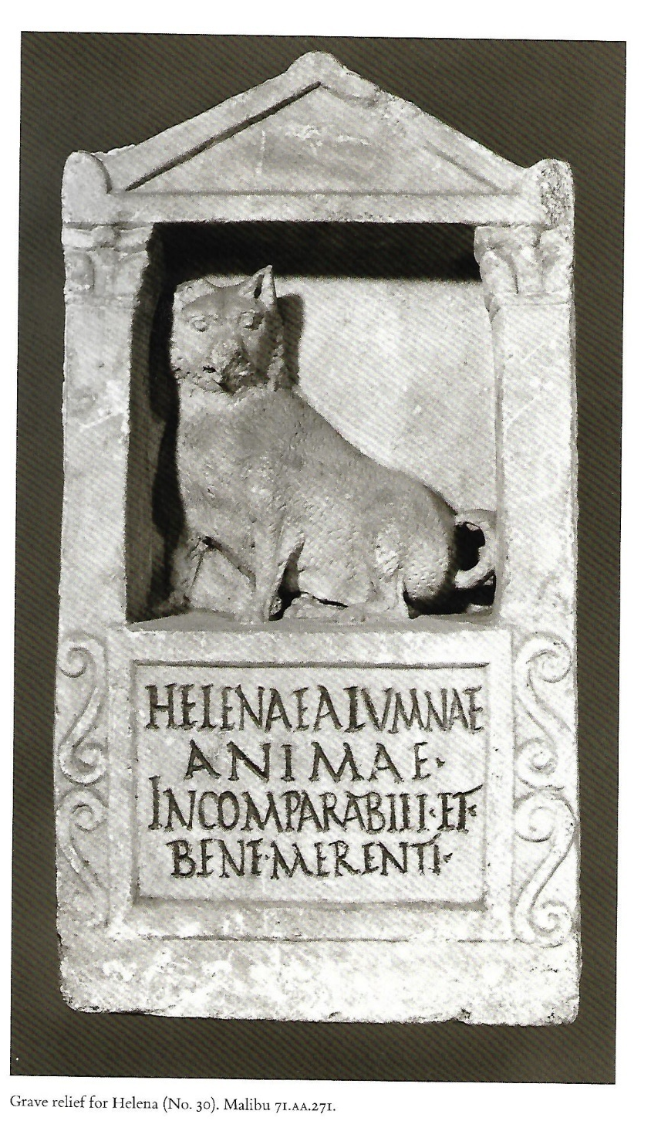

Slide 40
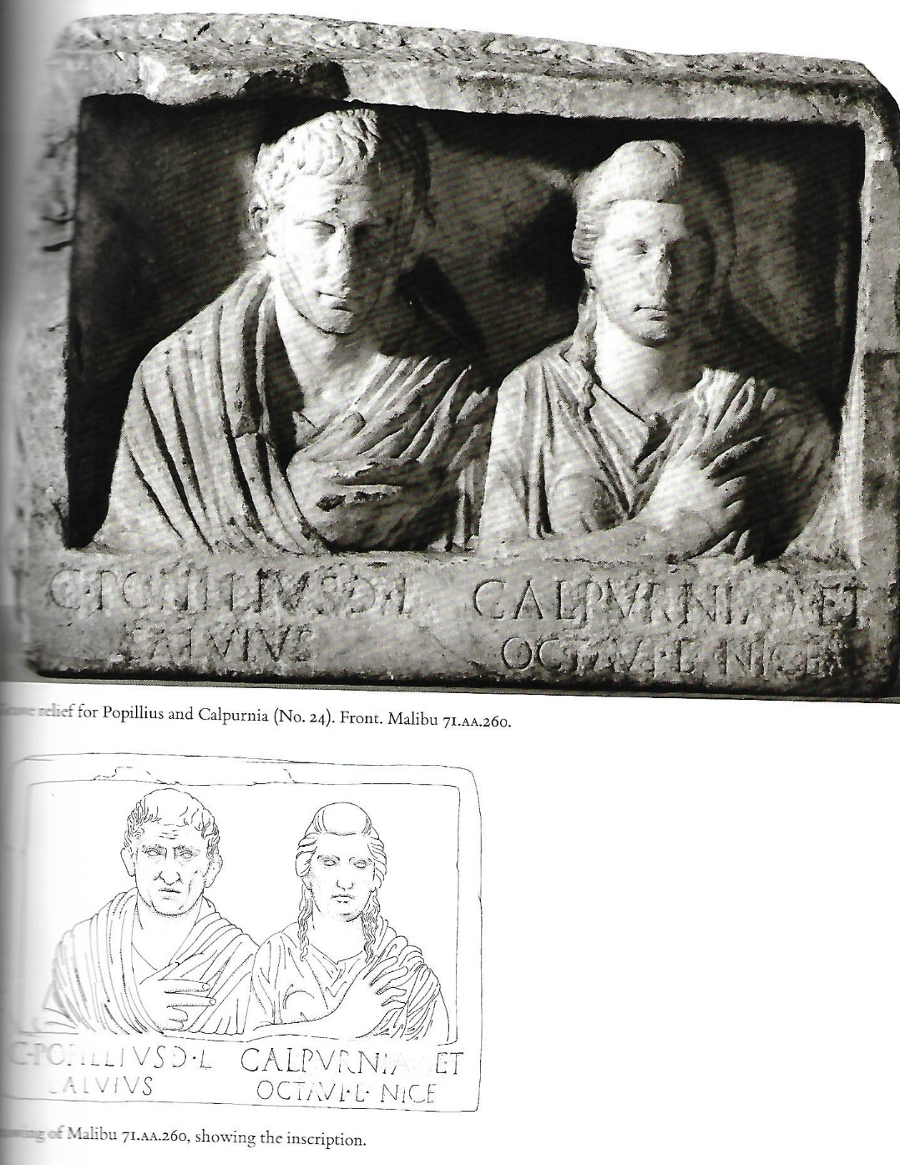

Slide 42
Literary
Funerary art
Epigraphy
Archaeology
Evidence

Slide 43
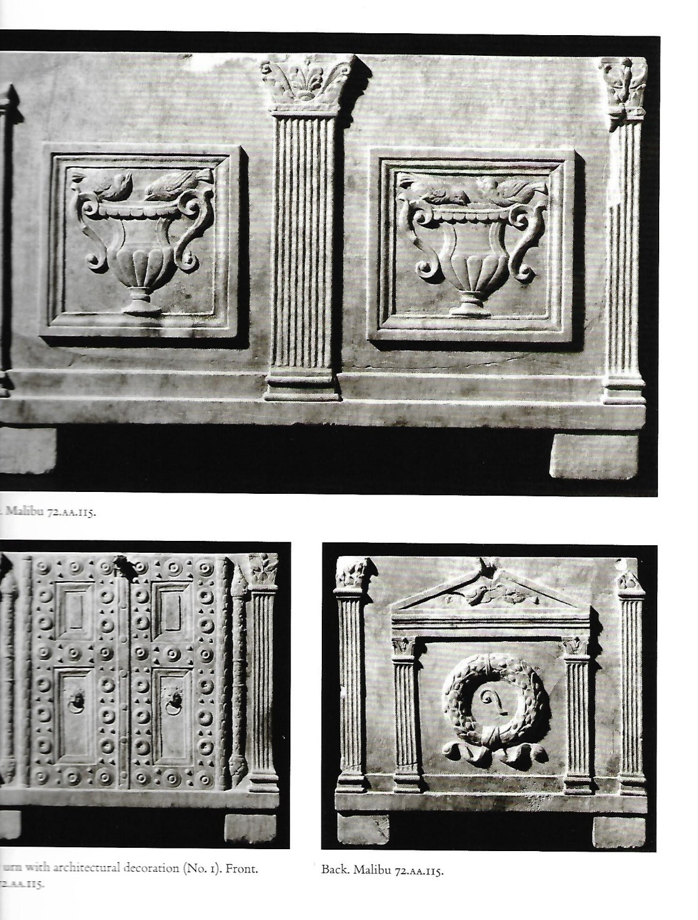

Slide 44
Lay the groundwork – talk about death and funerals/use this research to prep your class
Enact a funeral!
Props – find ‘em/make ‘em/have students make ‘em: bier; corpse; torch; urn; imagines; head coverings; write a laudatio or improvise; pyre.
Add to your classroom

Slide 45
Add to your classroom
Jobs: Family; friends; manumitted slaves; professional mourners; professional undertakers; powderers; bier-bearers; professional burners or gravediggers; mc; herald; 4 flute players; tuba player(s); horn player(s); mask/imago bearers; torch bearers.

Slide 46
Add to your classroom
Gather family around the dying, catch the soul, close the eyes
Conclamatio
Take body from bed, place on floor, wash and anoint
Dress body (togate? wreath?) place coin in mouth, powder
Lie in state

Slide 47
Add to your classroom
Pompa: 4 flute players, tuba player(s), horn player(s), professional mourners, widow(er), children precede bier
Camillus, slaves, manumitted slaves, other relatives follow bier
Carry to Forum, herald summons citizens along the way, laudatio
Carry to burning/inhumation site

Slide 48
Add to your classroom
At site: gravediggers dig or burners set up pyre
Ritually throw earth on body
“Ave atque vale” and, with head covered, nearest male relative lights pyre (if cremating)
Douse ashes with wine and remove portion for burial (if cremating), place remainder in urn
If inhumation, inter corpse

Slide 49
Add to your classroom
If you want to be thorough:
purify house, funeral feast, then return nine days later for the novendialis!
Most of all – have fun!

Slide 50
Sources:
Toynbee, J.M.C.; Death and Burial in the Roman World; Johns Hopkins University Press; 1996
Shelton, JoAnn; As The Romans Did; Oxford University Press; 1998
Adkins, Lesley and Roy A.; Handbook to Life in Ancient Rome; Oxford University Press, 1998
Hope, Valerie M. and Huskins, Janet, eds.; Memory and Mourning: Studies in Roman Death; Oxbow Books; 2011
Hope, Valerie M. and Marshall, Eireann, eds.; Death and Disease in the Ancient City, esp. Chapter 11 Death- Pollution and Funerals in the City of Rome; Hugh Lindsay; Routledge; 2011
Pearce, John; Death as a Process: The Archaeology of the Roman Funeral; Oxbow Books; 2017

