Slide 1
How to Bribe a Roman Jury
Manipulation of Voting in the Quaestiones Perpetuae
Tadeusz Mazurek
Univ of Notre Dame
CAMWS April 2019

Slide 2
SIZE of Quaestiones Perpetuae (QP) JURIES
Some attested jury numbers:
Lex Acilia 122 BC: 50 jurors
Junian Trial 74 BC: 32 jurors
Verres 70 BC: ca. 45 jurors
Clodius 62 BC: 56 jurors
Flaccus 59 BC: 75 jurors
Milo 52 BC: 51 jurors
Notes:
Juries can end up being of different sizes:
Senators can remove up to 6 jurors (but any number up to 6)
Urban praetor’s pool varies in number, presumably larger after lex Aurelia
Some in pool may be out of town, dead, etc.
For great info on jury size and selection:
Strachan-Davidson, Roman Criminal Law, vol II, pp 75 ff:
Greenidge, Legal Procedure, pp 433 ff

Slide 3
BRIBERY IN THE COURTS: very high stakes
Infamous Junian Trial in 74 BCE: total bribes over 1.3 million sesterces (pro Cluentio)
Verrines Act I:
1.40: Verres jokes that 1/3 of the money he’s stealing from Sicily is for bribing his future jurors
Milo’s trial in 52 BCE: final panel of jurors not chosen until just before voting to eliminate chance of bribery
Notes:
lex Pompeia de vi in 52 BC: 81 jurors were seated in Milo’s trial, but 30 of these were dismissed just prior to voting (each side ejected 15 jurors = 5 from each class).

Slide 4
Voting Procedure in Lex Acilia Repetundarum (122 BCE) [see handout #1]
praetor shall have an urn set up: 20? digits wide and ?? digits tall
pr himself places ballot into hand of jurors
ballot is ? digits wide and 4 digits long
one side has letter C (Condemno); other side has letter A (Absolvo)
pr orders juror to cancel out one letter
juror proceeds (directly it seems?) to the voting urn
"in full view and with arm bared", he must ascend a podium, display the ballot (with fingers covering the letter), release it, then descend
Counting the Ballots:
one juror is randomly selected to count ballots: reaches into the urn and declares the vote on each ballot as it is withdrawn
then he hands the ballot to the nearest juror, who hands it to the praetor
lacuna: rest of section on counting of votes is missing.
Notes:
For the text, translation and notes, see Crawford, Roman Statutes, vol 1 (on sections #49-54).
On the name and dating of the lex Acilia Repetundarum, see E. Badian, AJP 75.4 (1954), pp 374-84.

Slide 5
Praetor Controls Ballot Distribution & Disposition
Verrines 1.32: Cic prefers to have Marcus Metellus as a juror in this trial than as the praetor for the repetundae QP next year, when he will be entrusted with the ballots of others without being under oath.
Verrines 1.39: Verres as urban praetor (74 BCE) presided over a QP and distributed the ballots to the jurors.
Does praetor personally distribute the ballots?
Yes, in lex Acilia; perhaps in 74 BCE
Maybe assistants used at some later time?
Even more importantly, you want the praetor on your side to control ballots after a trial
ballots probably re-used?
Notes:
Verrines 1.39: Cicero mentions several other well known cases of bribing jurors.
Praetor’s support is also helpful before and during a trial:
accepts/denies lawsuit
controls length of pre-trial inquiry and of speeches
summons witnesses
perhaps chooses sleeve of jurors from the larger album

Slide 6
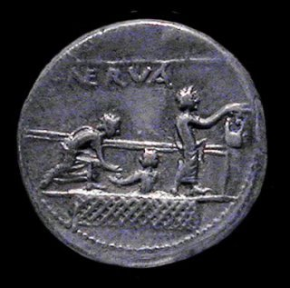
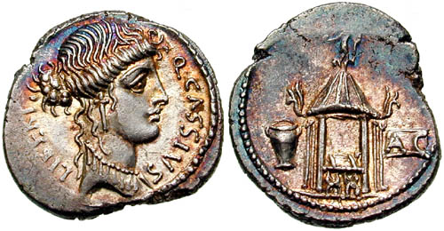
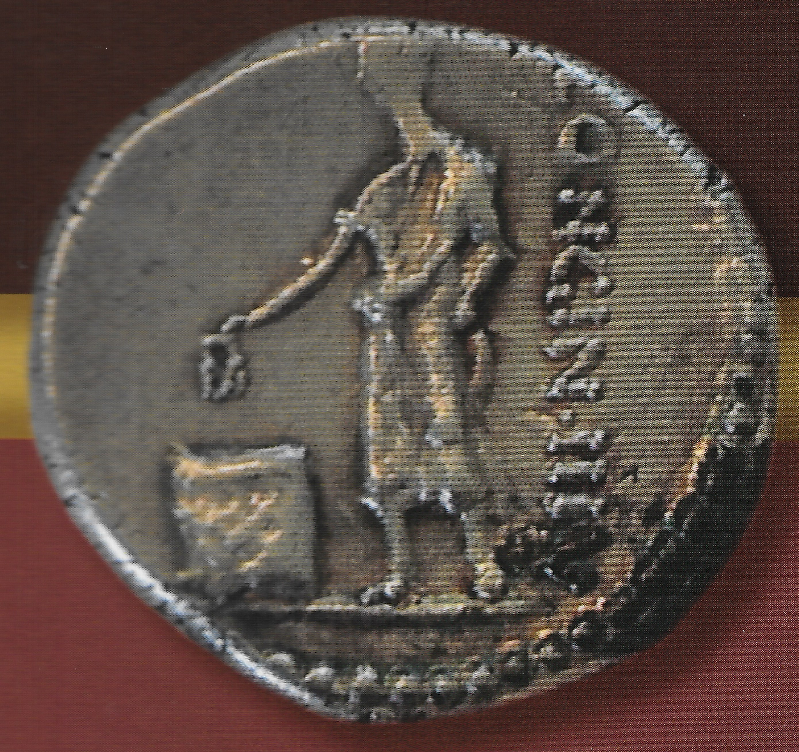
A(bsolvo) C(ondemno) ballot & urns/baskets used in voting
Nerva coin (113 BCE) shows voting bridge used in assembly voting. Capitoline Museum.
NB the bare arm.
Urn, Ballot, Curule Chair in Temple of Vesta, Libertas on obverse
53 BCE (modeled after similar in late 2nd c.)
Coin of L. Cassius Longinus (63 BCE).
Private collection.
Notes:
For more on the Longinus coin see Crawford, RRC, #413. Image from The Voting Districts of the Roman Republic by L.R. Taylor (updated, Ann Arbor 2013).

Slide 7
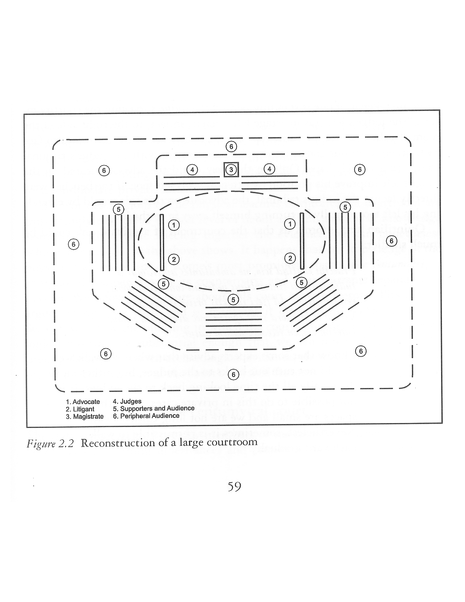
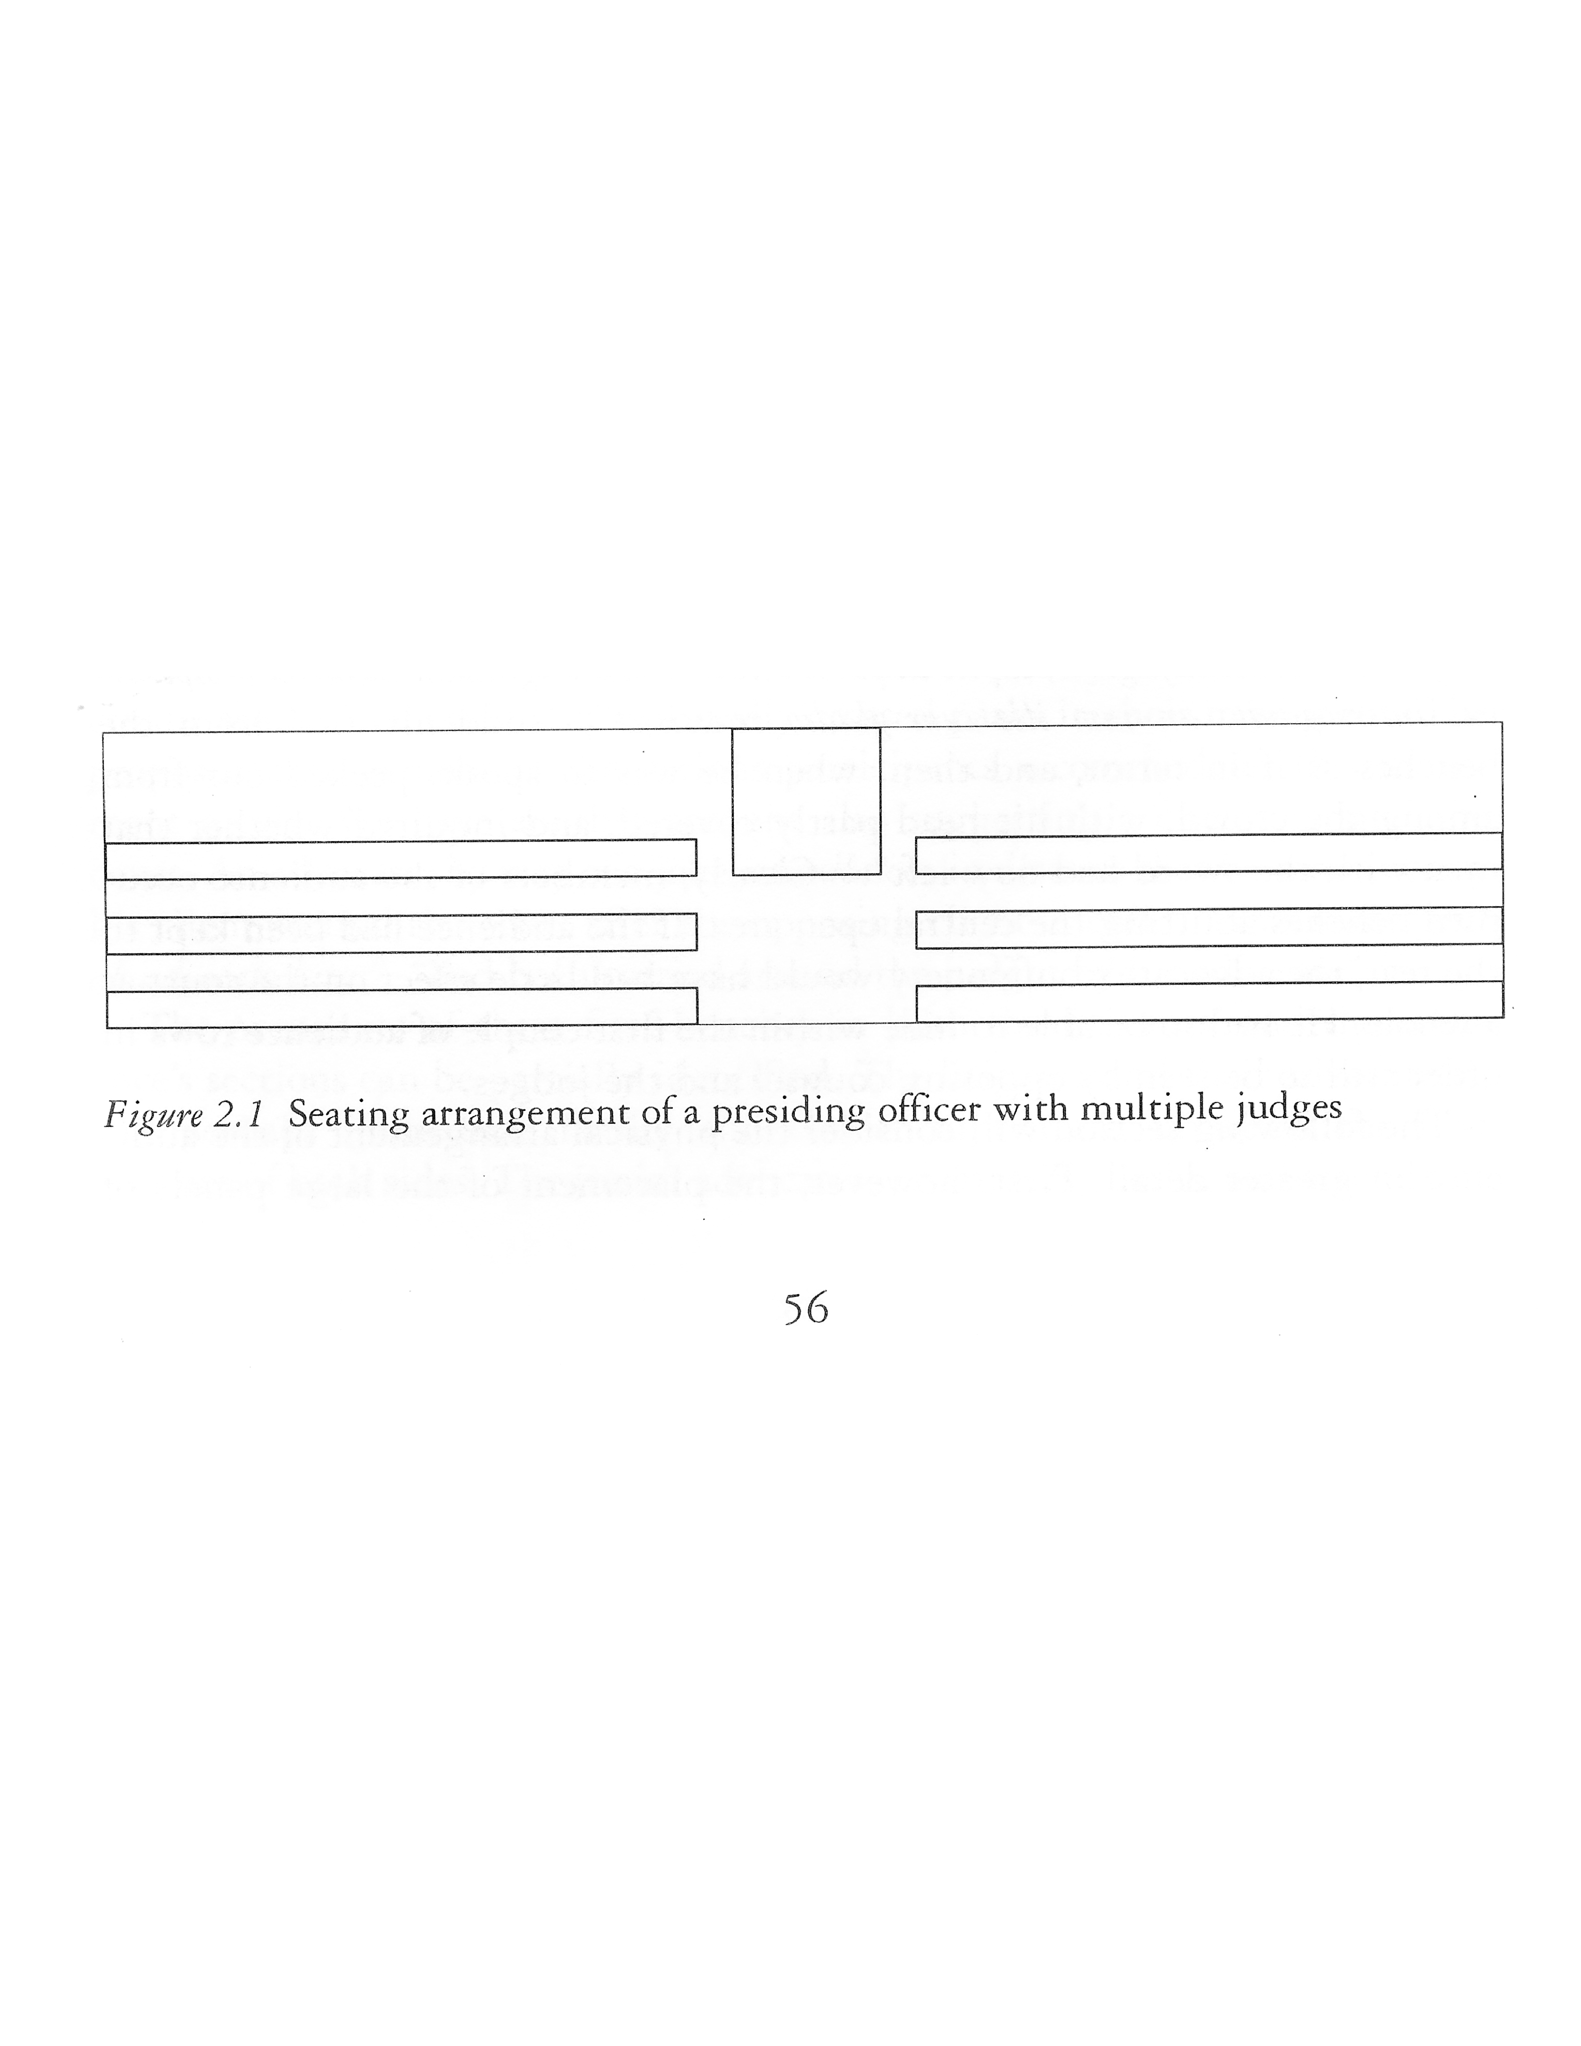
Quaestio Perpetua Tribunal
urn
Need to accommodate 32-81 jurors,
many hundreds in audience,
and urn on a raised podium.
Images from L. Bablitz, Actors and Audience, chap 2
Notes:
Juries range from 32 jurors (in the Junian Trial of 74 BCE) to 75 jurors (in Flaccus' trial of 59 BCE) [Strachan-Davidson, vol 2 , p 97]. 81 jurors needed to be accommodated for Milo’s trial, although only 51 voted in the end.
Just barely enough space on the podium for praetor & sella. Not much room surely in artistic depictions (relief sculptures or on coins) or literary descriptions (as per Bablitz, pp 29-30). But Asconius (on pro Milone) does say that M. Marcellus, advocate for Milo, jumped up on the podium with presiding magistrate Domitius Ahenobarbus to escape violence from Clodius’ supporters.
According to lex Acilia, praetor hands ballots to jurors who proceed onto a podium to cast ballots into an urn (surely located in front of praetor).
Presumably praetor remains on the podium (I would!).
Do jurors proceed directly to urn? Or get their ballots row by row? Then return to seats first to rub their ballots, then onward to urn?
Perhaps at some later date (post Sullan reforms?) it became customary to pass out ballots to jurors as they sat on the benches.

Slide 8
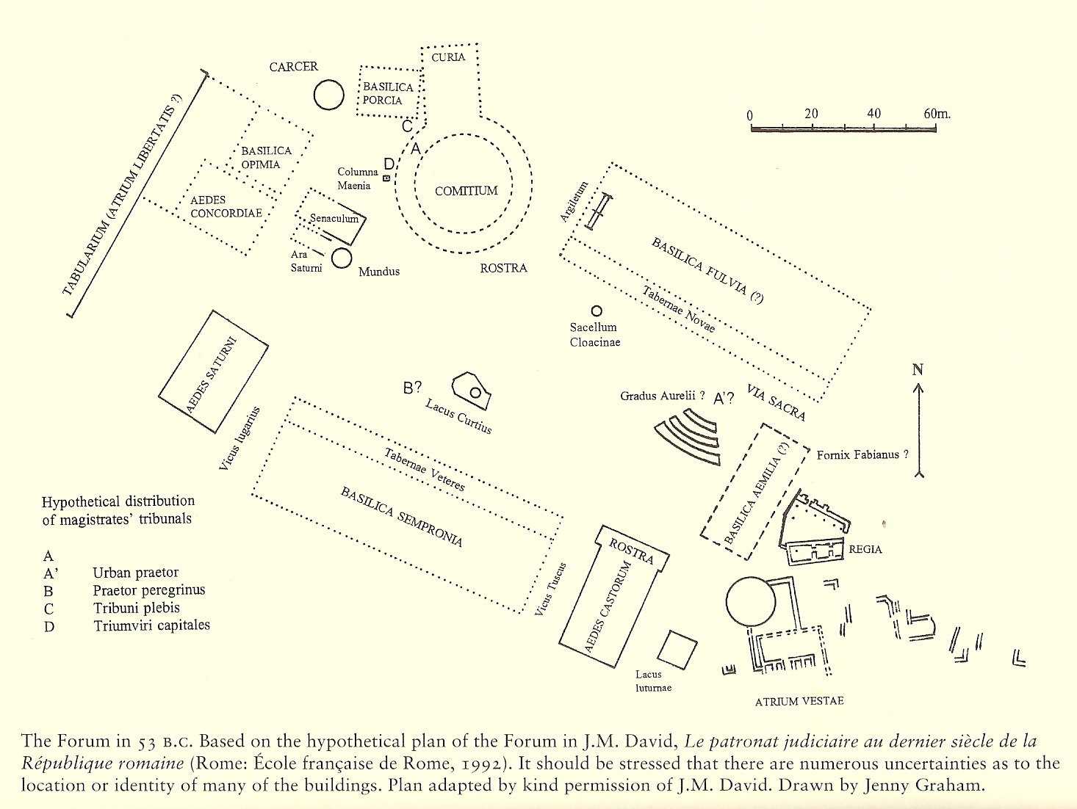
Notes:
Tribunes’ and praetor’s tribunals (offices) in different spots throughout forum.
Cic mentions wooden benches of these tribunals in pro Roscio Amerino 91, etc. (80 BCE).
Cic frequently refers to the crowd gathered around as he speaks in court.
Cicero in speeches mentions the Temple of Castor & Pollux, Fornix Fabianus (in Verrines).

Slide 9
BRIBE METHOD 1: ASK FOR ORAL VOTE
Easy as Pie!
80 BCE: Sullan reforms allow defendant to request this option.
pro Cluentio 74-75: jurors are seated on their benches before chosen by lot to proclaim their vote
takes 40,000-50,000 sesterces to bribe a juror
Infamous bribery in Junian Case of 74 BCE forces change.
70 BCE: lex Aurelia eliminates oral vote option (if not sooner)
Notes:
On the lot used to determine the order of proclaiming oral votes, see pro Cluentio 74-75.
Perhaps(?) the Cornelian reforms allowed jurors at time of voting to sit and either receive their wax ballots en masse or wait for their turn to proclaim vote orally. But even after oral vote eliminated, this procedure remained standard? No such evidence.

Slide 10
BRIBE METHOD 2: FLIP BALLOT TO AGENTS ON JURY (apparently only works in divinatio cases)
Divinatio in Caecilium 24: Hortentius wants jurors that he's bribed to display their ballots to his key agents within the jury. [see handout #2]
Cicero agrees that this is very easy (id esse perfacile).
Unique: votes are decided all together (universos), not singularly (non singulos).
Ballots are still distributed by praetor to jurors who approach him row by row?
Or in divinatio voting are ballots passed out to jurors in their seats (universos)?
Where they can "very easily" display their ballots to their neighboring jurors.
Then pass the ballots back (non singulos ferre sententias, sed universos constituere)?
or proceed to the urn as customary with ballots?
Why only for divinatio decisions?
Perhaps to give time for jurors to deliberate, but this is not normal for advisory councils
Better: jurors must use stylus to write the name of their preferred prosecutor (no rubbing out)
Notes:
That someone nearby could actually see the vote on a ballot flashed at them is confirmed by Cicero in de legibus 3.10 & 3.33-39.
OLD s.v. universus: “Regarded as a whole; taken all together; regarded as a group, occurring, acting, etc. all at once”
Strachan-Davidson, vol 2, 128 n. 3 agrees that jurors were seated while rubbing out their votes only in divinatio trials.
The lex Servilia de repetundis (111 BCE) is known to have mentioned the divinatio procedure. Perhaps divinatio needed only in QP de repetundis, otherwise praetor decides who gets to prosecute.

Slide 11
BRIBE METHOD 3: USE MARKED BALLOTS
Briber wants to track the vote of each juror that he’s bribed
In Caecilium 24: [see handout #2]
Cicero mentions the "scandalous and shocking... wax" on ballots in a previous trial
But the ballots here and now are with legitimate wax (legitima cera)
In Verrem:
Verrines 1.17: Verres became despondent and abandoned all attempts at bribery when the names of the jury panel were finalized. For he realized that "no mark (nota), color (color) or smudge (sordes) could be put on the ballots."
These jurors are too honest.
Presiding praetor Manlius Acilius Glabrio will not collude with Verres.
Verrines 1.40: Cicero refers to a previous senatorial jury whose cast ballots were marked by discolorations (discoloribus signis sententiae notarentur).
Notes:
In Caecilium 24:
“[Hortentius says that]…a ballot is being given to every juror, covered with the proper wax, and not with that notorious and nefarious wax.” tabellam dari cerā legitimā, non illā infamī ac nefariā
This previous trial may be Hortentius’ recent defense of Terentius Varro for corruption (repetundae).

Slide 12
BRIBE METHOD 3 con’t: USE MARKED BALLOTS
In Defense of Cluentius 129-30:
A few months after the infamous Junian Trial, juries are further discredited by discovery of markings on ballots (vehemens invidia ex notatione tabellarum versata [est])
tabellae = discovered before votes were cast
nota (OLD): "a mark attached, imprinted, etc in order to identify or distinguish."
------------------------------------------
But where were these markings/discolorations on the ballots?
Most likely faint colored marks on different spots on edge of frame.
When ballot is in juror's hand and while dropping into urn, he can cover any marking with his palm or fingers.
Notes:
Reaction to oral vote in Junian Trial makes such a request suspect, hence bribers must adapt. This option probably eliminated by lex Aurelia in 70 BCE (Greenidge 442).

Slide 13
HOW TO DISTRIBUTE MARKED BALLOTS?
Even for a colluding praetor, it would be very hard to hand specific marked ballots to jurors who've been bribed.
We want a different colored mark for each bribed juror, so…
Praetor would have to know which ballot to give to which juror.
Praetor would have to cover the marking with his finger or hands.
Not much elbow room up on that podium: no table.
Thousands of eyeballs staring at him.
Much easier to give forged ballots to bribed jurors beforehand.
Natural to look down and cover the ballot while erasing
Juror can switch out the official ballot with forged one from folds of toga as he moves in line from praetor to urn
lex Acilia implies that ballots could be secreted within folds of toga
Explains illegitima cera…
Notes:
Previous commentators presume that praetor handed out tainted ballots, but this is not a good plan.
Praetor must have had a basket of tabellae from which he chose one at a time to distribute to jurors.
For lack of elbow room on the praetor’s podium see Bablitz, Actors and Audience, chap 2.
Very telling that framers of lex Acilia stipulated to bare arm before dropping in ballot.

Slide 14
ILLEGITIMATE WAX: contra Strachan-Davidson
Illegitimate =
Produced at a different time and place than ‘legitimate’ ballots.
Hence, differs in color and/or texture from genuine ballots.
Lex Acilia #52: ”the juror is to place that ballot visible according to this statute (sortem ex hace lege apertam) and with his arm uncovered, the letter covered with his fingers, openly [in that urn and he is to descend from the platform].” [see handout #1]
S-D: Juror covers only one side of the ballot with his hand and must display the other blank side to those around him. This is to show that he has rubbed out at least one letter, i.e, he’s not abstaining.
misinterprets text/context, does not accomplish stated goal, physically awkward
S-D: wax is intentionally different colored to reveal juror’s vote
But Cicero never actually says that the wax is of a different color (just illegitimate)
a bad plan easily exposed!
Mazurek: wax on collusive ballots is mistakenly/unintentionally different, because they were produced and distributed before the day’s proceedings
Notes:
Cicero never specifically states that the wax was of a different color, but how else can it be identified as illegitimate?
Perhaps this wax was more brittle or softer--it didn’t look different, but felt different?
If many colors, then we can have a different color for each bribed juror (but that would require too many colors— ca. 2 dozen).
Probably different quality wax was unintentional, a mistake that exposed the bribery plot, i.e., accidentally produced in a slightly different way than the regular ballots.

Slide 15
ESCAPING DETECTION WHILE ASCERTAINING COLLUSIVE BALLOTS
Danger of ballot markings being exposed:
During the voting:
Discolorations can’t be too obvious lest they be noticed by crowd or honest jurors
contra S-D
As votes are being tallied:
Lex Acilia says that a juror (chosen by lot) is to read and declare the vote on each ballot.
Markings must elude this vote counter and the nearest juror to whom ballot is then handed.
Afterwards:
After all ballots have been returned to the praetor, before he disposes of them.
Colluding praetor (or other agent) must study the ballots to see if votes align with markings.
Marked ballots could then be removed and destroyed before being re-used.
This is what Cicero is referring to at Verrines 1.32: Praetor Marcus Metellus and Verres would be colluding on the back end of the process.
Notes:
Briber would prefer to see the cast ballots from the urn, which is better control than flashing a vote that can still be changed.

