Slide 1
Writing and its Discontents:
On the Decline of Delphic Divination in the 4th century BCE:
Lisa Maurizio, Bates College
CAMWS, Lincoln NE 2019

Slide 2
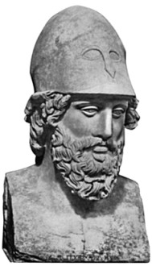
II. Herodotus 7.141
Vainly does Pallas strive to appease great Zeus of Olympus;
Words of entreaty are vain, and so too cunning counsels of wisdom.
Nevertheless I will speak to you again of strength adamantine.
All will be taken and lost that the sacred border of Cecrops
Holds in keeping today, and the dales divine of Cithaeron;
Yet a wood-built wall will by Zeus all-seeing be granted

Slide 3
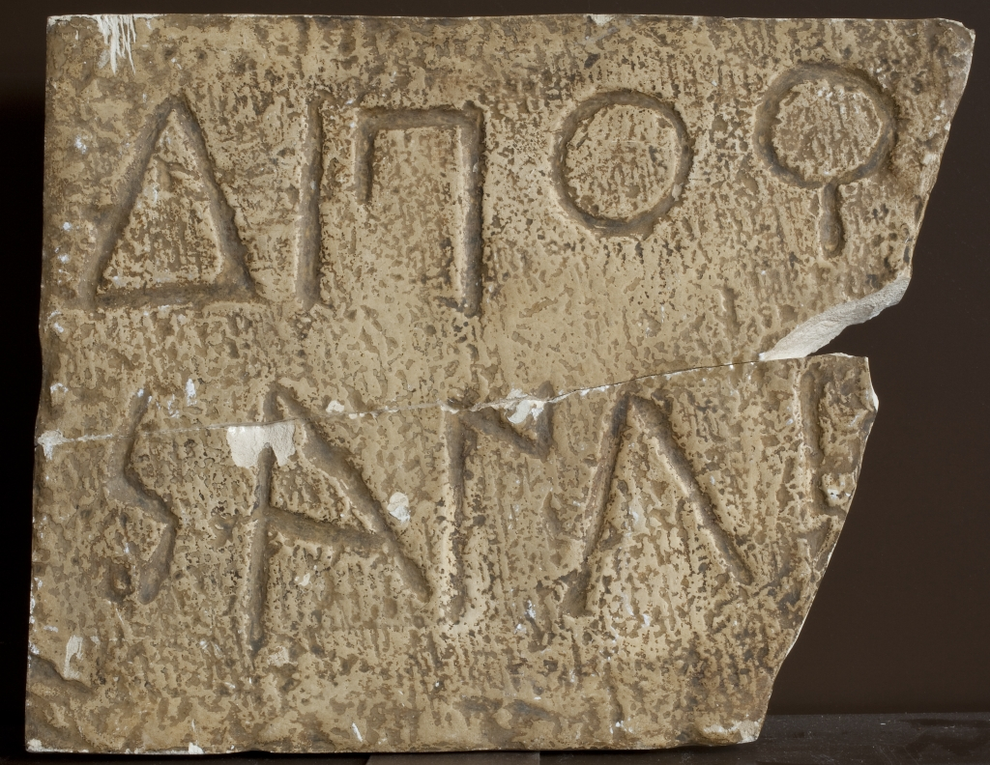
III. Albert Henrichs
2003a. “Writing Religion: Inscribed Texts, Ritual Authority, and the Religious Discourse of the Polis” in Written Texts and the Rise of Literate Culture in Ancient Greece. Harvey Yunis (ed.). Cambridge.
2003b. “‘Heiroi Logoi’ and ‘Heiroi Bibloi’.” HSCP101: 207 – 66.

Slide 4
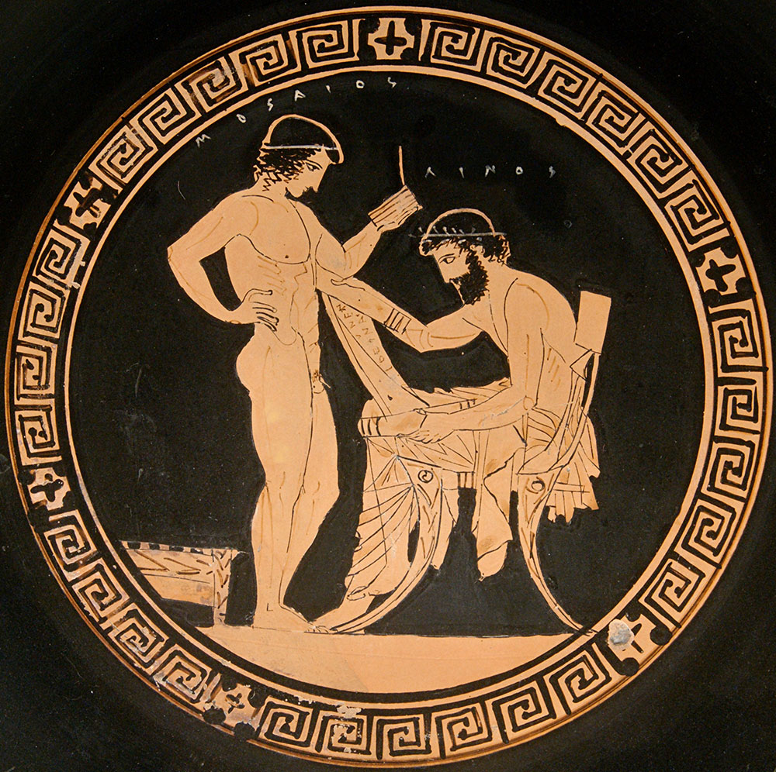
IV. Musée du Louvre, Atlas database: entry 7456
Beazley: ARV2 1254,80; Addenda2, 355
This school scene is one of the earliest surviving images of anyone reading a papyrus roll (440 BCE). Linos, seated, reads the roll vertically. The boy, Mousaios, stands reading from wooden tablets. The cup is attributed to the "Eretria Painter.”

Slide 5
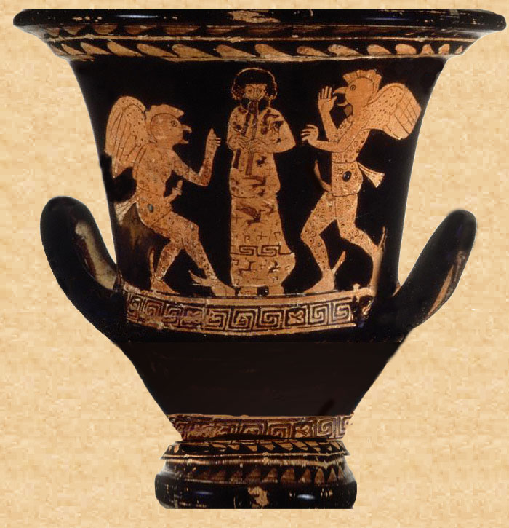
V. A scene from Aristophanes’ Birds
In this comedy, a chresmologue recites an oracle of Bacis.
Attic calyx crater
415–400 BCE.
Boardman 1989, no. 314
J. Paul Getty Museum, Malibu 82.AE.83

Slide 6
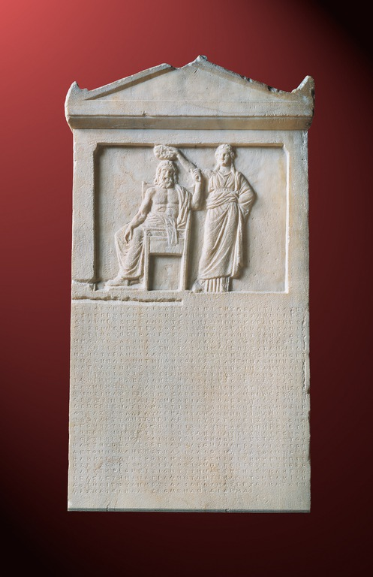
VI. Law against Tyranny
with a relief of Democracy crowning Demos (the people of Athens), 337/6 B.C.

Slide 7
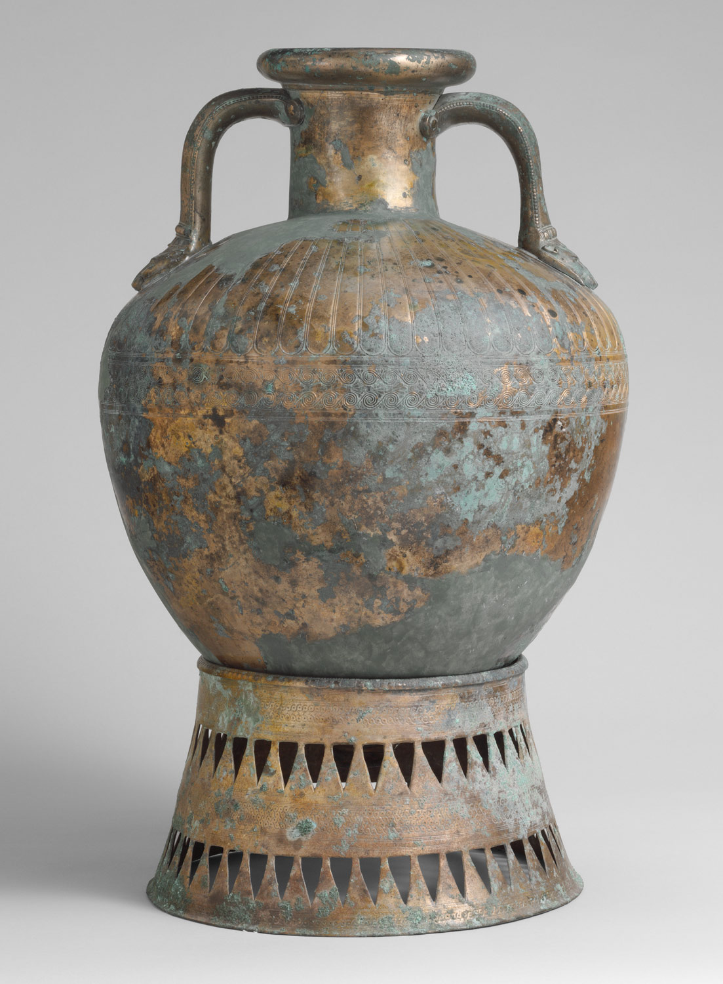
VII. 352/1
IGii² 204: Text, translation, and commentary in P.J Rhodes and Robin Osborn 2003: Greek Historical Inscriptions: 404 – 323 BCE . Oxford,
272 – 81.

Slide 8
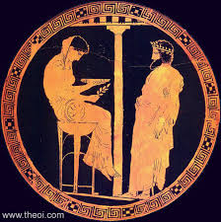
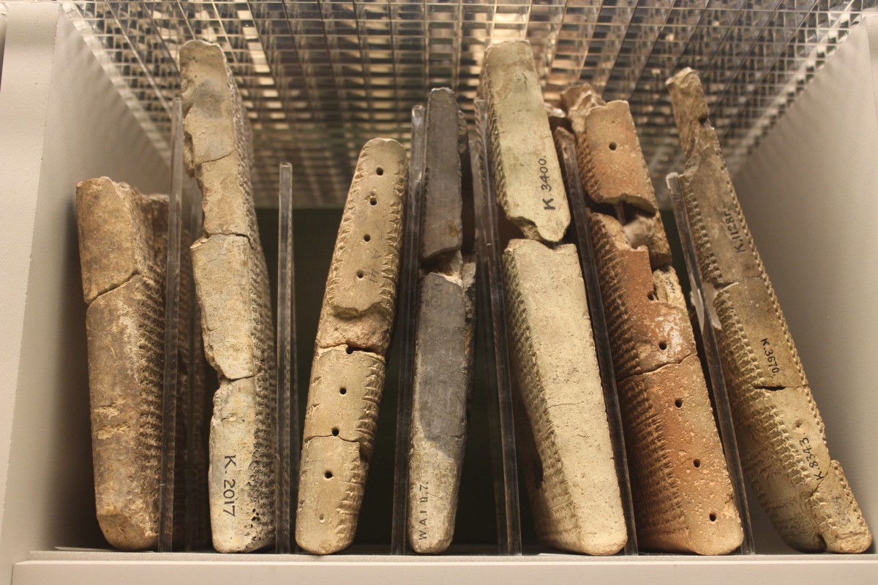
VIII. Writing and its Discontents

Slide 9
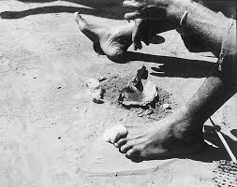
IX. Azande benge (poison) oracle
Wilce, J. M. 2001. ‘Divining Troubles, of Diving Troubles? Emergent and Conflictual Dimensions of Bangladeshi Divination’, Anthropological Quarterly 74: 190–200.
Zeitlyn, D. 2001. ‘Finding Meaning in the Text: The Process of Interpretation in Text-Based Divination’, The Journal of the Royal Anthropological Institute 7: 225–40.
Zeitlyn, D. 2012 ‘Divinatory Logics: Diagnosis and Predicting Mediating Outcomes’, Current Anthropology 53: 525–46.

