Slide 1
Lessons from a Competency-Based Online Greek Course
Robert Groves, University of Arizona
email: groves@email.arizona.edu twitter: @wisclassic (livetweeting is welcome!)

Slide 2
The traditional classroom model:
Vocabulary
Morphology
Syntax
Reading Skills
Evaluations (HW, Quiz, Test)
Grade
Gradebook
Student
Vocabulary
Morphology
Syntax
Reading Skills

Slide 3
Competency based model
Vocabulary
Morphology
Syntax
Reading Skills
Failure or Incomplete Success
Success!
Evaluations (HW, Quiz, Test)
Vocabulary
Morphology
Syntax
Reading Skills

Slide 4
Greek 112
Summer, 10-Week Session
Asynchronous, Online

Slide 5
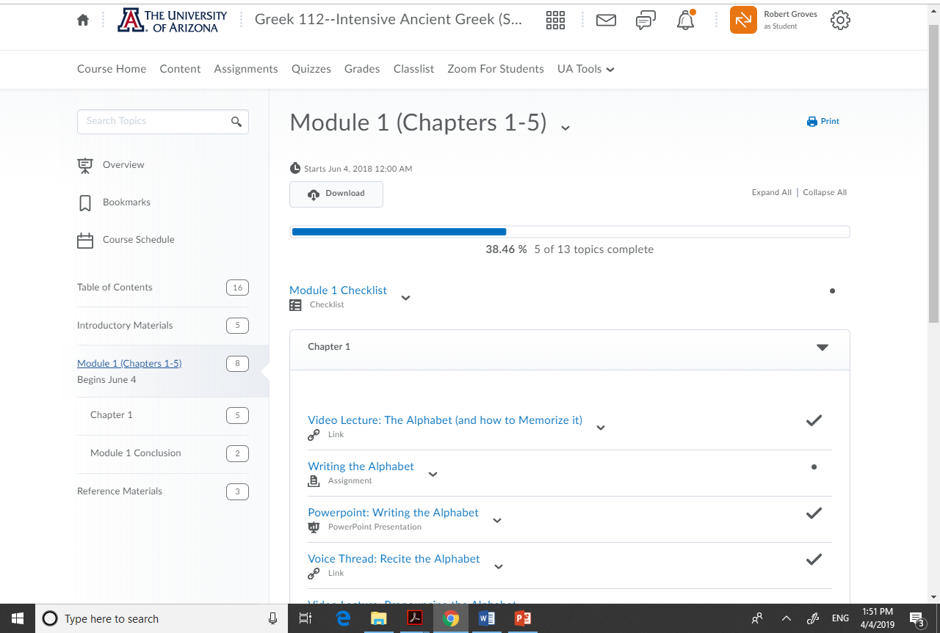
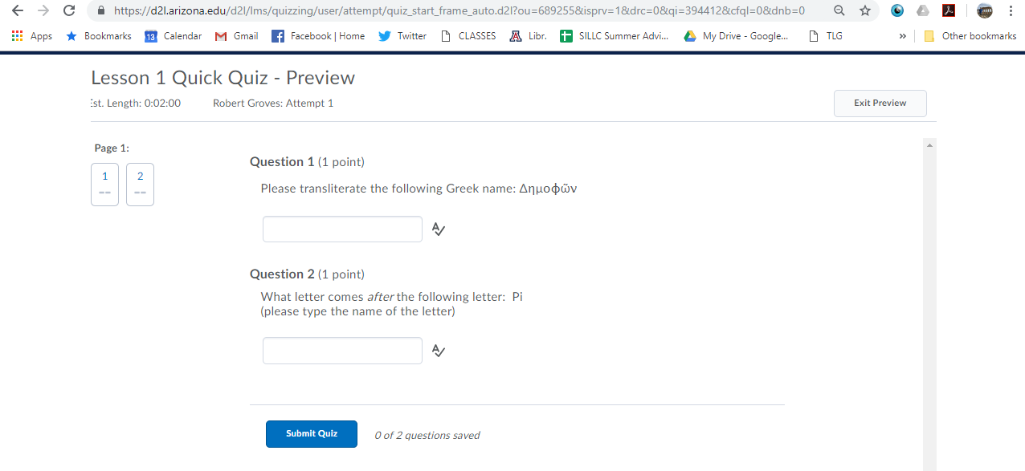
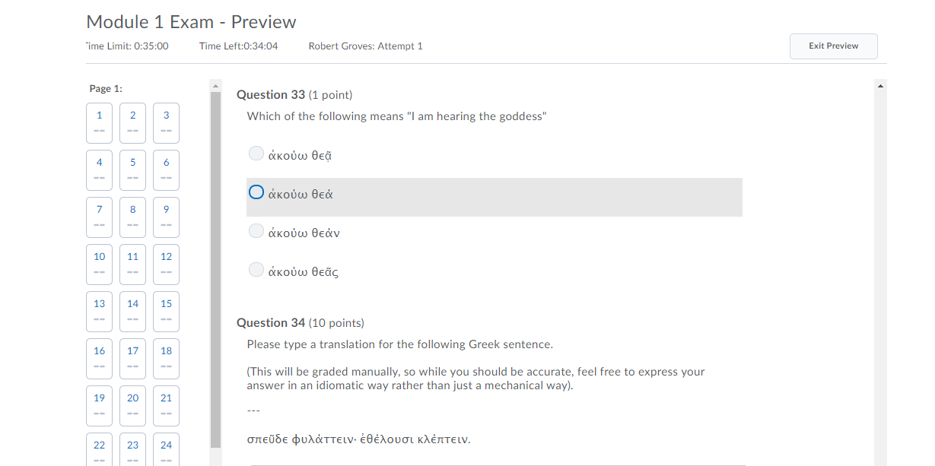
Module #1

Slide 6
Course Grading:

Slide 7
Competency-Based Model: Lessons
Benefits:
Retention
Life Happens!
More Secure Fundamentals
Skill Orientation vs. Knowledge Orientation
Higher Bloom levels
Drawbacks:
Weaker internal vocabulary and morphology
Social isolation

Slide 8
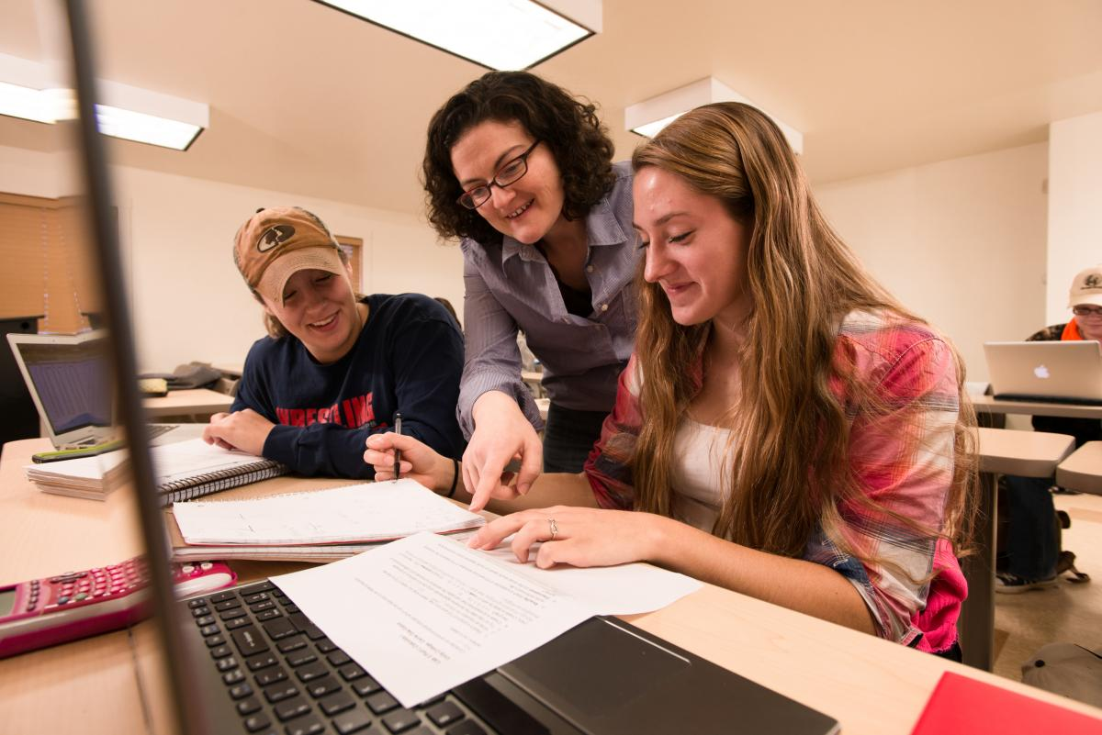
Towards a Competency Model in the Classroom?

Slide 9
Lessons from a Competency-Based Online Greek Course
Robert Groves, University of Arizona
email: groves@email.arizona.edu twitter: @wisclassic
Further Reading:
Meinking, Kristina. 2016. “Competency and Collaboration: An Approach to the Second-Semester Latin Course.” Teaching Classical Languages vol. 8.1. 1- 36. (link here)

