Slide 1
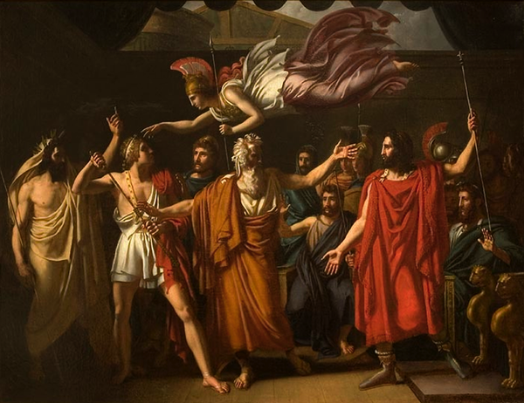
ACHILLES Revolutionary?
Iliad 1. 191
Jenny Strauss Clay

Slide 2
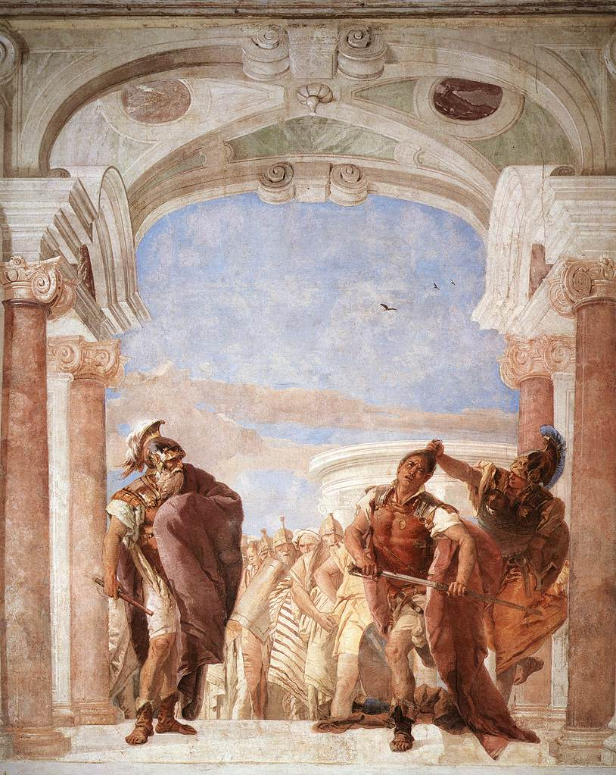
ἐν δέ οἱ ἦτορ στήθεσσιν λασίοισι διάνδιχα μερμήριξεν,
ἢ ὅ γε φάσγανον ὀξὺ ἐρυσσάμενος παρὰ μηροῦ
τοὺς μὲν ἀναστήσειεν, ὃ δ’ Ἀτρεΐδην ἐναρίζοι,
ἦε χόλον παύσειεν ἐρητύσειέ τε θυμόν.
The heart in his shaggy breast pondered two ways
Whether drawing his sharp spear from his thigh
And………….. and kill the son of Atreus,
Or whether he should cease his anger and restrain his spirit.

Slide 4
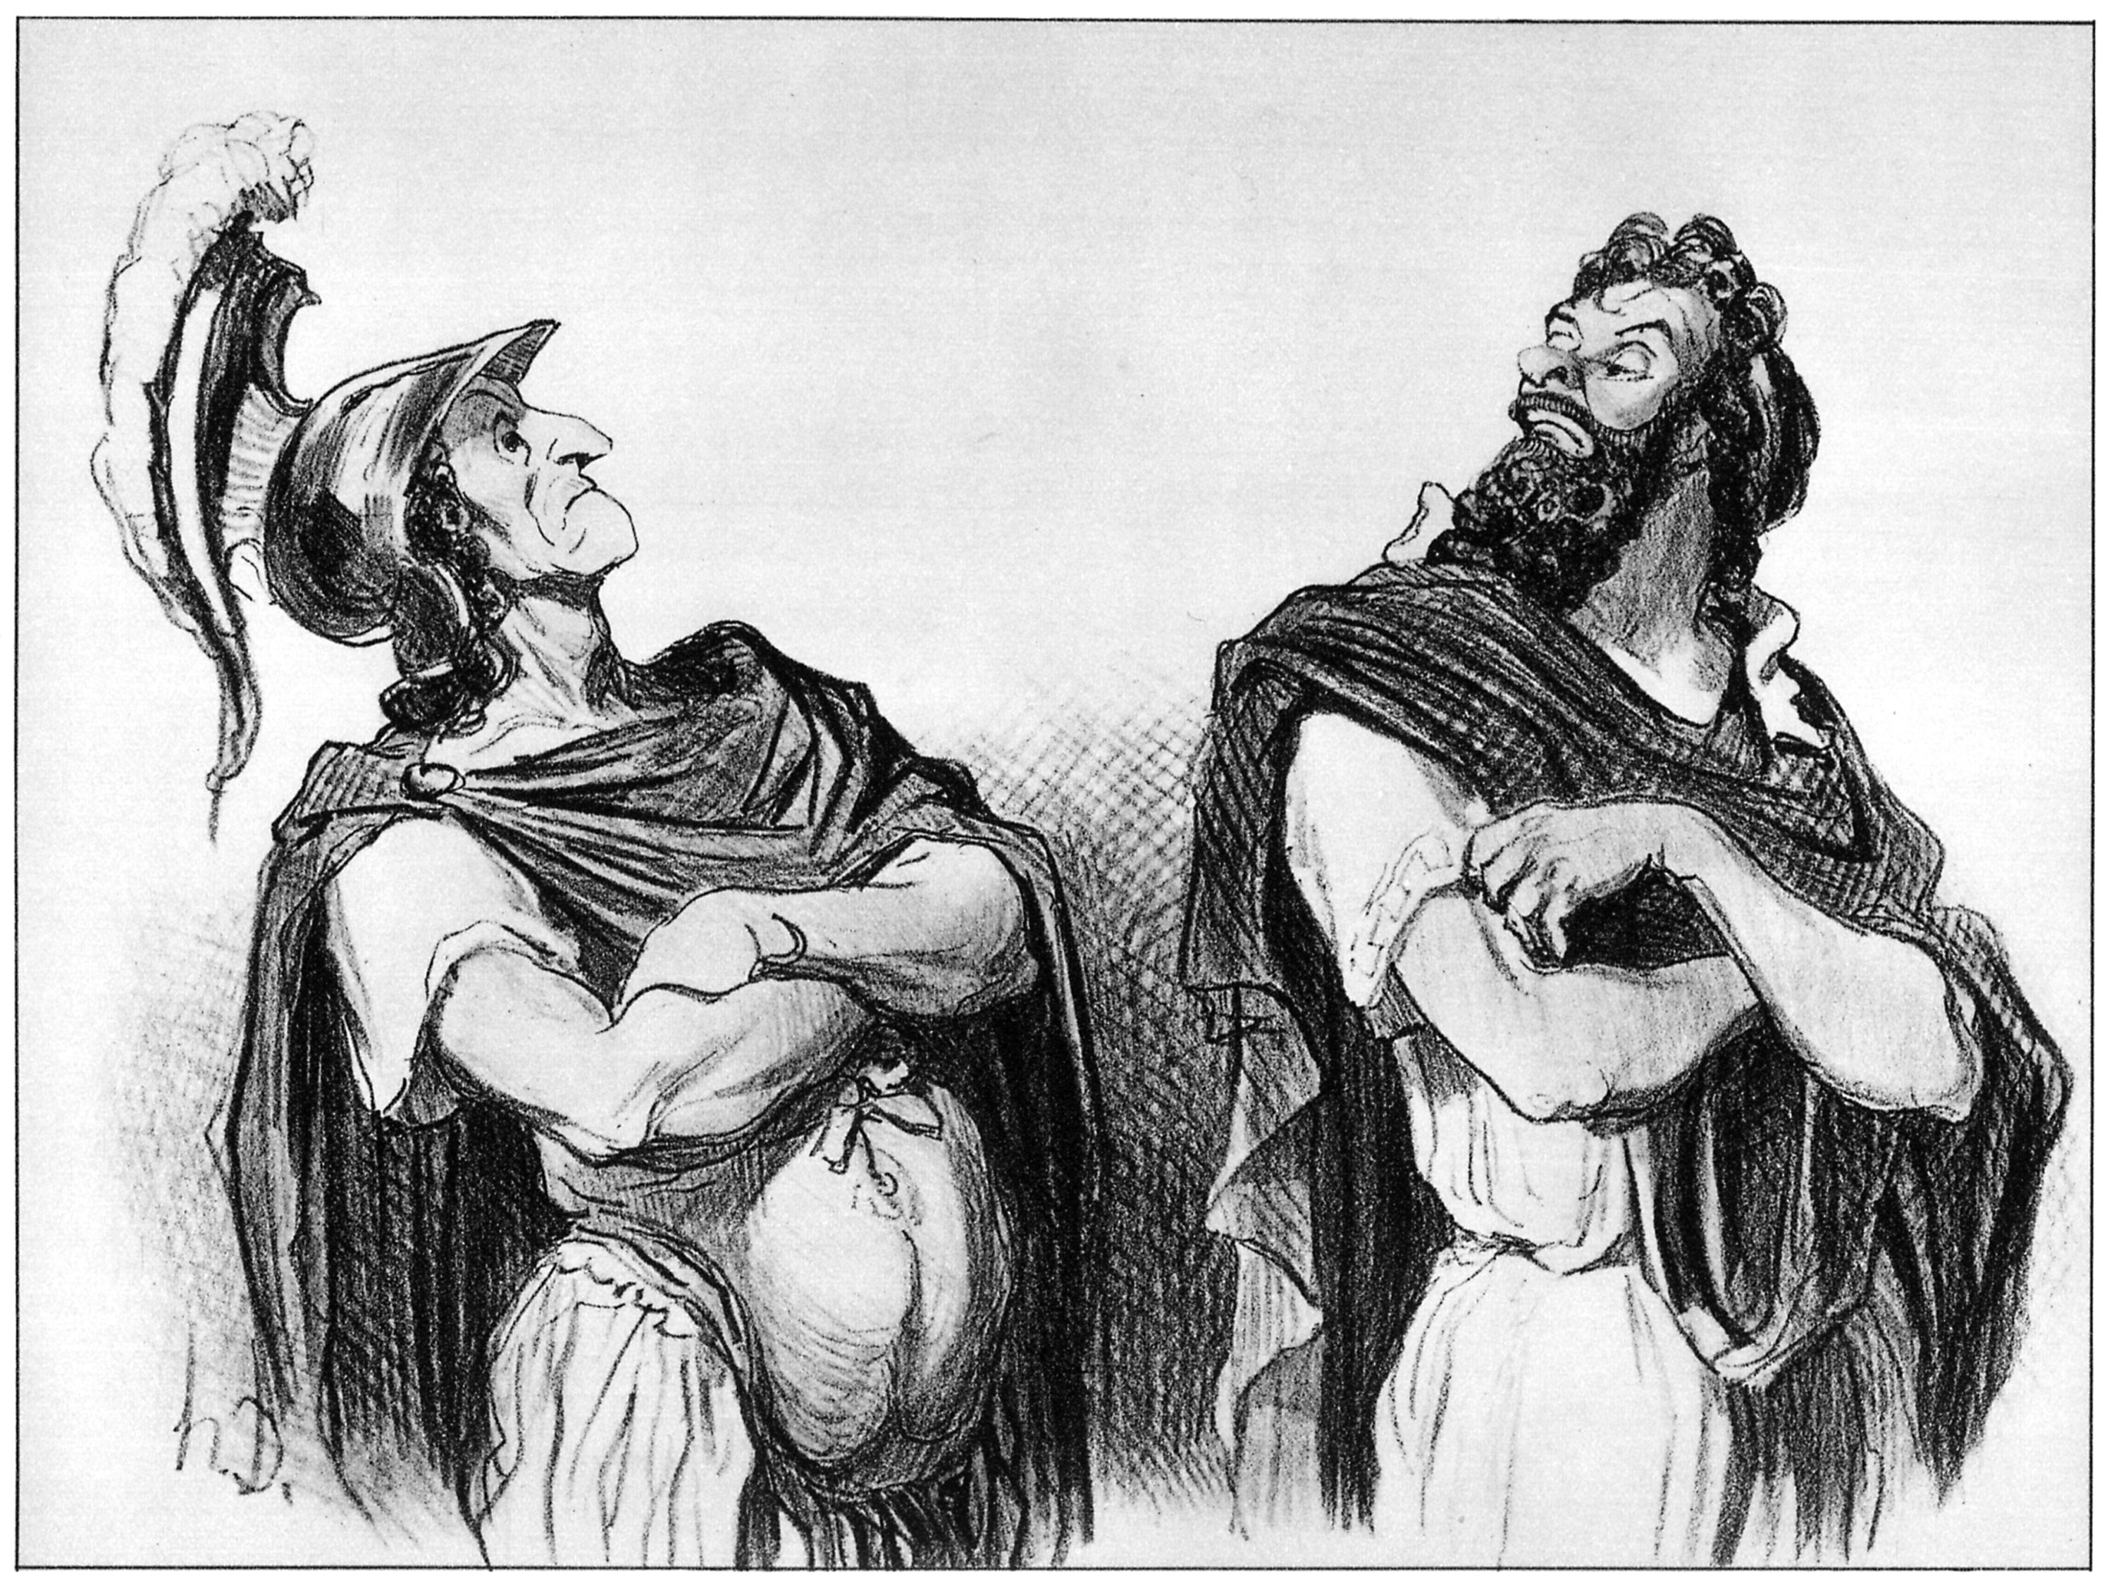
Bibliography
Ameis, C. Hentze, and P. Cauer, (edd.). 1913. Homer’s Ilias für den Schulgebrauch Erklärt⁷, vol. 1. Leipzig,
Andreev, Y. 1979. “Die politischen Funktionen der Volksversammlung im homerischen Zeitalter.” Klio 61: 385–405.
Elmer, D. 2013. The Poetics of Consent: Collective Decision Making in the Iliad. Baltimore.
Fränkel, H. 1968. Wege und Formen frühgriechischen Denkens. Munich.
Hammer, D. 2002. The Iliad as Politics: The Performance of Political Thought. Norman
Haubold, J. 2000. Homer’s People: Epic Poetry and Social Formation. Cambridge.
Kirk. G.S. 1985. The Iliad: A Commentary vol. 1. Cambridge.
Latacz, J., R. Nünlist, and M. Stoevesandt, (edd.). 2003. Homers Ilias Gesamtkommentar, vol. 1, part 2. Munich.
Porter. A. 2019. Agamemnon, the Pathetic Despot: Reading Characterization in Homer. Cambridge MA.
Raaflaub, K. 1997. “Politics and Interstate Relations in the World of Ancient Greek Poleis: Homer and Beyond.” Antichthon 31: 1–27.
Schesmer, I. 1927. “Zu Homer A 191.” Philologische Wochenschrift 47:765–6

