Slide 1
Foreign or Roman? Divination in Cicero’s De Divinatione
Elizabeth Zollner
University of Kansas
lezollner@ku.edu

Slide 2
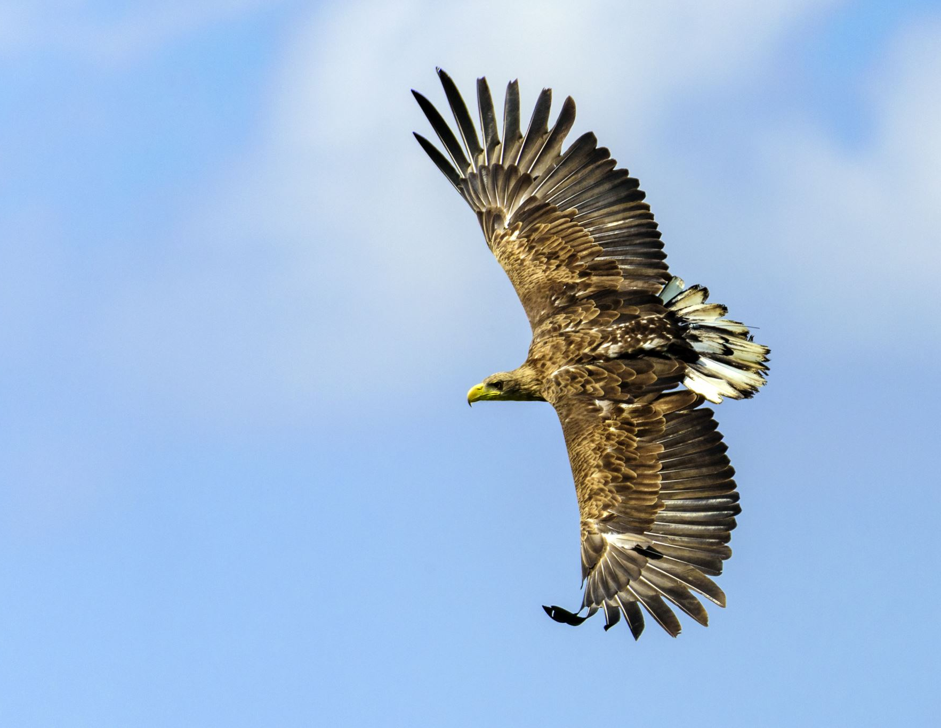

Slide 3
De Divinatione
Book One: Quintus’ Defense of Divination
Book Two: Cicero’s Critique of Divination

Slide 4
Cicero the Character vs. Cicero the Author
Beard 1986 and Schofield 1986
The characters “Quintus” and “Cicero” provide a useful framework for introducing different philosophical thoughts on the topic

Slide 5
Divination and Stoicism
Hankinson 1988, 130: Stoicism was “peculiarly fitted to the acceptance of divination”
Denyer 1985, 1: “the Stoic argument for divinatory realism ran: si divinatio est, di sunt (Div. 1.10)”

Slide 6
Quintus on Traditionally Roman Divination
Quoties senatus decemviros ad libros ire iussit! quantis in rebus quamque saepe responsis haruspicum paruit!
How many times the Senate has ordered the decemvirs to consult the Sibylline books! How often in matters of grave concern it has obeyed the responses of the soothsayers!
De Div. 1.97

Slide 7
Quintus on Foreign Divination
diuturna observatione siderum scientiam putantur effecisse, ut praedici posset quid cuique eventurum et quo quisque fato natus esset.
It is thought, by means of long-continued observation of the constellations, they perfected a science which enables them to foretell what any man's lot will be and for what fate he was born.
De Div. 1.2

Slide 8
Cicero on Traditionally Roman Divination
Ita nobis sinistra videntur, Graiis et barbaris dextra meliora…
Thus it seems to us that signs on the left are better, Greeks and barbarians signs on the right…
De Div. 2.82

Slide 9
Cicero on Traditionally Roman Divination
quod aliis avibus utuntur, aliis signis, aliter observant, alia respondent, non necesse est fateri partim horum errore susceptum esse, partim superstitione, multa fallendo?
In view, then, of the differences between different nations in the responses, in the manner in which observations are made and in the kinds of birds and signs employed, need I assert that divination is compounded of a little error, a little superstition, and a good deal of fraud?
De Div. 2.83

Slide 10
Cicero on Traditionally Roman Divination
retinetur autem et ad opinionem vulgi et ad magnas utilitates rei publicae mos, religio, disciplina, ius augurium, collegi auctoritas.
However, out of respect for the opinion of the masses and because of the great service to the State we maintain the augural practices, discipline, religious rites and laws, as well as the authority of the augural college.
De Div. 2.70

Slide 11
Cicero on Foreign Divination
O delirationem incredibilem!
What inconceivable madness!
Diogenes… etenim geminorum formas esse similis, vitam atque fortunam plerumque disparem.
Diogenes…says, for example, that twins are alike in appearance, but that they generally unlike in career and in fortune.
De Div. 2.90

Slide 12
Cicero on Foreign Divination
Quam multa ego Pompeio, quam multa Crasso, quam multa huic ipsi Caesari, a Chaldaeis dicta memini, neminem eorum nisi senectute, nisi domi, nisi cum claritate esse moriturum!
I remember how many prophecies spoken by the Chaldeans to Pompey, how many to Crassus, how many even to Caesar himself, that no one of them would die except in old age, at home and in great glory!
De Div. 2.99

Slide 13
Cicero on Superstitio vs. Religio
Nec vero—id enim diligenter intellegi volo—superstitione tollenda religio tollitur. Nam et maiorum instituta tueri sacris caerimoniisque retinendis sapientis est.
But I want it distinctly understood that the destruction of superstition does not mean the destruction of religion. For I consider it the part of wisdom to preserve the institutions of our forefathers by retaining their sacred rites and ceremonies.
De Div. 2.148

Slide 14
Dreams in De Div.
Quintus: uses successful predictions of foreign and Roman dreams to support credibility of divination in agreement with Stoic philosophy
Cicero: dreams cannot predict the future, part of superstitio not religio
Explodatur igitur haec quoque somniorum divinatio pariter cum ceteris.
Then let dreams, as a means of divination, be rejected along with the rest.
De Div. 2.148

Slide 15
Conclusion
Philosophical Exercise
Krostenko 2000, 355: “both feidism and skepticism fail to provide an adequate account of the Roman practice of divination”
Complex role of divination in both philosophy and Roman society
Quintus: Stoicism
Cicero: Roman identity

Slide 16
Bibliography
Beard, Mary. 1986. “Cicero and Divination: the Formation of a Latin Discourse.” Journal of Roman Studies 76, 33-46.
Denyer, Nicholas. 1985. “The Case against Divination: an Examination of Cicero’s De Divinatione.” Proceedings of the Cambridge Philological Society 31, 1–10.
Hankinson, R.J. 1988. “Stoicism, Science and Divination.” Apeiron 21.2.
Krostenko, Brian. “Beyond (Dis)belief: Rhetorical Form and Religious Symbol in Cicero’s de Divinatione”. Transactions of the American Philological Association 130, 353-391.
Riess, Ernst. 1933. “The Influence of Astrology on Life and Literature at Rome.” The Classical Weekly 27.10, 73.
Schofield, Malcolm. 1986. “Cicero for and against Divination.” Journal of Roman Studies 76, 47–65.

