Slide 1
The Romanization of Vulcan During the Rise and Reign of Octavian: A Change in Identity
Griffin Fleischaker

Slide 2
Thesis
During the rise and reign of Octavian Caesar, there was a shift in the identity of Vulcan that led to his increased Romanization.

Slide 3
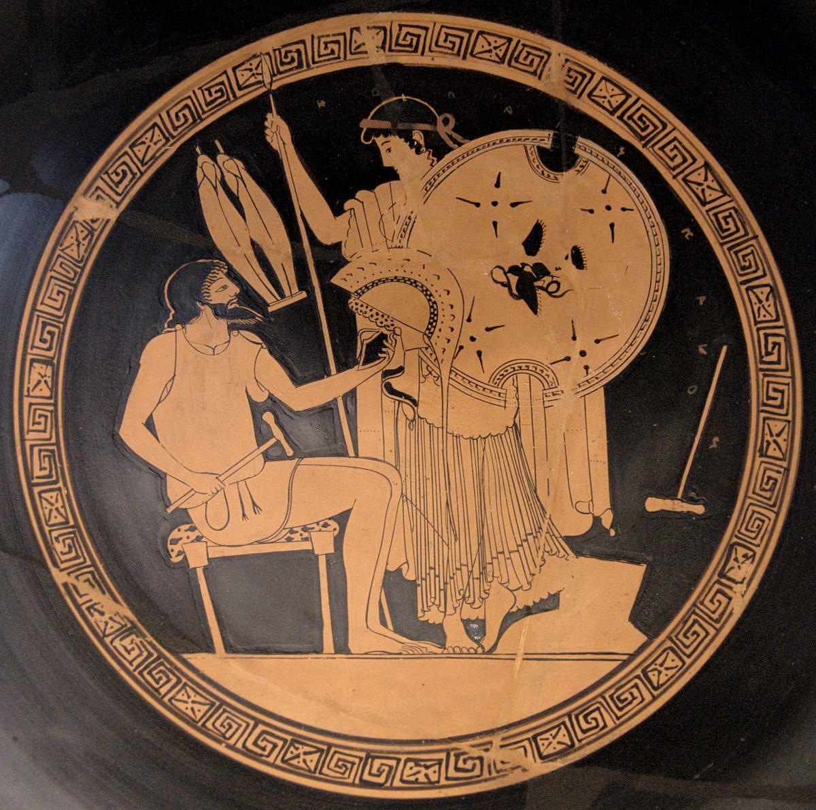
Hephaestus in Greece and Vulcan Early Rome
Hephaestus in Greece
God of craftsmen and smith of the gods
The Vocanal
Originally built during the age of Romulus
Thought to have been at the foot of the Capitoline Hill
The exact location relative to the modern Forum is unknown
214 BCE Temple
Built on the Campus Martius
Burned down after being struck by lightning and was not rebuilt

Slide 4
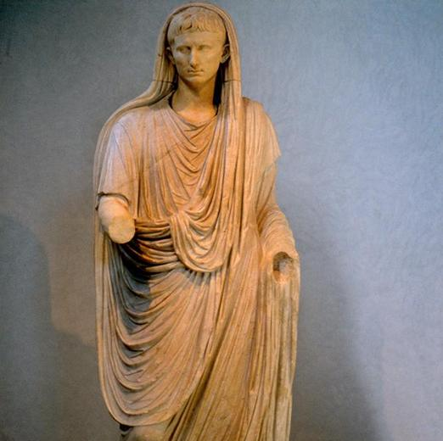
Octavian and the Divine
Claims divine heritage
Julius Caesar is deified
Venus Genitrix
Pontifex Maximus
He held the position starting in 12 BCE
Head priest of the empire

Slide 5
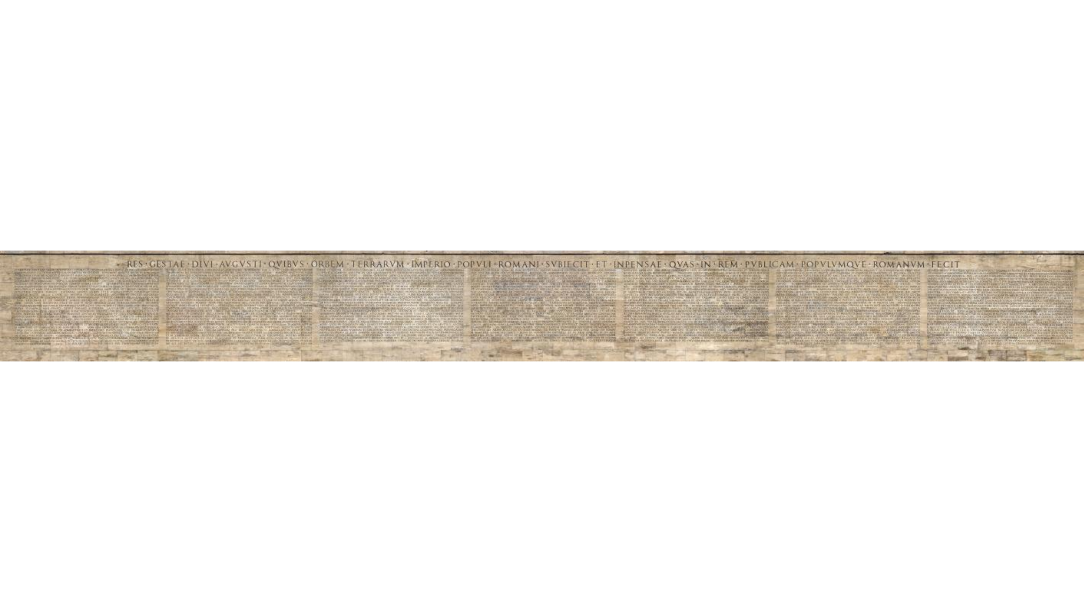
Octavian and the Divine cont.
On my land I built the Temple to Mars Ultor and the Augustan Forum from the spoils of war… From the spoils of war, I gave consecrated gifts to the Capitaline and to the temple of Divi Iulius and to the temple of Apollo and to the temple of Vesta and to the temple of Mars Ultor, which cost not far from 100 million sesterces… After my victory, I put back the ornaments in the temples in all the cities of the province of Asia, which [my enemy] stripped from the temples for his private use (Res Gestae Divi Augusti)

Slide 6
Vulcan in the Civil Wars and War in General
Liv. 8,10,13; App. Hann. 133; Serv. Aen. 8,562
The weapons of enemies were burned to honor Vulcan
Vulcan being related to war was not new to Rome, making it easier to expand his field of influence within a militarily based civilization
Appian shows Vulcanic devotion increased under Octavian prior to his rule starting
Winds picked up the flames from all of Perusia and burnt everything except the temple of Hephaestus… but then those left to divide the remains of the city, they placed Hephaestus to be god of the city over Hera. (Appian, The Civil Wars. 5.5.49)

Slide 7
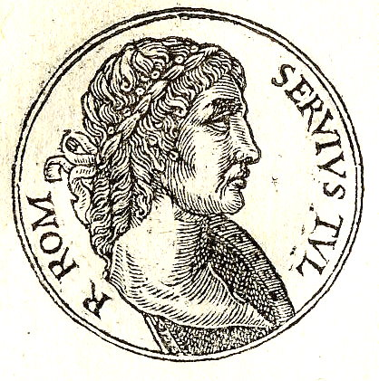
Servius Tullius
To this burned temple, yet he spared the fire // sign: Mulciber himself helped bear the birth // for Vulcan is the father of Tullius, Orcresia is the mother // made the distinguished little form. (Ovid. Fasti. 6.625 – 6.628)

Slide 8
Cacus, son of Vulcan
Livy
“A shepherd lived here, named Cacus, who was bold by means of strength, caught by the beauty of the cows he wished to take them with him… he dragged them to the cave.” (Ab Urbe Condita, 1.7.5-7)
Vergil
“Vulcan was the father of this monster” (Aeneid, 8.198)
Ovid
“The father of this monster was Mulciber” (Fasti, 1.554)

Slide 9
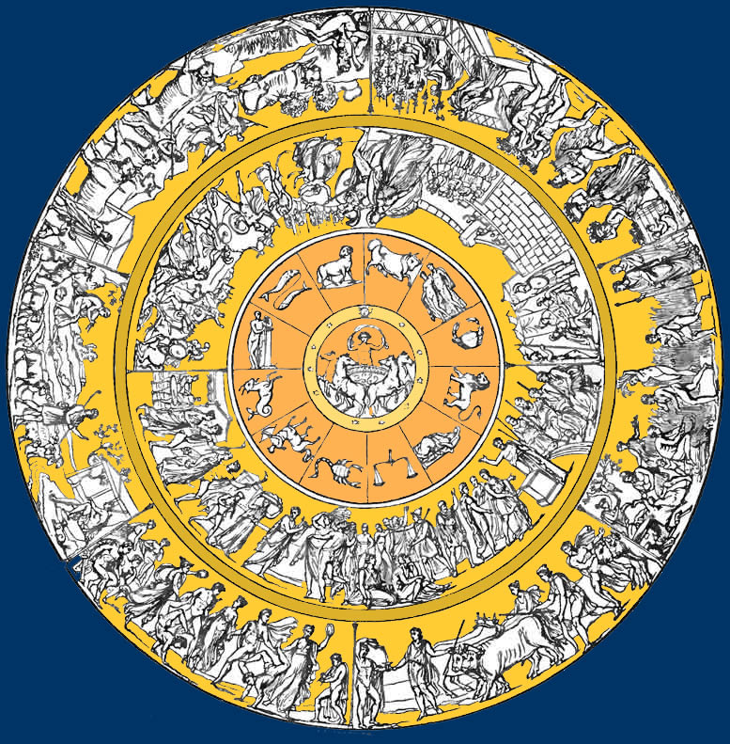
The Shield of Aeneas
Through this shield of Vulcan, a gift of the mother, // Delighting and wondering at the images, // Aeneas lifted it to his shoulder and Venus uttered a prophecy of his grandkids. (Vergil. Aeneid, 8.729-731)
Shifts Hephaestus to Vulcan
Increases the persuasive power of Venus Genitrix

Slide 10
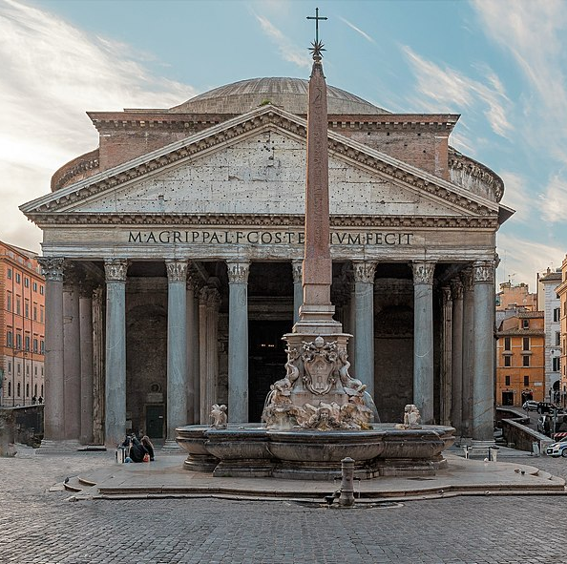
The Pantheon
Built by Marcus Agrippa in 29 BCE – 19 BCE
Dedicated to all the gods, with specific alters for
“First Jove and Juno, another is Neptune and Minerva, third is Mars and Venus, fourth is Apollo and Diana, fifth is Vulcan and Vesta, sixth is Mercury and Ceres.” (Livy. Ab Urbe Condita, 22.10.9)

Slide 11
Conclusion
The introduction of new stories, construction of the Parthenon, and increased dedication to Vulcan in terms of cities, leads one to see that there was shift in the identification of Vulcan during Octavian’s rule in Rome.

Slide 12
Bibliography
Appian. Roman History, Volume IV: The Civil Wars, Books 3.27 – 5. Translated by Horace White. Cambridge, MA: Harvard University Press, 1913.
Beard, Mary, John North, and Simon Price. 1998. Religions of Ancient Rome. 2 vols. New York: Cambridge University Press.
Brill’s New Pauly, s.v. “Volcanus,” accessed November 12, 2021,https://referenceworks-brillonline-com.ezproxy2.library.arizona.edu/entries/brill-s-new-pauly/volcanus-e12206780
Capdeville, G. Volcanus: recherches comparatistes sur les origins du culte de Vulcan. BEFAR. Rome. 1995.
Carandini, Andrea. 2017. “The Atlas of Ancient Rome: Biography and Portraits of the City.” Edited by Andrea Caradini, and Paolo Carafa. Translated by Andrew Campbell Halvais. Bologna, Italy. Princeton University Press.
Casali, Sergio. Oct., 2006. “The Making of the Shield: Inspiration and Repression in the “Aeneid”.” Greece & Rome, Oct., 2006, Vol. 53, No.2, pp. 185-204.
Cassius, Dio. Roman History, Volume IV: Books 41 – 45. Translated by Earnest Cary and Herbert B. Foster. Cambridge, MA: Harvard University Press, 1916.
Coarelli, F. 1977. Il comizio dale origini alla fine della republica: cornologia e topografia, PdP 32: 166-238.
Coarelli, F. 1983-5. Il Foro Romano. Rome and Bari. 2 vols.
Diodorus Siculus. The Library of History, Volume II: Books 2.35 – 4.58. Translated by C. H. Oldfather, Cambridge, MA: Harvard University Press, 1935.
Ennius. Fragmentary Republican Literature: Ennius: Testimonia: Epic Fragments. Translated by Sander M. Goldberg and Gesine Manuwald. Cambridge, MA: Harvard University Press, 2018.

Slide 13
Bibliography Continued
Gaius Octavian Caesar. Compendium of Roman History. Res Gestae Divi Augustus. Translated by Frederick W. Shipley. Cambridge, MA: Harvard University Press, 1924.
Griffin, J. 1997. “Cult and Personality in Horace.” The Journal of Roman Studies, 87, 54–69.
Horace. Ode 1.4. Edited by H. W. Garrod. Annotated by Edward C. Wickham. New York: Clarendon Press, 1834.
Livy. Ab Urbe Condita. Annotated by Robert Maxwell Oglivie. 6 vols. New York: Oxford University Press, 1974.
Ovid. Fasti. Annotated by R. J. Tarrant. New York: Oxford University Press, 2004.
Pliny the Elder. Natural History, Volume VI: Books 12 – 19. Translated by H. Rackham. Cambridge, MA: Harvard University Press, 1938.
Plutarch. Lives, Volume I: Theseus and Romulus. Lycurgus and Numa. Solon and Publicola. Translated by Bernadotte Perrin. Cambridge, MA: Harvard University Press, 1914.
Reid, J. S. 2012. “Human Sacrifices at Rome and Other Notes on Roman Religion,” Journal of Roman Studies, Vol. 2, pp. 34-52.
Rose, H. J. 1933. “The Cult of Volkanus at Rome.” The Journal of Roman Studies, 1933, Vol. 23, pp. 46-63.
Smolenaars, J. J. L. 2004. “A Disturbing Scene from the Marriage of Venus and Vulcan:“Aeneid" 8.370-415,” Vergilius, Vol. 50, pp. 96-107.
Thomas, Edmund. 2017. “The Cult Statues of the Pantheon,” The Journal of Roman Studies, Vol. 107, pp. 146-212.
Virgil. Aeneid. Annotated by R. A. B. Mynors. New York, NY: Clarendon Press, 1969.

Slide 14
Figure Citations
Figure 1: ”Hephaestus hands in the new Achilles' armor to Thetis (Iliad, XVIII, 617). Attic red-figure Kylix, 490–480 BC,” Antikenmuseen, accessed March 22, 2022.
Figure 2: “Via Labicana Augustus (Augustus as Pontifex Maximus),” The City of Rome, accessed March 2, 2022, https://romesummerclass.georgetown.domains/items/show/548.
Figure 3: “Panel 5 left-right,” Reed College, accessed March 2, 2022, https://www.reed.edu/ara-pacis/meier/exterior/res-gestae/res-gestae.php.
Figure 4: “Promptuarii Iconum Insigniorum,” Guillaume Rouille, accessed March 2, 2022, https://commons.wikimedia.org/wiki/File:Servius_by_Rouille.jpg.
Figure 5: “The Shield of Achilles,” Geneseo, accessed March 2, 2022, https://www.geneseo.edu/~walker/ShieldofAchilles.htm.
Figure 6: “Pantheon (Rome),” Rabax3, accessed March 3, 2022, https://commons.wikimedia.org/wiki/File:Pantheon_Rom_1_cropped.jpg.

