Slide 1
Stuck in the Middle: The Liminality of Artemis ephesia
Savhanna Long, University of Arizona
savhannalong@email.arizona.edu

Slide 2
Rites of Passage
Original Status
Separation
Transition
Liminal Phase
Reintegration
New Status
van Gennep, Arnold. The Rites of Passage. Translated by M.B. Vizedom. Chicago: University of Chicago Press, 1960.

Slide 3
Liminality and Artemis
Betwixt and Between
Structuralism and Artemis
Artemis as a binary
Virginity/motherhood
Huntress/animal tender
Sacrificial youth/protectress of youth
Extension of liminality to landscape and cult
Dag Øistein Endsjø and Susan Guettel Cole
Life vs death dichotomy
Reconstruction of the Temple of Artemis at Ephesos in Istanbul, southwest corner. Photograph by Zee Prime, distributed under a CC BY-SA 3.0 license.

Slide 4
City Goddess
Rustic vs Urban
1) πόλιν δέ μοι ἥντινα νεῖμον ἥντινα λῇς: σπαρνὸν γὰρ ὅτ᾽ Ἄρτεμις ἄστυ κάτεισιν (Callim. Hymn 3, 18-19)
And deal out whichever city to me, whatever city you want: for it is rare that Artemis goes down into town.
2)
Silver coin from the rule of Claudius depicting the Temple of Artemis and her cult statue. Asset Number 692001001 from the Trustees of the British Museum, licensed under CC BY-NC-SA 4.0.
 | Peloponnese (Borderlands) | Rural | Between Territories | Inside City Walls | Total
Sanctuaries (number) | 46 | 68 | 18 | 15 | 86
Cole, Susan Guettel. Landscapes, Gender, and Ritual Space. Berkeley: University of California Press, 2004.

Slide 5
Outline: Avenues of Liminal Expression
Cult
Male Rite of Passage
Fertility
Syncretism
Kybele
Hekate
Landscape
Between Polis and Eschatia
Marshy Spaces

Slide 6
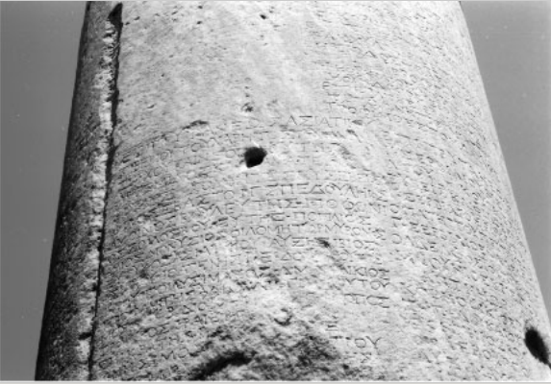
Cult of Artemis Ephesia - Rites of Passage
Inscription of the Kouretes. From McLean, Rogers 2003, fig. 3.
Temple of Artemis at Ephesos. Photograph by Erik Cleaves Kristensen, distributed under a CC BY-SA 2.0 license.
Birth at Ephesos
Mysteries performed by young Kouretes
Ritual death and rebirth

Slide 7
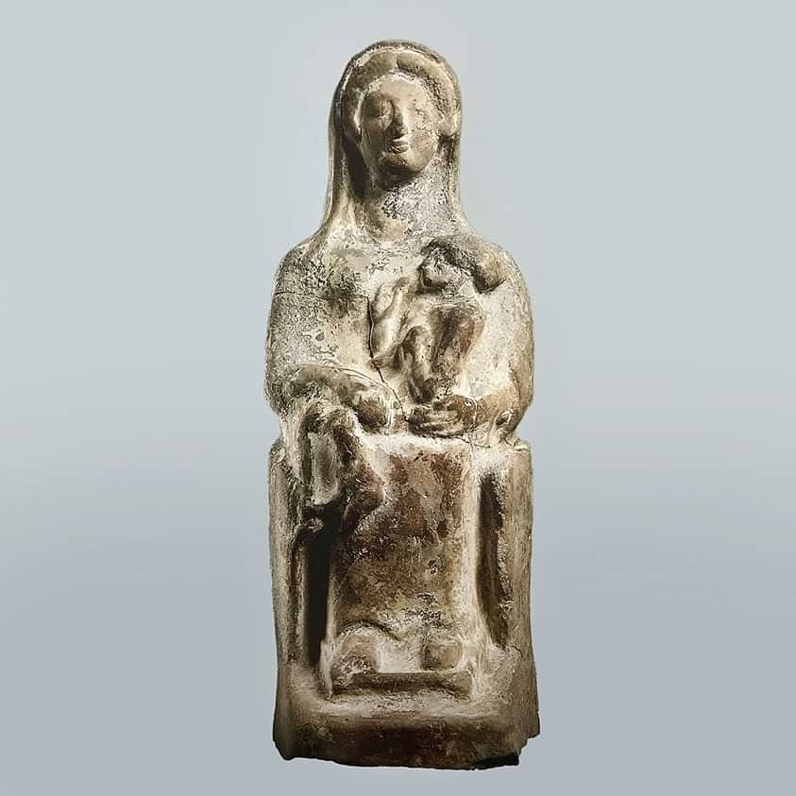
Cult of Artemis Ephesia - Fertility Cult
Birth at Ortygia
Kourotrophe
Asexuality =/= Virginity
Nymphe
Giving Birth
Gyne
Artemis Kourotrophe (500- 480 BCE), Courtesy of the Paul and Alexandra Canellopoulos Museum.

Slide 8
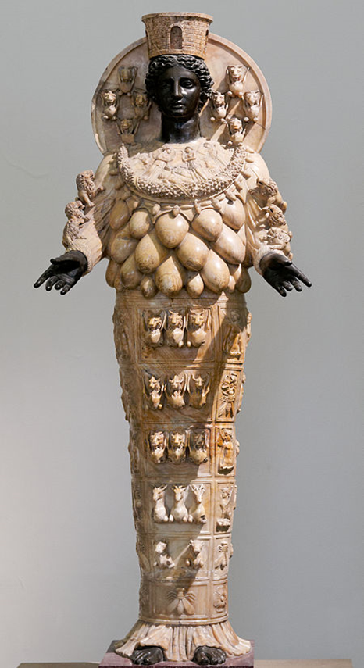
Right: Examples of vulva representations at Ephesos from the Geometric period. Asset Number 493881001 from the Trustees of the British Museum, licensed under CC BY-NC-SA 4.0.
Left: 2nd Century CE statue of Artemis of Ephesos from the Naples National Archaeological Museum collection. Photograph by Marie-Lan Nguyen, distributed under a CC BY-SA 2.5 license.

Slide 9
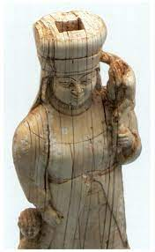
Syncretism - Kybele
Original patron goddess
Early shrine on Mt. Pion
Statuettes and coins
Kourotrophe
Kybele or Artemis ivory figurine. From Şare, Tuna 2010, fig. 2.

Slide 10
Syncretism - Hekate
Goddess of underworld and childbirth
Precinct of Hekate
Triodos Gate
Night-time processions
Artemis Hekate, as a goddess protector of the necropolis, 3rd century CE, Apollonia, Albania. Photograph by Carole Raddato, distributed under a CC BY-SA 2.5 license.

Slide 11
Landscape of the Sanctuary
Landscapes as ritual space
Sanctuary of Artemis slightly outside the city
Monitoring entrances and exits
Polis
Life
Borderlands
Disputed Territory
Sanctuaries
Eschatia
Death
Map of Ancient Ephesos. Image from Encyclopedia: Meyers Konversationslexikon.

Slide 12
3) 19th century CE geological view of Ephesos. From Buckner, Kayan and Engelmann 2007, fig. 2.

Slide 13
Ephesos
Sacred Harbor
Graves
Artemis Temple
Sacred Way
4) Geological view of Archaic and Classical Ephesos. From Buckner, Kayan and Engelmann 2007, fig. 6.

Slide 14
Conclusions
Explored the accuracy of liminal as a descriptor
Displays many of the transitional features scholars define as liminal even at a comparatively unique urban sanctuary
Mainly encompasses the binary of life and death

Slide 15
Bibliography
Bammer, Anton. "Forschungen im Artemision von Ephesos von 1976 bis 1981." Anatolian Studies 32 (1982): 61-87.
Brenk, Frederick E. "Artemis of Ephesos: An Avant-Garde Goddess." Kernos 11 (1998): 157-171.
Budin, Stephanie Lynn. Artemis. Gods and Heroes of the Ancient World. London: Routledge, 2015.
Burkert, Walter. Greek Religion: Archaic and Classical. Translated by John Raffan. Oxford: Basil Blackwell, 1985.
Burkert, Walter. Structure and History in Greek Mythology and Ritual. Berkeley: University of California Press, 1979.
Cole, Susan Guettel. Landscapes, Gender, and Ritual Space. Berkeley: University of California Press, 2004.
Endsjø, Dag Øistein. "To Lock Up Eleusis: A Question of Liminal Space." Numen 47, no. 4 (2000): 351-86.
Flaata, Amanda Ann. "The Early Cult of the Mother in Western Anatolia: An Archaeological Reassessment." PhD diss., The University of Wisconsin-Madison, 2012.
Gheorghiu, Ragos, "Archaeology and Space." In Archaeology and Buildings: Papers from a Session Held at the European Association of Archaeologists Fifth Annual Meeting in Bournemouth, edited by Gunilla Malm, 25-28. Oxford: Archaeopress, 2001.
Hill, A. E. "Ancient Art and Artemis: Toward Explaining the Polymastic Nature of the Figurine." The Journal of the Ancient Near Eastern Society (1992): 91-94.

Slide 16
Hogarth, David G. Excavations at Ephesus: The Archaic Artemisia. London: British Museum, 1908.
Kraft, John C, Helmut Bückner, Ilhan Kayan, and Helmut Engelmann. "The Geographies of Ancient Ephesus and the Artemision in Anatolia." Geoarchaeology 22, no. 1 (2007): 121-49.
Léger, Ruth M. "Artemis and Her Cult." PhD diss., University of Birmingham, 2015.
LiDonnici, Lynn R. "The Images of Artemis Ephesia and Greco-Roman Worship: A Reconsideration." The Harvard Theological Review 85, no. 4 (1992): 389-415.
Petrovic, Ivana. "Transforming Artemis: From the Goddess of the Outdoors to City Goddess." In The Gods of Ancient Greece, edited by Jan N. Bremmer and Andrew Erskine, 209-27. Edinburgh: Edinburgh University Press, 2010.
Rangos, Spyridon. "Cults of Artemis in Ancient Greece." PhD diss., Magdalene College, University of Cambridge, 1995.
Rietveld, James D. "Universal Goddess on the Via Sacra: The Evolving Image of Artemis Ephesia." PhD diss., Claremont Graduate University, 2006.
Rogers, Guy MacLean. The Mysteries of Artemis at Ephesos: Cult, Polis, and Change in the Graeco-Roman World. New Haven: Yale University Press, 2013.
Roller, Lynn E. In Search of God the Mother: The Cult of Anatolian Cybele. Berkeley: University of California Press, 1999.

Slide 17
Şare, Tuna. "An Archaic Ivory Figurine From A Tumulus Near Elmali: Cultural Hybridization and a New Anatolian Style." Hesperia: The Journal of the American School of Classical Studies at Athens 79, no. 1 (2010): 53-78. http://www.jstor.org/stable/40835454.
Senseney, John R. "Greek Public and Religious Architecture." In A Companion to Science, Technology, and Medicine in Ancient Greece and Rome, edited by Georgia L. Irby, 633-55. Hoboken: John Wiley & Sons Inc., 2016.
Turner, Victor. The Forest of Symbols; Aspects of Ndembu Ritual. Ithaca: Cornell University Press, 1967.
Turner, Victor. The Ritual Process: Structure and Anti-Structure. Somerset: Routledge, 2017.
van Gennep, Arnold. The Rites of Passage. Translated by M.B. Vizedom. Chicago: University of Chicago Press, 1960.
Vernant, Jean-Pierre. Mortals and Immortals: Collected Essays. Edited by Froma I. Zeitlin. Princeton: Princeton University Press, 1991.
Wankel, Hermann. Die Inschriften von Ephesos. Inschriften Griechischer Städte Aus Kleinasien 11. Bonn: Habelt, 1979.

Slide 18
Stuck in the Middle: The Liminality of Artemis EPhesia
Savhanna Long, University of Arizona
savhannalong@email.arizona.edu

