Slide 1
The Depth of Death
Liminal Space on Classical Attic Grave Stelai
Stephanie Polos, University of Virginia
24 March 2022

Slide 2
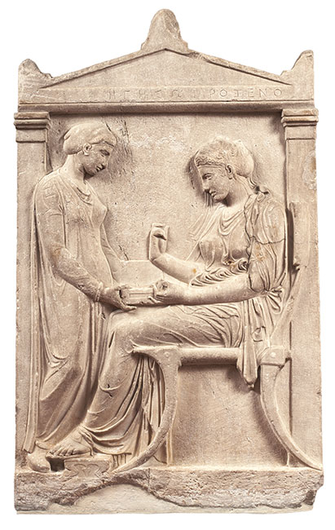
Grave Stele of Hegeso
Attic, Pentelic Marble
c. 410-400 BCE
Athens, NAM 3624

Slide 3
The Rites of Passage* and Greek Death
Pre-Liminal
Liminal
Post-Liminal
Rites of Separation
Rites of Transition
Rites of Initiation
Prothesis
Ekphora
Deposition
Funeral/
Mourning
Social
Reintegration
Death
Burial/
Journey to the Underworld
Death
Afterlife
*van Gennep, 1909/1960
Notes:
ROP Structure

Slide 4
Elpenor, Odysseus, and Hermes in the Underworld (Odyssey 11)
Attic Red-Figure Pelike, detail
The Lykaon Painter
c. 440 BCE
Boston, MFA 34.79
Notes:
Elpenor and burial

Slide 5
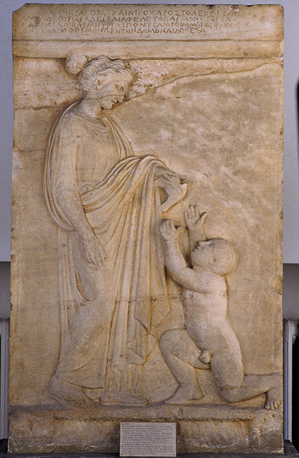
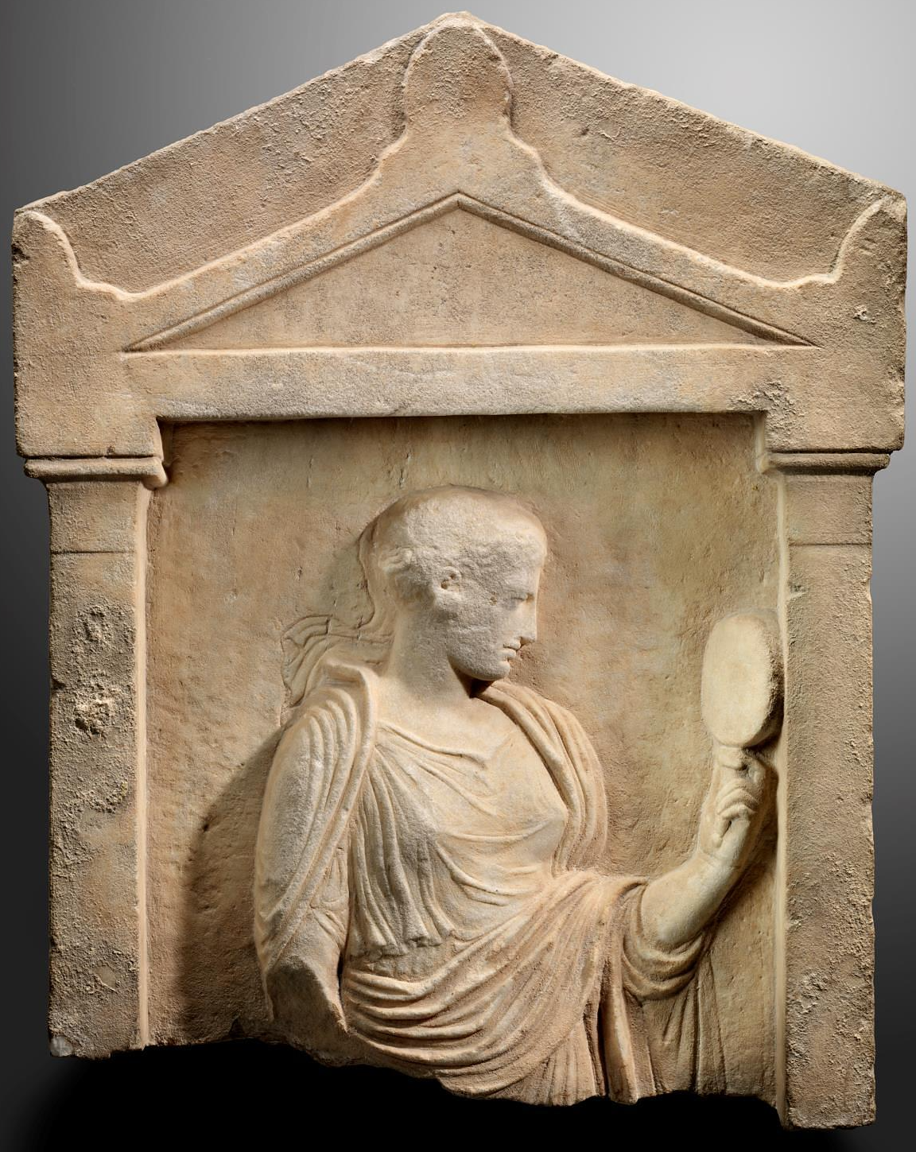
Grave Stele of Mnesagora and Nikochares
Attic, Pentelic Marble
Vari
c. 420-410 BCE
Athens, NAM 3845
Grave Stele with Woman Holding Mirror
Attic, Pentelic Marble
Late 5th-Early 4th century BCE
Boston, MFA 04.16
Notes:
Stelai

Slide 6
Left (obverse): Hades, Theseus & Peirithous, Herakles, Hermes, and Meleager in the Underworld
Below (reverse), right end: Persephone
Attic Red-Figure Calyx Krater,
obverse and reverse details
The Nekyia Painter
c. 450-440 BCE
New York, MMA 08.258.21
Notes:
Journeys to the Underworld

Slide 7
Prothesis Scene
Attic White-Ground Lekythos, Attributed to the Sabouroff Painter, details
c. 450 BCE, New York, MMA 07.286.40
Notes:
Funerary Rituals

Slide 8
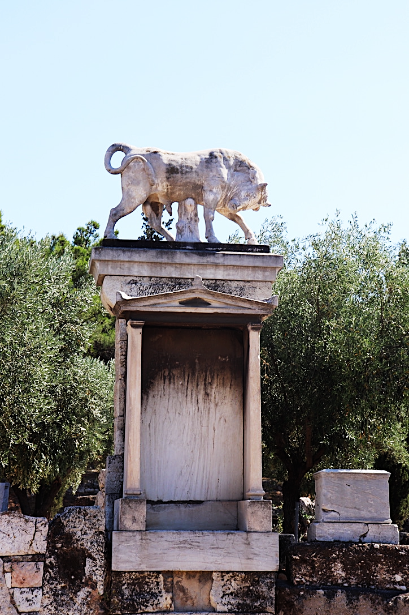
Decorating a stele with ribbons
Attic White-Ground Lekythos
c. 450-440 BCE
New York,
MMA 22.53
Grave of Dionysios of Kollytos (reproduction)
Street of Tombs,
Kerameikos, Athens
Original c. 345-340 BCE
Photo by S. Polos, 2019
Notes:
Site of grave stele

Slide 9
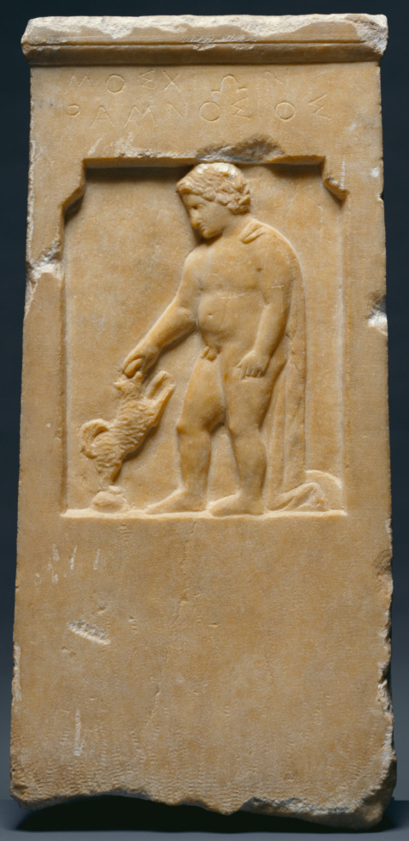
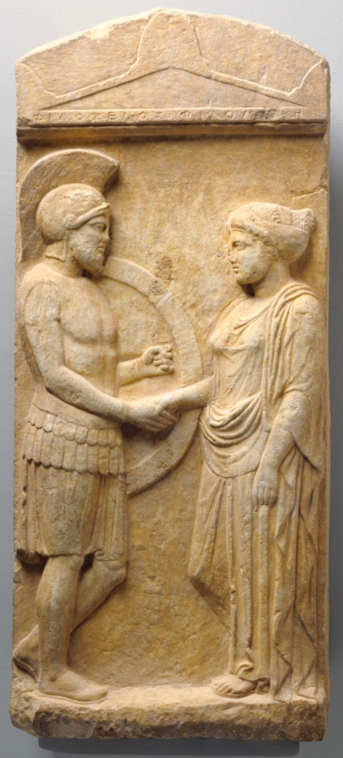
Left: Grave Stele of Moschion with his Dog
Attic, Marble
c. 375 BCE
Malibu, The J. Paul Getty Museum, Villa Collection 73.AA.117
Center: Grave Stele of Philonoe
Attic, Pentelic Marble
c. 400-375 BCE
Athens, NAM 3790
Photo by George E. Koronaios, 2018
Wikimedia commons, cropped
Right: Grave Stele of Philoxenos with his wife, Philoumene
Attic, Marble
c. 400 BCE
Malibu, The J. Paul Getty Museum, Villa Collection 83.AA.378
Notes:
Philoxenos, Philonoe, Moschion

Slide 10
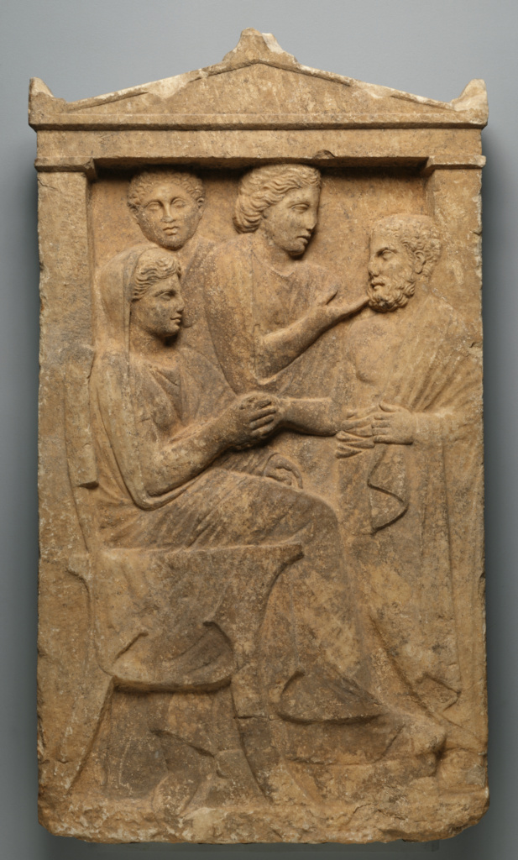
…ἔβη δόμον Ἄιδος εἴσω…
“…he went into the house of Hades…”
-Hom. Od. 11.150, 11.628
Grave Naiskos of Sime
Attic, Marble
c. 320 BCE
Malibu, The J. Paul Getty Museum,
Villa Collection 77.AA.89
Grave Stele of a young woman and servant
Attic, Pentelic Marble
c. 400-390 BCE
New York, MMA 36.11.1
Notes:
Naiskoi

Slide 11
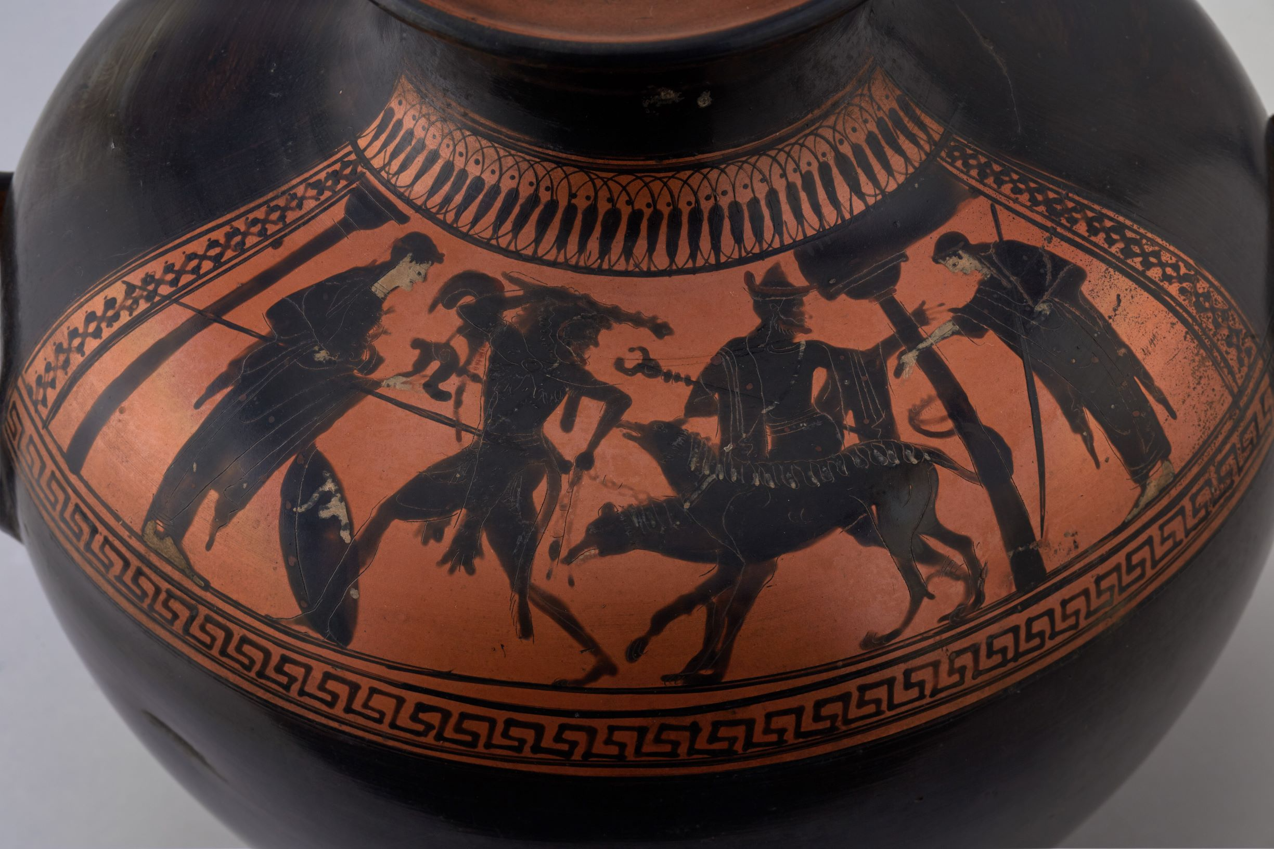
Herakles and Kerberos, with Athena, Hermes, and Persephone, in naiskos
Persephone in a naiskos (next to Palamedes)
Attic Red-Figure Calyx Krater, detail
The Nekyia Painter
c. 450-440 BCE
New York, MMA 08.258.21
Attic Black-Figure Kalpis Hydria
c. 510-490 BCE
Winchester, Hampshire, UK
Winchester College Museum, Gr16

Slide 12
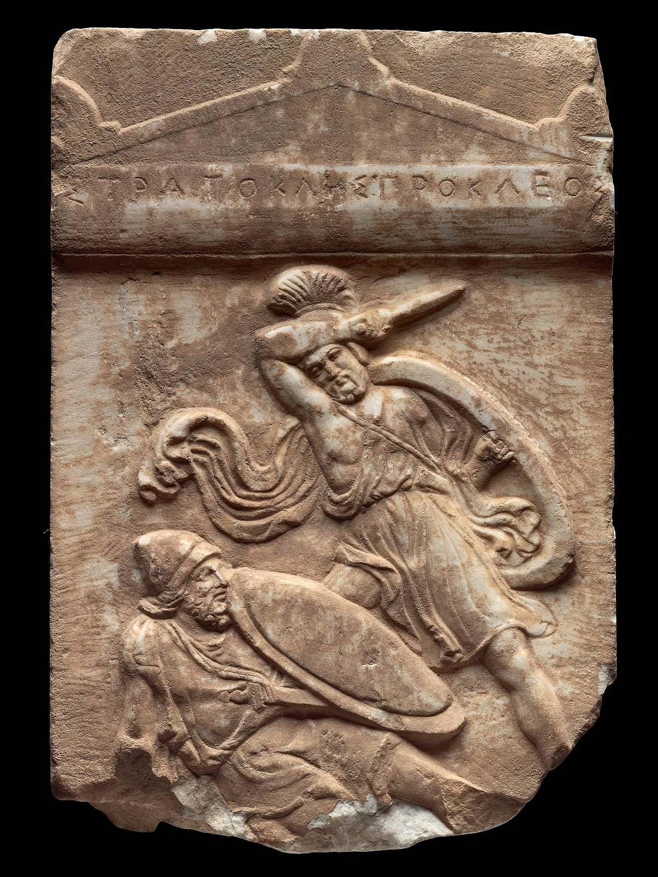
Grave Stele of Stratokles
Attic, Pentelic Marble
c. 390-380 BCE
Boston, MFA 1971.129
Grave Stele of a Young Woman
Attic, Pentelic Marble
c. 355-345 BCE
Boston, MFA 1973.169

Slide 13
Scene of a mourner and the deceased, with eidolon, at a stele
Attic White-Ground Lekythos, details
Attributed to the Achilles Painter
c. 440 BCE
New York, MMA 1989.281.72
Notes:
WG stele

Slide 14
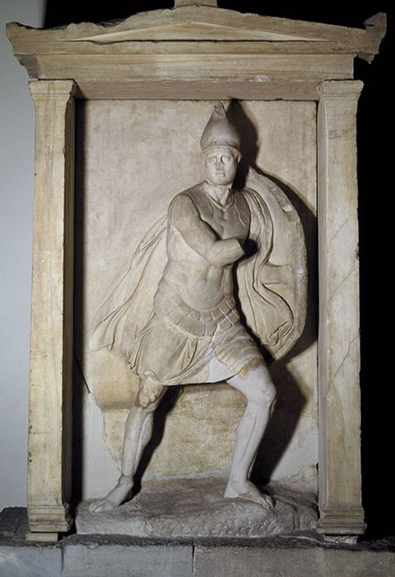
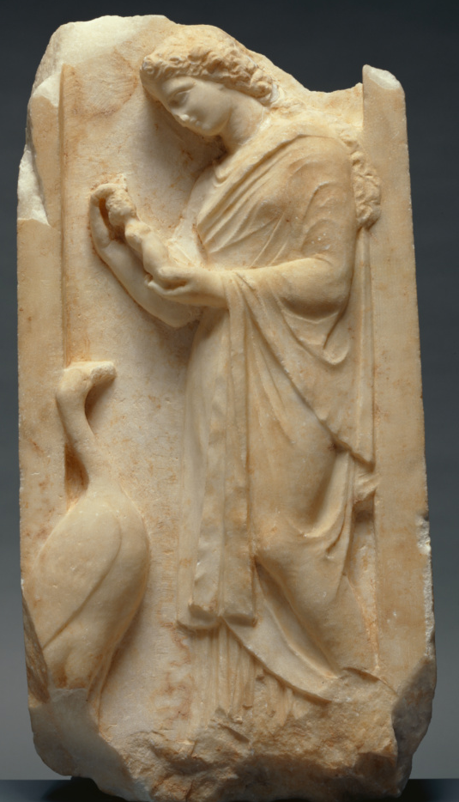
Naiskos of Aristonautes
Attic, Marble
Kerameikos, Athens
c. 350-325 BCE
Athens, NAM 738
Grave Naiskos of a Young Woman
Attic, Marble
c. 360 BCE
Malibu, The J. Paul Getty Museum
82.AA.135

Slide 15
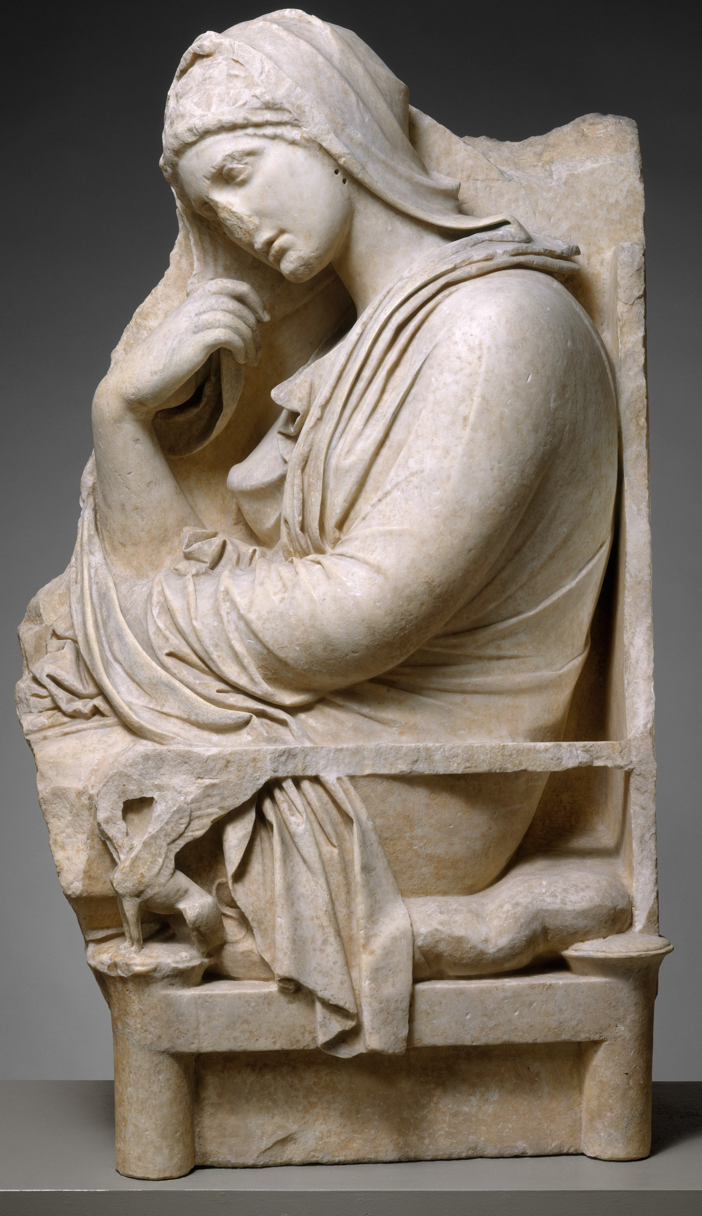
Thank you!
Dr. Tyler Jo Smith
Dr. J. E. Lendon
Dr. Dylan K. Rogers
Dr. Fotini Kondyli
Dr. Elizabeth Meyer
UVA Department of Art
UVA Art History Graduate Students
CAMWS
All of you in the audience
Stele of a Woman
Attic, Marble
Acharnae, Menidi
Mid-4th century BCE
New York, MMA 48.11.4

Slide 16
Select Bibliography
Andrianou, D. 2017. Memories in Stone: Figured Grave Reliefs from Aegean Thrace. Athens: Institute of Historical Research.
Allen, M. E. 2018. “Visualizing the afterlife in Classical Athens: Interactions between the living and the dead on white-ground lêkythoi.” In J. Harrisson, ed., Imagining the Afterlife in the Ancient World, 15-31. London: Routledge.
Arrington, N. T. 2018. “Touch and Remembrance in Greek Funerary Art.” The Art Bulletin 100, no. 3: 7-27.
Clairmont, C. W. 1993. Classical Attic Tombstones. Kilchberg, Switzerland: Acanthus.
Davies, G. 1985. “The Significance of the Handshake Motif in Classical Funerary Art.” American Journal of Archaeology 89, no. 4: 627-640.
Grossman, J. B. 2001. Greek Funerary Sculpture: Catalogue of the Collections at the Getty Villa. Los Angeles: The J. Paul Getty Trust.
Kurtz, D. C., and J. Boardman. 1971. Greek Burial Customs. Ithaca, NY: Cornell University Press.
Oakley, J. 2004. Picturing Death in Classical Athens: The Evidence of the White Lekythoi. Cambridge: Cambridge University Press.
Sourvinou-Inwood, C. 1995. ‘Reading’ Greek Death: To the End of the Classical Period. Oxford: Clarendon Press.
Van Gennep, A. 1960 [1909]. The Rites of Passage. Translated by M. B. Vizedom and G. L. Caffee. Chicago: University of Chicago Press.
Vernant, J.-P. 1991. “Death in the Eyes: Gorgo, Figure of the Other.” In F. I. Zeitlin, ed., Mortals and Immortals: Collected Essays, 111-138. Princeton, NJ: Princeton University Press.

