Slide 1
A Democratic Music:
Procession, Sacrifice, and the Aulos
in 5th c. Athenian Vase-Painting
Abigail Bradford
Section C: Greek Art and Archaeology
March 24, 2022

Slide 2
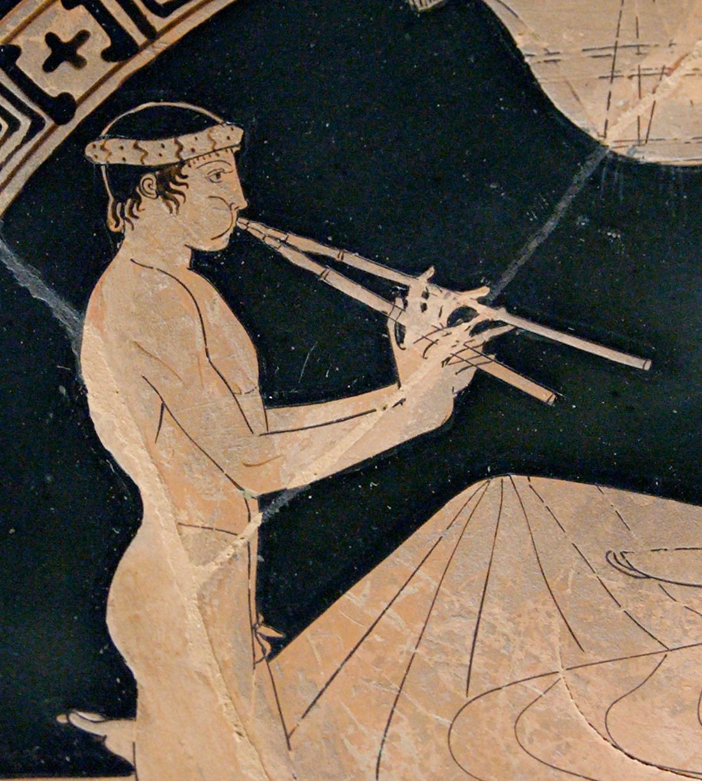
Attic red-figure cup attributed to the Euaion Painter,
ca. 460-450 BCE
Paris, Louvre Museum G467 (BAPD 209755)

Slide 3
“...when about to sacrifice, [the Persians] do not build altars or kindle fire, employ libations, or music, or fillets, or barley meal.”
Herodotus The Histories [1.132]
Attic red-figure cup attributed to the Euaion Painter,
ca. 460-450 BCE
Paris, Louvre Museum G467 (BAPD 209755)

Slide 4
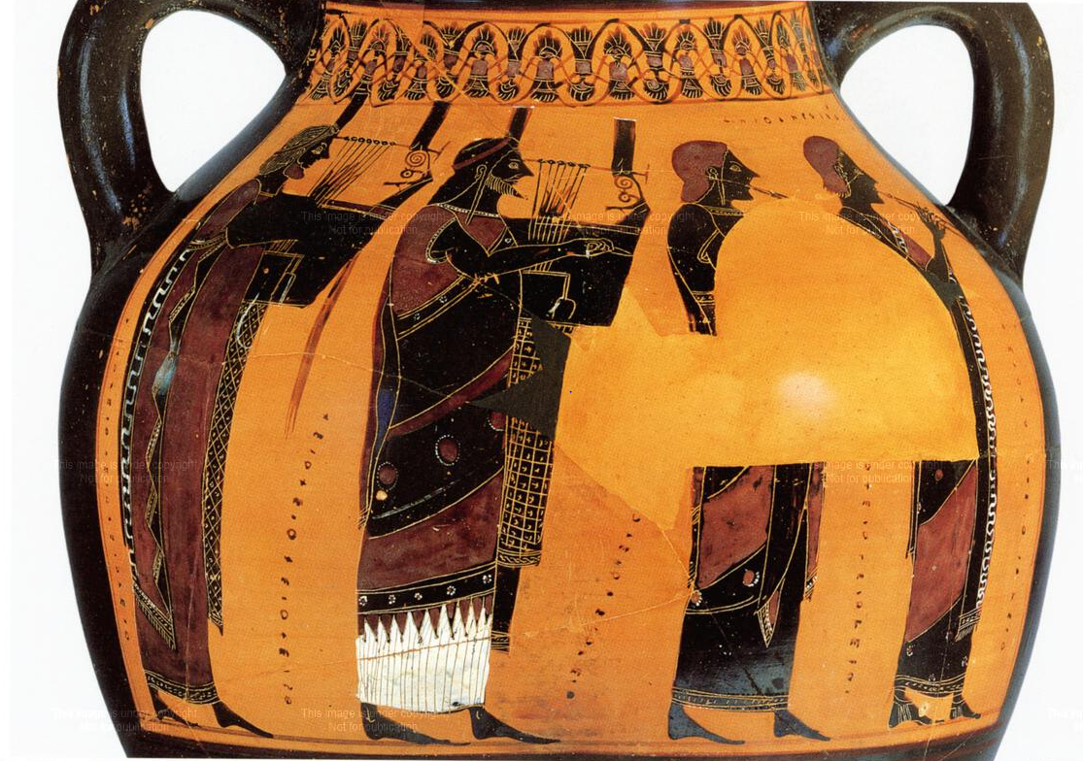
Attic black-figure amphora by the Painter of Berlin 1686, ca. 550–540 BCE
Berlin, Antikensammlung 1686 (BAPD 320383)

Slide 5
aulos
Attic black-figure amphora by the Painter of Berlin 1686, ca. 550–540 BCE
Berlin, Antikensammlung 1686 (BAPD 320383)

Slide 6
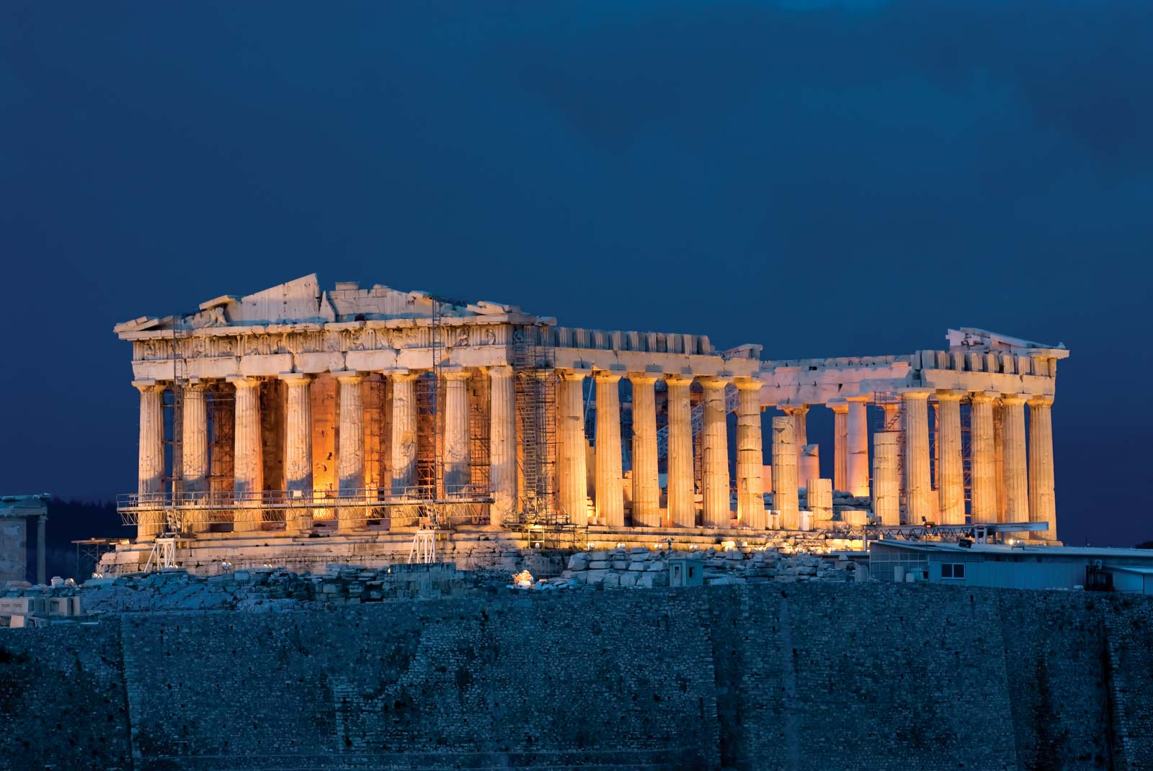

Slide 7
Growth of Democracy

Slide 8
Growth of Democracy
Development of “New Music”

Slide 9
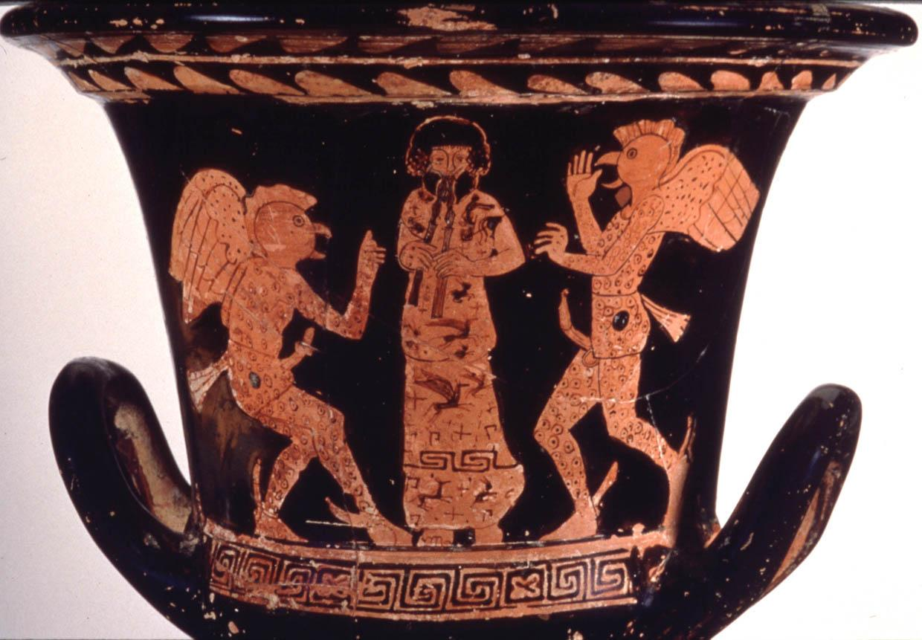
Attic red-figure calyx krater, possibly by the Painter of Munich 2335, ca. 415-400 BCE
Malibu, J. Paul Getty Museum 82.AE.83 (BAPD 13689)

Slide 10
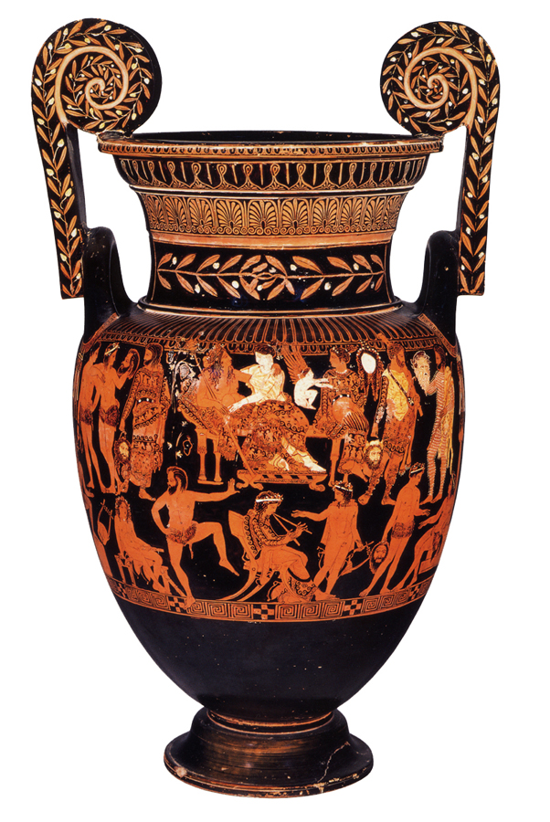
Attic red-figure volute krater attributed to the Pronomos Painter,
ca. 400 BCE
Naples, Museo Archeologico Nazionale H3240 (BAPD 217500)
Notes:
https://www.beazley.ox.ac.uk/XDB/ASP/imageViewerV2.asp?filename=\Vases\SPIFF\8316019C64944A6A9838046AFDEBC39E\\image.tif

Slide 11
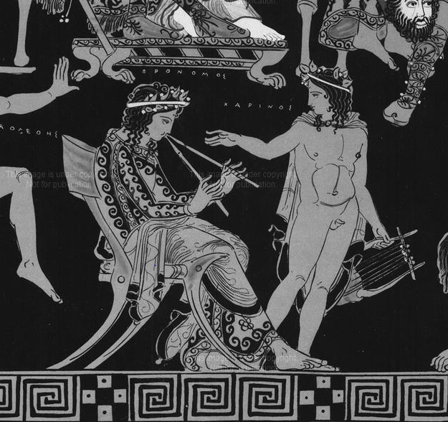
Attic red-figure volute krater attributed to the Pronomos Painter,
ca. 400 BCE
Naples, Museo Archeologico Nazionale H3240 (BAPD 217500)
Notes:
https://www.beazley.ox.ac.uk/XDB/ASP/imageViewerV2.asp?filename=\Vases\SPIFF\8316019C64944A6A9838046AFDEBC39E\\image.tif

Slide 12
“...[Pronomos] drove his audiences wild with his facial contortions and the gyrations of his body.”
Pausanias Description of Greece [9.12]
Attic red-figure volute krater attributed to the Pronomos Painter,
ca. 400 BCE
Naples, Museo Archeologico Nazionale H3240 (BAPD 217500)
Notes:
https://www.beazley.ox.ac.uk/XDB/ASP/imageViewerV2.asp?filename=\Vases\SPIFF\8316019C64944A6A9838046AFDEBC39E\\image.tif

Slide 13
Notes:
https://www.beazley.ox.ac.uk/XDB/ASP/imageViewerV2.asp?filename=\Vases\SPIFF\8316019C64944A6A9838046AFDEBC39E\\image.tif

Slide 14
“...in place of an aristocracy in music there sprang up a kind of base theatrocracy.”
Plato Laws [3.700d-3.701a]
Notes:
https://www.beazley.ox.ac.uk/XDB/ASP/imageViewerV2.asp?filename=\Vases\SPIFF\8316019C64944A6A9838046AFDEBC39E\\image.tif

Slide 15
“...in place of an aristocracy in music there sprang up a kind of base theatrocracy.”
Plato Laws [3.700d-3.701a]
democracy
Notes:
https://www.beazley.ox.ac.uk/XDB/ASP/imageViewerV2.asp?filename=\Vases\SPIFF\8316019C64944A6A9838046AFDEBC39E\\image.tif

Slide 16
Scene categorization
Chronological period
570-520 BCE
520-480 BCE
480-450 BCE
450-400 BCE
Sacrificial stage
pre-kill (procession)
pre-kill (altar)
post-kill (altar)
post-kill (taratalla)
van Straten (1995); Gebauer (2002); Bundrick (2014)

Slide 17
beginning
of sacrifice
end
of sacrifice
pre-kill (procession)
kill 💀 (altar)
post-kill (taratalla)
pre-kill (altar)
post-kill (altar)

Slide 18
beginning
of sacrifice
end
of sacrifice
pre-kill (procession)
kill 💀 (altar)
post-kill (taratalla)
pre-kill (altar)
post-kill (altar)
Attic black-figure amphora by the Painter of Berlin 1686,
ca. 550–540 BCE
Berlin, Antikensammlung 1686
(BAPD 320383)

Slide 19
beginning
of sacrifice
end
of sacrifice
pre-kill (procession)
kill 💀 (altar)
post-kill (taratalla)
pre-kill (altar)
post-kill (altar)
Attic red-figure bell krater
in the manner of the Kleophon Painter,
ca. 430–410 BCE
Boston, Boston Museum of Fine Arts 95.25 (BAPD 215220)

Slide 20
beginning
of sacrifice
end
of sacrifice
pre-kill (procession)
kill 💀 (altar)
post-kill (taratalla)
pre-kill (altar)
post-kill (altar)
Attic red-figure stamnos by Polygnotos, ca. 440–430 BCE
London, British Museum E455 (1839.2–14.68) (BAPD 213390)

Slide 21
beginning
of sacrifice
end
of sacrifice
pre-kill (procession)
kill 💀 (altar)
post-kill (taratalla)
pre-kill (altar)
post-kill (altar)
Attic red-figure kylix by Oltos,
ca. 525–500 BCE
Bologna, Museo Civico 361
(BAPD 200549)

Slide 22
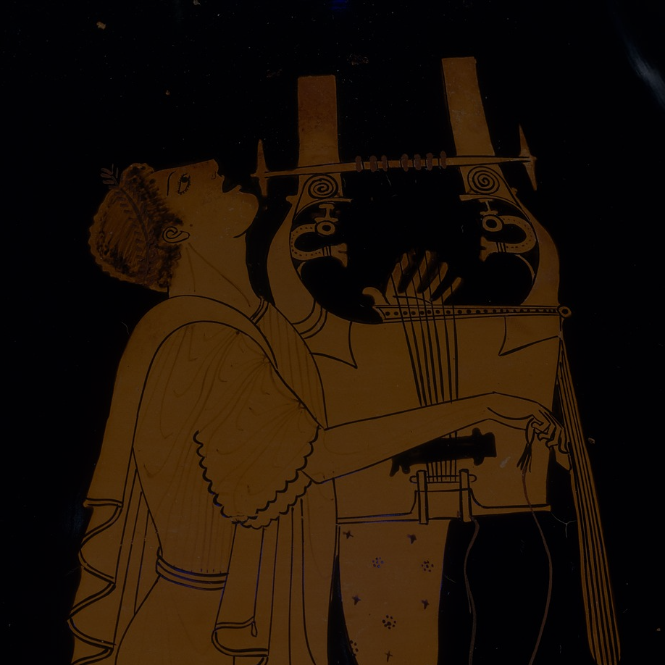
Attic red-figure cup attributed to the Euaion Painter,
ca. 460–450 BCE
Paris, Louvre Museum G467
(BAPD 209755)
aulos
Notes:
https://www.metmuseum.org/art/collection/search/254896

Slide 23
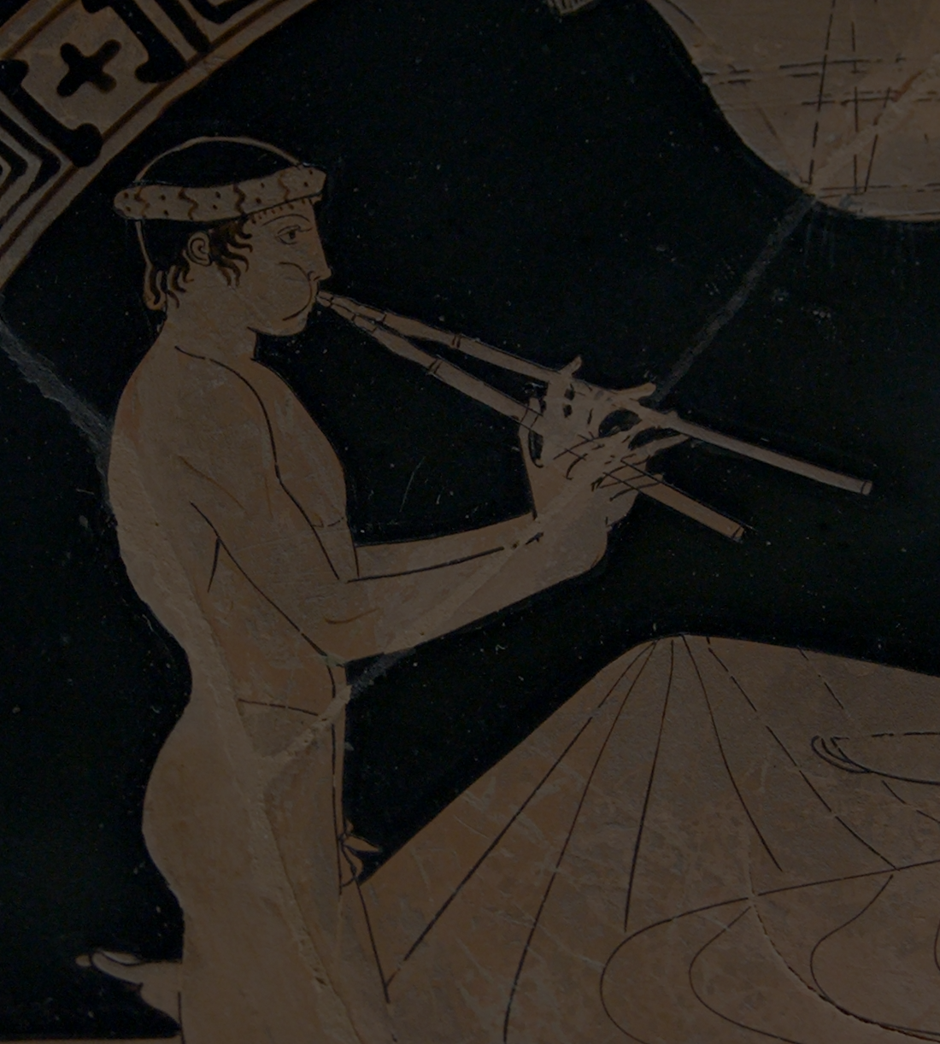
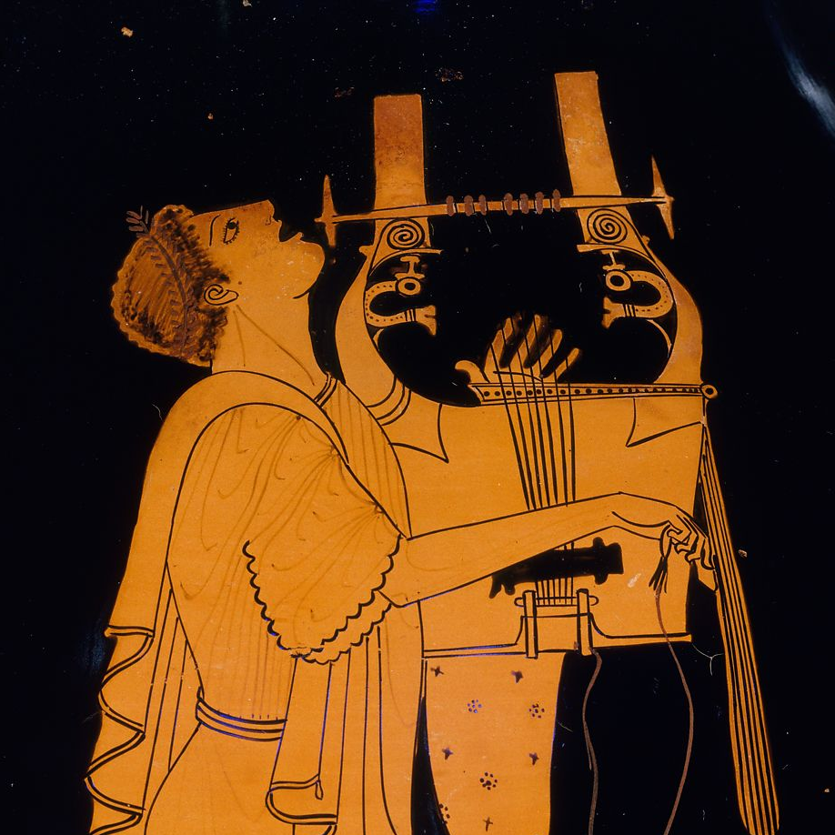
kithara
Attic red-figure amphora by the Berlin Painter, ca. 490 BCE
New York,
Metropolitan Museum of Art 56.171.38 (BAPD 201811)

Slide 24
Attic white-ground cup attributed to the Pistoxenos Painter, ca. 460 BCE
Delphi, Delphi Archaeological Museum 8140 (BAPD 5522)
lyre

Slide 25
salpinx
Attic black-figure plate attributed to Psiax,
ca. 520–500 BCE
London, British Museum 1867.0508.941 (BAPD 320366)

Slide 26
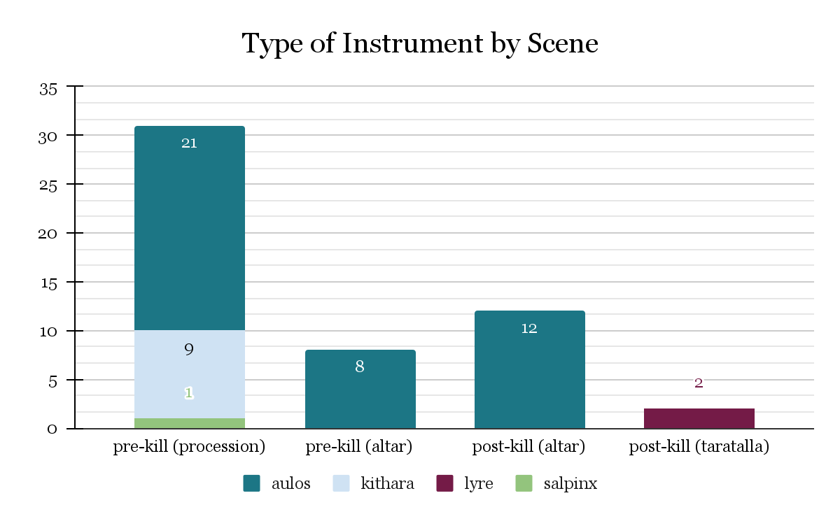

Slide 27
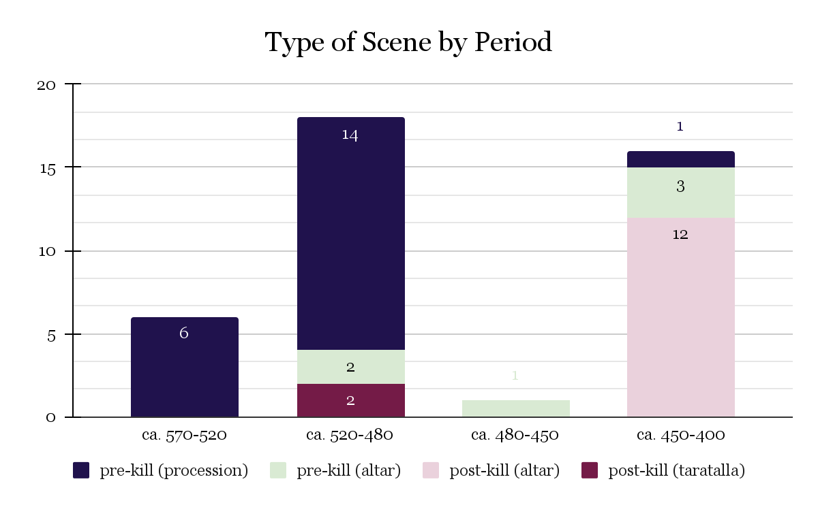

Slide 28
508 BCE: Kleisthenic reforms

Slide 30
450 BCE: Pericles’ citizenship laws

Slide 31
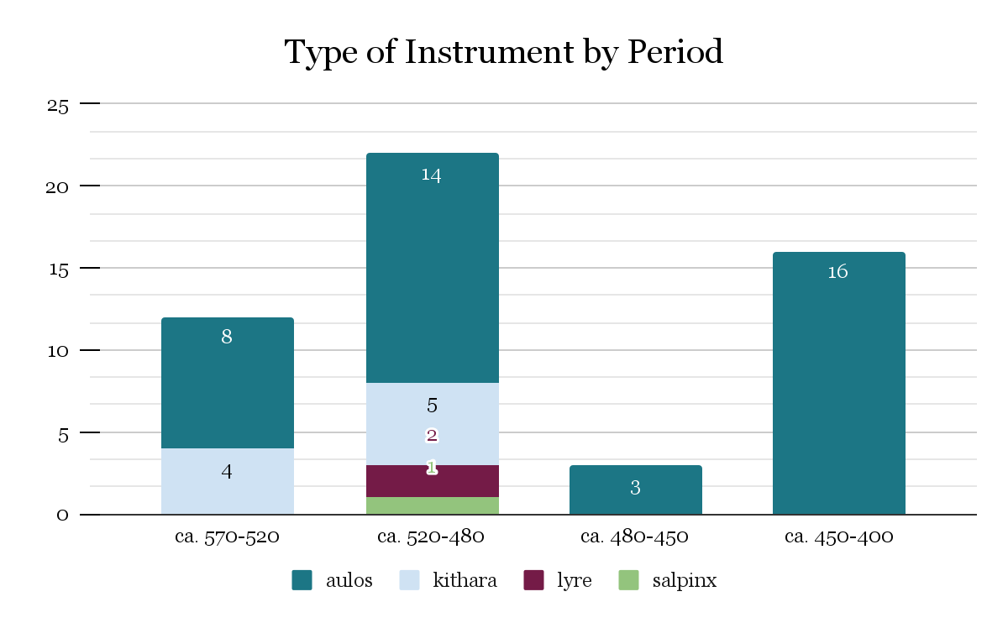

Slide 32
Attic red-figure bell krater in the manner of the Kleophon Painter, ca. 430–410 BCE
Boston, Boston Museum of Fine Arts 95.25 (BAPD 215220)

Slide 33
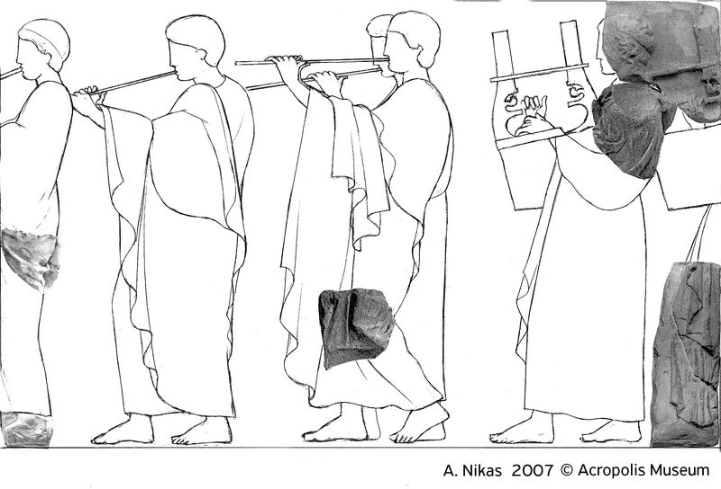
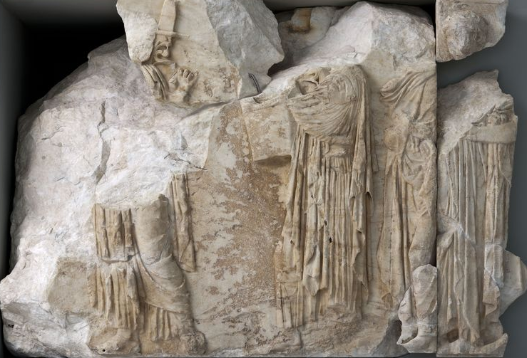
Block N VI
Block N VII
Acropolis Museum
Notes:
https://theacropolismuseum.gr/en/explore-collections?field_exhibit_collection_value=&field_exhibit_position_value_1=&title=frieze&field_exhibit_desc_web_value=frieze&field_exhibit_obj_code_value=&field_exhibit_category_value=&field_exhibit_period_value=&field_exhibit_material_value=&field_exhibit_position_value=&items_per_page=30&field_exhibits_format_view_value=&field_exhibit_web_date_value=&field_exhibit_collection_value_1=&field_exhibit_creator_value=&field_enilikoi_from_value=&field_date_value=&field_date_to_value=&field_drastiriotites_oloi_date=&field_drastiriotites_oloi_eos_value=&field_periodic_date_from_value=&field_periodic_date_to_value_1=&field_image_type_value=&field_etos_value=&field_dialexeis_imerominia_apo_value=&field_imerominia_apo_value=&field_imerominia_eos_value=&sort_order=&sort_by=&field_katigoria_anazitisis_value=&field_drastiriotites_oloi_date_value=&field_moyseio_taxideyei_eos_value=&page=1

Slide 34
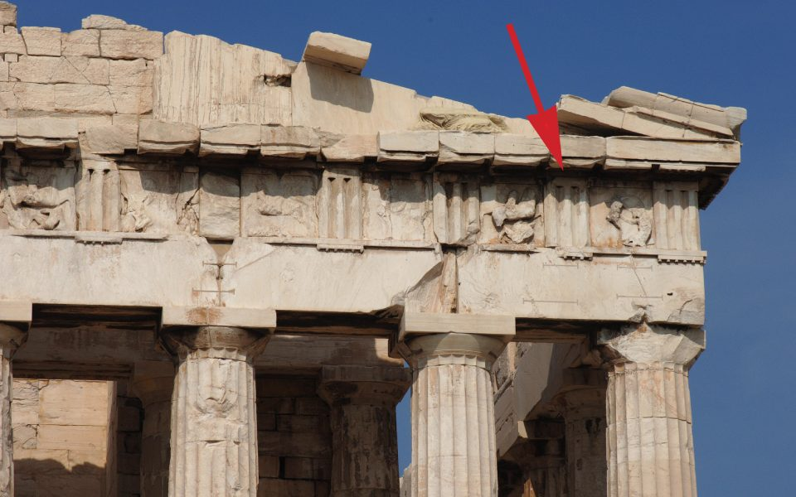
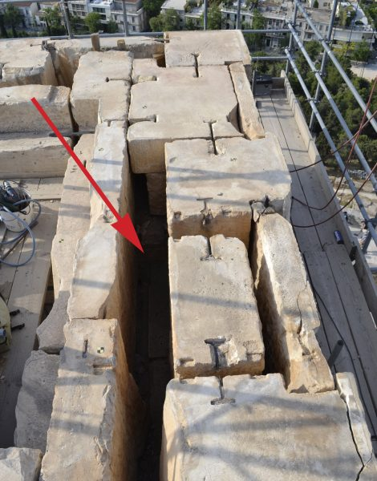
YSMA Archives

Slide 35
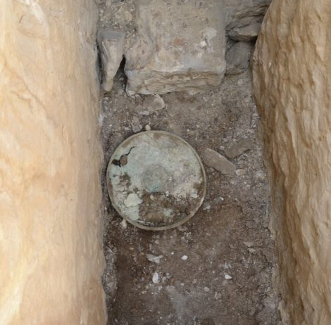
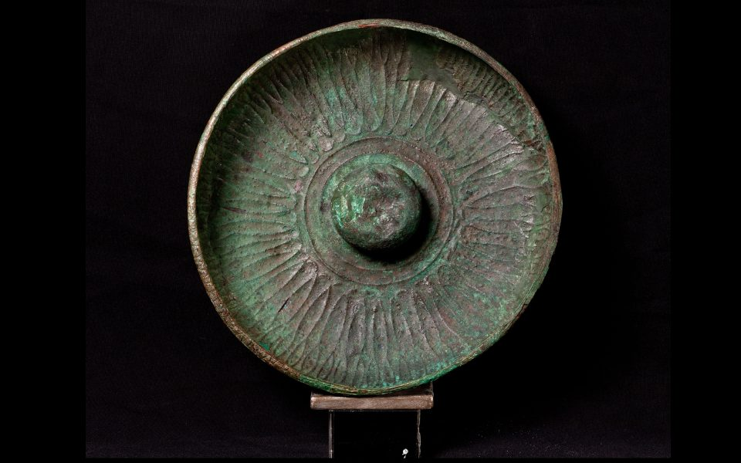
YSMA Archives

Slide 36
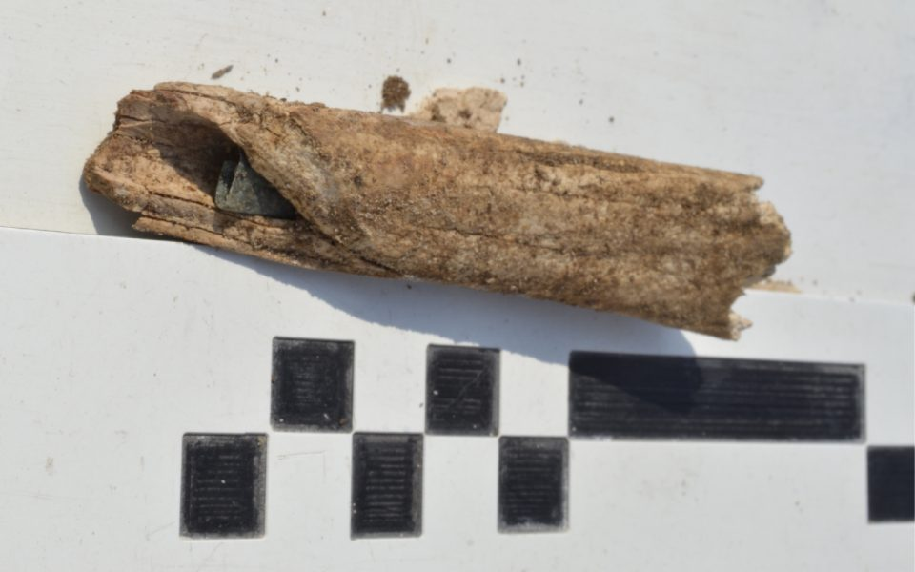
YSMA Archives

Slide 37
YSMA Archives

Slide 38
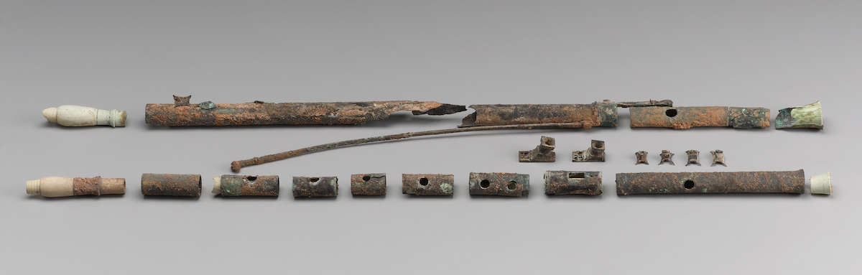
Bronze aulos from Meroë, ca. 10-1 BCE
Boston, Boston Museum of Fine Arts SC65062
Notes:
https://www.getty.edu/publications/artistryinbronze/conservation-and-analysis/45-gansicke/#&gid=1&pid=3

Slide 39
Thank You
Special Thanks To:
Dr. Tyler Jo Smith
Dr. Dylan Rogers
Dr. Fotini Kondyli
Dr. Elizabeth Meyer
Dr. Ted Lendon
Dr. Armand D’Angour
Callum Armstrong
Department of Art, University of Virginia
Religion, Race, and Democracy Lab
Institute of Humanities and Global Cultures
Student Council Art Fund
American School of Classical Studies at Athens

Slide 40
Select bibliography
Bundrick, S. D. 2005. Music and Image in Classical Athens. Cambridge: Cambridge University Press.
———. 2014. “Selling Sacrifice on Classical Athenian Vases.” Hesperia 83 (4):653–708.
Csapo, E. 2004. “The Politics of the New Music.” In Music and the Muses: The Culture of “Mousikē” in the Classical Athenian City, edited by P. Murray and P. Wilson, 207–248. Oxford: Oxford University Press.
D’Angour, A. 2006. “The New Music: So What’s New?” In Rethinking Revolutions Through Ancient Greece, edited by S. Goldhill and R. Osborne, 264–283. Cambridge: Cambridge University Press.
Gebauer, J. 2002. Pompe und Thysia: Attische Tieropferdarstellungen auf schwarz- und rotfigurigen Vasen. Münster: Ugarit-Verlag.
Goldhill, S., and R. Osborne, eds. 1999. Performance Culture and Athenian Democracy. Cambridge: Cambridge University Press.
Lynch, T. A., and E. Rocconi, eds. 2020. A Companion to Ancient Greek and Roman Music. Hoboken: Wiley-Blackwell.
Musti, D. 2000. “Musica greca tra aristocrazia e democrazia.” In Synaulía: cultura musicale in Grecia e contatti Mediterranei, ed. A. C. Cassio et al., 7–55. Naples: Istituto Universitario Orientale.
Nordquist, G. C. 1992. “Instrumental Music in Representations of Greek Cult.” In The Iconography of Greek Cult in the Archaic and Classical Periods, edited by R. Hägg, 143–68. Athens: Centre d’Étude de la Religion Grecque Antique.
Shapiro, H. A. 1992. “Mousikoi Agones: Music and Poetry at the Panathenaia.” In Goddess and Polis: The Panathenaic Festival in Ancient Athens, edited by J. Neils, 53–76. Princeton: Princeton University Press.
van Straten, F. T. 1995. Hierà Kalá: Images of Animal Sacrifice in Archaic and Classical Greece. Leiden: E. J. Brill.
West, M. L. 1992. Ancient Greek Music. Oxford: Clarendon Press.

Slide 41
“Remove the aulos, and the worship becomes a dismal affair, lacking the true festival spirit.”
Plutarch Moralia [1102b]

