Slide 1
The Democracy of Death
Criticism of elite Orphic ideology in Euripides’ Alcestis
Adam Rappold, Ph.D.
Brock University
arappold@brocku.ca

Slide 2
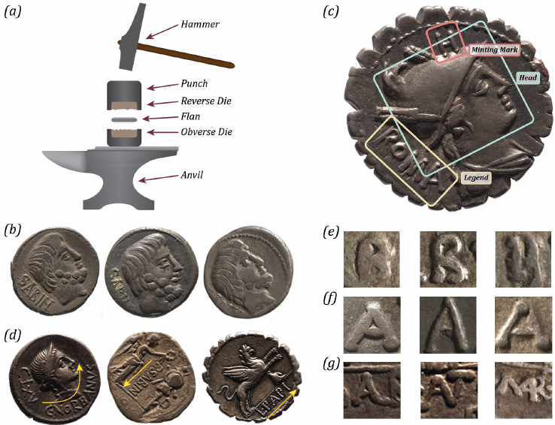
Euripides Alcestis
Adam Rappold, Ph.D.
Brock University
arappold@brocku.ca
Is it not apparent, then, that, for any work, the beginning is of the highest importance – for it then that opinion can best be molded and takes the impression that one wishes to stamp upon it. Plato. Rep. 377a-b
οὐκοῦν οἶσθ᾽ ὅτι ἀρχὴ παντὸς ἔργου μέγιστον, ἄλλως [377β]…; μάλιστα γὰρ δὴ τότε πλάττεται, καὶ ἐνδύεται τύπος ὃν ἄν τις βούληται ἐνσημήνασθαι ἑκάστῳ.
Kavelar (2014) -- Reading the legends of Roman Republican coins

Slide 3
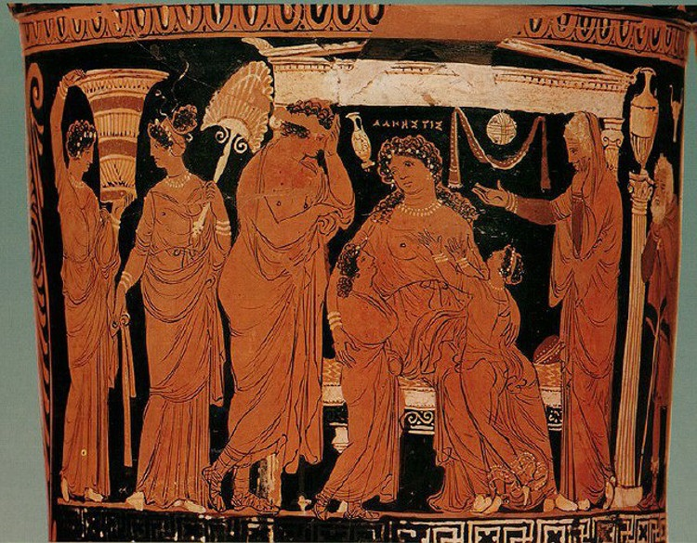
Euripides Alcestis
Adam Rappold, Ph.D.
Brock University
arappold@brocku.ca
Basic Outline
Traditional portrayal
Thanatos represents Democracy
Apollo is associated with Orphic initiation and anti-democratic aristocracy

Slide 4
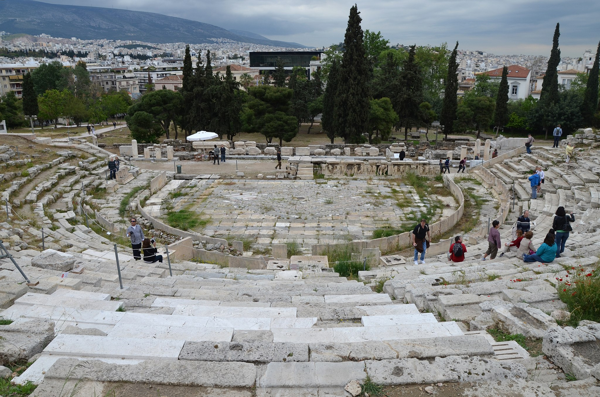
Euripides Alcestis
Adam Rappold, Ph.D.
Brock University
arappold@brocku.ca
Basic Outline
Traditional portrayal
Thanatos represents
Apollo is associated with Orphic initiation
Conclusion:

Slide 5
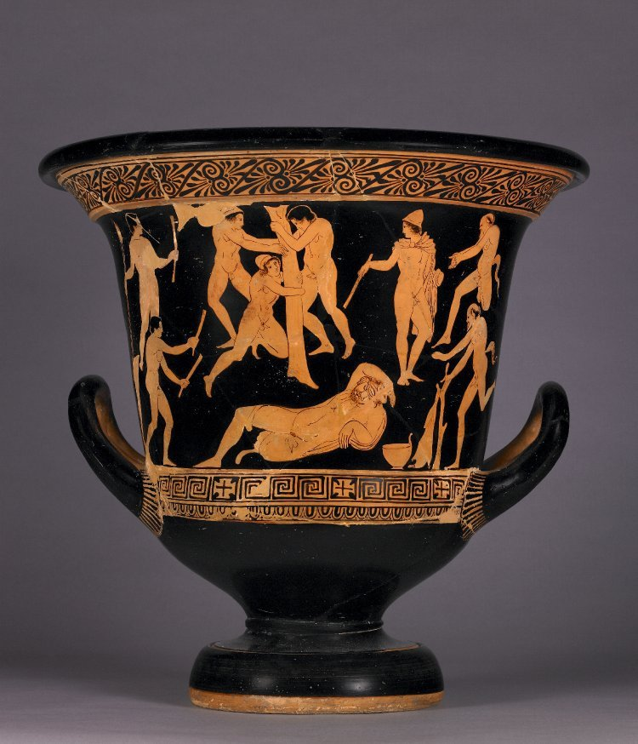
Apulian loutrophoros ca. 340s
Basel, Antikemuseum S21(4).
Euripides Alcestis

Slide 6
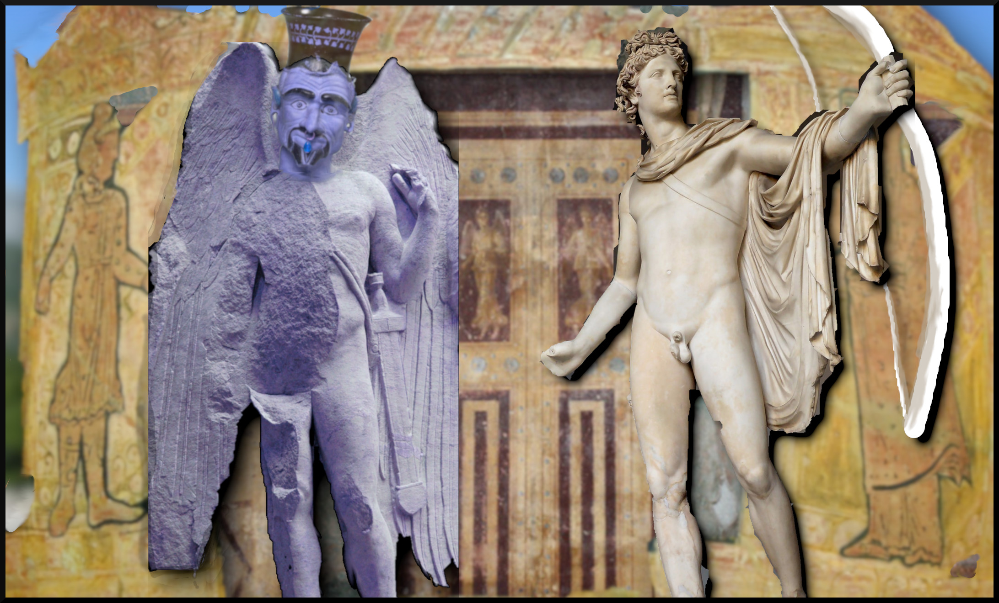
Euripides Alcestis
Adam Rappold, Ph.D.
Brock University
arappold@brocku.ca

Slide 7
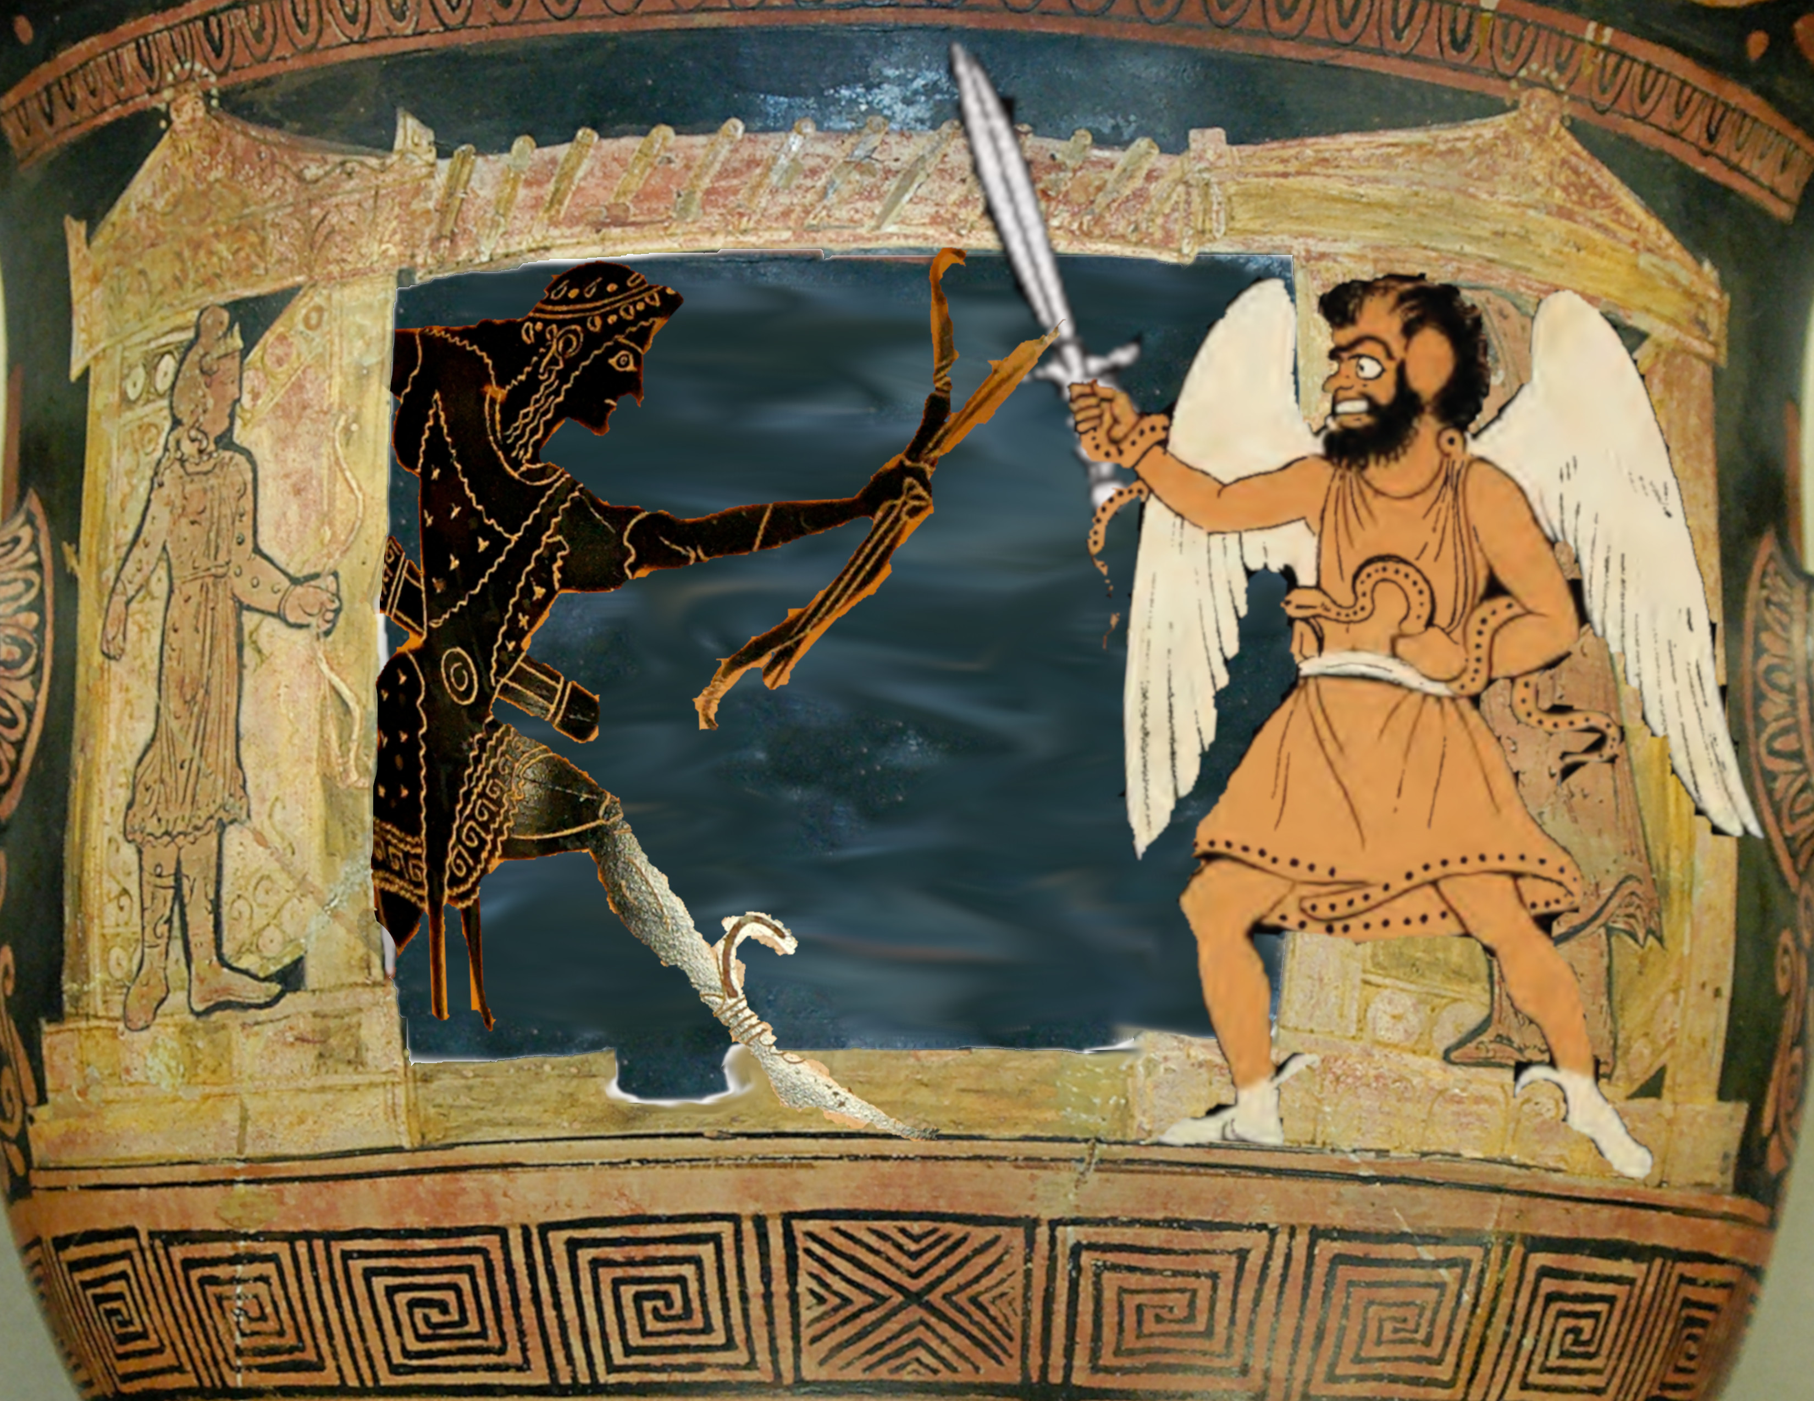
Euripides Alcestis
Adam Rappold, Ph.D.
Brock University
arappold@brocku.ca

Slide 8
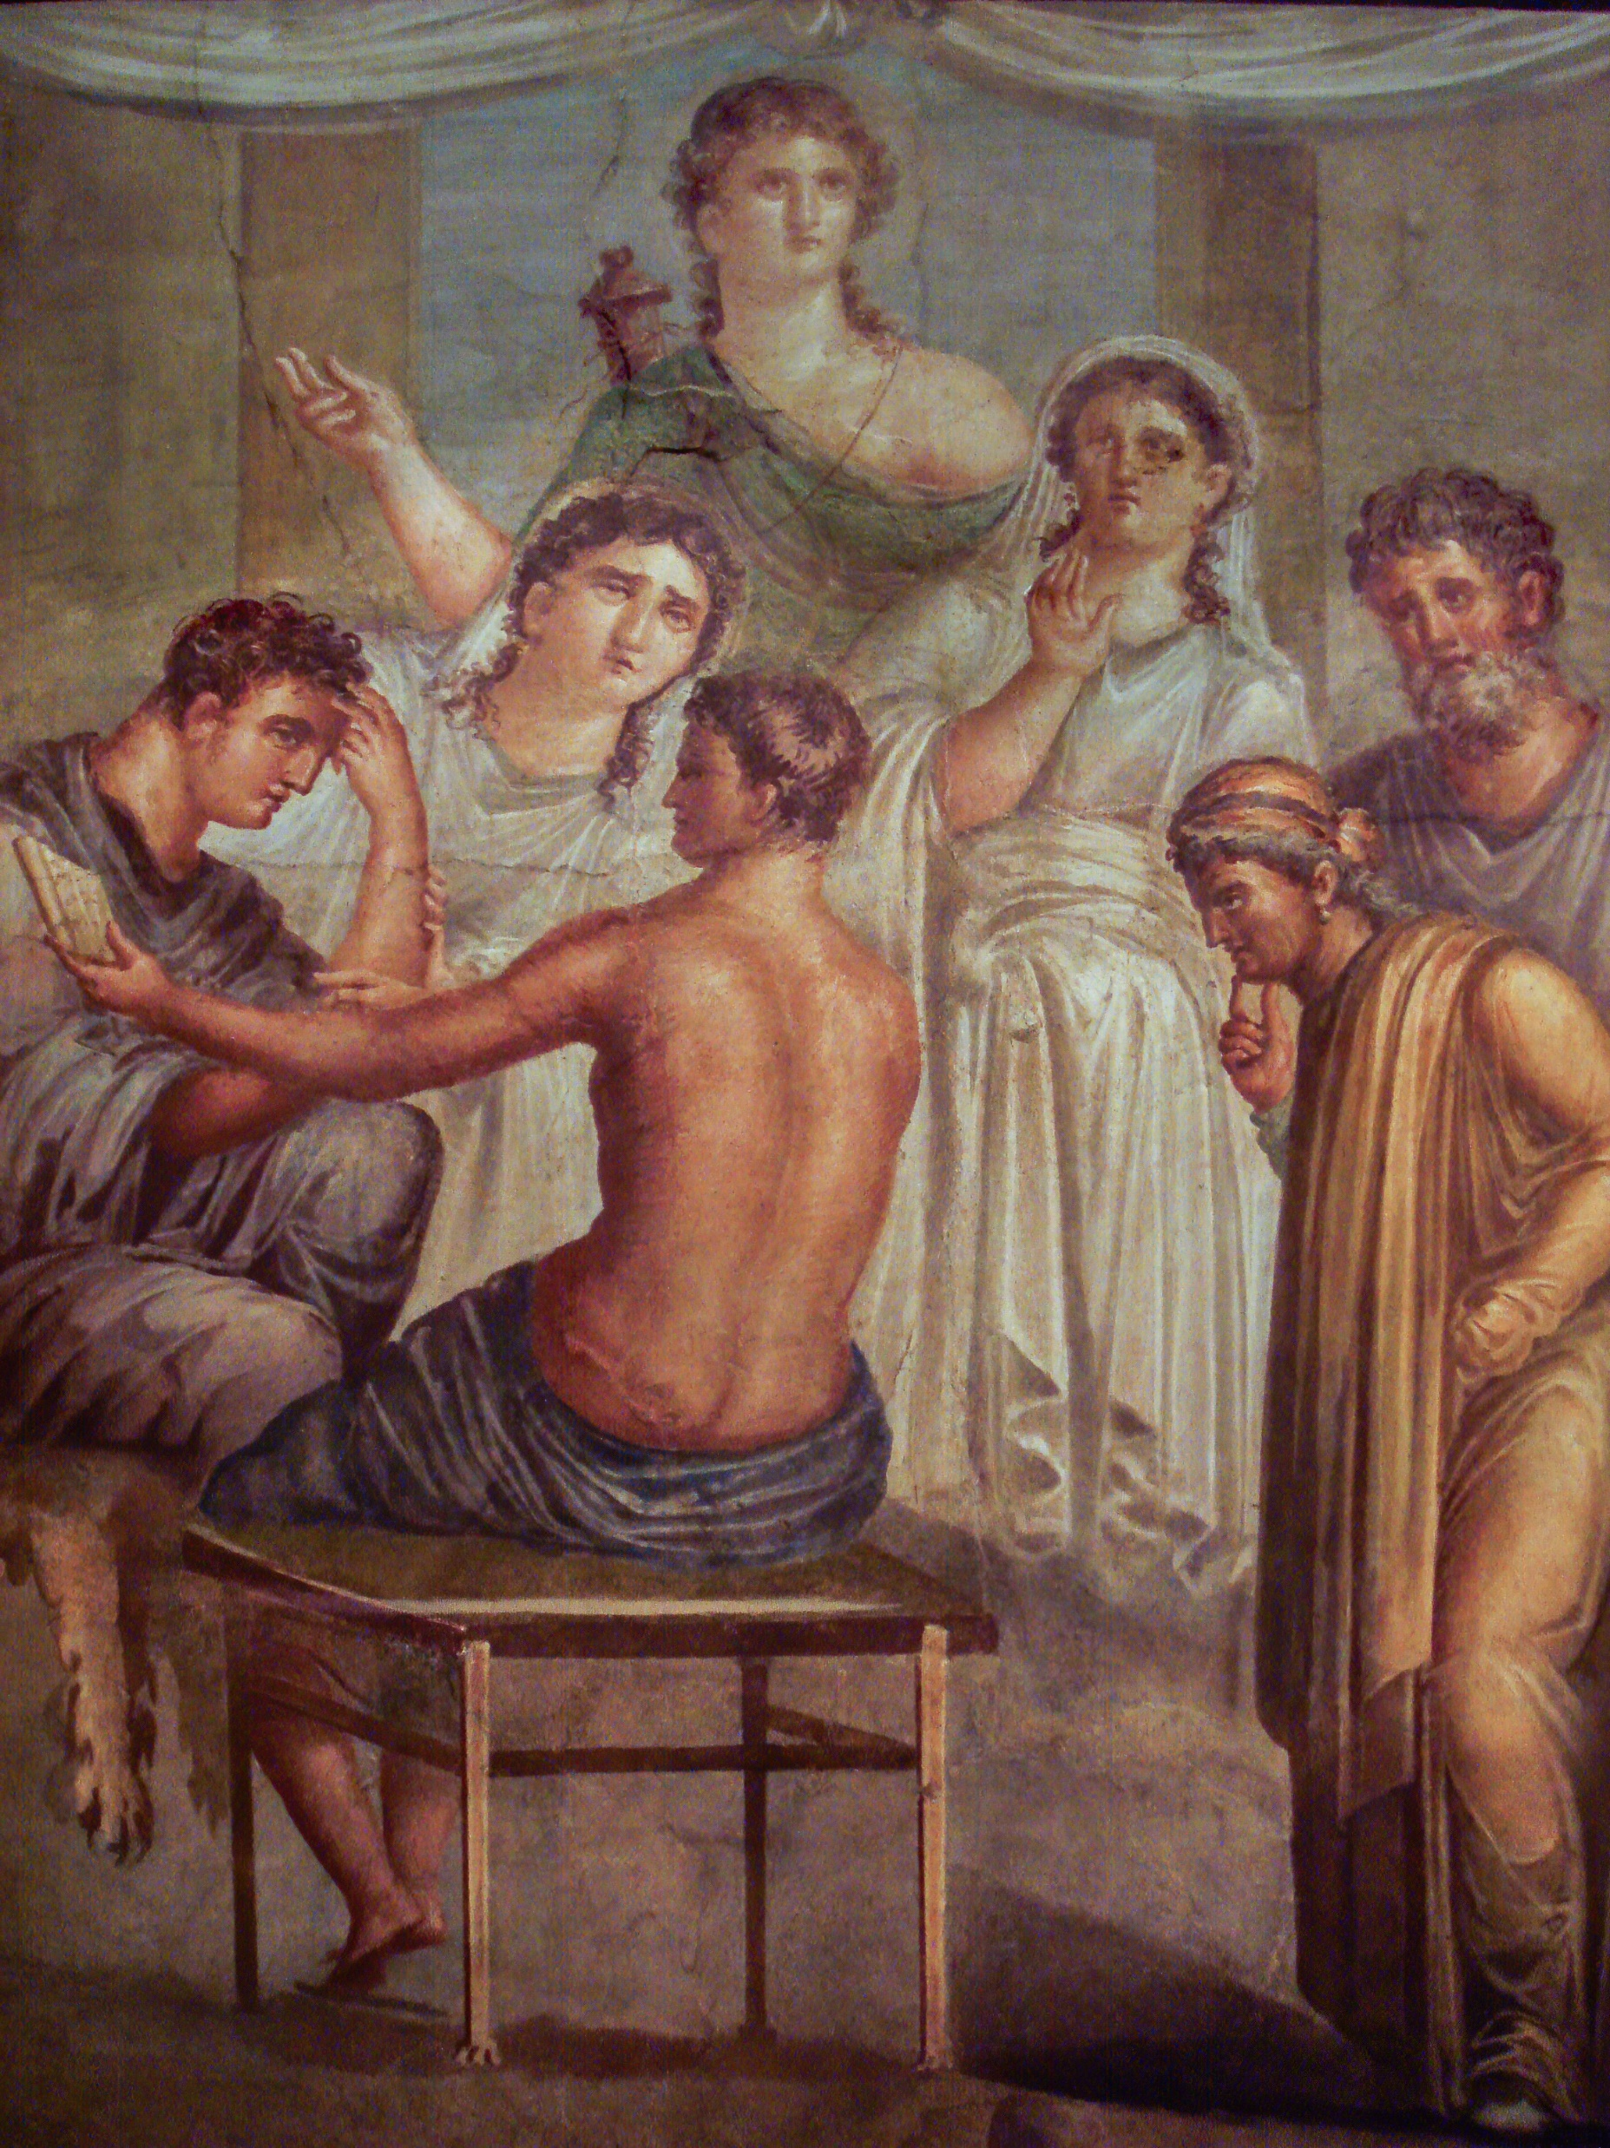
Euripides Alcestis
Adam Rappold, Ph.D.
Brock University
arappold@brocku.ca
“The disjunction between the two [modes: Tragedy and Satyr] contributes to both the play’s unique tone and “the uncanny effect of a near tragedy, suspended in, and finally dispelled by, a faintly mocking fairy tale”
Conacher (1967) Euripidean Drama: Myth, Theme, and Structure. Toronto. Pp. 327–339
Cf. Thornburn The Alcestis of Euripides (2002) xxvii, who sees him as ‘filling the role of [the] ogre’ who meets defeat in Satyr plays
Kavelar (2014) -- Reading the legends of Roman Republican coins

Slide 9
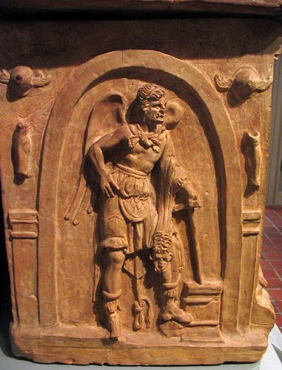
Euripides Alcestis
Adam Rappold, Ph.D.
Brock University
arappold@brocku.ca
“If we return to asking whether anything that the Athenian audience saw on stage in Alcestis that might have suggested satyric drama to them, the one possibility is the figure of Death…. The precise effect of the scene between Apollo and Death is hard to gauge, and could even depend to some extent on the interpetation of the individual actors. At all events, if the audience were reminded of satyr-plays, the entry of the chorus and the maidservant’s narrative would rapidly have wiped out that impression.”
Parker (2008), Euripides’ Alcestis, pp. xxii-xxiii
Kavelar (2014) -- Reading the legends of Roman Republican coins

Slide 10
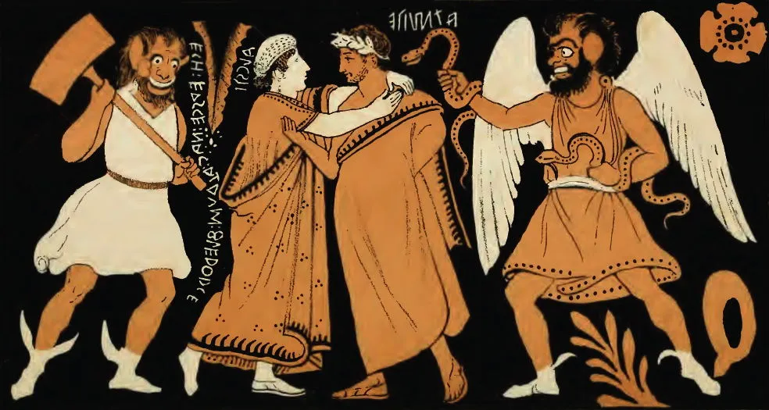
Euripides Alcestis
Farewell of Admetus and Alcestis
Drawing by George Dennis
Etruscan original c. 350 BCE

Slide 11
Euripides Alcestis
Admetus, Alcestis, and winged Charu, ca. 330 BC. Red figure skyphos. Boston Museum of Fine Arts (Museum photo).

Slide 12
Euripides Alcestis
Title: Terracotta bell-krater (mixing bowl)
Attributed to the Sarpedon Painter
Date: ca. 400–380 B.C.

Slide 13
Euripides Alcestis
Adam Rappold, Ph.D.
Brock University
arappold@brocku.ca
It is winged Hades, glowering from beneath his dark brows. (261-2)
I shall go and look out for the black-robed lord of the dead, Death himself, and I think I shall find him drinking from the offerings near the tomb. (843-5)
For when this sword has consecrated the hair of someone's head, he is the sacred property of the gods below. (74-6)
ὑπ᾽ ὀφρύσι κυαναυγέσι
βλέπων πτερωτός Ἅιδας.
ἐλθὼν δ᾽ ἄνακτα τὸν μελάμπεπλον νεκρῶν
Θάνατον φυλάξω, καί νιν εὑρήσειν δοκῶ
πίνοντα τύμβου πλησίον προσφαγμάτων.
στείχω δ᾽ ἐπ᾽ αὐτὴν ὡς κατάρξωμαι ξίφει:
ἱερὸς γὰρ οὗτος τῶν κατὰ χθονὸς θεῶν
ὅτου τόδ᾽ ἔγχος κρατὸς ἁγνίσῃ τρίχα.
Kavelar (2014) -- Readin he legends of Roman Republican coins

Slide 14
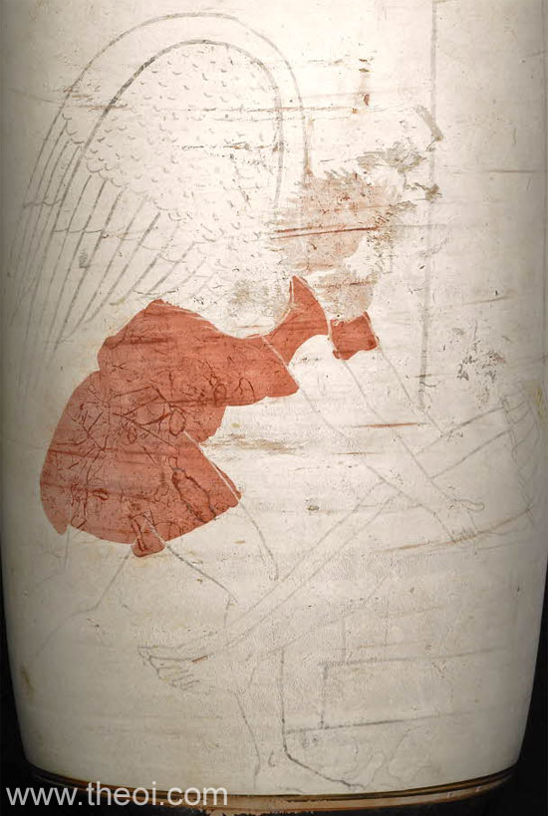
Euripides Alcestis
British Museum, London 1884,0223.2
c. 470-440 BCE

Slide 15
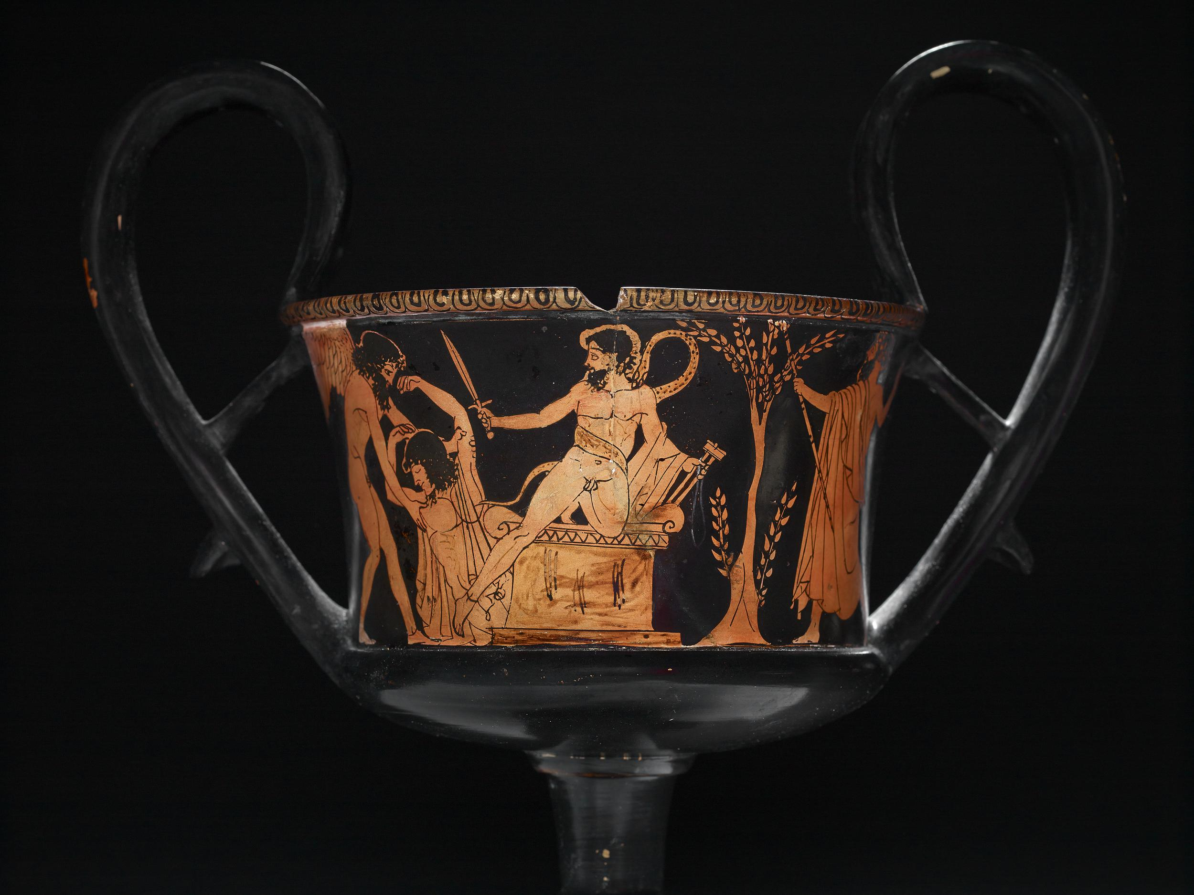
Euripides Alcestis
Punishment of Ixion
c. 470-460BCE
British Museum (1865,0103.23)

Slide 16
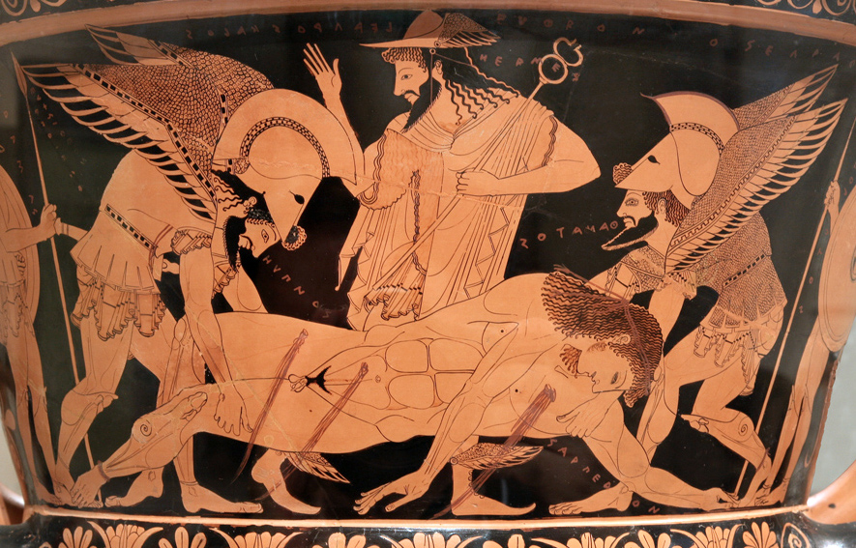
Euripides Alcestis
Punishment of Ixion
c. 470-460BCE
British Museum (1865,0103.23)

Slide 17
Euripides Alcestis
Adam Rappold, Ph.D.
Brock University
arappold@brocku.ca
(between -420 - -410 BCE)
CA 1264 Louvre

Slide 18
Euripides Alcestis
Title: Terracotta bell-krater (mixing bowl)
Attributed to the Sarpedon Painter
Date: ca. 400–380 B.C.

Slide 19
Euripides Alcestis
Adam Rappold, Ph.D.
Brock University
arappold@brocku.ca
Oh! Oh! And now the pain, the pain, comes over me. Let me go, wretched man that I am, and may death come to me as healer.
Eur. Hipp. 1370-3
May that Watcher leave a clear path for the stranger on his way to the nether fields of the dead! To you I call, giver of the eternal sleep.
Soph. OC. 1575-8
O death, the healer, reject me not, but come! For you alone are the medicine for incurable sickness, and no pain comes to the dead.
Aeschy. Frag 255 (Nauck TRGF 82)
αἰαῖ αἰαῖ:
καὶ νῦν ὀδύνα μ᾽ ὀδύνα βαίνει
μέθετέ με, τάλανες
καί μοι θάνατος Παιὰν ἔλθοι.
κατεύχομαι ἐν καθαρῷ βῆναι
ὁρμωμένῳ νερτέρας
τῷ ξένῳ νεκρῶν πλάκας:
σέ τοι κικλήσκω τὸν αἰένυπνον..
Kavelar (2014) -- Readin he legends of Roman Republican coins

Slide 20
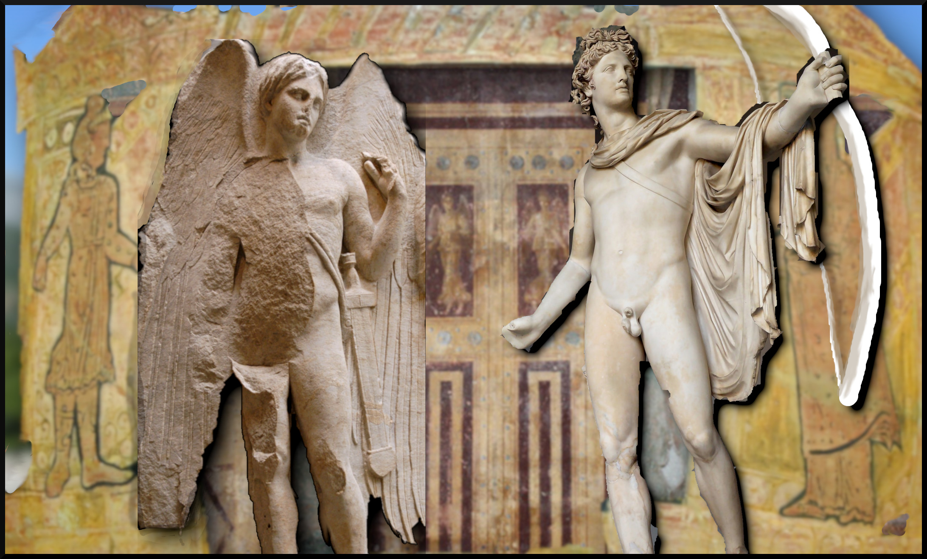
Euripides Alcestis
Adam Rappold, Ph.D.
Brock University
arappold@brocku.ca

Slide 21
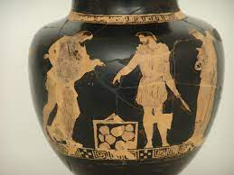
Euripides Alcestis
Adam Rappold, Ph.D.
Brock University
arappold@brocku.ca
Ah, I see that Death, the priest (iereus) of the dead, is already drawing near. [25] He is about to take her down to the house of Hades. He has arrived punctually, watching for today when she must die (trans. Kovacs 2014 with modification).
ἤδη δὲ τόνδε Θάνατον εἰσορῶ πέλας,
ἱερέα θανόντων, ὅς νιν εἰς Ἅιδου δόμους
μέλλει κατάξειν: συμμέτρως δ᾽ ἀφίκετο,
φρουρῶν τόδ᾽ ἦμαρ ᾧ θανεῖν αὐτὴν χρεών.
Kavelar (2014) -- Reading the legends of Roman Republican coins

Slide 22
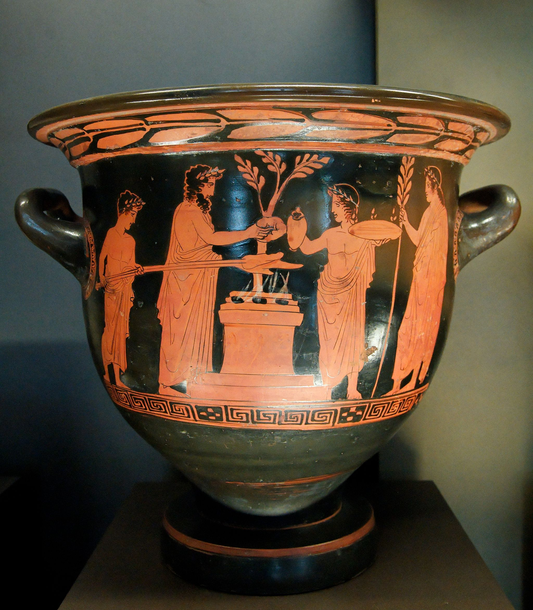
Euripides Alcestis
Adam Rappold, Ph.D.
Brock University
arappold@brocku.ca
Basic Outline
Traditional portrayal
Thanatos represents
Apollo is associated with Orphic initiation
Conclusion:
Sacrifice scene. Attic red-figure krater, ca. 430 BC–420 BC. Louvre G496

Slide 23
Euripides Alcestis
Adam Rappold, Ph.D.
Brock University
arappold@brocku.ca
Thanatos
Even if you keep talking forever, you would gain nothing further. Enough -- the woman is going down to the house of Hades and I head inside to take the sacrificial cutting of her hair. [75] For when this sword has consecrated the hair of someone's head, he is the sacred property of the gods below.
Θάνατος
πόλλ᾽ ἂν σὺ λέξας οὐδὲν ἂν πλέον λάβοις:
ἡ δ᾽ οὖν γυνὴ κάτεισιν εἰς Ἅιδου δόμους.
στείχω δ᾽ ἐπ᾽ αὐτὴν ὡς κατάρξωμαι ξίφει:
ἱερὸς γὰρ οὗτος τῶν κατὰ χθονὸς θεῶν
ὅτου τόδ᾽ ἔγχος κρατὸς ἁγνίσῃ τρίχα.
Kavelar (2014) -- Reading the legends of Roman Republican coins

Slide 24
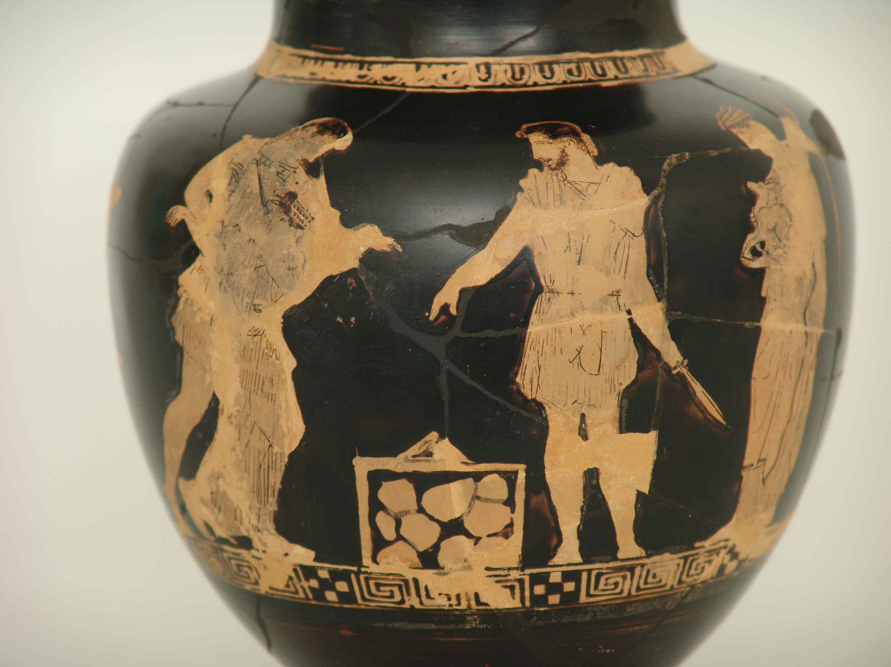
Euripides Alcestis
Adam Rappold, Ph.D.
Brock University
arappold@brocku.ca
Basic Outline
Traditional portrayal
Thanatos represents
Apollo is associated with Orphic initiation
Conclusion:
Sacrifice scene. Attic red-figure krater, ca. 430 BC–420 BC. Louvre G496

Slide 25
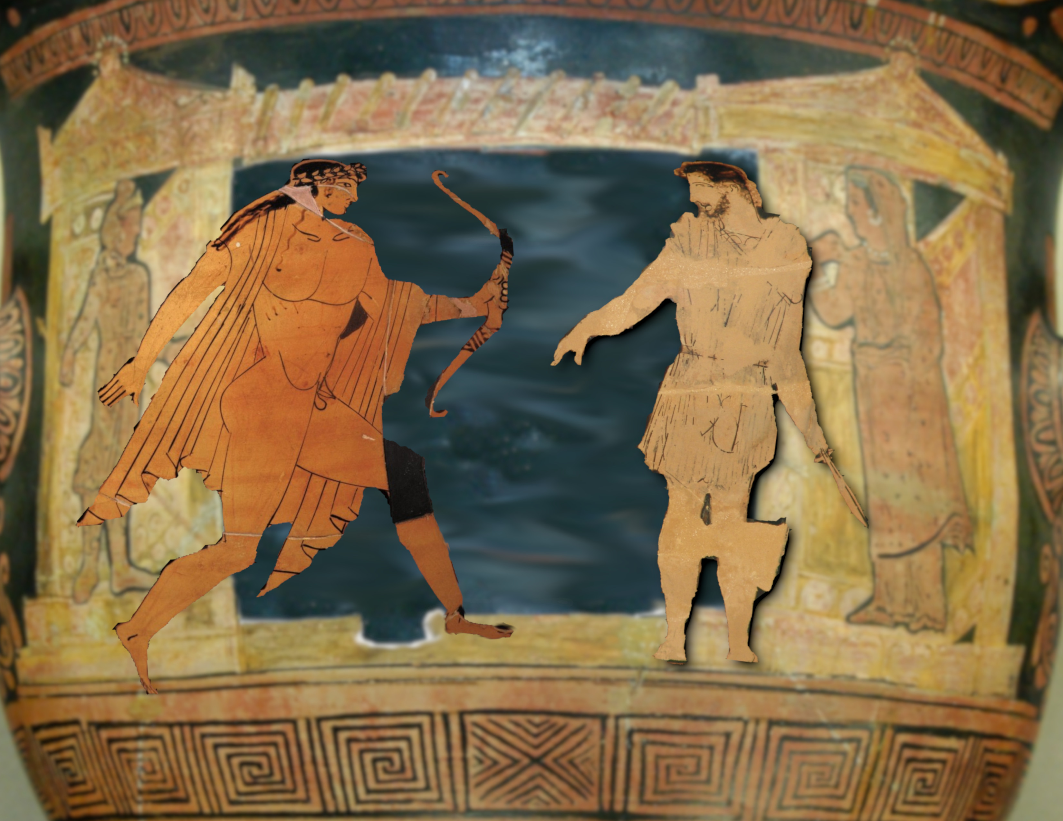
Euripides Alcestis
Adam Rappold, Ph.D.
Brock University
arappold@brocku.ca

Slide 26
Euripides Alcestis
Adam Rappold, Ph.D.
Brock University
arappold@brocku.ca
Apollo Take her and go. For I doubt if I can persuade you.
Death To kill my fated victims? Yes, for those are my orders.
Apollo [50] No, to postpone death for the doomed.
Death I grasp now your purpose and your desire.
Apollo Is there any way Alcestis might reach old age?
Death There is none. I too, you must know, get pleasure from my office.
Apollo You will not, of course, get more than one life in any case.
λαβὼν ἴθ᾽: οὐ γὰρ οἶδ᾽ ἂν εἰ πείσαιμί σε.
κτείνειν γ᾽ ὃν ἂν χρῇ; τοῦτο γὰρ τετάγμεθα.
οὔκ, ἀλλὰ τοῖς μέλλουσι θάνατον ἀμβαλεῖν.
ἔχω λόγον δὴ καὶ προθυμίαν σέθεν.
ἔστ᾽ οὖν ὅπως Ἄλκηστις ἐς γῆρας μόλοι;
οὐκ ἔστι: τιμαῖς κἀμὲ τέρπεσθαι δόκει.
οὔτοι πλέον γ᾽ ἂν ἢ μίαν ψυχὴν λάβοις.
Θάνατος
55νέων φθινόντων μεῖζον ἄρνυμαι γέρας.
Kavelar (2014) -- Reading the legends of Roman Republican coins

Slide 27
Euripides Alcestis
Adam Rappold, Ph.D.
Brock University
arappold@brocku.ca
Death [55] I win greater honor when the victims are young.
Apollo And yet if she dies old, she will receive a rich burial.
Death The law you are trying to establish, Phoebus, is to the advantage of the rich.
Apollo What do you mean? Can I have failed to appreciate what a thinker you are?
Death Those with means could buy death at an advanced age.
Apollo [60] You are not inclined, I take it, to grant me this favor
Death No, indeed. You know my character..
νέων φθινόντων μεῖζον ἄρνυμαι γέρας.
κἂν γραῦς ὄληται, πλουσίως ταφήσεται.
πρὸς τῶν ἐχόντων, Φοῖβε, τὸν νόμον τίθης.
πῶς εἶπας; ἀλλ᾽ ἦ καὶ σοφὸς λέληθας ὤν;
ὠνοῖντ᾽ ἂν οἷς πάρεστι γηραιοὶ θανεῖν.
οὔκουν δοκεῖ σοι τήνδε μοι δοῦναι χάριν.
οὐ δῆτ᾽: ἐπίστασαι δὲ τοὺς ἐμοὺς τρόπους.
Ἀπόλλων
ἐχθρούς γε θνητοῖς καὶ θεοῖς στυγουμένους.
Θάνατος
οὐκ ἂν δύναιο πάντ᾽ ἔχειν ἃ μή σε δεῖ..
Kavelar (2014) -- Reading the legends of Roman Republican coins

Slide 28
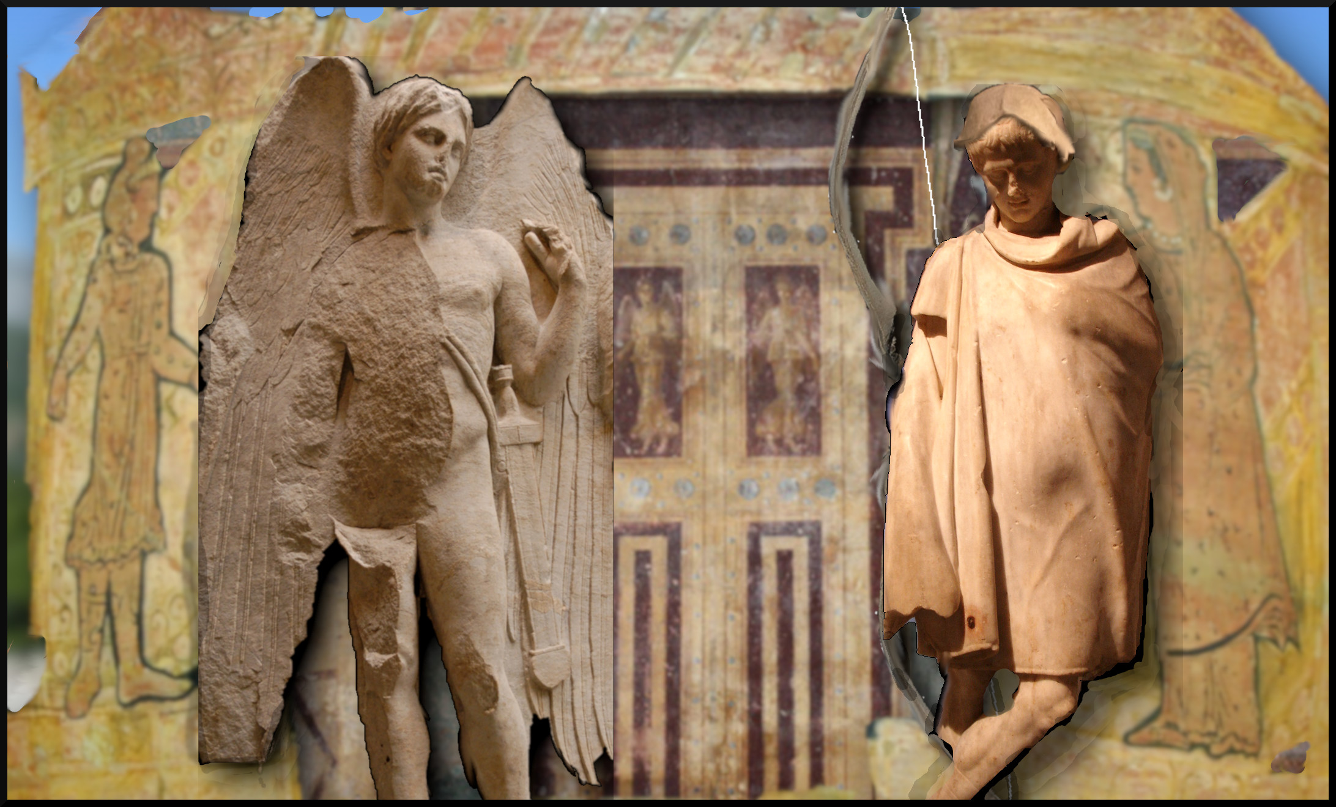
Euripides Alcestis
Adam Rappold, Ph.D.
Brock University
arappold@brocku.ca

Slide 29
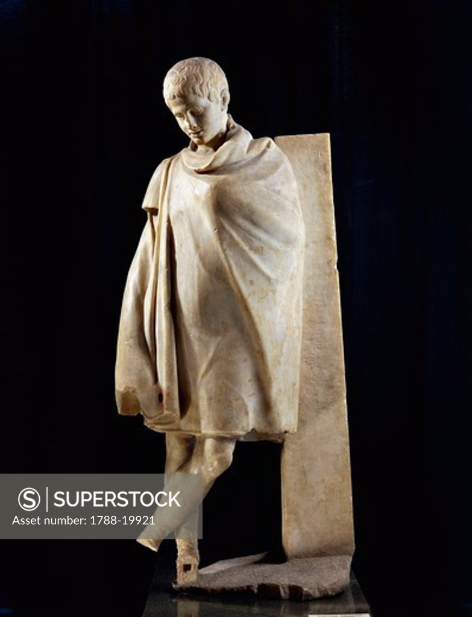
Euripides Alcestis
Adam Rappold, Ph.D.
Brock University
arappold@brocku.ca
[addressing the skene]
House of Admetus! Where “I” deigned
To put up with the Thete’s table… though I am a god.
Zeus was at fault – since he killed my child
Asclepius, throwing a thunderbolt into his chest.
Ὦ δώματ᾽ Ἀδμήτει᾽, ἐν οἷς ἔτλην ἐγὼ
θῆσσαν τράπεζαν αἰνέσαι θεός περ ὤν.
Ζεὺς γὰρ κατακτὰς παῖδα τὸν ἐμὸν αἴτιος
Ἀσκληπιόν, στέρνοισιν ἐμβαλὼν φλόγα

Slide 30
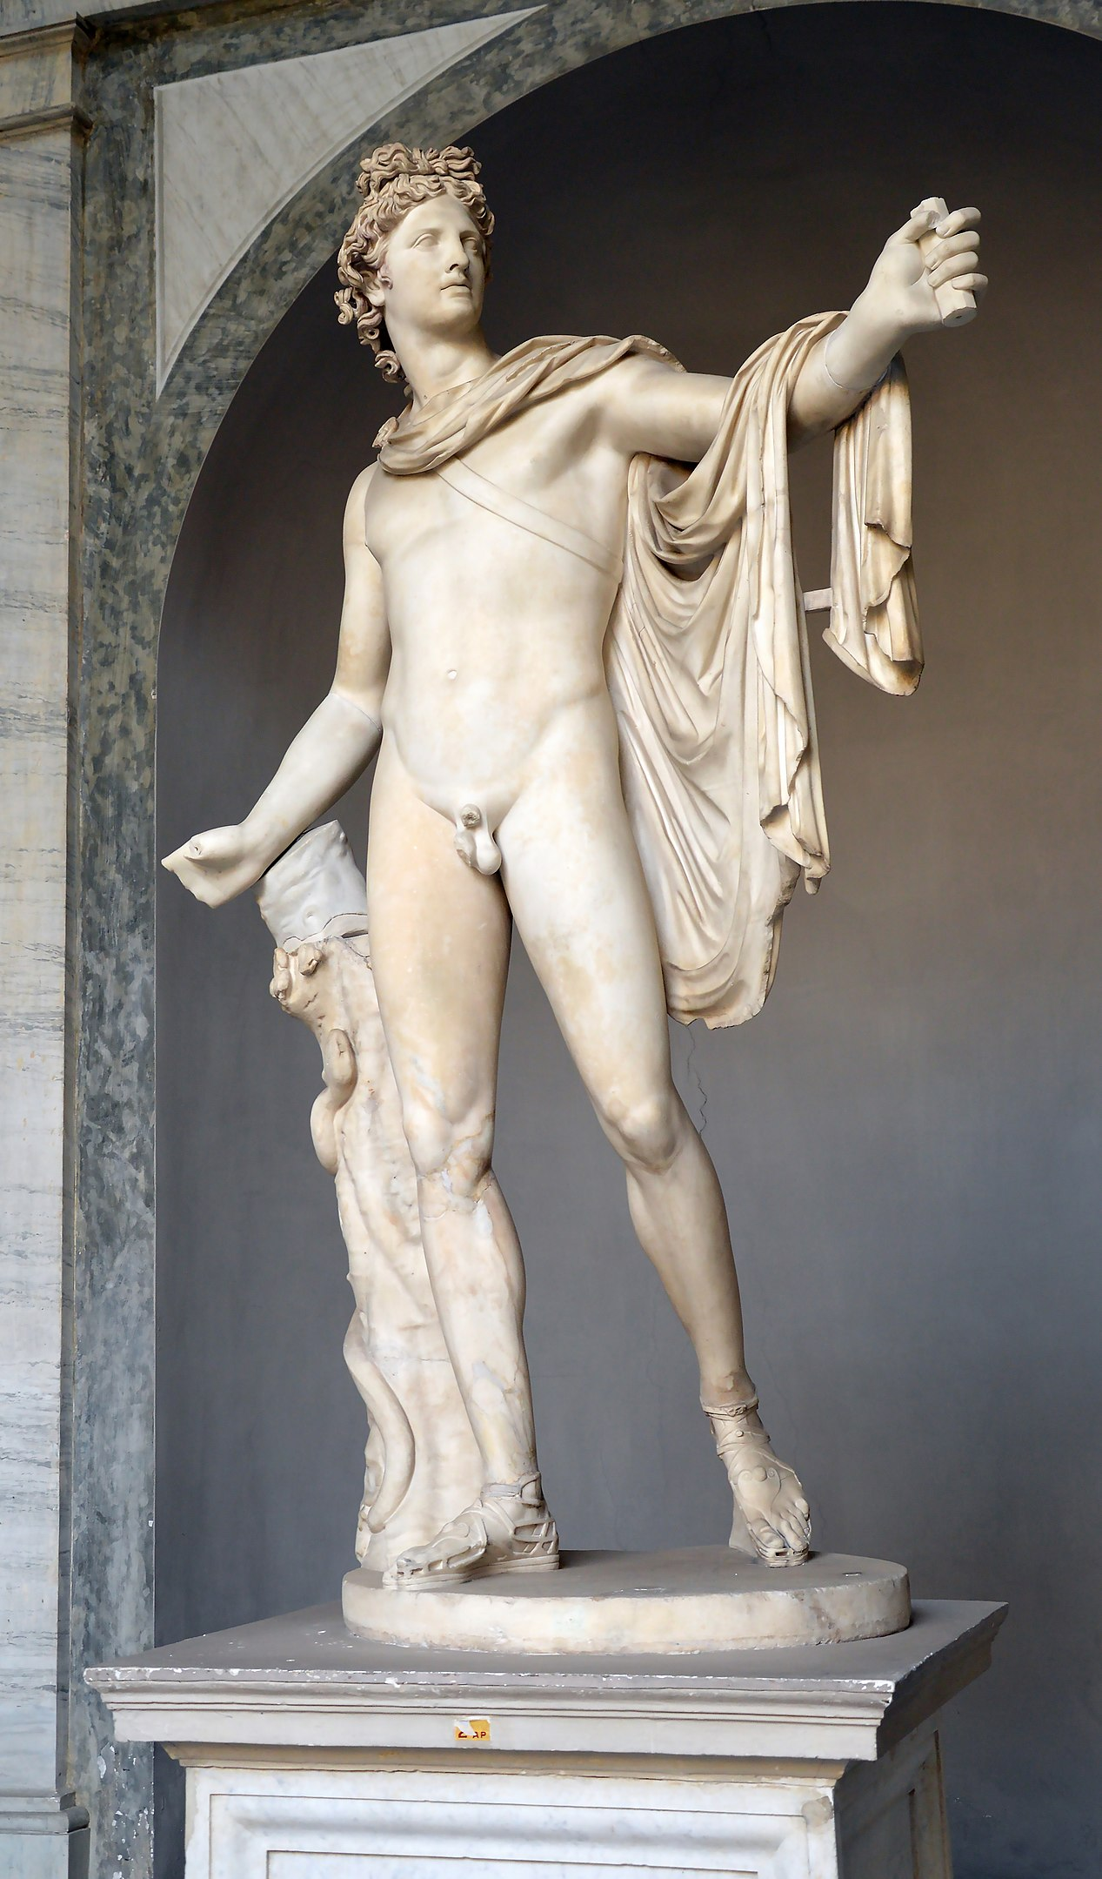
Euripides Alcestis
Adam Rappold, Ph.D.
Brock University
arappold@brocku.ca
I came to this land and served as herdsman to my host, and I have kept this house safe from harm to this hour. [10] I am myself godly, and in Admetus, son of Pheres, I found a godly man. And so I rescued him from death by tricking the Fates. These goddesses promised me that Admetus could escape an immediate death by giving in exchange another corpse to the powers below.
καί με θητεύειν πατὴρ
θνητῷ παρ᾽ ἀνδρὶ τῶνδ᾽ ἄποιν᾽ ἠνάγκασεν.
ἐλθὼν δὲ γαῖαν τήνδ᾽ ἐβουφόρβουν ξένῳ,
καὶ τόνδ᾽ ἔσῳζον οἶκον ἐς τόδ᾽ ἡμέρας.
10ὁσίου γὰρ ἀνδρὸς ὅσιος ὢν ἐτύγχανον
παιδὸς Φέρητος, ὃν θανεῖν ἐρρυσάμην,

Slide 31
Euripides Alcestis
Scenes from the myth of Admetus and Alcestis. Marble, sarcophagus of C. Junius Euhodus and Metilia Acte, 161–170 CE.

Slide 32
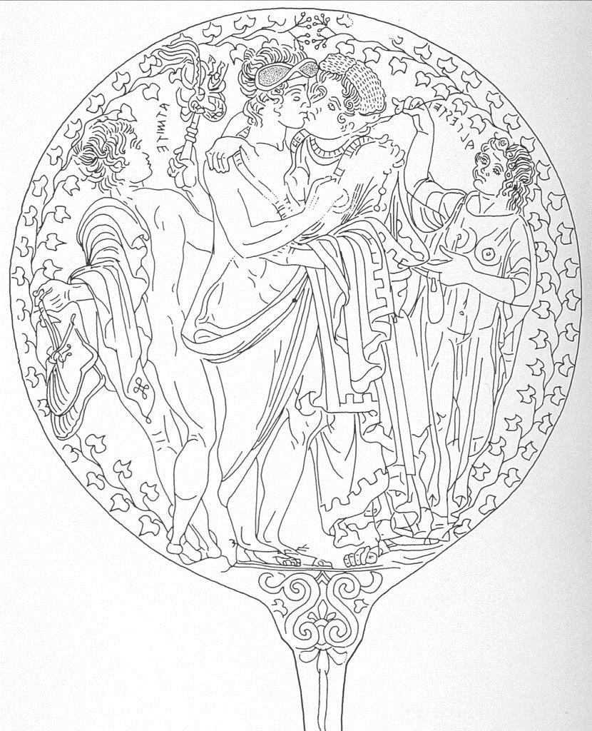
Euripides Alcestis
Atmite, Alcestei, and two attendants. Etruscan mirror from Civita Castellana (Falerii). 350 BC. New York, Metropolitan Museum of Art (CSE USA 3.6).

Slide 33
Euripides Alcestis
Farewell of Admetus and Alcestis
Drawing by George Dennis
Etruscan original c. 350 BCE

Slide 34
Euripides Alcestis
Admetus, Alcestis, and winged Charu, ca. 330 BC. Red figure skyphos. Boston Museum of Fine Arts (Museum photo).

Slide 35
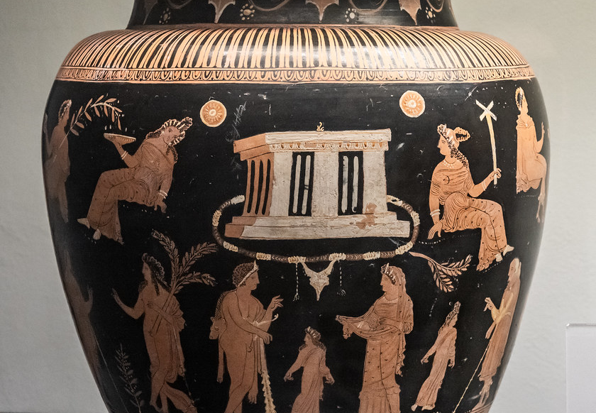
Title: Terracotta bell-krater (mixing bowl)
Attributed to the Sarpedon Painter
Date: ca. 400–380 B.C.
Euripides Alcestis

