Slide 1
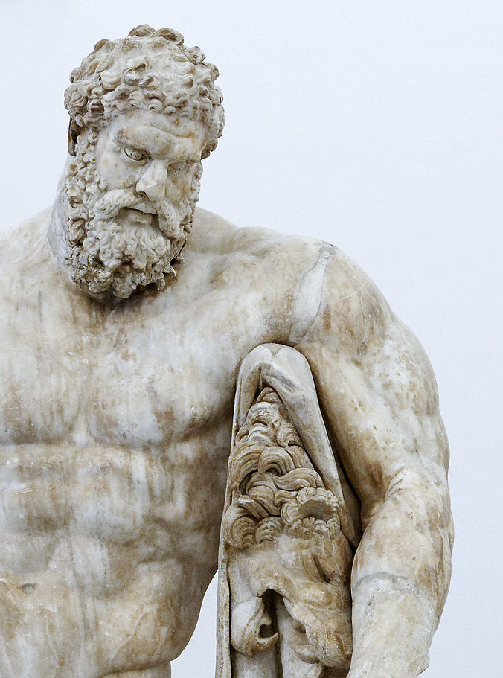
Why is the Wild Lion Still and Silent?
The Conceptual Metaphor of Thumos as a Lion in Herakles 1210-1211
Rebekah Rust
New York University
CAMWS Greek Drama: Euripides - March 24, 2022
Farnese Herakles, c. 216 AD
Museo Archeologico Nazionale, Naples

Slide 2
Herakles, 1202-1213
ὦ τέκνον,
πάρες ἀπ' ὀμμάτων πέπλον, ἀπόδικε, ῥέθος
ἀελίῳ δεῖξον.
βάρος ἀντίπαλον δακρύοις συναμιλλᾶται·
ἱκτεύομεν ἀμφὶ γενειάδα καὶ
γόνυ καὶ χέρα σὰν προπίτνων, πολιὸν
δάκρυον ἐκβάλλων· ἰὼ παῖ, κατά-
σχεθε λέοντος ἀγρίου θυμόν, ᾧ
δρόμον ἐπὶ φόνιον ἀνόσιον ἐξάγῃ
κακὰ θέλων κακοῖς συνάψαι, τέκνον.
My son,
slip off that veil from your eyes,
throw it down, show your face to the sun!
The weight of my body struggles with my tears:
I fall clutching your knees, your hands, your chin,
weeping an old man’s tears, begging you:
My son! Hold back the wild lion’s spirit,
the spirit by which you are carried on a course,
full of gore and unholy horror,
hoping to join new griefs with old…my son.

Slide 3
Previous Interpretations
Barlow (1996), p. 175:
“the lion image denotes extreme fierceness and bloodthirsty frenzy…”
Papadopoulou (2005), p. 159:
“The lion image used to describe Heracles’ inflexible character (1211)
encapsulates the problem that Theseus faces in trying to dissuade his friend from suicide.”
Bond (1988), pp. 372-3:
“Heracles the victor over the θυμολέων has been making loud animal noises
which have proclaimed the onset of madness.”

Slide 4
Conceptual Metaphor Theory
Source Domain
Target Domain
Blended Domain

Slide 5
Conceptual Metaphor Theory
Source Domain
Target Domain
Blended Domain
Hot Liquid
Anger
“His blood is boiling.”
“He is seething with rage.”
“You’re just adding fuel to the fire.”
“Simmer down!”

Slide 6
Thumos Is A Lion
A Conceptual Metaphor
Tyrtaeus fr. 13
ἀίθωνος δὲ λέοντος ἔχων ἐν στήθεσι θυμόν
“with a tawny lion’s spirit in his breast”
Pindar Isthmian 4.45-47
…τόλμᾳ γὰρ εἰκὼς
θυμὸν ἐριβρεμετᾶν θηρῶν λεόντων
ἐν πόνῳ, μῆτιν δ᾽ ἀλώπηξ…
“…for in daring he resembled the courage
of loud-roaring lions in toil,
but in cunning he resembles the fox…”
Aeschylus, Seven 53-54
σιδηρόφρων γὰρ θυμὸς ἀνδρείᾳ φλέγων
ἔπνει, λεόντων ὡς Ἄρη δεδορκότων
“Their iron-hearted spirit blew
blazing with courage, as of fierce-eyed lions

Slide 7
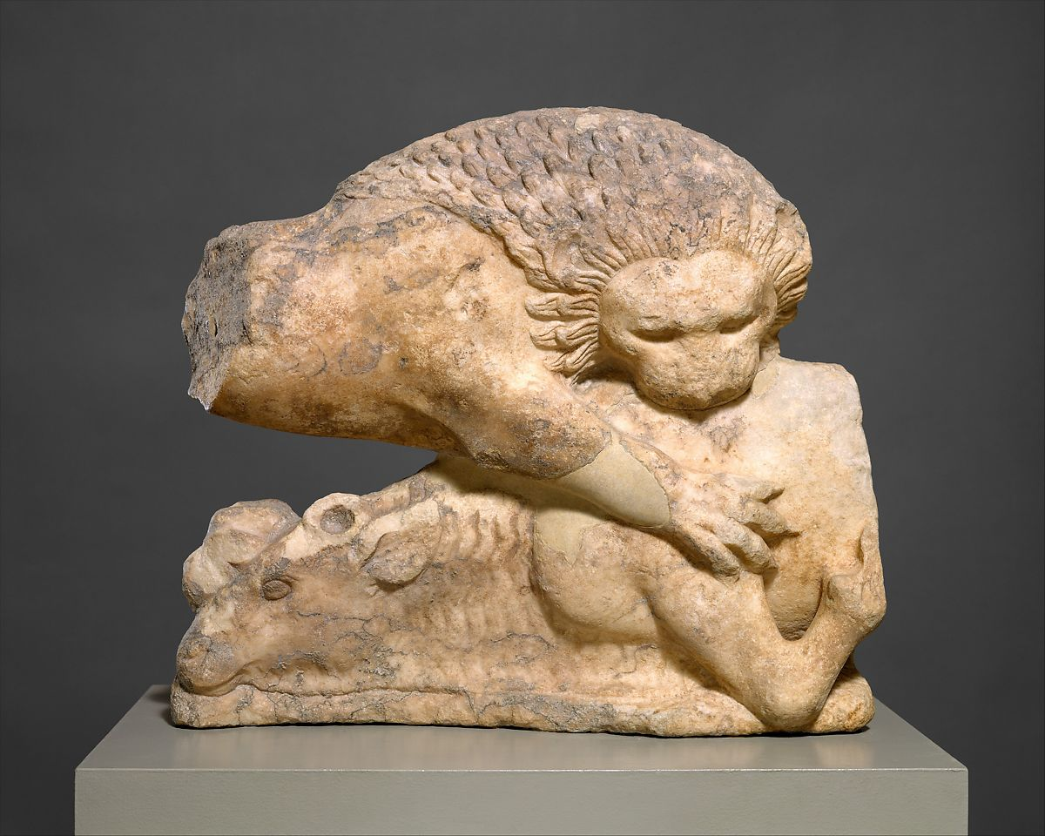
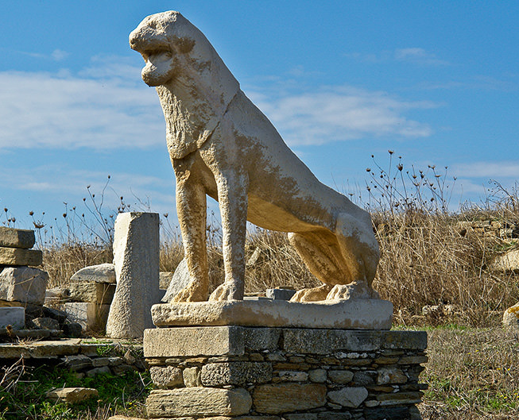
Thumos Is A Lion
The Two Paradigms
Iliadic Lion - The Hunter
Odyssean Lion - The Protector
Lion felling a bull, ca. 525-500 BC, MET Museum
Terrace of Lions, Delos, ca. 600 BC

Slide 8
Thumos Is A Lion
The Iliadic Paradigm
Clarke (1995), p. 147:
“the lion stands for the warrior’s most violent and warlike mood – in other words, for his state of mind when he behaves in the way that defines him as a hero.”
Clarke (1995), p. 150:
Achilles “has the strength and power that characterize the hero, but lacks the circumspection and restraint that should make a mortal man aware of his limitations.”

Slide 9
Thumos Is A Lion
The Iliadic Paradigm
Clarke (1995), p. 147:
“the lion stands for the warrior’s most violent and warlike mood – in other words, for his state of mind when he behaves in the way that defines him as a hero.”
Clarke (1995), p. 150:
Achilles “has the strength and power that characterize the hero, but lacks the circumspection and restraint that should make a mortal man aware of his limitations.”
e.g. Sarpedon crosses the stockade like a lion whose θυμός orders him to snatch a sheep from the flock (κέλεται δέ ἑ θυμὸς ἀγήνωρ, 12.300).
e.g. Apollo describes Achilles as a lion whose βίη and θυμός compel him to attack the flocks of men (λέων δ᾽ ὣς ἄγρια οἶδεν, / ὅς τ᾽ ἐπεὶ ἂρ μεγάλῃ τε βίῃ καὶ ἀγήνορι θυμῷ, 24.41-42).

Slide 10
Herakles, 1202-1213
ὦ τέκνον,
πάρες ἀπ' ὀμμάτων πέπλον, ἀπόδικε, ῥέθος
ἀελίῳ δεῖξον.
βάρος ἀντίπαλον δακρύοις συναμιλλᾶται·
ἱκτεύομεν ἀμφὶ γενειάδα καὶ
γόνυ καὶ χέρα σὰν προπίτνων, πολιὸν
δάκρυον ἐκβάλλων· ἰὼ παῖ, κατά-
σχεθε λέοντος ἀγρίου θυμόν, ᾧ
δρόμον ἐπὶ φόνιον ἀνόσιον ἐξάγῃ
κακὰ θέλων κακοῖς συνάψαι, τέκνον.
My son,
slip off that veil from your eyes,
throw it down, show your face to the sun!
The weight of my body struggles with my tears:
I fall clutching your knees, your hands, your chin,
weeping an old man’s tears, begging you:
My son! Hold back the wild lion’s spirit,
the spirit by which you are carried on a course,
full of gore and unholy horror,
hoping to join new griefs with old…my son.

Slide 11
Herakles, 1202-1213
ὦ τέκνον,
πάρες ἀπ' ὀμμάτων πέπλον, ἀπόδικε, ῥέθος
ἀελίῳ δεῖξον.
βάρος ἀντίπαλον δακρύοις συναμιλλᾶται·
ἱκτεύομεν ἀμφὶ γενειάδα καὶ
γόνυ καὶ χέρα σὰν προπίτνων, πολιὸν
δάκρυον ἐκβάλλων· ἰὼ παῖ, κατά-
σχεθε λέοντος ἀγρίου θυμόν, ᾧ
δρόμον ἐπὶ φόνιον ἀνόσιον ἐξάγῃ
κακὰ θέλων κακοῖς συνάψαι, τέκνον.
My son,
slip off that veil from your eyes,
throw it down, show your face to the sun!
The weight of my body struggles with my tears:
I fall clutching your knees, your hands, your chin,
weeping an old man’s tears, begging you:
My son! Hold back the wild lion’s spirit,
the spirit by which you are carried on a course,
full of gore and unholy horror,
hoping to join new griefs with old…my son.
Herakles, 1199-1202:
Th: τί γὰρ πέπλοισιν ἄθλιον κρύπτει κάρα;
A: αἰδόμενος τὸ σὸν ὄμμα καὶ φιλίαν ὁμόφυλον
αἷμά τε παιδοφόνον.
Th: ἀλλ᾽, εἰ συναλγῶν γ᾽ ἦλθον, ἐκκάλυπτέ νιν.
Th: But why does he cover his head with his garments?
A: Out of proper respect for your face and your kindred friendship and the blood of his slain children
Th: But what if I have come to share in his pain? Unveil him!

Slide 12
Thumos Is A Lion
The Odyssean Paradigm
Odyssey 4.787-93:
ἡ δ᾽ ὑπερωίῳ αὖθι περίφρων Πηνελόπεια
κεῖτ᾽ ἄρ᾽ ἄσιτος, ἄπαστος ἐδητύος ἠδὲ ποτῆτος,
ὁρμαίνουσ᾽ ἤ οἱ θάνατον φύγοι υἱὸς ἀμύμων,
ἦ ὅ γ᾽ ὑπὸ μνηστῆρσιν ὑπερφιάλοισι δαμείη.
ὅσσα δὲ μερμήριξε λέων ἀνδρῶν ἐν ὁμίλῳ
δείσας, ὁππότε μιν δόλιον περὶ κύκλον ἄγωσι,
τόσσα μιν ὁρμαίνουσαν ἐπήλυθε νήδυμος ὕπνος:
But she, the circumspect Penelope, lay there in her upper room, without bread, without porridge, without meat, without drink,
turning over in her mind whether her excellent son would escape death, or be struck down by the arrogant suitors. And just as a fear-stricken lion broods among a throng of men,
when they draw their crafty ring about her,
so was she tossing and turning when sweet sleep came upon her.

Slide 13
Thumos Is A Lion
The Odyssean Paradigm
Odyssey 4.787-93:
ἡ δ᾽ ὑπερωίῳ αὖθι περίφρων Πηνελόπεια
κεῖτ᾽ ἄρ᾽ ἄσιτος, ἄπαστος ἐδητύος ἠδὲ ποτῆτος,
ὁρμαίνουσ᾽ ἤ οἱ θάνατον φύγοι υἱὸς ἀμύμων,
ἦ ὅ γ᾽ ὑπὸ μνηστῆρσιν ὑπερφιάλοισι δαμείη.
ὅσσα δὲ μερμήριξε λέων ἀνδρῶν ἐν ὁμίλῳ
δείσας, ὁππότε μιν δόλιον περὶ κύκλον ἄγωσι,
τόσσα μιν ὁρμαίνουσαν ἐπήλυθε νήδυμος ὕπνος:
But she, the circumspect Penelope, lay there in her upper room, without bread, without porridge, without meat, without drink,
turning over in her mind whether her excellent son would escape death, or be struck down by the arrogant suitors. And just as a fear-stricken lion broods among a throng of men,
when they draw their crafty ring about her,
so was she tossing and turning when sweet sleep came upon her.
Odyssey 16.73 (Telemachus speaking):
μητρὶ δ᾽ ἐμῇ δίχα θυμὸς ἐνὶ φρεσὶ μερμηρίζει
“θυμός is divided in her and ponders two ways”
Odyssey19.524 (Penelope speaking):
ὣς καὶ ἐμοὶ δίχα θυμὸς ὀρώρεται ἔνθα καὶ ἔνθα,.
“My θυμός is divided and starts one way then another”

Slide 14
Thumos Is A Lion
The Odyssean Paradigm
Pache (2016), p. 10:
Her “language echoes Telemachos’ (δίχα θυμός) and the verb (ὄρνυμι) used here connects her back to the lion of the simile in 4.789 and 4.791.”
Pache (2016), p. 8:
“μερμηρίζω in Homer is never used to describe physical movement, and so the verb used here to describe the lion explicitly refers to a mental process.”

Slide 15
Thumos Is A Lion
The Odyssean Paradigm
Odyssey 4.787-93:
ἡ δ᾽ ὑπερωίῳ αὖθι περίφρων Πηνελόπεια
κεῖτ᾽ ἄρ᾽ ἄσιτος, ἄπαστος ἐδητύος ἠδὲ ποτῆτος,
ὁρμαίνουσ᾽ ἤ οἱ θάνατον φύγοι υἱὸς ἀμύμων,
ἦ ὅ γ᾽ ὑπὸ μνηστῆρσιν ὑπερφιάλοισι δαμείη.
ὅσσα δὲ μερμήριξε λέων ἀνδρῶν ἐν ὁμίλῳ
δείσας, ὁππότε μιν δόλιον περὶ κύκλον ἄγωσι,
τόσσα μιν ὁρμαίνουσαν ἐπήλυθε νήδυμος ὕπνος:
But she, the circumspect Penelope, lay there in her upper room, without bread, without porridge, without meat, without drink,
turning over in her mind whether her excellent son would escape death, or be struck down by the arrogant suitors. And just as a fear-stricken lion broods among a throng of men,
when they draw their crafty ring about her,
so was she tossing and turning when sweet sleep came upon her.
Odyssey 16.73 (Telemachus speaking):
μητρὶ δ᾽ ἐμῇ δίχα θυμὸς ἐνὶ φρεσὶ μερμηρίζει
“θυμός is divided in her and ponders two ways”
Odyssey19.524 (Penelope speaking):
ὣς καὶ ἐμοὶ δίχα θυμὸς ὀρώρεται ἔνθα καὶ ἔνθα,.
“My θυμός is divided and starts one way then another”

Slide 16
Thumos Is A Lion
The Odyssean Paradigm
Odyssey 22.401-06:
εὗρεν ἔπειτ᾽ Ὀδυσῆα μετὰ κταμένοισι νέκυσσιν,
αἵματι καὶ λύθρῳ πεπαλαγμένον ὥστε λέοντα,
ὅς ῥά τε βεβρωκὼς βοὸς ἔρχεται ἀγραύλοιο:
πᾶν δ᾽ ἄρα οἱ στῆθός τε παρήϊά τ᾽ ἀμφοτέρωθεν
αἱματόεντα πέλει, δεινὸς δ᾽ εἰς ὦπα ἰδέσθαι:
ὣς Ὀδυσεὺς πεπάλακτο πόδας καὶ χεῖρας ὕπερθεν.
There she [Eurykleia] found Odysseus amid the cut-down corpses, polluted with blood and gore, like a lion who comes from feeding on an ox at the nearby farm, and his breast and cheeks, all over on both sides are stained with blood, and he is terrible to look upon; even so was Odysseus stained, his feet and his hands above.

Slide 17
Thumos Is A Lion
The Odyssean Paradigm
Odyssey 22.401-06:
εὗρεν ἔπειτ᾽ Ὀδυσῆα μετὰ κταμένοισι νέκυσσιν,
αἵματι καὶ λύθρῳ πεπαλαγμένον ὥστε λέοντα,
ὅς ῥά τε βεβρωκὼς βοὸς ἔρχεται ἀγραύλοιο:
πᾶν δ᾽ ἄρα οἱ στῆθός τε παρήϊά τ᾽ ἀμφοτέρωθεν
αἱματόεντα πέλει, δεινὸς δ᾽ εἰς ὦπα ἰδέσθαι:
ὣς Ὀδυσεὺς πεπάλακτο πόδας καὶ χεῖρας ὕπερθεν.
There she [Eurykleia] found Odysseus amid the cut-down corpses, polluted with blood and gore, like a lion who comes from feeding on an ox at the nearby farm, and his breast and cheeks, all over on both sides are stained with blood, and he is terrible to look upon; even so was Odysseus stained, his feet and his hands above.
Odyssey 20.5-6:
ἔνθ᾽ Ὀδυσεὺς μνηστῆρσι κακὰ φρονέων ἐνὶ θυμῷ
κεῖτ᾽ ἐγρηγορόων…
There Odysseus lay awake, sleepless,
pondering evils for the suitors in his θυμός…
Odyssey 20.9-10:
τοῦ δ᾽ ὠρίνετο θυμὸς ἐνὶ στήθεσσι φίλοισι:
πολλὰ δὲ μερμήριζε κατὰ φρένα καὶ κατὰ θυμόν,
“In his breast his θυμός was stirred
and he pondered through many things
in his mind and θυμός

Slide 18
Thumos Is A Lion
Conceptual Metaphor Overview
What the metaphor and these paradigms in particular convey :
•How the θυμός is a powerful motivating source for honor and self-preservation
•How the θυμός is a mechanism of internal deliberation
•How the θυμός is a mechanism and source for endurance and courage

Slide 19
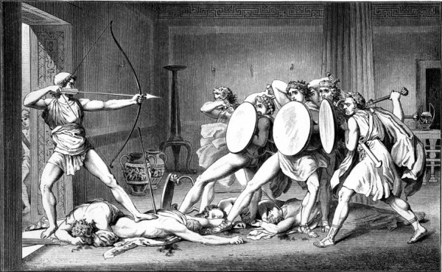
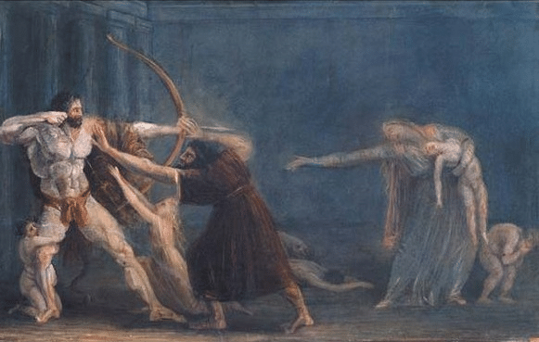
Herakles and Odysseus
General Similarities
Odysseus
Herakles
Odysseus kills the suitors by Gustav Benjamin Schwab 1882
Hercules firing his arrows at his children by Antonio Canova De Agostini 1799

Slide 20
Herakles and Odysseus
Odysseus as Model for Thumos
Odyssey 22.411-412:
ἐν θυμῷ, γρηῦ, χαῖρε καὶ ἴσχεο μηδ᾽ ὀλόλυζε:
οὐχ ὁσίη κταμένοισιν ἐπ᾽ ἀνδράσιν εὐχετάασθαι,
“Rejoice in your θυμός, old woman, restrain yourself,
and don’t shout: it is not right to boast over slain men”

Slide 21
Herakles and Odysseus
Odysseus as Model for Thumos
Herakles, 1347-52:
ἐσκεψάμην δὲ καίπερ ἐν κακοῖσιν ὤν,
μὴ δειλίαν ὄφλω τιν᾽ ἐκλιπὼν φάος:
ταῖς συμφοραῖς γὰρ ὅστις οὐχ ὑφίσταται,
οὐδ᾽ ἀνδρὸς ἂν δύναιθ᾽ ὑποστῆναι βέλος.
ἐγκαρτερήσω βίοτον: εἶμι δ᾽ ἐς πόλιν
τὴν σήν, χάριν τε μυρίων δώρων ἔχω.
But I, though mired in troubles, think
that I may not deserve such cowardice in dying:
he who does not withstand misfortunes could not withstand a man’s arrow. I shall persevere
in such a life: I will go to your city and I now give thanks for your countless gifts.
Herakles, 1190:
ἐμὸς ἐμὸς ὅδε γόνος ὁ πολύπονος…
This is my, my much-suffering son…
Herakles, 1250:
ὁ πολλὰ δὴ τλὰς Ἡρακλῆς λέγει τάδε;
Does the much-enduring Herakles
say these things?

Slide 22
Herakles, 1202-1213
ὦ τέκνον,
πάρες ἀπ' ὀμμάτων πέπλον, ἀπόδικε, ῥέθος
ἀελίῳ δεῖξον.
βάρος ἀντίπαλον δακρύοις συναμιλλᾶται·
ἱκτεύομεν ἀμφὶ γενειάδα καὶ
γόνυ καὶ χέρα σὰν προπίτνων, πολιὸν
δάκρυον ἐκβάλλων· ἰὼ παῖ, κατά-
σχεθε λέοντος ἀγρίου θυμόν, ᾧ
δρόμον ἐπὶ φόνιον ἀνόσιον ἐξάγῃ
κακὰ θέλων κακοῖς συνάψαι, τέκνον.
My son,
slip off that veil from your eyes,
throw it down, show your face to the sun!
The weight of my body struggles with my tears:
I fall clutching your knees, your hands, your chin,
weeping an old man’s tears, begging you:
My son! Hold back the wild lion’s spirit,
the spirit by which you are carried on a course,
full of gore and unholy horror,
hoping to join new griefs with old…my son.

Slide 23
Cited Sources
Barlow, S. 1996. Euripides: Heracles. Aris & Phillips: Warminster.
Bond, J. 1988 Euripides: Heracles. Oxford: Clarendon Press.
Papadopoulou, T. 2005. Heracles and Euripidean Tragedy. Cambridge: Cambridge Univ. Press.
Clarke, M. J. 1995. “Between Lions and Men: Images of the Hero in the Iliad” in Greek, Roman, and Byzantine Studies, Vol. 36, No. 2, pp. 137-159.
Pache, C. 2016. “Mourning Lions and Penelope’s Revenge” in Arethusa Vol. 49, No. 1, pp. 1-24.
Images
Farnese Herakles: https://en.wikipedia.org/wiki/Farnese_Hercules#/media/File:Herakles_Farnese_MAN_Napoli_Inv6001_n01.jpg
Lion eating bull: https://www.metmuseum.org/art/collection/search/254478
Delian lion: https://www.worldhistory.org/uploads/images/929.jpg?v=1646322303
Schwab print: https://commons.wikimedia.org/wiki/File:Odysseus_from_Schwab_book_1.jpg
Canova painting: https://www.art-n-literature.com/hercules-firing-arrows-at-his-children
Achilles: https://www.bmimages.com/preview.asp?image=01613192781&itemw=4&itemf=0001&itemstep=1&itemx=2
Boxer at Rest: https://en.wikipedia.org/wiki/Boxer_at_Rest#/media/File:Boxer_of_Quirinal_(Mys_from_Taranto)_-_Lateral_View.jpg

Slide 24
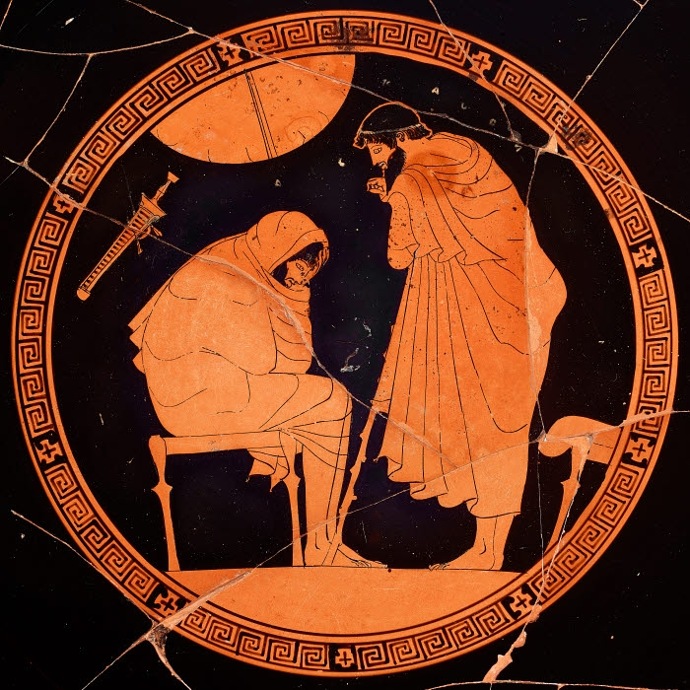
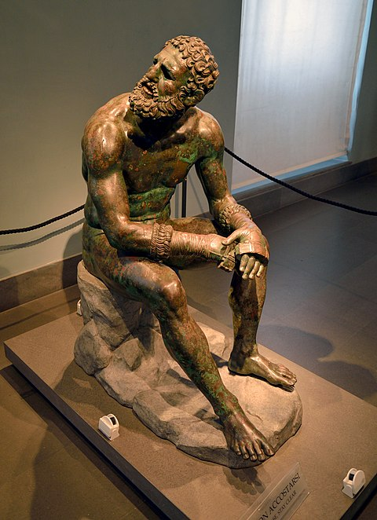
Herakles’ Thumos as a Lion
Mood Board for Staging
Weary Herakles
Achilles Veiled in Grief
Bloody Boxer at Rest

Slide 25
Herakles and Odysseus
Herakles and Theseus Exhibit A Distributed Thumos
Herakles, 1401-04:
H: παίδων στερηθεὶς παῖδ᾽ ὅπως ἔχω σ᾽ ἐμόν.
Th: δίδου δέρῃ σὴν χεῖρ᾽, ὁδηγήσω δ᾽ ἐγώ.
H: ζεῦγός γε φίλιον: ἅτερος δὲ δυστυχής.
ὦ πρέσβυ, τοιόνδ᾽ ἄνδρα χρὴ κτᾶσθαι φίλον.
H: Having lost my sons, I consider you my son.
Th: Put your arm around my neck, and I will guide you.
H: A true yoke of friendship: and one in ruin.
My father, such is the man one ought to have as a friend

