Slide 1
Murder Most Classic: The Influence of Classical Studies on Golden Age Detective Fiction
CAMWS 2022 kkitchell@umass.edu

Slide 2
Notes:
Detection Club meeting 1932

Slide 3
The detection club’s Group written books

Slide 4
W.H. Smith & Son

Slide 5
Chapter XLV.—The Open Graves.—The Dead Bodies.—A Scene of Terror
Chapter LVIII.—The Arrival of Jack Pringle.—Midnight and The Vampyre.—The Mysterious Hat
Chapter LXXX.—The Discovery of the Body of Marchdale in the Ruins by the Mob.—The Burning of the Corpse.—The Murder of the Hangman.
Chapter XLV.—The Open Graves.—The Dead Bodies.—A Scene of Terror

Slide 6
“Come, then,” said Dick, gripping his sword. “You have been false to your word and false to your king; this shall end it once for all!”
“I am with you, “replied Sir Robert, pale but undaunted.”

Slide 7
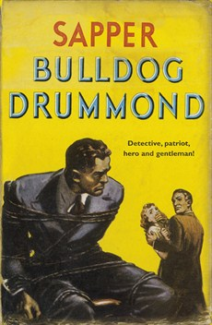

Slide 8
Dorothy Sayers and Eric the Skull

Slide 9
Oath of the Detection Club
Do you promise that your detectives shall well and truly detect the crimes presented to them using those wits which it may please you to bestow upon them and not placing reliance on nor making use of Divine Revelation Feminine Intuition Mumbo-Jumbo Jiggery-Pokery Coincidence or the Act of God? I do.
Do you solemnly swear never to conceal a vital clue from the reader? I do.
Do you promise to observe a seemly moderation in the use of Gangs, Conspiracies, Death-Rays Ghosts, Hypnotism, Trap-Doors, Chinamen, Super-Criminals,and Lunatics; and utterly and forever to forswear Mysterious Poisons unknown to Science? I do.
Will you honour the King’s English? I will.

Slide 10
Oath of the Detection Club --- The consequences!
“If you fail to remember your promises, and break even one of our unwritten laws, may other writers anticipate your plots, may total strangers sue you for libel, may your pages swarm with misprints, and your sales continually diminish.”

Slide 11
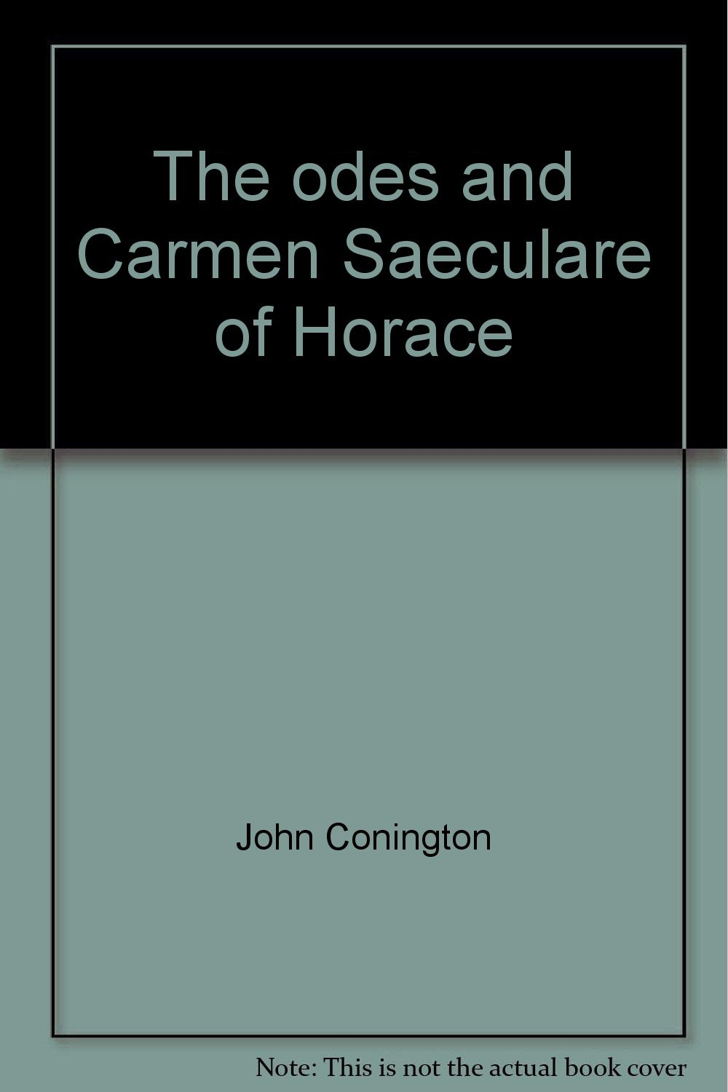
j.j.connington (Alfred W. Stewart)

Slide 12
"At St. Paul's we teach nothing but the classics, nothing but Latin and Greek. If you want your son to learn anything else you must have him taught at home, and for this purpose we give him three half-holidays a week.“
John Sleath
Headmaster 1814-1837

Slide 13
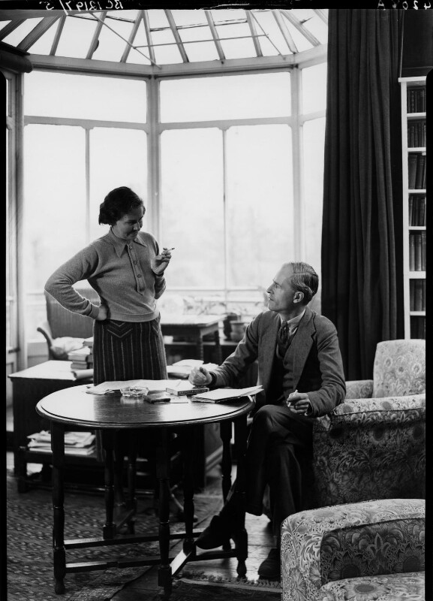
Margaret (Postgate) Cole

Slide 14
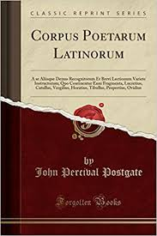
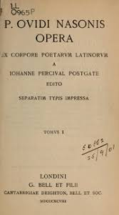
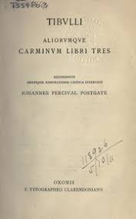
John Percival Postgate

Slide 15
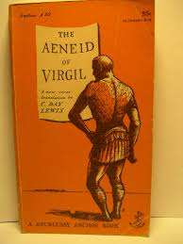
Nicholas Blake

Slide 16
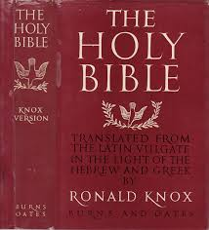
Robert Arbuthnott Knox

Slide 17
From Signa severa 1906 (He as 24 years old)

Slide 18
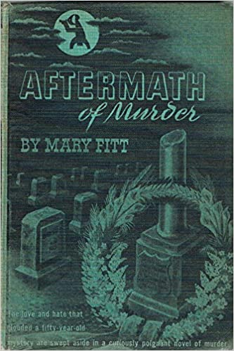
Mary Fitt

Slide 19
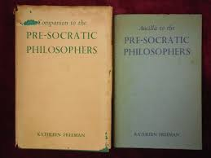
Kathleen Freeman

Slide 20
Freeman’s other works
1926 The Work and Life of Solon, with a translation of his poems,.
1941 It Has All Happened Before: What the Greeks Thought of their Nazis.
1947 The Greek way: an Anthology. Translations from verse and prose.
1948 The Philoctetes of Sophocles, a modern version.
1950 Greek city-states.
1952 God, Man and State. Greek concepts.
1954 The Paths of Justice.
1954 Everyday Things in Ancient Greece.
1954 The Sophists. Translation of Mario Untersteiner, I sofisti,

Slide 21
Dorothy sayers
Ms. Sayers & Eric
First Wimsey Novel

Slide 22
Vergil, Aeneid 3.214-218
Tristius haud illis monstrum nec saevior ulla
pestis et ira deum Stygiis sese extulit undis.
Virginei volucrum vultus foedissima ventris
proluvies uncaeque manus et pallida semper
ora fame….

Slide 23
Marriage proposal
Chapter 4
“One First of April, the question had arrived from Paris in a single Latin sentence, starting off dispiritedly. “Num …?”—a particle which notoriously “expects the answer No.” Harriet, rummaging the Grammar book for “polite negatives,” replied, still more briefly, “Benigne.”
Chapter 13
“Between the married (or about-to-be-married) and the unmarried, Harriet felt herself to be like Aesop’s bat between the birds and beasts.”

Slide 24
Final proposal
“Placetne, magistra?”
“Placet.”

Slide 25
The Incredible elopement……
"ὦ πέπον, εἰ μὲν γὰρ, πόλεμον περὶ τόνδε φυγόντε, αἰεὶ δὴ μέλλοιμεν ἀγήρω τ' ἀθανάτω τε ἔσσεσθ' οὔτε κεν αὐτὸς ἐνὶ πρώτοισι μαχοίμην, οὔτε κέ σε στέλλοιμι μάχην ἐς κυδιάνειραν
Iliad 12.322-32
“The wizard, setting aside his book, gravely accepted the silver penny, turned it magically into six gold pieces and laid the offering on the table. Over the oat-cake and the wine he showed a little hesitation, but at length, murmur[ed]:
"Ergo omnis longo solvit se Teucria luctu“
Aeneid 2.26

