Slide 1
The Miracle of Crossing the Red Sea:
Egyptians, Hebrews, Romans, and (not) knowing how to swim
Karen Eva Carr, Portland State University
Notes:
Thank you for having me! I’m so excited to be here.

Slide 2
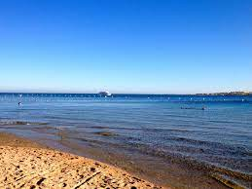
Notes:
The story of the Hebrews’ exodus from Egypt (Exodus 14) culminates in the episode where God parts the waters of the Red Sea so the Hebrews can cross, and then sends a terrible wave to drown the Egyptian soldiers who are chasing them.

Slide 3
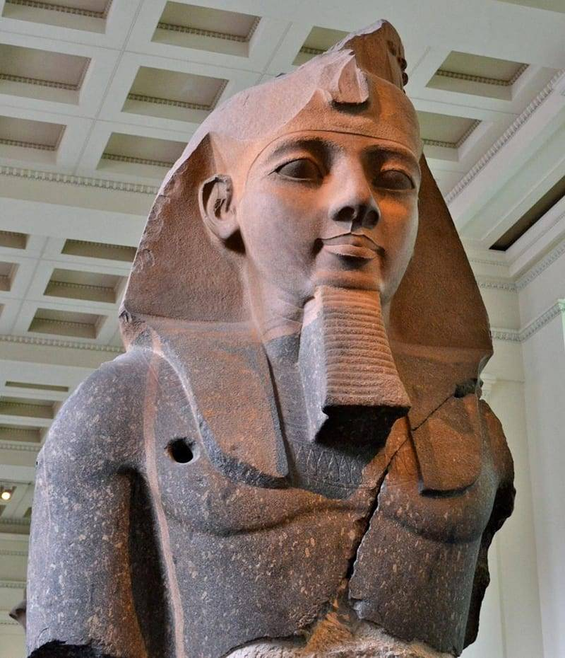
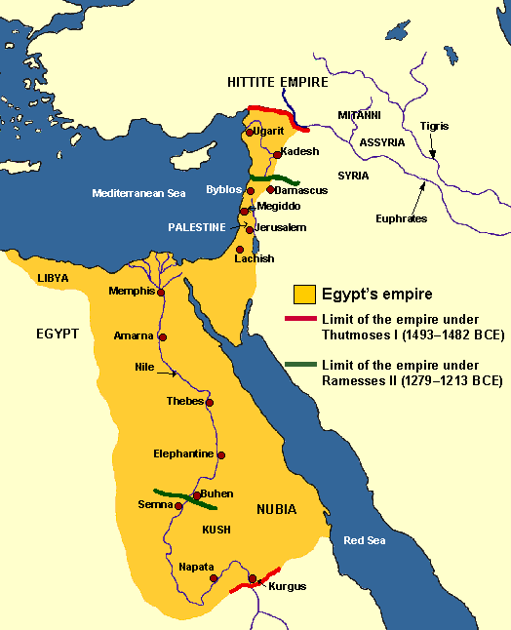
Rameses II (now British Museum) ca. 1250 BC
Notes:
The miracle is set in the Late Bronze Age, when the real Egyptians had colonized the Hebrews’ land, and was probably written down in the Iron Age.

Slide 4
Exodus 14
Then Moses stretched out his hand over the sea, and all that night the Lord drove the sea back with a strong east wind and turned it into dry land. The waters were divided, and the Israelites went through the sea on dry ground, with a wall of water on their right and on their left.
The Egyptians pursued them, and all Pharaoh’s horses and chariots and horsemen followed them into the sea… Then the Lord said to Moses, “Stretch out your hand over the sea so that the waters may flow back over the Egyptians and their chariots and horsemen.”
Moses stretched out his hand over the sea, and at daybreak the sea went back to its place….The water flowed back and covered the chariots and horsemen—the entire army of Pharaoh that had followed the Israelites into the sea. Not one of them survived.

Slide 5
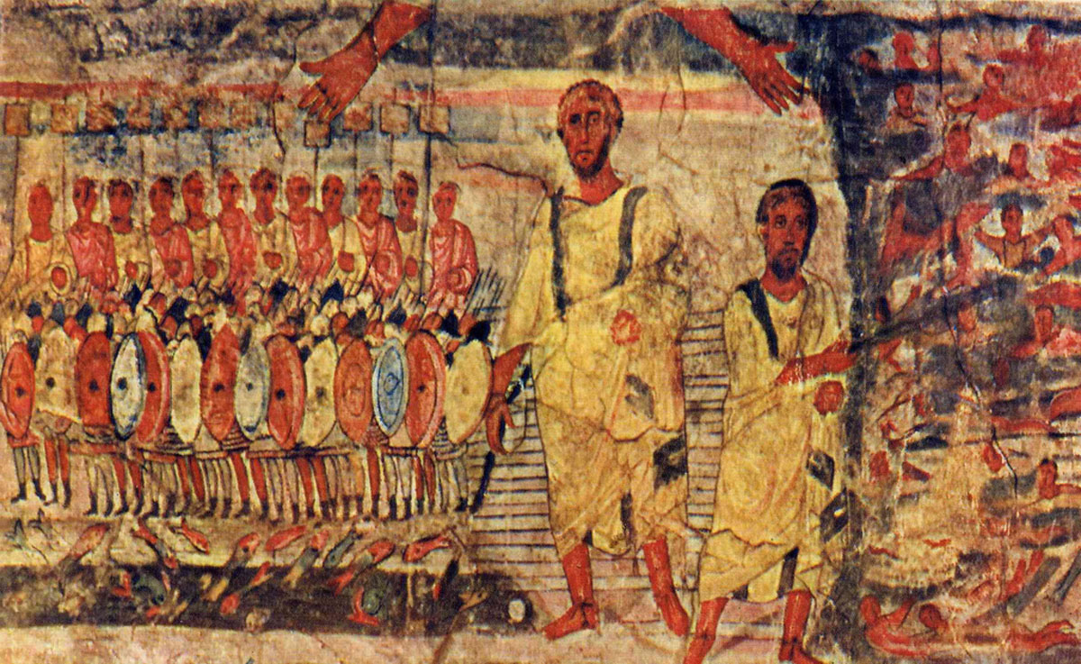
Moses parts the Red Sea and the Egyptians drown: Dura Europos synagogue, 245 AD
Notes:
The story remained popular throughout antiquity: there’s a detailed wall painting of the scene from the synagogue at Dura Europos from 245 AD.

Slide 6
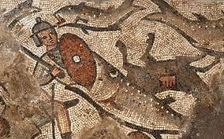
Huqoq mosaic, Galilee, 400s AD: Egyptian soldier drowning
(Jim Haberman/University of North Carolina Chapel Hill)
Notes:
Mosaics of the drowning Egyptian soldiers appear in the late Roman Huqoq synagogue (Magness 2018),

Slide 7
Quran 26:61–63; 10:90–92
And We inspired to Moses, "Travel by night with My servants; indeed, you will be pursued."
So they pursued them at sunrise.
And when the two companies saw one another, the companions of Moses said, "Indeed, we are to be overtaken!"
[Moses] said, "No! Indeed, with me is my Lord; He will guide me."
Then We inspired to Moses, "Strike with your staff the sea," and it parted, and each portion was like a great towering mountain.
And We advanced thereto the pursuers. And We saved Moses and those with him, all together.
Then We drowned the others.
Notes:
and the Quran repeats the story (26:61–63; 10:90–92) a century later. But the miracle of the Jews crossing the Red Sea becomes much more impressive when we add the crucial cultural context that ancient people would have known: that the Egyptians were known as strong swimmers, while the Hebrews were culturally unable to swim and afraid of the water.

Slide 8
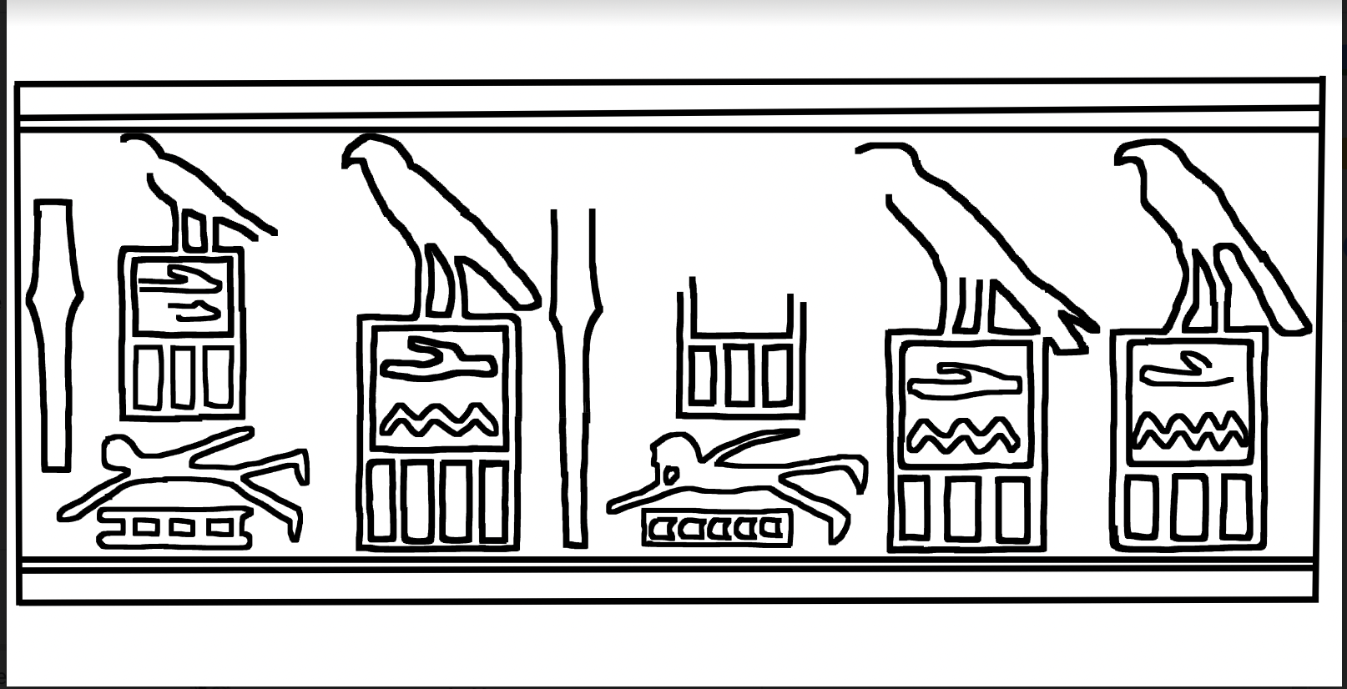
Notes:
The Egyptians left ample evidence of their ability to swim. Egyptian hieroglyphs include one representing the syllable ‘neb’ with a swimmer who uses a strong overhand stroke and a flutter kick, because ‘neb’ is also the ancient Egyptian word for ‘swim’.

Slide 9
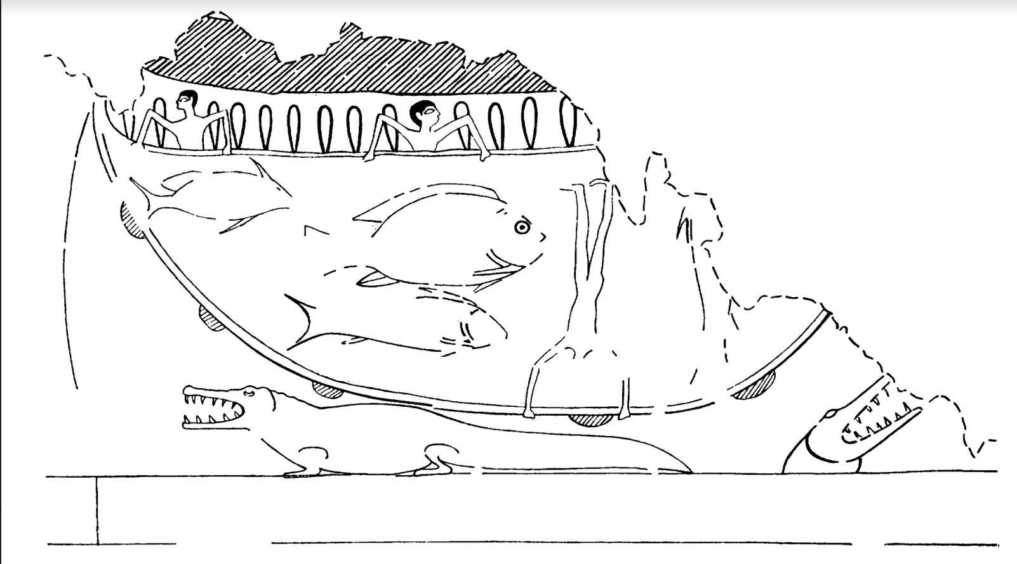
Notes:
In a later Egyptian image, a fisherman dives to the bottom of the river to pull up his net.

Slide 10
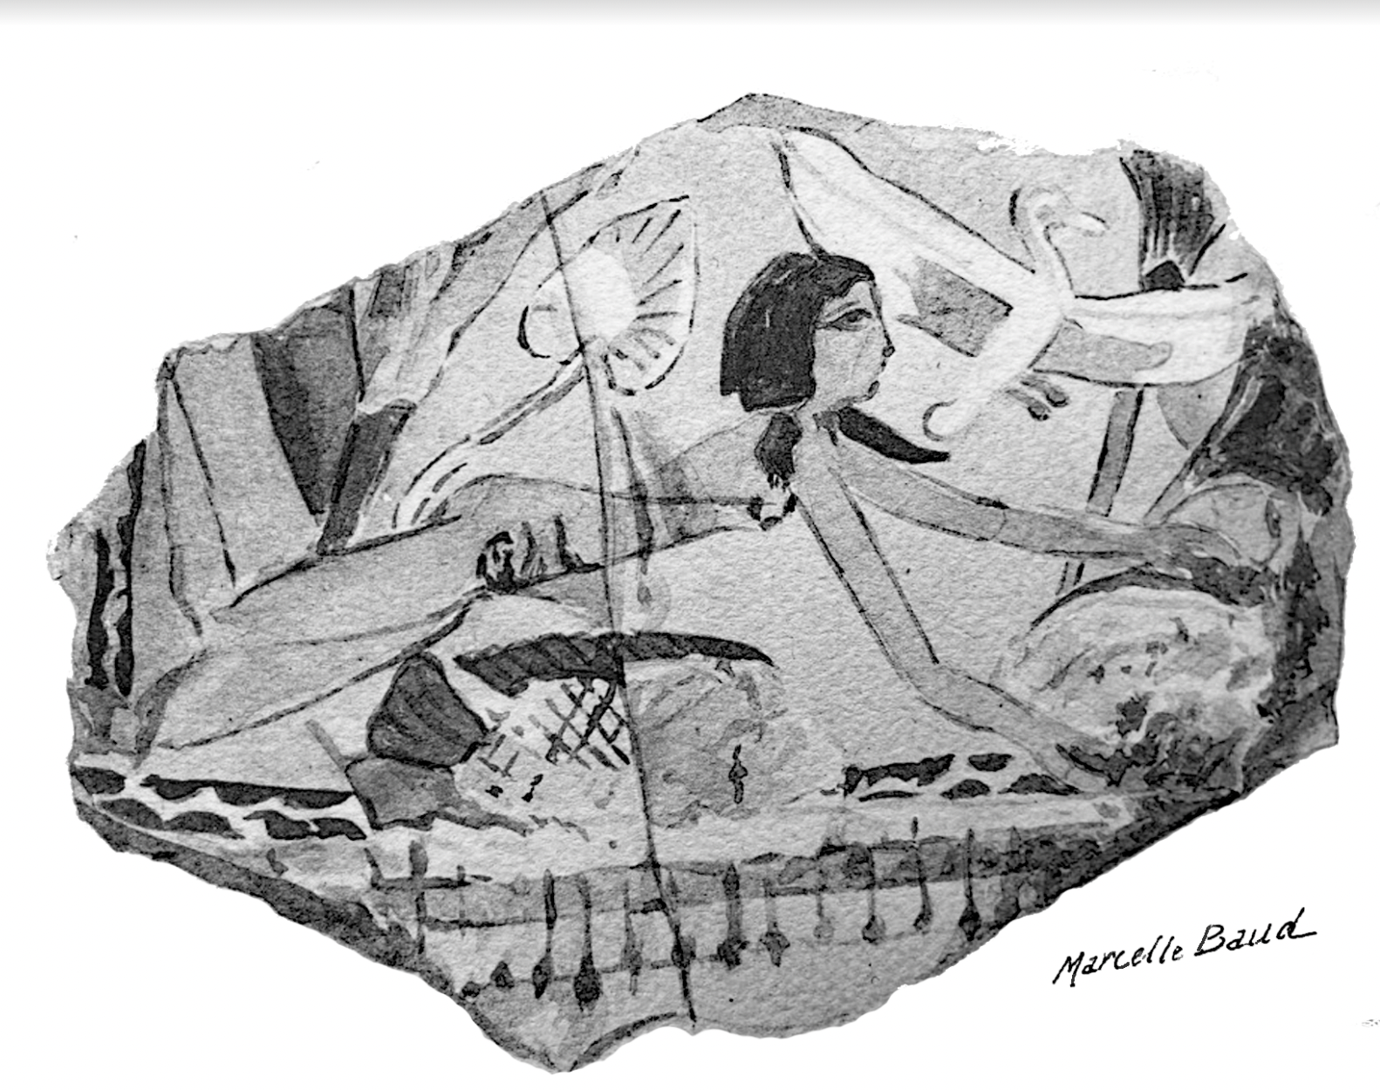
Notes:
In another, a young woman swims among the fish to pluck lotus flowers from a pond.

Slide 11
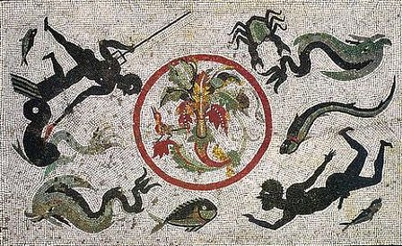
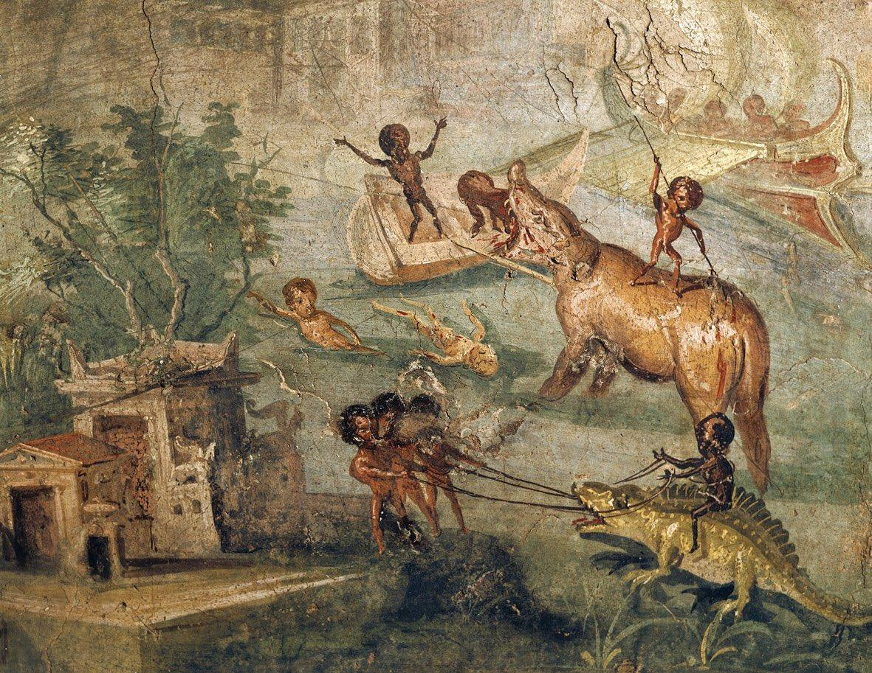
House of Menander, Pompeii, ≈ 60s AD
House of the Physician, Pompeii
Notes:
At Pompeii, in the first century AD, Roman mosaics and wall paintings mock Egyptians and Africans for their swimming. The man on the lower right of this bath mosaic from the House of Menander has African hair and an exaggerated erection, and he’s swimming. (There are a lot of other caricatures of Africans from the House of Menander, too). Apparently elite Romans thought it was funny to walk on African swimmers when you were heading to the baths.
Similarly, Nilotic pygmy scenes also from Pompeii show the Egyptian/East African pygmies swimming, in association with the kind of hippo and crocodile hunts described by Pliny in his Natural History about the same time.

Slide 12
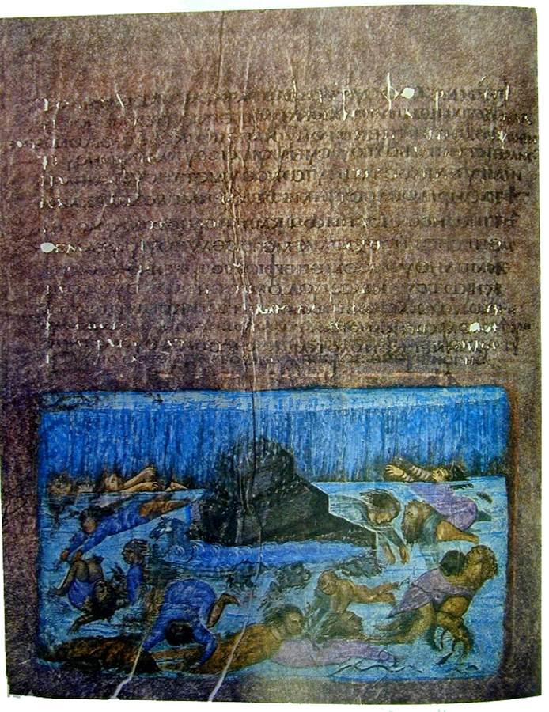
Vienna Genesis: The Flood
(about 500 AD)
The waters rose and covered the mountains to a depth of more than fifteen cubits.
Every living thing that moved on land perished—birds, livestock, wild animals, all the creatures that swarm over the earth, and all mankind.
Notes:
Although no great geographical distance separated these swimming Egyptians from the Hebrews to their north, the Hebrews emerged from a very different cultural background in which people generally did not know how to swim. Like their Mesopotamian, Canaanite, Hittite, and Greek neighbors, the Hebrews tended to be afraid of the water and to regard even disturbing the surface of the water as risky and ill-omened. We can see this in the story of Noah’s Flood (Genesis 7:19–22),

Slide 13
Ezekiel 47:5
PPsalm 69
a river that I could not cross; for the water was too deep, water in which one must swim, a river that could not be crossed.
Save me, O God, for the waters have come up to my neck. I sink in the miry depths, where there is no foothold. I have come into the deep waters; the floods engulf me.
Notes:
and again in Ezekiel 47:5, and in Psalm 69.

Slide 14
Job 47:5
Jonah 2:3
Can you pull in Leviathan with a fishhook or tie down its tongue with a rope?
Can you put a cord through its nose or pierce its jaw with a hook?
Now the Lord provided a huge fish to swallow Jonah, and Jonah was in the belly of the fish...
You hurled me into the depths,
into the very heart of the seas,
and the currents swirled about me; all your waves and breakers swept over me.
Notes:
Echoes of Canaanite sea monsters appear e.g. in the stories of Job and Jonah.
But we are not only reliant on the Bible to inform us that the Hebrews were not swimmers.

Slide 15
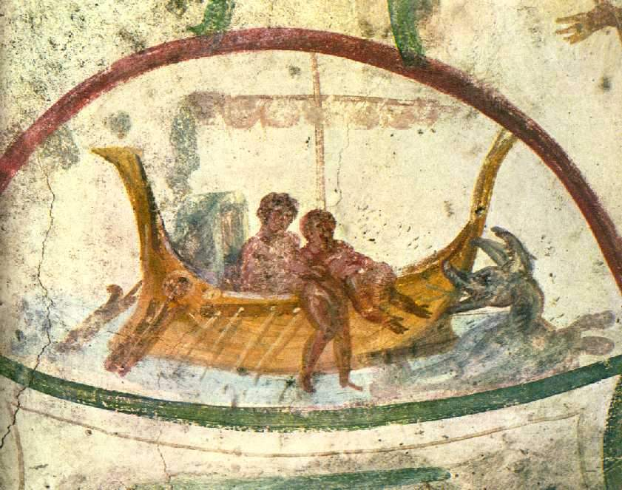
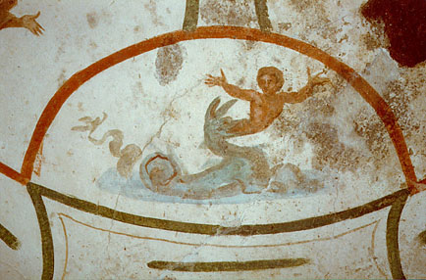
Jonah and the whale, from the
Catacomb of Saint Peter and Saint Marcellinus, Rome, Italy, (4th century?).
Notes:
But when it comes to the Jews, again, they don’t swim. Instead, there are plenty of images of Jonah being swallowed by the whale.

Slide 16
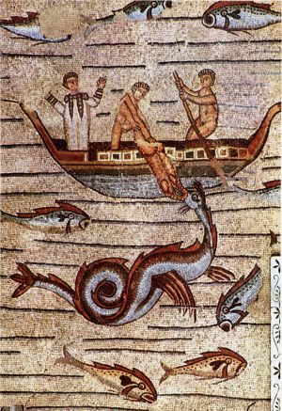
Jonah and the whale, mosaic from Aquileia (near Venice in the northern Adriatic), early 300s AD
(photo: YukioSanjo, CC BY-SA 3.0 license).
Notes:
Another one here.

Slide 17
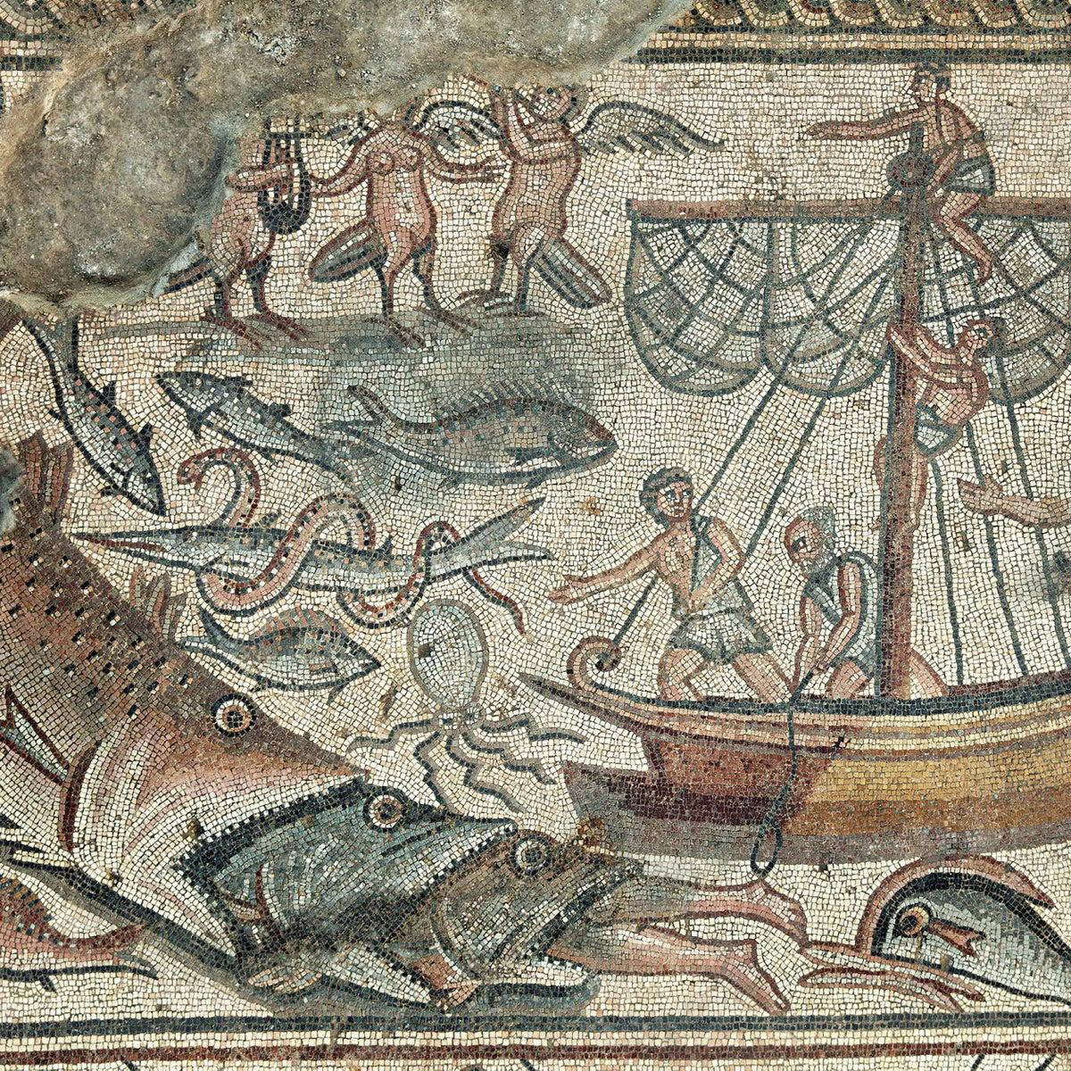
Huqoq Synagogue, Galilee, 400s AD: fish consume Jonah (photo Jim Haberman, thanks to Jodi Magness)
Notes:
In late antique mosaics from Huqoq’s Roman synagogue, giant fish swallow hapless Jonah.

Slide 18
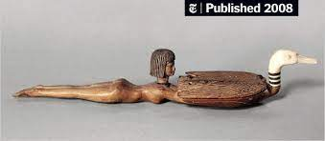
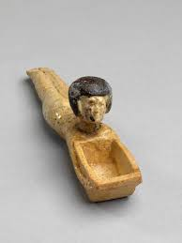
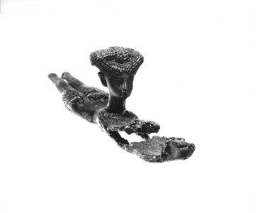
Notes:
The handles of cosmetic spoons often are carved into the shape of swimming women. In Egyptian literature, children take swim lessons. Young men bravely swim across the river to meet their lovers on the Cairo Vase 1266. Fathers use swimming metaphors to encourage their sons to study (Wallis Budge 1914: 251–2.).
Indeed, the earliest known model in literature for the Exodus story of the crossing of the Red Sea is an Egyptian story about magicians parting the water. This story was already very old in the time of Rameses II and the probably fictional Moses; it was even older by the time Exodus was being written in the Iron Age.
Egyptian. Cosmetic Spoon in the Form of a Woman, ca. 1390-1336 B.C.E. Wood, 2 5/16 x 1 7/16 x 10 5/16 in. (5.8 x 3.7 x 26.2 cm). Brooklyn Museum, Charles Edwin Wilbour Fund, 37.620E.
Harold Liebowitz,‘LateBronze ii Ivory Work in Palestine: Evidence of a Cultural Highpoint’, Bulletin of the American Schools of Oriental Research, cclxv (1987), pp. 3–24 (pp. 12–14).

Slide 19
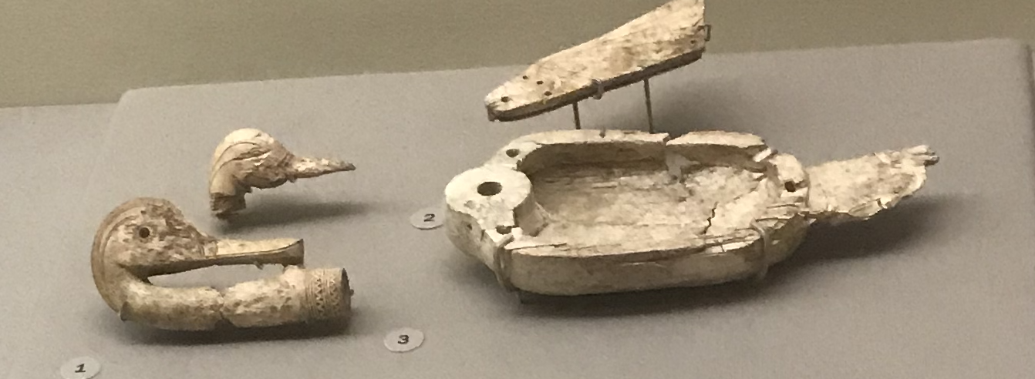
Notes:
When late Bronze Age artists working in the Levant copy the Egyptian cosmetic spoons, they generally leave out the swimming women, and retain only the duck-shaped bowls that the Egyptian women carried.
Egyptian. Cosmetic Spoon in the Form of a Woman, ca. 1390-1336 B.C.E. Wood, 2 5/16 x 1 7/16 x 10 5/16 in. (5.8 x 3.7 x 26.2 cm). Brooklyn Museum, Charles Edwin Wilbour Fund, 37.620E.
Harold Liebowitz,‘LateBronze ii Ivory Work in Palestine: Evidence of a Cultural Highpoint’, Bulletin of the American Schools of Oriental Research, cclxv (1987), pp. 3–24 (pp. 12–14).

Slide 20
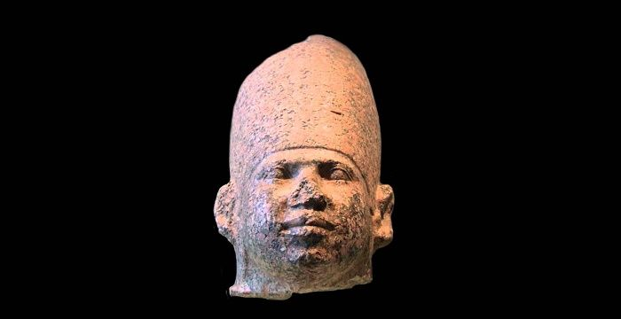
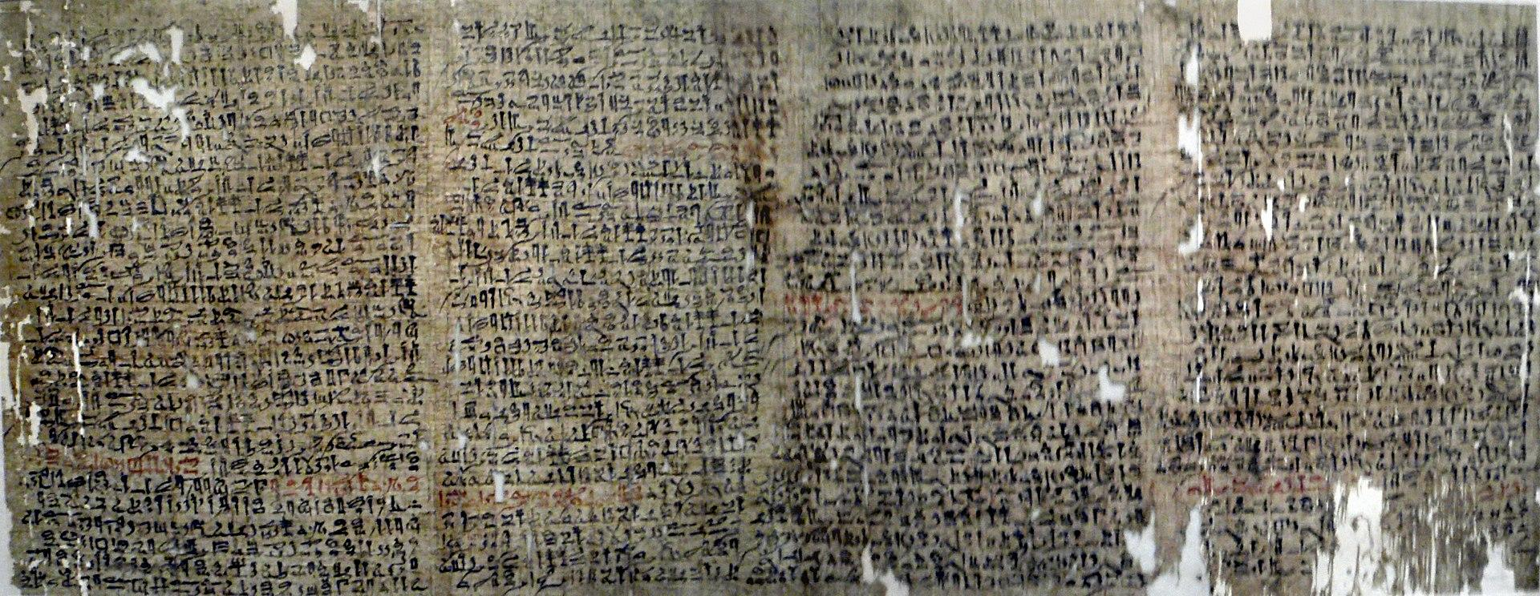
Notes:
It’s the story of King Sneferu and his magician Djadjaemankh (Ja jee mank) from the Fourth Dynasty in Old Kingdom Egypt, about 2500 BC. We know it from the Westcar Papyrus, dated to about 1700–1500 BC.

Slide 21
Djadjaemankh parts the waters - Westcar Papyrus
King Sneferu is bored and irritable. His magician-vizier Djadjaemankh suggests having the palace girls dress up pretty and row boats on the pond, and Sneferu can watch them. So he does, and he does cheer up.
But one of the girls loses her hair ornament in the pond. Sneferu offers her a new one, but she wants that one. So Sneferu tells Djadjaemankh the whole story (in indirect speech) and Djadjaemankh uses magic to part the waters and picks up the hair ornament, and then returns the water. Everyone is happy.
Notes:
So one thing that’s very interesting about the story is that it involves a lot of indirect speech. Sneferu says: "Ja Jee Mank, my brother, I have done all things that you have advised and the heart of your ruler was refreshed when seeing the girls rowing. Then a fish pendant made of fresh beaten malachite, belonging to the stroke girl, fell into the water. She became silent, without rowing. So it came that she distracted the whole rowing line. I asked her: 'Why don't you row?' and she said: 'That fish-pendant made of fresh beaten malachite is the reason. It fell into the water.' And I replied to her: 'Row! See, I'm someone who replaces it.' But the girl said: 'I prefer my own property before some substitute.'"
And why is that so interesting? Because the story of Moses and the Red Sea, in Exodus, also involves indirect speech: Exodus 14: Didn’t we say to you in Egypt, ‘Leave us alone; let us serve the Egyptians’? It would have been better for us to serve the Egyptians than to die in the desert!” Indirect speech is otherwise unusual in the Torah, so although there’s probably no direct connection, there could be some meandering literary connection between these two stories. And yet what a different tone and result!

Slide 22
Exodus 14:11-12
They said to Moses, “Was it because there were no graves in Egypt that you brought us to the desert to die? What have you done to us by bringing us out of Egypt? Didn’t we say to you in Egypt, ‘Leave us alone; let us serve the Egyptians’? It would have been better for us to serve the Egyptians than to die in the desert!”
Notes:
Armed with this cultural distinction, we can bring new insight to the story of the crossing of the Red Sea. Ancient audiences, Jewish or European, would have known that the Hebrews, standing on the shore of the Red Sea, could not swim, and were afraid of the water. No wonder the Jews scream at Moses so angrily (Exodus 14:11–12). Ancient audiences would have known that the Egyptians were still much better swimmers than themselves, and so God’s ability to drown the Egyptian soldiers would have seemed doubly miraculous.

