Slide 1
“Alexander Hamilton” & Greek Tragic Performance
Rob Groves, University of Arizona
groves@arizona.edu | Twitter: @wisclassic
CAMWS 2022

Slide 2
How does a bastard, orphan, son of a whore and a
Scotsman, dropped in the middle of a forgotten
Spot in the Caribbean by providence, impoverished, in squalor
Grow up to be a hero and a scholar?
—-Aaron Burr, “Alexander Hamilton”
How does a playwright, Ancient Greek or Puerto Rican,
Set the stage to let the people have a peek in
To the mythic Landscape of a different time and place
with Characters, settings, and tragic tropes to trace?
—me

Slide 3
˘ ˘ ˘ ¯ ˘ ¯ ˘ ¯ ˘ ˘ ¯ ˘ ˘ How does a bastard, orphan, son of a whore and a
¯ ˘ ¯ ˘ ˘ ¯ ˘ ˘ ˘ ˘ ¯ ˘ Scotsman, dropped in the middle of a forgotten
¯ ˘ ˘ ˘ ¯ ˘ ˘ ¯ ˘ ˘ ¯ ˘ ˘ ˘ ¯ ˘ Spot in the Caribbean by providence, impoverished, in squalor
˘ ¯ ˘ ˘ ˘ ¯ ˘ ˘ ˘ ¯ ˘ Grow up to be a hero and a scholar?

Slide 4
Alexander Hamilton.
(applause)
My name is Alexander Hamilton.
And there’s a million things I haven’t done.
But Just you wait,
Just you wait.
—Hamilton, “Alexander Hamilton”
For at first the poets themselves acted their tragedies. (ὑπεκρίνοντο γὰρ αὐτοὶ τὰς τραγῳδίας οἱ ποιηταὶ τὸ πρῶτον.)
—Aristotle, Rhetoric 1403b3

Slide 5
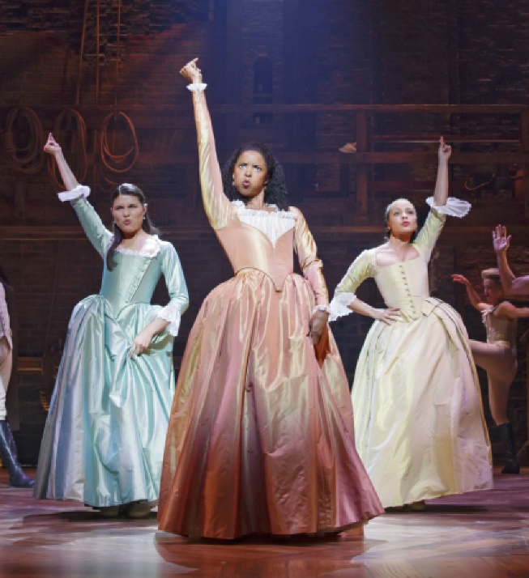
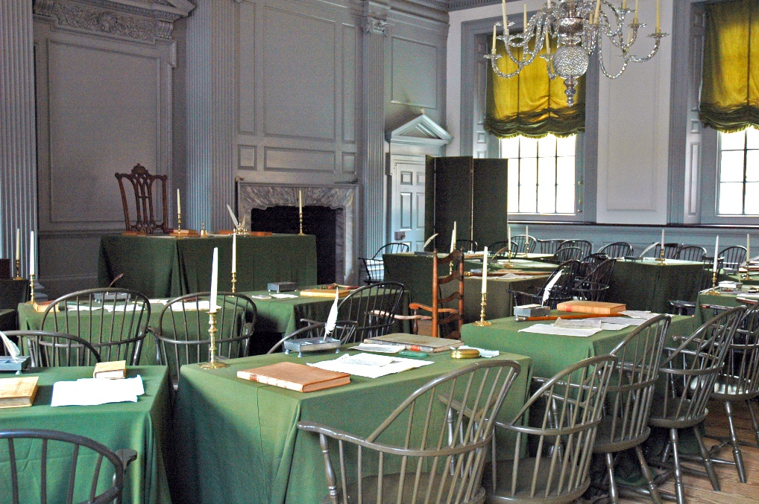

Slide 7
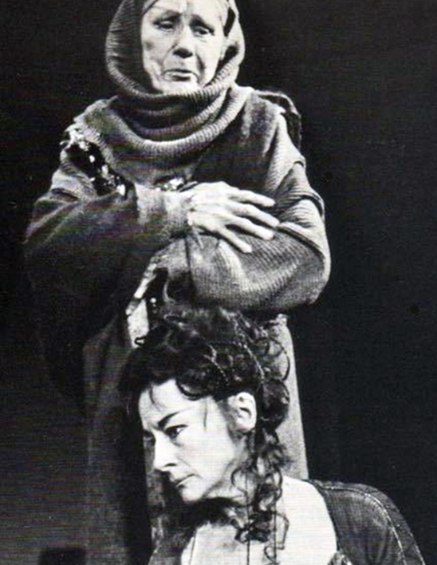
Εἴθ᾽ ὤφελ᾽ Ἀργοῦς μὴ διαπτάσθαι σκάφος
Κόλχων ἐς αἶαν κυανέας Συμπληγάδας …
If only The ship of Argos hadn’t flown through | The Blue Crashing Rocks to the Land of Colchis!
Euripides, Medea, 1-2

Slide 8
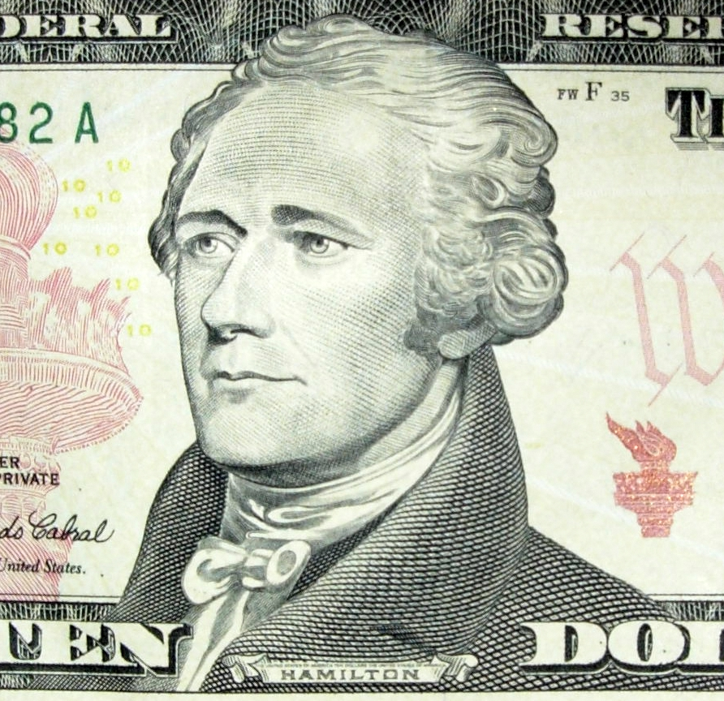

Slide 9
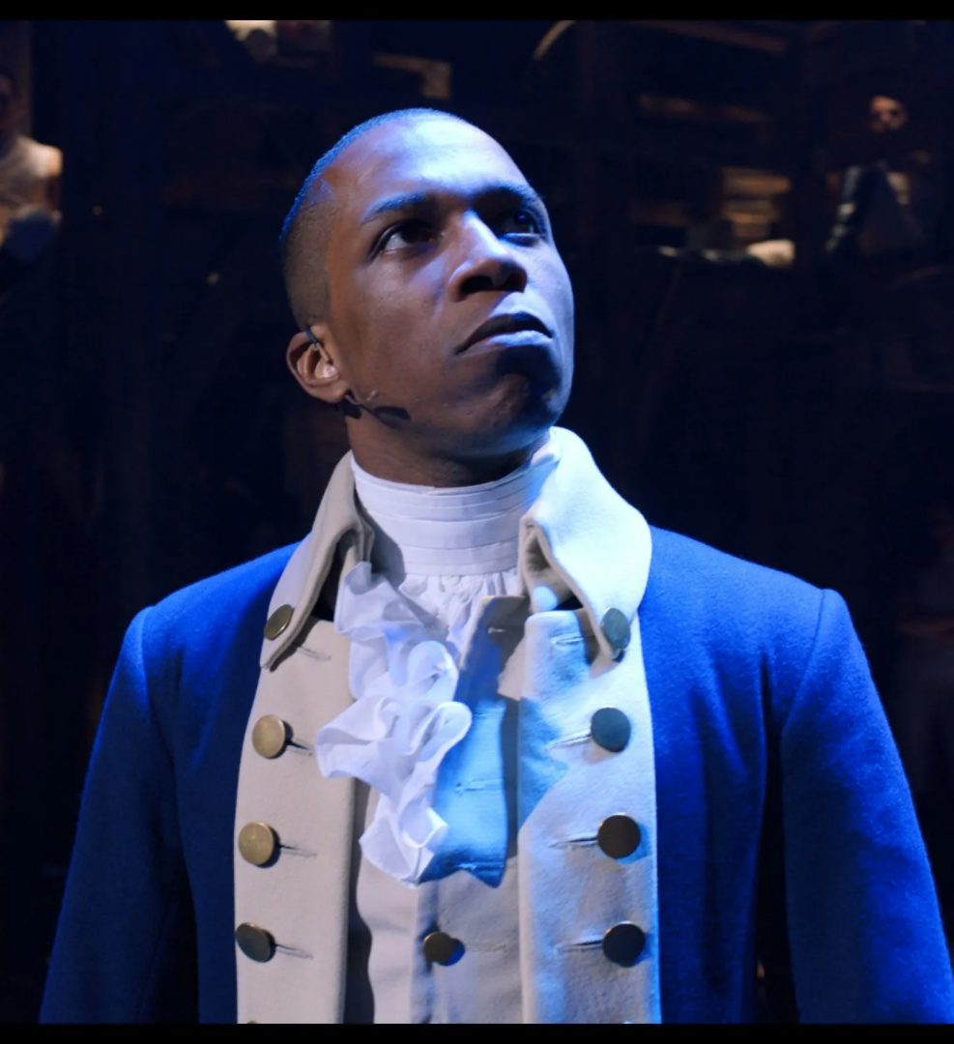
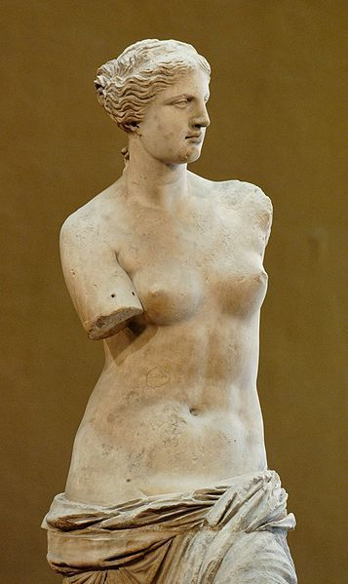
And me? I’m the damn fool that shot him!
—Aaron Burr, “Alexander Hamilton”

Slide 10
“Alexander Hamilton” & Greek Tragic Performance
Rob Groves, University of Arizona
groves@arizona.edu | Twitter: @wisclassic
CAMWS 2022

