Slide 1
Theodotus’ Reimagined Biblical World
Benjamin Nikota
New York university
Ancient Judaism regional seminar 2022

Slide 2
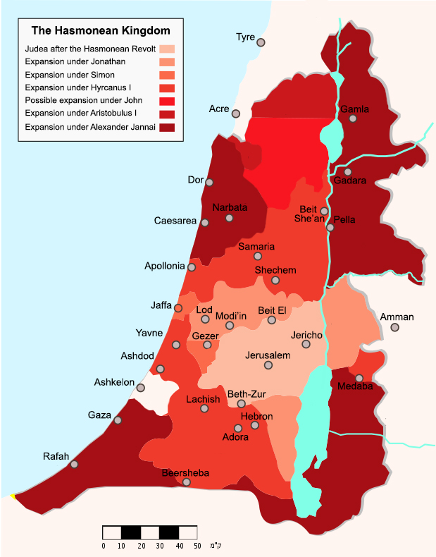
Some Historical Context
When and Where Theodotus Wrote
Expansion of the Hasmonean Kingdom
Chronology is disputed, but probably sometime in the 2nd century BCE
One school of thought: mid 1st century BCE
Other school of thought, later: Reign of John Hyrcanus (129-107 BCE)

Slide 3
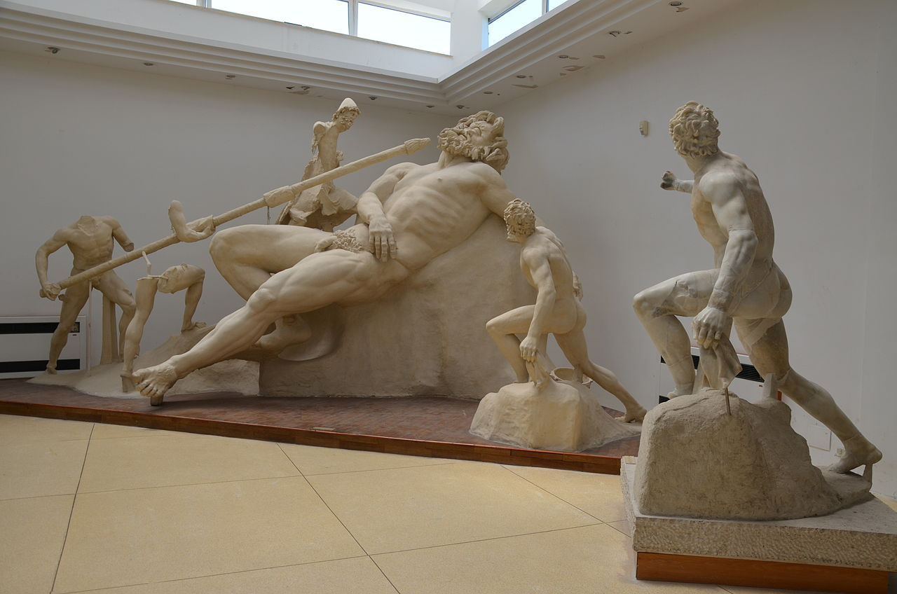
Shechemites as Homeric Cyclopes: What’s so Cyclopean About Them?
Obligatory Cyclopes Image
In What Ways are the Shechemites portrayed as Cyclopes?
They are wicked and mistreat their guests
  … οὐ γὰρ ἔτιον
  εἰς αὐτοὺς ὅστις κε μόλοι κακὸς οὐδὲ μὲν ἐσθλός ·
They lack law and justice:
  οὐδὲ δίκας ἐδίκαζον ἀνὰ πτόλιν οὐδὲ θέμιστας ·
They are violent:
  λοίγια δ᾽ ὠρώρει τοῖσιν μεμελημένα ἔργα
They are (possibly) Shepherds
  ποιμενόφι πτόλιν ἤλυθ᾽ ᾽Ιακὼβ

Slide 4
Theodotus’ Description of the City of Shechem
Greek Text
Translation (Holladay)
ἡ δ᾽ ἄρ᾽ ἔην ἀγαθή τε καὶ αἰγινόμος ὐδρηλή,
οὐδὲ μὲν ἔσκεν ὁδὸς δολιχὴ πόλιν εἰσαφικέσθαι
ἀγρόθεν, οὐδέ ποτε δρία λαχνήεντα πονεῦσιν.
ἐξαυτῆς δὲ μάλ᾽ ἄγχι δύ᾽ οὔρεα φαίνετ᾽ ἐρυμνά,
ποίης τε πλήθοντα καὶ ὕλησ· τῶν δὲ μεσηγὺ
ἀτραπιτὸς τέτμηται †ἀραιή αὐλῶπισ† ἔνθ᾿ ἑτέρωθι
ἡ διερὴ Σικίμων καταφαίνεται, ἱερὸν ἄστυ
νέρθεν ὑπὸ ῥίζηι δεδμημένον, ἀμφὶ δὲ τεῖχος
λισσόν, ὑπώρειαν <δ᾽> ὑποδέδρομεν αἴποθεν ἕρκος
Now thus the land was indeed fertile, browsed by goats and well-watered,
Neither was it a long way to enter the city
From the country. Nor were there ever dense thickets for labourers
And out of it very near two mountains appear quite steep,
Full of grass and tress. And between them
Is cut a path, a narrow hollow; and on the other side
The living (city of) Shechem appears, a holy city,
Built below at the base (of the mountain), and around (the city) a smooth wall
Running (in) under the foot of the mountain, on high, a defensive enclosure.

Slide 5
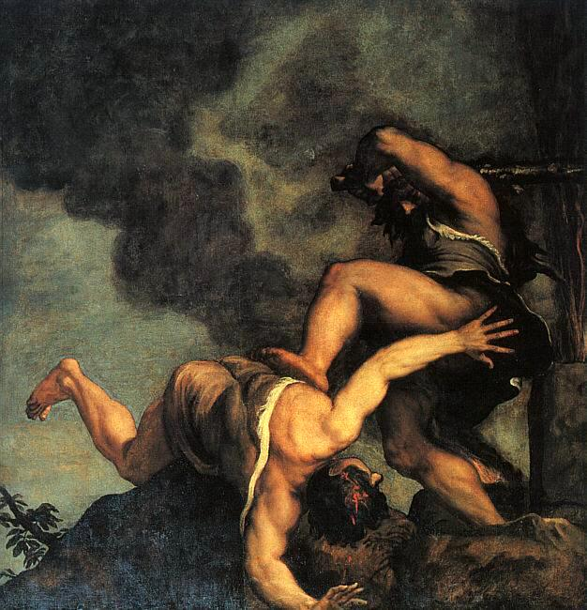
Shepherds and Farmers
From Theodotus’ Text: Professional Designations of Biblical Characters
Cain and Abel, Titian
“Ἐντθένδε, ξένε, ποιμενόφι πτόλιν ἤλυθ᾽ ᾽Ιακὼβ”
  From there, stranger” to the shepherds’ city came Jacob
καὶ αὐτὸν μὲν τὸν ᾽Ιακὼβ γεωμορεῖν, τοὺς δὲ υἱοὺς αὐτοῦ ἕνδεκα τὸν ἀριθμὸν ὄντας ποιμαίνειν, τὴν δὲ θυγατέρα Δείναν καὶ τὰς γυναῖκας ἐριουργεῖν
  Jacob himself was a farmer but his eleven sons were shepherds. And his daughter Dinah and his wives worked in wool.

Slide 6
Theodotus’ Description of the City of Shechem
Greek Text
Translation (Holladay)
ἡ δ᾽ ἄρ᾽ ἔην ἀγαθή τε καὶ αἰγινόμος ὐδρηλή,
οὐδὲ μὲν ἔσκεν ὁδὸς δολιχὴ πόλιν εἰσαφικέσθαι
ἀγρόθεν, οὐδέ ποτε δρία λαχνήεντα πονεῦσιν.
ἐξαυτῆς δὲ μάλ᾽ ἄγχι δύ᾽ οὔρεα φαίνετ᾽ ἐρυμνά,
ποίης τε πλήθοντα καὶ ὕλησ· τῶν δὲ μεσηγὺ
ἀτραπιτὸς τέτμηται †ἀραιή αὐλῶπισ† ἔνθ᾿ ἑτέρωθι
ἡ διερὴ Σικίμων καταφαίνεται, ἱερὸν ἄστυ
νέρθεν ὑπὸ ῥίζηι δεδμημένον, ἀμφὶ δὲ τεῖχος
λισσόν, ὑπώρειαν <δ᾽> ὑποδέδρομεν αἴποθεν ἕρκος
Now thus the land was indeed fertile, browsed by goats and well-watered,
Neither was it a long way to enter the city
From the country. Nor were there ever dense thickets for labourers
And out of it very near two mountains appear quite steep,
Full of grass and tress. And between them
Is cut a path, a narrow hollow; and on the other side
The living (city of) Shechem appears, a holy city,
Built below at the base (of the mountain), and around (the city) a smooth wall
Running (in) under the foot of the mountain, on high, a defensive enclosure.

Slide 7
Theodotus’ Description of Syria
Translation
Greek Text
“Jacob came to Syria rich in cattle, and the wide
Stream of the Euphrates he left behind, a roaring river.
For he also went there, having left the bitter rebuke
Of his own brother. Graciously did Laban receive him into his home
Laban, who was his own cousin, but at that time alone
Did he rule over Syria, having acquired newborn blood.
᾽Ιακὼβ Συρίην κτηνοτρόφον ἷκτο καὶ εὐρὺ
ῥεῖθρον ᾽Εϋφρήταο λίπεν ποταμοῦ κελάδοντοσ·
ἤλυθε γὰρ κἀκεῖθι λιπὼν δριμεῖαν ἐνιπὴν
αὐτοκασιγνήτοιο, πρόφρων <δ᾿> ὑπέδεκτο δόμονδε
Λάβαν, ὅς οἱ ἔην μὲν ἀνεψιός, ἀλλὰ τότ᾽ οἶος
ἤνασσε<ν> Συρίης, †νεηγενὲς αἷμα λελογχώς.

