Slide 1
Philip Francis Wooby, (1922-2017): The First African American in the School of Classical Studies and Archaeology at the American Academy in Rome
Michele Valerie Ronnick
Session 10, Section E, CAMWS, 26 March 2022

Slide 2
Philip Francis Wooby (1922-2017), Archives, Millersville University.

Slide 3
1941 Draft Card while with the Techny Brothers

Slide 4
St. John’s University, Collegeville, Minnesota Wooby is 4th from the left April 16, 1945

Slide 5
The Centennial Directory of the American Academy in Rome (New York, The Academy, 1995) p. 335

Slide 6
“Mr. Wooby Speaks His Piece,” The Hilltop, Howard University Cathy Porter, staff artist (10 April 1956): 5

Slide 7
Nuntius, Eta Sigma Phi’s 39th National Convention, Buffalo, NY (1 April 1966) Hosted by Canisius College & by Professor Philip F. Wooby

Slide 8
Classics Club, Millersville, 1972. Professor Wooby is standing on the far left.

Slide 9
Aulularia Cast Party, Spring, 1988 (Courtesy of Tim Moore)

Slide 10
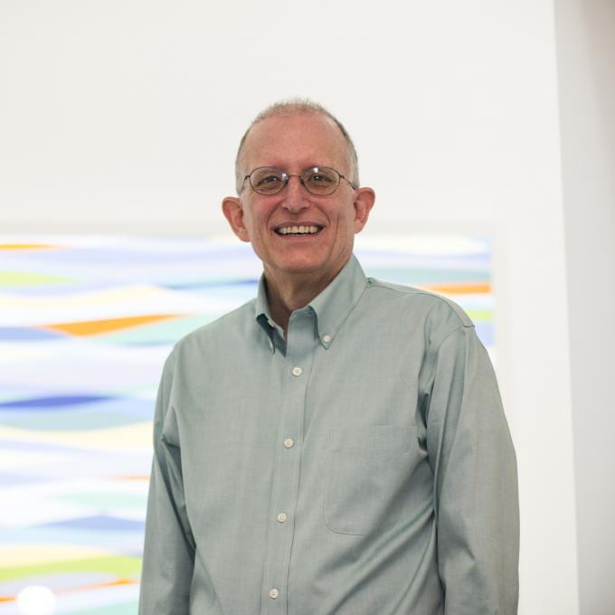
T
Timothy Moore, John & Penelope Biggs Distinguished Professor of Classics, Washington University in St, Louis
Philip Francis Wooby

