Slide 1
A Woman’s Right(?) of Appeal in the Roman Republic
Hank Blume

Slide 2
Gellius 4.14
Narratur historia de Hostilio Mancino aedilium et Manilia meretrice; verbaque decreti tribunorum, ad quos a Manilia provocatum est.
Cum librum IX Atei Capitonis coniectaneorum legeremus, qui inscriptus est de iudiciis publicis, decretum tribunorum visum est gravitatis antiquae plenum. Propterea id meminimus, idque ob hanc causam et in hanc sententiam scriptum est: Aulus Hostilius Mancinus aedilis curulis fuit. Is Maniliae meretrici diem ad populum dixit, quod e tabulato eius noctu lapide ictus esset, vulnusque ex eo lapide ostendebat. Manilia ad tribunos plebi provocavit. Apud eos dixit comessatorem Mancinum ad aedes suas venisse; eum sibi recipere non fuisse e re sua, sed cum vi inrumperet, lapidibus depulsum. Tribuni decreverunt aedilem ex eo loco iure deiectum, quo eum venire cum corollario non decuisset; propterea, ne cum populo aedilis ageret, intercesserunt.
A story narrated about Hostilius Mancinus, an aedile, and Manilia, a courtesan; and the decision of the tribunes, to whom an appeal was made by Manilia.
When I wsa reading the 9th book of the miscellany of Ateius Capito, a decision of the tribunes seemed to me to be full of ancient dignity. For this reason, I remembered it. It was written for this reason and in this opinion: Aulus Hostilius Mancinus was the curule aedile. He indicted Manilia, the courtesan, before the people, because during the night he had been struck with a stone from her flat, and he displayed the wound that had been made by the stone. Manilia appealed to the people. In their presence she said that Mancinus had come to her house as a reveler; that it was not her wish to receive him, but when he forced his way in, she drove him off with stones. The. Tribunes decreed that the aedile was lawfully driven out from her home, where it had not been right for him to go while garlanded. Therefore, they interceded so as to prevent the aedile from bringing the case before the people.

Slide 3
Provocatio and Appellatio
et appellatio provocatioque adversus iniuriam magistratuum ostentata tantum inanibus litteris an vere data sit.
And it would be discovered whether appellatio and provocatio against magisterial abuse had really been given or were empty words. Liv. 3.56
Volero appellat tribunos. Cum auxilio nemo esset, consules spoliari hominem et virgas expediri iubent. "Provoco" inquit, "ad populum" Volero…
Volero appealed to the tribunes. When none came to his aid, the consules ordered him to stripped and the canes to be readied. “I appeal to the people” Volero said… Liv. 2.55
et in senatu et ad populum magnis contentionibus certatum, et imperia inhibita ultro citroque, et pignera capta, et multae dictae, et tribuni appellati, et prouocatum ad populum est.
There was a serious struggle both in the senate and before the people, commands were prevented back and forth, pledges were taken, fines were established, the tribunes were appealed to, and the people were appealed to. Liv. 37.51.1

Slide 4
Options:
Scribal Error
Capito wrote provocatio but mean appellavit
Manilia said provocatio, but meant appellatio, which was then heard by the tribunes
Gellius misquoted, he wrote provocavit but meant appellavit
Everyone wrote provocait and meant it.

Slide 5
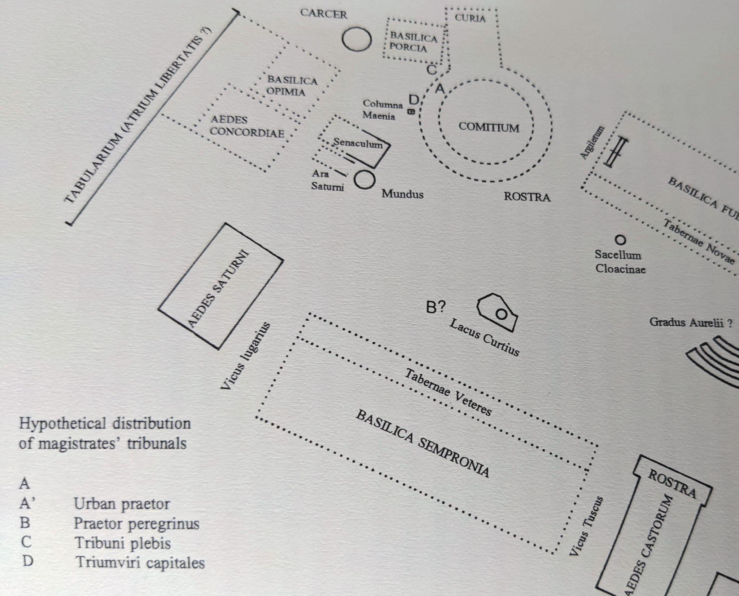
Forum Romanum
This map is from J.M. David’s Le patronat judicaire au. Dernier siècle de la Républicque romane. It was reused in Fergus Millar’s the Crowd in Rome in the Late Republic.
It represents the forum in 53 B.C.E.
However, the location of the Urban Praetor and the tribunes were not, in any substantially different location from their position in the upper center of this map in the Middle Republic.

Slide 6
Women “Tried” and Executed in Private
Plin. Nat. 14.89
Killed for drinking alcohol
Liv. Per. 48 and Val. Max. 6.3.8
Publicia and Licinia killed by their families for poisoning their husbands
Liv. 39.18
Female Bacchanalian conspirators executed by family members if available.
Liv. 8.18
Matrons who poisoned their husbands ordered to drink poison they are caught making. Spectators made to depart prior to their consumption. Also, at Val. Max. 2.5.3 but with far less detail.

Slide 7
Meretrices
Examples of Meretrices ”In the Right”
Meretrix, who killed a soldier
militem, qui ad se [meretricem] venerat, cum exorare non posset, colluctantem et vim inferentem occidit. accusata et absoluta remissa ad suos est;
The courtesan killed a soldier, who had come to her, and when he had been refused, he struggled and attempted force. She was accused and acquitted.
Sen. Contr. 1.2
Hispala Faecenia, meretrix, who gave evidence in the Bacchanalian Conspiracy
Utique Faeceniae Hispalae datio, deminutio, gentis enuptio, tutoris optio item esset, quasi ei uir testamento dedisset; utique ei ingenuo nubere liceret, neu quid ei qui eam duxisset ob id fraudi ignominiaeue esset.
Giving and selling property, marrying outside of her clan, and choosing a tutor, just as if her husband had given it to her in a will; and that she should be able to marry a noble, and that there should be no dishonor for the man she married.
Liv. 39.19

