Slide 1
Helpers of Heroes
A Connection between Potnia Hera, Athena, and the Mycenaean Wanax/Anax
R.G. Sanders
University of Arizona
rebeccasanders@email.arizona.edu

Slide 2
Acknowledgments
Graduate Student Educational and Professional Development Fund (GSEPDF), University of Arizona Department of Classics
Courtney Friesen, University of Arizona
Kyle Mahoney, Swarthmore College
Notes:
I’d like to thank the Classics Department at the University of Arizona for funding my trip here and allowing me to present my paper to all of you.
I’d also like to thank Kyle Mahoney, my undergraduate advisor who has played an integral role in my research in Linear B.

Slide 3
Outline of Presentation
Methodology
Potnia in the Linear B tablets (at Knossos, Mycenae, Pylos)
Hera and Athena in the Iliad
Hera/Athena as Protectresses of a Homeric wanax/lawagetas
Notes:
I’d like to start off with a brief outline before we really dig into the Linear B tablets and Homer. So, in this presentation I will start with a brief discussion of methodology, then move on to characterize Potnia in the LB tablets. Then, I will describe how Athena and Hera tend to act together when they intercede on behalf of a Greek hero. Finally, I will conclude by arguing that Hera/Athena have taken on the role of the Mycenaean Potnia who protects the wanax/lawagetas.

Slide 4
Methodology
Palaima 1995:
Mycenaean palace ruled by
Wanax - king
Lawagetas – “crown prince” and heir to wanax, military responsibilities
Nakassis 2012
Wanax held ritual authority
Boëlle 2004
Mycenaean goddess Potnia as the patron goddess of Mycenaean kingship
Notes:
For the sake of time, I will be working from the work of three scholars. Palaima, the leading Linear B scholar, lays out the structure of authority at a Mycenaean palace. The wanax acts as the king and the lawagetas, or leader of the lawos, is the “crown prince” and heir to the wanax and also holds military responsibilities.
Nakassis demonstrates that the wanax and lawagetas held ritual authority and Boëlle demonstrates that the goddess Potnia acted as the patron goddess of Mycenaean kingship.

Slide 5
Potnia – one or many?
Fresco from Mycenae, 1400-1200 BCE

Slide 6
What can we say about the Mycenaean Potnia?
Potnia of many spheres
Potnia as a goddess in her own right, especially at Pylos
Hera already present in Linear B

Slide 7
Knossos

Slide 8
No. 1 – Potnia of the Labyrinth
.2 da-pu₂-ri-to-jo po-ti-ni-ja laburi(n)thoio potnia

Slide 9
No. 2 – Potnia of Athana
a-ta-na-po-ti-ni-ja
Athana-Potnia
Is this Athena?
Notes:
This is the tablet that some scholars will point to as evidence of Athena in Mycenaen times. However, seeing that this tablet was found in Knossos and the lack of LB tablets from Athens in Attica, this is probably a local toponym on Crete.

Slide 10
Mycenae

Slide 11
No. 3 – Potnia of Grain
si-to-po-ti-ni-ja
σίτου Πότνια
sitou Potnia
Potnia of the Grain

Slide 12
Pylos

Slide 13
No. 4-9 – Many Potnias
No. 4 – Potnia of Horses (i-qe-ja )
No. 5 – Potnia of Newos (ne-wo-pe-o )
No. 6 – Potnia of Aswija (a-si-wi-ja )
No. 7-9 – Potnia of Upo (u-po-jo)

Slide 14
No. 10 – Potnia
po-ti-ni-ja without any modifiers
offerings to
the Wanax
Potnia
the Lawagetas

Slide 15
No. 11 – Potnia and Hera
.3 to Potnia 1 Cup, 1 Woman
*Potnia without modifiers
v.9 to Zeus 1 Cup, 1 Man and to Hera 1 Cup, 1 Woman
*Zeus and Hera already a divine couple
Notes:
On No. 11, the human sacrifice tablet we see a differentiation between Potnia and Hera. And we also see Hera and Zeus as a divine couple.

Slide 16
No. 12 – Potnia Hera
e-re-wi-jo-po-ti-ni-ja
Heraia-Potnia
hmm…very similar to Hera’s epithet in Homer
πότνια Ἠρή
Notes:
However, we see Hera as a modifier of Potnia on No. 12, which is very similar to Hera’s epithet in Homer.

Slide 17
Iliad
Notes:
Now turning to the Iliad, which is the second page of the handout, the first question to ask is why is Hera special? Why would she receive the epithet potnia the most?

Slide 18
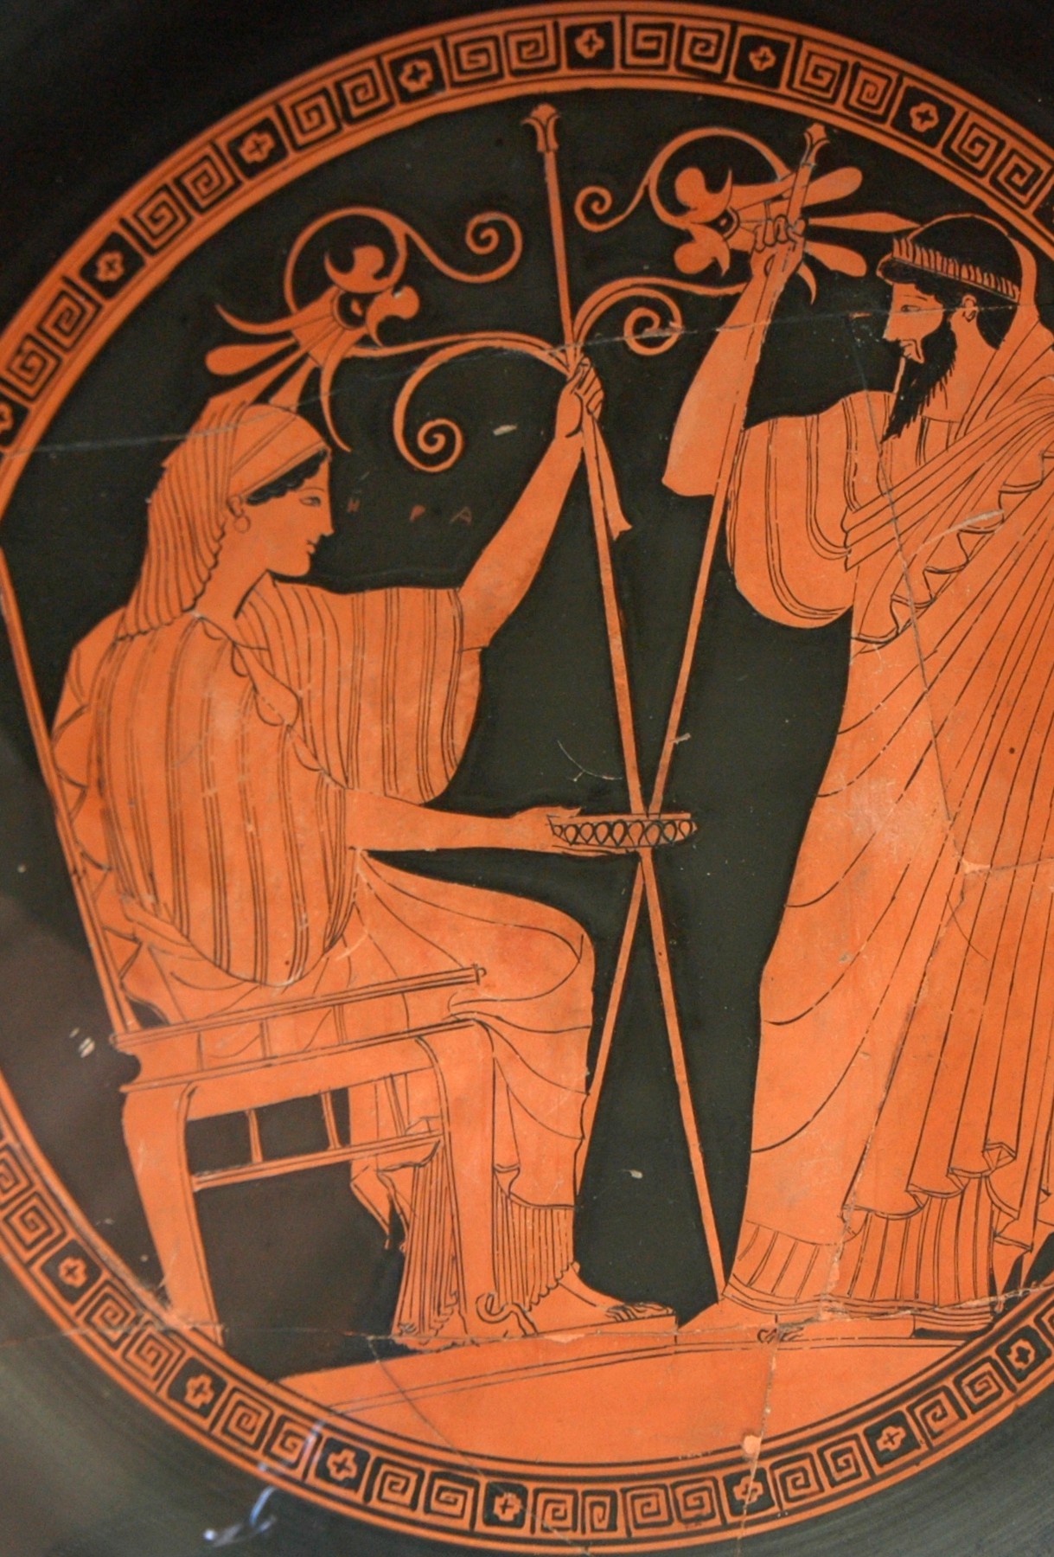
No. 1 – Potnia Hera
Ἥρη πρέσβα θεὰ θύγατερ μεγάλοιο Κρόνοιο
Hera, the elder goddess daughter of great Kronos
5.721; 8.383; 14.194, 243
Hera and Prometheus. Tondo of an Attic red-figured kylix, 490–480 BC. From Etruria.
Notes:
As we can see from No. 1, she is a very powerful goddess, the elder daughter of Kronos. She also tricks Zeus many times, and so I wonder if her power in the Iliad is a cultural memory of the superiority of Potnia within Mycenaean times.

Slide 19
No. 2 - Potnia Athena?
εὐχομένη δ’ ἠρᾶτο Διὸς κούρῃ μεγάλοιο·
πότνι’ Ἀθηναίη ἐρυσίπτολι δῖα θεάων
ἆξον δὴ ἔγχος Διομήδεος…
And having prayed, she beseeched the daughter of great-hearted Zeus
“Potnia Athena, protectress of the city, divine among goddesses,
break now the spear of Diomedes…” (6.304-306)
*direct address
Notes:
But what about Athena? She only receives the epithet once, in passage 2, she is called Potnia in direct prayer. And I argue that this reflects the use of potnia as a title of respect and not as reflecting the Mycenaean Potnia-status of Athena.
The best explanation for the rise in popularity of the Attic Athena seems to be the similar rise to prominence of the Attic Athens which was only a Mycenaean fortress, but during the Early Iron Age sees a population increase.

Slide 20
Hera and Athena in the Iliad
When interceding on behalf of Greek hero, always done as a pair
Favor Agamemnon, Achilles, Diomedes, Menelaus
Notes:
Now, if we think about how Hera and Athena interact in the Iliad. They always act as a pair and they favor Greek heroes who are either kings of a palace, the equivalent of a wanax, or they hold military power, the equivalent of the lawagetas.

Slide 21
No. 3 – Hera and Athena
ἕλκετο δ᾽ ἐκ κολεοῖο μέγα ξίφος, ἦλθε δ᾽ Ἀθήνη
οὐρανόθεν: πρὸ γὰρ ἧκε θεὰ λευκώλενος Ἥρη
ἄμφω ὁμῶς θυμῷ φιλέουσά τε κηδομένη τε
And he drew his great sword from its sheathe, but Athena came
down from the heavens: for the white-armed goddess Hera sent her,
since she loved and cared for them both in her heart (Il. 1.194-96)
Notes:
In passage 3, we see the first intercession of Athena and Hera in Book 1. Right before Achilles is about to strike down Agamemnon, Hera sends Athena to stop him.
Why, you might ask? Because she cared and loved for them both, φιλέουσά τε κηδομένη τε. But why does she care about Agamemnon and Achilles? I argue it is because she is the protectress of the heroes who are vestiges of the Mycenaean power structure, the wanax and the lawagetas.

Slide 22
No. 4
τοὺς δ᾽ ὡς οὖν ἐνόησε θεὰ λευκώλενος Ἥρη
Ἀργείους ὀλέκοντας ἐνὶ κρατερῇ ὑσμίνῃ,
αὐτίκ᾽ Ἀθηναίην ἔπεα πτερόεντα προσηύδα
But just then the white-armed goddess Hera recognized that they (the Trojans)
were destroying the Argives in great combat,
and immediately she spoke winged words to Athena (5.711-13)
Notes:
Again, in passage 4, Hera sends Athena into combat after noticing that the Trojans are beating back the Greeks.

Slide 23
No. 5
…αἳ δ᾽ ἐπέμυξαν Ἀθηναίη τε καὶ Ἥρη
πλησίαι αἵ γ᾽ ἥσθην, κακὰ δὲ Τρώεσσι μεδέσθην
and they murmured together, both Athena and Hera
and close together they say, thinking up evils for the Trojans (4.20-21; 8.457-58
Notes:
We also see Athena and Hera plotting together in passage 5: sitting close together (Greek) and thinking up evils for the Trojans (Greek)

Slide 24
Protectresses of Atreides
No. 6 - Menelaus
δοιαὶ μὲν Μενελάῳ ἀρηγόνες εἰσὶ θεάων
Ἥρη τ᾽ Ἀργείη καὶ Ἀλαλκομενηῒς Ἀθήνη
Menelaus has two helpers among the goddesses
Argive Hera and Athena the Protectress
(4.8-9)
No. 7 - Agamemnon
ἐπὶ δ᾽ ἐγδούπησαν Ἀθηναίη τε καὶ Ἥρη
τιμῶσαι βασιλῆα πολυχρύσοιο Μυκήνης
and there both Athena and Hera thundered to honor the king of Mycenae rich in gold (11.45-46)
Notes:
We also see Hera and Athena as protectresses of the Atreides. In Passage 6, Zeus taunts them for being helpers for Menelaus. No. 7 shows Athena and Hera honoring Agamemnon.

Slide 25
No. 8 - Il. 9.253-56
Peleus – wanax
Achilles – lawagetas
Hera + Athena – Potnia
Notes:
Passage 8 is where I bring this all together. When Phoenix is trying to convince Achilles to fight, he reminds him of what his father Peleus told him. Peleus says: τέκνον ἐμὸν κάρτος μὲν Ἀθηναίη τε καὶ Ἥρη
δώσουσ᾽ αἴ κ᾽ ἐθέλωσι, both Athena and Hera will give you strength if they wish.”
So, we have Peleus, the king of Phthia as the wanax. Achilles as the military leader or the lawagetas and Hera and Athena as special protectresses of Achilles. This one passage demonstrates that the way Hera and Athena protect particular Greek heroes remembers or reflects the way Potnia served as a protectress of the wanax and the lawagetas.

Slide 26
Conclusions and Beyond
Mycenaean Potnia – individual spheres and protectress of Mycenaean kingship
Hera + Athena as depicted in the Iliad take on role of Mycenaean Potnia
No. 8
Further research needed on Diomedes and Odysseus in the Odyssey

Slide 27
Select Bibliography
Aurora, Federico. 2015. “DAMOS (Database of Mycenaean at Oslo) Annotating a fragmentarily attested language.” In Current Work in Corpus Linguistics: Working with Traditionally-conceived Corpora and Beyond. Selected Papers from the 7th International Conference on Corpus Linguistics (CILC2015) edited by Pedro A. Fuertes-Olivera et al. Special issue, Procedia - Social and Behavioral Sciences, vol. 198: 21-31. doi: 10.1016/j.sbspro.2015.07.415
Bennet, J. 2014. “Linear B and Homer.” In A Companion to Linear B: Mycenaean Greek Texts and Their World, vol. 3, edited by Y. Duhoux and A. Morpurgo Davies, 187-233. Dudley, MA: Peeters-Leuven.
Boëlle, Cécile. 2004. PO-TI-NI-JA: L’élément féminin dans la religion mycénienne (d’après les archives en linéaire B). Etudes anciennes 26. Paris: De Boccard.
Hiller, Steffan. 2011. “Mycenaean Religion and Cult.” In A Companion to Linear B: Mycenaean Greek Texts and Their World, vol. 2, edited by Y. Duhoux and A. Morpurgo Davies, 169-212. Dudley, MA: Peeters-Leuven.
Murray, Caroline M. 1977. “The Community of Pa-ki-ja-na.” Bulletin of the Institute of Classical Studies, vol. 24: 142-144.

Slide 28
Select Bibliography Con.
Nakassis, Dimitri. 2012. “Prestige and Interest: Feasting and the King at Mycenaean Pylos.” Hesperia, vol. 81: 1-30.
O’Brien, Joan V. 1993. The Transformation of Hera: A Study of Ritual, Hero, and the Goddess in the Iliad. Lanham, MD: Rowman & Littlefield.
Palaima, T.G. 1995. “The Nature of the Mycenaean Wanax: Non-Indo-European Origins and Priestly Functions.” In The Role of the Ruler in the Prehistoric Aegean, edited by P. Rehak, 119-139. Aegaeum 11: Liège.
Palmer, L.R. 1963. The Interpretation of Mycenaean Greek Texts. New York: Oxford University Press.
Shear, Ione Mylonas. 2004. Kingship in the Mycenaean World and Its Reflections in the Oral Tradition. Philadelphia, PA: INSTAP Academic Press.
Walcot, Peter. 1967. “The Divinity of the Mycenaean King.” Studi Micenei ed Egeo-Anatolici 2: 53-62.

Slide 29
Questions?

