Slide 1
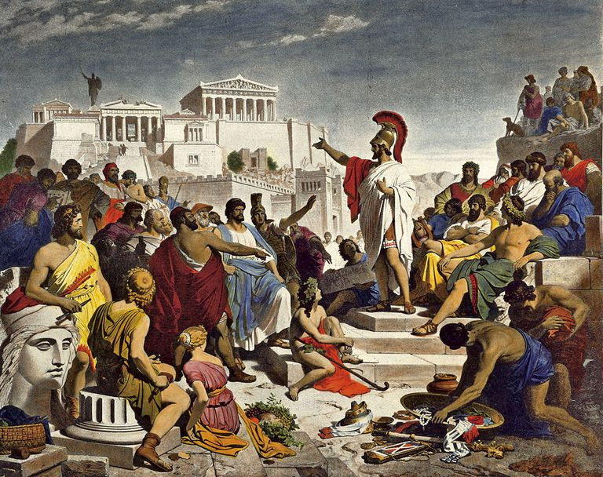
Imperial Ambitions: Athenian Statecraft in the Use of Colonies and Cleruchies
By: River Ramirez
University of Arizona
riverramirez@email.arizona.edu

Slide 2
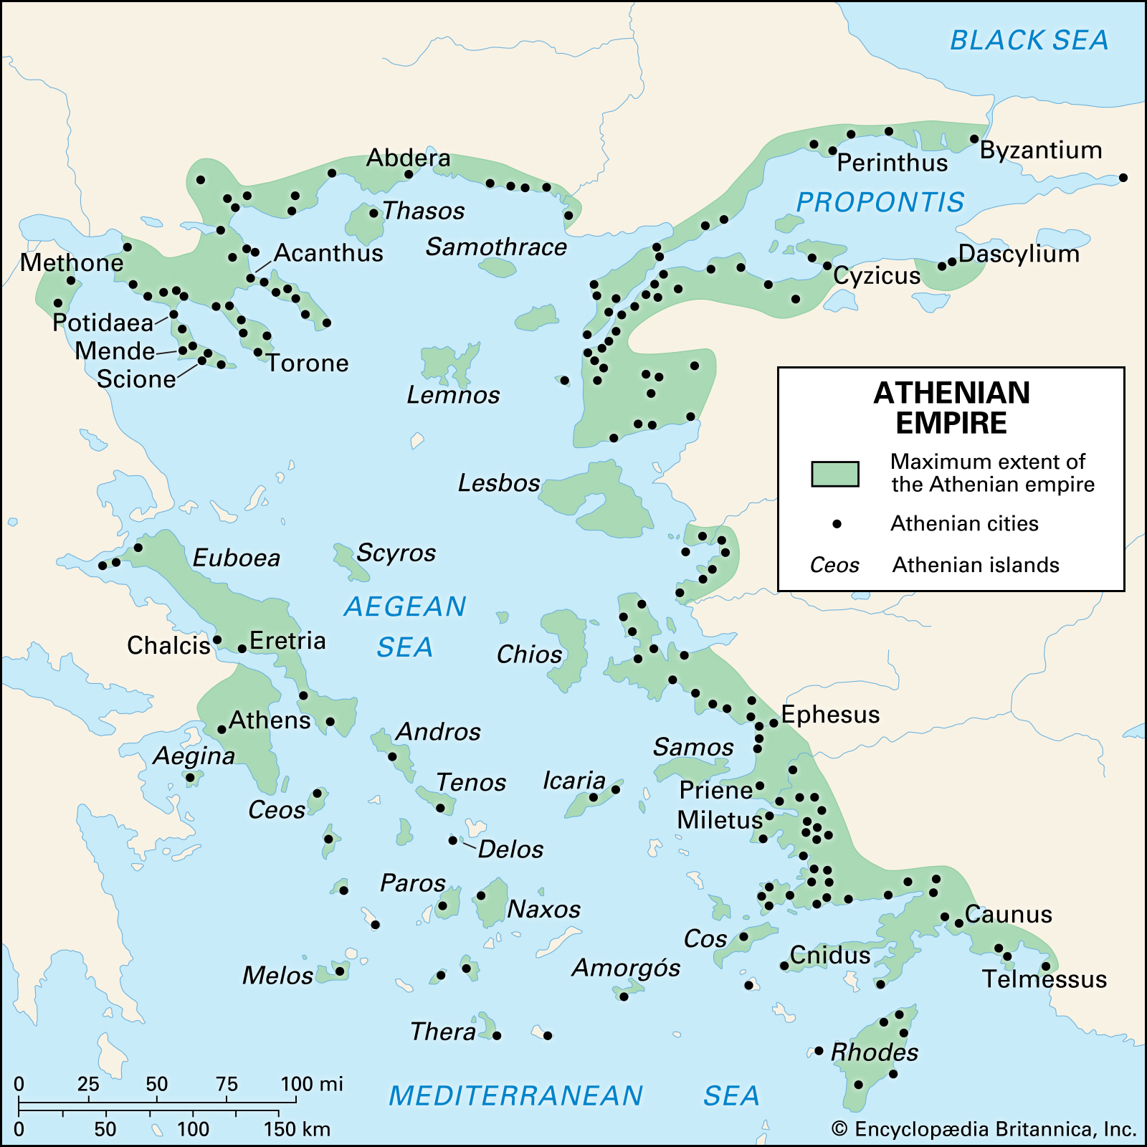

Slide 3
Collective Action Theory
Blanton and Fargher: If agents (taxpayers) produce little revenue internally, then principals (rulers) provide less and exert more control. Opposite is also true.
Application to 5th c BC Athens: It appears that Athenian revenues were largely external, so how was Athens so cooperative and collective?
Answer: Innovation in the use of colonies and cleruchies.
Consider also:
Collective action in a democracy
Theories of power: Weber and Mann (IEMP)

Slide 4
The Successful Athenian State
Cooperation leads to more success (Prisoner’s Dilemma)
See Ober (2008) and Athenian “aggregate flourishing”
Athenian state: 2,500 sq. km. 250,000 people.

Slide 5
Estimating Revenues
Internal
External
Laureion Silver Mines
Property Tax (eisphora)
Harbor Tax
Individual Liturgies
Tribute (phoros)
Control of colonies and emporia
Leasing of Athenian controlled foreign land

Slide 6
Aristophanes’ Wasps lines 655-660 Henderson trans., Loeb
ἀκρόασαί νυν, ὦ παππίδιον, χαλάσας ὀλίγον τὸ μέτωπον.
καὶ πρῶτον μὲν λόγισαι φαύλως, μὴ ψήφοις ἀλλ᾿ ἀπὸ χειρός,
τὸν φόρον ἡμῖν ἀπὸ τῶν πόλεων συλλήβδην τὸν προσιόντα,
κἄξω τούτου τὰ τέλη χωρὶς καὶ τὰς πολλὰς ἑκατοστάς,
πρυτανεῖα, μέταλλ᾿, ἀγοράς, λιμένας, μισθώσεις, δημιόπρατα·
τούτων πλήρωμα τάλαντ᾿ ἐγγὺς δισχίλια γίγνεται ἡμῖν.
Then listen, pop, and relax your frown a bit.
First of all, calculate roughly, not with counters but on your fingers,
how much tribute we receive altogether from the allied cities.
Then make a separate count of the taxes and the many one percents,
court dues, mines, markets, harbors, rents, proceeds from confiscations.
Our total income from all this is nearly 2000 talents.

Slide 7
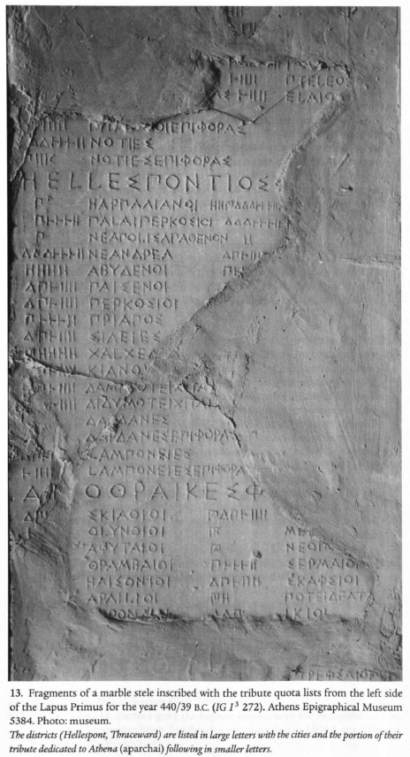
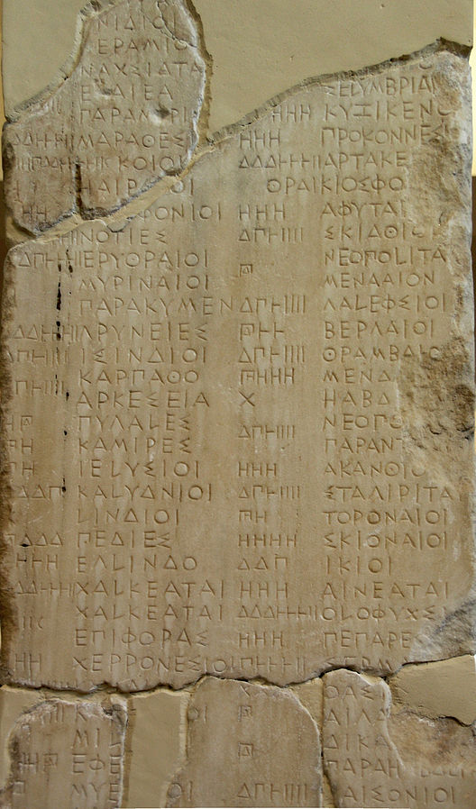
Tribute list for 439/8. IG I³ 273-280. Athens Epigraphical Museum.
From Kallet 2005, 34.

Slide 8
A Note on Laureion Silver
The influx of wealth from the Laureion mines increased authority of principals to enact change and increase state capacity.
Themistocles and the construction of navy.
With capture of Eion, however, external revenues begin to take precedence in collective action equation.
Athenian Tetradrachm, 5th c. BC

Slide 9
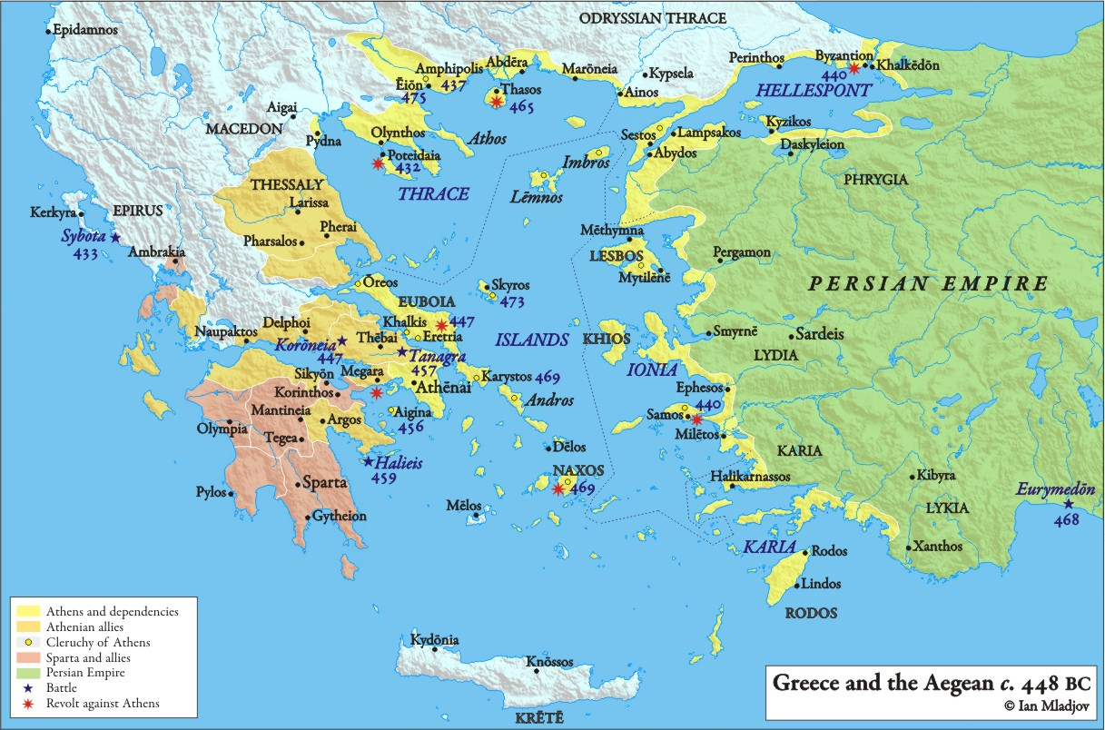

Slide 10
Eion and The Economic Character of Athenian Arche
Eion: Lucrative port on Strymon river with internal access to Thrace, export of timber and silver.
Under pretext of fighting Persians, Cimon uses funds of Delian League to take control.
Athens subsequently subsumes Thasian Peraia
From the beginning then, Athenian imperial ambitions were economically motivated.
Cimon’s familial relations, Mann’s IEMP, and legitimization in the use of force.

Slide 11
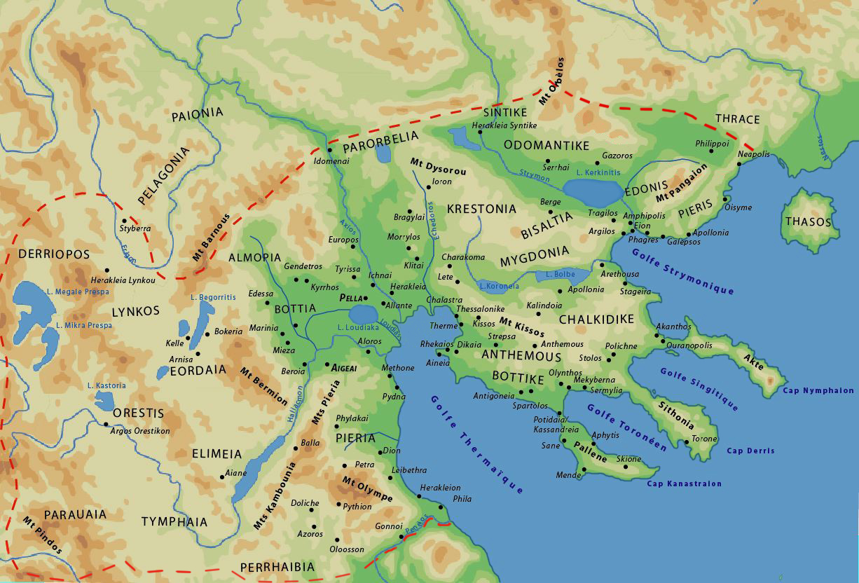

Slide 12
Amphipolis
Similar to Eion, located just up the River Strymon
Oikist: Hagnon
Instituted democracy
Returned to Athens in time to be strategos in 430.
Collective action in Democracy
“[A]lthough a democratic political system should ideally provide politicians with good reasons for supplying public goods desired by citizens whose votes they need to stay in office, in reality the combination of the information asymmetry and the influence asymmetry between members of internal and external constituencies gives politicians an incentive to respond to the particular interests of some politically useful citizens rather than to the general interests of the public as a whole.” (Geddes 1994, 41).
Shortcomings of the “Mixed Colony”

Slide 13
The Athenian Cleruchy
Definition: An establishment of Athenian citizens abroad.
Mytilene on island of Lesbos
According to Thucydides, Athenians crushed a revolt in 427 BC.
Land divided into 3,000 lots (300 for the gods, 2,700 for cleruchs)
Lots worked by natives paying yearly rent of 2 minae per lot.
Athenian coercive control of native inhabitants (perhaps equitable to condition of slavery)

Slide 14
Conclusion
Athens initially appears as a paradigm collective state.
By applying collective action theory, we may re-focus our attention to the periphery of the Athenian state.
Doing so allows us to view the more coercive elements of Athenian policy.

Slide 15
Bibliography
Axelrod, Robert M. 1984. The Evolution of Cooperation. New York: Basic Books.
Blanton, Richard and Lane Fargher. 2009. “Collective Action in the Evolution of Pre-Modern States.” Social Evolution & History 8:133-166.
———. 2008. Collective Action in the Formation of Pre-Modern States. New York: Springer.
Bolmarcich, Sarah. 2015. "Interstate Relations, Colonization, and Empire among Greek Participatory Communities." In A Companion to Greek Democracy and the Roman Republic, edited by D. Hammer, 311-28. Chichester, UK: Wiley-Blackwell.
Brunt, P.A. 1966. “Athenian Settlements Abroad in the Fifth Century B.C.” In Ancient Society and Institutions. Studies Presented to Victor Ehrenberg on his 75th Birthday, edited by E. Badian, 71-92. Oxford.
Finley, M.I. 1982. “The Fifth-Century Empire: A Balance-Sheet.” In Imperialism in the Ancient World, edited by P.D.A. Garnsey and C.R. Whittaker, 103-26. Cambridge
Fleury, Eric A. 2020. “Daring and Deliberation: Virtue, Rhetoric, and Diplomacy in Thucydides’ Account of the Athenian Empire.” Journal of International Political Theory 16, no. 3: 270–86.
Geddes, Barbara. 1994. Politician’s Dilemma: Building State Capacity in Latin America. California Series on Social Choice and Political Economy. Berkeley: University of California Press.
Graham, A. John. 1983. Colony and Mother City in Ancient Greece. 2nd ed. Chicago: Ares.
Hansen, Ove. 1999. "The Athenian Colony of Brea = Amphipolis?" Hermes 127 (1): 121.
Kagan, Donald. 2013. "The Consolidation of the Empire." In The Outbreak of the Peloponnesian War, 179-92. Ithaca, NY: Cornell University Press.
Kallet, Lisa. 2013. “The Origins of the Athenian Economic ἀρχή.” The Journal of Hellenic Studies 133: 43-60.
———. 2005. “Wealth, Power, and Prestige: Athens at Home and Abroad.” In The Parthenon: From Antiquity to the Present, edited by Jenifer Neils, p.34-65. Cambridge: Cambridge University Press.
Meiggs, Russell and David Lewis. 1988. A Selection of Greek Historical Inscriptions to the End of the Fifth Century B.C. Rev. ed. Oxford: Oxford University Press.
Meiggs, Russell. 1972. The Athenian Empire. Oxford: Oxford University Press.
Ober, Josiah. 2008. Democracy and Knowledge: Innovation and Learning in Classical Athens. Princeton: Princeton University Press.
Thurston, T.L. 2018. “There Is No Means by Which I Live: Livelihood and Power at the Margins of the State.” Archeological Papers of the American Anthropological Association 29: 99-119.
Zelnick-Abramovitz, R. 2004. “ Settlers and Dispossessed in the Athenian Empire.” Mnemosyne 57 no.3: 325-45.

Slide 16
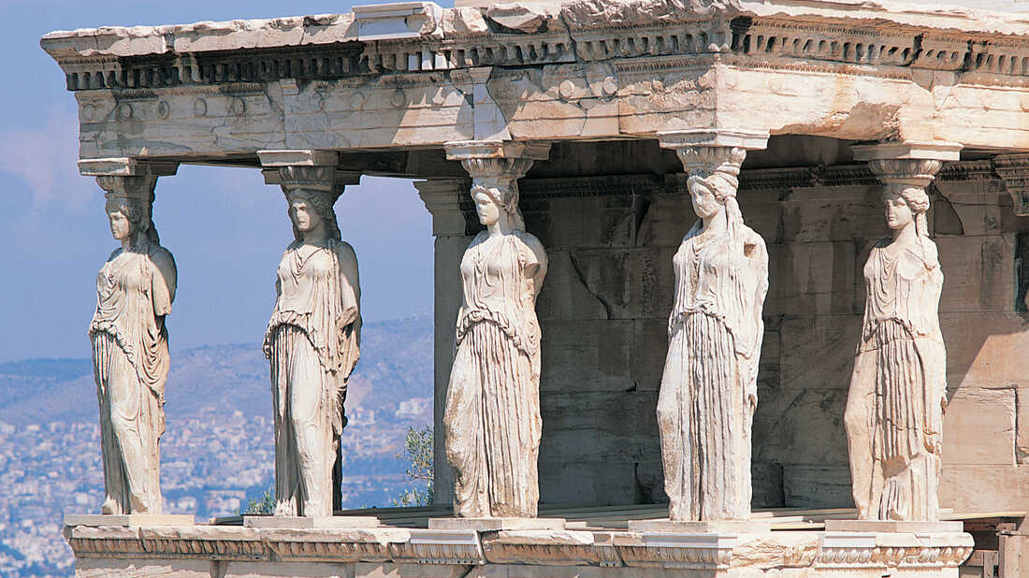
Questions

