Slide 1
The Early Roman Dictatorship: A Dangerous Institution? CAMWS 2022
Jeffrey Easton
Southwestern University
eastonj@southwestern.edu

Slide 2
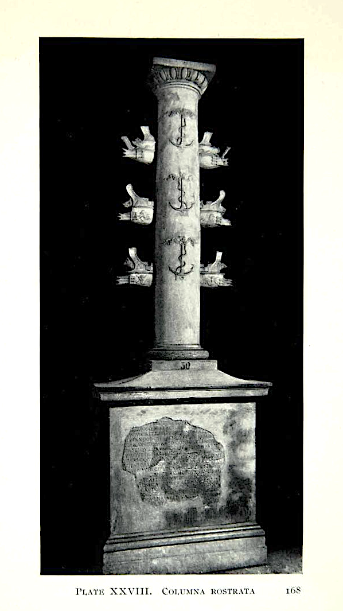
Duilius’ Columna Rostrata
Reconstruction by M. Fischer 1969

Slide 3
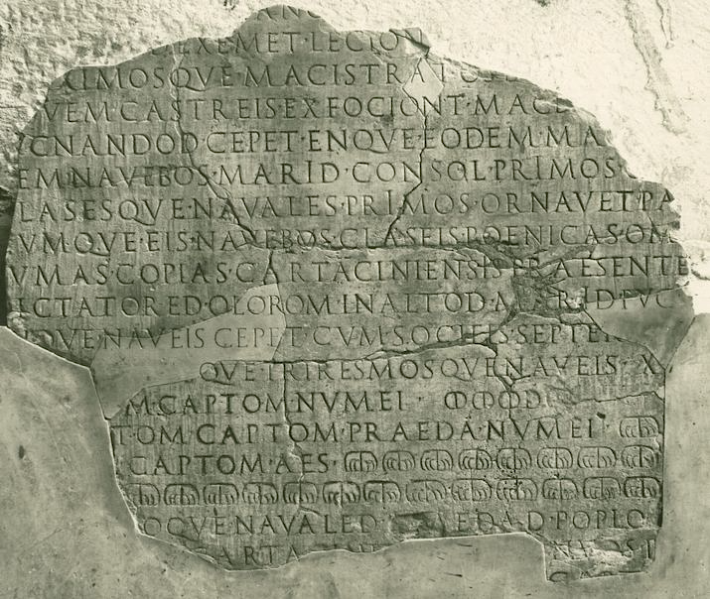
CIL VI 1300
Inscription on base of rostral column in the Roman Forum (second one in Forum Boarium)
Celebrated the naval victory of C. Duilius at Mylae in 260 BCE, erected within a generation of his life
This version is an Augustan reissue of the original inscription; fragments found in mid-sixteenth century near Arch of Septimius Severus
Center for Epigraphical Studies, Ohio State University

Slide 4
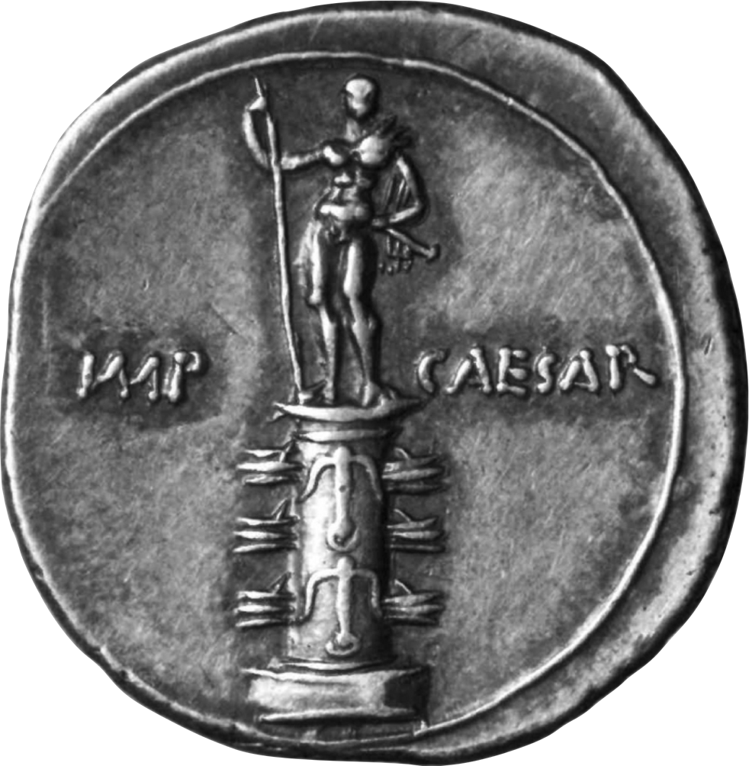
RIC I² Augustus 271 = BMC 633
Denarius, c. 30 BCE (reverse)
Celebrated naval victories at both Naulochus (36 BCE) and Actium (31 BCE)
From Roller 2018: 150

Slide 5
CIL VI 1300
Inscription on base of rostral column in the Roman Forum (second one in Forum Boarium)
Celebrated the naval victory of C. Duilius at Mylae in 260 BCE, erected within a generation of his life
This version is an Augustan reissue of the original inscription; fragments found in mid-sixteenth century near Arch of Septimius Severus
D
I
C
T
A
T
O
R
E
D
O
L
O
R
O
M
DICTATORED OLORUM = DICTATORE ILLORUM
Center for Epigraphical Studies, Ohio State University

Slide 6
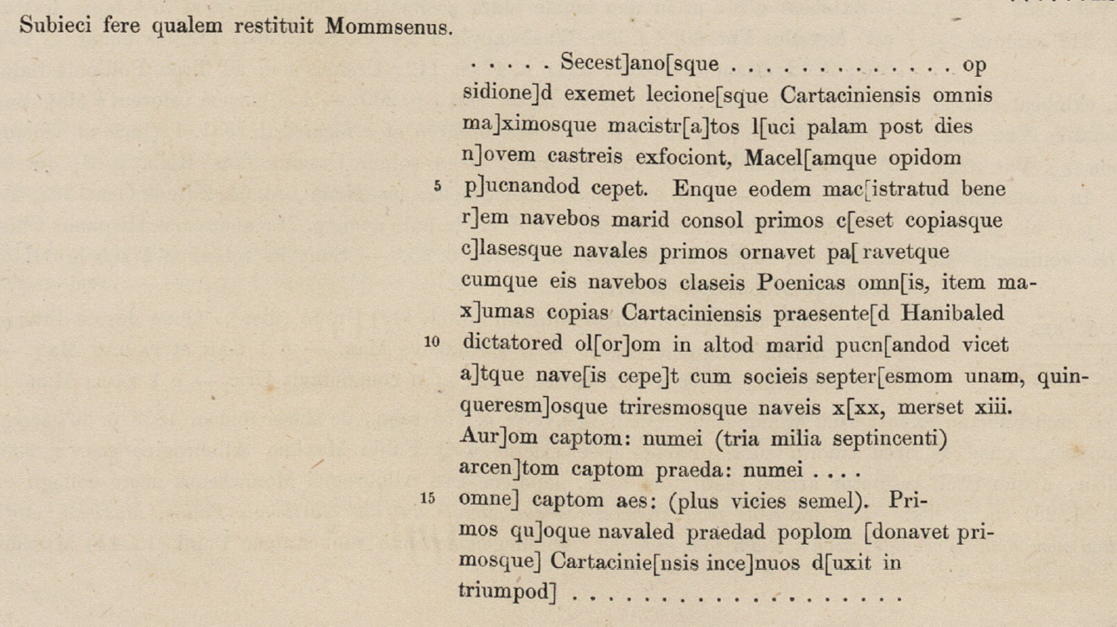
Mommsen’s reconstruction of the text (CIL VI.1, Bormann and Henzen, 1876)

Slide 7
Dictatorial causae
Military (militiae)
rei gerundae causa
Civic (domi)
comitiorum habendorum causa
exercendis quaestionibus causa
clavi figendi causa
ludorum Romanorum causa
feriarum Latinarum causa
interregni causa
seditionis sedendae causa (doubtful)

Slide 8
Livy 7.11.4-9 (on events of 360 BCE; trans. J. Yardley)
et, cum adversus Tiburtem hostem duce consule contenta res publica esset, Gallicus tumultus dictatorem creari coegit. creatus Q. Servilius Ahala T. Quinctium magistrum equitum dixit et ex auctoritate patrum, si prospere id bellum evenisset, ludos magnos vovit. dictator ad continendos proprio bello Tiburtes consulari exercitu iusso manere, omnes iuniores nullo detractante militiam sacramento adegit… egregie cum ab dictatore tum ab consule res gesta est. et consul alter Fabius proeliis ... dictator consulibus in senatu et apud populum magnifice conlaudatis et suarum quoque rerum illis remisso honore dictatura se abdicavit. Poetelius de Gallis Tiburtibusque geminum triumphum egit: Fabio satis visum ut ovans urbem iniret.
To combat the Tiburtine enemy the state was content to have a consular commander, but the Gallic incursion made the appointment of a dictator imperative. The man appointed was Quintus Servilius Ahala, who named Titus Quinctius as his master of horse, and with the authority of the Senate made a vow of Great Games should that war prove successful. To keep the Tiburtines pinned down in their own theatre of operations, the consular armies were ordered to remain in place, and the dictator made all the younger men take the oath of loyalty (and none tried to avoid service)… The operation was admirably conducted by dictator and consul alike. Fabius, the other consul, also won a decisive victory over the Hernici, at first in minor skirmishes, and then finally in an outstanding engagement in which the enemy launched an all-out attack … The dictator praised the consuls to the skies in the Senate and before the people, even conceding to them the glory of his own successful exploits, and after that Poetelius celebrated a double-triumph over the Gauls and Tiburtines; entering Rome with an ovation was thought sufficient for Fabius.

Slide 9
Livy 7.3.4-9 (on events of 363 BCE; trans. J. Yardley)
lex vetusta est, priscis litteris verbisque scripta, ut qui praetor maximus sit idibus Septembribus clavum pangat; fixa fuit dextro lateri aedis Iovis optimi maximi, ex qua parte Minervae templum est. eum clavum, quia rarae per ea tempora litterae erant, notam numeri annorum fuisse ferunt eoque Minervae templo dicatam legem quia numerus Minervae inventum sit. (Volsiniis quoque clavos indices numeri annorum fixos in templo Nortiae, Etruscae deae, comparere diligens talium monumentorum auctor Cincius adfirmat.) M. Horatius consul ea lege templum Iovis optimi maximi dedicavit anno post reges exactos; a consulibus postea ad dictatores, quia maius imperium erat, sollemne clavi figendi translatum est. intermisso deinde more digna etiam per se visa res propter quam dictator crearetur. qua de causa creatus L. Manlius, perinde ac rei gerendae ac non solvendae religionis gratia creatus esset, bellum Hernicum adfectans dilectu acerbo iuventutem agitavit; tandemque omnibus in eum tribunis plebis coortis seu vi seu verecundia victus dictatura abiit.
There is an old law, written in archaic script and language, stipulating that the chief praetor should hammer in a nail on September 13th; it was fixed on the right side of the temple of Jupiter Optimus Maximus, at the spot where the temple of Minerva stands. Because literacy was rare in those days, that nail, they say, served to enumerate the passage of years, and the reason for its consecration in the temple of Minerva was that enumeration was Minerva’s invention. (Cincius, who is a meticulous scholar of such monuments, claims that nails as an annual numerical indicator are also to be seen at Volsinii, driven into the temple of the Etruscan goddess Nortia.) The consul Marcus Horatius established that law and dedicated the temple of Jupiter Optimus Maximus in the year after the expulsion of the kings. Subsequently the ceremony of hammering in the nail passed from the consuls to dictators, because these had greater authority. Then, when there was a lapse in the tradition, it was thought to be important enough in itself to have a dictator appointed expressly for that purpose. This was the reason for Lucius Manlius’ appointment, but he acted as if he had been appointed for military purposes and not in order to correct a failure in religious observance. He harboured ambitions for war with the Hernici, and plagued the young men with an oppressive conscription, but finally all the plebeian tribunes rose up against him and he resigned his dictatorship, overcome by their force or his feelings of shame.

Slide 10
History of the ‘original’ dictatorship
95

Slide 11
The Dictatorship after Sulla
Sulla’s new causa => rei publicae constituendae causa (‘for the purpose of setting the Republic in order’)
Dionysius of Halicarnassus Ant. Rom. 5.77.4
ἐπὶ δὲ τῆς κατὰ τοὺς πατέρας ἡμῶν ἡλικίας ὁμοῦ τι τετρακοσίων διαγενομένων ἐτῶν ἀπὸ τῆς Τίτου Λαρκίου δικτατορίας διεβλήθη καὶ μισητὸν ἅπασιν ἀνθρώποις ἐφάνη τὸ πρᾶγμα Λευκίου Κορνηλίου Σύλλα πρώτου καὶ μόνου πικρῶς αὐτῇ καὶ ὠμῶς χρησαμένου· ὥστε τότε πρῶτον αἰσθέσθαι Ῥωμαίους, ὃ τὸν ἄλλον ἅπαντα χρόνον ἠγνόουν, ὅτι τυραννίς ἐστιν ἡ τοῦ δικτάτορος ἀρχή.
In the time of our fathers, some four hundred years after the dictatorship of Titus Larcius, the office was misrepresented and became hated when Lucius Cornelius Sulla, for the first and only time, used it harshly and cruelly. The result was that the Romans understood for the first time what they did not know for the whole time before, that the office of dictator is a tyranny.
Appian BC 1.98-9
[98] ὁ δὲ ἔργῳ βασιλεὺς ὢν ἢ τύραννος, οὐχ αἱρετός, ἀλλὰ δυνάμει καὶ βίᾳ.
He was in practice a king or tyrant, not by election but by force and violence.
[99] τότε δὲ πρῶτον ἐς ἀόριστον ἐλθοῦσα τυραννὶς ἐγίγνετο ἐντελής.
Then, being unrestricted for the first time, [the dictatorship] became a full-fledged tyranny.

Slide 12
Select Bibliography
Brennan, T. 2000. The Praetorship in the Roman Republic (2 vols.). Oxford.
Easton, J. 2010. A New Perspective on the Early Roman Dictatorship. MA Thesis, University of Kansas.
Feeney, D. 2007. Caesar’s Calendar: Ancient Time and the Beginnings of History. Berkeley.
Hartfield, M. 1982. The Roman Dictatorship: Its Character and Its Evolution. PhD Dissertation, University of California at Berkeley.
Kondratieff, E. 2004. ‘The column and coinage of C. Duilius: Innovations in iconography in large and small media in the Middle Republic,’ Scripta Classica Israelica 23: 1-39.
Oakley, S. 1998. A Commentary on Livy, Books VII-VIII. Oxford.
Pina Polo, F. 2011. The Consul at Rome: The Civil Functions of the Consuls in the Roman Republic. Cambridge.
Ridley, R. 1979. ‘The Origin of the Roman Dictatorship: An Overlooked Opinion,’ RhM 122: 303-9.
Smith, C. 2011. ‘The magistrates of the early Roman Republic,’ in H. Beck, et al. (eds.), Consuls and Res Publica: Holding High Office in the Roman Republic. Cambridge, pp. 19-40.
Wilson, M. 2021. Dictator: The Evolution of the Roman Dictatorship. Ann Arbor.

