Slide 1
VRoma Reborn: Teaching & Learning
In A Virtual World

Slide 2
Presented at CAMWS MMXXII
BY
Suzanne Bonefas
John Gruber-Miller
Ann Raia

Slide 3
overview
I
Gratitude & GOALS
IV
olc 24 Treasure Hunt (John)
Role playing: Plying a Trade in VRoma (Ann)
II
Brief History
V
III
VIA APPIA
VI
DISCUSSION:
what’s next?
Basics of communication and navigation

Slide 4
I
Acknowledgments
&
GOALS FOR TODAY
Provide an overview of VRoma
Demonstrate some of the current pedagogical features and capacities
Get your feedback and ideas about the future of VRoma

Slide 5
II
A Brief History of VRoma
MCMXCVI - MMXXII

Slide 6
WHAT IS VROMA?
First and foremost, we are a community of instructors, scholars, and learners who share a passion for the ancient world!
Our original goals were to promote Latin teaching and learning, enable remote collaboration between and among instructors at all levels, and provide professional development for use of technology in the classroom

Slide 7
TIMELINE
1996-97
1998-2015
2008
2010-
NEH grant! First instructor workshop → resources and initial Rome building
Ongoing training.
145 instructor and 700(?) student users
Sustained usage of resource archive > 1000 users/day
The MOO (virtual environment)speaks Latin!

Slide 8
VRoma Components
resources
training
Virtual Environment
Teaching modules and an image archive all created by instructors in our community for all levels (update in progress)
PD: Workshops and seminars for learning to use and enhance VRoma
An online teaching and learning space with interactive lessons & games created by VRomans

Slide 9
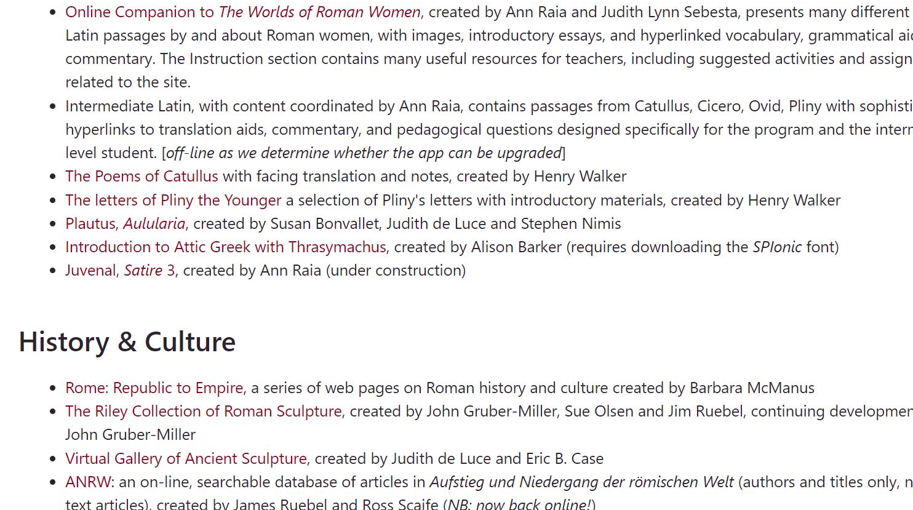
Resources
Teaching & Learning Modules [vroma.org/vr_new/resources/]
Juvenal Satire 3

Slide 10
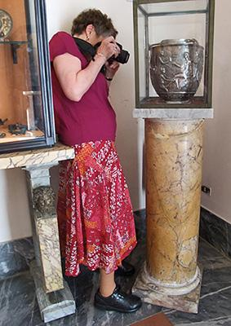
Resources
Image Archive [vroma.org/images]
Barbara F. McManus (shown at the National Archaeological Museum in Naples in 2012) and Ann R. Raia (shown at the Ny Carlsberg Glypotek in Copenhagen in 2008) have travelled to many different countries over the years, taking photographs of classical artifacts and sites in order to continually expand the VRoma Image Archive. We hope that these images open a valuable visual window onto the ancient world for teachers, students, and lovers of classical antiquity, making learning a richer and more enjoyable experience for all.

Slide 11
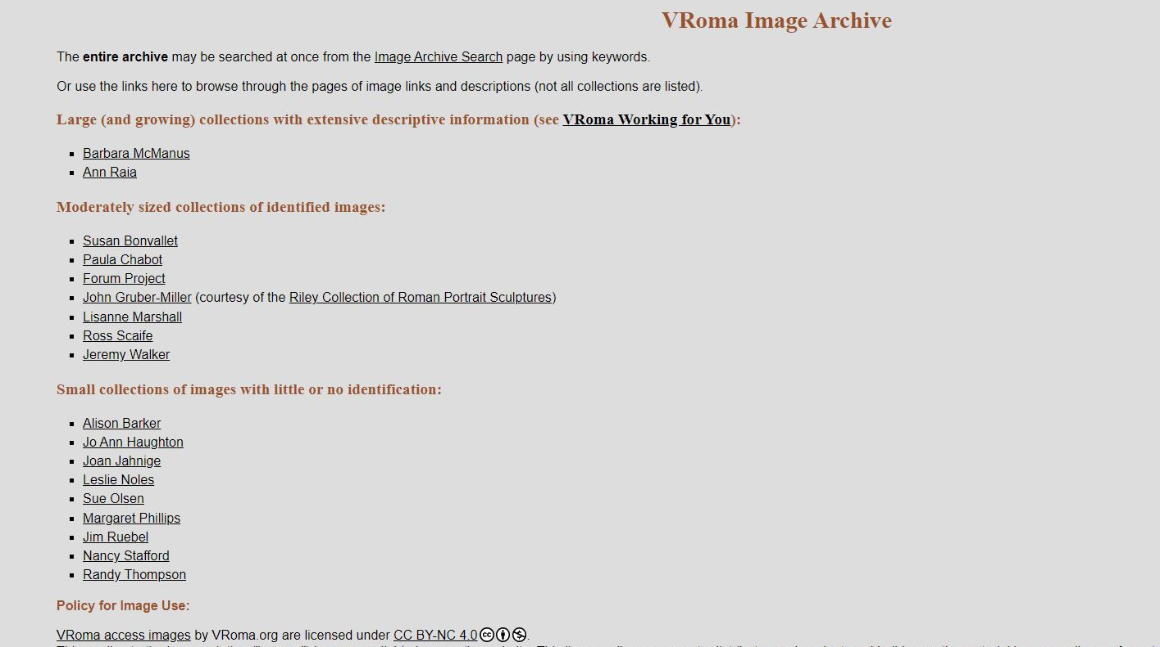
Resources
Image Archive [vroma.org/images]
Ann Raia’s Images

Slide 12
VRoma Components
resources
training
Virtual Environment
Teaching modules and an image archive all created by Latin instructors in our community
Workshops and seminars for learning to use and enhance VRoma
An online teaching and learning space with interactive lessons & games created by VRomans

Slide 13
Training
Professional & Resource Development [NEH-funded workshop page]
VRoma Workshops and Seminars , e.g.:
1998 Workshop hosted by Miami University:
building Rome,
add images from personal collections,
design and initiate a personal independent project (Juvenal Satire 3)
2008 VRoma Latin Translation Seminar
hosted by Ball State University
funded by CAAS grant

Slide 14
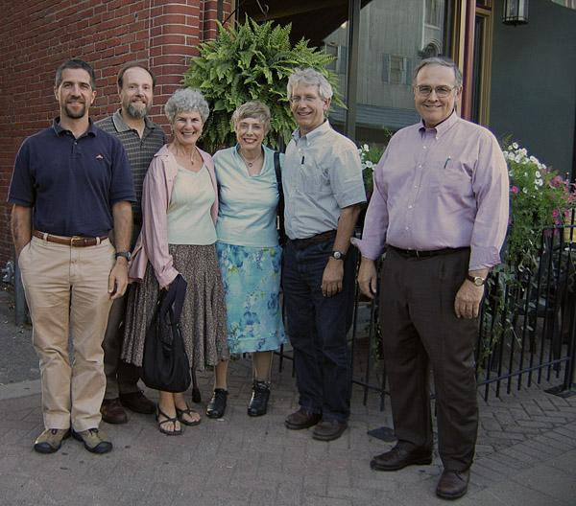
Vromans at work!

Slide 15
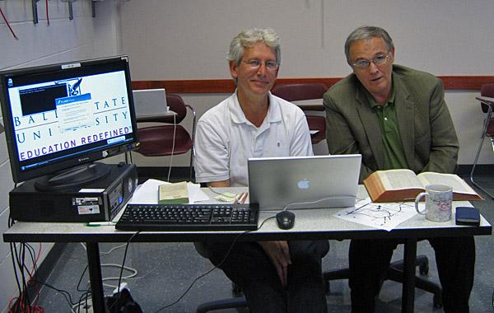
Vromans at work!

Slide 16
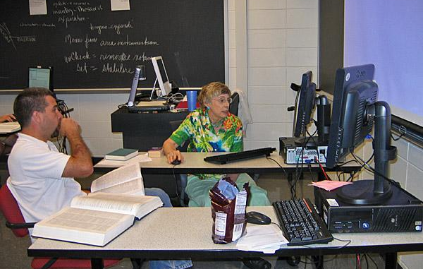
Vromans at work!

Slide 17
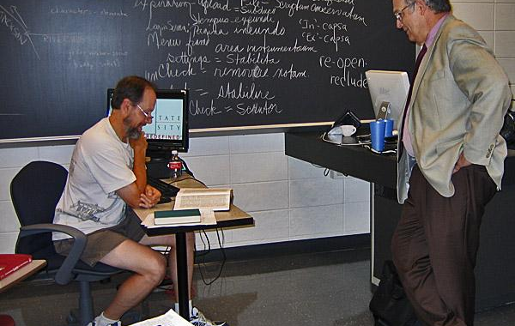
Vromans at work!

Slide 18
VRoma Components
resources
training
Virtual Environment
Teaching modules and an image archive all created by Latin instructors in our community
Workshops and seminars for learning to use and enhance VRoma
An online teaching and learning space with interactive lessons & games created by VRomans

Slide 19
Virtual Rome
Interactive Online Environment built by VRomans
Enhanced text-based VR based on ancient Rome
images and details
non-player characters (“bots”)
“objects” that can be manipulated
Classroom area where instructors can bring students for interactive activities or create your own
Instructors can provide access for student building projects
e.g. students work in groups to “build” a Roman villa or other structure
Activities we will show you today:
Travelling the Via Appia (Suzanne)
Quest keyed to OLC II Chapter 24 (John)
Plying a Trade in VRoma (Ann)

Slide 20
III
Eamus VRomam!
To join us online:
Start at vroma.org
Click “Log In” the “Log into the VRoma MOO”
Click “Log in as a guest”
Or sit back and observe as we show you a tiny portion of the massive site!
Notes:
****

Slide 21
VIA APPIA
From the Prima Porta, go to Rome, then Regio I to begin your journey.
[Link to original exercise (under revision)]

Slide 22
Treasure Hunt
John Gruber-Miller
OLC II, Chapter 24

Slide 23
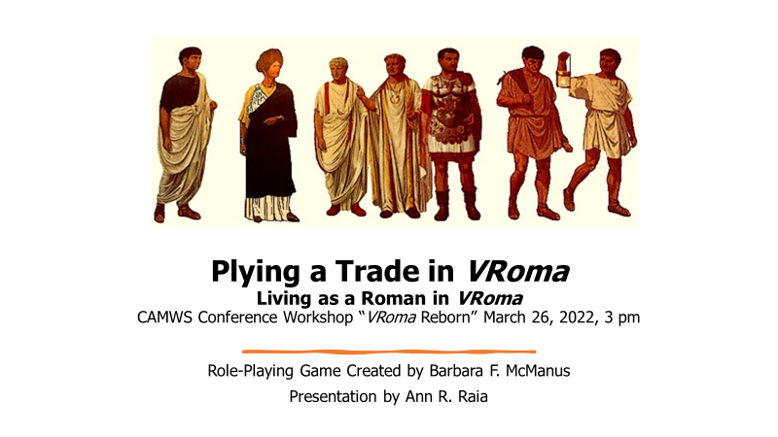
[Link to student instructions] [Link to Instructor Information]

Slide 24
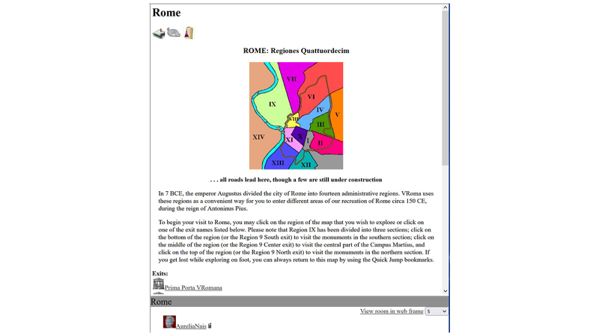

Slide 25
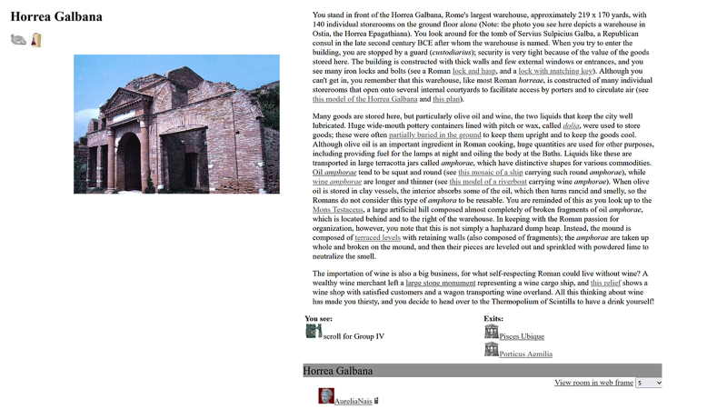

Slide 29
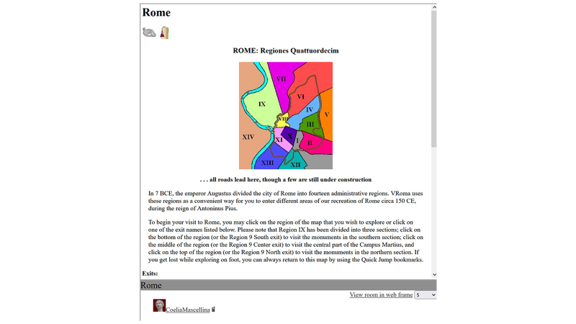

Slide 31
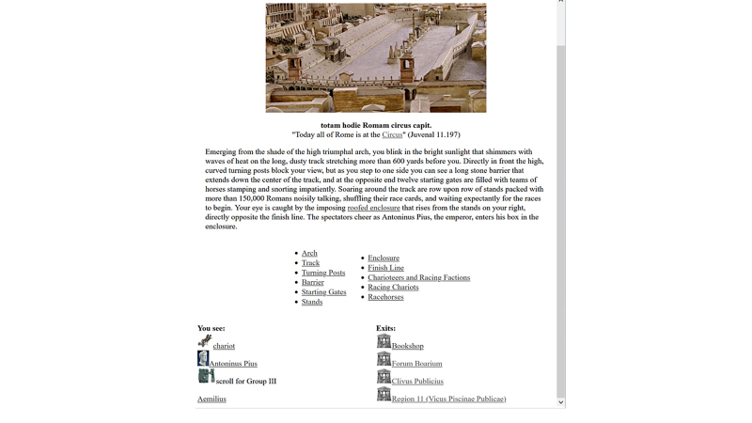

Slide 32
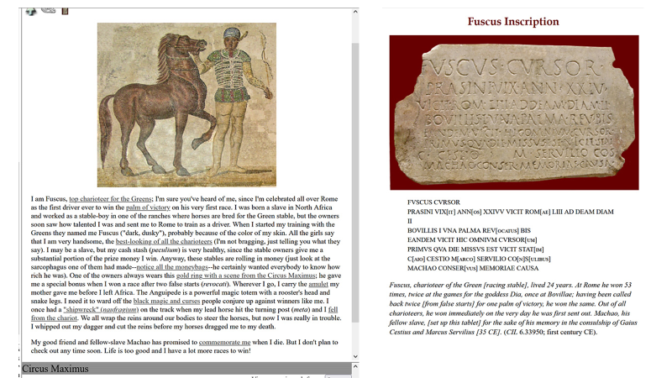

Slide 33
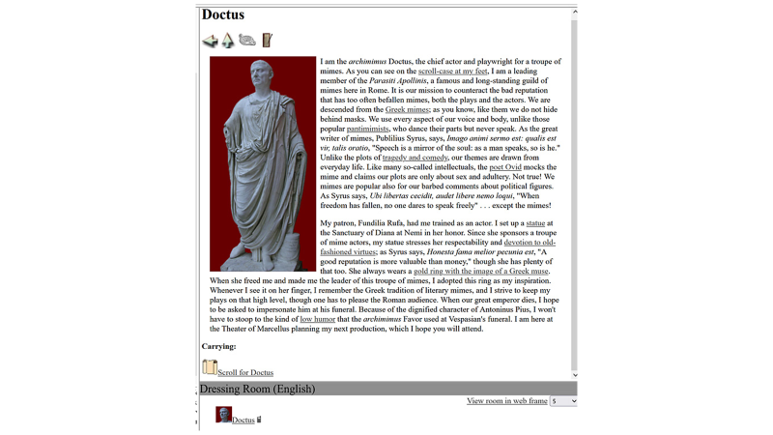

Slide 36
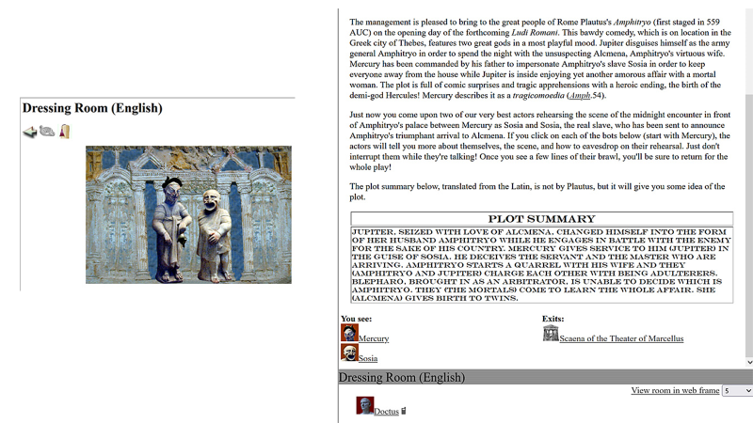

Slide 37
IV
What’s Next?
Planned updates to interface to address accessibility.
Developing sustainability plan for site and instructor support
Regular gatherings (formal and informal) and trainings
Programming and Building classes
How can we tailor VRoma to meet your needs as an instructor in today’s real and virtual classroom?

Slide 38
V
Join Us!
Become a VRoman!
www.vroma.org
info@vroma.org

Slide 39
THANKS!
facebook.com/Freepik
@Freepik_Vectors
company/freepik-company
Please keep this slide for attribution

