Slide 1
Comparative rates of text reuse in classical Latin hexameter poetry Neil W. Bernstein
March 2015
CAMWS Boulder

Slide 2
What is text reuse? Example of summa dies, “the final day”
Statius Thebaid 3.624: summa dies, uetitumque dari mortalibus armis.
Lucan Bellum Civile 7.195: 'uenit summa dies, geritur res maxima,' dixit
Virgil Aeneid 2.324: uenit summa dies et ineluctabile tempus
Plautus Persa 34: haec dies summa hodie est, mea amica sitne libera

Slide 3
Tesserae Features tesserae.caset.buffalo.edu
Match two lexemes occurring together in two different texts
Score results by word frequency and phrase density. How common are the words? How close together are they?
Languages: Latin, Greek, English

Slide 4
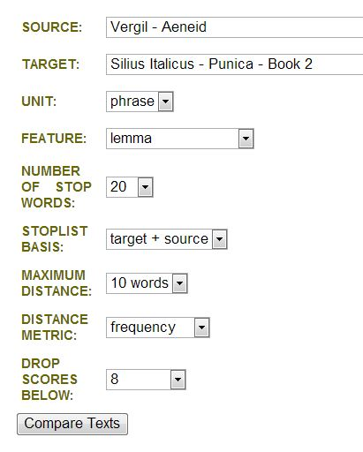
Interface features

Slide 5
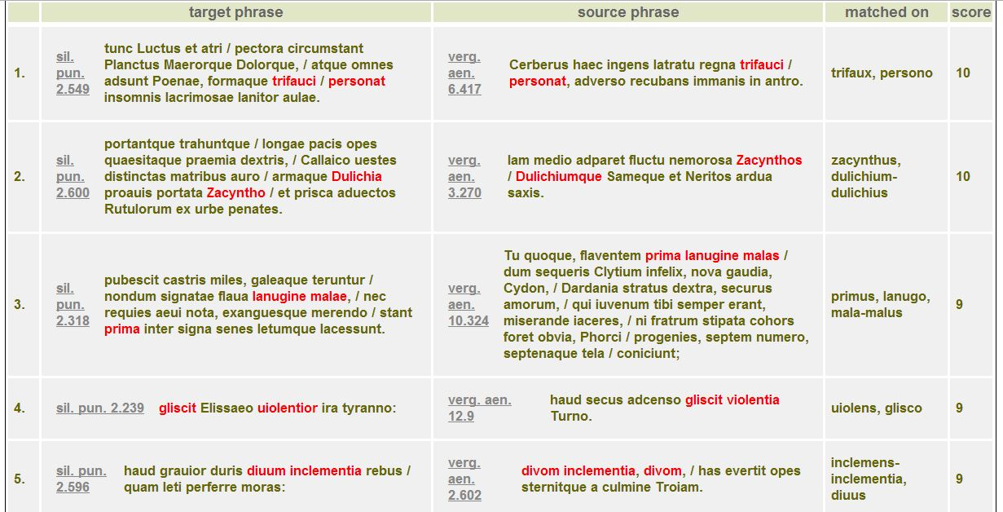
Initial results from search of Silius Punica 2 (target) and Virgil Aeneid (source)

Slide 6
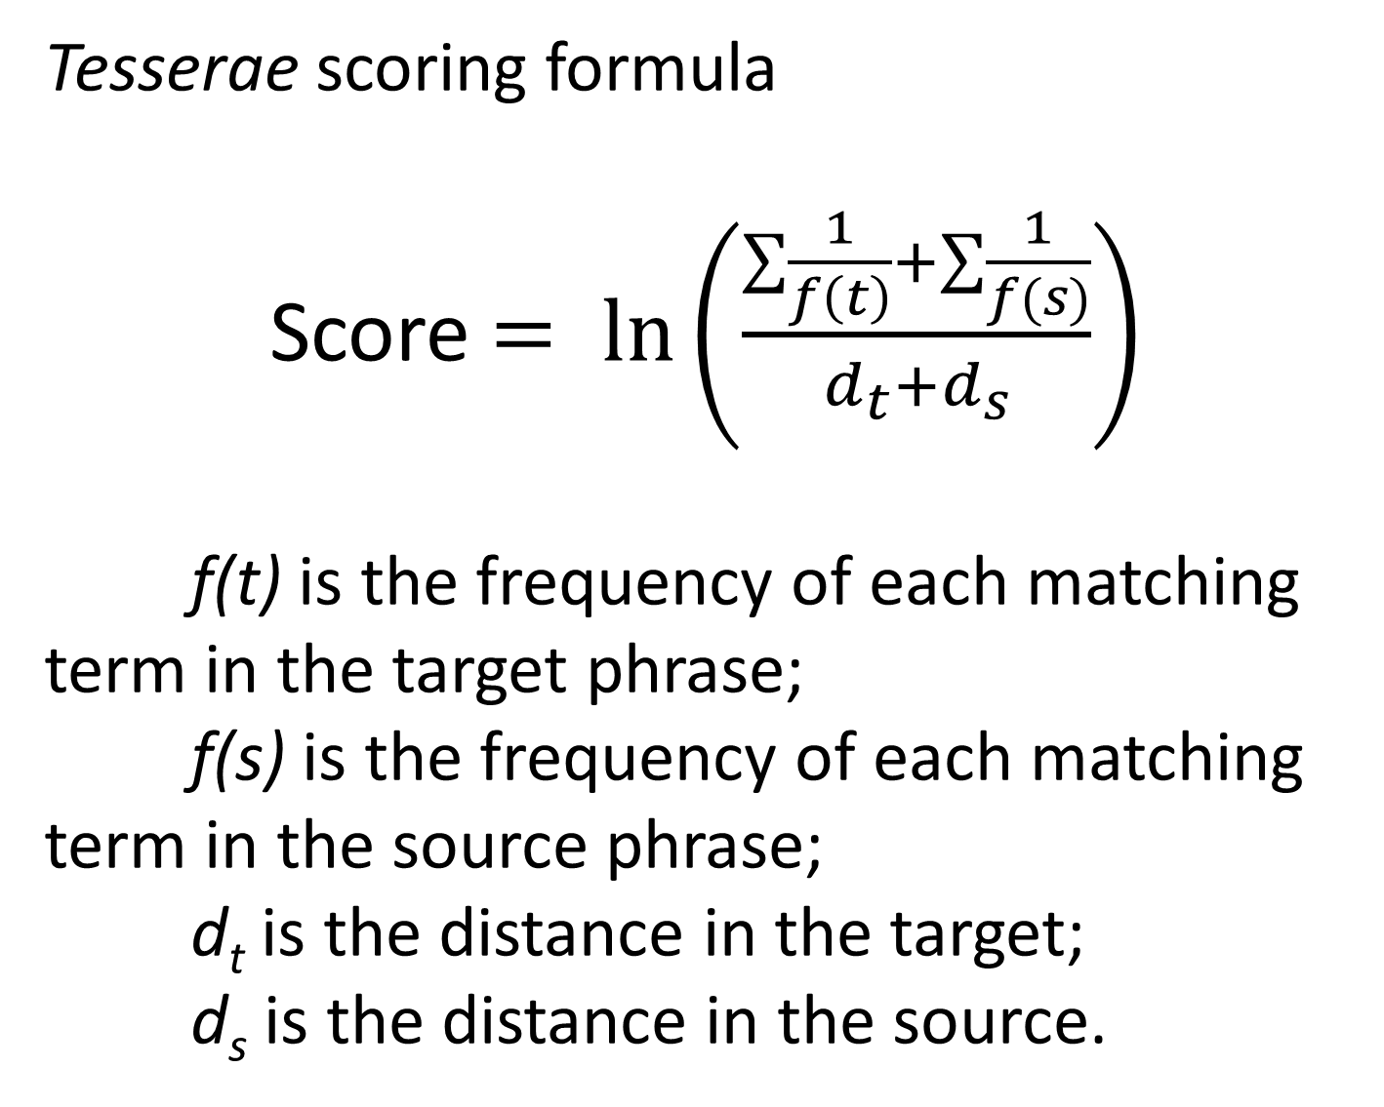
Tesserae scoring formula
Score $= \ln\left(\frac{\sum{\frac{1}{f\left(t\right)}}+\sum{\frac{1}{f(s)}}}{d_{t}+d_{s}}\right)$
f(t) is the frequency of each matching term in the target phrase;
f(s) is the frequency of each matching term in the source phrase;
d_{t} is the distance in the target;
d_{s} is the distance in the source.

Slide 7
Macrophilological applications
How “Lucretian” is Lucan’s Bellum Civile compared to Manilius’ Astronomica?
How “Ovidian” is Valerius’ Argonautica compared to Statius’ Thebaid?
Step toward objective quantification of text reuse within a genre and across genres.

Slide 8
This study: 7 centuries of Latin hexameter poetry
Text | Date (approximate) | Length (words)
Lucretius, De Rerum Natura | before 55 bce | 49099
Vergil, Eclogues | 42–39 bce | 5629
Horace, Satires | 40–30 bce | 14282
Vergil, Georgics | 36–29 bce | 14177
Horace, Epistles | 23–20 bce | 9914
Vergil, Aeneid | 19–29 bce | 63726
Horace, Ars Poetica | 14 bce | 3092
Ovid, Metamorphoses | 2–8 ce | 78026
Manilius, Astronomicon | after 9 ce | 27565
Persius, Satires | before 62 ce | 4521
Lucan, Bellum Civile | 64–65 ce | 51015
Ilias Latina | 60–70 ce | 6630
Valerius Flaccus, Argonautica | before early 90s ce | 37411
Statius, Thebaid | 92 ce | 62701
Statius, Achilleid | 95 ce | 7223
Silius Italicus, Punica | before 96 ce | 76457
Juvenal, Satires | after 96 ce | 25098
Juvencus, Historia Evangelica | 330 ce | 20590
Ausonius, Mosella | 370 ce | 2949
Claudian, De Raptu Proserpinae | 395–397 ce | 6993
Claudian, De Quarto Consulatu Honorii Augusti | 397 ce | 3985
Claudian, De Bello Gildonico | 398 ce | 3184
Claudian, De Consolatu Stilichonis | 399–400 ce | 7580
Corippus, Johannis | 6th c. ce | 32003

Slide 9
Large-scale comparison
Results for source = Virgil Aeneid and target = Ovid Metamorphoses
Score 10 hits: 60 results
Score 9 hits: 599 results
Score 8 hits: 2976 results
Score 7 hits: 11205 results

Slide 10
Normalization and scaling of results
Weight the composite count of high-scoring hits
Normalize the results from texts of varying lengths by multiplying number of words in source and target
Scale the resulting scatter plot to determine the average rate of reuse in the corpus of Latin epic texts.

Slide 11
Conversion of scores to residual counts Wei Lin, Dept of Mathematics, Ohio University
C_{obs} = 0.057C₇ + 0.225C₈ + C₉ + 6.286C₁₀ + 227.744C₁₁
c_{exp} = −19.591 + 1.311w_{s} + 1.208w_{t}
C = weighted hit count
Score 11 hits are more meaningful than score 7 hits
w_{s} = word count of source
w_{t} = word count of target
residual count (r) = c_{obs} − c_{exp}
determined by subtracting expected weighted count of Tesserae hits (based on length of texts) from actual weighted count

Slide 12
Sample pairs with high positive residual counts
Source | Target | r | Standardized r
Georgics | Aeneid | 1.280 | 4.571
Ov. Met. | Mosella | 1.073 | 3.830
Ov. Met. | Ilias Latina | 0.719 | 2.565
Eclogues | Georgics | 0.603 | 2.153
Aeneid | Ilias Latina | 0.594 | 2.119
Georgics | Ov. Met. | 0.560 | 1.999
Aeneid | Punica | 0.540 | 1.928

Slide 13
Sample pairs with residual counts close to 0
Source | Target | r | Standardized r
Aeneid | Man. Astr. | 0.011 | 0.039
Hor. AP | Persius | 0.008 | 0.028
Hor. Epist. | Juvenal | 0.003 | 0.010
Eclogues | VF Arg. | -0.003 | -0.012
Ov. Met. | VF Arg. | -0.006 | -0.020
Hor. Sat. | Juvenal | -0.007 | -0.026
Eclogues | De Raptu | -0.009 | -0.032

Slide 14
Sample pairs with high negative residual counts
Source | Target | r | Standardized r
Thebaid | Juvenal | -0.434 | -1.548
Man. Astr. | Persius | -0.468 | -1.669
Hor. Sat. | De Raptu | -0.485 | -1.731
Aeneid | Persius | -0.537 | -1.917
Persius | De Raptu | -0.579 | -2.065

Slide 15
Centrality
For each text, determine the mean value of r for all pairs involving that text.
Measures how often each text reuses earlier texts and is reused by later texts.
A text strongly influenced by its predecessors and influential to its successors would have a higher mean r than a text more peripheral to the literary tradition of Latin hexameter poetry.

Slide 16
Sample centrality measures
Text | Mean residual (r)
Georgics | 0.279
Aeneid | 0.133
Achilleid | 0.117
De Raptu | 0.088
Ovid Met. | 0.073
De Rerum Naturae | -0.151
Horace Satires | -0.187
Persius | -0.270

Slide 17
Provisional conclusions
Author signal
Genre signal
Conceptual vs. verbal resource: Lucretius’ De Rerum Natura
The prevalence of imitation: Flavian epic
Late antiquity: Ausonius’ Mosella

Slide 18
Author signal
One of the strongest determinants of intensity of text reuse.
In all 13 cases where a pair of texts was written by the same author, the reuse intensity was higher than average.

Slide 19
Genre signal
Especially marked when comparing epic and satiric texts.
Authors of satire do not often reuse the texts of epic, and vice versa.
The quantitative results indicate a strong separation between the genres in terms of their vocabulary.

Slide 20
Lucretius’ afterlife
De Rerum Natura not reused as extensively as works of Vergil and Ovid. r < 0.000 when paired with 21 of 23 suceeding target texts.
Only positive r values resulted from pairings with other didactic works, Vergil’s Georgics and Manilius’ Astronomica; neither significantly high.
Points to difference between importance of DRN as a conceptual resource and its relative insignificance as a verbal resource.

Slide 21
Flavian epic
Intensity of text reuse of Vergil’s works by Valerius Flaccus and Statius higher than average.
But not as high as the intensity of reuse of any of Vergil’s works by Ovid’s Metamorphoses.
Intertextual engagement with Vergil’s texts by Valerius Flaccus and Statius is accordingly less intense than commonly assumed in the scholarship.

Slide 22
Ausonius’ Mosella
Identified in prior scholarship as primarily Vergilian in character, with several secondary influences.
Mosella’s intensity of reuse of Ovid’s Metamorphoses highest of any two independently authored texts in the study.
Second only to Vergil’s reuse of the Georgics in the Aeneid.

Slide 23
Thanks to:
Tesserae team, Wei Lin, Kyle Gervais
University at Buffalo Departments of Classics and Linguistics
NEH Office of Digital Humanities

