Slide 1
Politics and Violence in
Jorge Alí Triana's
Edipo Alcalde
Annette M. Baertschi, Bryn Mawr College
CAMWS Annual Meeting, Boulder, 3/27/2015

Slide 2
Edipo Alcalde (Oedipus Mayor)
Director: Jorge Alí Triana
Cast: – Jorge Perugorría (Edipo)
  – Ángela Molina (Yocasta)
  – Francisco (Paco) Rabal (Tiresias)
  – Jairo Camargo (Creonte)
  – Jorge Martinez (Priest)
  – Miriam Colon (Deyanira)
  • Screenplay: Gabriel García Márquez
  • Theatrical release: 1996; DVD release: 2007

Slide 3
Gabriel García Márquez
Autobiography: Living to Tell the Tale (Vivir para contarla, 2002)
Works influenced by Sophocles, Oedipus the King:
Autumn of the Patriarch (El otoño del patriarca, 1975)
Chronicle of a Death Foretold (Crónica de una muerte anunciada, 1981)
The General in His Labyrinth (El general en su laberinto, 1989)

Slide 4
Gabriel García Márquez
“What most moved me about Oedipus Rex in 1949 was its tremendous resemblance to the Colombian situation. […] The situation as it was then was not the same as it is today, of course, but it was very like it; and if we just scratch the surface it won’t take much to discover that it also resembles the way things were yesterday, and the day before yesterday, and the way they always were. […] I am about to say something to you that I shall never again repeat in public: I believe that the Colombian situation will always be like this. Aren’t we talking about fatum? Well, there you have it. I find this mystery fascinating.”

Slide 5
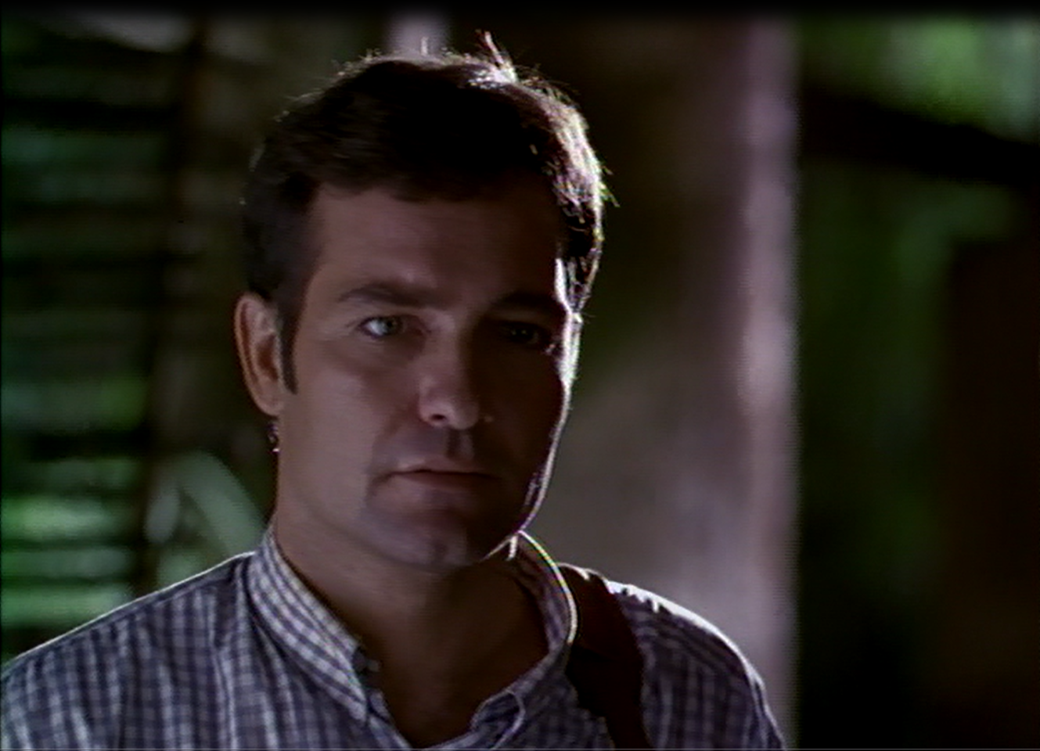
The Alcalde

Slide 6
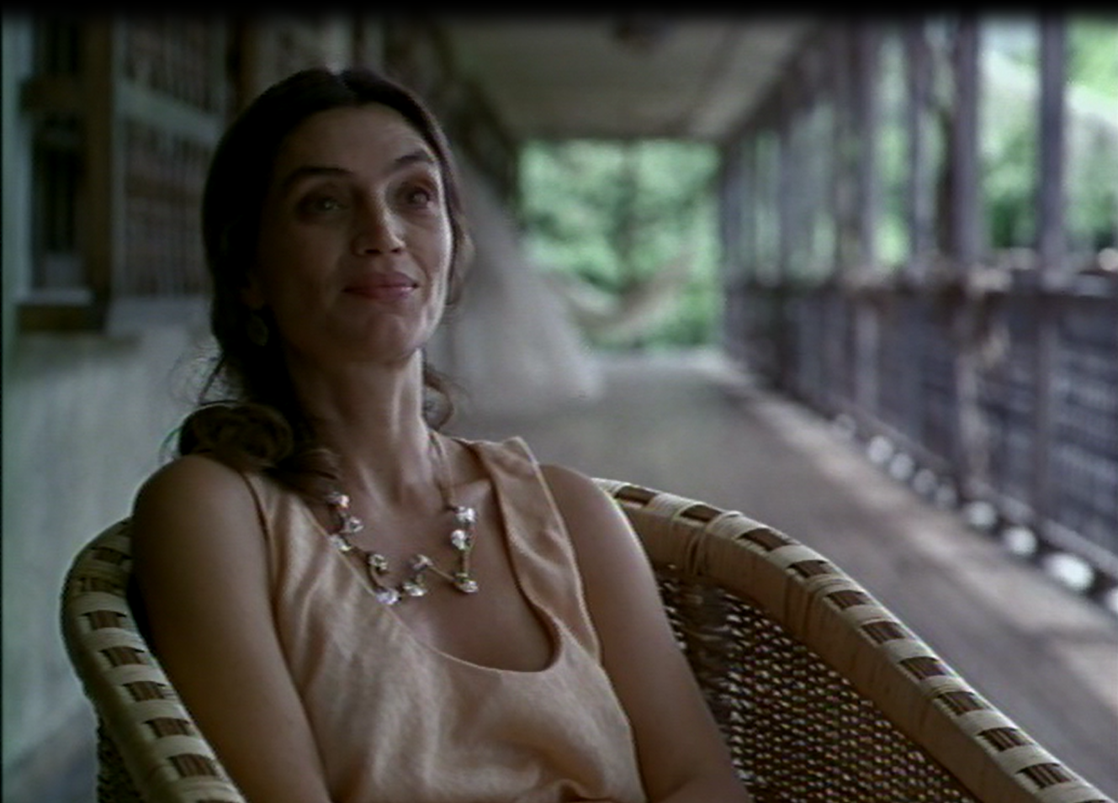
Yocasta

Slide 7
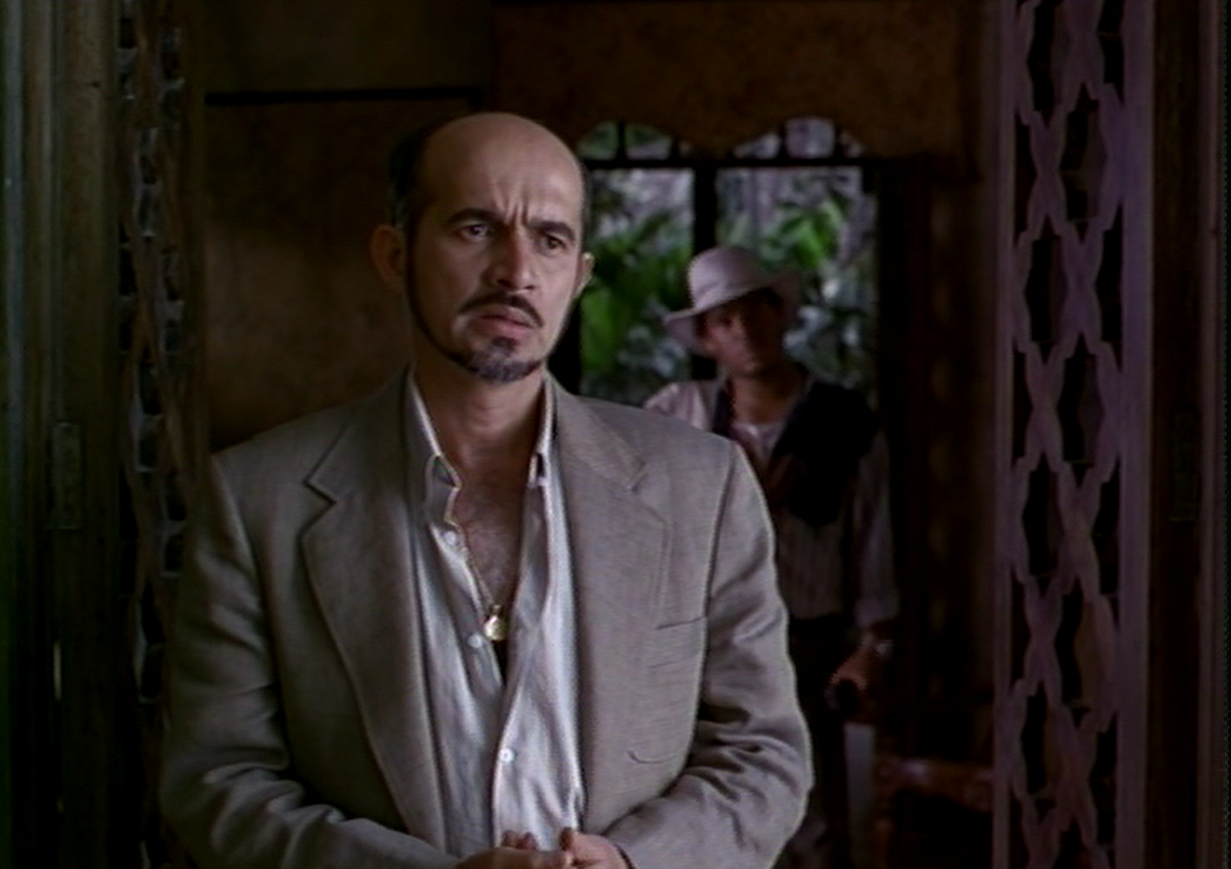
Creonte

Slide 8
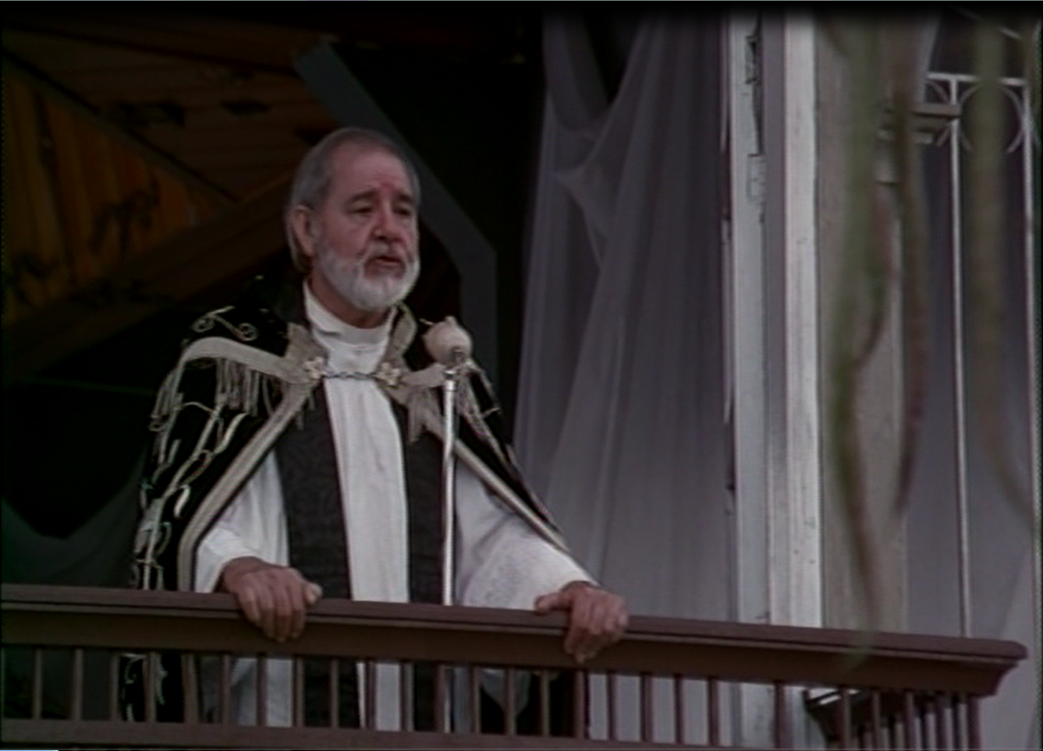
The Priest

Slide 9
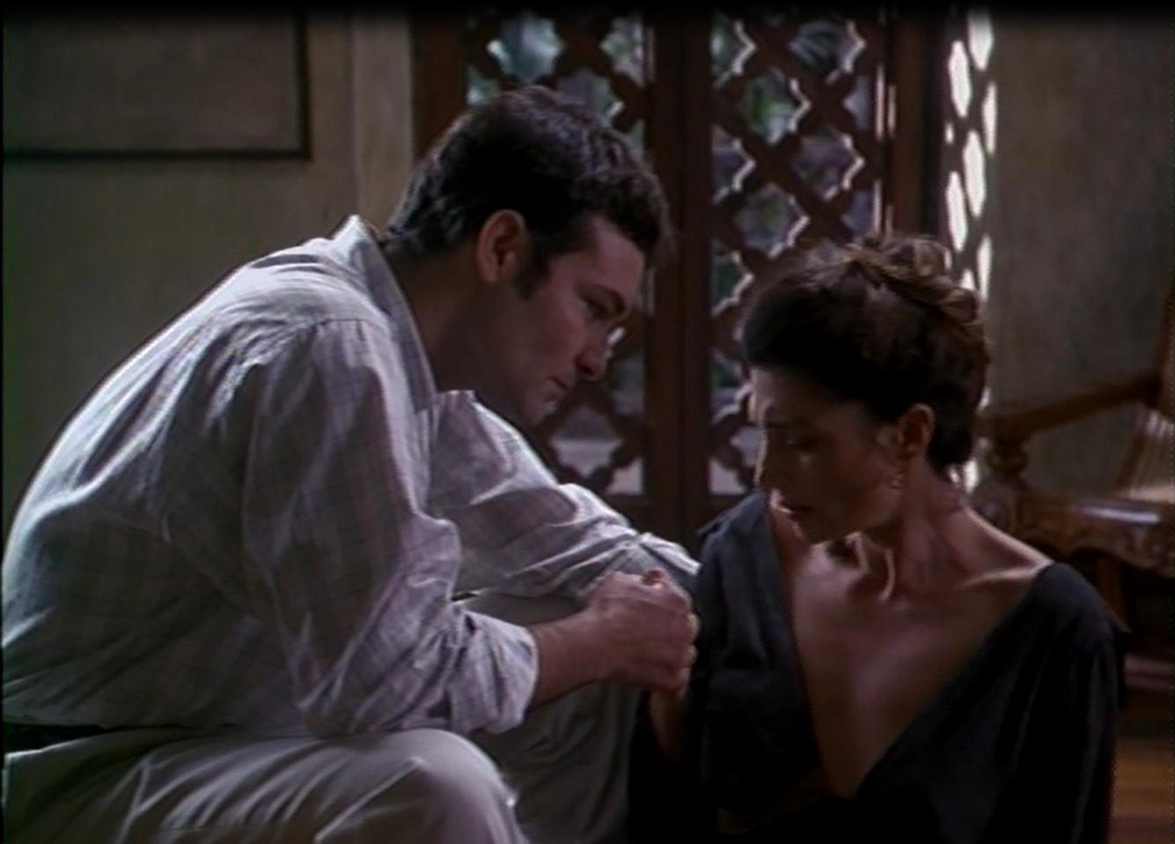
Edipo and Yocasta

Slide 10
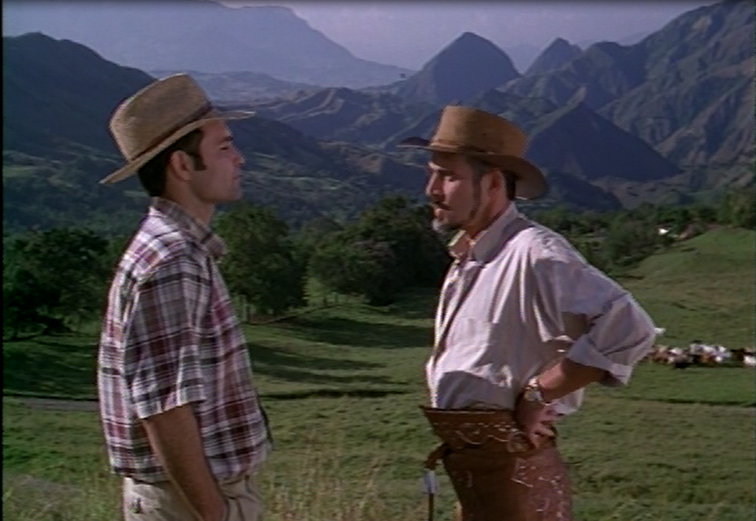
Edipo and Creonte

Slide 11
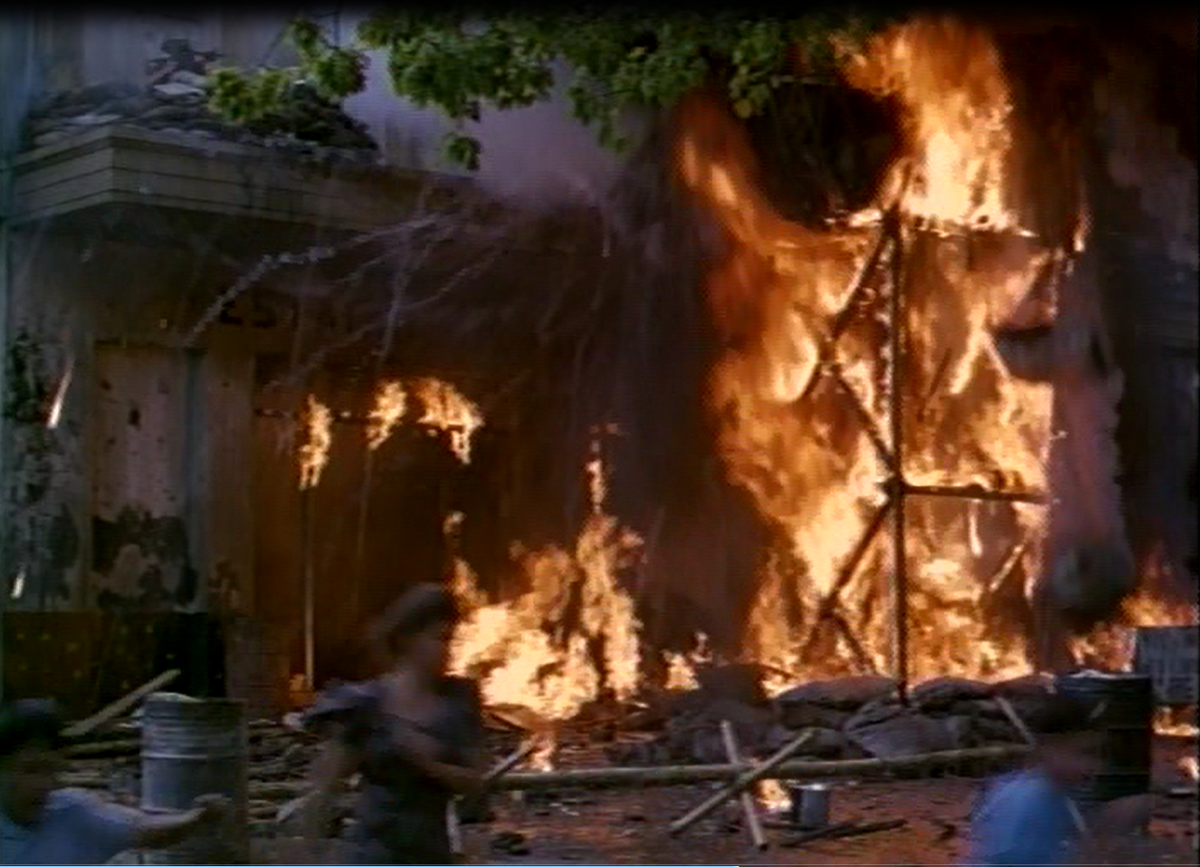
La Violencia

Slide 12
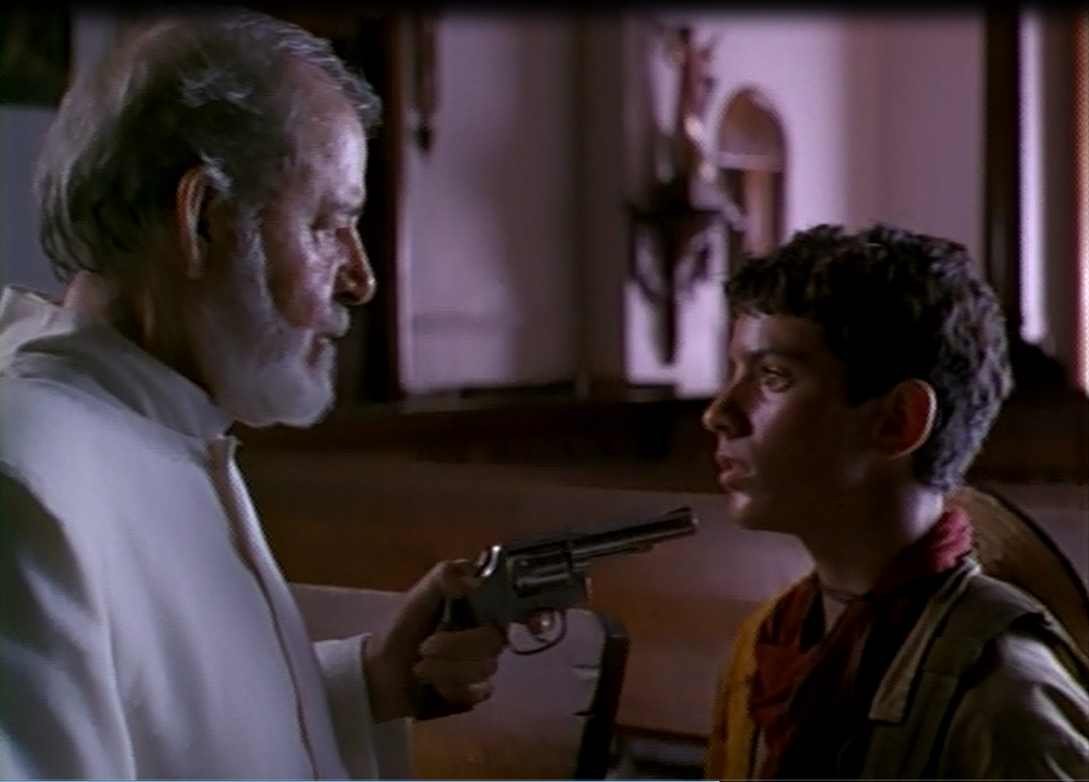
La Violencia

Slide 13
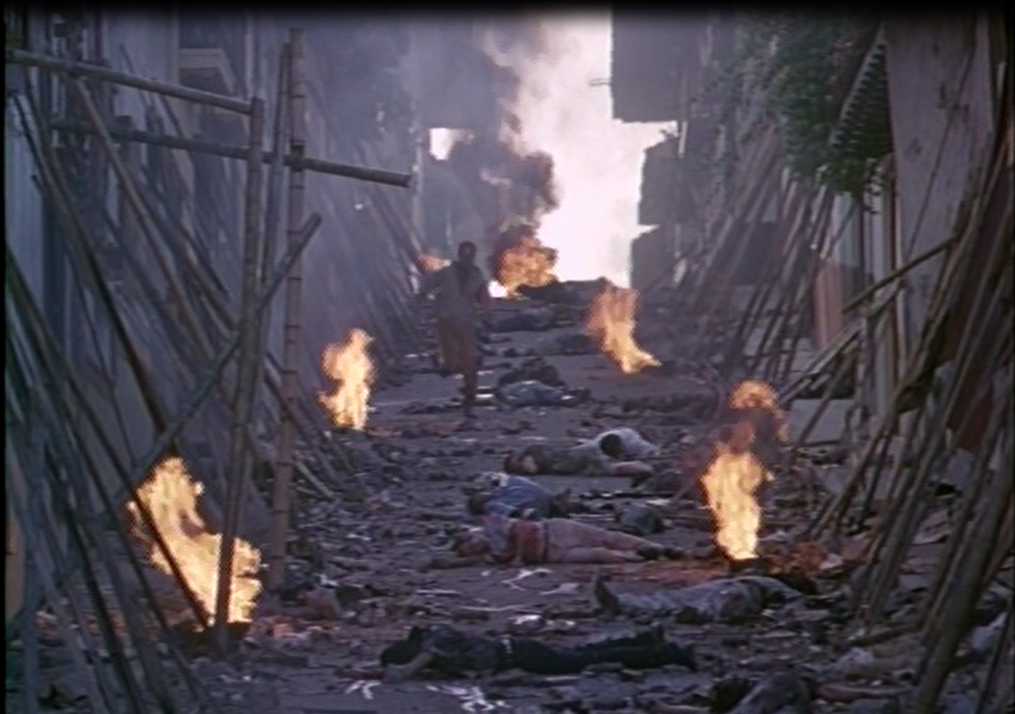
La Violencia

Slide 14
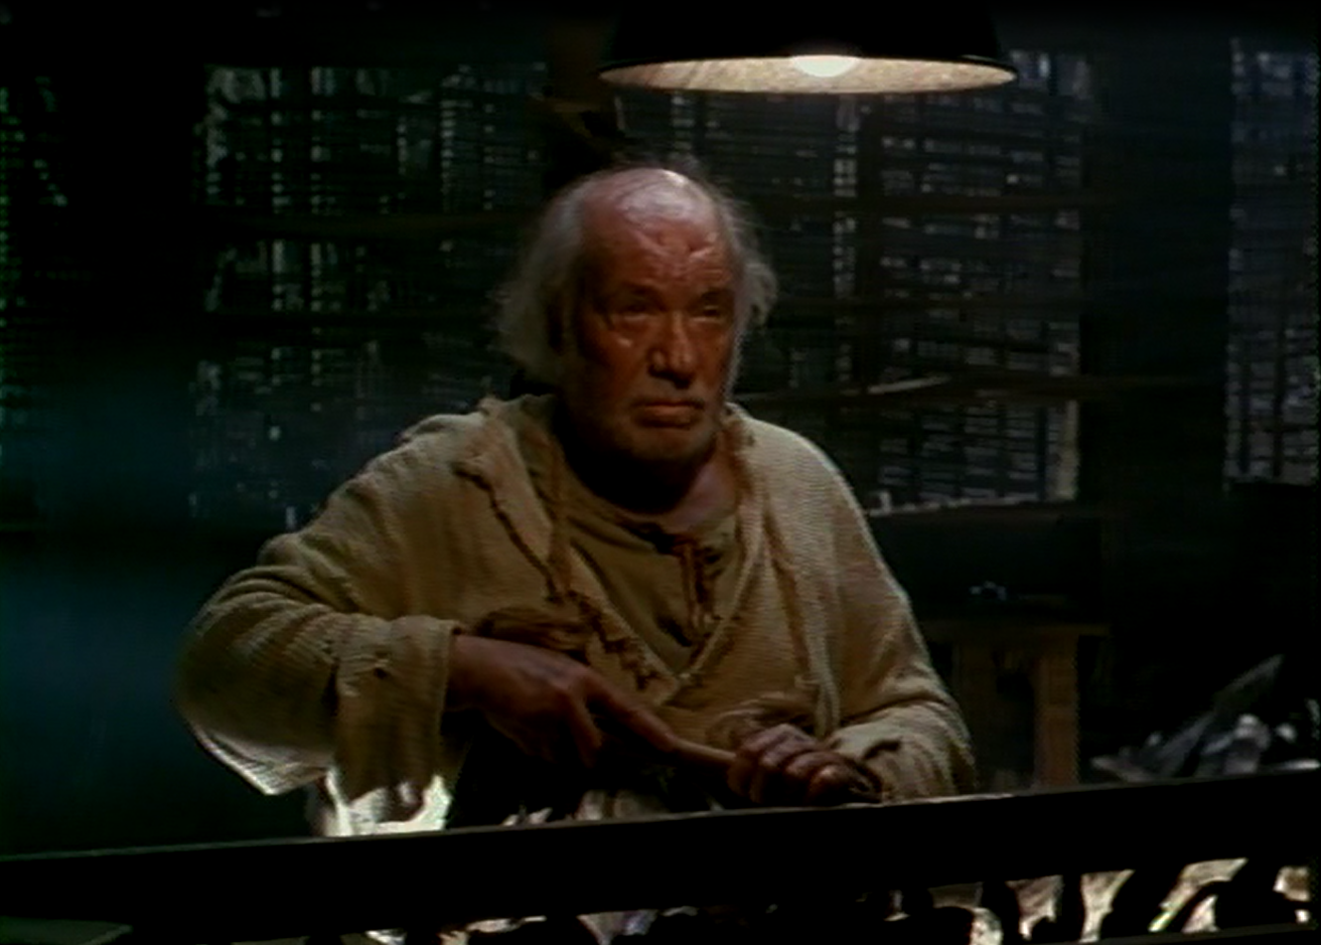
Tiresias

Slide 15
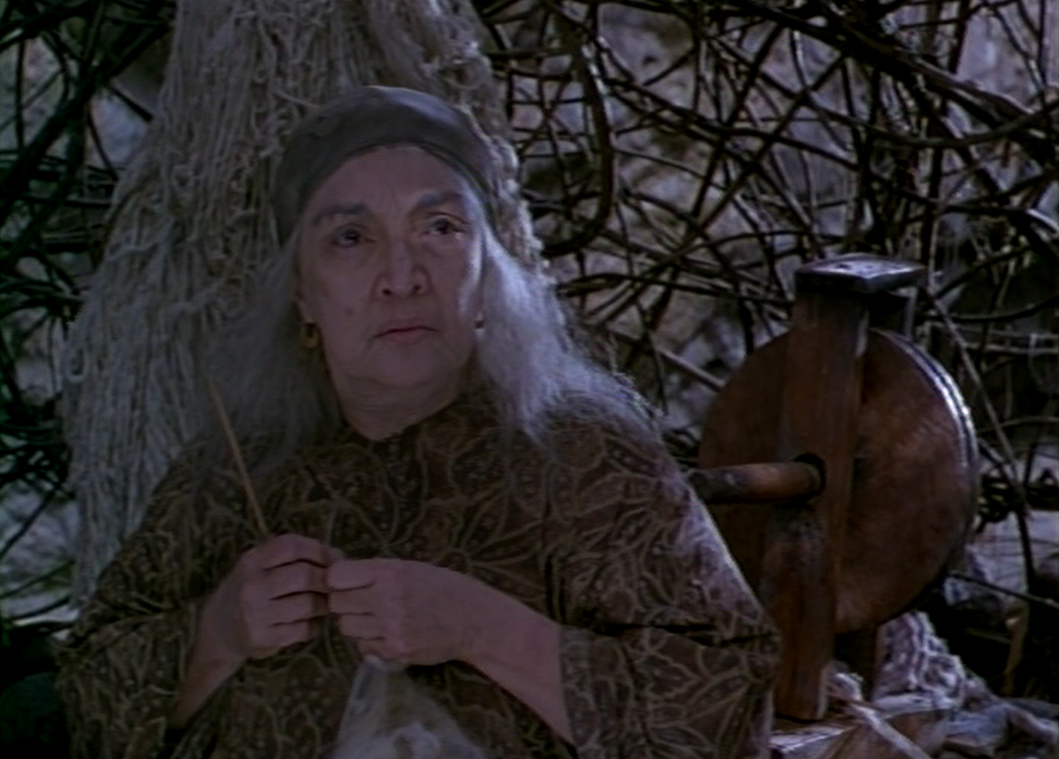
Deyanira

Slide 16
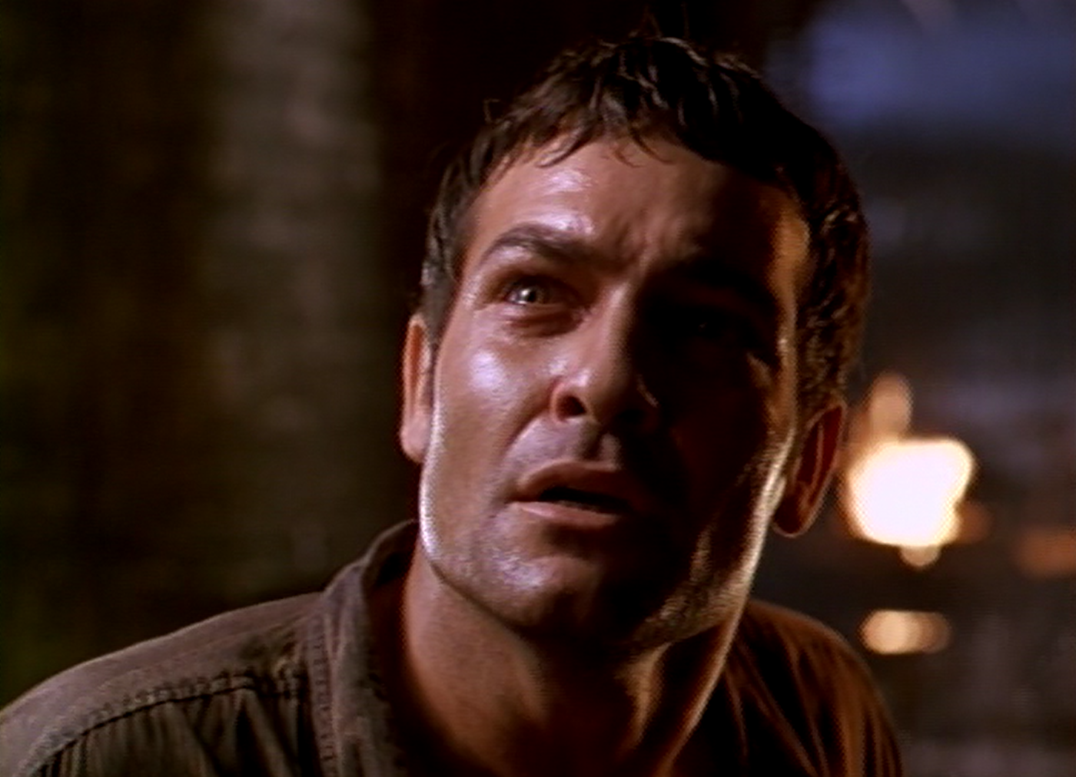
The Truth

Slide 17
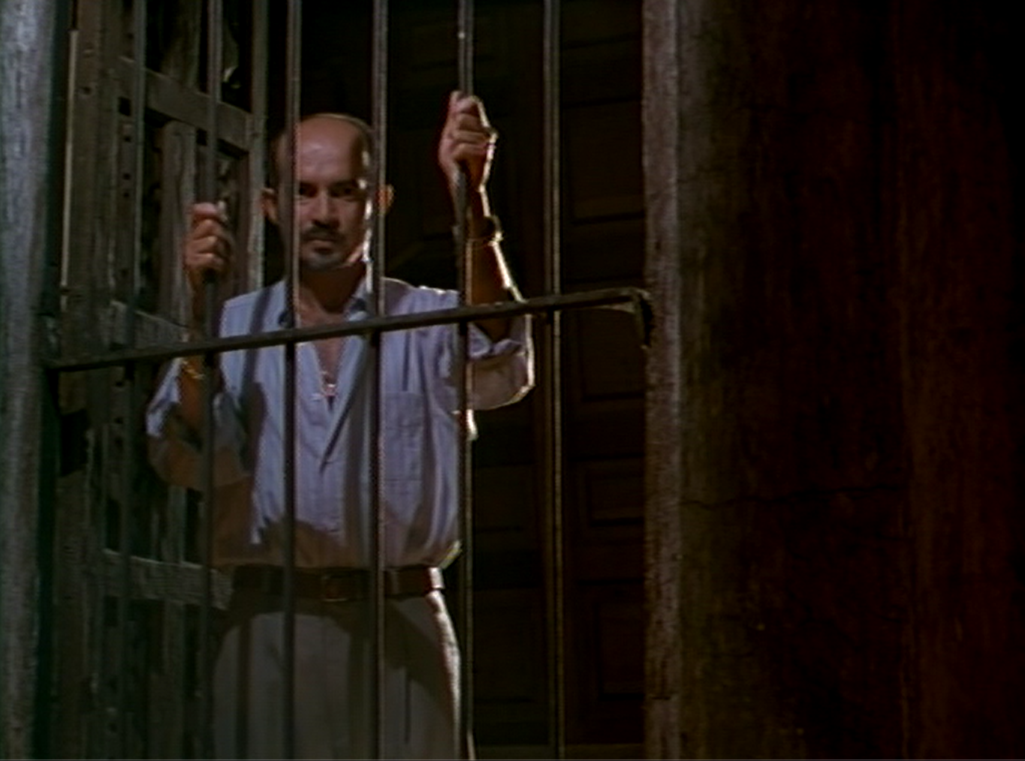
Creonte in Power

Slide 18
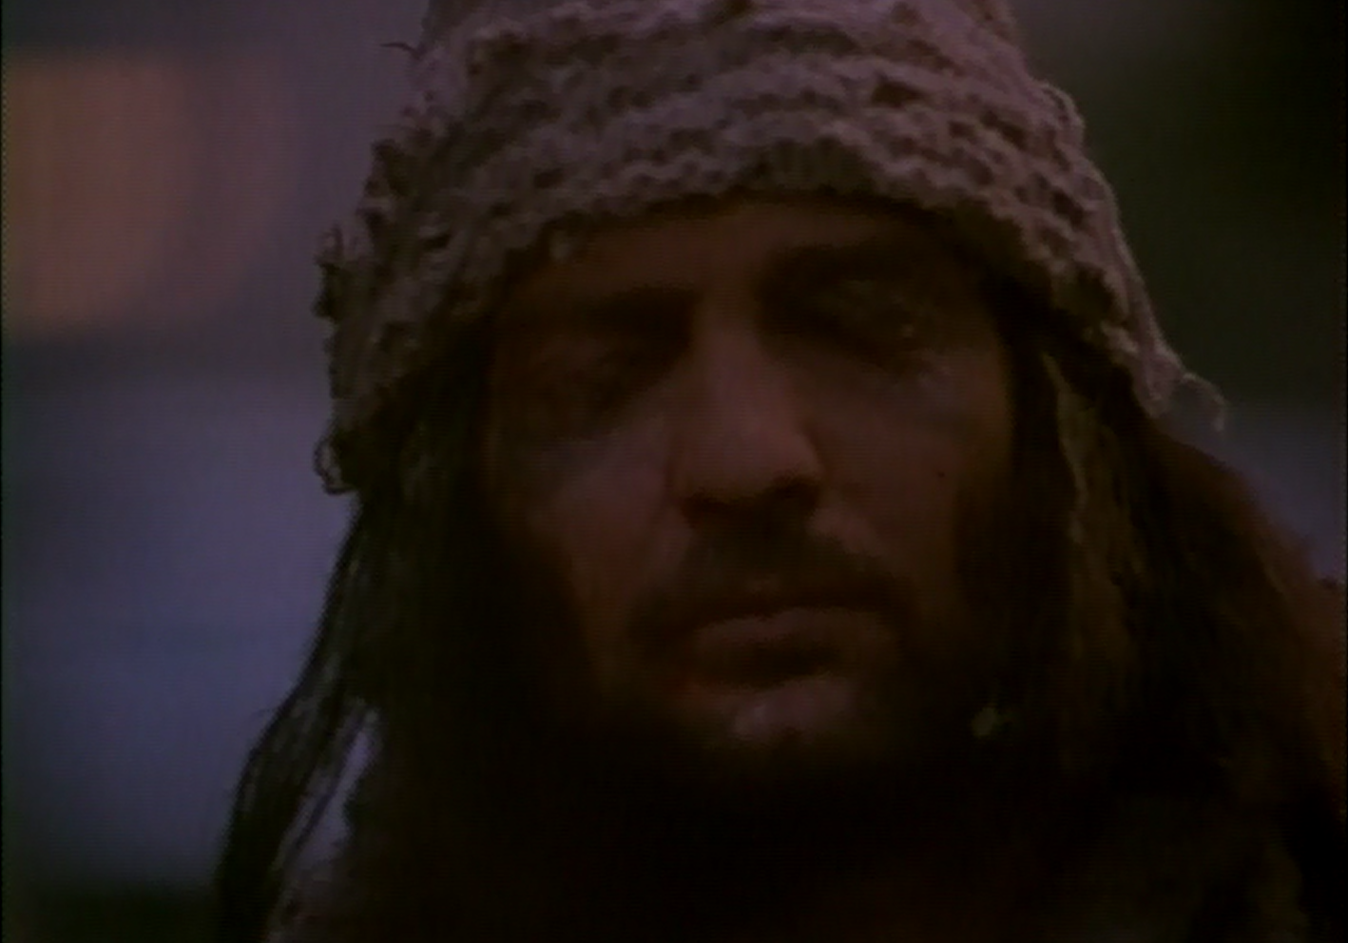
The End

Slide 19
Select Bibliography
L. S. Acón, “Edipo Alcalde: Reelectura edípica de Alí Triana,” Escena 30 (2007), 67–75
M. R. Calpe, “La creación del espacio trágico en la obra de Gabriel Garciá Márquez: Una lectura sofoclea,” Synthesis 19 (2012), 43–61
M. E. Davis, “Sophocles, Garciá Márquez and the Labyrinth of Power,” Revista Hispánica Moderna 44 (1991), 108–123
P. Michelakis, Greek Tragedy on Screen, Oxford 2013
M. F. Nelli, “Oedipus Tyrannus in South America,” in: K. Bosher, F. Macintosh, J. McConnell, P. Rankine (eds.), The Oxford Handbook of Greek Drama in the Americas, Oxford 2015 (forthcoming)

Slide 20
Select Bibliography (cont.)
J. L. Rivera-Betancur, S. Ruiz-Moreno, “Representations of the Armed Conflict in Colombian Cinema,” Revista Latina de Comunicación Social 65 (2010), 503–515
A. Rocco, Gabriel García Márquez and the Cinema. Life and Works, Woodbridge, Suffolk 2014
H. Ruiz, “Jorge Alí Triana, Edipo Alcalde,” Casqui 28 (1999), 135–138
P. Swanson (ed.), The Cambridge Companion to Gabriel Garciá Márquez, Cambridge/New York 2010
M. M. Winkler, Cinema and Classical Texts. Apollo’s New Light, Cambridge 2009

