Slide 1
Using Present Tense Markers to Make Beginning Greek Easier
Growing Greek:
New Activities and Resources
at the Beginning Level
CAMWS – Boulder, CO
Thursday March 26, 2015 3:30-5:15pm
Wilfred E. Major
wmajor@lsu.edu

Slide 2
Using Present Tense Markers to Make Beginning Greek Easier
Verbs
A standard way students first learn the construction of Greek verbs:
λύω
stem | + personal endings
λυ | + ω

Slide 3
Using Present Tense Markers to Make Beginning Greek Easier
Verbs
A standard way students first learn the construction of Greek verbs:
δείκνυμι, λύω, λαμβάνω, δίδωμι, γιγνώσκω
stem | + personal endings
δεικνυ λυ λαμβαν διδω γιγνωσκ γιγν | + μι + ω + ω + μι + ω + ομαι
This chart shows
the stem
of only ONE
of the verbs here.

Slide 4
Using Present Tense Markers to Make Beginning Greek Easier
Verbs
Greek verbs have four parts:
prefix + | stem | + marker | + ending
preposition augment reduplication | meaning of verb | tense mood | person number voice
stem + marker
= stem of tense

Slide 5
Using Present Tense Markers to Make Beginning Greek Easier
stopdoi
stopdoyou
stopdohe
stopdowe
stopdoy’all
stopdothey
Building a Greek Verb
Now IMAGINE verbs like this!

Slide 6
Using Present Tense Markers to Make Beginning Greek Easier
Verb markers of the present tense:
ν
δείκνυμι, λαμβάνω, βαίνω
doubling the initial sound + ι:
γίγνομαι, γιγνώσκω, δίδωμι, τίθημι, ἵστημι, ἵημι
σκ
εὑρίσκω
ζ
θαυμάζω
NB: Verbs with strong/2nd aorists tend to add markers on their present stems: e.g., λαβ + ν + ω ➔ λαμβάνω

Slide 7
Using Present Tense Markers to Make Beginning Greek Easier
Verbs
Greek verbs have four parts:
δείκνυμι, λύω, λαμβάνω, δίδωμι, γιγνώσκω
prefix + | stem | + marker | + ending
δι + γι + γι + | δεικ λυ λαβ δω γεν γνω | + νυ + αν + σκ | + μι + ω + ω + μι + ομαι + ω

Slide 8
Using Present Tense Markers to Make Beginning Greek Easier
As a starter list of common verbs with present tense markers, the next two slides collect verbs that are on both of two lists:
The Dickinson College Commentaries core vocabulary (http://dcc.dickinson.edu/greek-core-list).
New Testament Vocabulary: verbs which appear 30+ times in the NT.
For more on this and related topics, see B. Stayskal and W. Major, “Teaching Greek Verbs: A Manifesto,” Teaching Classical Languages 3 (2011) 23-42. http://tcl.camws.org/sites/default/files/MajorAndStayskal_0.pdf.

Slide 9
Using Present Tense Markers to Make Beginning Greek Easier
-ω Verbs (present tense markers underlined)
ἁμαρτάνω, ἁμαρτήσομαι, ἥμαρτον make a mistake, sin
ἀποθνῄσκω, ἀποθανοῦμαι, ἀπέθανον die
βαίνω, βήσομαι, ἔβην walk, come, go
γίγνομαι, γενήσομαι, ἐγενόμην happen, become, be born
γιγνώσκω, γνώσομαι, ἔγνων know, learn, think
εὑρίσκω, εὑρήσω, εὗρον find
λαμβάνω, λήμψομαι, ἔλαβον take, grab; receive, get
πίνω, πίομαι, ἔπιον drink
Notes:
This is the vocabulary that appears on both the DCC and NT 30+ list

Slide 10
Using Present Tense Markers to Make Beginning Greek Easier
-μι Verbs (present tense markers underlined)
ἀπο + ολ- ➔ ἀπόλλυμι, ἀπολῶ, ἀπώλεσα kill, destroy
δω- ➔ δίδωμι, δώσω, ἔδωκα give
ἀποδίδωμι, ἀποδώσω, ἀπέδωκα give back
παραδίδωμι, παραδώσω, παρέδωκα hand over, deliver
ἥ- ➔ ἵημι, ἥσω, ἧκα throw
ἀφίημι, ἀφήσω, ἀφῆκα let go, allow, forgive
στη- ➔ ἵστημι, στήσω, ἔστησα/ἔστην stand
θη- ➔ τίθημι, θήσω, ἔθηκα put, make
Notes:
This is the vocabulary that appears on both the DCC and NT 30+ list

Slide 11
Ancient Greek for Everyone
An essential principle about the ancient Greek alphabet:
SPELL IT LIKE IT SOUNDS!
Greeks in antiquity spelled words the way they pronounced them.
If they changed the pronunciation of a word, they changed the spelling to match.

Slide 12
Ancient Greek for Everyone
An essential principle about the ancient Greek alphabet:
SPELL IT LIKE IT SOUNDS!
Consider the verb “record” (reCORD)
and the noun “record” (RECord),
which are spelled alike but pronounced differently in English.
In Greek, such words would be spelled according to their pronunciations: “rikórd” and “rékerd”

Slide 13
Ancient Greek for Everyone
An essential principle about the ancient Greek alphabet:
SPELL IT LIKE IT SOUNDS!
Imagine these examples in English:
If anyone pronounced “going” as “gonna,”
they would spell it “gonna.”
Homophones like “but” and “butt” would both be spelled “but,” even though they have different meanings.

Slide 14
How to Make Beginning Greek Rational and Regular (Really)
An essential principle about the ancient Greek alphabet:
SPELL IT LIKE IT SOUNDS!
However you teach accents, make the core principle that the accents are written to help pronounce the words!
Rather than an arcane set of rules, accents are written in so you do not have to remember where the accents are!
Once again, the writing system is exceptionally committed to recording the sound of the spoken language.

Slide 15
Ancient Greek for Everyone
Now we start learning the Greek alphabet.
We learn how to make the letters, but equally importantly, what sounds the letters represent.
Whereas in English, the consonants tend to dominate, in Greek the vowels are more important.
So we start with the Greek vowels.

Slide 16
Ancient Greek for Everyone
Short
Long
α “ah”
ε “eh”
ι “ih”
ο “o”
υ “u”
ᾱ “aah”
η “ay”
ῑ “ee”
ω “oh”
ῡ “οοh”
Like English, Greek has short and long versions of its vowels.

Slide 17
Ancient Greek for Everyone
Saying two vowels in a row
Speakers of Classical Greek did not like to say
two vowel sounds in a row.
Consequently, if two vowels came together,
they tended to merge them into one
(called a “diphthong,” Greek for “double sound”)
or contract them.
Specifically:
A vowel + ι or υ forms a diphthong.
α, ε and ο contract with each other.

Slide 18
Ancient Greek for Everyone
A vowel + ι forms a diphthong:
α + ι = αι “eye”
ᾱ + ι = ᾱι “aah” usually written ᾳ
ε + ι = ει “ay”
η + ι = ηι “ay” usually written ῃ
ο + ι = οι “oy”
ω + ι = ωι “oh” usually written ῳ
υ + ι = υι “wee”

Slide 19
Ancient Greek for Everyone
A vowel + υ forms a diphthong:
α + υ = αυ “ow!”
ε + υ = ευ “eu”
ο + υ = ου “oo”

Slide 20
Ancient Greek for Everyone
α, ε and ο + α contract:
α + α = ᾱ
ε + α = η
ο + α = ω
α + ε = ᾱ
ε + ε = ει
ο + ε = ου
α + ο = ω
ε + ο = ου
ο + ο = ου

Slide 21
Ancient Greek for Everyone
CONSONANTS
Labial Dental Palatal
π p τ t κ k = unvoiced
β b δ d γ g = voiced
φ ph θ th χ kh = aspirated
ψ ps σ s ξ ks = + σ
μ m ν n γκ, γγ, γχ, γξ ng nasals
λ l ρ r = liquids

Slide 22
Ancient Greek for Everyone
The Trouble with Sigma
Greek is strange when it comes to pronouncing and writing words with the “s” sound:
Culturally, ancient Greeks hated the “s” sound.
Poets were known to compose whole poems that never used the sound.
Nevertheless, the sound is very common in Greek.
Most often, if a word is odd or difficult to spell or pronounce, it is because of a sigma.
The weirdness appears even in the alphabet itself.

Slide 23
Ancient Greek for Everyone
The Trouble with Sigma
Greek is strange when it comes to pronouncing and writing words with the “s” sound:
The combinations πσ, βσ and φσ never appear.
Instead, ψ replaces them.
τ, δ and θ disappear before a σ.
The combinations κσ, γσ and χσ never appear.
Instead, ξ replaces them.
nasal + σ = short vowel + nasal or nasal + short vowel
λ + σ = λε

Slide 24
Ancient Greek for Everyone
Alphabet Algebra
Teach, test, reinforce and reward understanding these sound combinations.
Some examples:
short ω =
ε + ε =
π + breathing =
δ – voice =
κ + σ =

Slide 25
Ancient Greek for Everyone
Ending a Greek Word
Greek allows only a limited number of sounds to end a word.
The only sounds allowed to end a word are:
a vowel sound
-ν
-ρ
-ς
If a Greek word might end in a sound other than one of these, the speaker simply omits the sound, and so it is not written.

Slide 26
How to Make Beginning Greek Rational and Regular (Really)
Some helpful points about –ω verbs and –μι verbs:
–ω verbs and –μι verbs differ in that:
–ω verbs have the stable -ο/ε- thematic vowel,
but–μι verbs do not.
In this way, they are more like the present and perfect systems in Latin than like different conjugations.
NB: –μι verbs tend to have long vowels in the singular
and short in the plural.

Slide 27
How to Make Beginning Greek Rational and Regular (Really)
All Greek verbs are combinations
of –ω verbs and –μι verbs:
In the present/imperfect, some verbs are –ω verbs and some are –μι verbs. Some change from one to the other over time (δείκνυμι ➔ δεικνύω).
In the future tense, all verbs are –ω verbs.
In the aorist,
weak/1st aorists are –μι verbs;
strong/2nd aorists are mostly –ω verbs.
All verbs are –μι verbs in the aorist “passive.”
All verbs are –μι verbs in the perfect system.

Slide 28
How to Make Beginning Greek Rational and Regular (Really)
Some helpful points about –ω verbs and –μι verbs:
–ω verbs and –μι verbs differ in that –ω verbs have the stable -ο/ε- thematic vowel, but–μι verbs do not.
The thematic vowel combines with the personal endings of the Active Voice in ways that make it easier to memorize these endings as a distinct set.
In the Middle Voice, the endings are stable and recognizable for all verbs.

Slide 29
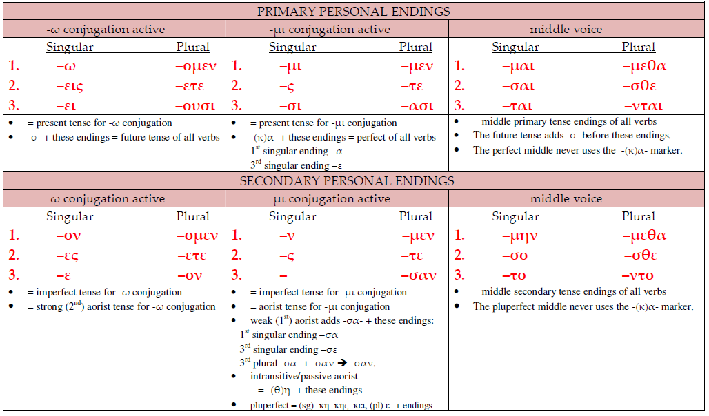
Ancient Greek for Everyone

Slide 30
Ancient Greek for Everyone
Verbs
“Contract Verbs” follow the universal rules of contraction, with minor variations or exceptions.
Given the universal rules of sound combination, most principal parts of Greek verbs are predictable, at least to the extent that it is possible to recognize them. Memorizing them in detail can be deferred to the advanced level.
A dozen or so verbs have mixed stems that merit learning as distinct vocabulary items. The last slides in this presentation detail these cases.

Slide 31
Ancient Greek for Everyone
Nouns and Adjectives
The definite article is a guide for first and second declension endings.
The remaining variations (e.g., α/η in the first declension) are minor and again reflect the commitment to recording even small variations in pronunciation.
Third declension nouns and adjectives are predictable and sensible when students already know the universal rules for sigma combinations and vowel contraction.

Slide 32
Ancient Greek for Everyone
Singular
Nominative –ς
Genitive –ος
Dative –ι
Accusative –α
Plural
Nominative –ες
Genitive –ων
Dative –σι
Accusative –ας
Building a Greek Noun
Third Declension Endings

Slide 33
Ancient Greek for Everyone
Singular
Nom. (παιδς ➔) παῖς
Gen. παιδός
Dat. παιδί
Acc. παῖδα
Plural
Nom. παῖδες
Gen. παίδων
Dat. (παιδσι ➔) παισί
Acc. παῖδας
Building a Greek Noun
declension of παῖς, παιδός ὁ child

Slide 34
Ancient Greek for Everyone
Singular
Nom. (νυκτς ➔) νύξ
Gen. νυκτός
Dat. νυκτί
Acc. νύκτα
Plural
Nom. νύκτες
Gen. νυκτῶν
Dat. (νυκτσι ➔) νυξί
Acc. νύκτας
Building a Greek Noun
νύξ, νυκτός ἡ night

Slide 35
Ancient Greek for Everyone
Nouns and Adjectives
The Neuter Law: two rules apply to all neuter words in Greek.
(1) The nominative singular and the accusative singular must be identical.
(2) The nominative plural and the accusative plural must both end in a short -α.

Slide 36
Ancient Greek for Everyone
Singular
Nominative –
Genitive –ος
Dative –ι
Accusative –
Plural
Nominative –α
Genitive –ων
Dative –σι
Accusative –α
Building a Greek Noun
Third Declension Endings for neuter nouns

Slide 37
Ancient Greek for Everyone
Singular
Nom. (σωματ ➔) σῶμα
Gen. σώματος
Dat. σώματι
Acc. (σωματ ➔) σῶμα
Plural
Nom. σώματα
Gen. σωμάτων
Dat. σώμασι
Acc. σώματα
Building a Greek Noun
declension of σῶμα -ατος τό body

Slide 38
How to Make Beginning Greek Rational and Regular (Really)
Nouns and Adjectives
The vocative case is most often identical with the nominative.
The most common exception is for the vocative singular to be just the stem of the noun (subject to the rules of ending a Greek word, so *παιδ ➔ παι).
The vocative of 2nd declension masculine/feminine nouns follows the same -ο/ε- pattern as –ω verbs.

Slide 39
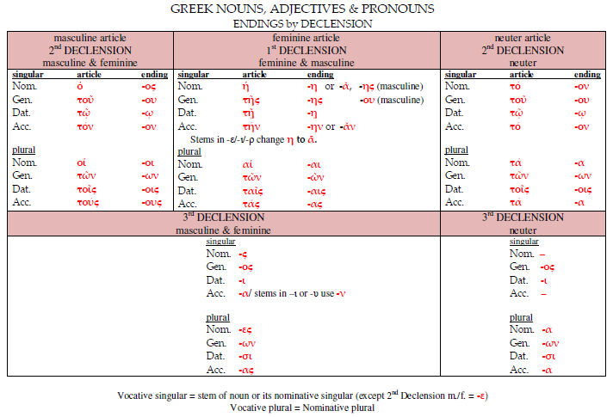
Ancient Greek for Everyone

Slide 40
How to Make Beginning Greek Rational and Regular (Really)
Problem: The plethora of inflected forms in ancient Greek overwhelms students and teachers.
Benefits of shifting priorities in Beginning Greek:
Students are equipped with skills to analyze all types of Greek words.
They can practice these skills with isolated words, so they can work early on vocabulary and English derivatives.
This frees up time to analyze true exceptions variations in context instead of as more forms to memorize.
These same skills work for different dialects (Homeric, Ionic, Classical, Koine, even Demotic) and for related reading skills (deciphering elided words, compound words).

Slide 41
How to Make Beginning Greek Rational and Regular (Really)
Recommendation:
Shift the priorities of Beginning Greek:
More:
alphabet work (transliteration, derivatives)
sound combinations (vowel contractions, consonant patterns)
Fewer:
paradigms
principal parts of verbs: the first three at most; priority for verbs with mixed stems
Full paradigms and principal parts are resources to be consulted, NOT lists to be memorized and tested.

Slide 42
Ancient Greek for Everyone
VOCABULARY: Although a Greek verb can morph into many different forms, it is listed in a dictionary (Greek “lexicon”) under just one form.
In a handful of cases, the stems of Greek verbs in their present, future and aorist tenses differ beyond the basic patterns of sound change. These differences are of two types:
A stem goes through multiple and subtle changes. Some common English verbs have changes that have to be learned individually, too (e.g., “do” ➔ “did”).
A verb mixes stems from different verbs. This is known as “suppletion.” This process occurs in English, too (e.g., “go” ➔ “went”).
The following slides present corresponding Greek verbs of these types under the label “mixed” stems.

Slide 43
Ancient Greek for Everyone
Classical Vocabulary (mixed) Dickinson College Commentaries
ἄγω, ἄξω, ἤγαγον lead, bring, pass (time)
αἱρέω, αἱρήσω, εἷλον (stem ἑλ-) take, grasp; (mid.) choose
ἀναιρέω raise up; kill, destroy
ἀφαιρέω take from, take away
ἁλ- ➔ ἁλίσκομαι, ἁλώσομαι, ἑάλων be captive
See separate slide on these forms and their meanings.
ἐλαύνω, ἐλῶ (-α contract), ἤλασα march
ἔρχομαι, ἐλεύσομαι, ἦλθον (stem ἐλθ-) come, go
Notes:
Dickinson College Commentaries vocabulary: http://dcc.dickinson.edu/greek-core-list

Slide 44
Ancient Greek for Everyone
Classical Vocabulary (mixed)
ἔχω, ἕξω and σχήσω, ἔσχον (stem σχ-) have, hold, be
Imperfect: εἶχον
See separate slide on these forms and their meanings.
παρέχω provide
λέγω, ἐρῶ, εἶπον (stem ἐπ-) say, speak, report
ὁράω, ὄψομαι, εἶδον (stem ἰδ-) see
Imperfect: ἑώραον ➔ ἑώρων
πάσχω, πείσομαι, ἔπαθον suffer, experience
πίπτω, πεσοῦμαι, ἔπεσον fall

Slide 45
Ancient Greek for Everyone
Classical Vocabulary (mixed)
τίκτω, τέξομαι, ἔτεκον give birth
τρέφω, θρέψω, ἔθρεψα feed, support, educate
τυγχάνω, τεύξομαι, ἔτυχον happen (+participle ), meet (+gen)
φέρω, οἴσω, ἤνεγχον (stem ἐνεγχ-) carry, bring
διαφέρω spread, differ
συμφέρω benefit, profit

Slide 46
Ancient Greek for Everyone
New Testament Vocabulary (mixed) 30+ times
ἄγω, ἄξω, ἤγαγον lead, bring, pass (time)
συνάγω gather together, assemble
ὑπάγω go away, depart
ἔρχομαι, ἐλεύσομαι, ἦλθον (stem ἐλθ-) come, go
ἀπέρχομαι go away
διέρχομαι come, go through, cross
ἐξέρχομαι come, go out of
ἐσθίω, φάγομαι, ἔφαγον eat
ἔχω, ἕξω, ἔσχον (stem σχ-) have, hold, be
Imperfect: εἶχον
See separate slide on these forms and their meanings.

Slide 47
Ancient Greek for Everyone
New Testament Vocabulary (mixed)
λέγω, ἐρῶ, εἶπον (stem ἐπ-) say, speak, report
ὁράω, ὄψομαι, εἶδον (stem ἰδ-) see
Imperfect: ἑώραον ➔ ἑώρων
πάσχω, πείσομαι, ἔπαθον suffer, experience
πίπτω, πεσοῦμαι, ἔπεσον fall
φέρω, οἴσω, ἤνεγχα (stem ἐνεγχ-) carry, bring
προσφέρω offer, present

Slide 48
Ancient Greek for Everyone
Classical Vocabulary
αἱρέω, αἱρήσω, εἷλον take, grasp; (mid.) choose
ἁλ- ➔ ἁλίσκομαι, ἁλώσομαι, ἑάλων be captive
The above cluster is all related in meaning as follows:
Active: αἱρέω, αἱρήσω, εἷλον means “take” “capture” etc.
Middle: αἱρέομαι, etc., means “take for oneself” ➔ “choose”
Passive: ἁλίσκομαι, ἁλώσομαι, ἑάλων serves as the passive of αἱρέω ➔ “be taken” “be captured” etc.

Slide 49
Ancient Greek for Everyone
VOCABULARY
ἔχω, ἕξω and σχήσω, ἔσχον (stem σχ-) have, hold, be
Despite their final appearances, all these stems derive from one root, which is roughly -σεχ-.
Present: σεχ- ➔ ἐχ-
Imperfect: ἐσεχ- ➔ εἶχον
Future: σεχσ- ➔ ἑξ- notice the rough breathing (ἑ-) here.
Future: σεχ + σ- ➔ σχησ- strictly speaking has “aorist aspect” and refers to “getting hold of” something as a single action in the future.
Aorist: ἐ + σεχ- ➔ ἐσχ-

