Slide 1
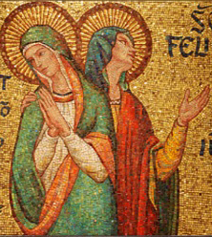
Pity, Pietas, and Roman Forensic Oratory in the Passion of Sts. Perpetua and Felicity
Katherine E. Milco
27 March 2015
katherine.milco@Marquette.edu

Slide 2
Inversion of Roles at Perpetua’s Trial
Perpetua’s father and the judicial magistrate act like litigants by drawing on recognizable forensic topoi.
Their pleas for pity turn Perpetua, who is a defendant, into a kind of judge.

Slide 3
Passion of Sts. Perpetua and Felicity 5.2-6
Take pity (miserere), O daughter, on my grey hairs; take pity (miserere) on your father – if I am worthy to be called your father, if I have reared you with these hands to this springtime of your life, if I have favored you over all your brothers: do not hand me over to the reproach of men. Think of your brothers, think of your mother and aunt, think of your son who will not be able to live after you are gone. Give up your pride: do not destroy us all. For no one of us will speak freely if you suffer anything.

Slide 4
Passion of Sts. Perpetua and Felicity 6.2-8
And my father immediately appeared with my son and dragged me from the step, saying: ‘Take pity (miserere) on your baby – offer the sacrifice!’ And Hilarianus, the procurator, who had received the ius gladii upon the death of Minucius Timinianus, said, ‘Spare (parce) your father’s grey hairs, spare your infant child. Offer the sacrifice for the welfare of the emperors!’

Slide 5
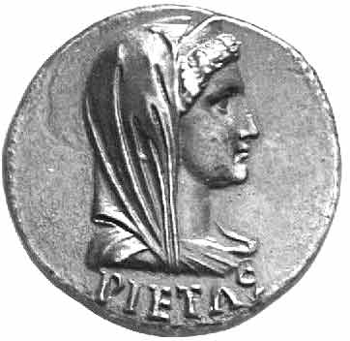
Roman Pietas at a Glance
*Cultic duty (gods)
*Domestic duty (family)
*Civic duty (extended to the emperor)

Slide 6
Pietas in the Passion of Sts. Perpetua and Felicity
1. Father-daughter relationship
2. Mother-child relationship
3. Other familial relationships
4. Martyr-state relationship

Slide 7
Christian Pietas at a Glance
* Knowledge and worship of God as father
* Rendering what is due to God and other human beings

Slide 8
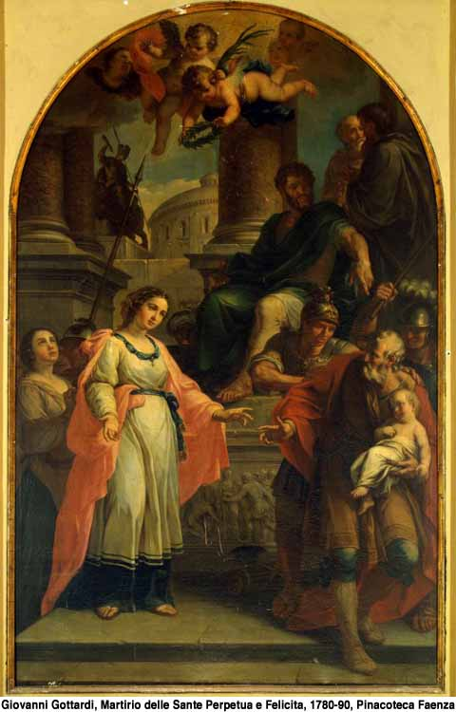
Perpetua’s Pietas in Prison (5.6)
I comforted him as I said: “It will happen on
that prisoner’s dock as God wills.
Know that we are not in our own power
but in God’s.”
Perpetua’s Pietas at her Trial (6.4-6)
“I am a Christian.”
Joyful at her condemnation
Perpetua and her Father

Slide 9
Recapitulation:
‘Pity’ = Roman pietas
‘Piety’ = Christian pietas
Differing notions of pietas inform the conflict between Perpetua and her persecutors.
Christian expression of pietas shows both fidelity to and divergence from the original Roman conception.

