Slide 1
A Cute Illness in Epidaurus
Morbus hepatiarius and other sick jokes in Plautus’ Gorgylio (Curculio)
Michael Fontaine
Cornell University

Slide 2
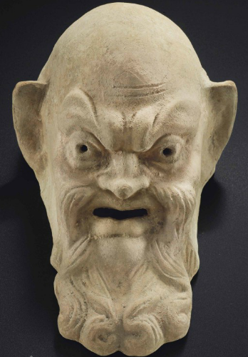
lien enecat, renes dolent,
pulmones distrahuntur,
cruciatur iecur,
radices cordis pereunt, hirae
omnes dolent.
Gorgylio 236-8

Slide 3
My spleen is killing me, my kidneys hurt, my lungs are being torn apart, my liver is in agony, the deepest part of my heart is dying, all my intestines ache!
Gorgylio 236-8

Slide 4
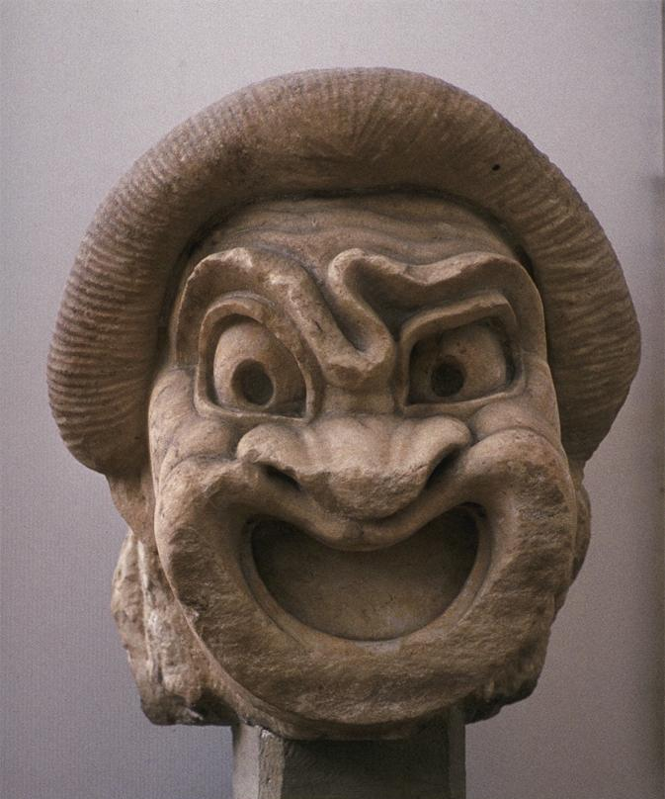
tum te igitur morbus agitat hepatiarius.
Then you must suffer from a liver disease.
Gorgylio 239 (tr. de Melo 2011)

Slide 5
facile est miserum inridere.
It’s easy to mock a poor wretch.
Gorgylio 240 (tr. de Melo 2011)

Slide 6
What is morbus hepatiarius?
The word hepatiarius is hapax legomenon (it is found only here).
The regular word for liver disease is ἡπατικός (hepaticus in Latin).
So is it a joke?
Or a real diagnosis?

Slide 7

A hepatologist’s view
“From the hepatologist’s [= liver doctor’s] point of view, two different chronic diseases, ESLD [end-stage liver disease from cirrhosis] and FMF [Familial Mediterranean Fever], could individually explain all of Cappadox’s physical ailments. … Of the two, I would favor FMF.”

Slide 8
What is morbus hepatiarius?
Thierfelder’s explanation
hepatiarius derives not from ἧπαρ (genitive ἧπατος) “liver” but from ἡπάτιον, “pâté.”
Hence Plautus’ word is hepati-arius, not hepat-iarius.
Hence Cappadox (supposedly) has a tummy ache from eating too much pâté.

Slide 9
What is morbus hepatiarius?
Fontaine’s new explanation
hepatiarius derives not from ἧπαρ “liver” or ἡπάτιον “pâté” but from ἥπατος, the hepatus fish (Latin hepar).
Hence Plautus’ word is hepat-iarius, not hepati-arius.
Hence Cappadox (supposedly) is turning into a hepatus fish.

Slide 10
-arius vs. -iarius
The usual suffix is –arius. That favors Thierfelder’s hepati-arius (from hepati-on).
But the suffix –iarius is also attested (and is probably the source of French –ière).
Examples: anatiarius, condiarium, dupliciarius, frontiarius, iustiaria, maioriarius, occiarius, pecudiarius, rubiniarius, partiarius, trepidiarius; ambiguous: custodiarius, nerviaria, cruciarius
That ambiguity enables my hepat-iarius.

Slide 11
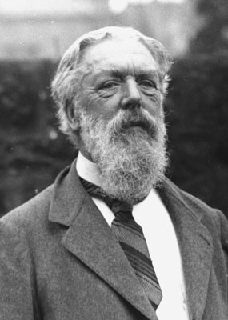
hepat-iarius: a true pun
It [ἥπατος] is, like λεβίας, one of the Greek fish-names for which I suspect an Egyptian origin; to wit, abtu, a word for a fish occurring in the Book of the Dead.
D’Arcy Thompson (1947, 76)

Slide 12
Aristotle on pyloric caeca
(Historia Animalium 508b19)
“A peculiar feature of fishes and most birds is that they have gut-appendages or caeca… Fish have them high up, around their stomach, and some have many of them…. But some fish, such as the hepatus, possess these appendages only in small numbers…”

Slide 13
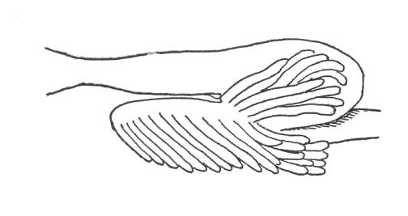
Pyloric caeca

Slide 14
Eubulus fr. 61 KA [Spartans or Leda]
“Did you think that I had no guts (χολή), like you were talking to some hepatus fish? I can still be a tough old bastard!”
(χολή is literally bile, gall)

Slide 15
What is morbus hepatiarius?
A humorous diagnosis
hepatiarius derives from ἥπατος, the hepatus fish.
Hence Cappadox (supposedly) is turning into a hepatus fish.
That means his “guts” are failing or disappearing, as in the “gutless” hepatus fish.
It’s causing a deficiency of bile.

Slide 16
Brothel keepers-as-fish jokes
Labrax in Rudens means “bass.”
Lycus in Poenulus means “bass.”
Phallio (Ballio) in Pseudylus means “whale.”

Slide 17
Aristotle on the hepatus
“It is solitary, carnivorous, and has jagged teeth. Its color is black, and it has disproportionately large eyes and a triangular white heart.”
--Athenaeus Deipn. 7.301c

Slide 18
Summing up:
Three other sick jokes in Gorgylio, 1
In 240-2, Palinurus cryptically suggests a remedy for Cappadox’s condition based on salsatura (salting, pickling; salted fish).
My new interpretation suits a man figured as a fish better than a man figured only as patient. (An allusion to garum?)

Slide 19
Summing up:
Three other sick jokes in Gorgylio, 2
In 242-3, Palinurus oddly refers to the brothel keeper “being sold.”
Since in New and Roman Comedy brothel keepers are not slaves, this jest also better suits a fish than a man or patient.

Slide 20
Summing up:
Three other sick jokes in Gorgylio, 3
Later in the play Gorgylio wears an eye patch that he refers to only as hoc.
Since the word for a patch in Greek and Latin is σπληνίον (splenium), a “little spleen,” we can now recognize an ironic allusion to the brothel keeper’s supposedly enlarged spleen (also mocked by Palinurus).

