Slide 1
Judging Medea: Reimagining Magic and Murder in Syfy’s Olympus
Meredith Prince
Auburn University

Slide 2
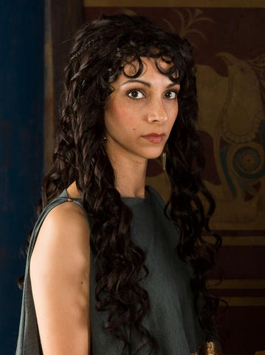
Sonita Henry as Medea on Olympus
“Medea - yes, THAT Medea - is a powerful sorceress who has one true love: Power. She seeks the Lexicon, the hidden code that allows for entry into Olympus. She even married Aegeus to get it. She's charismatic, she's ruthless, she's sexy and she's magical (literally). In short, Medea is irresistible and terrifying.” - Syfy web site for Olympus

Slide 3
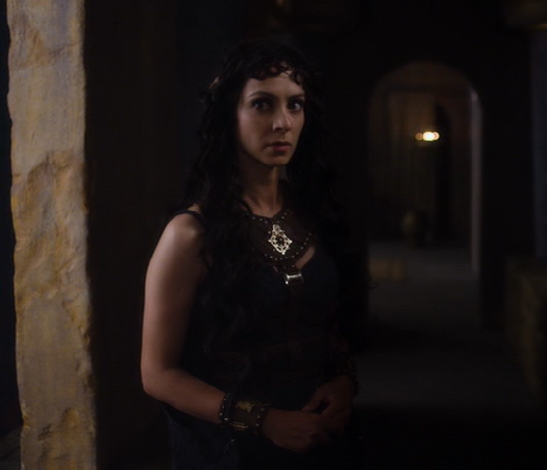
Episode 1: meeting Medea

Slide 4
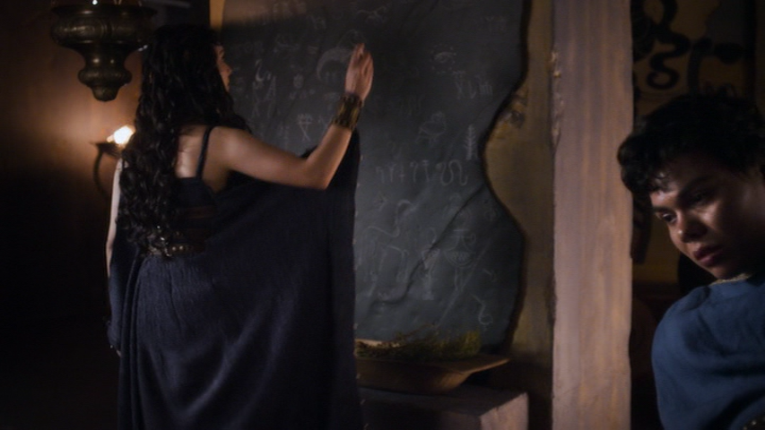
Episode 1: bleeding her son

Slide 5
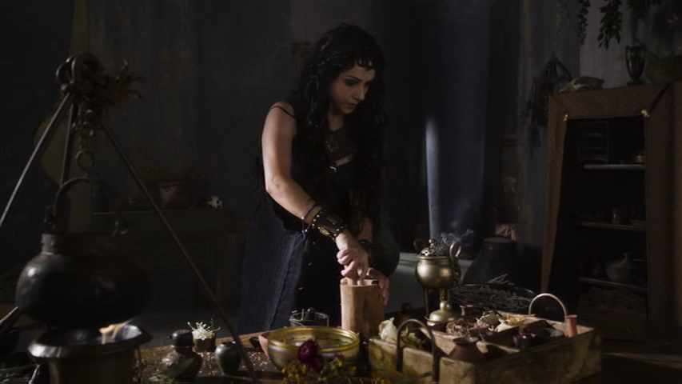
Episode 3: working with her herbs

Slide 6
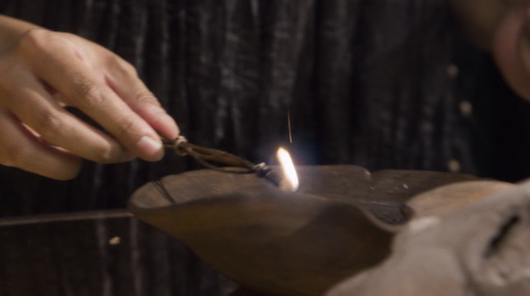
Episode 4: summoning spell
“Titan Helios, summer sun and winter light, act as my sentinel, in this my greatest hour of need. Fire your golden arrow at the eldest son of Aegeus, king of Athens.”

Slide 7
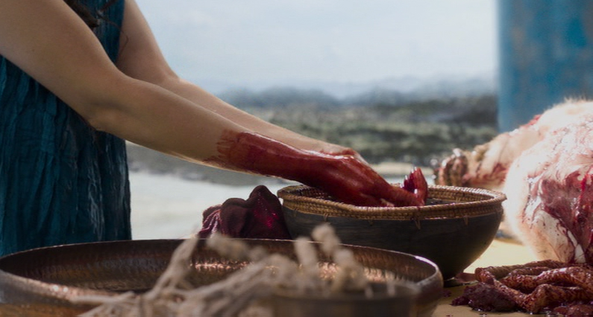
Episode 5: courage spell
“Holy mother Athena, virgin goddess of wisdom, fortify your son’s heart, Aegeus, king of Athens. Give him the courage to face his abandoned son.”

Slide 8
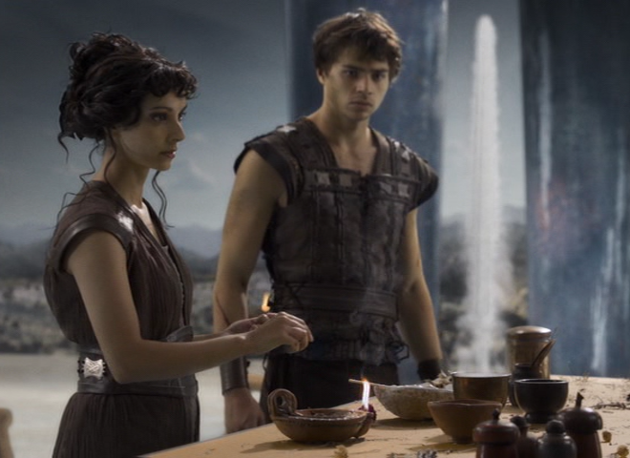
Episode 10: heritage spell
“Sacred mother, cast your watchful gaze over our quest. Look through the fog and show us how to find the heritage of Athens.”

Slide 9
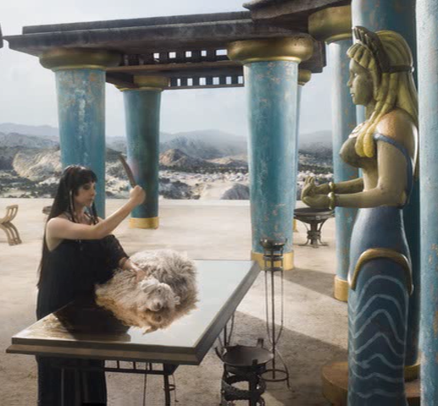
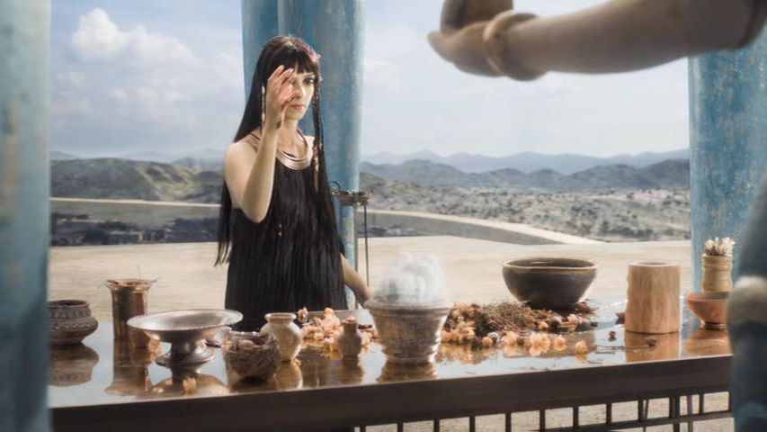
Episode 2: conjures phantom

Slide 10
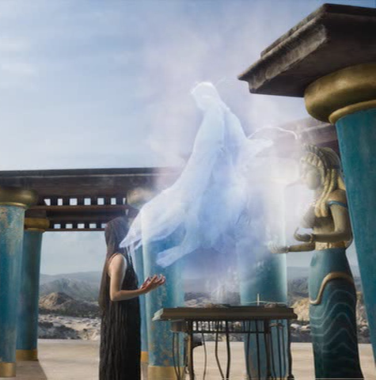
Episode 2: controlling Hero from afar

Slide 11
Episode 3: oil on her robes, her (almost) Glauce moment

Slide 12
Episode 12: calling on Circe

Slide 13
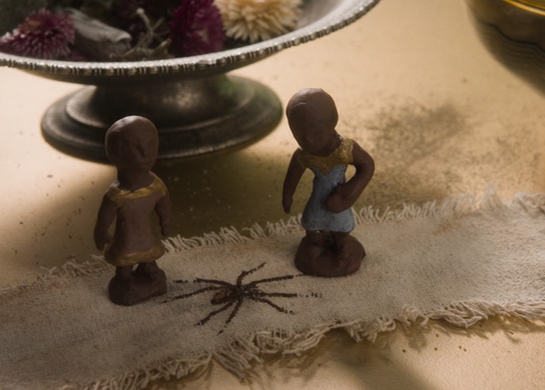
Episode 3: first reference to the children
“Blessed Athena, accept this offering as thanks for guiding my priests. May they return with the eldest son of Aegeus to me quickly so that I can unravel the mysteries of the Lexicon and deliver my loved ones.”

Slide 14
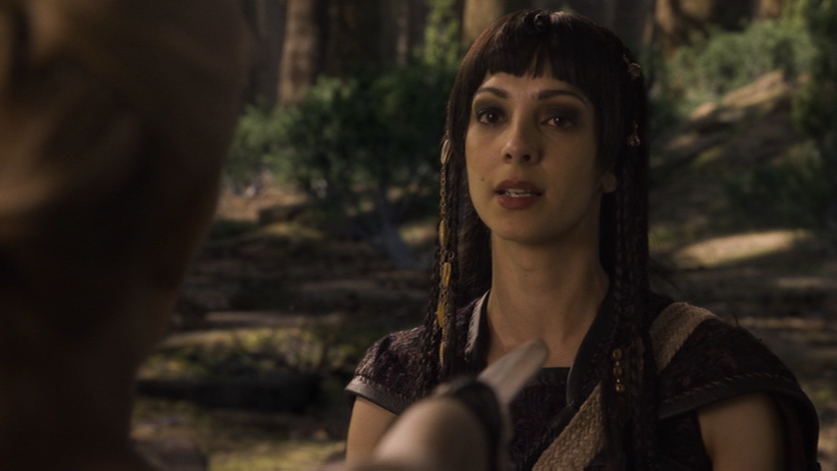
Episode 7: Medea and Chalciope

Slide 15
Episode 10: meeting the children

Slide 16
Episode 10: seeing the children

Slide 17
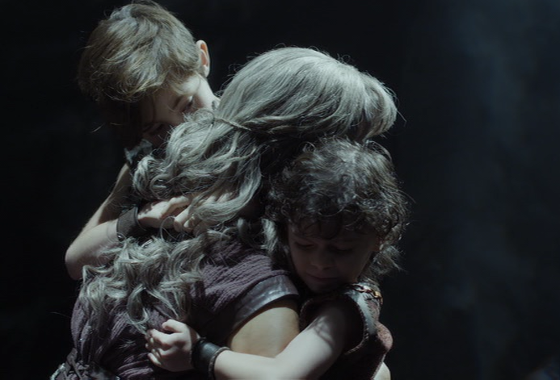
Episode 13: reunited?

Slide 18
Episode 13: judging Medea

