Slide 1
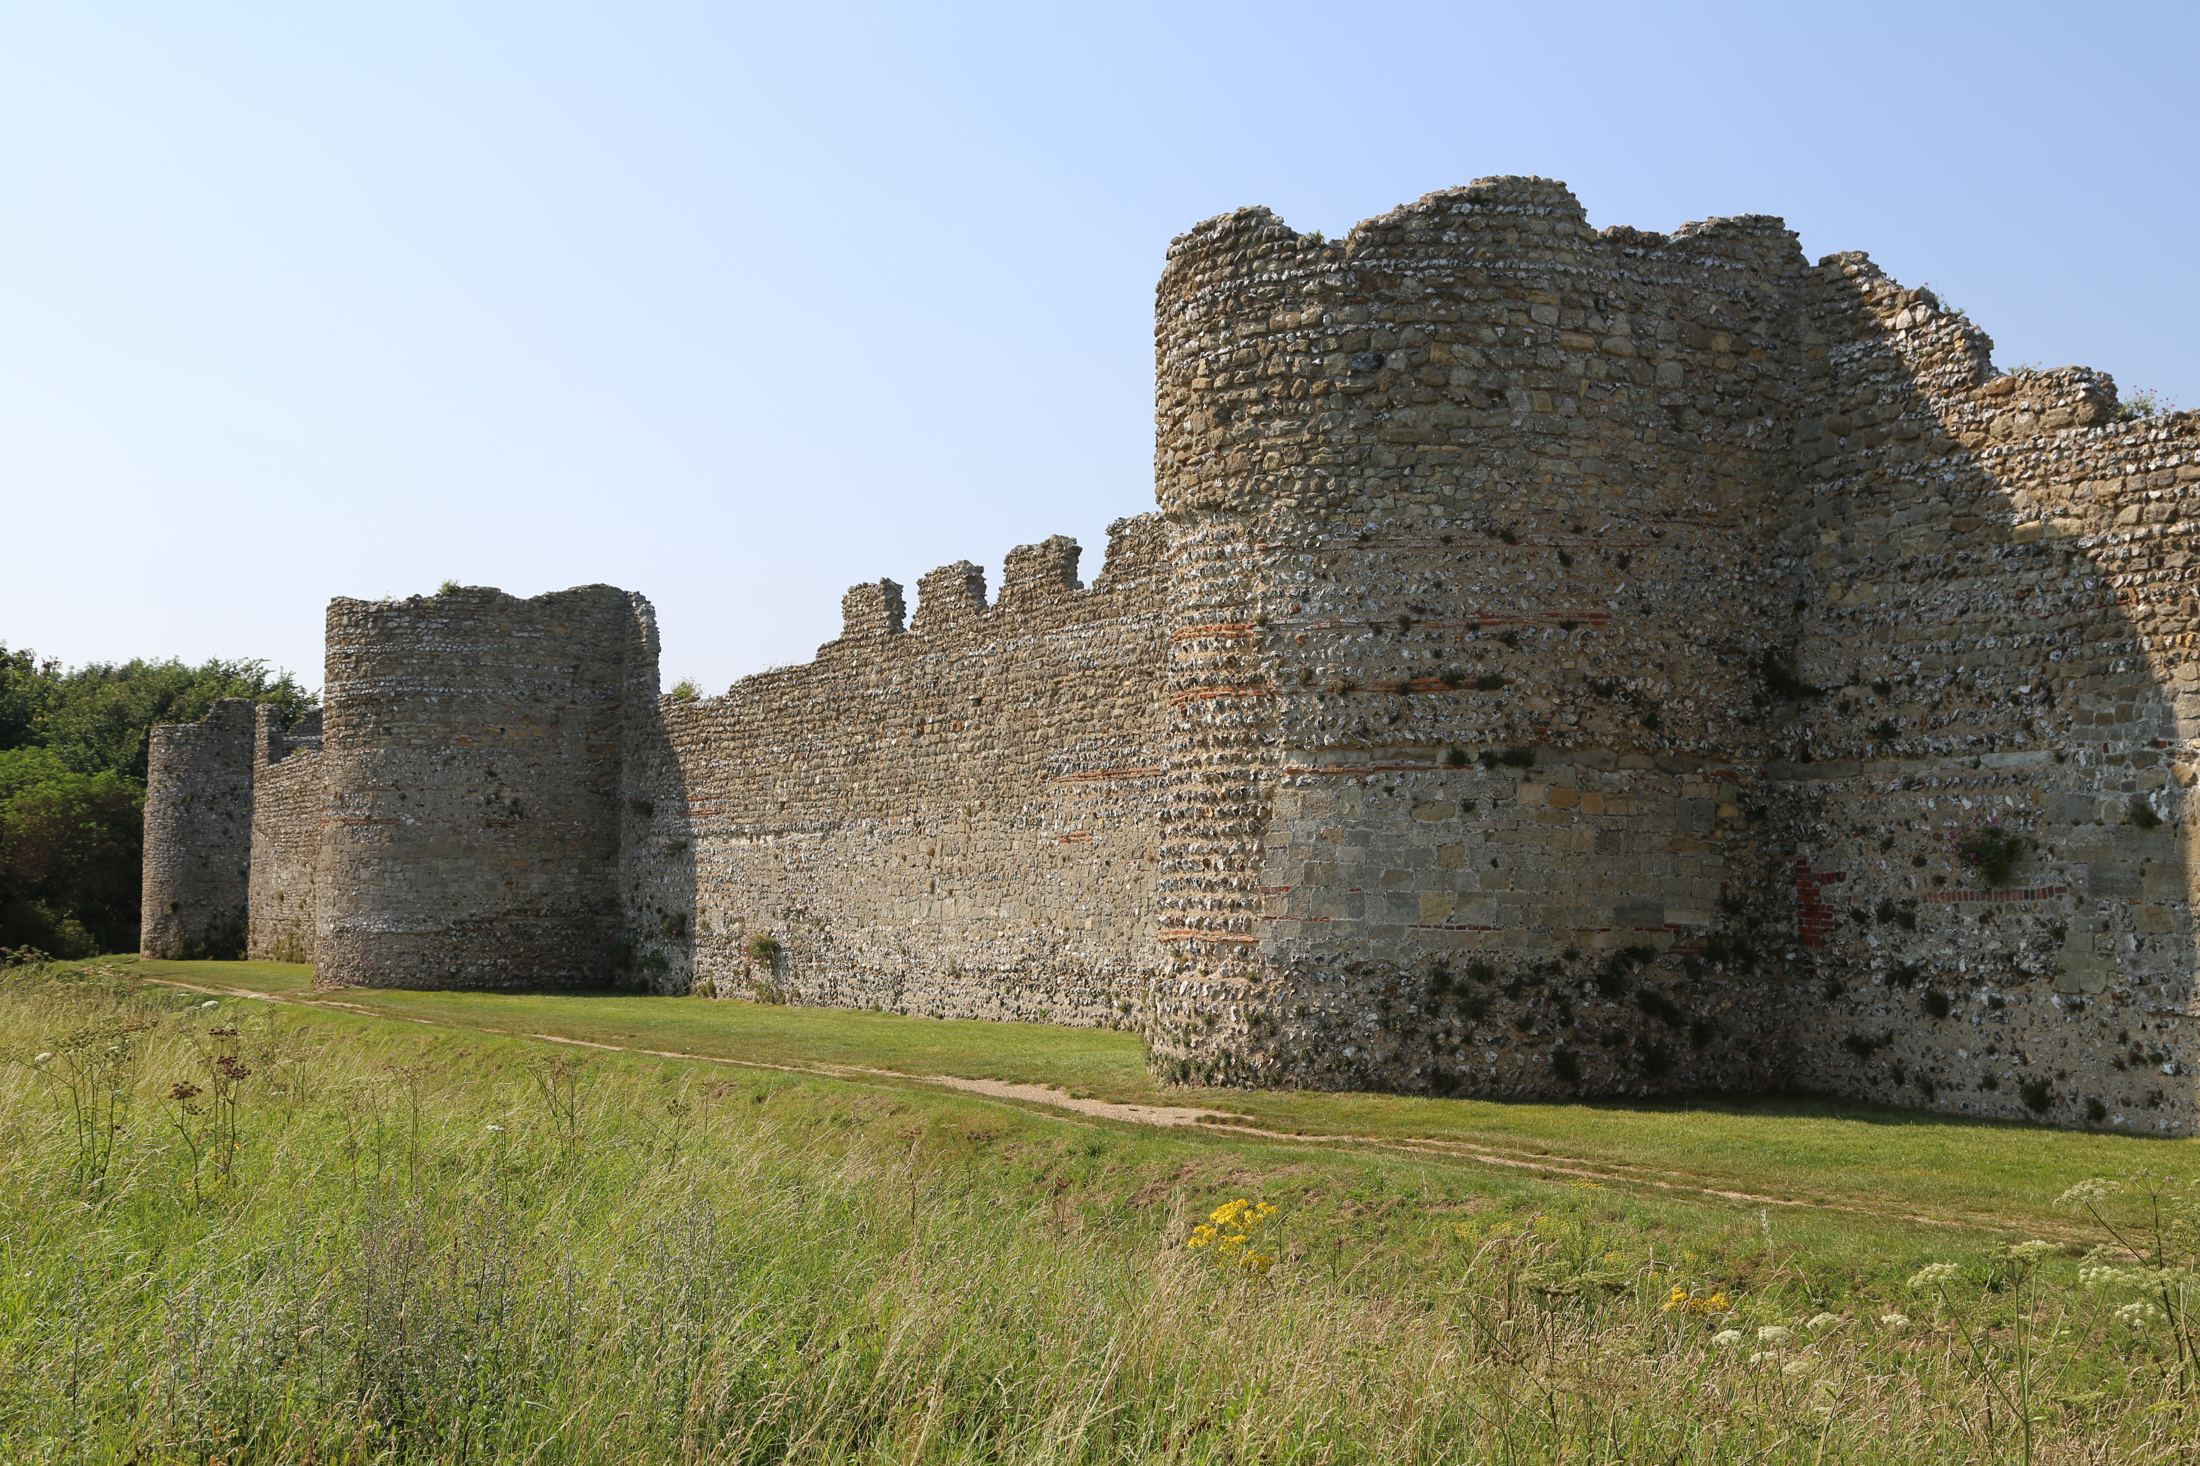

A Tale of Two Frontiers?: Hadrian’s Wall and the Saxon Shore Forts in the
3rd to 5th centuries A.D.
Nathaniel Durant

Slide 2
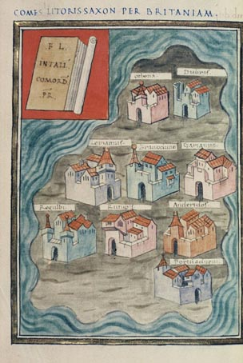

Slide 3
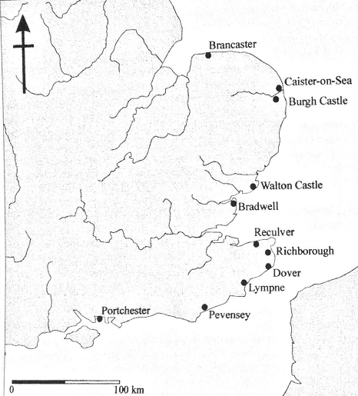

Slide 4
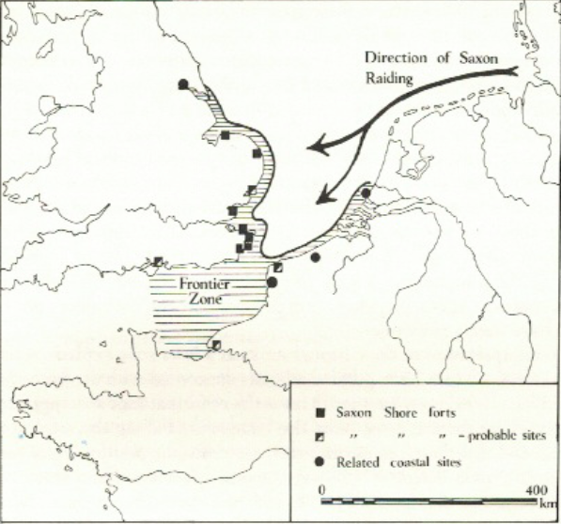
From Johnson, 1976

Slide 5
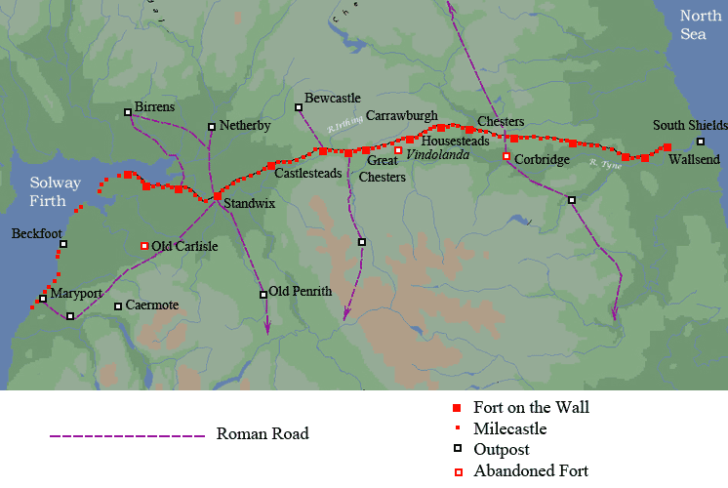

Slide 7
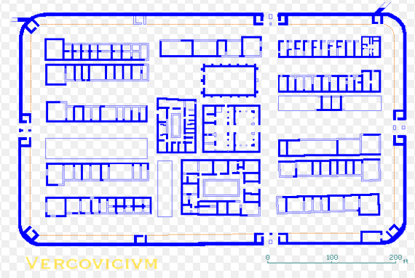

Slide 8
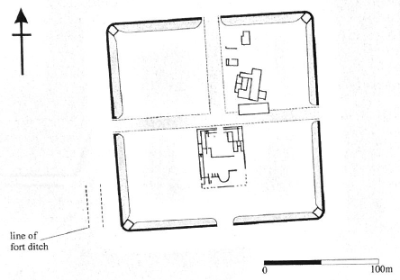
Brancaster
From Pearson, 2003

Slide 9
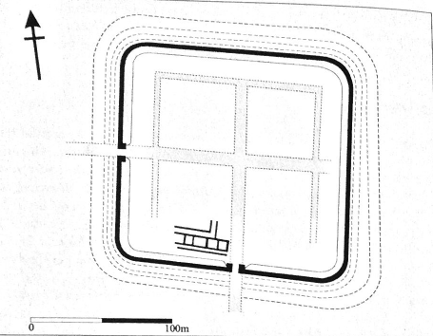
Caister On Sea
From Pearson, 2003

Slide 10
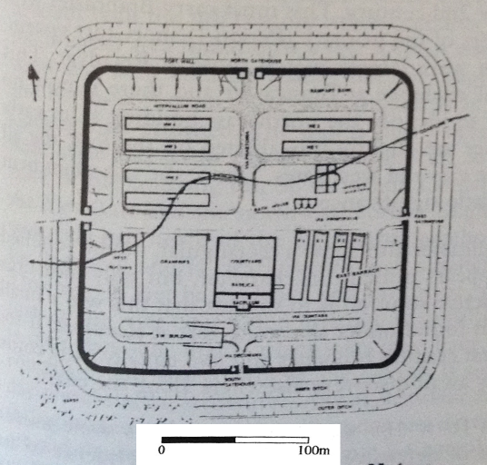
Reculver
From Philp, 2005

Slide 11
Fort | Wall Thickness (m) | Tile Coursing | Bastions | Corners | Rampart Bank? | Hectares | Ditches
Period I
Reculver | 3.05 | No | No | Rounded | Yes | 3.24 | 2
Brancaster | 3 | No | No | Rounded | Yes | 3.03 | ?
Caister | 3 | No | No | Rounded | Yes | 3.53 | ?
Carisbrooke | 3 | No | Vestigial | Rounded | ? | 2 | ?
Dover | 2.5 | No | Yes | Angular | Yes | 1.56 | 1
Richborough Earth Fortlet | Earth Rampart | No | No | Rounded | Yes | 0.5 | 3
After Philp, 2012

Slide 12
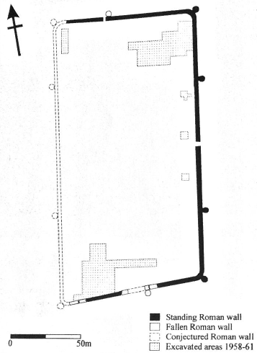
Burgh Castle
From Pearson, 2002

Slide 13
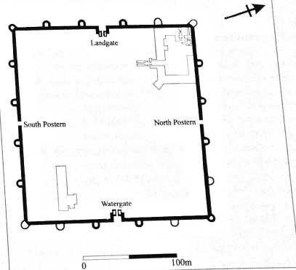
Portchester
From Pearson, 2003

Slide 14
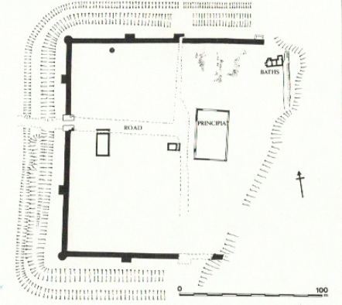
Richborough
From Pearson, 2003

Slide 15
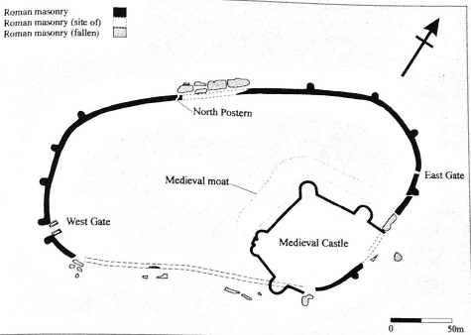
Pevensey
From Pearson, 2003

Slide 16
Fort | Wall Thickness (m) | Tile Coursing | Bastions | Corners | Rampart Bank? | Hectares | Ditches
Period I
Reculver | 3.05 | No | No | Rounded | Yes | 3.24 | 2
Brancaster | 3 | No | No | Rounded | Yes | 3.03 | ?
Caister | 3 | No | No | Rounded | Yes | 3.53 | ?
Carisbrooke | 3 | No | Vestigial | Rounded | ? | 2 | ?
Dover | 2.5 | No | Yes | Angular | Yes | 1.56 | 1
Richborough Earth Fortlet | Earth Rampart | No | No | Rounded | Ues | 0.5 | 3
Period II
Richborough | 3.3 | Yes | Yes | Angular | No | 2.7 | 2
Burgh Castle | 3.2 | Yes | Yes | Rounded | No | 2.58 | ?
Lympne | 3.5 | Yes | Yes | Angular | No | 3.23 | ?
Walton | ? | Yes | Yes | Rounded | ? | ? | ?
Pevensey | 3.7 | Yes | Yes | None | No | 4 | ?
Portchester | 4 | Yes | Yes | Angular | No | 3.42 | ?
Bradwell | 4.27 | Yes | Yes | Rounded | ? | 2+ | ?

Slide 17
Strong Military Indicators | Sub Category |  | Possible Military Evidence | Sub Category
Melee Weapon | Sword |  | Brooch | Crossbow Brooch
Melee Weapon | Scabbard Slide |  | Brooch | All other types
Melee Weapon | Scabbard Mount |  | Horse Equipment | Harness Mount
Melee Weapon | Scabbard Chape |  | Horse Equipment | Strap Distributor
Melee Weapon | Spearhead |  | Horse Equipment | Snaffle Bit
Missile Weapon | Balista Bolt |  | Horse Equipment | Horseshoe
Missile Weapon | Axehead |  | Horse Equipment | Ring
Missile Weapon | Stone Shot |  | Horse Equipment | Spur
Missile Weapon | Javelin |  | Melee Weapon | Ferrule
Armor | Scale Armor |  | Missile Weapon | Arrowhead
Armor | Helmet |  | Belt Accessories | Zoomorphic Buckle
Armor | Helmet Handle |  | Other | Miscellaneous
Armor | Shield Boss
Belt Accessories | Belt Mount
Belt Accessories | Belt Buckle
Belt Accessories | Strap End
Belt Accessories | Buckle Plate
Belt Accessories | Buckle Tongue
Belt Accessories | Belt Stiffeners
Other | Miscellaneous

Slide 18
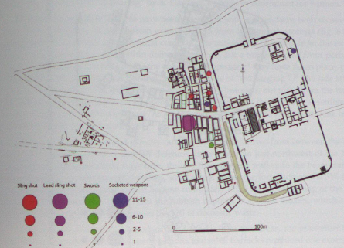
From Birley, 2013

Slide 19
Number of Objects

Slide 20
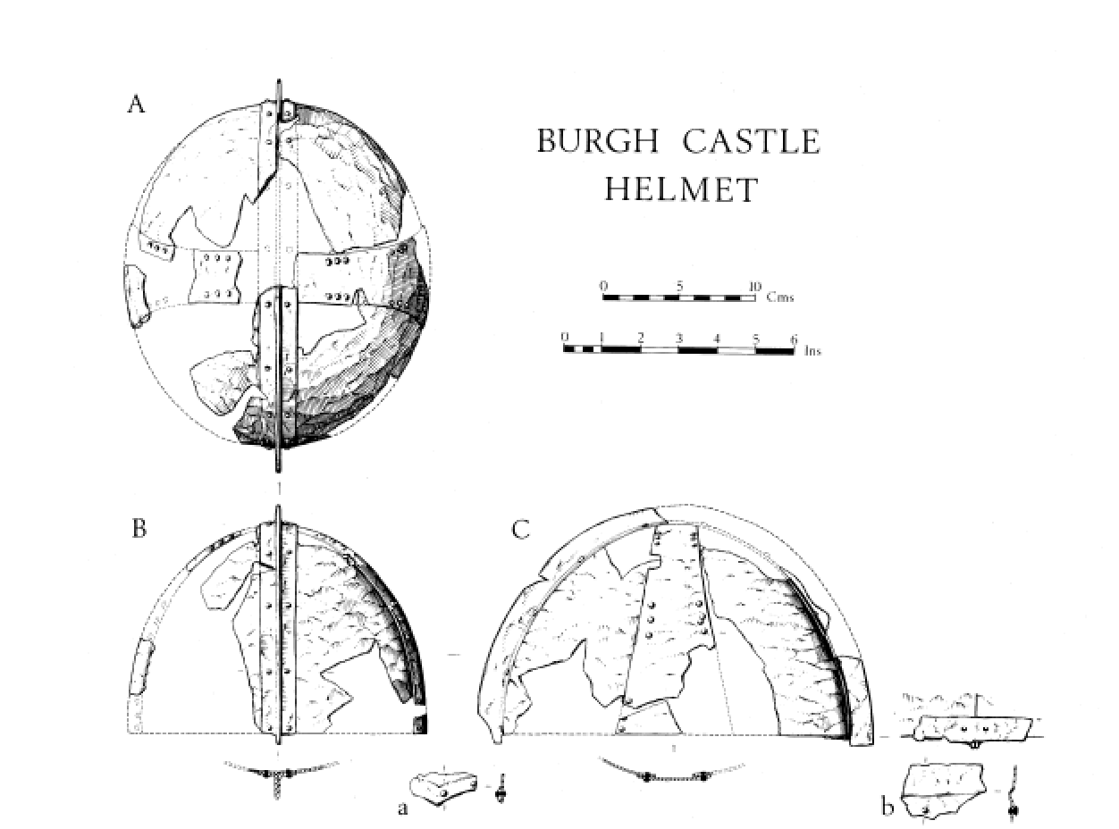

Slide 21
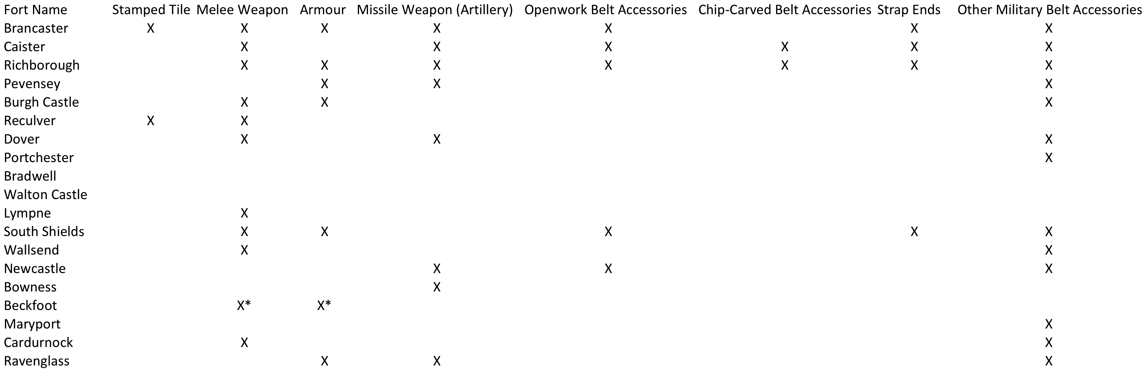

Slide 22
