Slide 1
“They Make Themselves Immortal”: Worship of the Great God at the Greek Colony of Odessos
Travis Hill
University of Arizona
CAMWS 2016
Williamsburg, VA
March 18, 2016

Slide 2
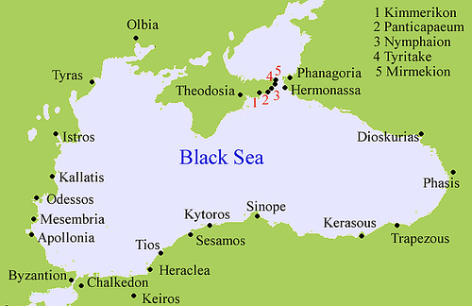
Odessos – Greek Colony

Slide 3
Evidence of θεὸς μέγας
Pick, Regling I, 2, #2214, 2215, pl IV; 1, 2

Slide 4
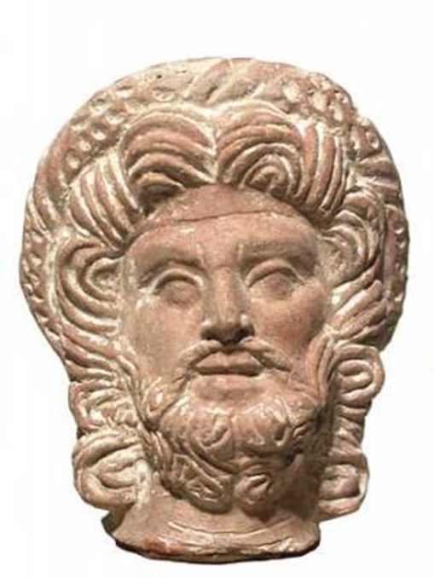
Evidence of θεὸς μέγας
Image from Varna Museum of Archaeology website

Slide 5
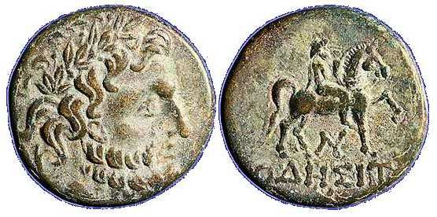
Evidence of θεὸς μέγας
AMNG (Die Antiken Münzen Nord-Griechenlands) 2205

Slide 6
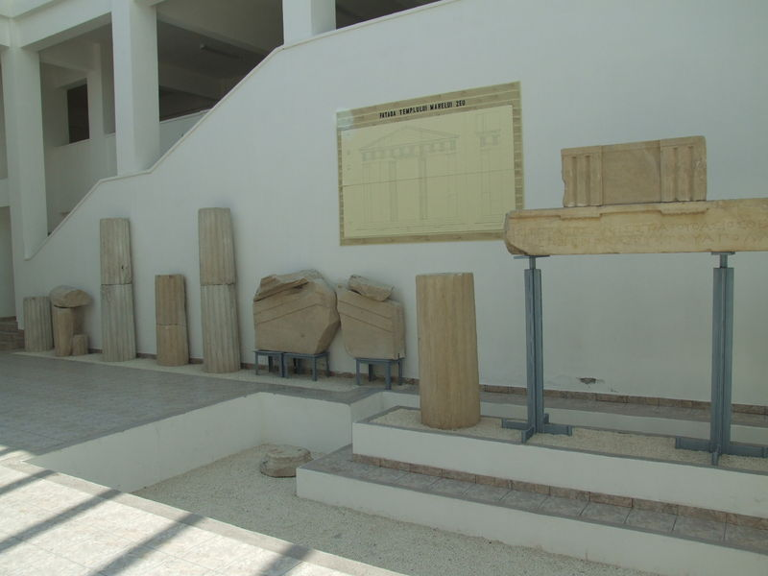
Evidence of θεὸς μέγας
[Πεισίστρατος Μνησιστράτου Θάσιος Θεῶι Μεγάλωι
[ἐ]πὶ ἱέρεω Ξενοχάρους τοῦ Ἀπολλωνίου.

Slide 7
Who is θεὸς μέγας?
Zeus or Poseidon
  Not chthonic
Pluto
  No analog as polis deity
  Fr. 161 from Aeschylus’ Niobe: “Alone of the gods, Death desires no gifts; one can gain nothing by making sacrifice or pouring libation to him, nor has he any altar, nor is he addressed in songs of praise; from him, alone among divinities, Persuasion stands aloof.” (Trans. by Sommerstein)
Great Gods of Samothrace
  Separate identity on inscription IGB I, 13
  Always plural
Serapis
  Separate identity on coins & inscription IGB I, 13
Thracian Deity – Zalmoxis

Slide 8
Herodotus 4.93-96
But before [Darius] came to the Ister he conquered first the Getai, who believe in immortality. . . . And their belief in immortality holds that they do not die, but that he who is killed goes to Zalmoxis, a divinity. . . . and at intervals of four years they send one of themselves, whomsoever the lot may select, as a messenger to Zalmoxis, charging him with such requests as they have on each occasion. . . .
[Zalmoxis] prepared a banqueting-hall, where he received and feasted the chief men of the tribe and instructed them meanwhile that neither he himself nor his guests nor their descendants in succession after them would die. They would come to a place where they would live forever and have all things good. While he was doing and saying these things, he was making for himself meanwhile a chamber under the ground; and when his chamber was finished, he disappeared from among the Thracians and went down into the underground chamber, where he continued to live for three years. They grieved for his loss and mourned for him as dead. Then in the fourth year he appeared to the Thracians, and in this way the things which Zalmoxis said became credible to them. (Macaulay 2004)

Slide 9
Plato Charmides 156d-156e
Such, then, Charmides, is the nature of this charm. I learnt it on campaign over there, from one of the Thracian physicians of Zalmoxis, who are said even to make one immortal. This Thracian said that the Greeks were right in advising as I told you just now: “but Zalmoxis,” he said, “our king, who is a god, says that as you ought not to attempt to cure eyes without head, or head without body, so you should not treat body without soul.” (Lamb 1955)

Slide 10
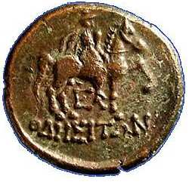
Thracian Rider
CCET I, 40 from Odessos
AMNG 2207

Slide 11
Euripides (attrib.) Rhesus 962 - 973
[Rhesus] shall not go into earth's dark soil; so earnest a prayer will I address to the bride of the nether world, the daughter of the goddess Demeter, giver of increase, to release his soul; and, debtor as she is to me, show that she honors the friends of Orpheus. And to me for the rest of time he will be as one who is dead and does not see the light; for never again will he meet me or see his mother; but he will lie hidden in a cavern of the land with veins of silver, restored to life, a deified man, just as the prophet of Bacchus dwelt in a grotto beneath Pangaeus, a god whom his votaries honored. (Coleridge 1891)

Slide 12
Selected Bibliography
Archibald, Z. H. 1998. The Odrysian Kingdom of Thrace. Oxford: Clarendon Press.
Condurachi, E. 1940. “Le ‘Theos Megas’ des Monnaies D’Odessos.” Revue numismatique 1940: 1-20.
Eliade, Mircea. 1970. Zalmoxis: The Vanishing God. Chicago: University of Chicago Press.
Gotcheva, Zlatozara. 1980. “Pretres eponymes d’Odessos et de Dionysopolis.” Klio 62, no. 1: 49-53.
----- 1996. “Organization of Religious Life in Odessos.” Kernos 9: 121-127.
----- 2007. “La Thrace Pontique et la mythologie Grecque.” In Ancient Greek Colonies in the Black Sea 2. Vol. 1, edited by Dimitrios Grammenos and Elias Petropoulos, 51-84. Oxford: Archaeopress.
Hoddinott, R. F. 1975. Bulgaria in Antiquity: An Archaeological Introduction. London: Ernest Benn Limited.
Karayotov, Ivan. 2007. “Le monnayage de Messambria et les Monnayages d’Apollonia, Odessos et Dionysopolis.” In Ancient Greek Colonies in the Black Sea 2. Vol. 1, edited by Dimitrios Grammenos and Elias Petropoulos, 127-174. Oxford: Archaeopress.
Mihailov, Georgius, ed. 1956, 1997. Inscriptiones Graecae in Bulgaria Repertae, Vol 1.-5 Sofia: Bulgarian Academy of Culture.
Minchev, Alexander. 2003. “Odessos: 6th century B.C. to early 1st century A.D.” In Ancient Greek Colonies in the Black Sea. Vol. 1, edited by Dimitrios Grammenos and Elias Petropoulos, 209-278. Thessaloniki: Archaeological Institute of Northern Greece.
Pippiki, Dionisie M. and Gabrielle Bordenache. 1959. “Un temple du Theos Megas a Istros.” Bulletin de correspondence hellenique 83, no. 2: 455-465.
Tsontchev, Dim. 1962. “Iconographie et Culte de Quelques Divinites Grecques en Bulgarie.” Revue Archeologique 1962, no. 1 (January – June): 179-198.
Vianu, Maria Alexandrescu. 1999. “Theos Megas.” Dacia 43-45: 73-78.
Zelazowski, Jerzy. 1992. “Le Culte et l’Iconographie de Theos Megas sure les Territoires Pontiques.” Archeologia 43: 35-51.

