Slide 1
Profiles of Twice-Exceptional Students: What Works
Ariel Baska
CAMWS
March 18th, 2016
Ariel Baska - Fairfax County Public Schools

Slide 2
Table of Contents
What is Twice-Exceptionality (2E)?
Why Latin for 2E?
Case Studies
Learner Profiles
Accommodations
Trajectory
Lessons Learned
Commonalities and Conclusions
Teaching Strategies

Slide 3
What is 2E?
Describes a group of students who have strong abilities, but are unable to activate those abilities due to other learning impediments and disabilities.

Slide 4
What is 2E?
GT with physical disabilities
GT with sensory disabilities
GT with Attention Deficit/Hyperactivity Disorder (ADHD)
GT with Specific Learning Disabilities (SLD)
GT with Autism Spectrum Disorder (ASD)
GT with emotional or behavioral disorders
(Doobay & Foley Nicpon, 2014)

Slide 5
What is 2E?
Students appear to have a “flat profile” – giftedness and/or compensatory strategies mask disability and vice versa.
2E often comorbid with ADD/ADHD, depression, and anxiety disorders.
Numbers have more than doubled in the last decade (NEA, 2011).
Better identification?
Increased academic pressure?

Slide 6
What is 2E?
Students appear to have a “flat profile” – giftedness and/or compensatory strategies mask disability and vice versa.
2E often comorbid with ADD/ADHD, depression, and anxiety disorders.
Numbers have more than doubled in the last decade (NEA, 2011).
Better identification?
Increased academic pressure?

Slide 7
Characteristics of 2E students
Often differ widely from each other, but many may have:
Metacognitive issues
Motivational problems
Executive functioning difficulties

Slide 8
Why focus on 2E students?
Underidentified - Only 1% of students who receive IDEA services are identified for G/T programs, compared to 7% of the general population (Office of Civil Rights, 2014)
385,000 identified – fast-growing population
Need academic interventions to access the curriculum at the highest level
Lack of appropriate challenge can lead to behavior problems
Increased risks for this population
Price to our society when school fails these kids

Slide 9
Why Latin for 2E students?
Continuity with one (or two) teachers
Structure of the language
Variety – mythology, history, art, architecture
Interdisciplinary connections
Challenge!

Slide 10
Why Case Studies?
2E students differ from one another
Lack of research on specific academic strategies that work
No panacea
Anecdotal data more revealing

Slide 11
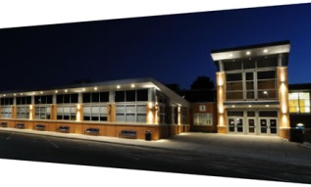
W.T. Woodson High School
Fairfax, Virginia
Suburb of Washington, D.C.

Slide 12
Background on School Environment
Enrollment this year: 2,464
Programs and Services
Strong honors/AP program (25 AP courses offered)
ESL (English as a Second Language) program
Regional DHOH (Deaf and Hard of Hearing) Center
CSS (Comprehensive Service Site) for students with emotional disabilities

Slide 13
Background on School Environment
By percentages:
51% male, 49% female
39% minority enrollment
9% economically disadvantaged
88% of students take an AP exam
97.2% graduate on time
US News and World Report, 2014

Slide 14
THE CASE FOR RYAN

Slide 15
Learner Profile A - Ryan
White, male student
Diagnosed with ASD (autism spectrum disorder), ED, dysgraphia
Served by the CSS program
Executive functioning difficulties
Deep need for acceptance, lashes out in anger
Strengths: Scientific knowledge, facts, vocabulary
General interests: Animals, environmental issues, comic books

Slide 16
Learner Profile A - Ryan
Frequent behavioral incidents in Latin I
Difficulty following rules, directions
Oppositional-defiant behavior
Outbursts
Cheating
Disrespect

Slide 17
Accommodations Profile A - Ryan
From His IEP:
Frequent Breaks (Flash Pass)
Electronic devices
Assignments broken down
Clearly defined limits/expectations
Assignment Notebook

Slide 18
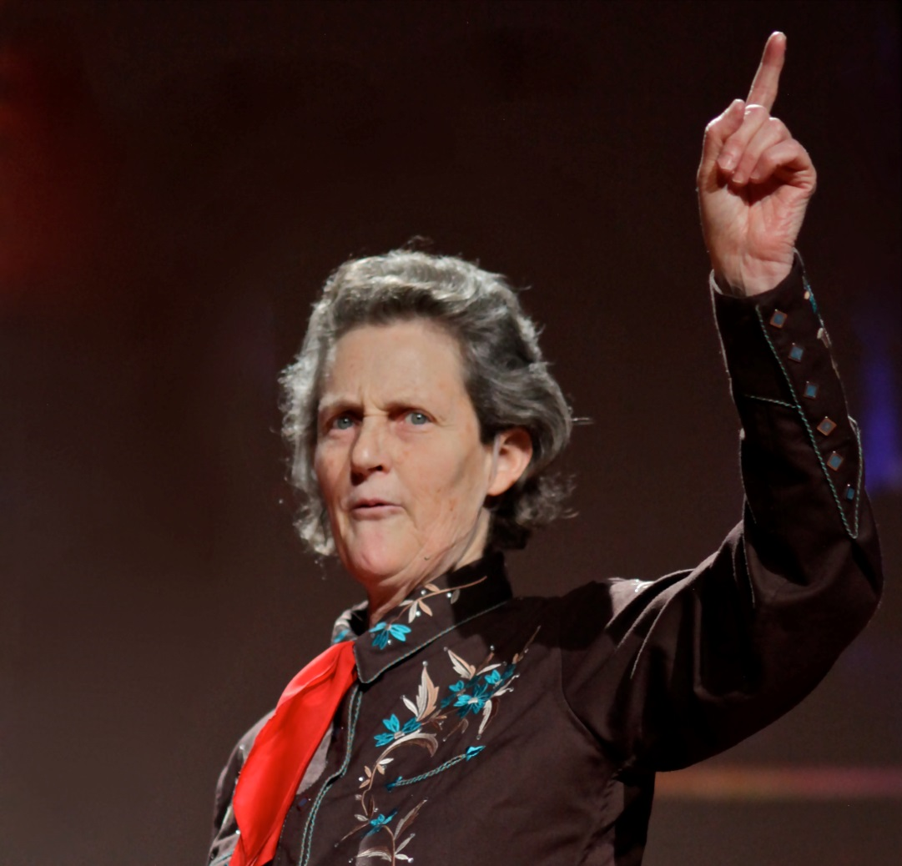
Temple Grandin
A best-selling author, autistic activist, and consultant on animal behavior. Listed in the Time 100 list of the most influential people in the world in the "Heroes" category.

Slide 19
Accommodations Profile A - Ryan
In the Latin Classroom:
Frequent check-in surveys (emotional/metacognitive)
Address student’s long-term goals
Aid with career research, job skills practice
Remove competitive games from classroom activities
Individually timed and tiered assignments – race against the clock

Slide 20
Latin Trajectory A - Ryan
Three years of Latin, beginning in 10th grade
Upward grade trend
Graduated with Advanced Diploma
“I always appreciated that Mrs. Baska tried to help me as a person, not just a Latin student. The Latin certainly helped me with my writing, with scientific names, but she was the first to help me figure out… how to get an interview, or an internship, or pursue zoology.”

Slide 21
What I Learned From Ryan
Practical experiences linked to ability and interest are a great motivator
Make friends with Employment Transitional Specialist or Career Services counselor at your school
Never too early to be career-minded
Classroom activities/strategies which work well for some 2E students do NOT work for all

Slide 22
Where are they now?

Slide 23
THE CASE FOR LAURA

Slide 24
Learner Profile B - Laura
White, female student
Born deaf, learned American Sign Language (ASL) as first language
No other diagnosed disability/learning impediment, though severe difficulties with math
Served by the DHOH Center
Easily bored, retreats into books often
Refused to work in groups
Strengths: Avid and advanced reader (college texts in MS), complex vocabulary
General interests: History, reading, medieval stuff

Slide 25
Accommodations Profile B - Laura
From Her IEP:
Interpreters working with her in class
Electronic devices and whiteboards for communication
Extended time
Captioned media
Access to notes

Slide 26
Accommodations Profile B - Laura
In the Latin Classroom:
Visual coding of text from day one
Acceleration of content – Aesop (1) Caesar (2)
Text manipulation via SmartBoard tech
Independent contract on long-term projects – role and assignment specifically spelled out
Meter – had to learn via extensive list of rules about pronunciation and how letters do/don’t blend

Slide 27
Latin Trajectory B - Laura
Level One
Level Two
First deaf student to compete in VJCL Certamen
Level Three
Scholarship to attend NJCL
AP Latin
First deaf student to attend Governor’s Latin Academy
Level Five

Slide 28
In Her Own Words - Laura
“Truly, the period which I spent in the Latin program at both Frost and Woodson was a time of great intellectual flourishing in my life... [Latin] class was always the eye of the storm, so to speak, in the barren desert of my formal education... Indeed, my time in the Latin program cast a luster on that part of my life which had been utterly shorn of meaningful accomplishments...”

Slide 29
What I Learned From Laura
Any student can fully access the curriculum as long as it is broken down adequately
Independent contracts are helpful
Students themselves don’t always recognize how they learn best or what’s best for them educationally

Slide 30
Where are they now?

Slide 31
THE CASE FOR MAX

Slide 32
Learner Profile C - Max
White, male student
Diagnosed with ED, ADD, dysgraphia
Served by the CSS program
Often fatigued/bored by school
Executive functioning difficulties
Memory difficulties
Strengths: highly verbal, excitable, excellent with presentations, curious, wanting to go beyond the curriculum
General interests: Acting, performing, military tactics, architecture, comic books

Slide 33
Learner Profile C - Max
Parents: “We believe he is a bored gifted student with a possible mood disorder. Teachers don’t understand how a boy who sleeps all the time in class could possibly be gifted.”
Max: “I know I’m smart, but I only realize that outside of school, when I’m in the real world. School is so far from reality… I can’t play the game.”

Slide 34
Accommodations Profile C - Max
From his IEP:
Test/classroom directions read aloud
School-supplied note-taking devices
Graphic organizers
In reality:
Forgot many directions if given orally
Lost note-taking devices, no longer supplied
Only graphic organizers worked

Slide 35
It’s Your Turn!
Using this student profile, complete the chart provided.
Known 2E Factors
Unknown 2E Factors
Steps to Inquiry and Possible Accommodations
Predictions on Trajectory?

Slide 36
Accommodations Profile C - Max
In the Latin classroom:
Road maps for all translation assignments
Table of contents for more involved readings (Latin or English)
Hand signals for vocabulary retention
Completed classwork on teacher laptop
Re-organized backpack by declension (5 sections)
Met individually once a week to discuss what was working for him that week, how he was thinking, what he had learned, what he still needed (in lieu of post-it-note exit tickets/surveys)

Slide 37
Latin Trajectory C - Max
Took 2 years of Latin, maintained a B average
Didn’t feel confident enough in vocabulary retention to continue
Wanted to pursue American Sign Language
Pushed by parents into Spanish, maintained a C average
Graduated with Standard Diploma
“I learned a lot about how I learn from Latin, and could not have passed most classes my junior and senior year without it.”

Slide 38
What I Learned From Max
Importance of metacognitive activities
Understanding student interests
Individualization is scary, but works

Slide 39
Where are they now?

Slide 40
THE CASE FOR MITCH

Slide 41
Learner Profile D - Mitch
Asian-American male student
Diagnosed with ASD, ED, anxiety disorders
Served by the ESL program
Selective mutism – reluctance/refusal to speak in classroom/social situations
Strengths: Profoundly gifted writer, critical thinking skills, research skills
General interests: Philosophy, Greek, drumming, political activism

Slide 42
Accommodations Profile D - Mitch
From His IEP:
Preferential seating
Extended time to respond orally
Assign groups/partners for him
Alternative assignments for oral presentations

Slide 43
It’s Your Turn!
Using this student profile, complete the chart provided.
Known 2E Factors
Unknown 2E Factors
Steps to Inquiry and Possible Accommodations
Predictions on Trajectory?

Slide 44
Accommodations Profile D - Mitch
In the Latin Classroom:
Independent contract on long-term projects – role and assignment specifically spelled out
Frequent check-in surveys (metacognitive/emotional)
Certamen to encourage speaking out in controlled situations
Long-term planning and goal-setting
Acceleration – Latin 2 to AP Latin

Slide 45
Latin Trajectory D - Mitch
Completed Latin I, II, AP Latin, V and is currently working on Latin VI as an independent study
Perfect score on NLE four years in a row
Selected for Governor’s Latin Academy
Parent: “I am most grateful for the transformation that I have seen in my son, in terms of his participation in Certamen... [which he kept as] his top priority… for the last three years, which in itself is nothing short of miracle, considering how limited his social world has been all of his school life since first grade; his coming out of the comfort zone to be in these team competitions has been possible only through the deep trust that Ms. Baska has built within him. No therapists or counselors have ever been able to help him take such risk to be out in public eye on a regular basis.”

Slide 46
What I Learned From Mitch
Advocate, advocate, advocate!
Whole-level acceleration can work too
Educate colleagues (however possible) on successful student strategies
Never underestimate what a student can do

Slide 47
COMMONALITIES
“Masked”
3 out of the 4 never identified for gifted services
“Unmasked”
Identification can happen via challenging curriculum

Slide 48
COMMONALITIES
All Needed
Teachers to Focus on Strengths First

Slide 49
COMMONALITIES
“Buffet of Options”
All Appreciated Variety and Novelty

Slide 50
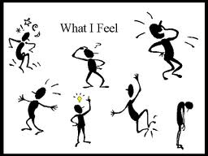
COMMONALITIES
All Needed
Social Emotional Support
Not Just Academic

Slide 51
Conclusions: What Works?
Acceleration in Strength Areas
Metacognitive Interventions
Long-Term Planning
Notes:
Name: (i.e. Ms Hilliard, Period 4: Life Science)
General Settings: specify grade level and/or subject
Teacher Settings: determine whether teacher will censor student submissions.
Student Settings: set parameters of student use (see “Installing Controls” on the next page)
Student List: (after saving the classroom) add the names of Students who will participate in this class forum

Slide 52
How to achieve acceleration?
If you suspect even one student may need it…
Give pre-tests to “level” students
Offer curriculum extensions or “tiered” projects
Occasionally throw authentic/advanced literature at them and see who excels
If you have time to give, set up advanced reading groups, in or outside of class time
If a student needs more than you can give, consider advocating for whole-level acceleration
Notes:
1. i.e. Level 1: Match dialogue box with a picture. Level 2: Fill in the blanks for in the dialogue boxes with a word box; ..Level 4: Finish the sentence for a person’s dialogue boxes; ..Level 6: Come up with your own sentence for dialogue boxes.
3. i.e. Level 1: Pictures only; Level 2: Pictures and one word descriptors…

Slide 53
How to achieve acceleration?
For more information on acceleration:
A Nation Deceived (2004)
available for free at
nationdeceived.org
and its follow-up,
A Nation Empowered (2015)
Notes:
1. i.e. Level 1: Match dialogue box with a picture. Level 2: Fill in the blanks for in the dialogue boxes with a word box; ..Level 4: Finish the sentence for a person’s dialogue boxes; ..Level 6: Come up with your own sentence for dialogue boxes.
3. i.e. Level 1: Pictures only; Level 2: Pictures and one word descriptors…

Slide 54
ACCELERATION

Slide 55
How to incorporate metacognition?
Pre-assessments that allow students to consider what they already know on a topic, and discuss what and how they’d like to learn more
Explicitly teach how to read in your language and create a mission statement regarding the ultimate goal of the program
Exit tickets/surveys regarding what confused them about a reading/speaking assignment (whether grammar or content) or what questions they still have
Frequent reflections, particularly after assessments (what did I do to study that worked, what didn’t?)
Keep post-it notes on hand for students to write down study questions and identify themes while working on translations, reading articles etc.
Model good strategies - discuss how you know when you are done with a translation, dialogue or paper
Notes:
1. i.e. Level 1: Match dialogue box with a picture. Level 2: Fill in the blanks for in the dialogue boxes with a word box; ..Level 4: Finish the sentence for a person’s dialogue boxes; ..Level 6: Come up with your own sentence for dialogue boxes.
3. i.e. Level 1: Pictures only; Level 2: Pictures and one word descriptors…

Slide 56
How to include long-term planning?
Facet of both acceleration and metacognition – help student confirm own abilities and interests through those activities
Embrace multipotentiality – encourage, don’t limit
Share where possible about planned education/career path and current destination
Discuss interview skills, job skills, self-advocacy
Locate compadres or mentors for students at varying stages of school/career/life
Encourage career/school research by teaming up with Career Services or guidance office
Notes:
1. i.e. Level 1: Match dialogue box with a picture. Level 2: Fill in the blanks for in the dialogue boxes with a word box; ..Level 4: Finish the sentence for a person’s dialogue boxes; ..Level 6: Come up with your own sentence for dialogue boxes.
3. i.e. Level 1: Pictures only; Level 2: Pictures and one word descriptors…

Slide 57
References and Resources
Baum, S.M., Rizza, M., & Renzulli, S. (2006). Twice exceptional adolescents: Who are they? What do they need? In F.A. Dixon & S.M. Moon (Eds.), The handbook of secondary gifted education (pp 137-164). Waco, TX: Prufrock Press.
Gallagher, S.A. & Gallagher, J.J. (2002). Giftedness and Asperger’s Syndrome: A new agenda for education. Understanding Our Gifted, 14 (2), 7-12.
Lovecky, D.V. (2004). Different minds. Philadelphia, PA: Jessica Kingsley.
National Educational Association (2011). The twice-exceptional dilemma. Washington, D.C.
Weinfeld, R., Barnes-Robinson, L., Jeweler, S. & Roffman Shevitz, B. (2013). Smart kids with learning difficulties. Waco, TX: Prufrock Press.

Slide 58
Questions?
Ariel Baska
Fairfax County Public Schools
asbaska@fcps.edu

