Slide 1
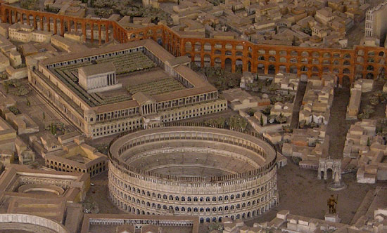
It’s Rough Being Claudius: Rustication in the Templum Divi Claudii
Stephen Czujko
http://sites.duke.edu/claudianum/history/
Stephen Czujko
University of Arizona, Classics M.A. student
Friday March 18, 2016

Slide 2
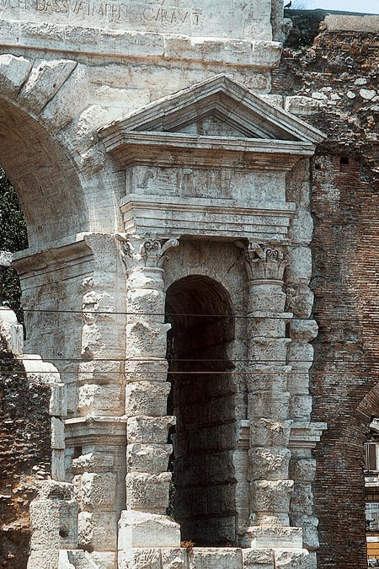
INTRODUCTION
TOPIC:
Rustication: the deliberate practice of making stone masonry look rough and recently quarried
ISSUE:
Rustication appears in a small number of Claudian monuments
Principally- the Aqua Virgo, the harbor at Ostia, the Port Maggiore, and the Templum Divi Claudii
No consensus on the issue of rustication in Claudian monuments
DEBATE (2 CAMPS):
A reflection of inferior quality of craftsmanship
A connection between the style and Claudius’ personal tastes
DISCUSSION:
rusticated monuments offer clues for a re-interpretation of Claudian architecture
Aedicule. Porta Maggiore. 54 AD. Rome. http://www.architetturadipietra.it/wp/?p=4952

Slide 3
BACKGROUND
The term was coined in the renaissance
Vitruvius and the Etruscan order of architecture
Identified by Michelozzo and Bernini as a Rustic/Tuscan order
Rustication was not a new architectural element
Robert Coates-Stephens notes that rustication appears in the Forum of Augustus, the Templum Pacis, and the Forum of Trajan
Enjoyed unparalleled prominence during Claudius’ reign
Key Distinction: in all other instances, it is only used in engineering projects

Slide 4
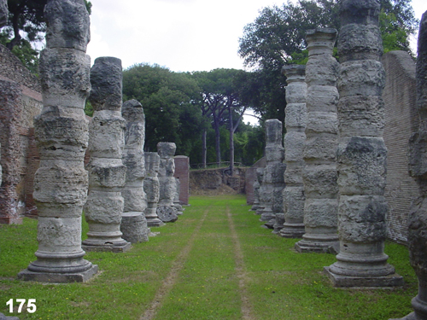
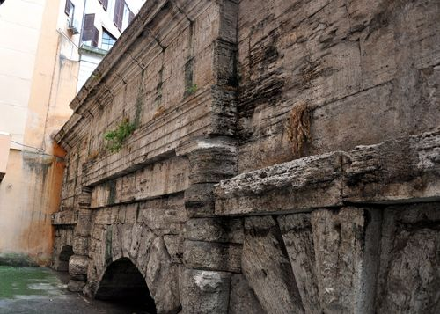
OSTIA & The Aqua virgo
Ostia
Built c. AD 50
Addressed supply and grain problems that Claudius inherited
Porticoes and piers exhibit heavy rustication
Aqua Virgo
Torn down by Caligula
Terminal portion rebuilt by Claudius in AD 46
Today: only upper arcade with dedicatory inscription and rusticated peers survive
Prime example of the visual power of rustication → both severe and arresting
Ostia. Porticoes and Piers from Claudian harbor. 50 AD. http://www.grad.ucl.ac.uk/comp/2004/research/gallery/depts.pht?department=30&personID=171&entryID=175
Terminal Arch of the Aqua Virgo. 46 AD. Rome. http://romefromhome.blogspot.com/2012_09_01_archive.html

Slide 5
Dedicatory INSCRIPTIONS
Aqua Virgo
Ti. Claudius Drusi f. Caesar Augustus Germanicus pontifex maxim. trib. potest. V imp. XI p.p. cos. desig. IIII arcus ductus Aquae Virginis disturbatos per C. Caesarema fundamentis novos fecit ac restituit
Tiberius Claudius Caesar August Germanicus, son of Drusus, pontifex maximus, in his fifth year of tribunician power, imperator eleven times, father of the country, designated consul for four times, made new and restored to their original place the arches of the aqueduct Aqua Virgo razed to the ground by Gaius Caesar.
Porta Maggiore
Ti. Claudius Drusi f. Caisar Augustus Germanicus pontif. maxim. tribunicia potestate XII cos. V imperator XXVII pater patriae Aquas Claudiam ex fontibus qui vocabantur Caeruleus et Curtius a milliario XXXXV item Anienem Novam a milliario LXII sua impensa in urbem perducendas curavit
Tiberius Claudius Caesar Augustus Germanicus, son of Drusus, pontifex maximus, in his twelfth year of tribunician power, consul 11 times, imperator 27 times, father of his country, from his own funds had brought into the city the Aqua Claudia, from the fountains that are called Caeruleus and Curtius, from milestone 45, and also the same (Aqua) Anio Novus, from milestone 62.
References:
1. ILS 5747b; Smallwood, Edith Mary. Documents Illustrating the Principates of Gaius Claudius and Nero. (Cambridge: U, 1967). No. 308b.
2. ILS. 218; Smallwood. Documents Illustrating the Principates of Gaius Claudius and Nero. No. 309.

Slide 6
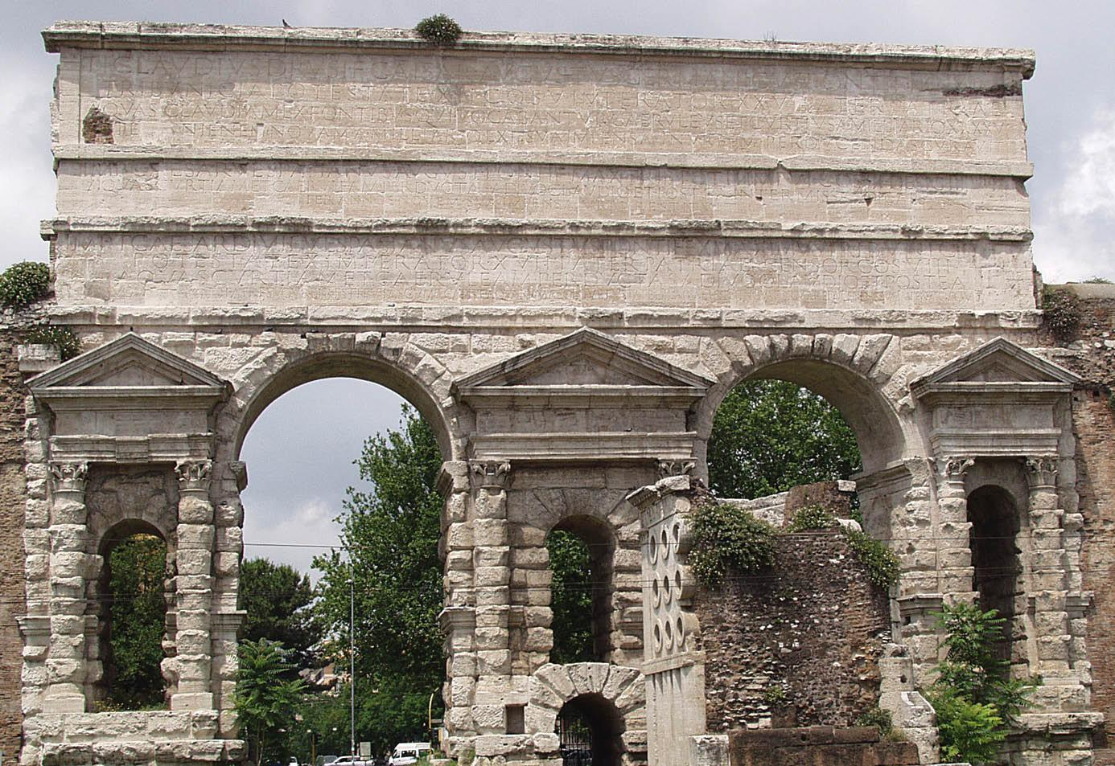
The PORTA MAGGIORE
Double-Archway, over Via Labicana and Via Praenestina
Incorporated into the Aqua Claudia and Aqua Anio Novus
Arches flanked by 3 aedicules
Engaged Corinthian columns
Heavy rustication
Monument most referenced in debate
Porta Maggiore. 54 AD. Rome. http://www.hotellatinum.it/en/default.html

Slide 7
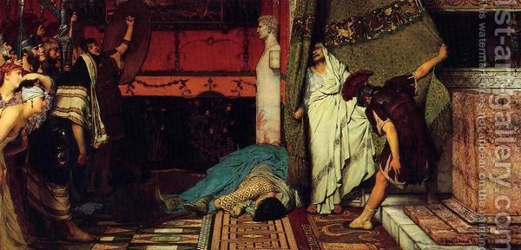
The Construction of the TEMPLUM DIVI CLAUDII
Claudius died 13 October, AD 54
Senate decrees immediately follow his death:
Senate decreed Claudius’ consecration
Mons Caelius chosen for his cult temple
The Mons Caelius location was problematic:
Associated with brothels and fish markets
more longstanding connection with an Etruscan chief of ill-repute, Caeles Vibenna
There was still suitable space near the Palatine and Capitoline
“A Roman Emperor (Claudius)” by Sir Lawrence Alma Tadema. Oil on canvas. 1871.
http://www.1st-art-gallery.com/Sir-Lawrence-Alma-Tadema/A-Roman-Emperor-Claudius.html

Slide 8
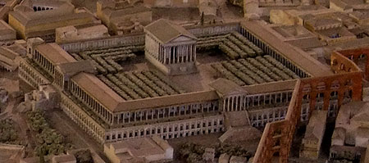
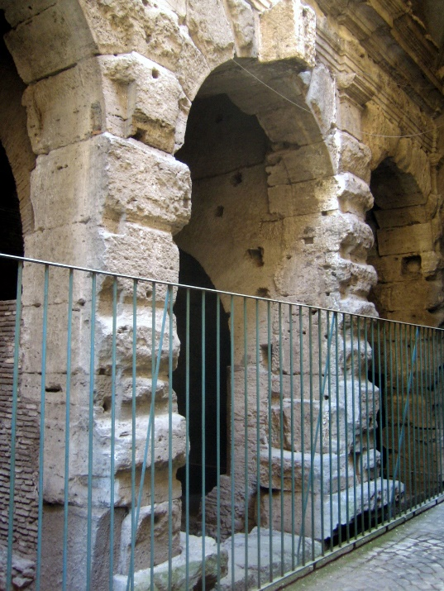
Templum Divi Claudii
Model of Reconstructed Templum Divi Claudii.
http://www.vroma.org/images/mcmanus_images/index11.html
Templum Divi Claudii. Travertine, West Façade. 54-69 AD. https://upload.wikimedia.org/wikipedia/commons/1/18/Temple_of_Claudius_-_antmoose.jpg

Slide 9
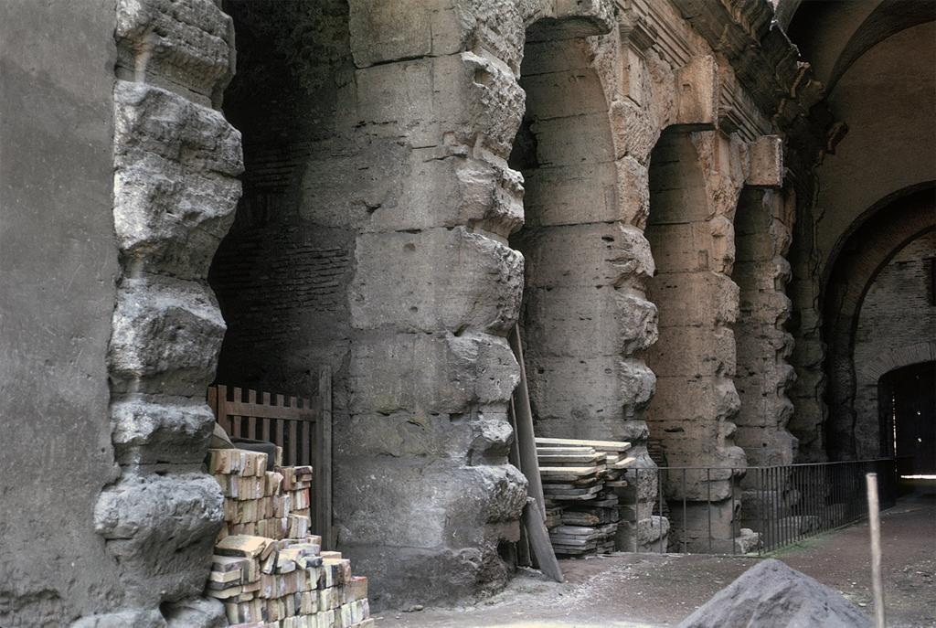
TEMPLUM DIVI CLAUDII continued…
Templum Divi Claudii: axonometric section of platform. Rome. 54-69 A.D. ARTstor Slide Gallery. http://library.artstor.org/library/iv2.html?parent=true
Templum Divi Claudii. Platform, general view. Rome. Dedicated 54 AD; Rebuilt 70 AD. William L. MacDonald Collection (Princeton University). http://library.artstor.org/library/iv2.html?parent=true#

Slide 10
Bibliography
---. “Tacitean Usage and the Temple of ‘Divus Claudius.’” Britannia 4 (1973): 264–265. JSTOR. Web.
Ackerman, James S. “The Tuscan/Rustic Order: A Study in the Metaphorical Language of Architecture.” Journal of the Society of Architectural Historians 42, no. 1 (1983): 15–34, accessed October 9, 2015, JSTOR.
Adam, Jean-Pierre. La Construción Romana: Materiales Y Técnicas. (León: Editorial De Los Oficios, 2002).
Ashby, Thomas. “Rome.” The Town Planning Review 10, no. 1 (1923): 43–52.
Boise, Van Deman Esther. The Building of the Roman Aqueducts. (Washington: Carnegie Institution of Washington, 1934).
Bowersock, G.W. 1973. “Syria under Vespasian.” The Journal of Roman Studies 63: 133-140.
Burgers, P. “Coinage and State Expenditure: The Reign of Claudius AD 41-54.” Historia: Zeitschrift für Alte Geschichte 50, no. 1 (2001): 96–114.
Coates-Stephens, Robert. Porta Maggiore: Monument and Landscape: Archaeology and Topography of the Southern Esquiline from the Late Republican Period to the Present. (Roma: L'Erma Di Bretschneider, 2004).
Domingo, Javier A. “The Templum Divi Claudii. Decoration and architectural elements for reconstruction.” Archivo español de arqueología. 84 (2011): 207-230.
Fishwick, Duncan. "The Deification of Claudius." The Classical Quarterly 52, no. 1 (2002): 341-49, accessed October 1, 2015, JSTOR.
Fishwick, Duncan. “Seneca and the Temple of Divus Claudius.” Britannia 22 (1991): 137–141, accessed October 1, 2015, JSTOR.
Giovenale, G.B. “Le porte del recinto di Aureliano e Probo.” Bullettino della Commissione archeologica comunale di Roma. 59 (1932): 7-116.
Hülsen, Ch. “The Burning of Rome under Nero.” American Journal of Archaeology 13, no. 1 (1909): 45–48, accessed October 9, 2015, JSTOR.

Slide 11
BIBLIOGRAPHY
Ippolito, A. “Modelling the Wall Surfaces of the Temple of Divine Claudius in Rome.” Disegnare : idee, immagini : rivista semestrale del Dipartimento di rappresentazione e rilievo, Universita' degli studi di Roma 'La Sapienza. 20, no. 38 (2009): 76-85.
Levick, B.M. 1978. “Antiquarian or Revolutionary? Claudius Caesar’s Conception of His Principate.” The American Journal of Philology 99, no.1: 82, accessed October 2, 2015.
Momigliano, Arnaldo. Claudius, the Emperor and His Achievement. (Cambridge: Heffer, 1961).
Nash, Ernest. Pictorial Dictionary of Ancient Rome. (New York: Praeger, 1961).
Osgood, Josiah. Claudius Caesar: Image and Power in the Early Roman Empire. (Cambridge: Cambridge UP, 2011).
Plommer, Hugh, Vitruvio Pollione, and Marcus Cetius Faventinus. Vitruvius and Later Roman Building Manuals. (Cambridge: At the UP, 1973).
Pollitt, Jerome Jordan. The Art of Rome: C 753 B.C. - A.D. 337: Sources and Documents. (Cambridge U.a.: Cambridge U Pr., 1983).
Ramage, Edwin S. “Denigration of Predecessor under Claudius, Galba, and Vespasian.” Historia: Zeitschrift für Alte Geschichte 32, no. 2 (1983): 201–214.
Sear, Frank. Roman Architecture. (Ithaca, NY: Cornell UP, 1983).
Sicca, Cinzia. “The Architecture of the Wall: Astylism in the Architecture of Lord Burlington.” Architectural History 33 (1990): 83–101, accessed October 9, 2015, JSTOR.
Stierlin, Henri, and Anne Stierlin. The Roman Empire: From the Etruscans to the Decline of the Roman Empire. (Köln: Taschen, 2002).
Ward-Perkins, J. B. Roman Architecture. (New York: H.N. Abrams, 1977).
Ward-Perkins, J. B. Roman Imperial Architecture. (Harmondsworth, Eng.: Penguin, 1981).

