Slide 1
CARTHAGO INDIARUM OBSESA (sic) SED NON EXPUGNATA:
NEW PUNIC WARS IN THE NEW WORLD

Slide 2
CARTHAGO INDIARUM OBSESSA SED NON EXPUGNATA
[Title]
Carthago Indiarum obsessa sed non expugnata
‘Cartagena de Indias, assailed but not captured’
Anonymous/Unknown author,
Published in Madrid, 1742

Slide 3
CARTHAGO INDIARUM OBSESSA SED NON EXPUGNATA
Composed of 56 verses (distich, hexameter verse)
Composed of 11 parts, each labeled with a subsection heading
Three main themes of the Poem:
The Spanish Victory
The English Defeat
The Consequences in the battle’s aftermath

Slide 4
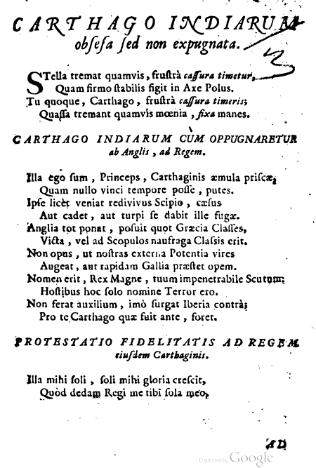
CARTHAGO INDIARUM OBSESSA SED NON EXPUGNATA
First Theme: The Spanish Victory (18 verses)
Prelude (Cartagena is compared with a star)
To the King of Spain: While Cartagena was under attack)
To the King of Spain: Pledge of Fidelity to the King of Cartagena

Slide 5
CARTHAGO INDIARUM OBSESSA SED NON EXPUGNATA
Excerpt 1: [Verses 5-6]
. . . Carthaginis aemula priscae.
quam nullo vinci tempore posse putes.
‘. . .A replica and a rival of the old Carthage
which you would think could never be conquered’.

Slide 6
CARTHAGO INDIARUM OBSESSA SED NON EXPUGNATA
[Verses 7-8]
Ipse licet veniat redivivus Scipio caesus
aut cadet, aut turpi se dabit ille fugae.
‘For if the dead Scipio should come revived,
he would die again or shamefully take flight’

Slide 7
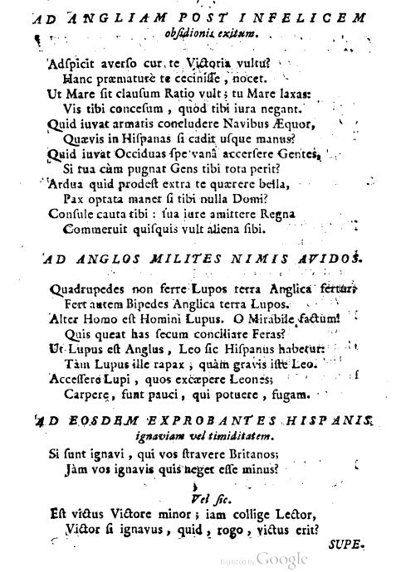
CARTHAGO INDIARUM OBSESSA SED NON EXPUGNATA
Second Theme:
The English Defeat (24 verses)
To England: After the unfortunate outcome of the attack
To the Voracious English Soldiers
To the English Soldiers who condemn the cowardice and fear of the Spanish

Slide 8
CARTHAGO INDIARUM OBSESSA SED NON EXPUGNATA
Excerpt 3: [Verse 29]
consule cauta tibi
‘consider with yourself only prudent plans’

Slide 9
CARTHAGO INDIARUM OBSESSA SED NON EXPUGNATA
Excerpt 4: [Verses 7-8]
alter homo est homini lupus
one man is a wolf to another man
COMPARE WITH:
‘lupus est homo homini, non homo, quom qualis sit non novit’ (Plautus, Asinaria II, 495)
‘Ἄνθρωπος ἀνθρώπου λύκος’ (Erasmus, Adagia I.70).

Slide 10
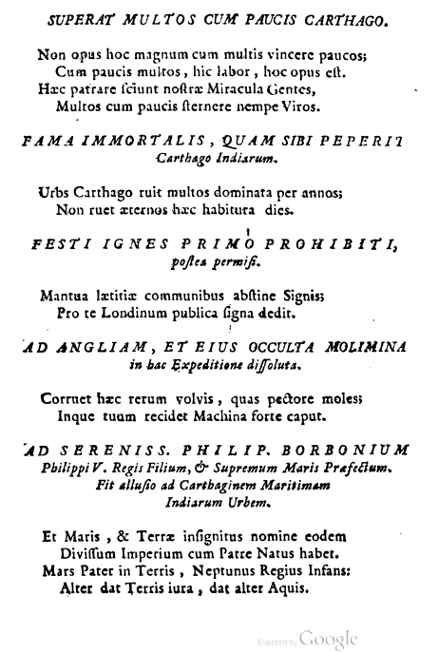
CARTHAGO INDIARUM OBSESSA SED NON EXPUGNATA
Third Theme:
Consequences in the battle’s aftermath (14 verses)
Cartagena conquers many with few
Cartagena obtained immortal fame
Concerning the fireworks for a victory not yet achieved
Verses to England and to her secret plans in their failed expedition
To Philip of Bourbon, son of King Philip V

Slide 11
CARTHAGO INDIARUM OBSESSA SED NON EXPUGNATA
Excerpt 5: [Verses 43-44 ]
non opus hoc magnum cum multis vincere paucos
cum paucis multos hic labor hoc opus est
‘it is not a great deed to conquer few with many,
but it is a great toil, a great effort [to conquer] many with few’.
COMPARE WITH:
‘hoc opus, hic labor est.’ (Aen. VI 129) – Sibyl’s words to Aeneas upon entering the underworld.

Slide 12
CARTHAGO INDIARUM OBSESSA SED NON EXPUGNATA
Excerpt 6: [Verses 52 ]
Inque tuum recidet machina forte caput
‘and these plans will return to you with harm on your stubborn head’

Slide 13
CARTHAGO INDIARUM OBSESSA SED NON EXPUGNATA
Excerpt 7: [Verse 44]
hic labor, hoc opus est
‘it is a great toil, a great effort
[to conquer many with few].’
COMPARE WITH:
(c.f. ‘hoc opus, hic labor est.’ Aen. VI 129) – Sibyl’s words to Aeneas upon entering the underworld.

Slide 14
CARTHAGO INDIARUM OBSESSA SED NON EXPUGNATA
Excerpt 8: [Verse 47]
Urbs Carthago ruit multos dominata per annos’
‘The city of Carthage that ruled for years fell’
COMPARE WITH:
Urbs antiqua ruit multos dominata per annos (Aen. II. 363).
‘The old city [sc. Troy] that ruled for many years fell’ (Aen. II. 363).

