Slide 1
Learning from Gaia: Bringing Environmental History into the Classics Classroom
Christina A. Salowey
Hollins University

Slide 2
“Gaia, the earth goddess, teaches justice to those who can learn; for the better she is served, the more good things she gives in return,” (Xenophon, Oeconomicus 5.12)
Photo credit: Western Argolid Regional Project

Slide 4
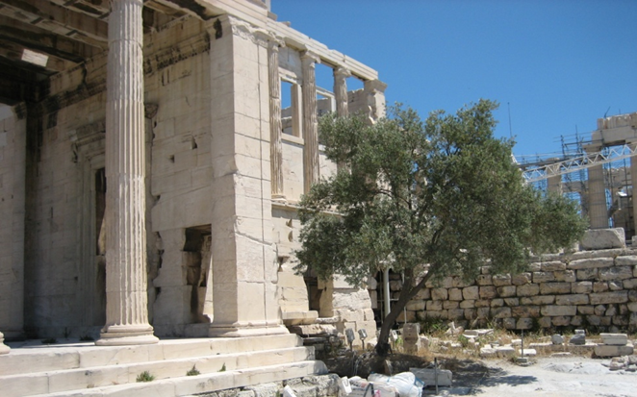
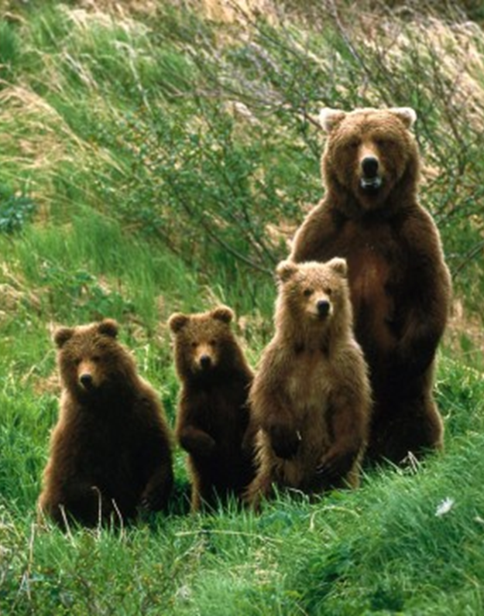
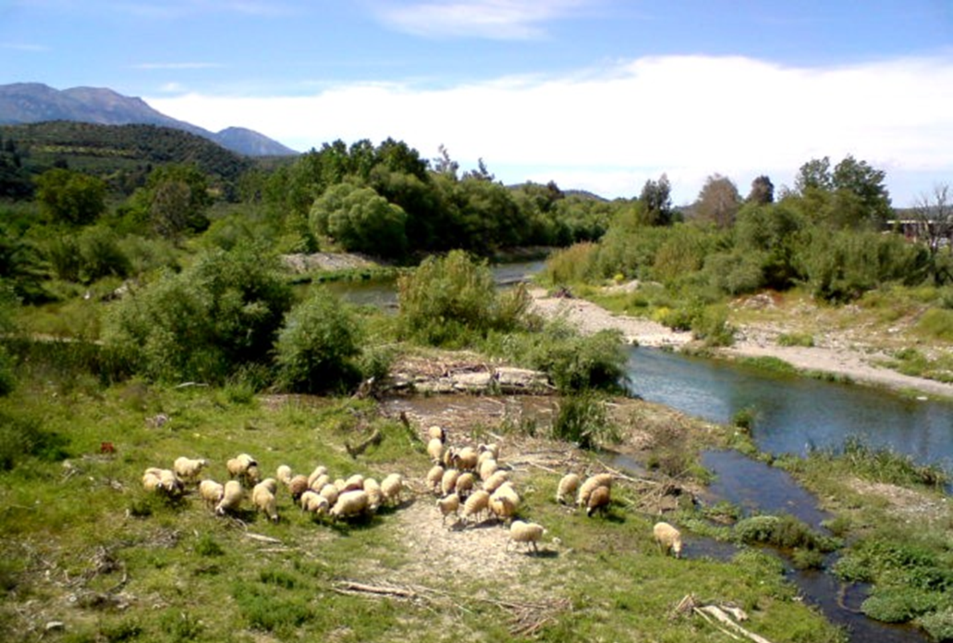

Slide 5
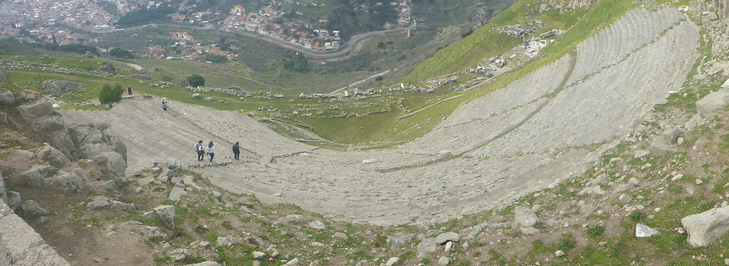

Slide 6
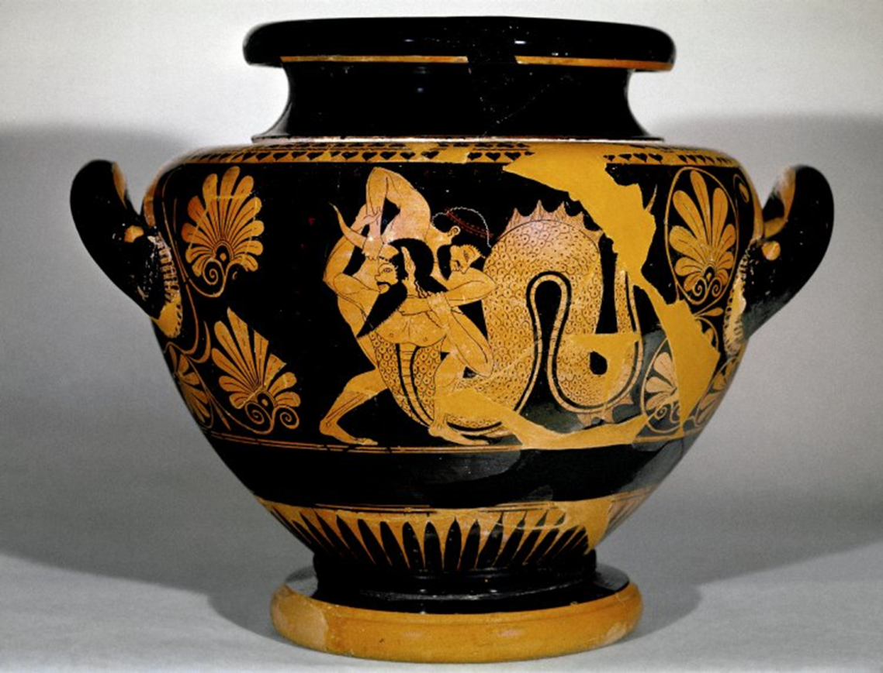
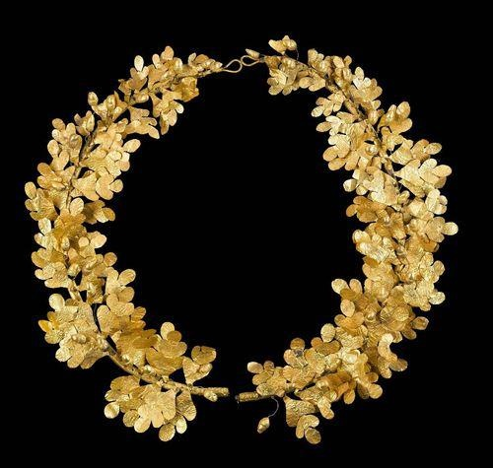
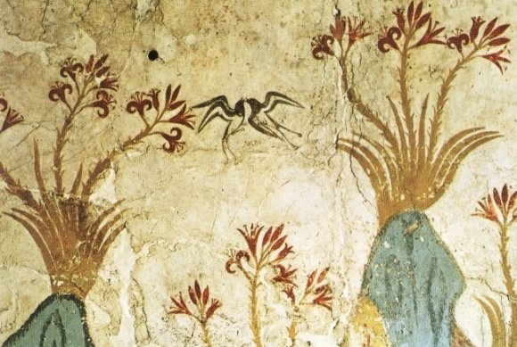

Slide 7
Themes
Influence of environmental factors on human history
Environmental changes caused by human action and the many ways in which human-caused changes in the environment rebound and affect the course of change in human societies
The history of human thought about the environment and the ways in which patterns of human attitudes have motivated actions that affect the environment.
(Hughes 2006, p. 3)

Slide 8
Themes
Influence of environmental factors on human history
Environmental changes caused by human action and the many ways in which human-caused changes in the environment rebound and affect the course of change in human societies
The history of human thought about the environment and the ways in which patterns of human attitudes have motivated actions that affect the environment.
(Hughes 2006, p. 3)

Slide 9
Unpacking these Themes
Environmental Factors
(paleo)Ecological analysis as a means of understanding human history
Living and non-living systems of the earth have influenced the course of human affairs
Environmental changes
Human agency in the natural environment: hunting, gathering, fishing, herding, agriculture, organization of villages, urban development, procurement of basic resources like water, metal, wood.
Ecological repercussions: deforestation, reduction of biodiversity, desertification, salinization, pollution.
Human Thought/Attitudes
social and intellectual history
filtered through artist’s voices

Slide 10
Environment is not the stage on which human history is enacted. It is an actor.
Theater at Epidauros, Greece.
4th century B.C.E.
Seats 12,000-15,000

Slide 11
Cosquer Cave. France. 16500 BCE. Great Auk.
Art, as an intermediary, expresses a relationship to or with nature.

Slide 12
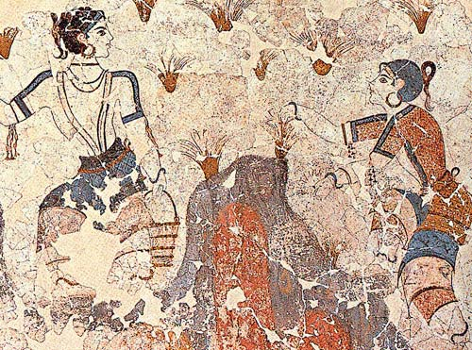
Fresco Painting. Thera 1550 BCE.
Girls collecting saffron crocuses.
Rhyton (vessel used to pour out ritual libations) in the shape of a bull.
From Knossos, Crete. 1550 – 1450 BCE; steatite with shell, rock crystal, jasper and gilt wood horns.
Bull - virility, strength, source of life and vitality.

Slide 13
First Year Seminar
Fall 2012
Fall 2013
Textbook: J. Donald Hughes, The Mediterranean. An Environmental History. ABC-Clio 2005.
Initial Text Analysis: Myth of Atlantis from Plato, Timaeus and the Crito
Textbooks:
David Abulafia. The Mediterranean in History. Los Angeles 2003.
J. Donald Hughes. Pan’s Travail. 1994
Intial Text Analysis
Mary Atwell. Wild Girls 2012.
Euripides’ Bacchae. Translated with notes by Paul Woodruff. Hackett 1999.
Other Resources Used:
David Attenborough, The First Eden. The Mediterranean World and Man. 1987

Slide 14
Myth Summary
A summary of a myth, its ancient sources, and a discussion of its allusions to the natural world.
A select list of myths: Aristaios (the beekeeper), Arkas, Atlas, Atalanta, Nereus, Boreas, Triptolemus, Chiron, Orion, Deucalion , Meliai, Persephone
Introduction to the Lexicon Iconographicum Mythologiae Classicae (LIMC), Brill’s New Pauly, the Oxford Classical Dictionary, and other reference tools in the library.
Read the ancient sources in English translation and take notes on what details of the myth each author provides.
Write a summary of the story of the myth, citing the ancient source for each detail or variation.
Weave into your summary, observations about the myth’s use of imagery from the natural world.

Slide 15
Ancient Site Project
When scholars of antiquity research an ancient site, it is a collaborative enterprise. Only rarely is a site published by a single scholar alone, since the understanding of an ancient site requires the mastery of many different disciplines: topography, architecture, pottery, mythology, history, geology, paleosteology (zoöarchaeology), paleobotany, just to name a few. Your second research project in this course will replicate this methodology. A group of 3 or 4 students will work together to produce a 12 – 15 page document on an ancient site, in particular investigating its environmental history.
Site possibilities: Chauvet Cave, (Tell el) Amarna, Çatal Hüyük, Uruk, Abu Simbel, Babylon (in the time of Nebuchanezzar II), Knossos, Priene, Sparta, Olynthus, Cosa, Ostia

Slide 16
In addition to gathering basic information on the site (where is it, what was there, when was it settled and used, how big is it, who excavated it, what historical events occurred there) some questions your paper might answer are:
What were the elements of the landscape that caused the site to be founded and settled?
What elements of landscape (pasture, springs, mountains, harbors) make the site particularly useful or unique?
What natural resources were used in the construction of the site?
What natural resources/local products contributed to the economic success of the community?
How did the community adapt/change the landscape over time?
Did any natural disasters change the habitation pattern of the community?
What survives of the site and how has it been preserved/reused/abandoned?

Slide 17
Textbooks
J. Donald Hughes, Pan’s Travail. 1994
J. Donald Hughes. The Mediterranean. An Environmental History 2005.
Lukas Thommen. The Environmental History of Greece and Rome. 2012.
Kevin Walsh. The Archaeology of Mediterranean Landscapes. Human-Environment Interaction from the Neolithic to the Roman Period. 2014.

Slide 18
Mythology
Richard Buxton, “Imaginary Greek Mountains,” JHS 112.1-15 (1992).
Richard Buxton, Imaginary Greece. The Contexts of Greek Mythology. 1994.
Pedro Olalla, Mythological Atlas of Greece. 2005.

Slide 19
Geography and Geology
Jamie Woodward, The Physical Geography of the Mediterranean. 2009.
Michael Denis Higgins and Reynold Higgins, A Geological Companion to Greece and the Aegean. 1996
George Rapp, Jr. and Christopher L. Hill, Geoarchaeology. The Earth Science Approach to Archaeological Interpretation. 1998.
Duane Roller, The Geography of Strabo. 2015.
Richard J.A. Talbert, Barrington Atlas of the Greek and Roman World. 2000. IPad edition 2013.

Slide 20
Survey: Prehistoric Stones

Slide 21
Ancient Olive Grove
Aegina 2016.

