Slide 1
Princess, Prisoner, Queen: Searching for Identity and Agency in the Life of Kleopatra Selene
Sara Stack
Purdue University

Slide 2
All women speak two languages: the language of men and the language of silent suffering.
Some women speak a third, the language of queens
Mohja Khaf
Notes:
Selene expressed her identity (of which suffering was a big part) through the ‘language of queens’-coins, titles, etc

Slide 3
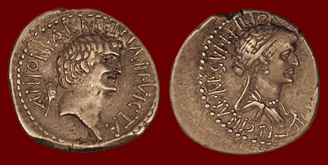

Slide 4
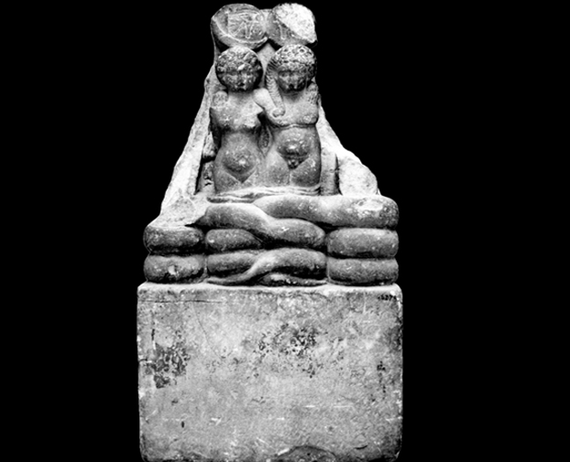
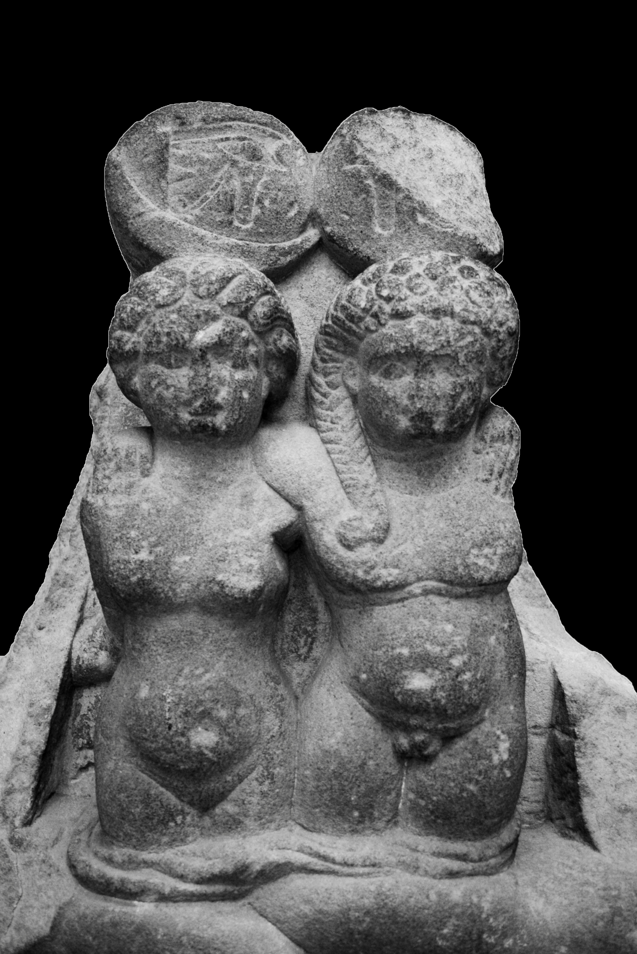

Slide 5
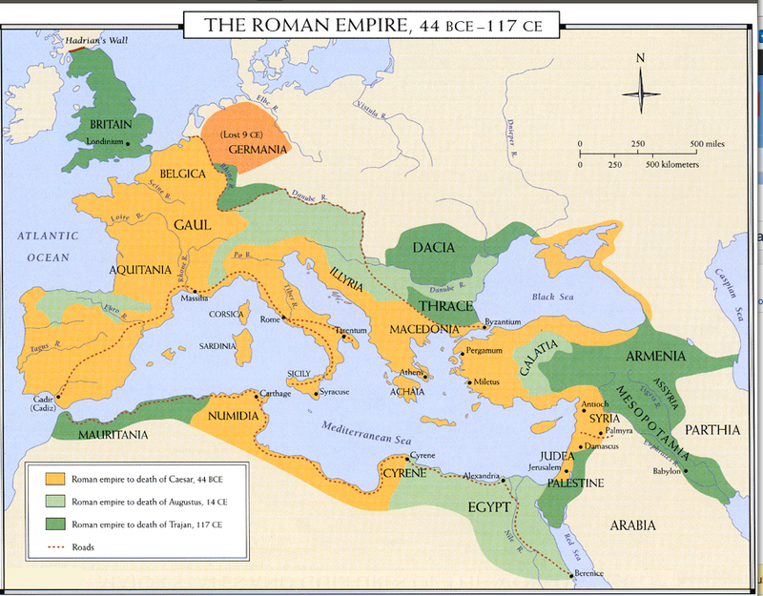

Slide 6


Slide 7

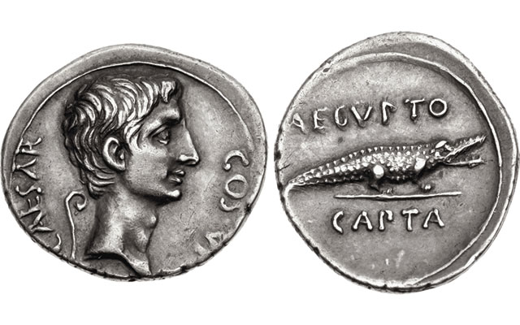

Slide 8
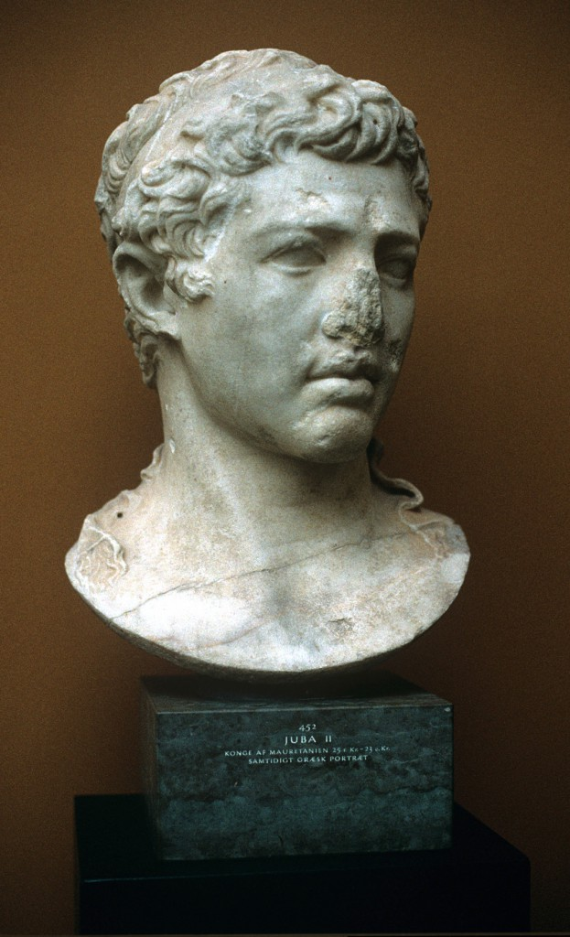
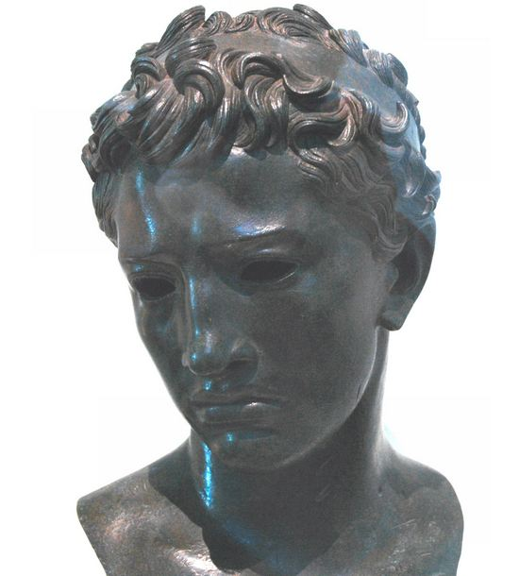

Slide 9
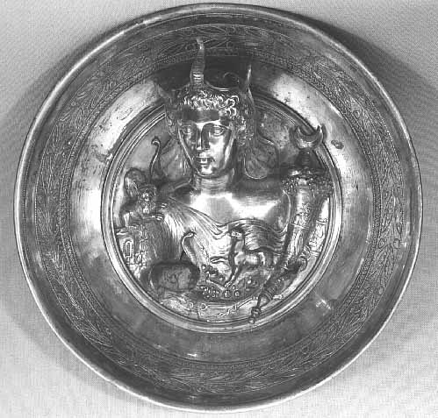
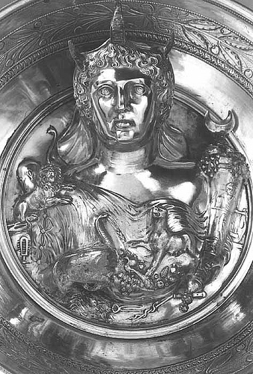

Slide 10
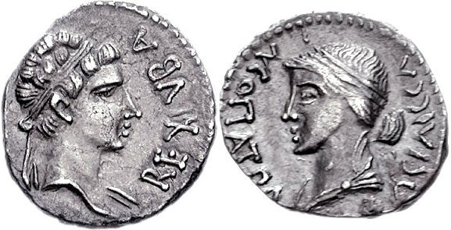

Slide 11
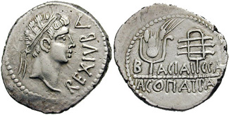
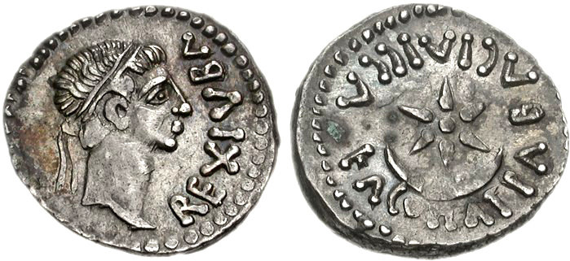

Slide 12
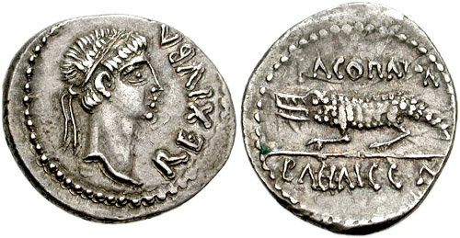

Slide 13
