Slide 1
The Ties That Bind: Women and Funerary Ritual in Classical Athens
Laura McClure
University of Wisconsin-Madison

Slide 2
(1) ἡ παῖς ὁρᾶται, κἀνακωκύει πικρᾶς
ὄρνιθος ὀξὺν φθόγγον ὥς, ὅταν κενῆς
εὐνῆς νεοσσῶν ὀρφανὸν βλέψῃ λέχος·
οὕτω δὲ χαὔτη, ψιλὸν ὡς ὁρᾷ νέκυν,
γόοισιν ἐξῴμωξεν, ἐκ δ᾿ ἀρὰς κακὰς
ἠρᾶτο τοῖσι τοὔργον ἐξειργασμένοις.
καὶ χερσὶν εὐθὺς διψίαν φέρει κόνιν,
ἔκ τ᾿ εὐκροτήτου χαλκέας ἄρδην πρόχου
χοαῖσι τρισπόνδοισι τὸν νέκυν στέφει. (S. Ant. 423-31)
And when after a long time this went away, we saw the girl; she cried out bitterly, with a sound like the piercing note of a bird when she sees her empty nest robbed of her young; just so did she cry out, weeping, when she saw the corpse laid bare and called down curses on those who had done the deed. At once she brought in her hands thirsty dust, and from the well-wrought brazen that she was carrying she poured over the corpse a threefold libation.

Slide 3
2) ἡ δ᾿ ἐξ ὕπνου κέκλαγγεν ἐπτοημένη,
πολλοὶ δ᾿ ἀνῄθοντ’ ἐκτυφλωθέντες σκότῳ
λαμπτῆρες ἐν δόμοισι δεσποίνης χάριν.
πέμπει δ᾿ ἔπειτα τάσδε κηδείους χοάς,
ἄκος τομαῖον ἐλπίσασα πημάτων. (A. Cho. 535-539 Garvie)
She cried out in terror in her sleep, and many braziers which had been blinded by the darkness blazed up again for the sake of our mistress. Then she sent these funerary libations, hoping for a surgical cure for her troubles.

Slide 4
3) τορὸς γὰρ ὀρθόθριξ δόμων
ὀνειρόμαντις ἐξ ὕπνου κότον πνέων,
ἀωρόνυκτον ἀμβόα-
μα μυχόθεν ἔλακε περὶ φόβῳ,
γυναικείοισιν ἐν
δώμασιν βαρὺς πίτνων. (A. Cho. 33-37 Garvie)
For shrill fear, the dream interpreter of the house, its hair on end, breathing wrath in sleep, uttered a crying fear at dead of night from the depths of the palace, falling heavily upon the women’s quarters. (trans. Garvie)

Slide 5
4) ἀλλὰ ταῦτα μὲν μέθες· σὺ δὲ
τεμοῦσα κρατὸς βοστρύχων ἄκρας φόβας
κἀμοῦ ταλαίνης, σμικρὰ μὲν τάδ᾿, ἀλλ᾿ ὅμως
ἅχω, δὸς αὐτῷ, τήνδε, λιπαρῶ, τρίχα
καὶ ζῶμα τοὐμὸν οὐ χλιδαῖς ἠσκημένον. (S. El. 448-52)
But abandon these [grave gifts], and you yourself, cutting the end-strands of your hair from your head, and mine too, poor thing—small gifts, but all that I have to offer—give him this hair, I beg you, and my belt not worked in luxurious ornaments.

Slide 6
Ελ. σύ νυν χάριν μοι τὸν φόβον λύσασα δός.
Ηλ. οὐκ ἂν δυναίμην μητρὸς ἐσβλέψαι τάφον.
Ελ. αἰσχρόν γε μέντοι προσπόλους φέρειν τάδε.
Ηλ. τί δ᾿ οὐχὶ θυγατρὸς Ἑρμιόνης πέμπεις δέμας;
Ελ. ἐς ὄχλον ἕρπειν παρθένοισιν οὐ καλόν.
Ηλ. καὶ μὴν τίνοι γ᾿ ἂν τῇ τεθνηκυίᾳ τροφάς.
Ελ. ὀρθῶς ἔλεξας, πείθομαί τέ σοι, κόρη.
[ναί, πέμψομέν γε θυγατέρ᾿· εὖ γάρ τοι λέγεις.]
ὦ τέκνον, ἔξελθ᾿, Ἑρμιόνη, δόμων πάρος
καὶ λαβὲ χοὰς τάσδ᾿ ἐν χεροῖν κόμας τ᾿ ἐμάς·
ἐλθοῦσα δ᾿ ἀμφὶ τὸν Κλυταιμήστρας τάφον
μελίκρατ᾿ ἄφες γάλακτος οἰνωπόν τ᾿ ἄχνην,
καὶ στᾶσ᾿ ἐπ᾿ ἄκρου χώματος λέξον τάδε·
Ἑλένη σ᾿ ἀδελφὴ ταῖσδε δωρεῖται χοαῖς,
φόβῳ προσελθεῖν μνῆμα σόν, ταρβοῦσά τε
Ἀργεῖον ὄχλον. (E. Or. 104-18)
Helen So do me a favor and relieve me of this fear.
Electra I could not look on my mother’s tomb.
Helen But it wouldn’t be proper for servants to bring these offerings.
Electra Well, why don’t you send your daughter Hermione?
Helen It’s not good for unmarried girls to appear in public.
Electra But she would be repaying her dead aunt for raising her.
Helen Your suggestion is good and I will take it, girl.
[Yes, I will send my daughter: your advice is good.]
Hermione, daughter, come out in front of the house!
Take these libations and my hair offering in your hands. Go to the tomb of
Clytaemestra and around it pour out the milk and honey mixture and
the foaming wine. Then stand on top of the grave mound and say,
“These libations are a gift to you from your sister Helen. She was afraid
to approach your tomb for fear of the Argive mob.”

Slide 7
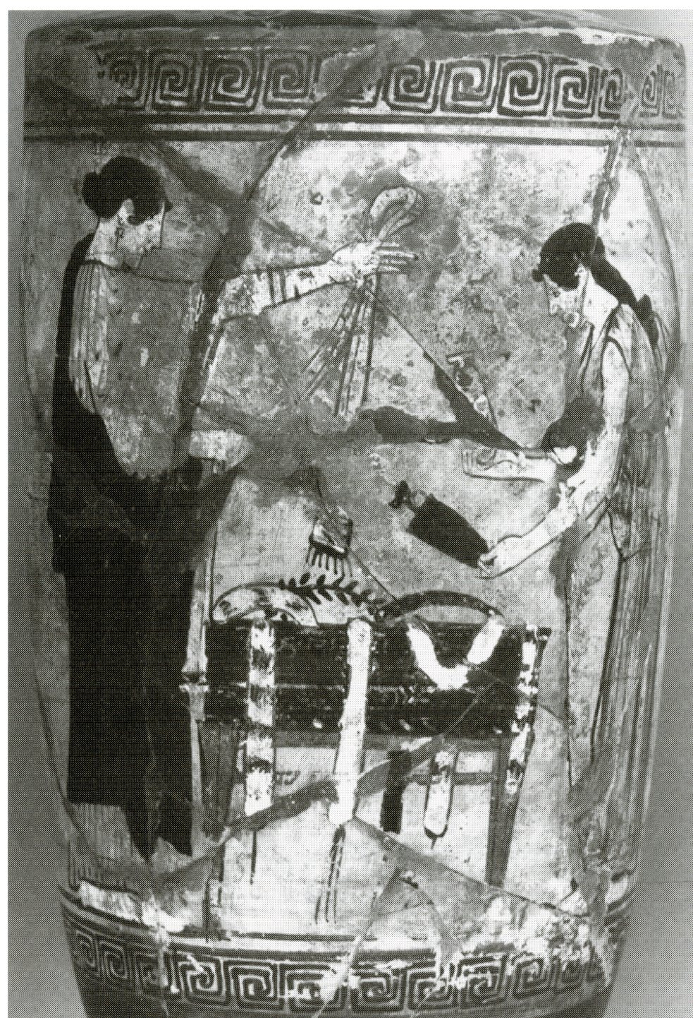
Timocrates Painter, ca. 470-60 BCE, Athens National Museum, 1929

Slide 8
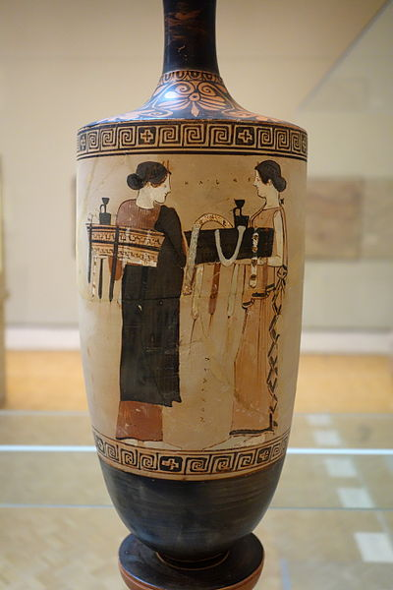
Near the Timocrates Painter, c. 460 BCE
Chazen Museum, Madison, WI, 70.2

Slide 9
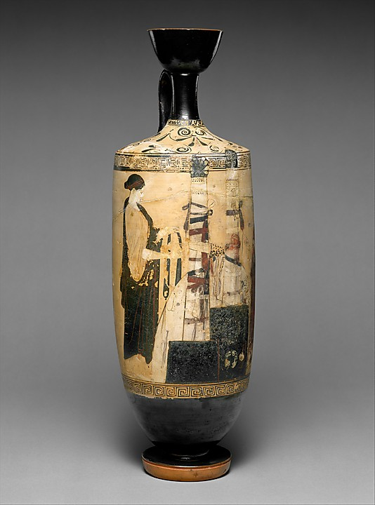
Vouni Painter, c. 460, Metroplitan Museum of Art, New York 35.11.5

Slide 10
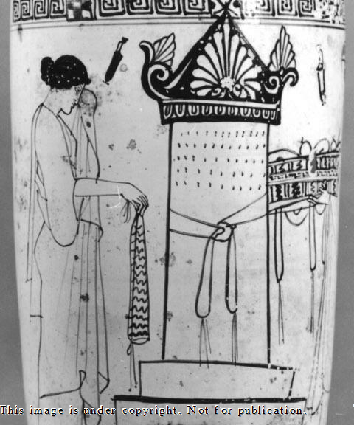
Inscription Painter, c. 460, Athens, National Museum 1958

Slide 11
Bibliography
Arrington, N. 2015. Ashes, Images, and memories. The Presence of the War Dead in Fifth Century Athens. Oxford.
_______. 2014. “Fallen Vessels and Risen Spirits: Conveying the Presence of the Dead on White-ground Lekythoi.” In J. Oakley (ed.), Athenian Potters and Painters Volume III, pp. 1-10. Oxford and Philadelphia.
Blok, J. 2004. “Recht und Ritus der Polis.” HZ 28: 1-26.
Connor, W. R. 1988. “‘Sacred’and ‘secular’: Hiera kai hosia and the Classical Athenian Concept of the State.” AncSoc 19: 161–188.
Eidinow, E. 2011. “Networks and Narratives: A Model for Ancient Greek Religion.” Kernos 24: 9-38.
Garland, R. 2001. The Greek Way of Death. 2nd ed. Ithaca, NY.
Glazebrook, A. and Tsakirgis, B. (eds.) 2016. Houses of Ill-Repute: The Archaeology of Brothels, Houses, and Taverns in the Greek World. Philadelphia, PA.
Houby-Nielsen, S. 1996. “Women and the Formation of the Athenian City State: The Evidence of Burial Customs.” Metis 11: 233–60.
Nevett, L. 2011. “Towards a Female Topography of the Ancient Greek City: Case Studies from Late Archaic and Early Classical Athens (c.520–400 BCE).” Gender & History 23: 576–596.
Oakley, J. 2004. Picturing Death in Classical Athens. Cambridge.
Reilly, J. 1989. “Many Brides: ‘Mistress and Maid’ on Athenian Lekythoi.” Hesperia 58: 411-44.
Shapiro, A. 1991. “The Iconography of Mourning in Athenian Art.” AJP 95 1991: 629–56.
Stansbury-O’Donnell, M. 2006. Vase Painting, Gender, and Social Identity in Archaic Athens. Cambridge.
Taylor, C. 2011. “Women's Social Networks and Female Friendship in the Ancient Greek
City.” Gender & History 23: 703-20.

