Slide 1
Next to Normal: An Interior Oresteia
Rob Groves
University of Arizona
groves@email.arizona.edu

Slide 2
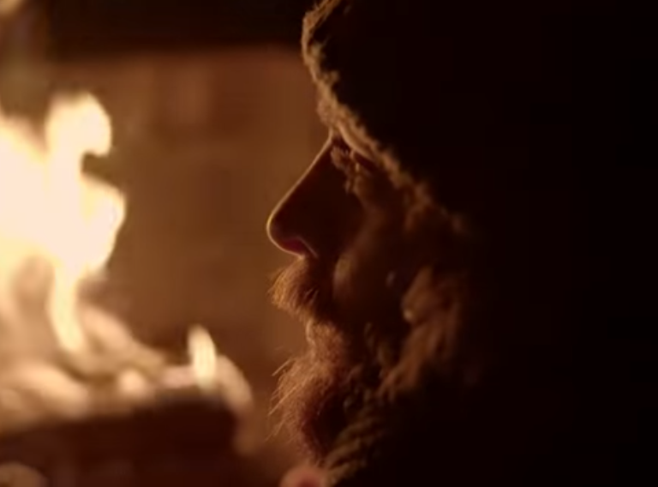
Waiting for the Light

Slide 3
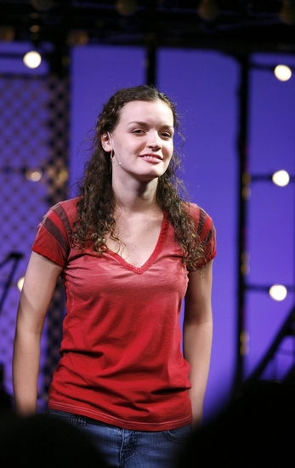
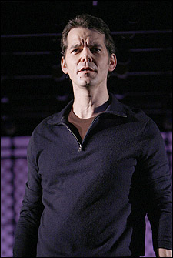
The Goodmans
Dan, Her Husband
Gabriel,
Her Son
Her Daughter, Natalie
Diana

Slide 4
Passage 1
“When I was young, my mother called me "high-spirited." She would know. She was so high-spirited they banned her from the PTA.”

Slide 5
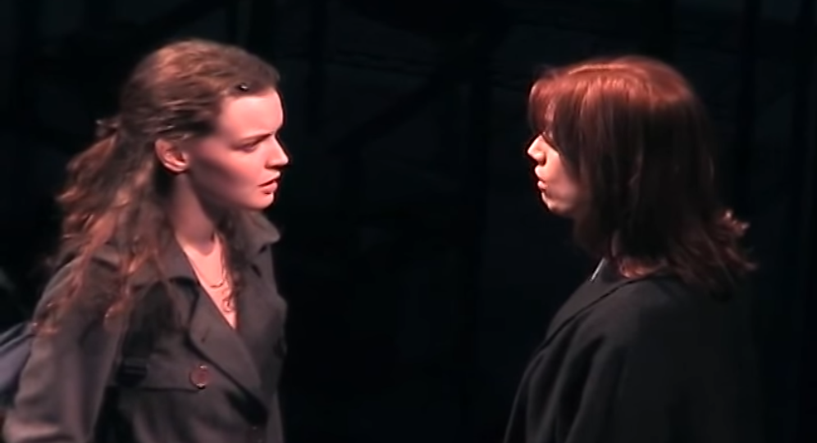
Passage 2: “Maybe”
I see me in you. A girl full of anger and hope… A girl with a mother who just couldn’t cope… A girl who felt caught And thought no one could see— But maybe one day she’ll be free.

Slide 6
“Wish I Were Here” (Diana’s E.C.T. & Natalie’s Trip)

Slide 7
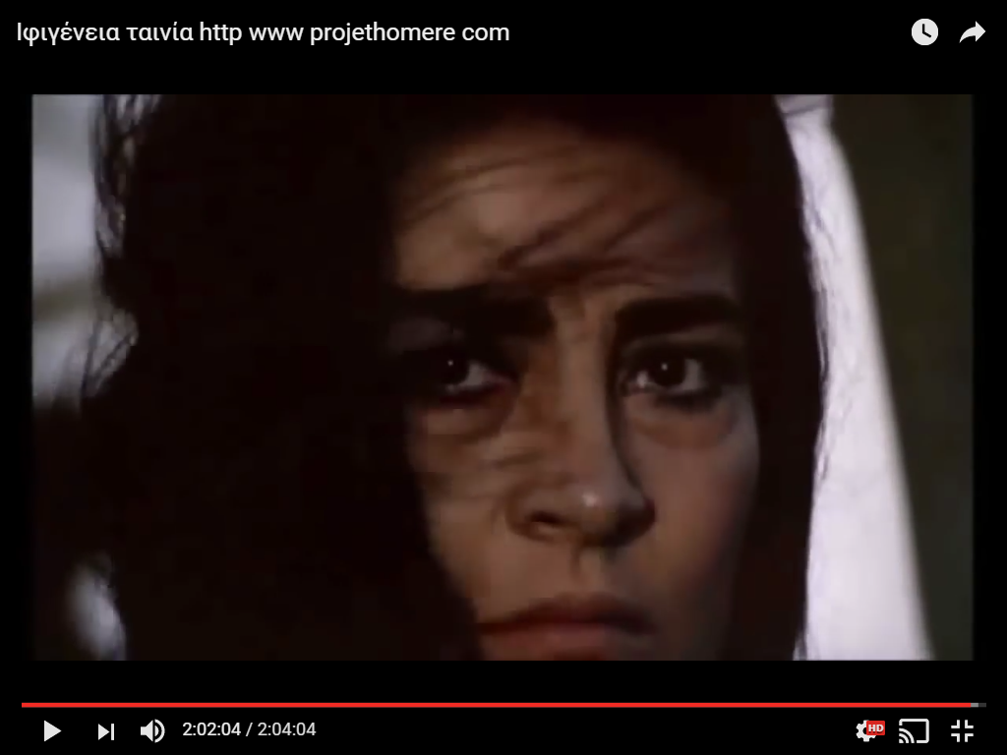
Doctor Madden: Sometimes there's a predisposition to illness, but actual onset is only triggered by some ... traumatic event.

Slide 8
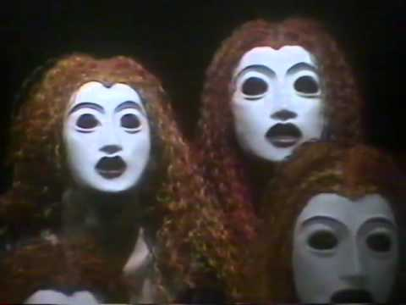
Supernatural Antagonists

Slide 9
Passage 3: “I’m Alive”
I am flame and I am fire, I am destruction, decay, and desire I'll hurt you, I’ll heal you. I'm your wish, your dream come true, And I am your darkest nightmare too… I’ve shown you. I own you.

Slide 10
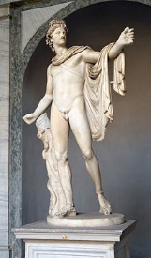
Healer Figures

Slide 11
Passage 4: “A Light in the Dark”
One light shines in the drive—
One single sign that our house is alive.
Our house, our own -
So why do I live there alone?
Tell me why I wait through the night,
And why do I leave on the light?
You know. I know.
Our house was a home long ago.…
Take this chance
And we’ll make a new start
Somewhere far
From what keeps us apart,
And I swear that somewhere in the night
There’s a light…
A light in the dark.

Slide 12
Passage 5: “Moments of Light”
Make up your mind that you'll try again. Make up your mind there are moments of light. The one thing that's sure Is that there is no cure but That doesn't mean we don't fight.

Slide 13
Passage 6: “Finale: Light”

Slide 14
Double Casting

Slide 15
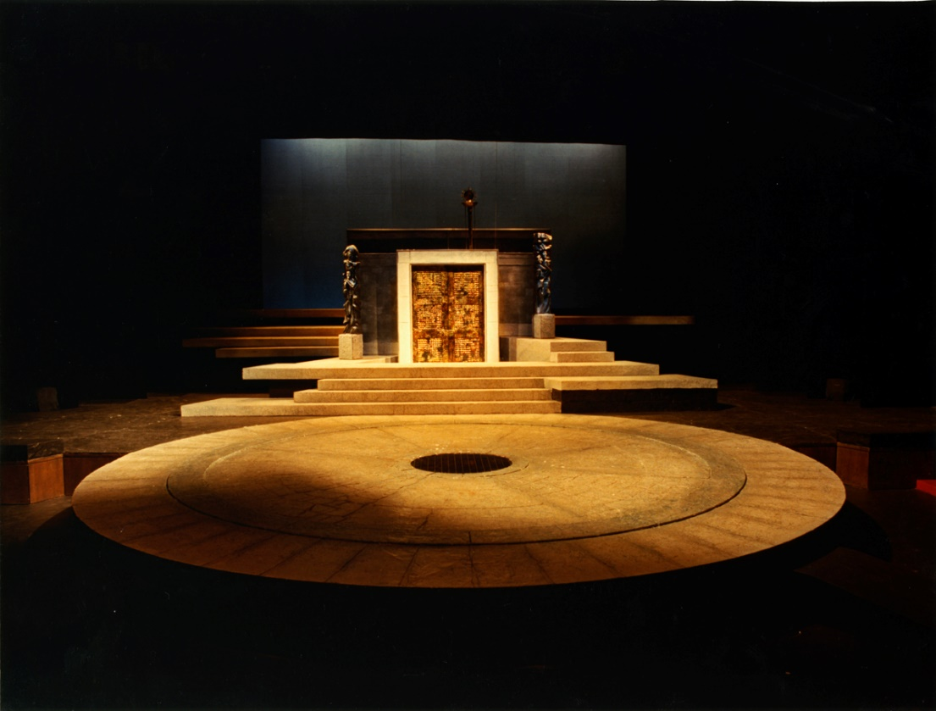
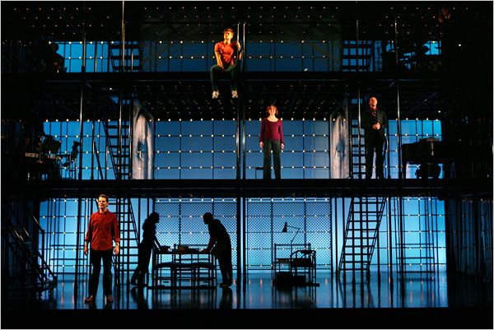
Set Design

Slide 16
Passage 7: “Just Another Day”
When it's up you to hold your house together...
A house you built with patience and with care...
But you're grappling with that grey and rainy weather,
And you're living on a latte and a prayer…

Slide 17
Passage 4: “A Light in the Dark”
One light shines in the drive—
One single sign that our house is alive.
Our house, our own -
So why do I live there alone?
Tell me why I wait through the night,
And why do I leave on the light?
You know. I know.
Our house was a home long ago.…
Take this chance
And we’ll make a new start
Somewhere far
From what keeps us apart,
And I swear that somewhere in the night
There’s a light…
A light in the dark.

Slide 18
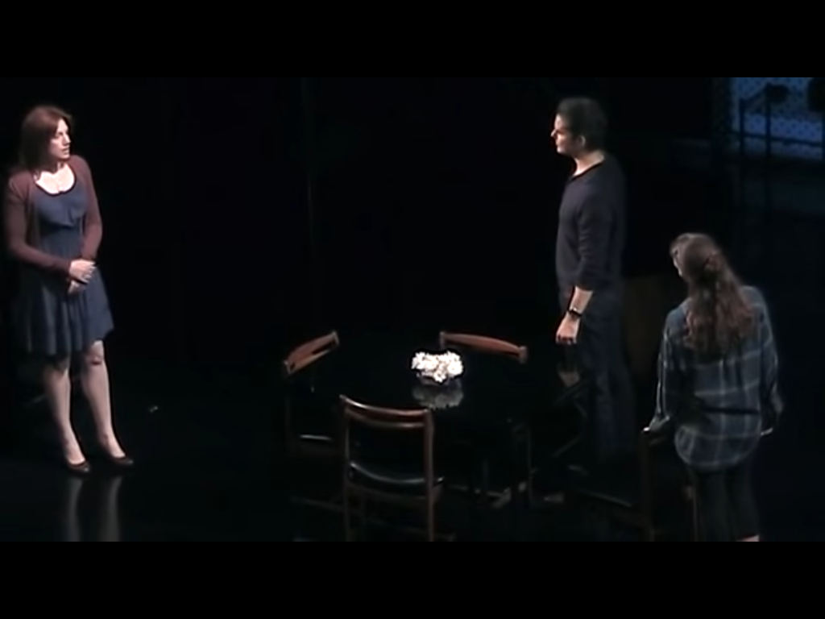
Passage 8: “Song of Forgetting”
Dan: Diana, don’t you…you don’t remember…any of this?
Diana: I should, right?
Dan: This house and all these rooms?
Last Christmas or last year? Out back the dogwood blooms—
Diana: Do I really live here?
Dan: the paint, the walls...
All this glass and wood...
You don't recall?
Diana: How I wish I could.
Dan: Our house on Walton way—
The house with the red door?

Slide 19
Set Design

Slide 20
Next to Normal: An Interior Oresteia
Rob Groves
University of Arizona
groves@email.arizona.edu

