Slide 1
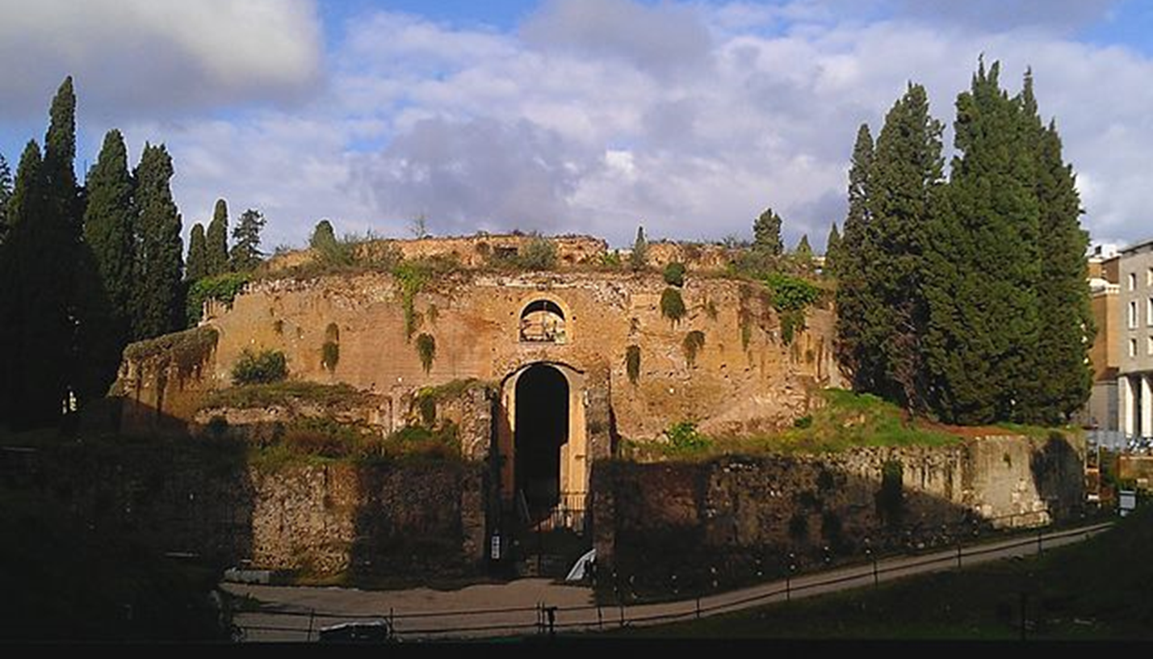
Deconstructing the Monuments: Tacitus on the Mausoleum of Augustus
Thomas E. Strunk Xavier University strunkt@xavier.edu

Slide 2
Mausoleum of Augustus

Slide 3
Mausoleum and Campus Martius
Horologium and
Ara Pacis
Via Flaminia
Mausoleum of Augustus
Tiber River

Slide 4
Mausoleum of Augustus and Clupeus Virtutis from Arles

Slide 5
CIL VI 40360
[ - - - decrevit senatus ut interesset]
consiliis publicis - coi[retque inter senatores cum]
annum expleturus [erat XV].
Mortem eius iustitio per con[sules indicto]
omnes luxerunt; censu [ - - - ]
insignibus decorata cu[- - - ]
The senate decreed that he should participate in public affairs and that he be ranked among the senators when he turned fourteen years old. All mourned his death and a iustitium was declared by the consuls . . .

Slide 6
CIL VI 40360
[ - - - decrevit senatus ut interesset]
consiliis publicis - coi[retque inter senatores cum]
annum expleturus [erat XV].
Mortem eius iustitio per con[sules indicto]
omnes luxerunt; censu [ - - - ]
insignibus decorata cu[- - - ]
Res Gestae 14.1
ex eo die, quo deducti sunt in forum, ut interessent consillis publicis decrevit senatus
The senate decreed that from that day on which they were led into the forum they should participate in public affairs.

Slide 7
Annales 1.3.1
ceterum Augustus subsidia dominationi
Yet Augustus [sought] a bulwark for his autocracy.
Res Gestae 1.1
rem publicam dominatione factionis oppressam in libertatem vindicavi
I freed the state oppressed by the tyranny of a faction.

Slide 8
Tacitus and Vergil on Marcellus
Annales 1.3.1
admodum adulescentem
merely a youth
Aeneid 6.882-883
Heu, miserande puer, si qua fata apsera rumpas
tu Marcellus eris.
Alas, wretched boy, if you could only crush the fates,
you will be Marcellus
Tu eris Marcellus – Jean-Auguste-Dominique Ingres

Slide 9
The Character of Tiberius
Tacitus, Annales 1.4.3-4
vetere atque insita Claudiae familiae superbia, multaque indicia saevitiae . . . eductum in domo regnatrice . . . aliud quid quam iram et simulatinoem et secretas libidines meditatum.
the inveterate and customary arrogance of the claudian family, and many indications of cruelty . . . brought up in the house of a regnatrix . . .nor had he contemplated anything other than anger, pretense, and hidden lusts

Slide 10
The Adoption of Tiberius
Velleius 2.104.1: hoc, inquit, rei publicae causa facio
He said, “I do this for the sake of the republic.”
Suetonius Tib. 21.3: rei publicae causa adoptare se eum
He adopted him for the sake of the republic.
Tacitus Annales 1.10.7: ne Tiberium quidem caritate aut rei publicae cura successorum adscitum, sed, quoniam adrogantiam saevitiamque eius introspexerit, comparatione deterrima sibi gloriam quaesivisse
Not even was Tiberius adopted as successor out of affection or care for the republic, but, since he had understanding of his arrogance and cruelty, he sought glory for himself through a contemptible comparison.

Slide 11
Bibliography
Alston, Richard. “Seeing Caesar in Ruins: Towards a Radical Aesthetic of Ruins.” European Review of History 18 (2011): 697-716.
Bérard, François. “Tacite et les inscriptions.” ANRW 2.33.4 (1991): 3007-50.
Cooley, Alison E. “Inscribing History at Rome.” In The Afterlife of Inscription: Refusing, Rediscovering, Reinventing & Revitalizing Ancient Inscriptions. Ed. Alison E. Cooley, 7-20. London: Institute of Classical Studies, 2000.
Cooley, Alison E. Res Gestae Divi Augusti: Text, Translation, and Commentary. Cambridge: Cambridge University Press, 2009.
Davis, P.J. “‘Since My Part Has Been Well Played’: Conflicting Evaluations of Augustus.” Ramus 28 (1999): 1-15.
Edwards, Catharine. Writing Rome: Textual Approaches to the City. Cambridge: Cambridge University Press, 1996.
Elsner, Jaś. “Inventing imperium: Texts and the Propaganda of Monuments in Augustan Rome.” In Art and Text in Roman Culture. Ed. Jaś Elsner, 32-53. Cambridge: 1996.
Hesberg, Henner von. “Das Mausoleum Augusti.” In Kaiser Augustus und die verlorene Repbulik. Mainz: Philipp von Zabern, 1988, 245-51.
Hesberg, Henner von. “Mausoleum Augusti – Das Monument.” LTUR III, ed. E.M. Steinby. Rome: 1996, 234-37.
Hesberg, Henner von and Silvio Panciera. Das Mausoleum des Augustus: der Bau und seine Inschriften. Munich: 1994.
Kraft, Konrad. “Der Sinn des Mausoleum des Augustus.” Historia 16 (1967): 189-206.
Lott, J. Bert. Death and Dynasty in Early Imperial Rome: Key Sources, with Text, Translation, and Commentary. Cambridge: Cambridge University Press, 2012.
Pettinger, Andrew. The Republic in Danger: Drusus Libo and the Succession of Tiberius. Oxford: Oxford University Press, 2012.
O’Sullivan, Timothy. “Augustan Literary Tours: Walking and Reading the City.” In The Moving City: Processions, Passages, Promenades in Ancient Rome. Ed. Ida Östenberg, Simon Malmberg and Jonas Bjørnebye, 111-22. London: Bloomsbury Academic, 2015.
Pollini, John. From Republic to Empire: Rhetoric, Religion, and Power in the Visual Culture of Ancient Rome. Norman: 2012.
Rehak, Paul. Imperium and Cosmos: Augustus and the Northern Campus Martius, edited by John G. Younger. Madison, WI: 2006.
Rouveret, Agnès. “Tacite et les monuments.” ANRW 2.33.4 (1991): 3051-99.
Sailor, Dylan. Writing and Empire in Tacitus (Cambridge: Cambridge University Press, 2008.
Scott, James C. Domination and the Arts of Resistance: Hidden Transcripts. New Haven: Yale University Press, 1990.
Strunk, Thomas E. History after Liberty: Tacitus on Tyrants, Sycophants, and Republicans. Ann Arbor: University of Michigan Press, 2017.
Zanker, Paul. The Power of Images in the Age of Augustus. Ann Arbor: University of Michigan Press, 1988.

