Slide 1
Beer: A Digital Transcription of a Medieval Manuscript
James R. prosser

Slide 2
Introduction
Demonstration of digital transcription on the Perseids Platform
Pedagogical applications of method
Skills in the field of codicology
Notes:
The digital transcription method on the Perseids platform allows for the efficient input of information from epigraphic materials. The use of a digital environment allows for the transparent display of all information from texts to be available at the viewer’s request without a bulky appearance. Perseids is the open-source digital humanities platform of the Perseus Project at Tufts University. This method uses Epidoc rules of TEI XML coding in order to transcribe all of the text, ligatures, lacunae, and other features from texts. Epidoc is a subset of Text Encoding Initative’s (TEI) standard for the representations of texts. XML or Extensible Markup Language “is a markup language that defines a set of rules for encoding documents in a format that is both human-readable and machine-readable”
The pedagogical uses of this transcription method provide a framework for students of different levels to learn epigraphy and how to encode transcriptions in an XML editing environment with different tools to aid students and provide immediate results.
Other than a personal interest in the subject matter of the text, I chose to transcribe this text in order to gain skills in pedagogy and codicology

Slide 3
MS-13
16th Century German Manuscript Written in Latin
Written in a Question and Answer Form
Discusses the Physical Qualities of Different Kinds of Beer
Points to Knowledge of Ancient Authors such as Pliny the Elder, Dioscorides, Aritstotle, and a quote from Galen
Notes:
MS-13 is a 16th Century German Manuscript written in Latin by an unnamed author. The manuscript resides in the Tisch Library manuscript and rare books collection at tufts university. The text was written in a question and answer format where the author asked 10 questions regarding the physical qualities of beer. The effects of different brewing methods and ingredients such as wheat, barley, and hops on beer were discussed by the author in terms how they changed the color, texture, potency, and taste of beer. In the author’s discussion of beer, he includes the opinions of the ancient scholars : Pliny the Elder, Dioscorides, Aristotle, and Galen. These scholars typically deride beer as an unhealthy and harmful drink causing several ailments, including leprosy.

Slide 4
MS-13
Notes:
The text is a short manuscript written on 6 paper folios in ink

Slide 5
Transcription Method
Notes:
The transcription of this text was performed on the Perseids Platform to create a TEI XML document using the rules of Epidoc. Here, we see the process of transcribing a single line of text. First, I highlighted the area of the line to be transcribed in the mapping tool.

Slide 6
Transcription Method
Notes:
Following this, I delimited each word of the line with a box encompassing the entire word and possible ligatures or accent marks in order to preserve all of the information of the text. I transcribed the text word-by-word for specificity and to make edits more easily in the XML document.

Slide 7
Transcription Method
Notes:
Once each word of the line has been demarcated, a preliminary transcription of the letters written can be performed on top.

Slide 8
Transcription Method
Notes:
With the words delimited and a preliminary transcription done for the whole line, the XML code below including the mapping coordinates on the image and the transcription should be copied and pasted into the proper placement in the XML document below.

Slide 9
Transcription Method
Notes:
Here the XML document shows the code related to the line seen above. The line number has been added so that the presentation of this text maintains as much of the original format as possible.

Slide 10
Transcription Method
Cer<hi rend= “ligature”> e</hi>uisia<hi rend=“ligature”>e</hi></w>
Notes:
Once the code has been added to the document in its proper location, elements of the text that are not a part of the normal line of the word may be added. Here, ligatures have been added to the code for the line cerevisiae since the author wrote this word with a shorthand.

Slide 11
Transcription Method
Notes:
Other features of the text, such as words split across two lines may also be encoded and resolved into the normalized text (see end of line 5 for an example).

Slide 12
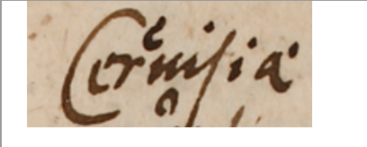
Presentation
Notes:
Perseids allows for a quick creation of a normalized text from the XML document which resolves any ligatures, missing text, or abbreviations in an understandable manner. Another feature of this normalized text is the ability to display the exact image delimited for each word of the text allowing for the examination of any inconsistencies.

Slide 13
Presentation
Notes:
With the completion of the normalized text, a translation is now possible. Perseids allows the user to input the translation into a new XML which mimics the form of the transcription document. Here, the translation was not split up by line, but by paragraph to maintain a fluid translation.

Slide 14
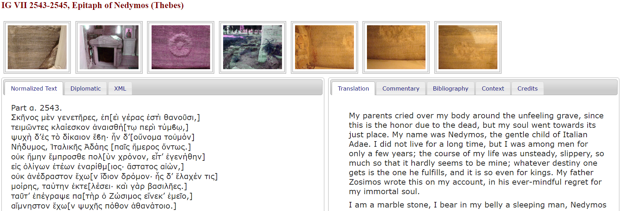
Publication
http://pubs.perseids.org/epifacs/src/
Notes:
When both the transcription and translation XML documents have been completed, Perseids allows for the publication of the transcription on its public platform. Perseids grants the viewer access to the normalized text, diplomatic version of the text which would maintain certain features (such as being in all capitals if an inscription), the XML document itself, the translation of the text, commentary on the text (usually including contextual information on the text), and a bibliography. For more examples of published transcription projects, please see the Perseids website.

Slide 15
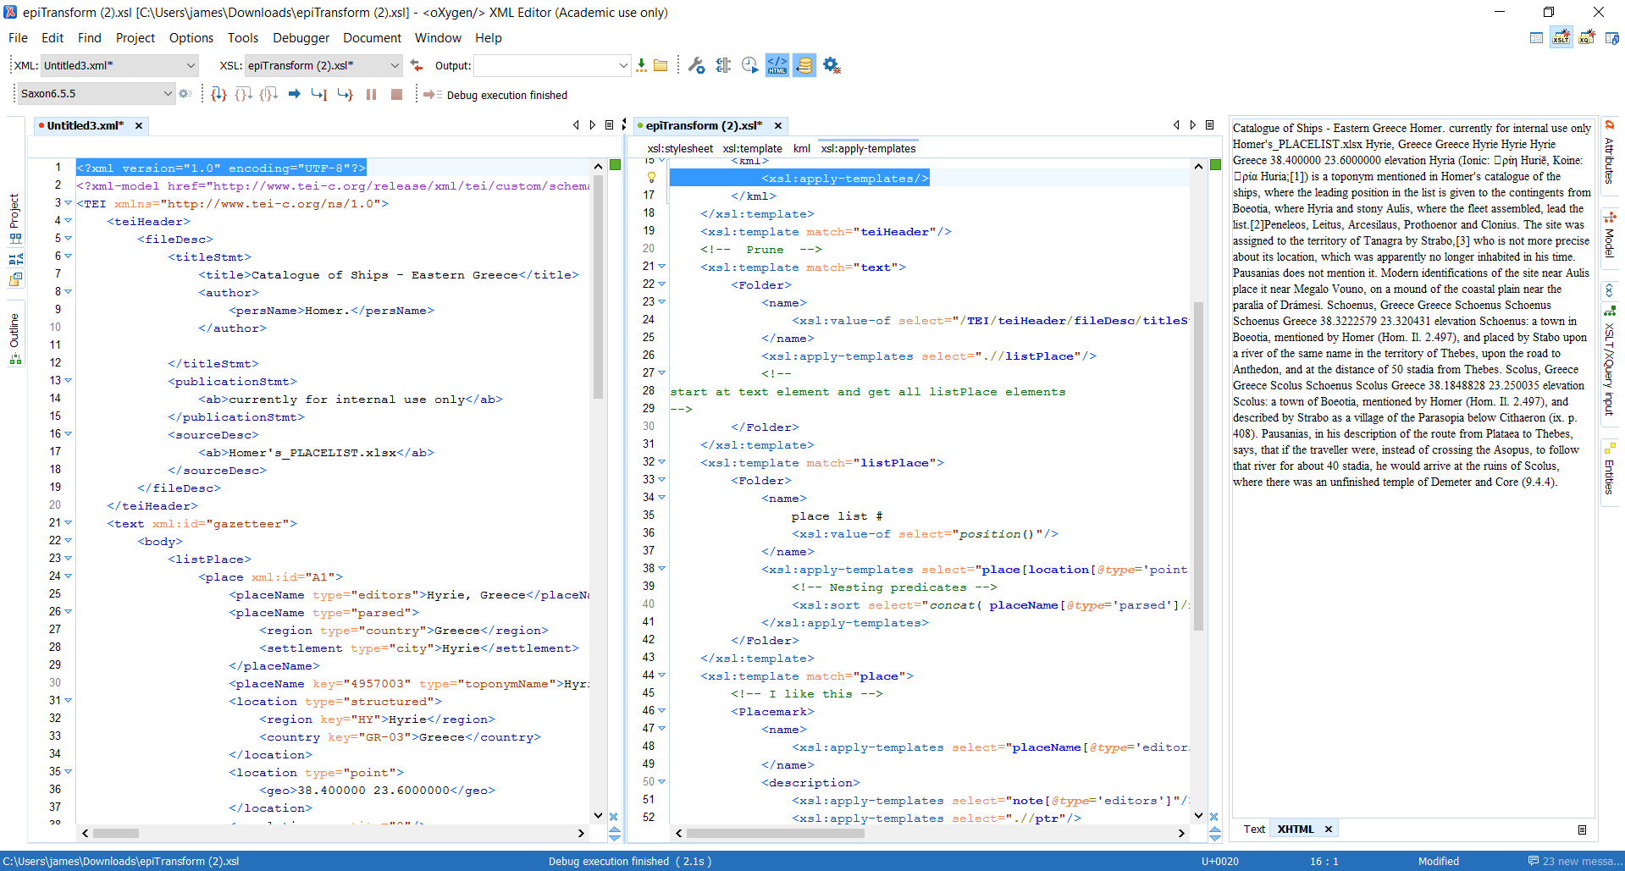
XSLT Transforms
Notes:
Outside of Perseids, Using the Oxygen editing environment, it is possible to create XSLT transforms on the XML document to highlight different aspects of the text such as ligatures, other languages, and missing text. XSLT or Extensible Stylesheet Language Transformations is a language for XML documents into other formats such as HTML for web pages.

Slide 16
Conclusion
Results
Applications of Perseids transcription method
Advantages of digital transcription in Epidoc TEI XML
http://sites.tufts.edu/perseids/
Notes:
The result of this project was a scientific digital transcription of this unique manuscript which is readily available for interpretation and display using the Epidoc rules of TEI XML and the Perseids platform.
The use of TEI XML on the Perseids platform applies not only to manuscripts, but can be extended to inscriptions very easily. In fact, the transcription of short inscriptions provides the skills necessary to create a project of this sort. There is a bit of a learning curve to this method of transcription,
The use of Perseids also allows the inclusion of direct access to intertextual references through the embedding of links into the XML document.
Digital transcription in Epidoc TEI XML preserves all of the information of the original texts and presents it in an efficient manner which does not bear the same verbosity and bulkiness of traditional textual transcriptions. In addition to these benefits, Epidoc is a system agreed upon by a large number of codicologists which allows for collaboration for more comprehensive projects.
In addition to Epidoc, coding in XML and XSLT are both supported with a variety of online tools, including a large number of tutorials on github.
Perseids is free to use and easy to sign up with most emails through this website.

