Slide 1
Prudentius at Large: Quantifying the Influence of Latin Epic on Prudentius’ Psychomachia
Caitlin Diddams
CAMWS 2017
acstaab@buffalo.edu

Slide 2
Outline
Background of Psychomachia
Quantitative Methodology
Interpretation of Data
Close Reading of Intertexts
Conclusion

Slide 3
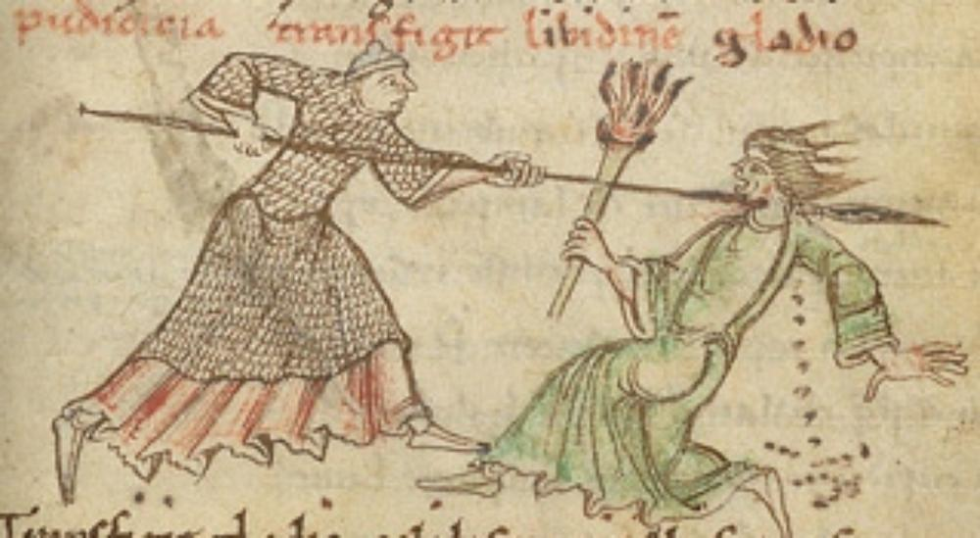
Background

Slide 4
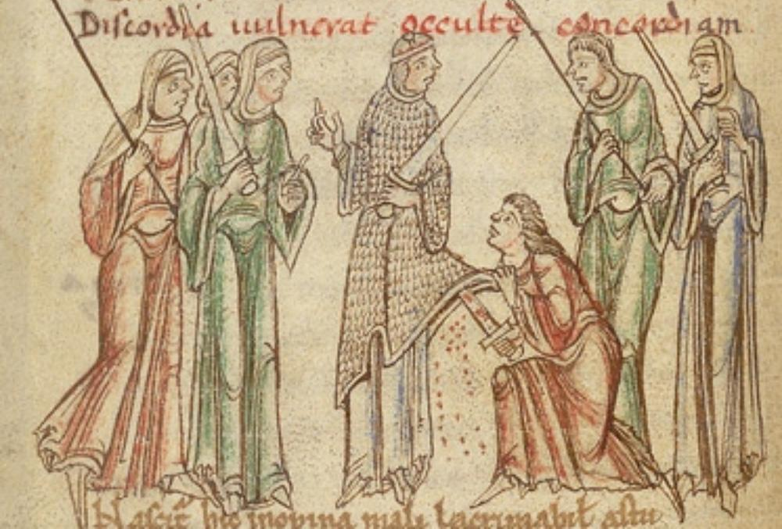
Background

Slide 5
Methodology
Notes:
Many of you are familiar with the Tesserae Project, an automated tool to identify intertextuality between a source text and a target text. Batch.multi expands the capabilities of Tesserae far beyond tracing allusion, to quantitatively measuring an authors’ influence.

Slide 6
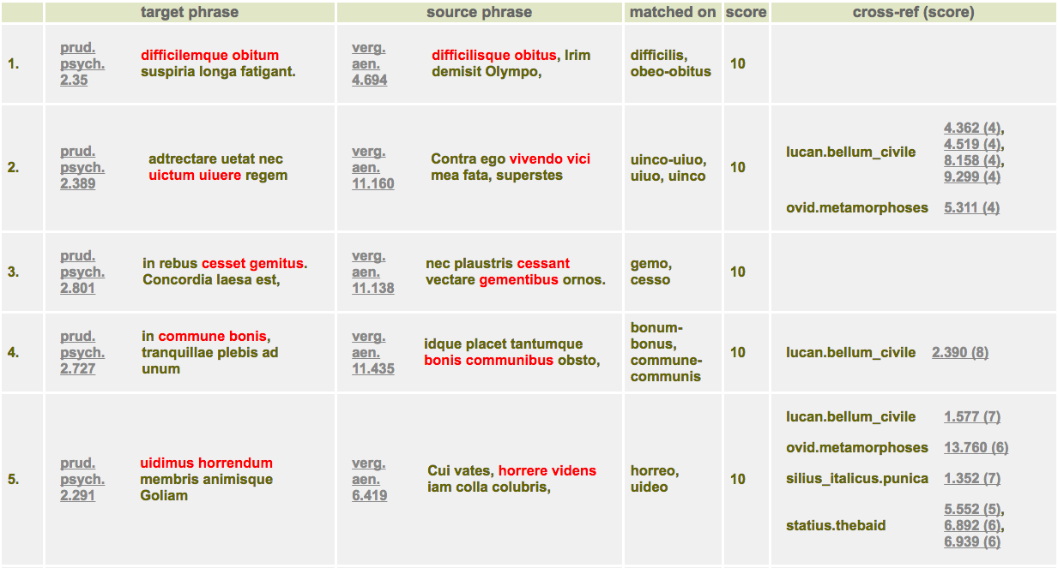
Methodology: a “unique” result

Slide 7
Results
Unique Reuse of Latin Epic in Psychomachia

Slide 8
Results - Example
Psych. 30:
Difficilemque obitum suspiria longa fatigant.
Long gasps make a hard and agonizing death.
Theb. 6.796:
Et iam utrumque labor suspiriaque aegra fatigant.
And now both are wearied with toil and distressful panting.

Slide 9
Close Reading
Psych. 464-466:
Cura, Famis, Metus, Anxietas, Periuria, Pallor,
Corruptela, Dolus, Commenta, Insomnia, Sordes,
Eumenides variae monstri comitatus aguntur.
Care, Hunger, Fear, Anguish, Perjuries, Pallor, Corruption, Treachery, Falsehood, Sleeplessness, Meanness, diverse fiends, go in attendance on the monster.

Slide 10
Close Reading
Aen. 6.273-281:
vestibulum ante ipsum primisque in faucibus Orci
Luctus et ultrices posuere cubilia Curae,
pallentesque habitant Morbi tristisque Senectus
et Metus et malesuada Fames ac turpis Egestas,
terribiles visu formae, Letumque Labosque:
tum consanguineus Leti Sopor et mala mentis
Gaudia, mortiferumque adverso in limine Bellum
ferreique Eumenidum thalami et Discordia demens,
vipereum crinem vittis innexa cruentis.
Notes:
Just before the entrance, even within the very jaws of Hell, Grief and avenging Cares have set their bed; there pale Diseases dwell, sad Age, and Fear, and Hunger, temptress to sin, and loathly Want, shapes terrible to view; and Death and Distress; next, Death’s own brother Sleep, and the soul’s Guilty Joys, and, on the threshold opposite, the death-dealing War, and the Furies’ iron cells, and maddening Strife, her snaky locks entwined with bloody ribbons.

Slide 11
Close Reading
Aen. 6.273-281:
Just before the entrance, even within the very jaws of Hell, Grief and avenging Cares have set their bed; there pale Diseases dwell, sad Age, and Fear, and Hunger, temptress to sin, and loathly Want, shapes terrible to view; and Death and Distress; next, Death’s own brother Sleep, and the soul’s Guilty Joys, and, on the threshold opposite, the death-dealing War, and the Furies’ iron cells, and maddening Strife, her snaky locks entwined with bloody ribbons.

Slide 12
Close Reading
Theb. 4.661-663:
nec comitatus iners: sunt illic Ira Furorque
et Metus et Virtus et numquam sobrius Ardor
succiduique gradus et castra simillima regi.
No lazy retinue is his: Wrath and Madness are there, and Fear and Valour and Ardour never sober and staggering steps and a camp like to its king.

Slide 13
Close Reading
Theb. 7.47-53:
… primis salit Impetus amens
e foribus caecumque Nefas Iraeque rubentes
exsanguesque Metus, occultisque ensibus adstant
Insidiae geminumque tenens Discordia ferrum.
innumeris strepit aula Minis, tristissima virtus
stat medio, laetusque Furor voltuque cruento
Mors armata sedet.

Slide 14
Close Reading
Theb. 7.47-53:
Wild Impulse leaps from the outer gates and blind Evil and ruddy Angers and bloodless Fears. Treachery lurks with hidden swords and Strife holding tow-edged steel. The court resounds with countless Threats, Valour most sombre stands in the centre, and joyful Rage and armed Death with bloodstained countenance there sit. On the altars is blood of wars.

Slide 15
Close Reading
Pun. 4.324-325:
Aduolat aurato praefulgens murice ductor
Sidonius, circaque Metus Terrorque Furorque.
Now the Carthaginian leader flew to the spot, gleaming in purple and gold, and with him were Fear and Terror and Madness.

Slide 16
Close Reading
Pun. 4.436-439:
… exercitus una
Irarum Eumenidesque simul letique cruenti
innumerae facies, frenisque operata regendis
quadriiugos atro stimulat Bellona flagello.
With him went his train—Wrath accompanied by the Furies, and countless forms of bloody death; and Bellona, busy with the reins, urged on the four coursers with her fatal scourge.

Slide 17
Close Reading
Psych. 902:
… fervent bella horrida, fervent
ossibus inclusa, fremit et discordibus armis
non simplex natura hominis.
Savage war rages hotly, rages within our bones, and man’s two-sided nature is in an uproar of rebellion.

Slide 18
Close Reading
Compare:
bella horrida in Statius’ Thebaid 4.601 and 6.457
horrida bella in Silius Italicus’ Punica 1.630
horrida bella Statius’ Silvae 3.3.170

Slide 19
Works Cited
Burton, R. 1989. Prudentius: Psychomachia. Bryn Mawr; Bryn Mawr Commentaries. p.1-2.
Coffee, Neil and Chris Forstall. “Claudian’s Engagement with Lucan in his Historical and Mythological Hexameters” in Lucan and Claudian: Context and Intertext ed. Valery Berlincourt et al. Heidelberg: Universitatsverlag Winter GmbH. p. 255-284.
Diddams and Gawley. Forthcoming. “Measuring the Presence of Roman Rhetoric: An Intertextual Analysis of Augustine’s De Doctrina Christiana IV.” Mouseion.
Gawley and Diddams. Forthcoming. “Big Data and the Study of Allusion: An Exploration of Tesserae’s Multitext Capability.” Digital Scholarship in the Humanities.
Hanna R. 1977. “The Sources and the Art of Prudentius’ Psychomachia.” Classical Philology, Vol. 72, No. 2. p. 108-115.

Slide 20
Works Cited
Malamud, M. 1989. A Poetics of Transformation: Prudentius and Classical Mythology. Ithaca, Cornell University Press. p. 47-78.
Mastrangelo, M. 2008: The Roman Self in Late Antiquity: Prudentius and the Poetics of the Soul. Baltimore, Johns Hopkins University Press. p. 15.
Prudentius. Fight for Mansoul. Translated by H. J. Thomson. Loeb Classical Library 387. Cambridge, MA: Harvard University Press, 1949.
Silius Italicus. Punica, Volume I: Books 1-8. Translated by J. D. Duff. Loeb Classical Library 277. Cambridge, MA: Harvard University Press, 1934.
Statius. Thebaid, Volume I: Thebaid: Books 1-7. Edited and translated by D. R. Shackleton Bailey. Loeb Classical Library 207. Cambridge, MA: Harvard University Press, 2004.
Virgil. Aeneid: Books 1-6. Translated by H. Rushton Fairclough. Revised by G. P. Goold. Loeb Classical Library 63. Cambridge, MA: Harvard University Press, 1916.

Slide 21
Thanks / Resources
Special thanks to Neil Coffee, James Gawley, and the Tesserae team
Web Service: tesserae.caset.buffalo.edu
GitHub: https://github.com/tesserae/tesserae

