Slide 1
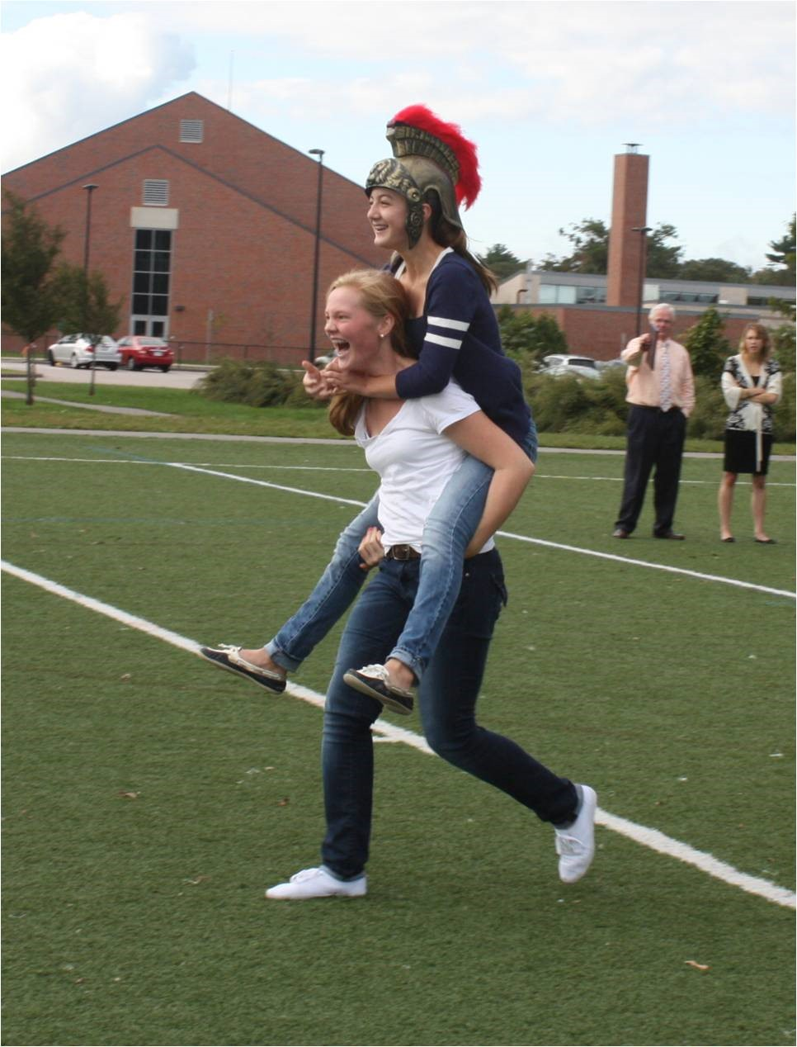
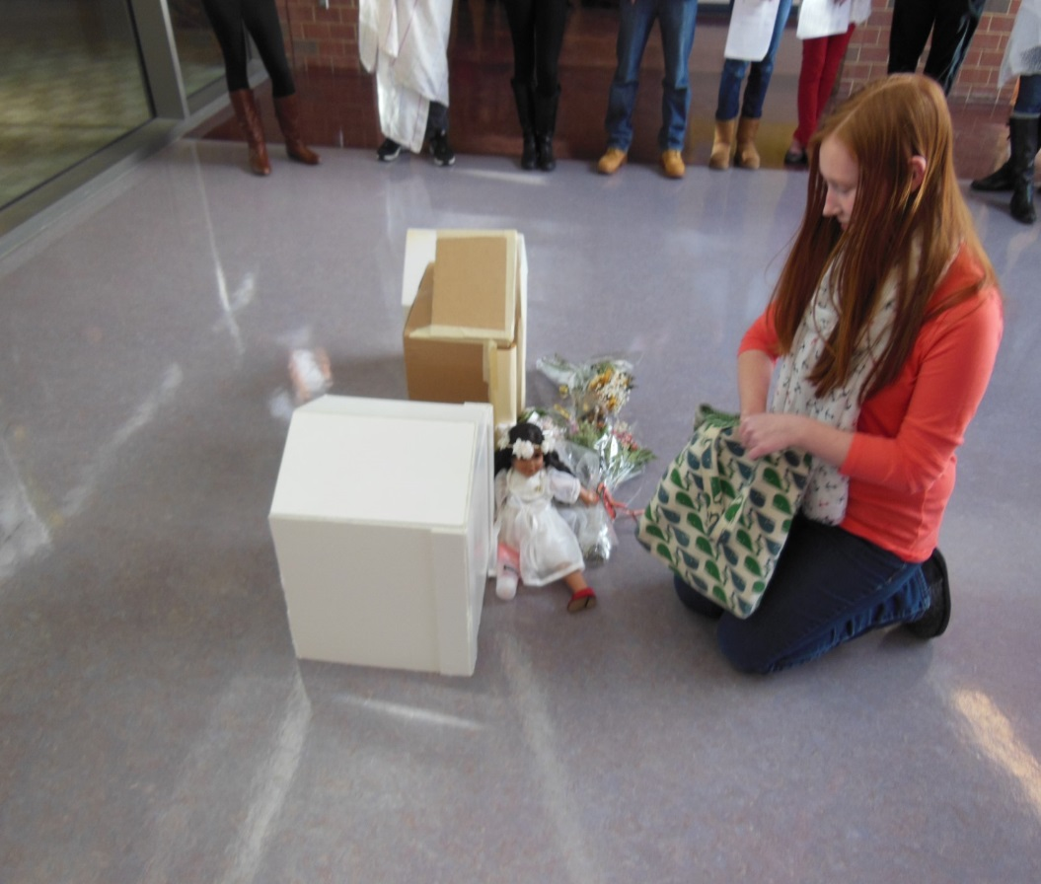
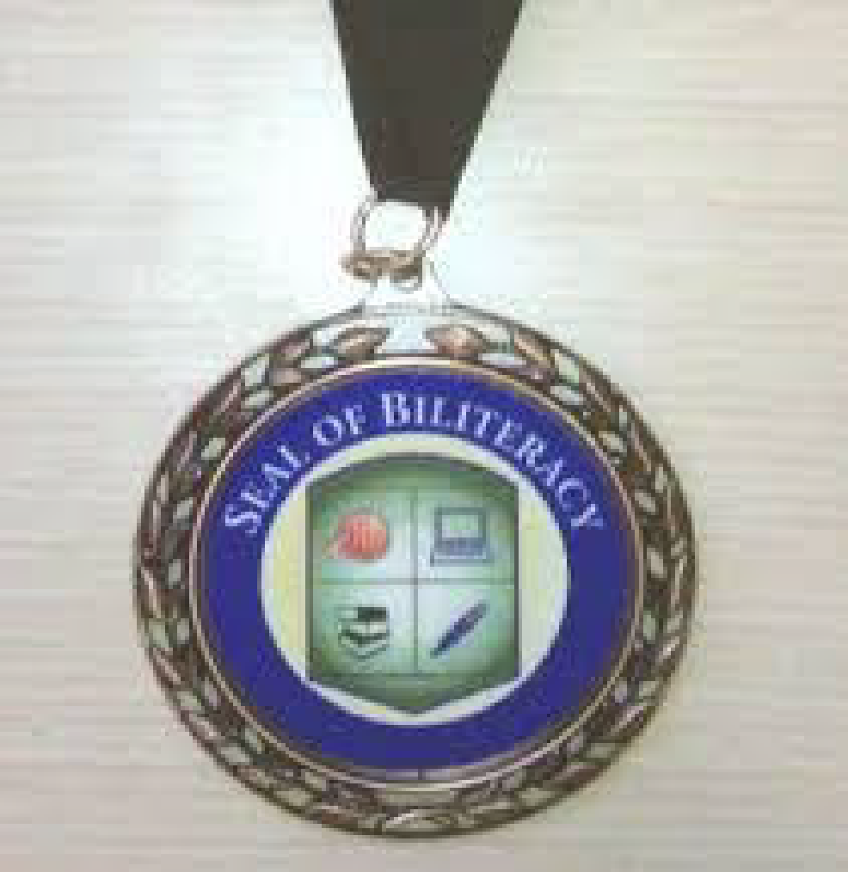


History of the Seal of Biliteracy and National Guidelines
tinyurl.com/zarrowCAMWS
Dr. Edward M. Zarrow
Westwood High School
ACTFL 2016 National Language
Teacher of the Year
tzarrow@westwood.k12.ma.us
@drzarrow
CAMWS 2017
Kitchener, Ontario

Slide 2
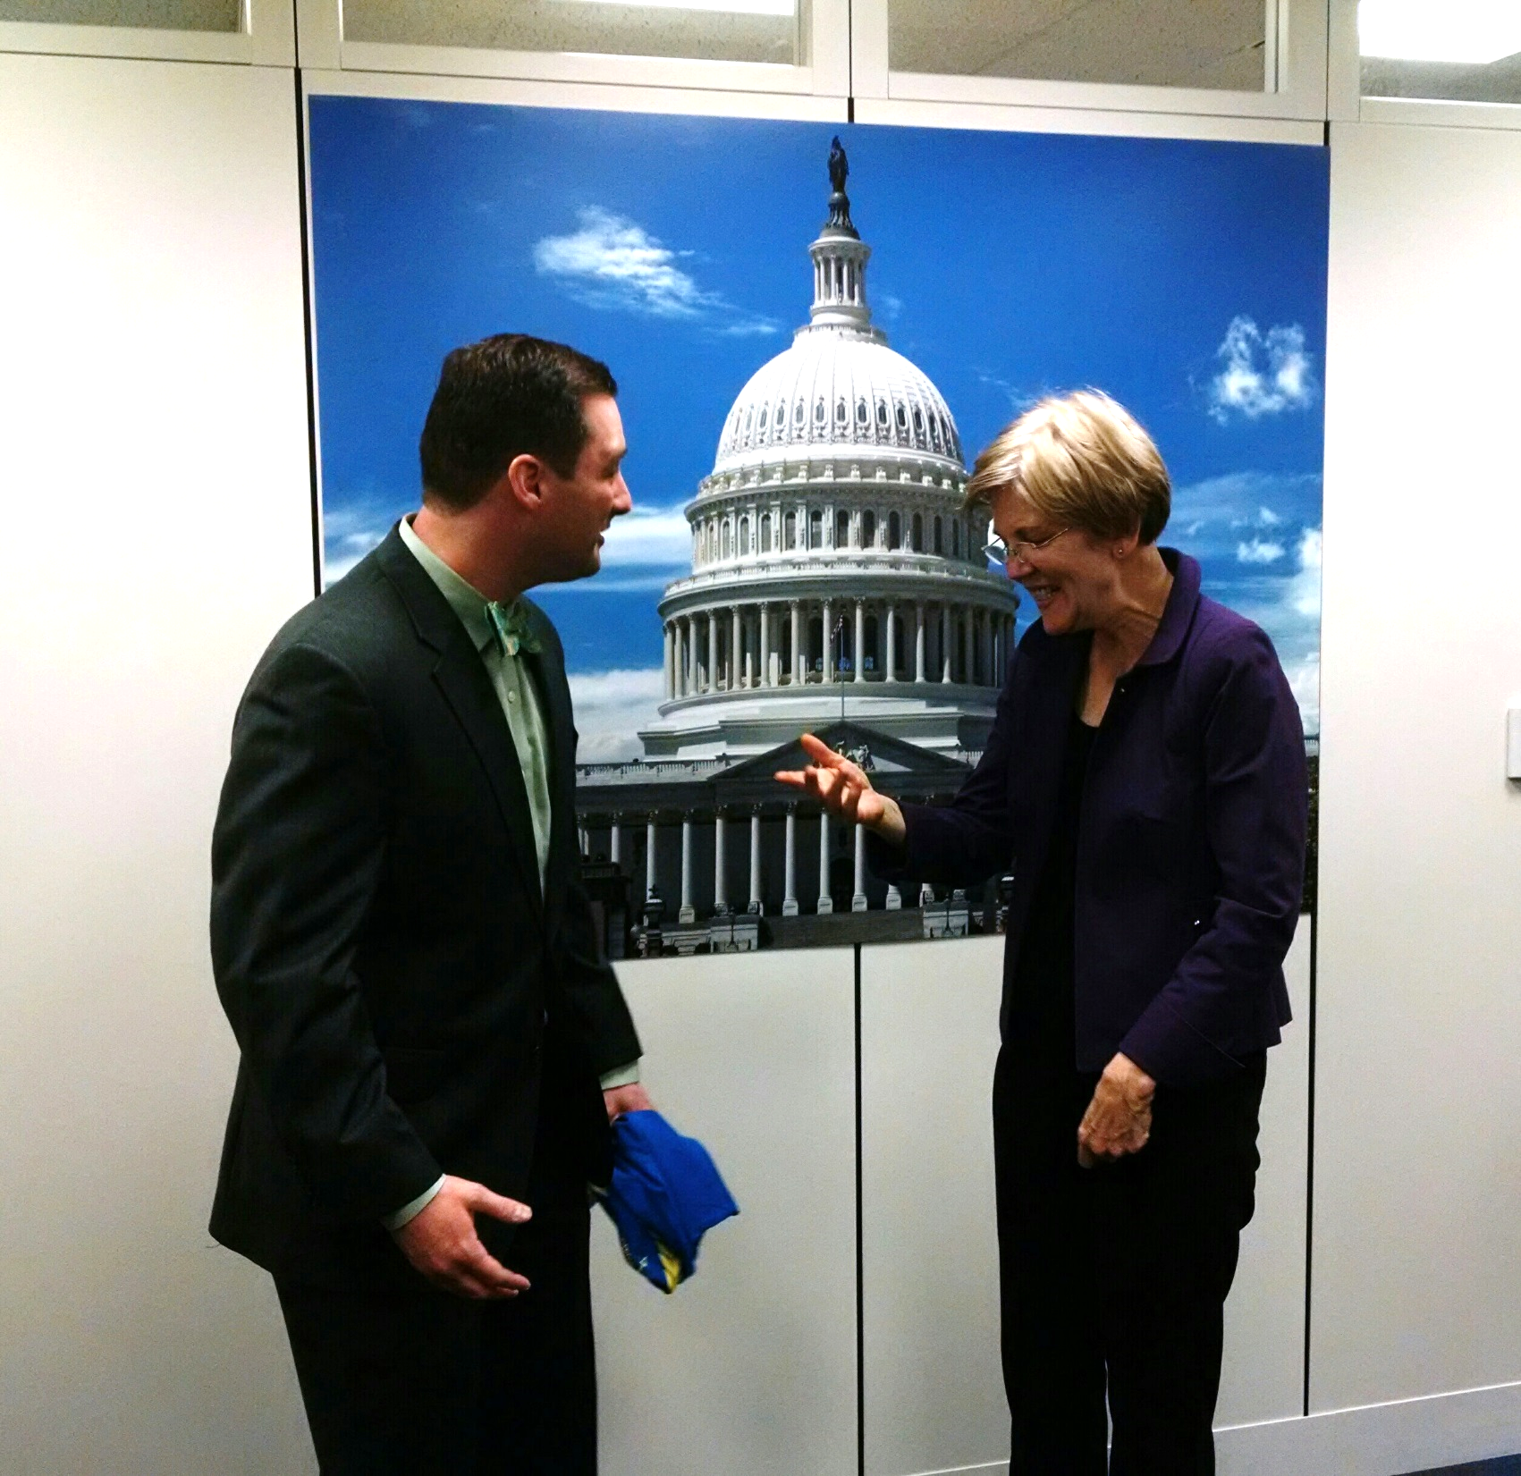

Slide 3
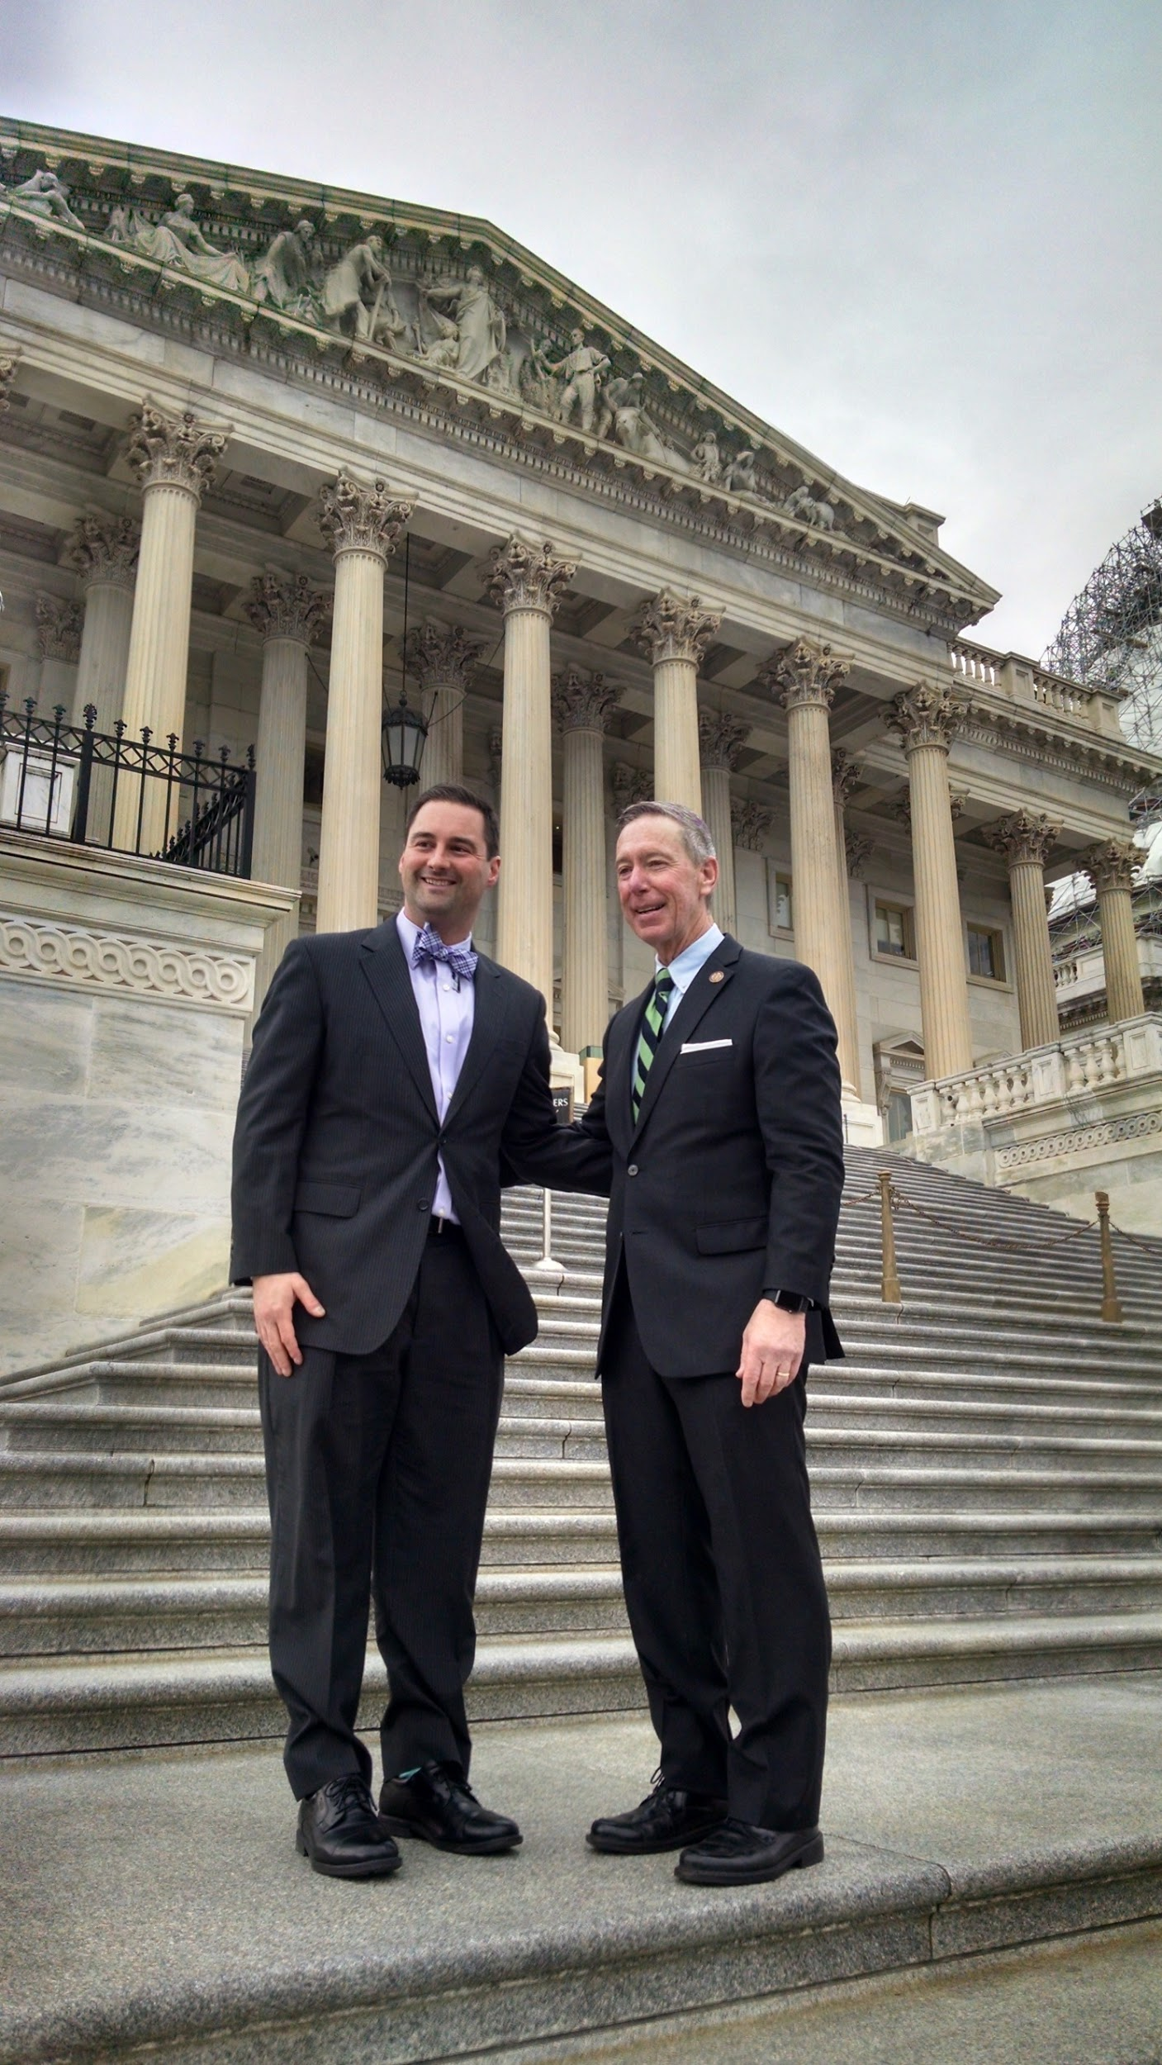
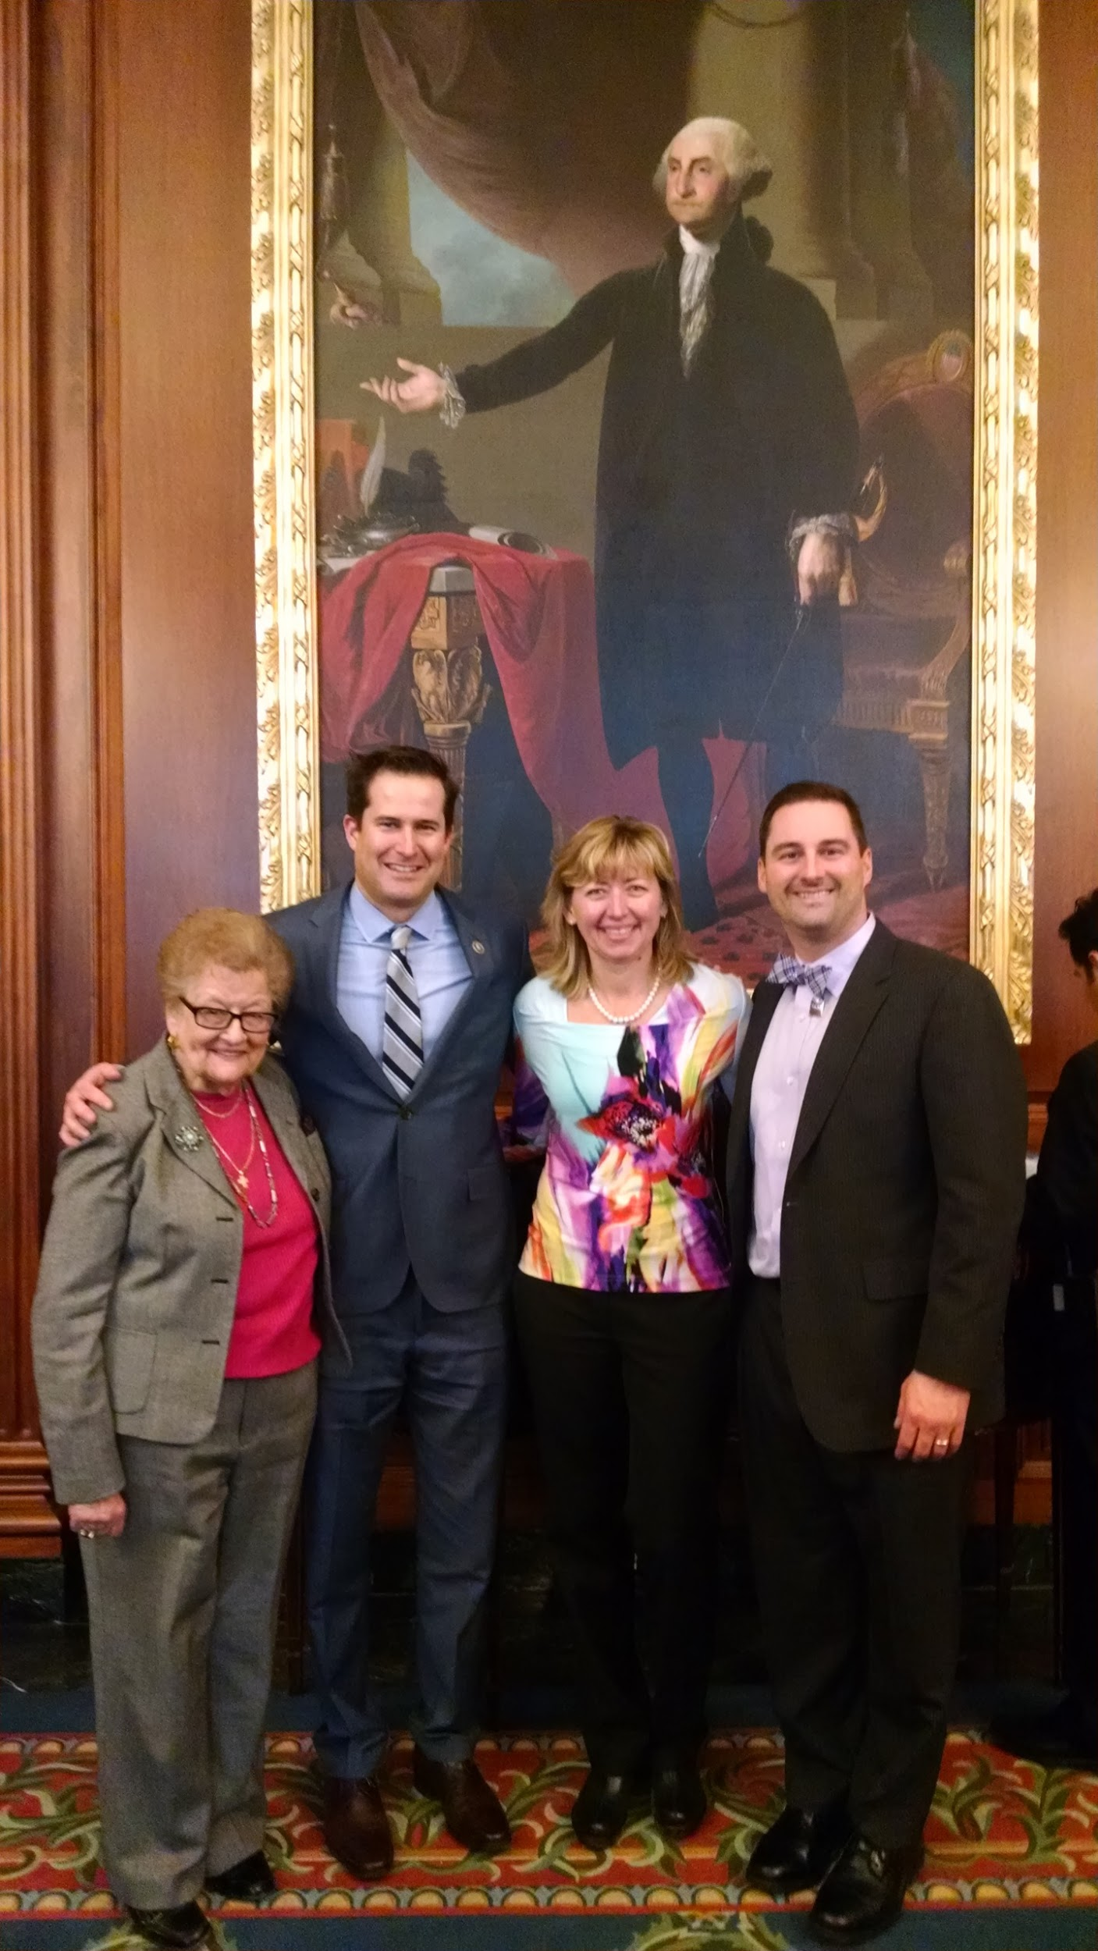

Slide 4
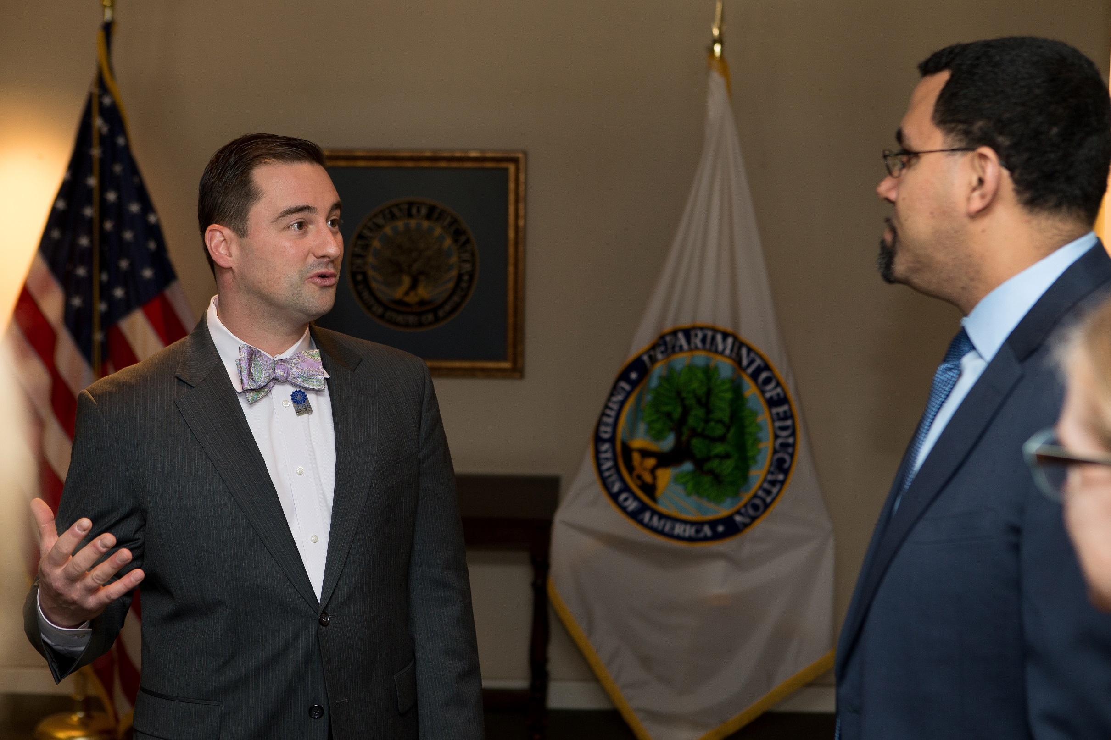

Slide 5
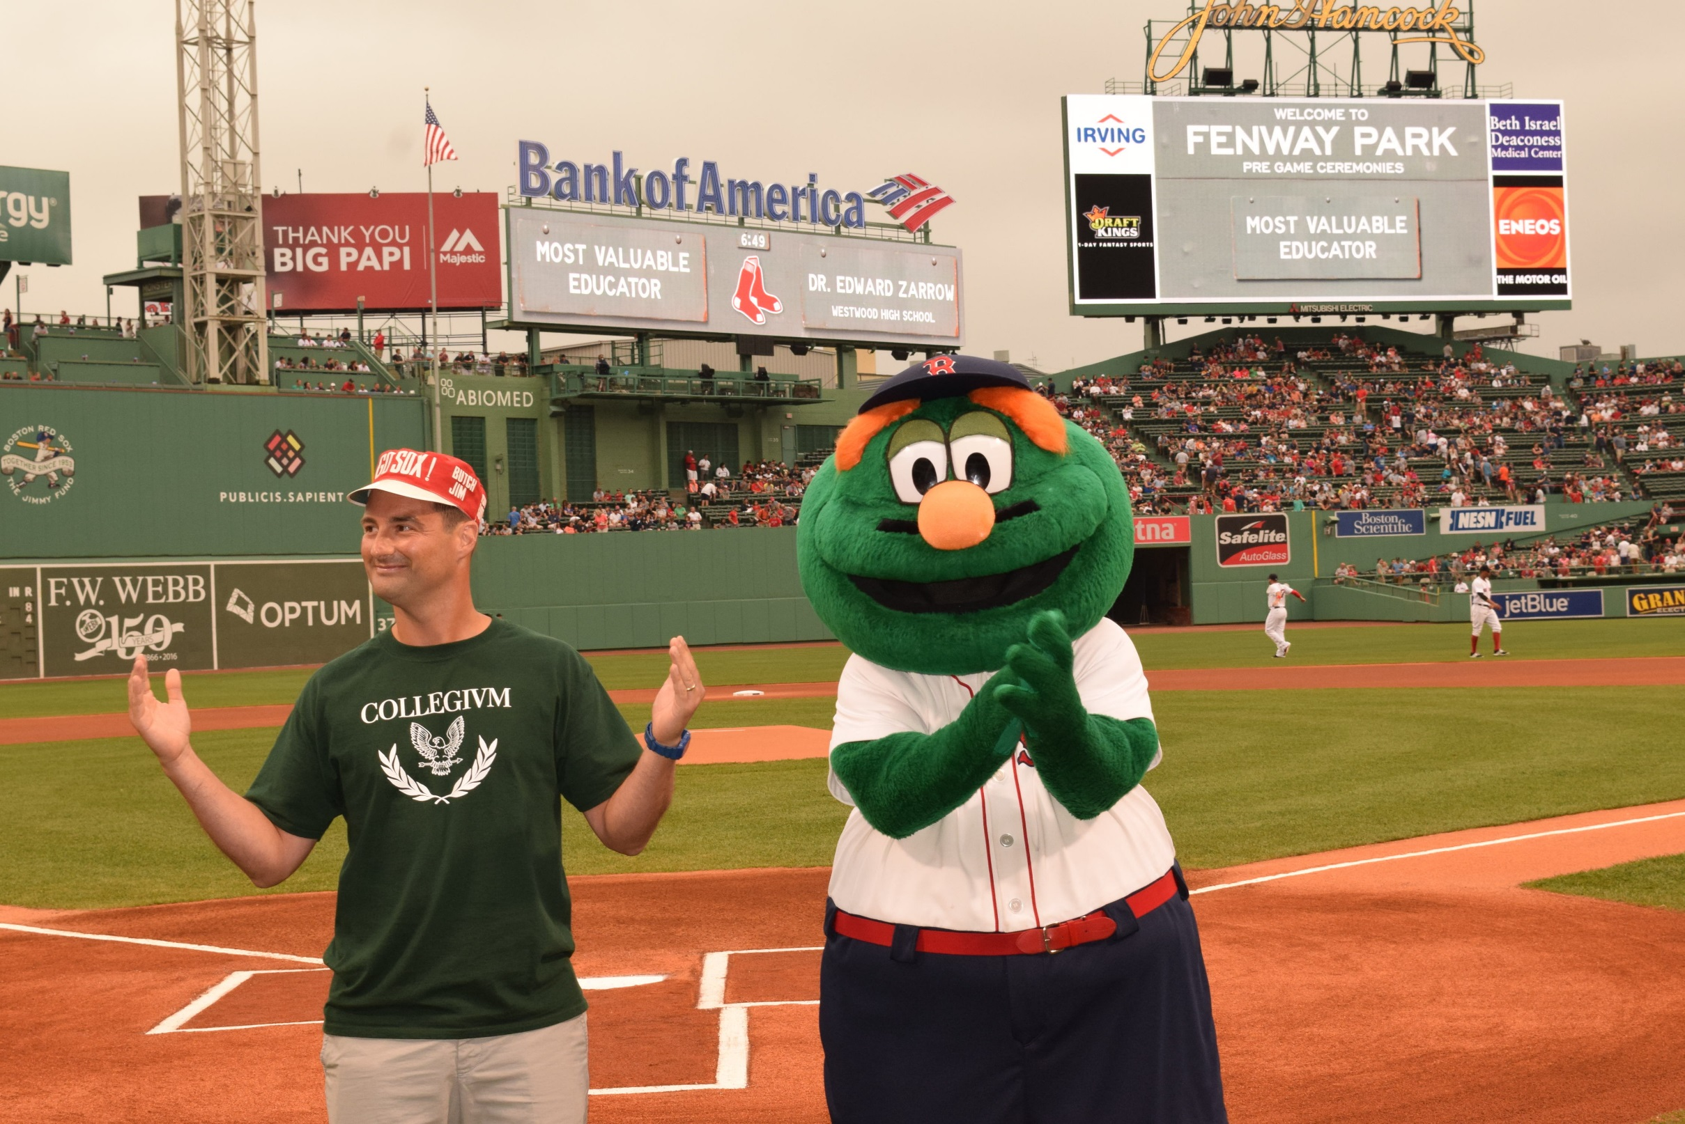

Slide 6

It’s a Brave New World …
Other than Spanish and English, what is the most common language (as of 2014) spoken in:
Massachusetts?
Georgia?
Texas?
Michigan?
Oregon?

Slide 7
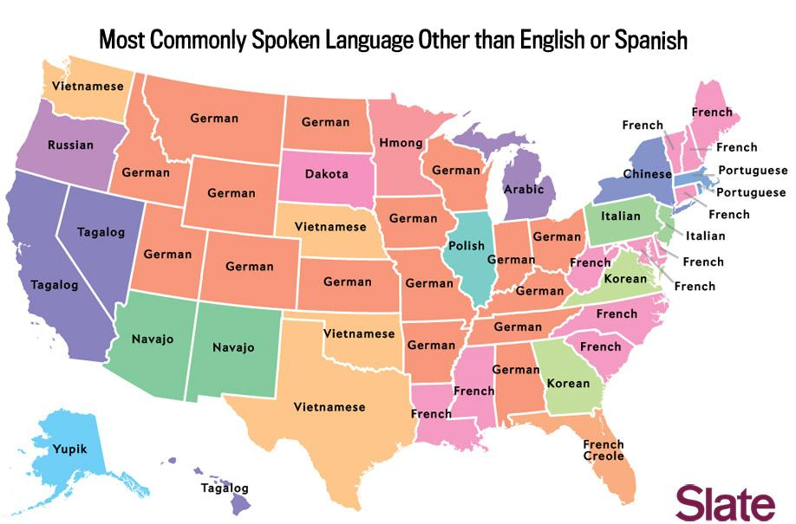

Slide 8

* There are a lot of legitimate misconceptions about what we do.
What are the goals and benefits to studying languages?
What is actually
happening in a
WL classroom?

Slide 9
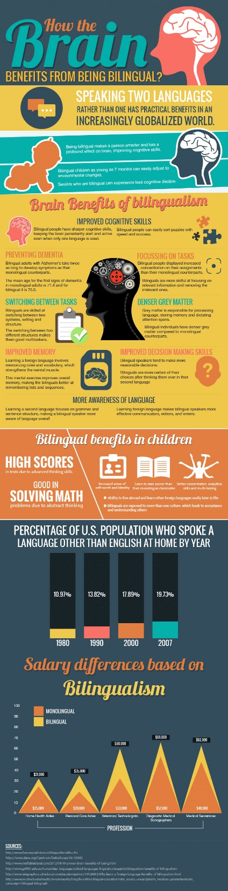
*The bilingual brain has better attention and task-switching capacities
*Being bilingual enhances overall cognition
*Being bilingual delays the potential onset of Alzheimer’s
*Over the past five years, demand for bilingual workers has more than doubled

Slide 10
*Dual Language Education can Close the Achievement Gap
*Language learners consistently outperform control groups in core subject areas on standardized tests often significantly (this includes math).
*Nearly ½ of all U.S. States offer special recognition for bilingual graduates

Slide 11
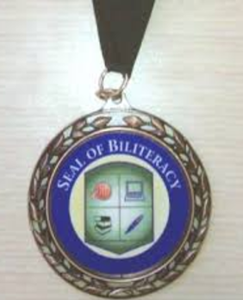
What Is the “Seal of Biliteracy?”
The “Seal of Biliteracy” recognizes high school & college graduates for demonstrating proficiency in English and at least one other world language with a seal on their diploma or transcript.
The “Seal of Biliteracy” award may be granted by a school, school district, county office, or state department of education in recognition of student accomplishment for future employers (and for college admissions).
Students can earn the “Seal of Biliteracy” for proficiency in LATIN

Slide 12
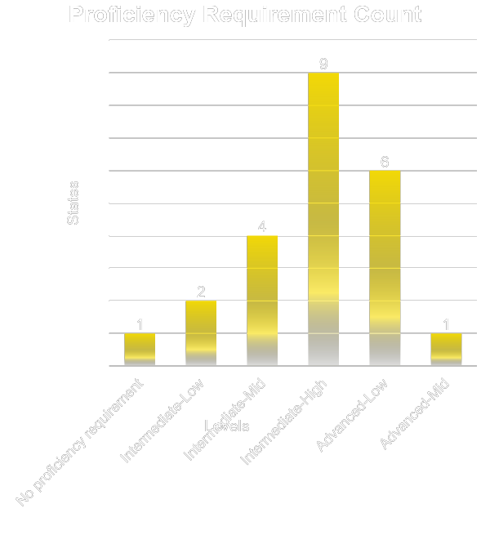
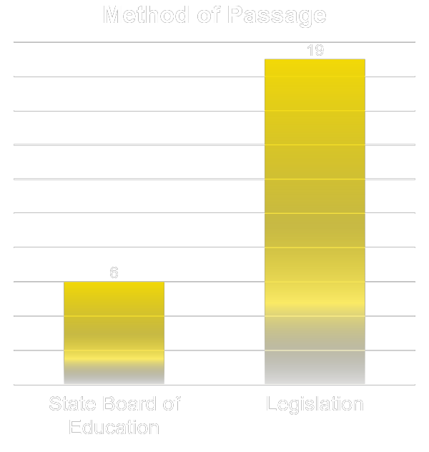
TOTAL: 25 State Seals

Slide 13
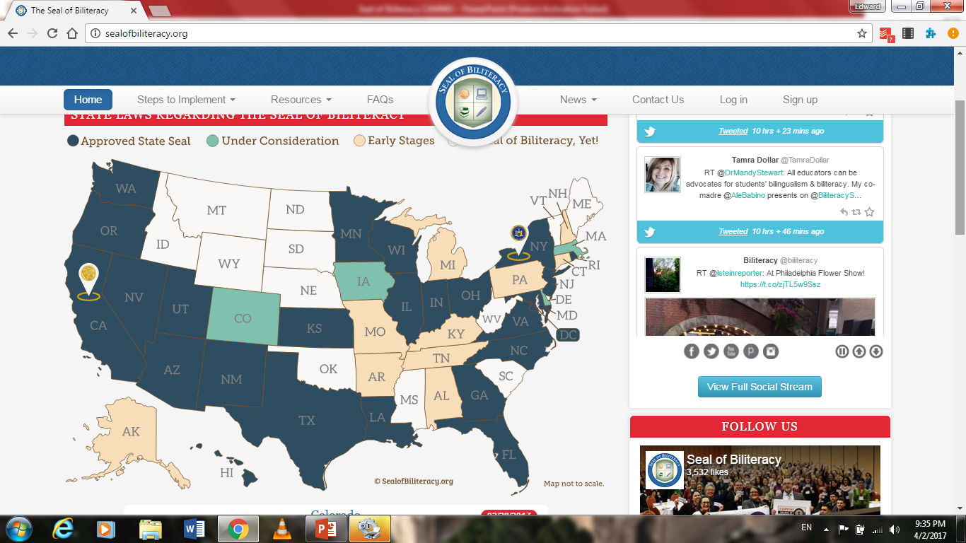
Languages are non-partisan …
25 States (including the District of Columbia) offer the Seal

Slide 14

of the Seal:
The Seal places the focus on what students can do with the language. In terms of Latin, that focus is on interpretive reading.
The Seal provides measured evidence to Universities and businesses / potential employers of a student’s language proficiency and the skills that are engendered in terms of being college, career, and citizenship ready.
The Seal has become a national effort to reward students for their functional biliteracy in English and another language – this is transforming world language programming.

Slide 15
Proficiency Level | State | Method of Passage
Advanced-Mid | Wisconsin (Distinguished Seal) | State Board of Ed
Advanced-Low | Kansas (Platinum) Utah (Platinum) Minnesota (Platinum) District of Columbia Louisiana Oregon | State Board of Ed Legislation Legislation State Board of Ed Legislation State Board of Ed
Intermediate-High | Wisconsin (Seal) Minnesota (Gold) Georgia Illinois Texas Maryland New Mexico New York Virginia | State Board of Ed Legislation Legislation Legislation Legislation Legislation Legislation Legislation Legislation
Intermediate-Mid | Kansas (Gold) Utah (Gold) New Jersey Washington | State Board of Ed Legislation Legislation Legislation
Intermediate-Low | Minnesota (Certificate) North Carolina | Legislation State Board of Ed
No proficiency requirement | California | Legislation

Slide 16

Shift to Proficiency

Slide 17
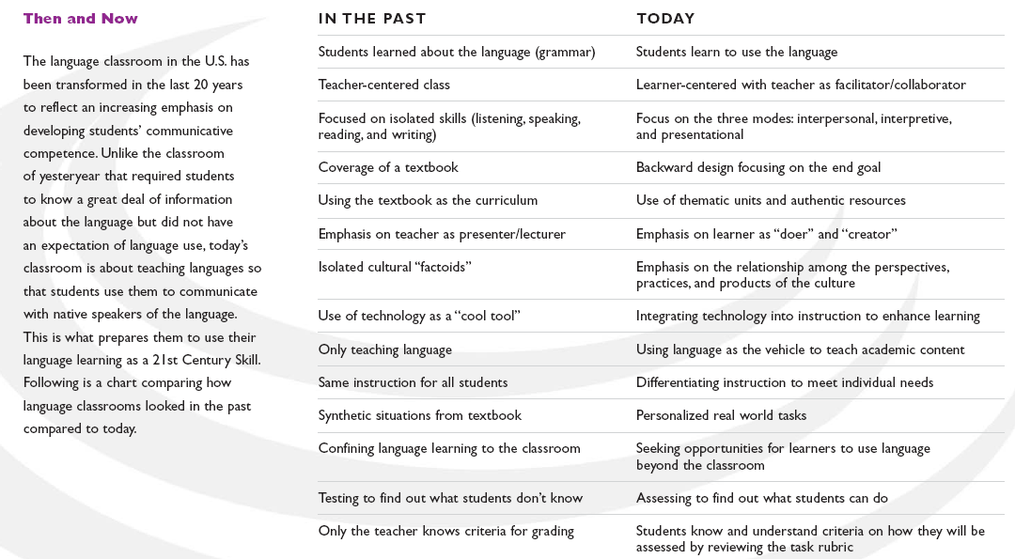
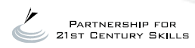
www.P21.org

Slide 18
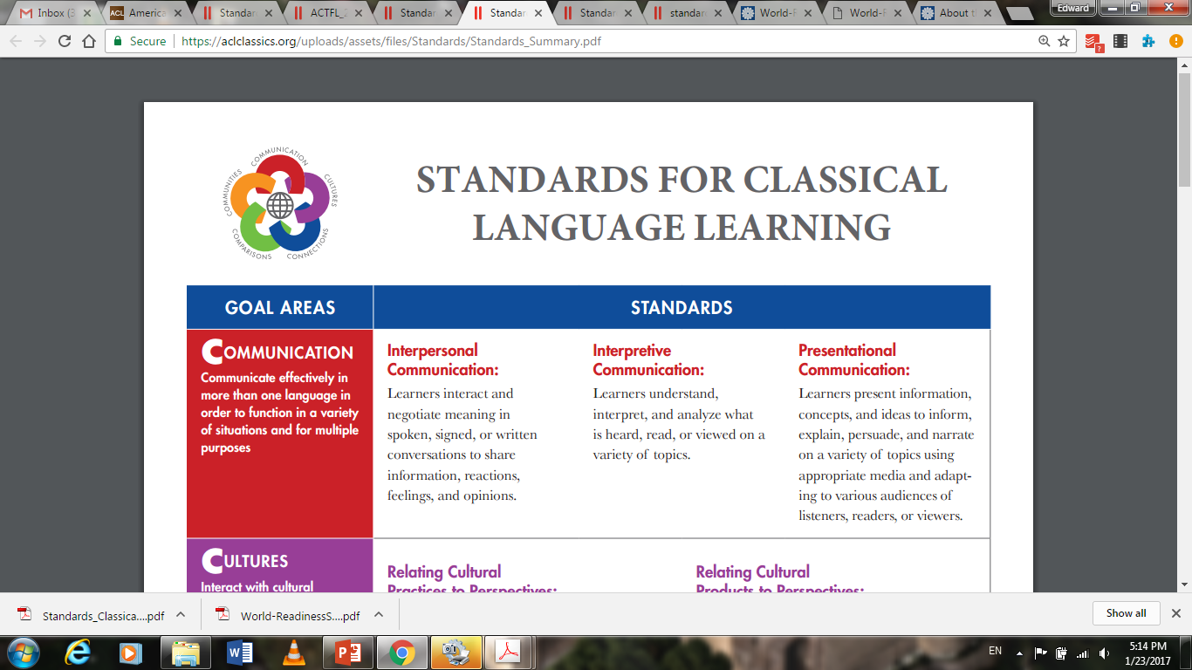
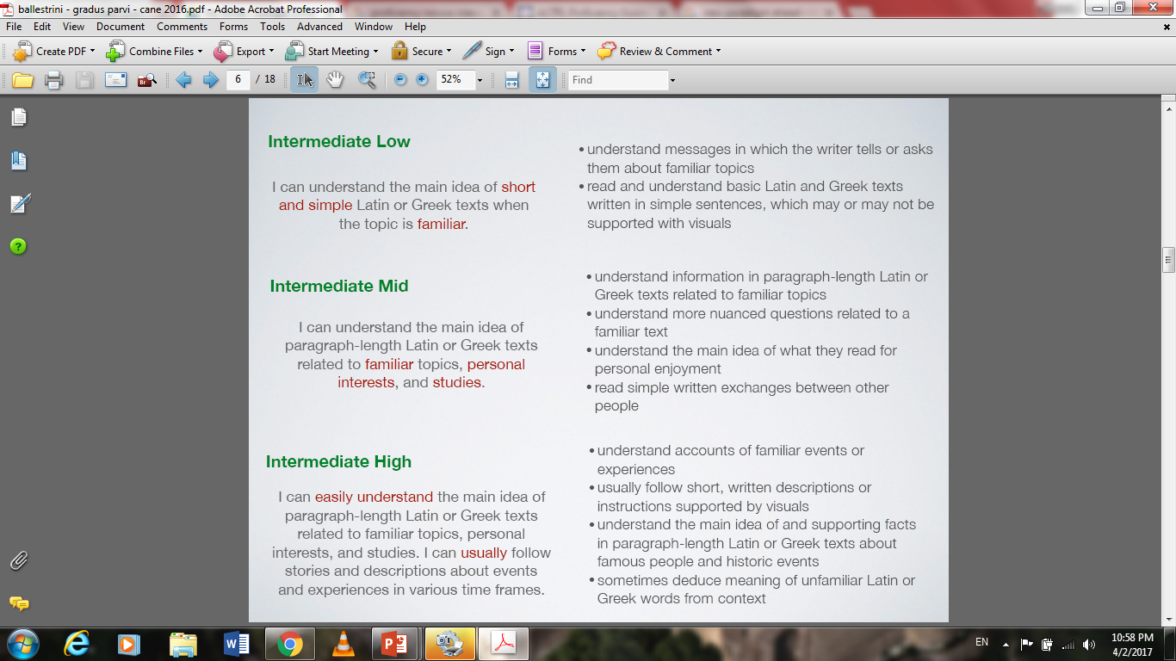

Slide 19
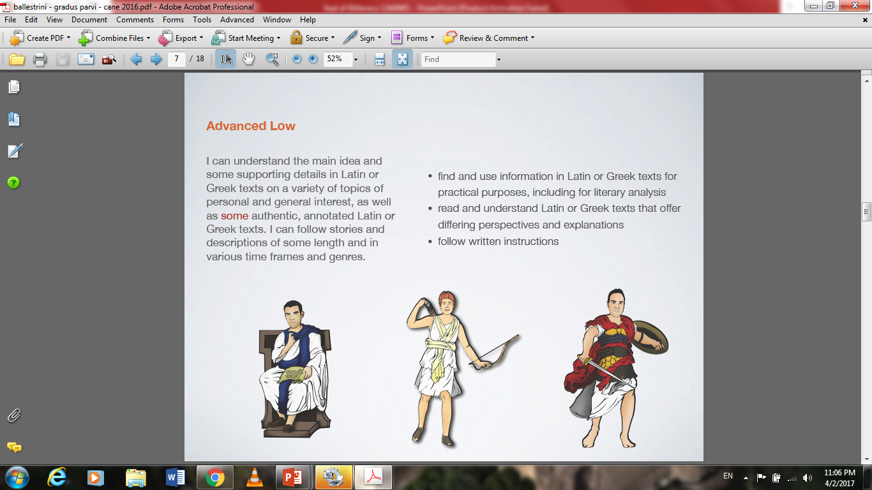

Slide 20

The ACTFL Latin Interpretive Reading Assessment (ALIRA)
The ACTFL Latin Interpretive Reading Assessment (ALIRA) is a computer-adaptive assessment of Latin students’ ability to read for comprehension a variety of Latin-language texts that typify those used in an instructional setting. One or two multiple-choice questions accompany each text and gather evidence of understanding of main ideas, supporting details, point-of-view, inferences, or text purpose.

Slide 21
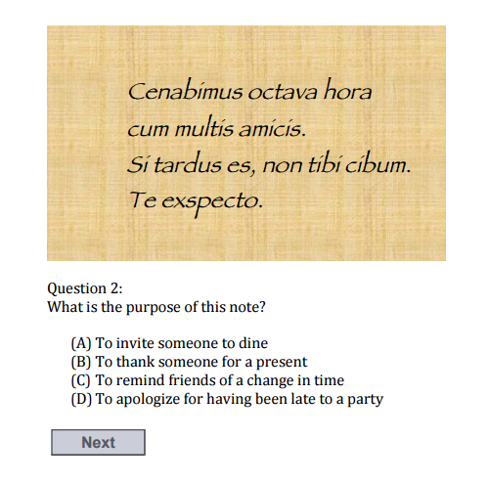

Slide 22
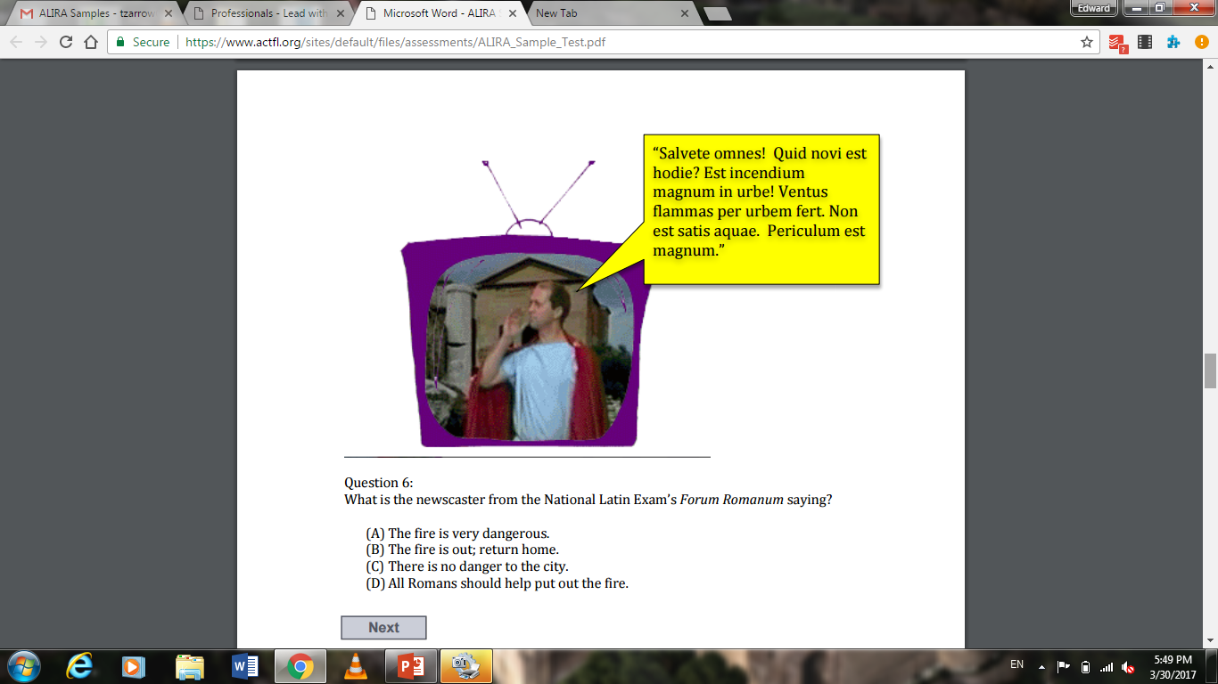

Slide 23
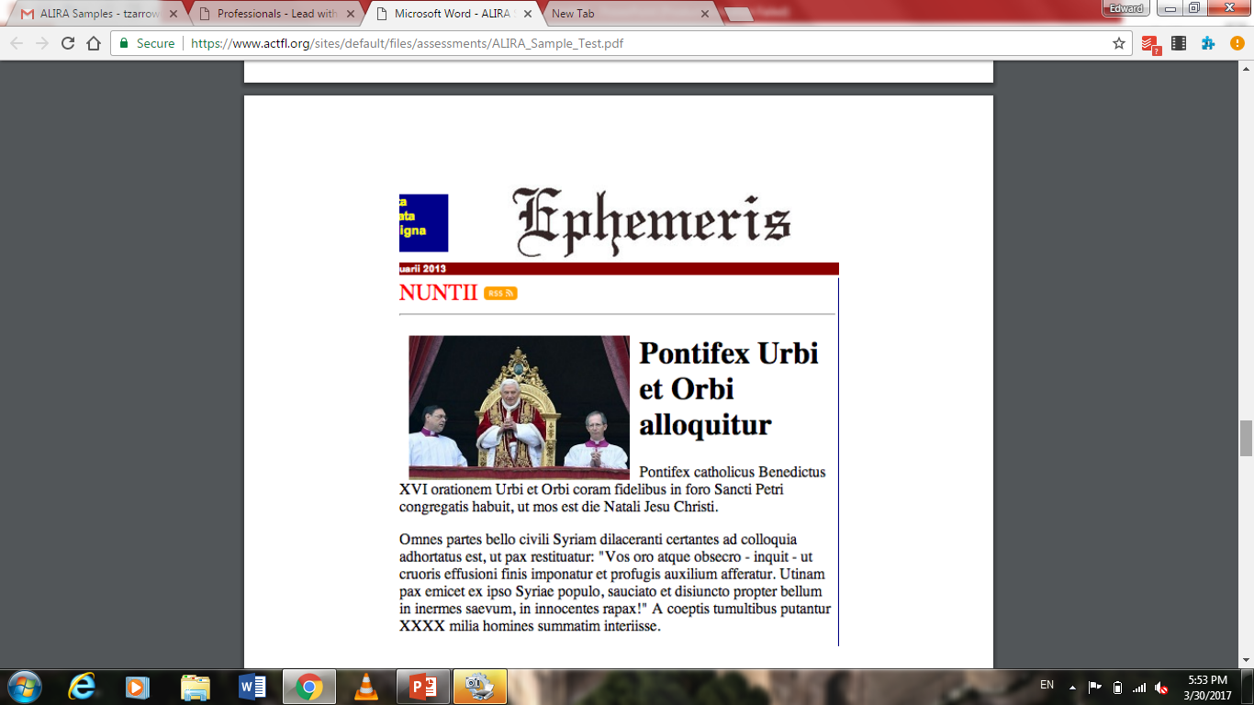
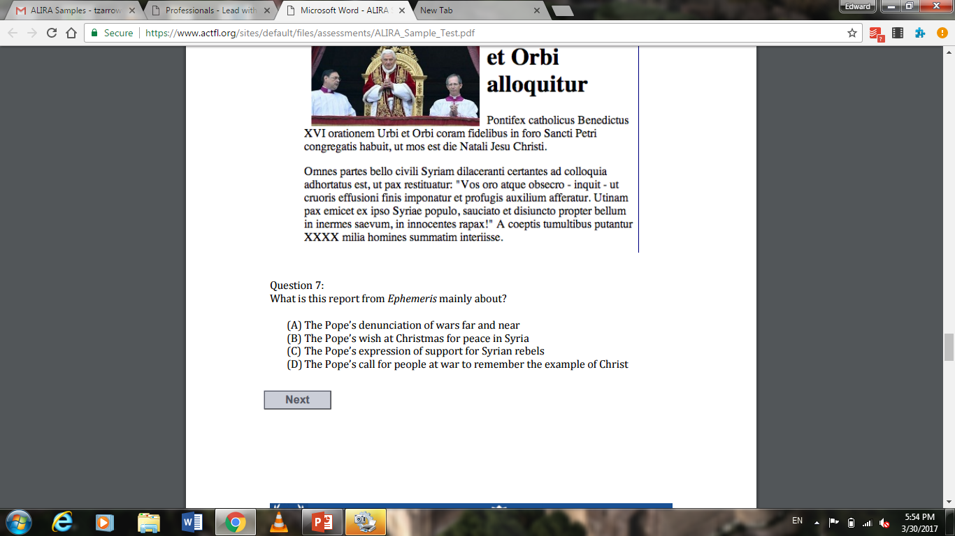

Slide 24
The ALIRA asks students to:
Work toward a context driven understanding of a text
Rephrase short selections of text or predict what might happen next
Give the main idea of a whole text
The ALIRA does not ask students to:
Translate
Hunt for trivial details
Parse esoteric vocabulary

Slide 25

SALVE!

Slide 26
Other benefits of promoting the “Seal of Biliteracy”
Increase enrollment and world language options in programs for all grade levels
Strengthen and expand language programs and their funding
Find a means to engage leaders in education, business, and government and make languages part of a national (and international :) conversation
Notes:
DESA – introduce Lead with Languages (state, local, and school level advocacy - - linking with national advocacy)
MARTY – go into details
At the same time that the AAAS report is released, ACTFL will launch a nationwide campaign aimed at the general public to build awareness of the importance of learning languages.

Slide 27
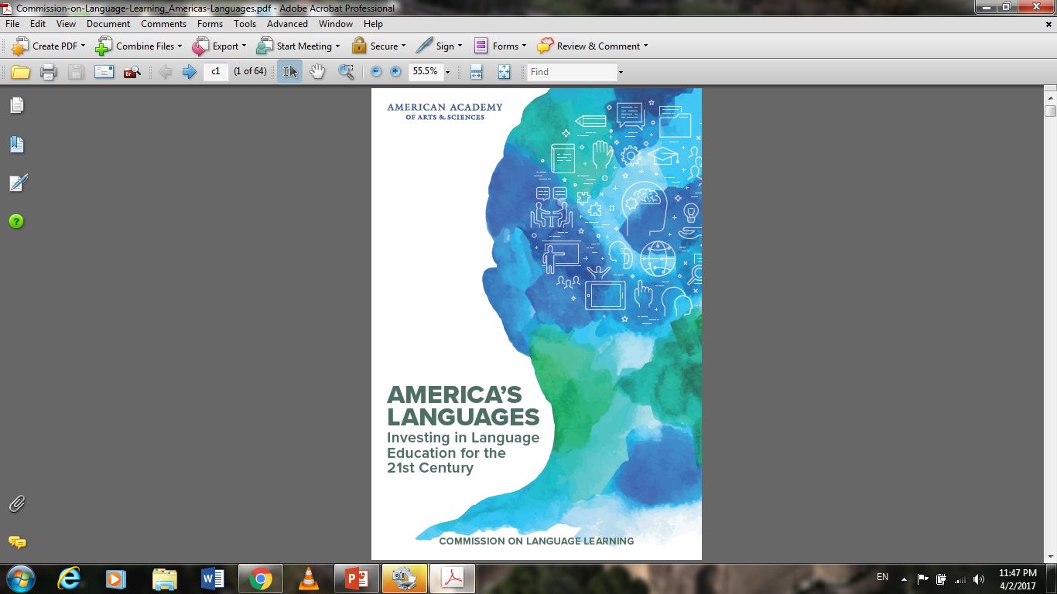
AAAS Commission
“We are a proudly multicultural, polyglot nation, home to more than 350 languages. Yet we continually ignore opportunities to value, nurture, and sustain languages other than English—opportunities that would greatly enhance our personal, cultural, professional, and civic lives, as well as the economic strength and security of our nation.”
“In this report, language refers to the forms of communication (spoken, written, or gestural) that people and cultures use to express their ideas, discoveries, needs, and aspirations—including classical and ancient languages …”

Slide 28
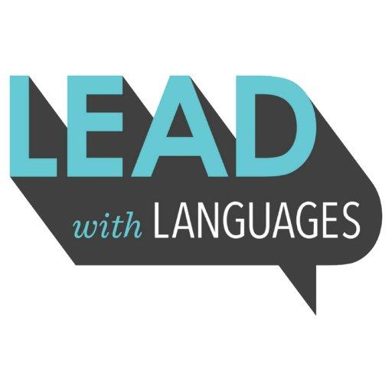
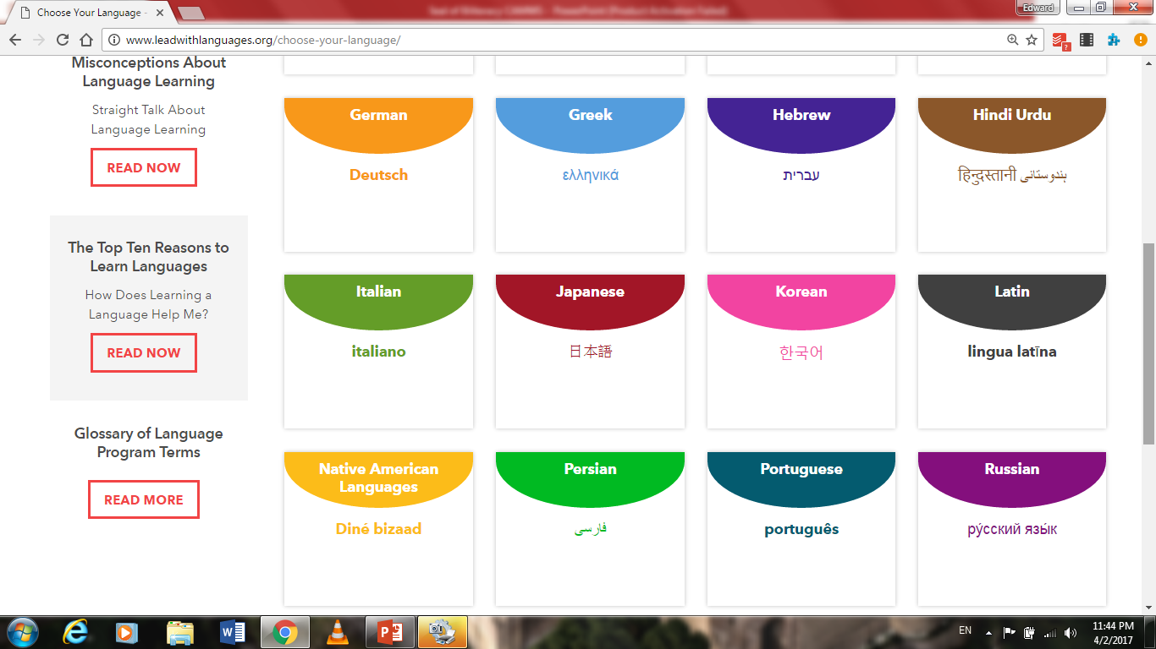
Leadwithlanguages.org
“Definitely some useful information to share with students and parents when they are on the fence about continuing with a language and how it might benefit them down the road. I think helping to promote opportunities for students to learn languages and also gain a better understanding of other cultures is key.”
WHS Guidance Counselor

Slide 29
When it comes to languages, we are all advocates
tinyurl.com/zarrowCAMWS
Dr. Edward M. Zarrow
Westwood High School
ACTFL 2016 National Language
Teacher of the Year
tzarrow@westwood.k12.ma.us
@drzarrow
CAMWS 2017
Kitchener, Ontario

Slide 30
A Seal of Biliteracy
Practical Applications for the Classroom

Slide 31
Chris Mural Adlai E. Stevenson High School
Latin and Social Studies Teacher for 17 years
Farrand Baker Latin Teacher of the Year - 2016
Membership Chair - Illinois Classical Conference
Head Bass Fishing Coach
4 time National Blue Ribbon Award Recipient
More square footage than any other high school in America
Ranked 1st in Niche.com annual rankings of high schools in America

Slide 32

Articulation and Backwards Design: AP Latin and ALIRA
Notes:
Four year program - Capstone assessments are the AP exam and the ALIRA exam for the Seal of Biliteracy - How can I prepare my students to be successful on these assessments by the completion of their fourth year of Latin?

Slide 33
The Issue: A Focus on Skills
Moving from a Content Based course to a Skills Based course:
What skills are the primary focus of my classroom, and what skills will lead to successful transition into post secondary studies?
Primary Focus:
Translation
Reading Comprehension
Notes:
From there I had to determine how I would assess, provide feedback, and teach those skills. In addition, I had to determine what supporting understandings would help to support the development of these skills.

Slide 34

The solution
New Rubrics
New Reflection Tools
Systematic Reform of Grading: Student-Focused rather than Teacher-Focused
New Formative Assessments

Slide 35
The Changes
Moving from content based to skills based instruction
Rubrics
Reflection
Assessment
Grades
Translation
Reading Comprehension
Frequent Opportunities for self-assessment pre and post assessment
Formative Assessments with Immediate Feedback
Balancing Performance and Proficiency Assessments
Opportunities for reassessment following remediation
Notes:
Rubrics - Broken down into specific categories to give students the most clear feedback possible.
Reflection - Focus not only on skills in Latin but also skills in “studenting”
Assessment - New tools - GoFormative, Socrative to give students immediate feedback on their work - in class, group work/collaboration on translations and reading comprehension - frequent unannounced assessment of supporting skills such as vocab and grammar. No “summative” assessments in terms of Final since students will be transitioning into the next level...
Grades - Reassessment following remediation focuses students on learning rather than on cramming for one assessment

Slide 36
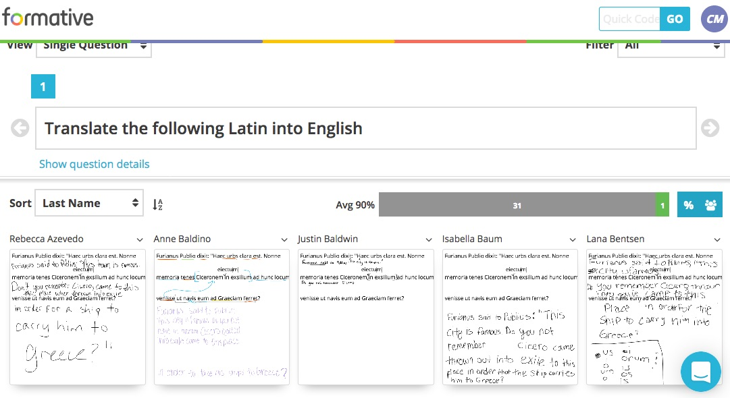
Formative Assessment and Feedback
GoFormative, Socrative, Quizlet, Quizizz = Instant Feedback
Students Pre-Assess using rubrics
Teach-Student Conferencing post assessment
Students reflect using rubrics and feedback

Slide 37
Rubrics
Translation
Noun/Adj Forms
Verb Forms
Vocabulary
Sentence Structure
Reading Comprehension
Main Idea Detection
Key Details
Context

Slide 38
How is it working:
Step 3
Step 2
Step 1
Success on ALIRA - Greater retention and increased rates of post-secondary studies
Assessment/Reassessment - Students frequently retake and remediate
Self-Assessment - Students can articulate strengths and weaknesses

Slide 39
Caveats:
Time
Values
Resources
Some things to consider when changing the structure of your courses:

Slide 40
The Seal of Biliteracy and Students of Latin and Greek
An Advocacy Opportunity

Slide 41
Mary Pendergraft
Chair, National Committee
For Latin and Greek

Slide 42
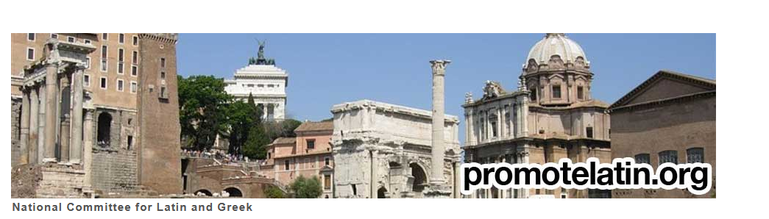
NCLG
Notes:
A standing committee of the American Classical League
Supported by CAMWS, SCS, and other state and regional organizations
Founding member of JNCL-NCLIS

Slide 43
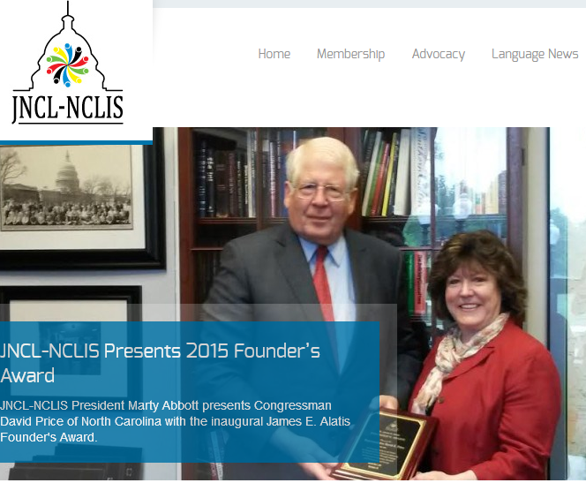
JNCL-NCLIS
www.languagepolicy.org
Notes:
Legacy member of board of directors
Marty Abbott, past president
Close working relationship with classics community

Slide 44
Why access matters
Student recognition
Evidence that Seal increases student retention

Slide 45

National Guidelines
.
Notes:
Issued 2015
"> We recommend that in cases where language assessments across all three modes of communication may not be appropriate or available, states/districts have the right to substitute a different assessment that meets the spirit of the Seal of Biliteracy. Students seeking the Seal through languages not characterized by the use of listening, speaking, reading, or for which there is not a writing system, will demonstrate the expected level of proficiency on an assessment of the modalities that characterize communication in that language. Examples include: Latin and Classical Greek – recommend assessment of interpretive reading and presentational writing, not of listening or interpersonal face-to-face communication

Slide 46
But there are still wrinkles
Some states include only specifically named languages
Some limit the acceptable assessments
Notes:
Examples: Minnesota requires spoken-language assessments.
Several accept only AP or IB scores

Slide 47
Statement from NCLG and co-signers
· that all states accept and implement the national guidelines, specifically that which asks students to demonstrate proficiency by assessments beyond classroom performance, in both English and one or more other languages;
· that each state or district make its own determination of the level of proficiency a student must demonstrate to earn a seal;
·

Slide 48
that states use one or more of the following assessments to demonstrate proficiency in Latin and Greek:
o Advanced Placement Latin Exam
o ALIRA (ACTFL Latin Interpretive Reading Exam)
o International Baccalaureate Exams in Latin or Greek
o National Latin Exam
o National Greek Exam
o SAT Subject Test in Latin
o state-specific exams when appropriate;
·

Slide 49
that states recognize but do not require students to demonstrate productive use in either oral or written mode in either Latin or Greek;
· that Classicists research the status of Seals of Biliteracy in their own states and advocate for appropriate assessments for students of Latin and Greek.

Slide 50
What’s your next step?
http://tinyurl.com/jwn6kay

Slide 51
Here you’ll find
Information by state, with specifics about Latin
Documents from many states
Recommendation from NCLG

Slide 52
Questions?
Mary Pendergraft
pender@wfu.edu

