Slide 1
Assessment at the Secondary Level: Demands and Benefits
Keely Lake, Ph.D.
Wayland Academy
klake@wayland.org

Slide 2
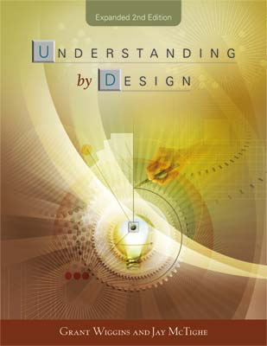
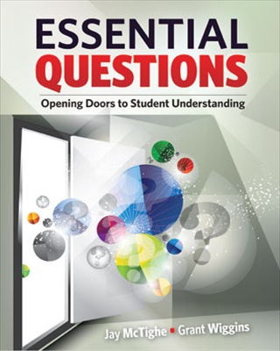
Backwards design
Setting goals before choosing instructional methods and forms of assessment (it is often paired with essential questions, or big picture questions)
Formative Assessment
Ongoing feedback to improve teaching and learning
Summative Assessment
Evaluation of student learning against a benchmark

Slide 3
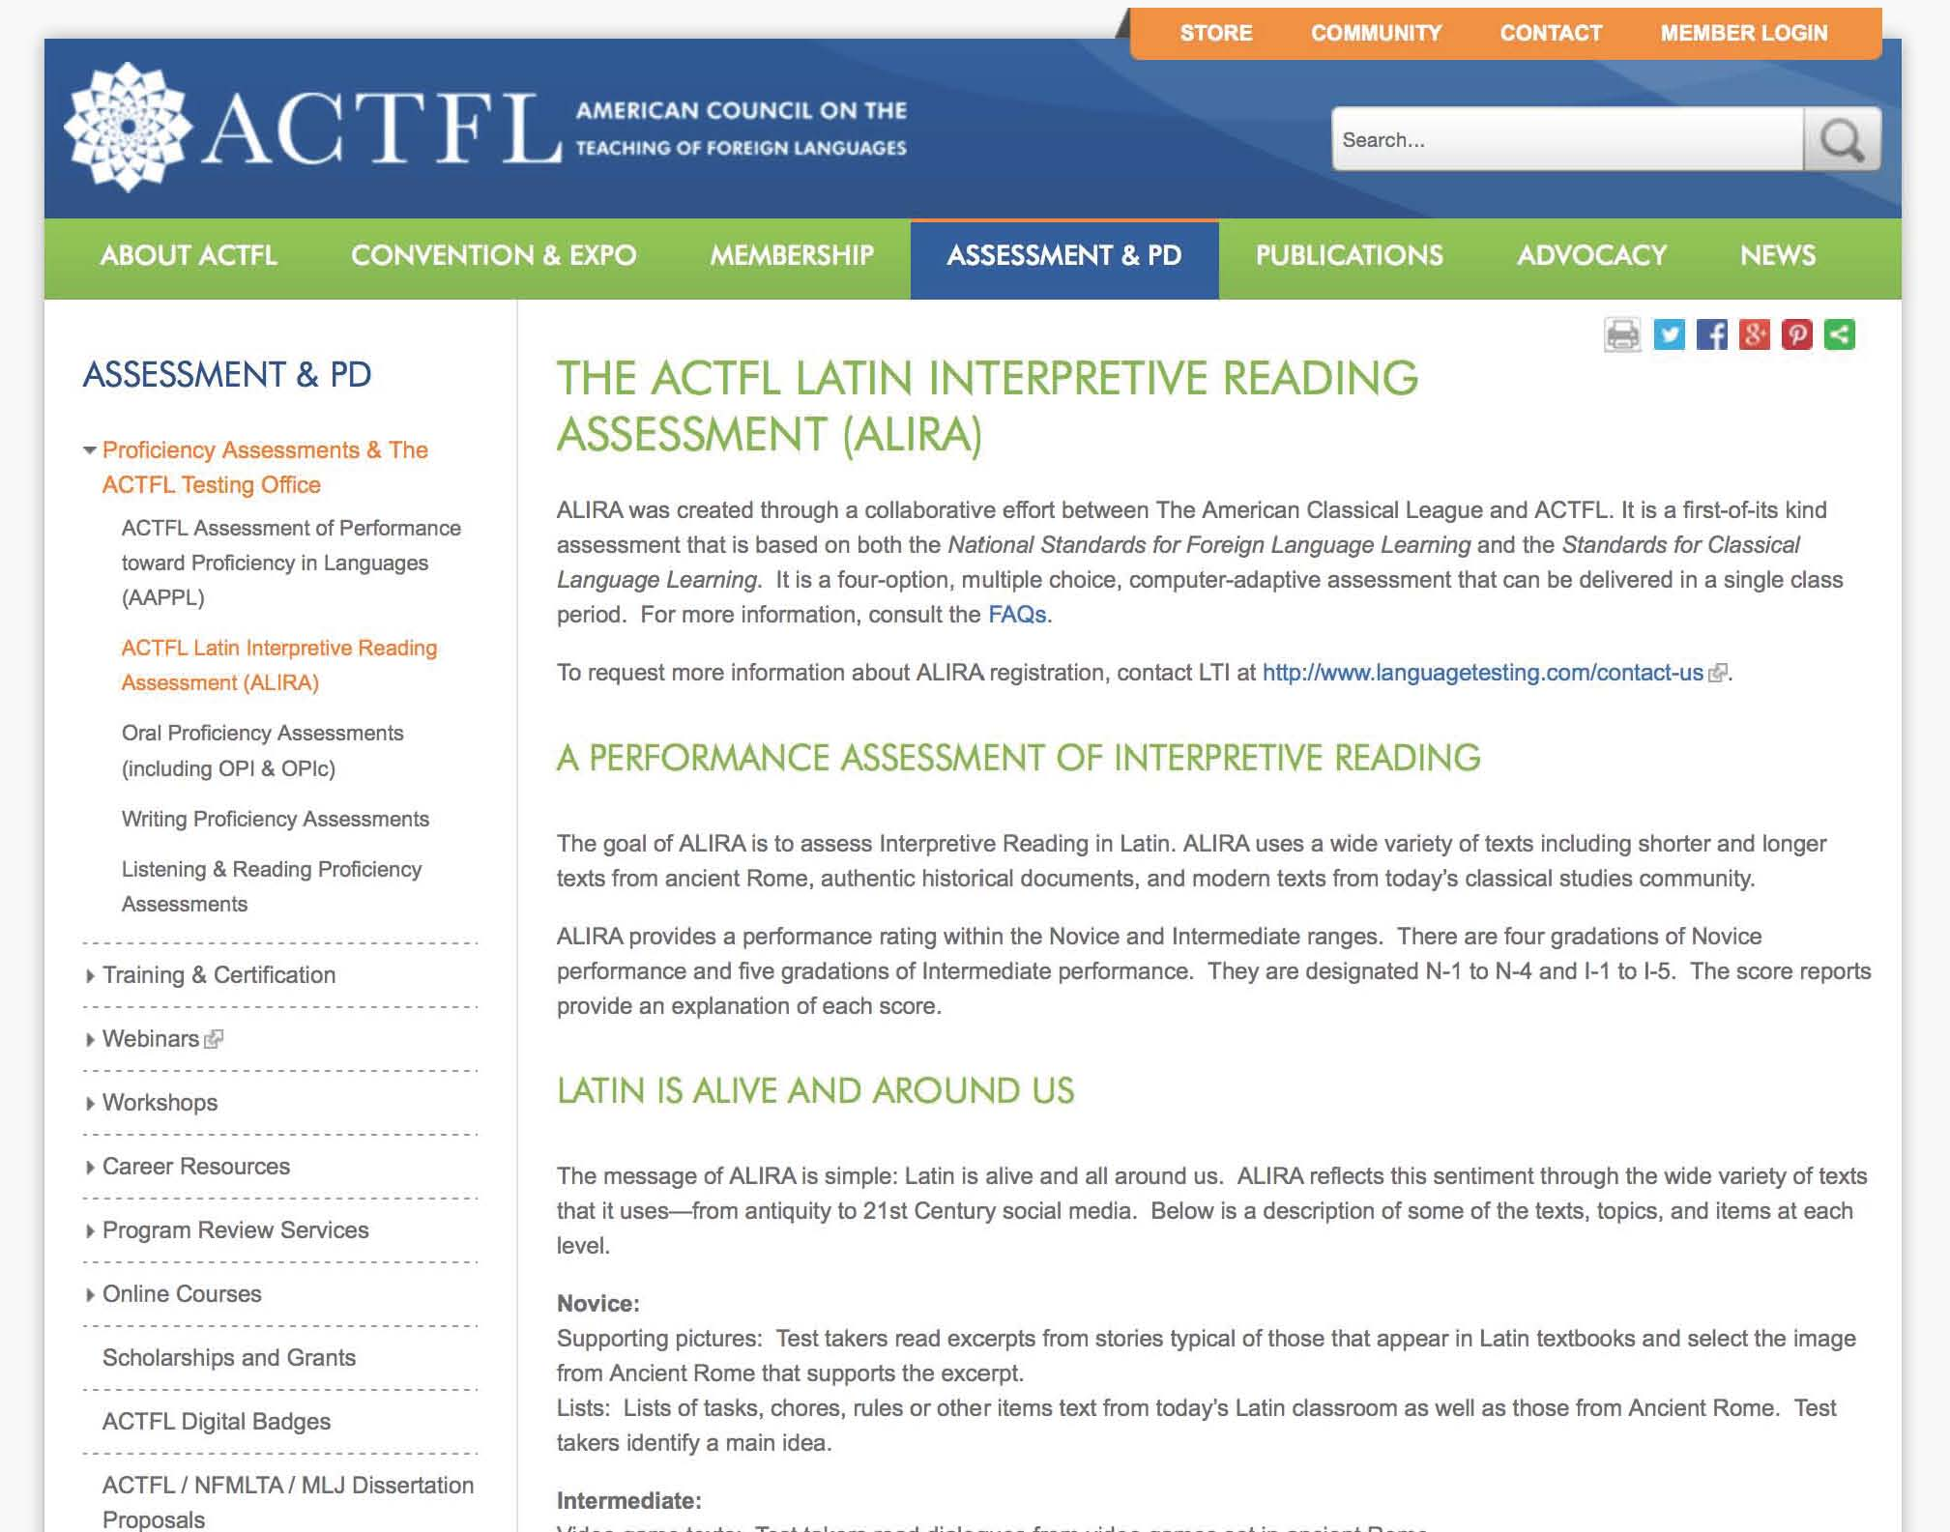
http://www.actfl.org/assessment-professional-development

Slide 4
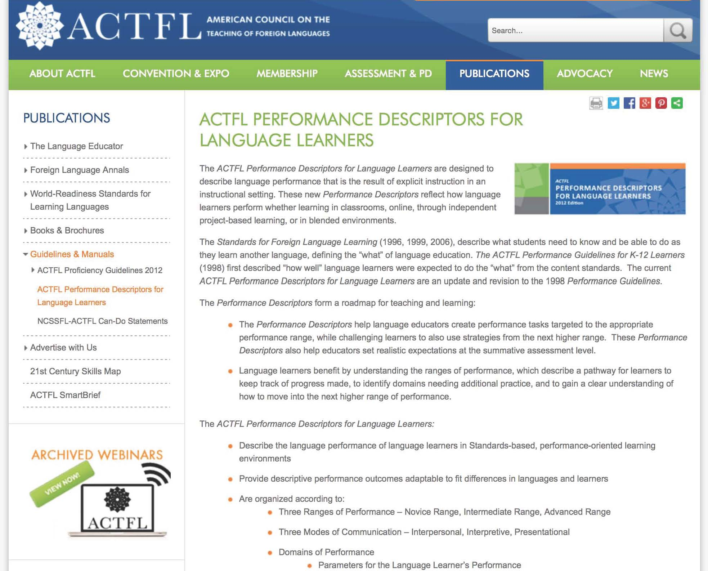
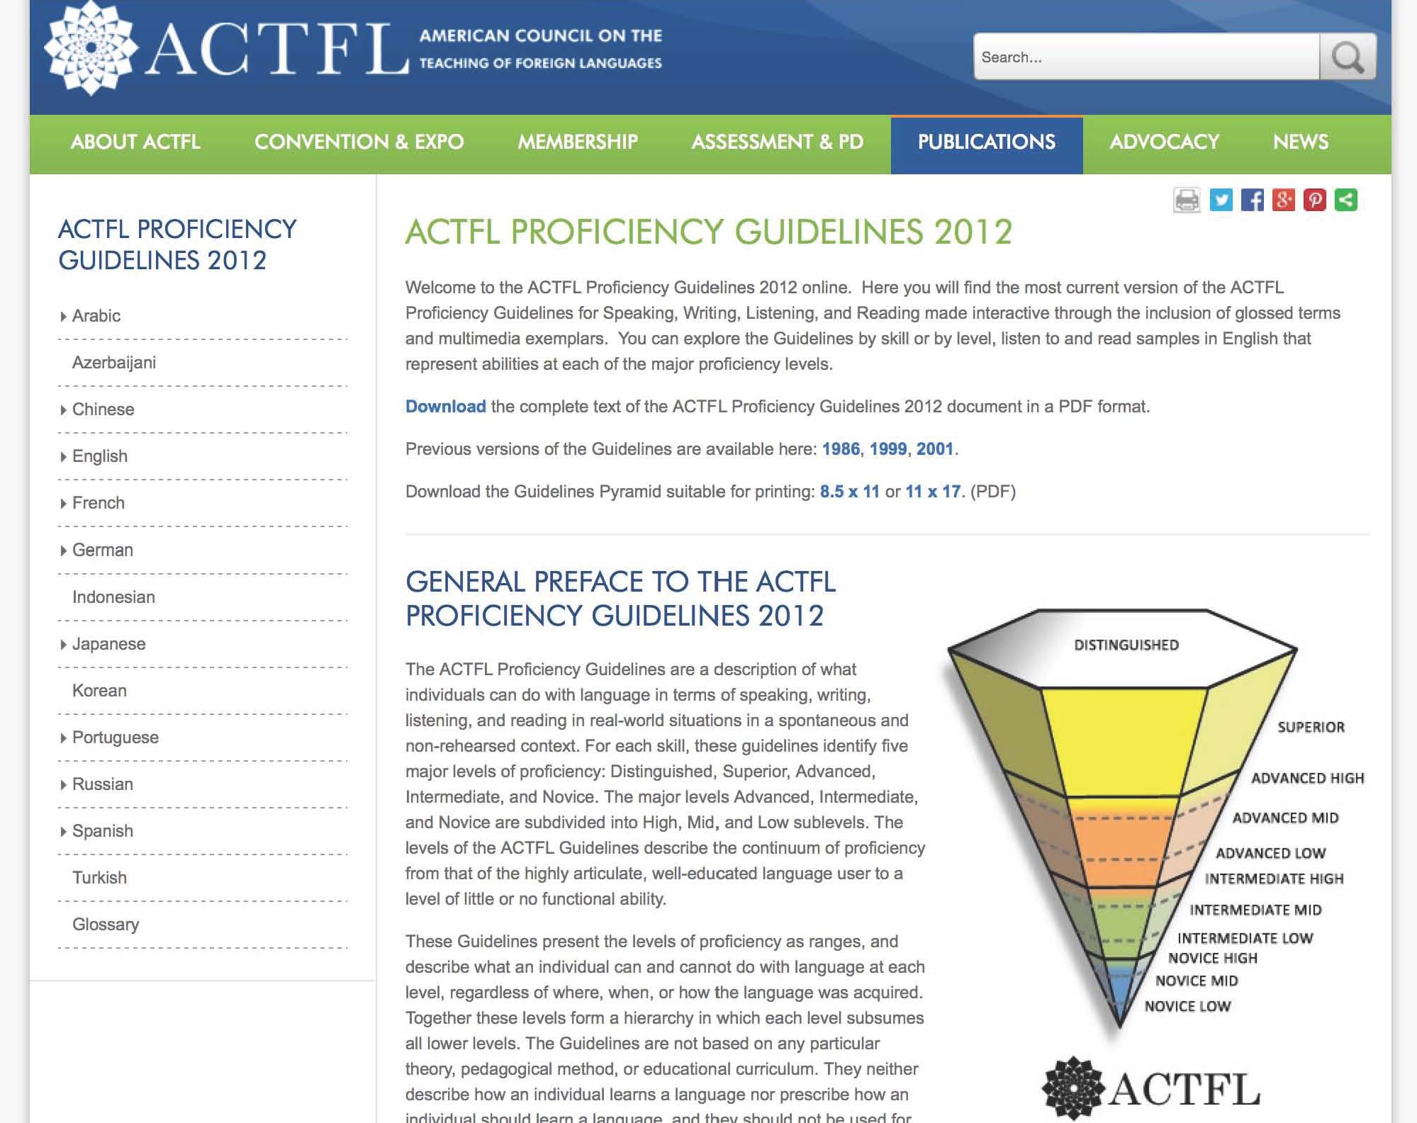
http://www.actfl.org/publications/all

Slide 5
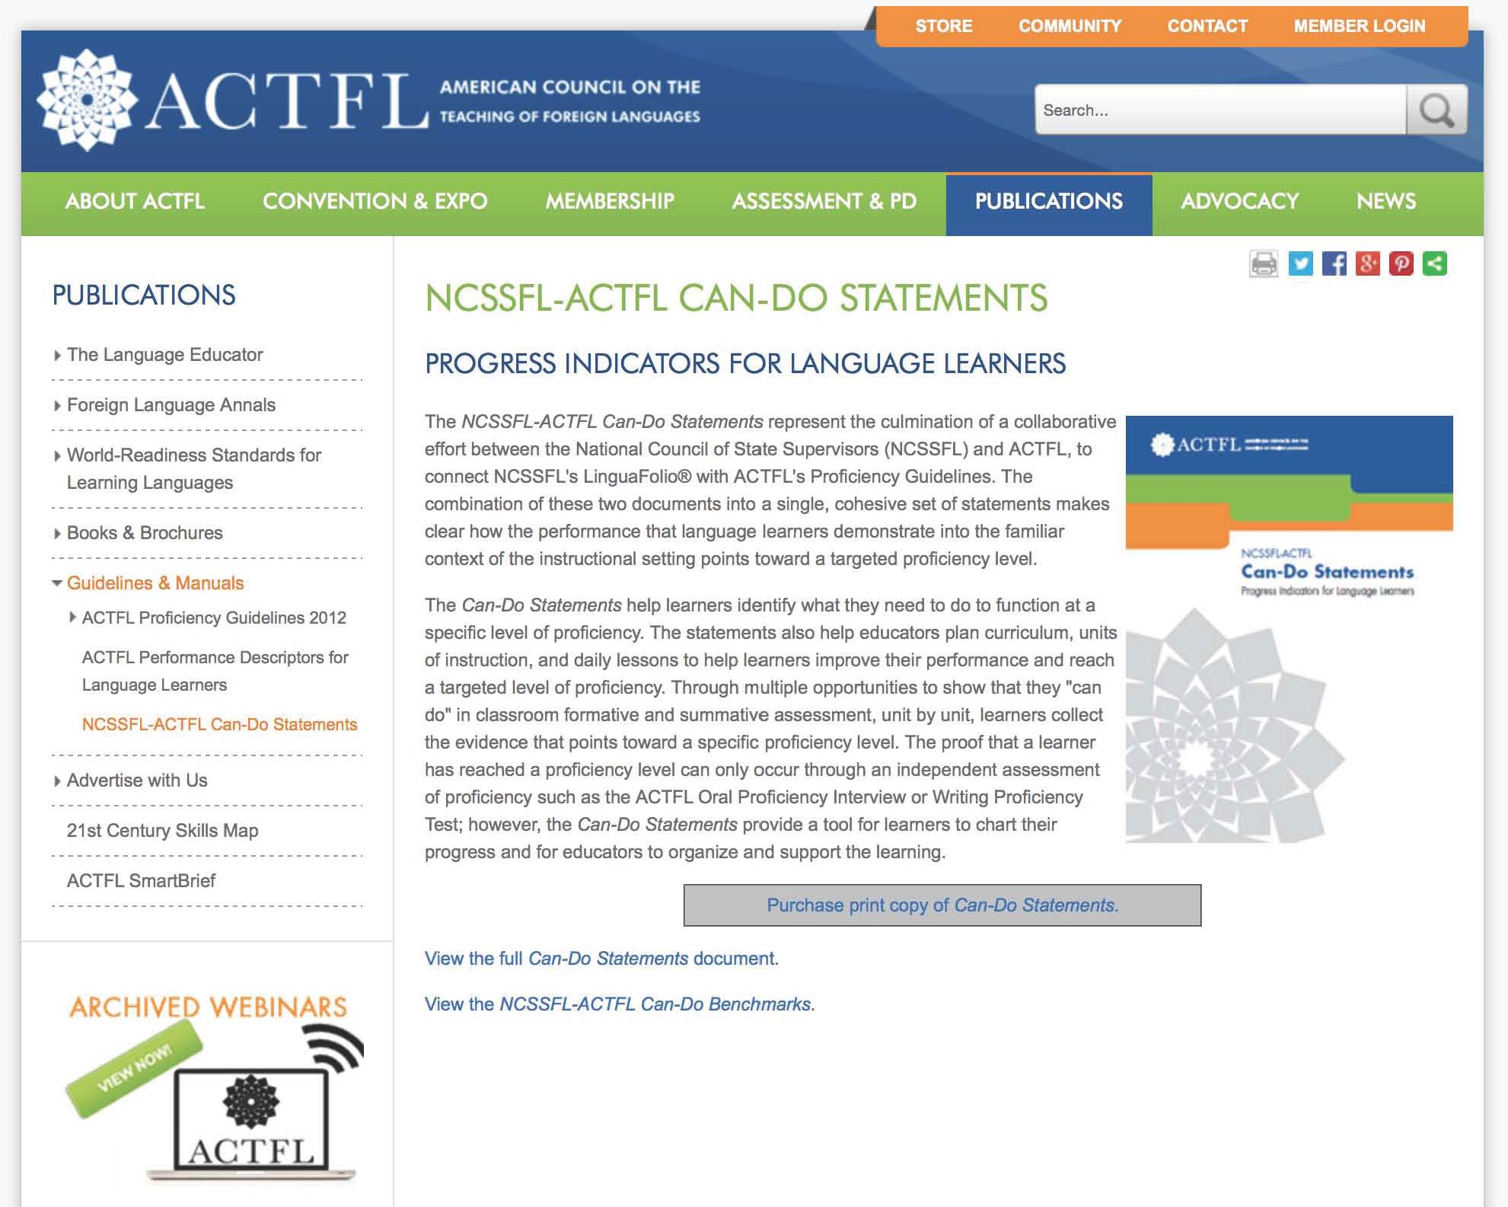
http://www.actfl.org/publications/all

Slide 6
Dan Tess, Brookfield Central

Slide 7
Ever so helpful. . .
Standards for Classical Learning
http://www.aclclassics.org/uploads/assets/files/Standards_Classical_Learning.pdf
Standards for Latin Teacher Preparation
http://apaclassics.org/education/standards-latin-teacher-preparation
Latin AP Course and Exam Description
http://apcentral.collegeboard.com/apc/public/courses/teachers_corner/2260.html

Slide 8
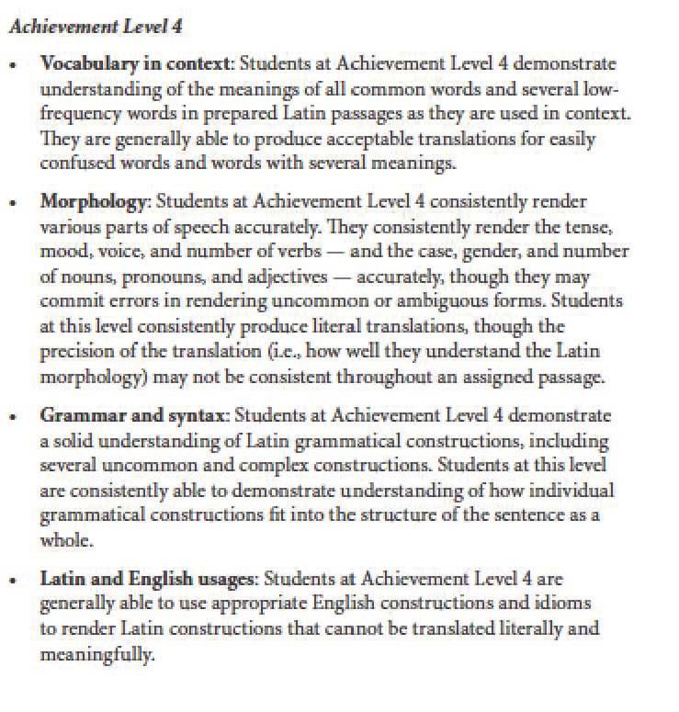

Slide 9
Where I am now.
Flipped Classroom
Quizzes can be retaken if under 80%
4th quarter staggered “final”
Verbs
Vocabulary
Nouns/Adjectives
Pronouns
Grammar
Translation/Comprehension
“Fame and Glory”

